Slide 1
CS 0449 Recitation 5
Gordon Lu

Slide 2
General Announcements
Queue lab was released on Monday, start it if you haven’t already!
The malloc lab will be posted sometime after the Queue Lab is due: this is a tough assignment, please start it early!
Homework 3 was just posted, make sure you understand your x86. The labs following malloc will be very difficult otherwise.
The bomb lab is one of the toughest assignments you’ll go through: Every time you get into a bomb, you lose actual points from your assignment score, be careful!!

Slide 3
General Announcements (cont.)
We’re (wilkie and the other TAs) are trying to restructure the class so it’s not so intense.
We are planning on tossing the cache lab, and extending the amount of time you get for the malloc lab.
I have talked to Dr.Petrucci regarding the constraints of the malloc lab, and now you will no longer have to worry about having malloc run in O(n) time and space, neither will you need to worry about caching pointers for a Quick Fit allocation scheme.

Slide 4
Make
You can try the exploration on Multifile compilation on Wilkie’s website, it’s a fun activity that you do in your spare time!!

Slide 5
Plan for today
Recap Memory Deallocation
Hints on the Queue Lab

Slide 6
Let’s get back to business

Slide 7
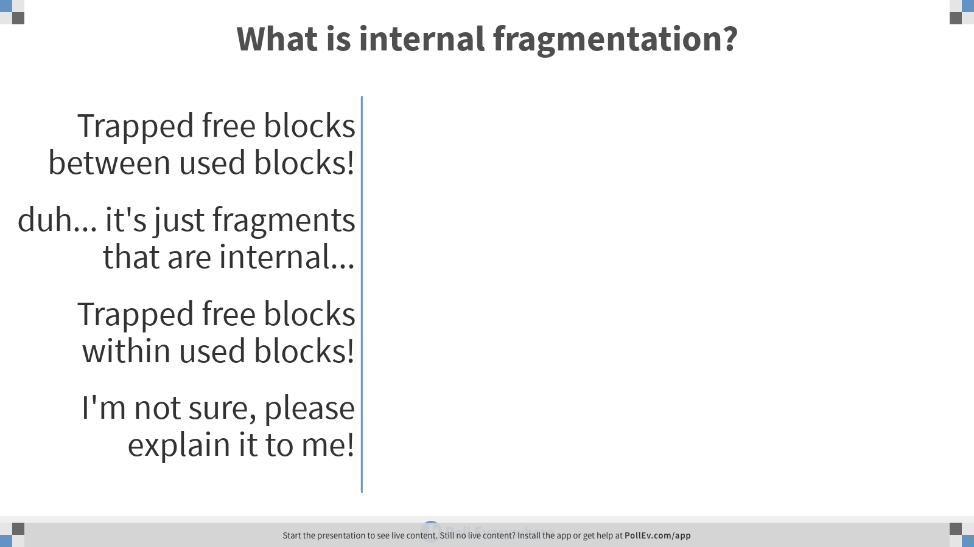
Notes:
Poll Title: What is internal fragmentation? https://www.polleverywhere.com/multiple_choice_polls/XduAG6BHEoOwX3jdBswNG

Slide 8
The correct answer is C!!

Slide 9
A brief reminder of internal fragmentation
Let’s say we called malloc(60), and we have the following heap:

Slide 10
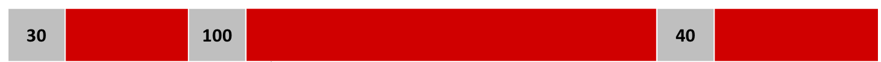
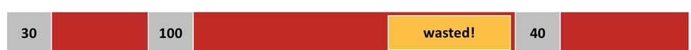
A brief reminder of internal fragmentation
Well, we could just allocate the 60, and mark the block as used:
But… we’ve left ourselves with 40 free blocks as used ☹
This is internal fragmentation!!

Slide 11
Splitting a Free Block

Slide 12
Efficient Memory Allocation
Rather than just carelessly allocate memory, we want to allocate exactly the amount of memory that the user requests!

Slide 13

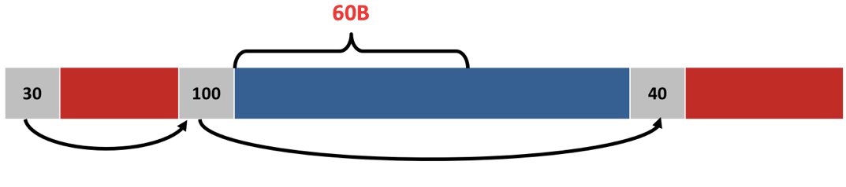
A General Split Block Algorithm
If we want to allocate 60 bytes:
Count 60B into the block and put a new header there:

Slide 14
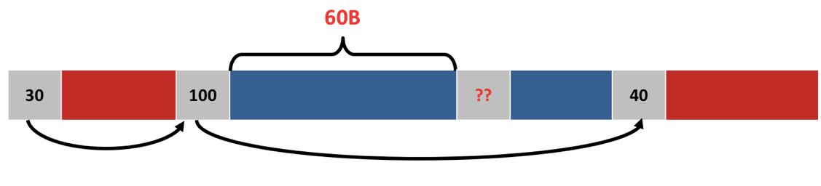
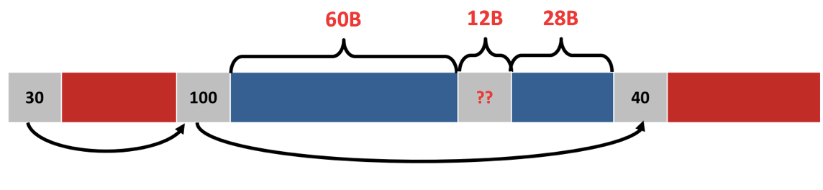
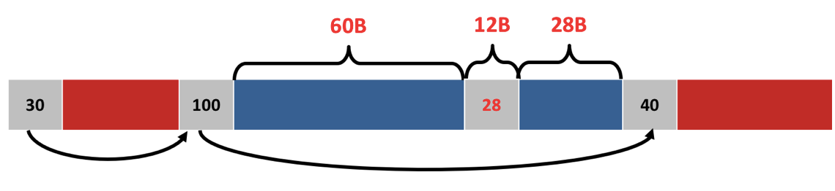
A General Split Block Algorithm (cont.)
2) Do 100-60-sizeof(header) to get the size of the new free block
Assume headers are 12 bytes

Slide 15
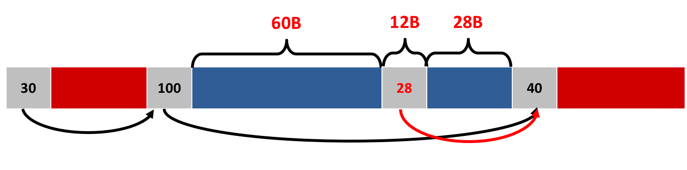
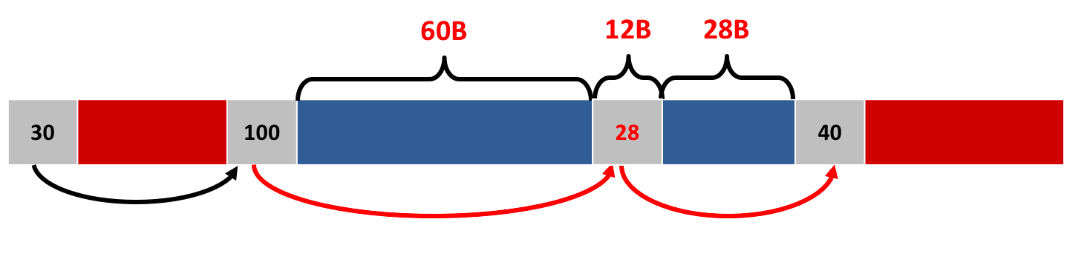
A General Split Block Algorithm (cont.)
3) Insert the new header into the linked list

Slide 16
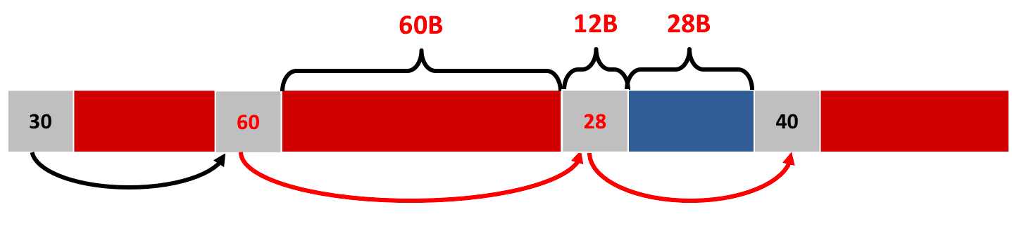
A General Split Block Algorithm (cont.)
Update the old header to the new size and mark it used

Slide 17
Heap Deallocation

Slide 18
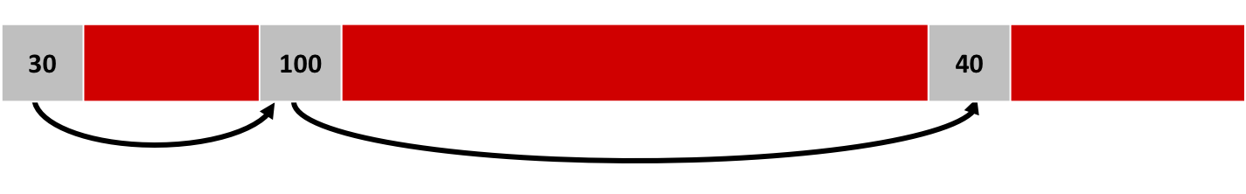
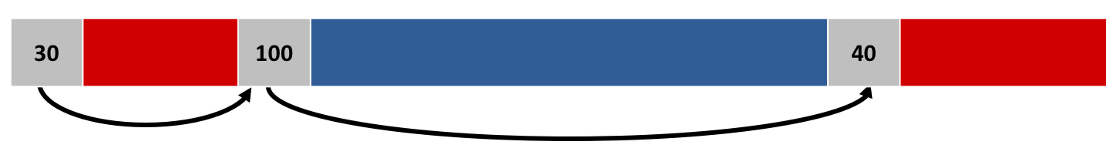
It’s actually a lot easier than malloc!
So, the user wants to free up 100B of memory:
So, just mark the block as free, and that’s it!!

Slide 19
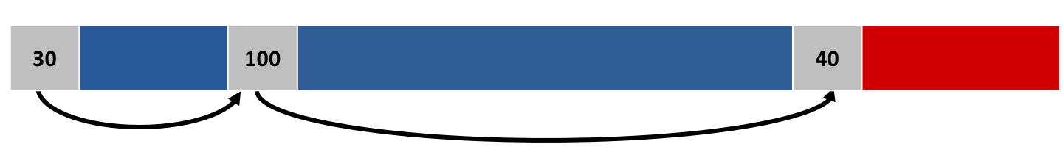
But… what if we have two adjacent free blocks?
Even if we have 120B of memory, we can’t allocate it!!

Slide 20
Coalescing
So, we coalesce the adjacent free blocks! (coalesce -> compact them blocks together!!)

Slide 21
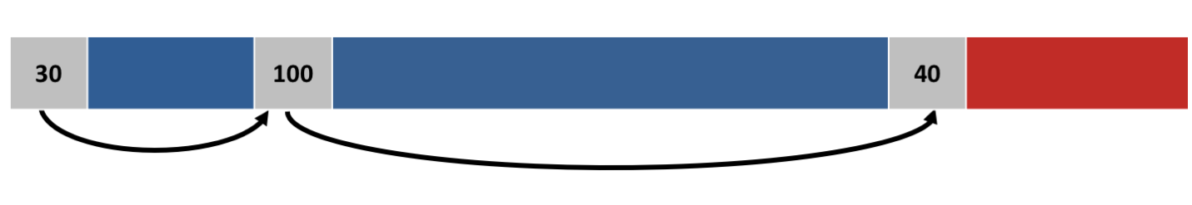
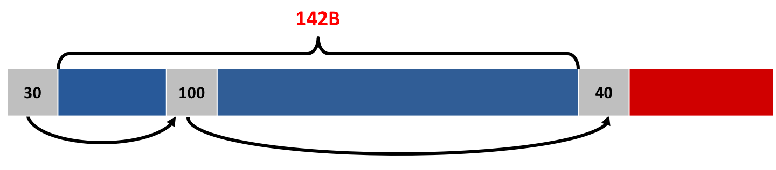
General Coalescing Algorithm
Given the current heap:
Sum the sizes of the two blocks + sizeof(header)

Slide 22
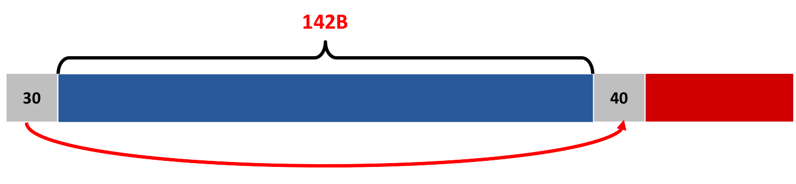
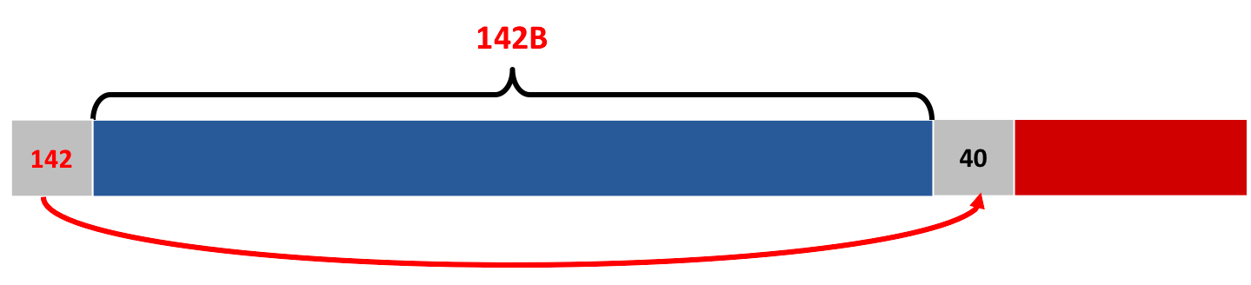
General Coalescing Algorithm (cont.)
2) Remove the middle header from the linked list.
3) Update the first header with the new size.

Slide 23
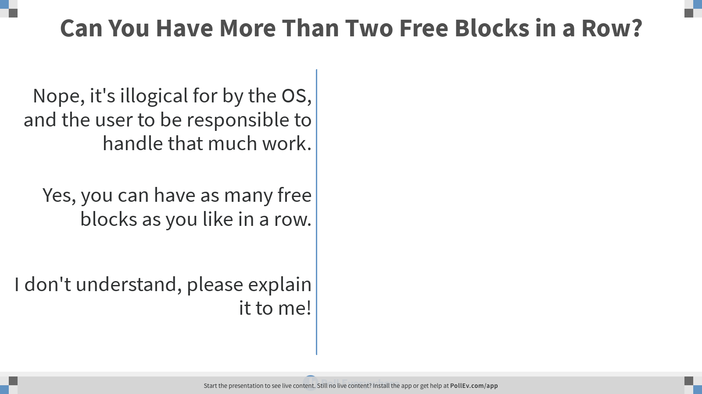
Notes:
Poll Title: Can You Have More Than Two Free Blocks in a Row? https://www.polleverywhere.com/multiple_choice_polls/85TOEckFMrn1Pstr7SD5o

Slide 24

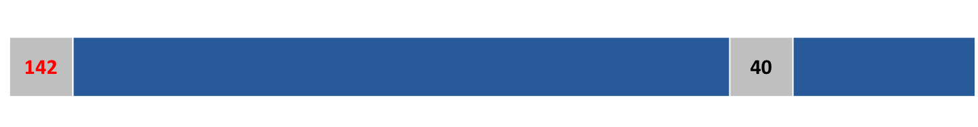
Can you have more than two free blocks in a row?
Yep, if you free a block between two free blocks!
Coalescing the first two free blocks yields:

Slide 25
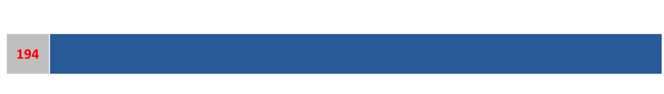
Can you have more than two free blocks in a row (cont.)?
2) Coalescing the new free block with the third free block yields:

Slide 26
Hints on the Lab

Slide 27
The Queue Lab
As dumb as it may sound, the best way to debug this lab is to draw a picture!
I’ll walk through the logic, and the picture of the diagram will be here:

Slide 28
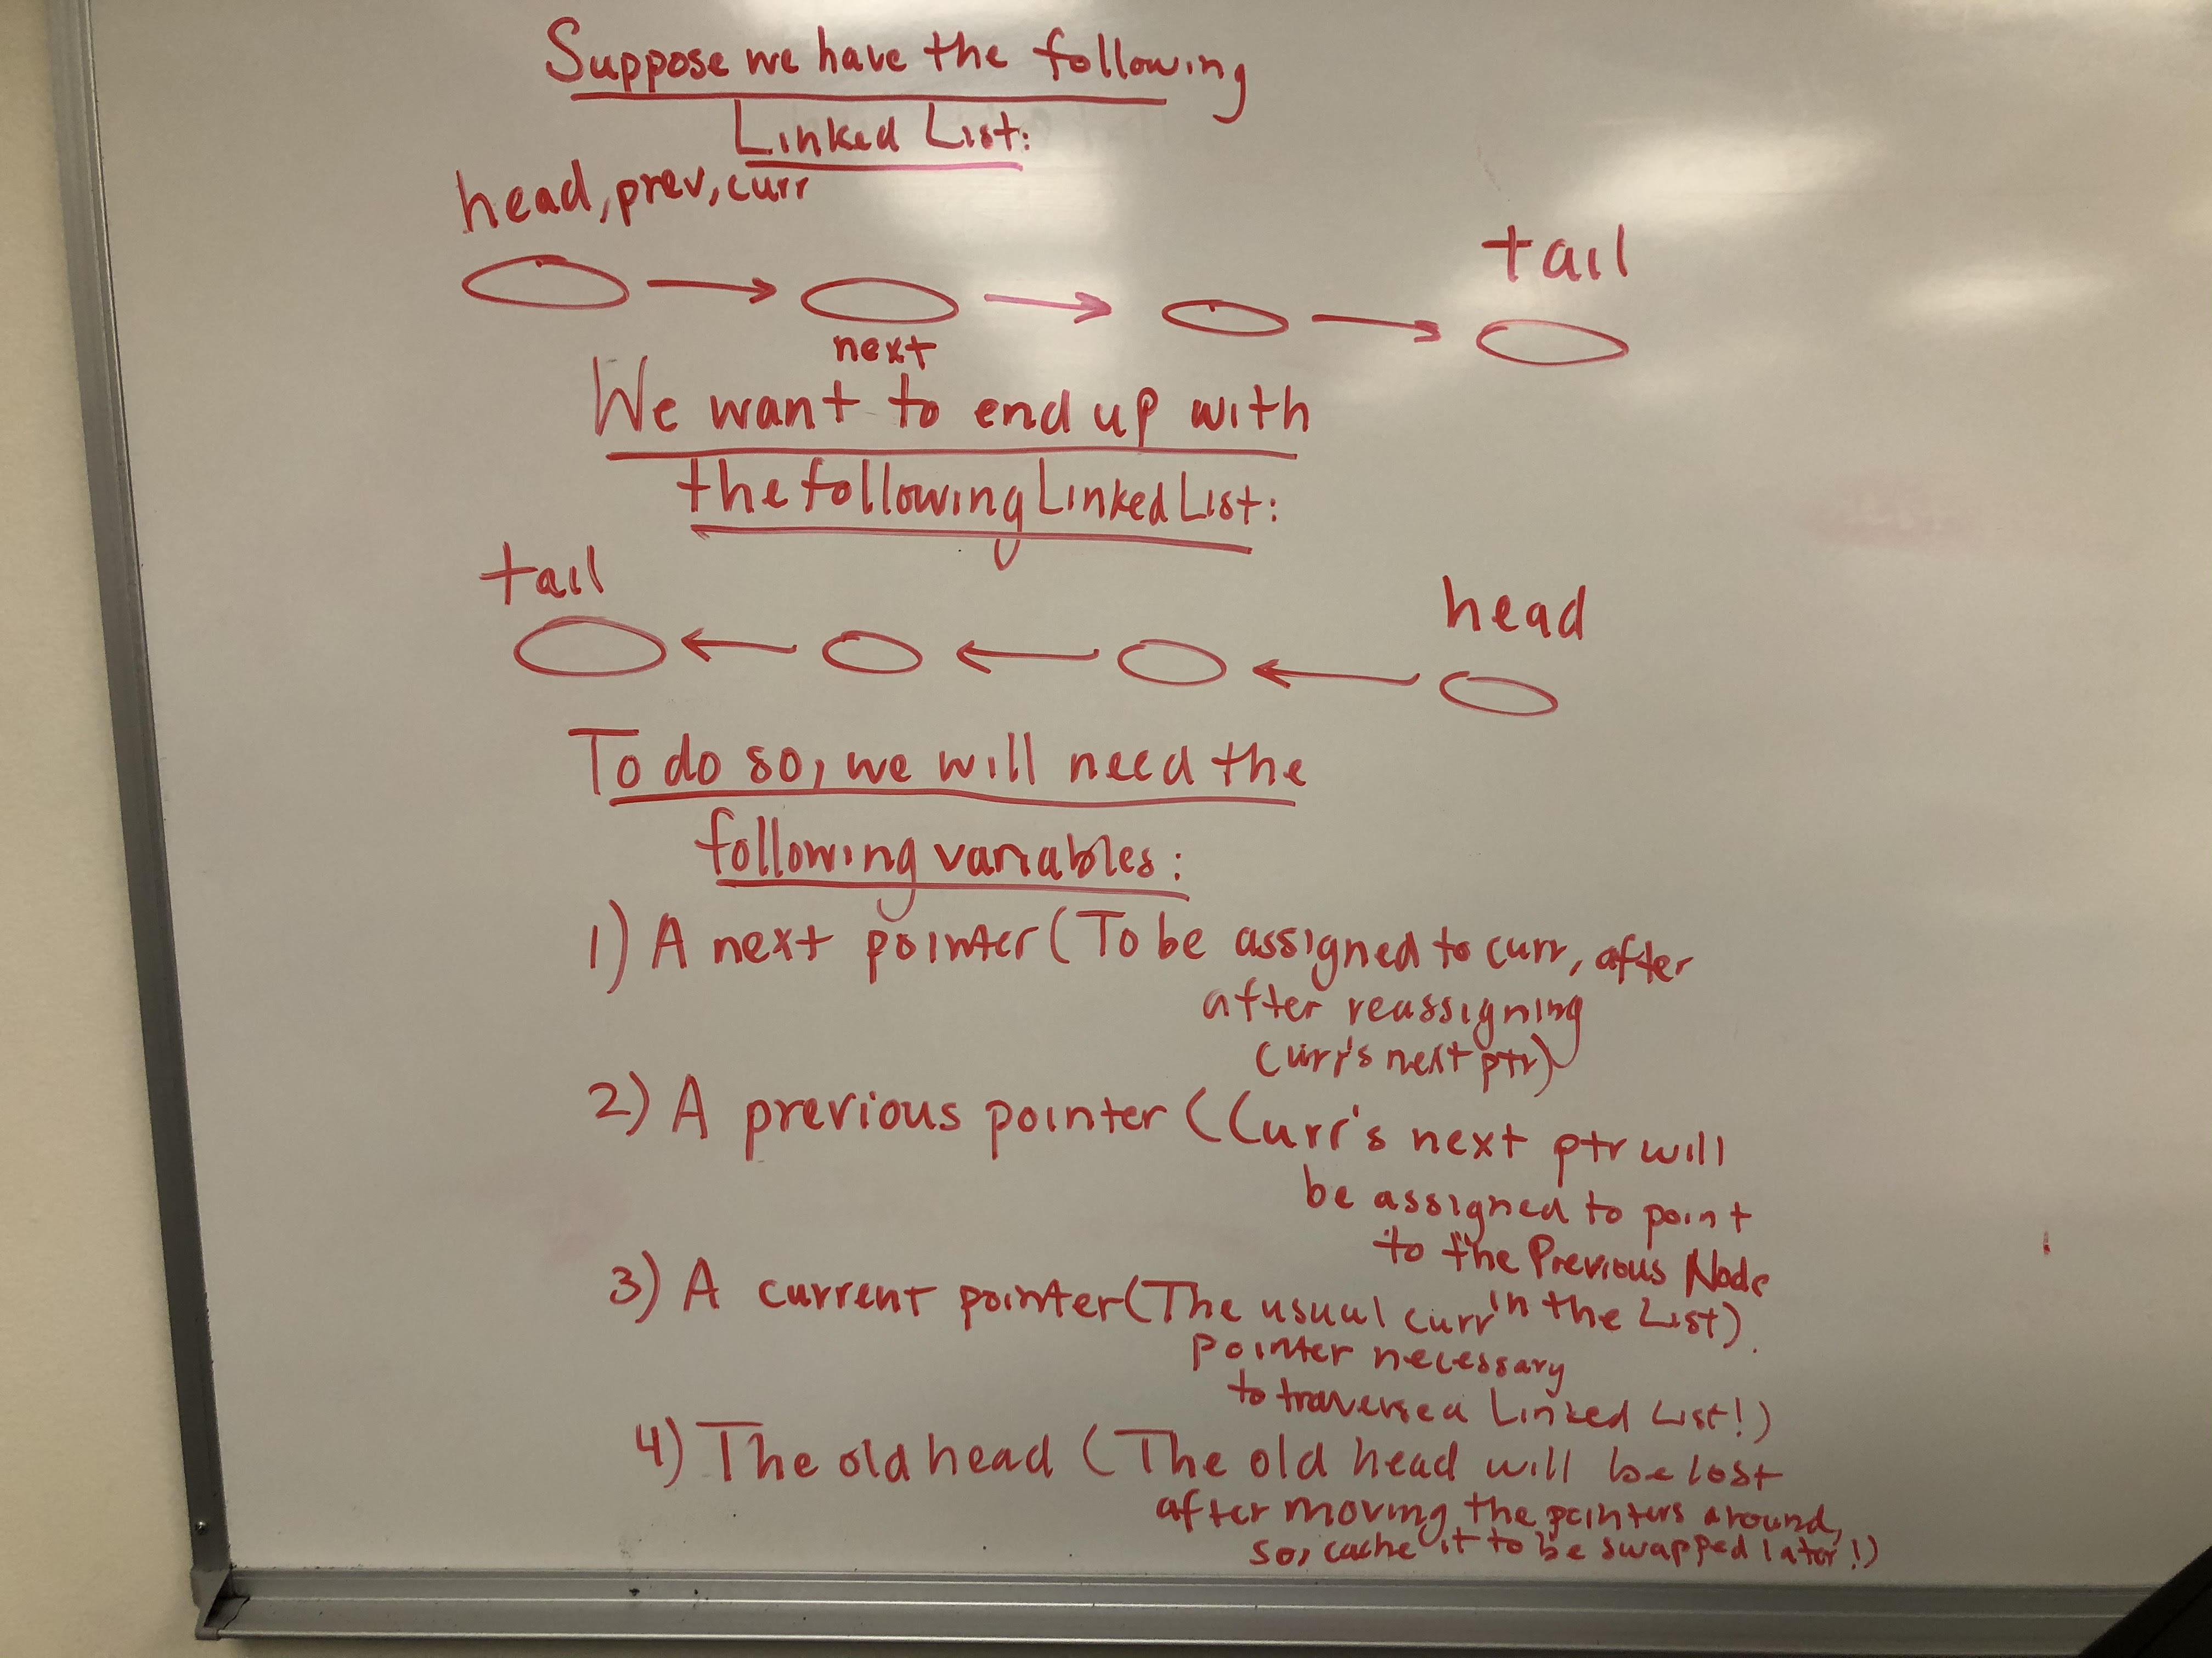
Basic Visual Algorithm

Slide 29
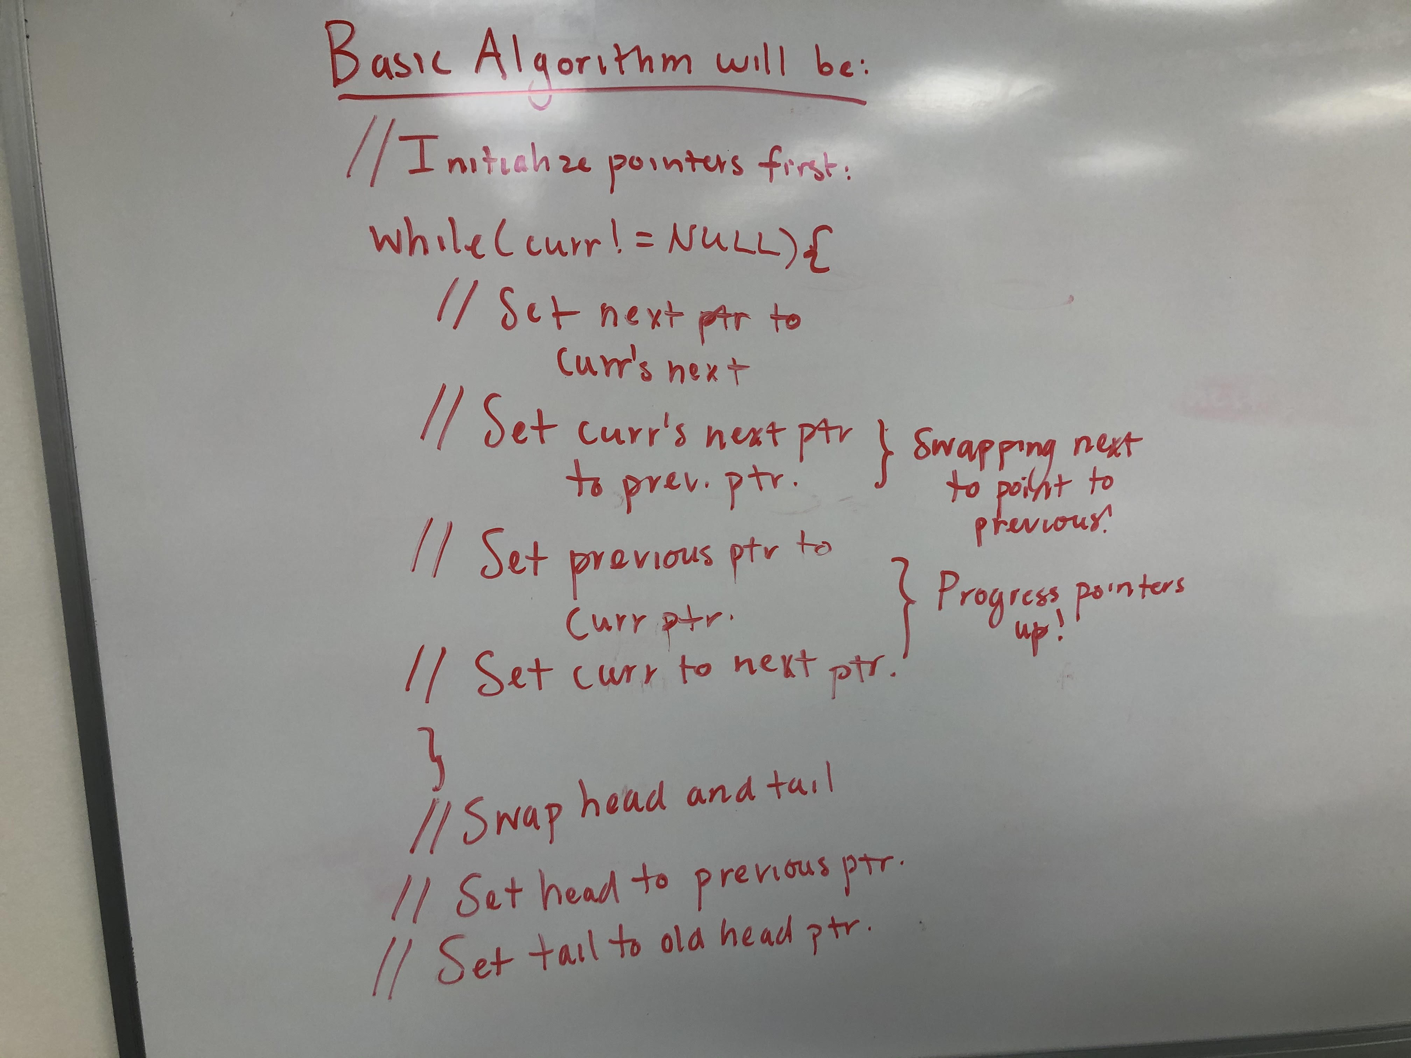
Basic Algorithm in Pseudocode

Slide 30
Any Questions?

