Slide 1
CS 0449 Recitation 1
Gordon Lu

Slide 2
Who Am I?
My name is Gordon Lu!
I’m a junior CS/Econ/Math/Stat major!
If you ever need help with anything CS-related, don’t hesitate to send me an email!
My goal is to make sure you get the most out of this course. I hate to see someone struggle, so feel free to contact me if you ever feel stuck!
I’m not only limited to 449, I’m also a UTA for 447, and help lots of people with some of the upper-levels such as 1501 and 1550!

Slide 3
Logistics
I will be frequently posting slides on my website!
https://glu99331.github.io/
You can schedule appointments with me here:
https://glu99331-office-hours.youcanbook.me/

Slide 4
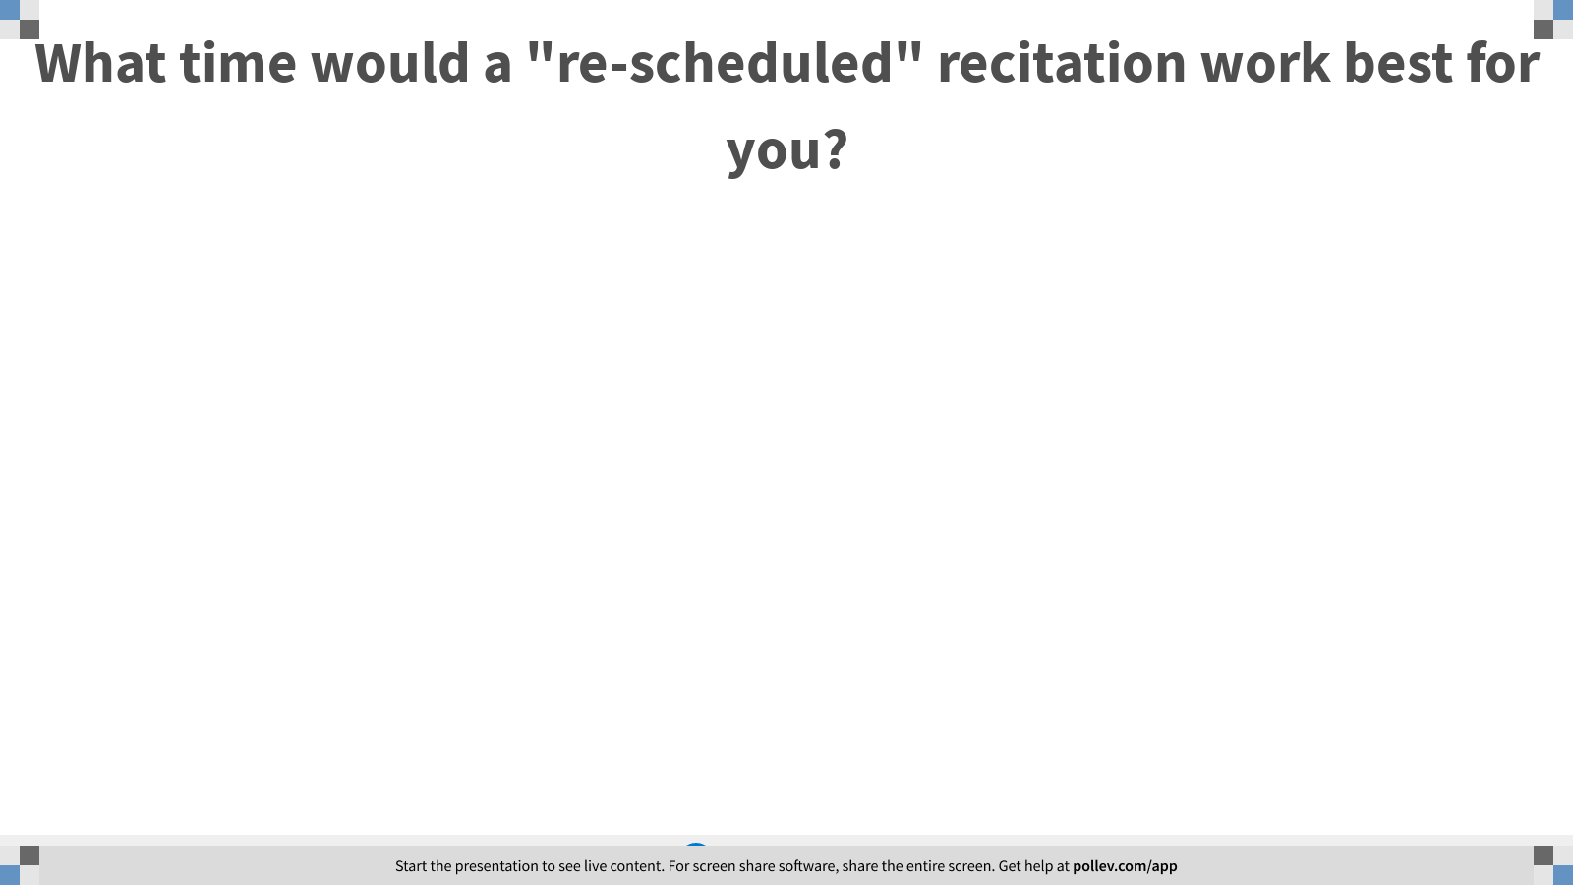
Notes:
Poll Title: What time would a "re-scheduled" recitation work best for you? https://www.polleverywhere.com/free_text_polls/OhZxLX36wElVRoVj8ibZq

Slide 5
The Programming Language Continuum
So… you’re probably wondering: Why are we learning C?
Going from left to right:
Each hides a further layer of abstraction
Where we are:
Low-Level
High-Level
MIPS, x86
C, C++
Java, Python

Slide 6
Setting up Aliases on Thoth
Once you ssh into Thoth, you can set up aliases to reduce the amount of typing you do!
To add an alias, first open the bash_source file like so: nano .bash_profile
Scroll down to the portion of text that says ALIASES, this might take a little bit to find!
Add the aliases you want, like this: alias compile=“gcc –Wall –Werror --std=c99 -o”
Now CTRL+O, and then CTRL+X
Then refresh the bash environment like so: source ~/.bash_profile
Then try to compile a program like so: compile filename filename.c
YAY! LESS TYPING ☺

Slide 7
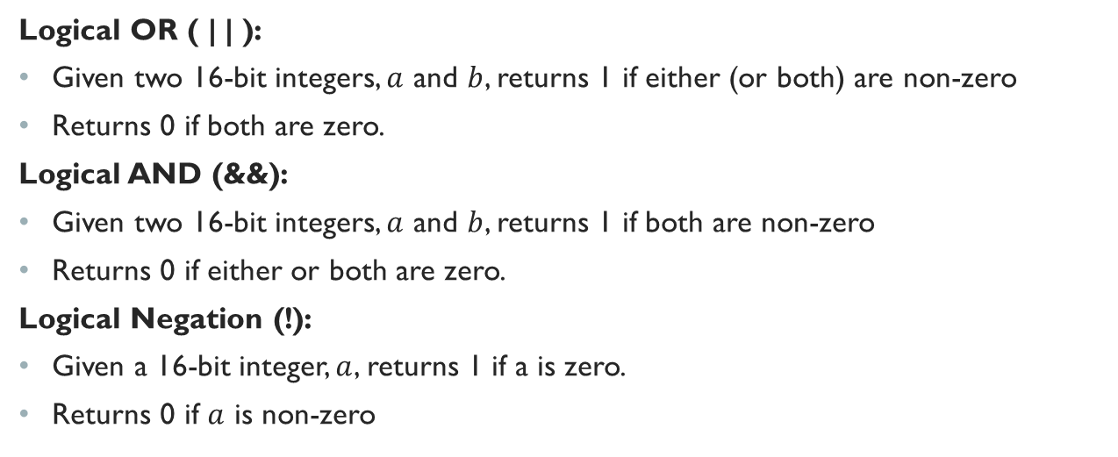
Logical Operators
Logical OR ( | | ):
Given two 16-bit integers, $a$ and $b$, returns 1 if either (or both) are non-zero
Returns 0 if both are zero.
Logical AND (&&):
Given two 16-bit integers, $a$ and $b$, returns 1 if both are non-zero
Returns 0 if either or both are zero.
Logical Negation (!):
Given a 16-bit integer, $a$, returns 1 if a is zero.
Returns 0 if $a$ is non-zero

Slide 8

Examples
!0x9A
1001 1010 $→$ 0x00
(0x1F || 0xD2)
0001 1111 || 1101 0010 $→$ 0x1
(0x6E && 0x92)
0110 1110 && 1001 0010 $→$ 0x1

Slide 9
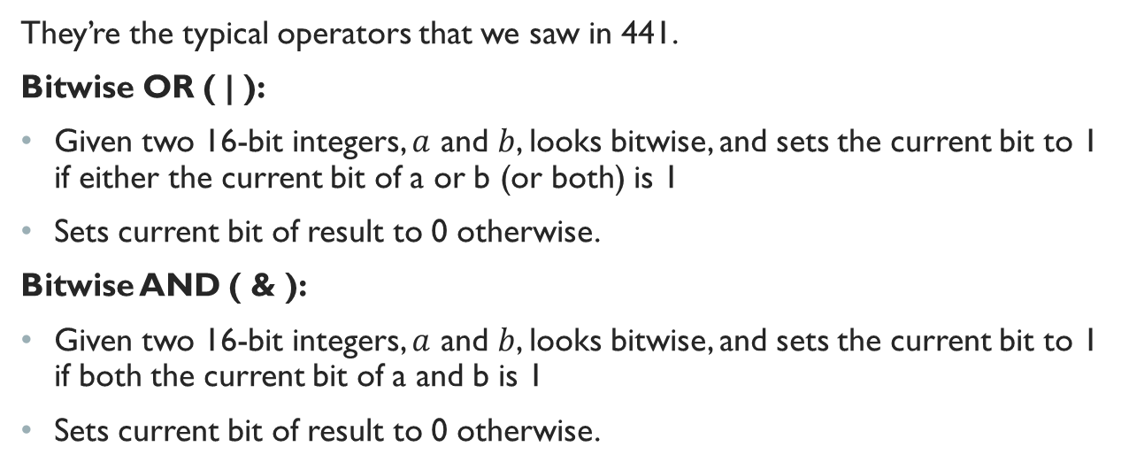
Bitwise Operators
They’re the typical operators that we saw in 441.
Bitwise OR ( | ):
Given two 16-bit integers, $a$ and $b$, looks bitwise, and sets the current bit to 1 if either the current bit of a or b (or both) is 1
Sets current bit of result to 0 otherwise.
Bitwise AND ( & ):
Given two 16-bit integers, $a$ and $b$, looks bitwise, and sets the current bit to 1 if both the current bit of a and b is 1
Sets current bit of result to 0 otherwise.

Slide 10
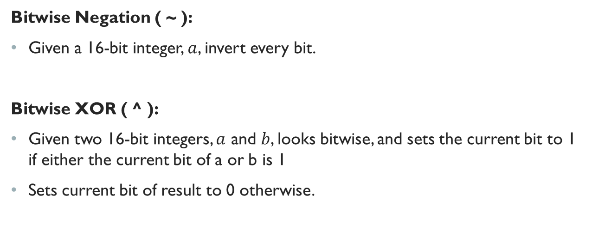
Bitwise Operators (Continued)
Bitwise Negation ( ~ ):
Given a 16-bit integer, $a$, invert every bit.
Bitwise XOR ( ^ ):
Given two 16-bit integers, $a$ and $b$, looks bitwise, and sets the current bit to 1 if either the current bit of a or b is 1
Sets current bit of result to 0 otherwise.

Slide 11
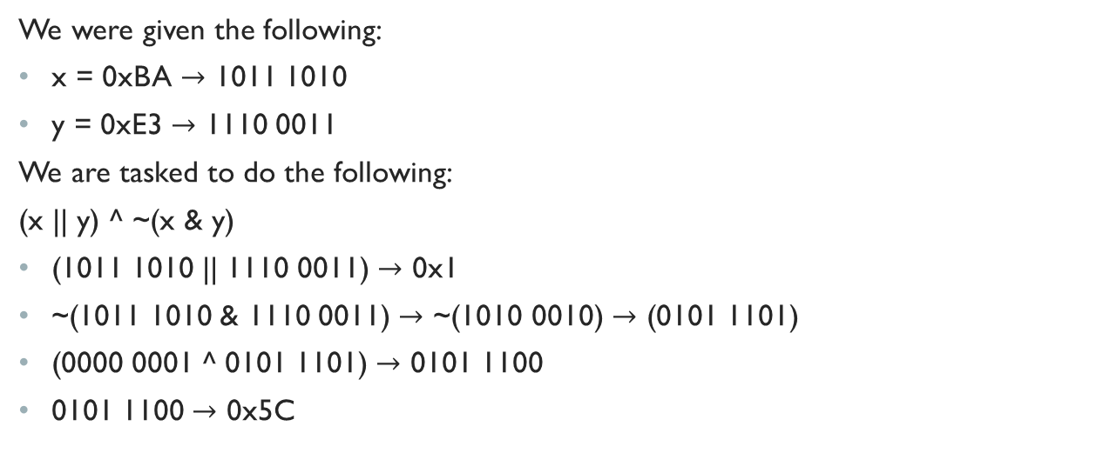
Going over the Quiz
We were given the following:
x = 0xBA $→$ 1011 1010
y = 0xE3 $→$ 1110 0011
We are tasked to do the following:
(x || y) ^ ~(x & y)
(1011 1010 || 1110 0011) $→$ 0x1
~(1011 1010 & 1110 0011) $→$ ~(1010 0010) $→$ (0101 1101)
(0000 0001 ^ 0101 1101) $→$ 0101 1100
0101 1100 $→$ 0x5C

Slide 12
IEEE 754 Review

Slide 13

Fixed-Point Representation
Formally,
Let $x∈ℝ$ (Binary).
Then, x can be uniquely written as:
$$x=σ\overline{x}+2^{e}$$
where $σ=Sign Bit$
$$1≤x<(10)_{2}$$
$$e∈ℝ$$

Slide 14
Convert 15.375 to Binary
Apply Conversion of Bases
1) For the Decimal portion:
1 = 3/2 = 7/2 = 15/2
Mark each bit that is odd as a 1, otherwise mark it as 0.
15 -> 1111 in binary
2) For the Fractional portion:
0.375 * 2 = 0.750 * 2 = (1.500 – 1) * 2 = 1.000
Mark each number that did not exceed 1 with a 0, and 1 otherwise.
0.375 -> 011 in binary.
Therefore, 15.375 is 1111.011 in Binary!

Slide 15

IEEE 754 Single Precision
1 bit for the sign bit, $σ$
8 bits for the exponent bits,$E=e+127$ ($1≤E≤254$)
(0 and 255 are reserved values for error-checking, like NaN)
23 bits for the fractional bits

Slide 16


31.25 in IEEE 754
Apply conversion of bases on decimal part:
1) 1 = 3/2 = 7/2 = 15/2 = 31/2
31 = 11111 in Binary.
Apply conversion of bases on fraction part:
1) (0.25 * 2) = 0.50 * 2 = 1.00
0.25 = 01 in Binary
In binary, 31.25 = 11111.01
Write in terms of Scientific Notation: $±1.111101 ∗2^{4}$
$$σ=0$$
$e=4→E=127+4=131=10000011$ in binary
Therefore, in IEEE 754:
Fractional Bits
0 | 1 | 0 | 0 | 0 | 0 | 0 | 1 | 1 | 1 | 1 | 1 | 1 | 0 | 1 | 0 | 0 | 0 | 0 | 0 | 0 | 0 | 0 | 0 | 0 | 0 | 0 | 0 | 0 | 0 | 0 | 0
Sign Bit, $σ$
E = e + 127
Trailing Zeros

Slide 17
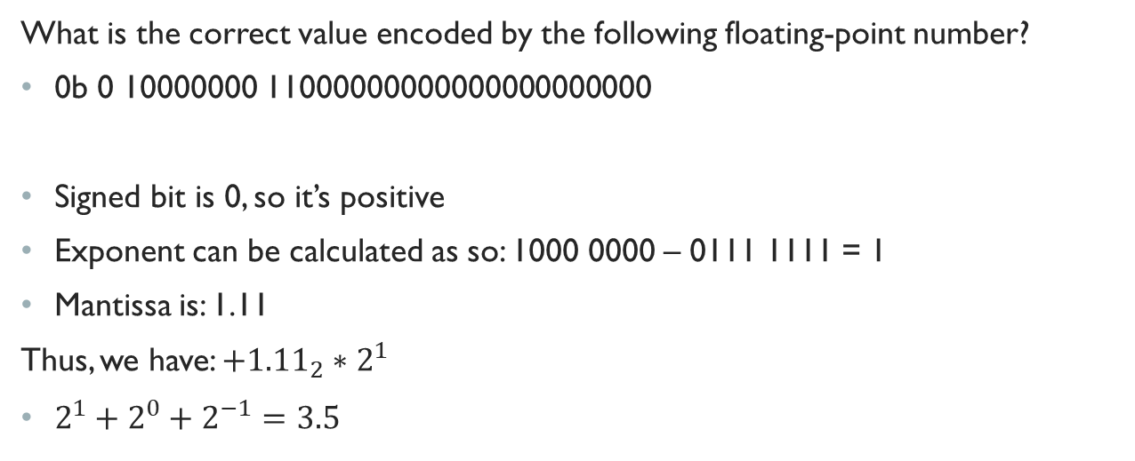
Let’s review the second Question from the Quiz
What is the correct value encoded by the following floating-point number?
0b 0 10000000 11000000000000000000000
Signed bit is 0, so it’s positive
Exponent can be calculated as so: 1000 0000 – 0111 1111 = 1
Mantissa is: 1.11
Thus, we have: $+{1.11}_{2}∗2^{1}$
$2^{1}+2^{0}+2^{−1}=3.5$

Slide 18
Pointers next time…
Pointers will take a while to explain…I’d rather not rush it, and wait till next week to cover it along with Lab 1…

Slide 19
Now for some live coding and the Data Representation Worksheet!

