Slide 1
CS 449 Recitation 2
Gordon Lu

Slide 2
Repeat after me
Repeat after me:
Arrays aren’t real in C!
Never invoke sizeof() on a pointer!
Never do heavy string manipulation in C!

Slide 3
Memory

Slide 4
Memory
Before we talk about what pointers are… it’s helpful to understand memory a little more!
Memory is …. a huge one-dimensional array of bytes
Every byte has an associated address
That address is its array index
For values bigger than a byte, we scale up, and use consecutive bytes!
But… regardless of size, the address of any value is the address of the first byte!

Slide 5
The sizeof() function
sizeof() is a compile-time operation which tells you how many bytes something takes up!
EXTREMELY IMPORTANT:
C does not know how big an array of a pointer is!!
All pointers in C will be 8 bytes.
Repeat after me: NEVER INVOKE SIZEOF ON A POINTER
ANOTHER THING:
sizeof(array) GIVES YOU THE BYTE SIZE!!

Slide 6
Pointers: An Analogy

Slide 7
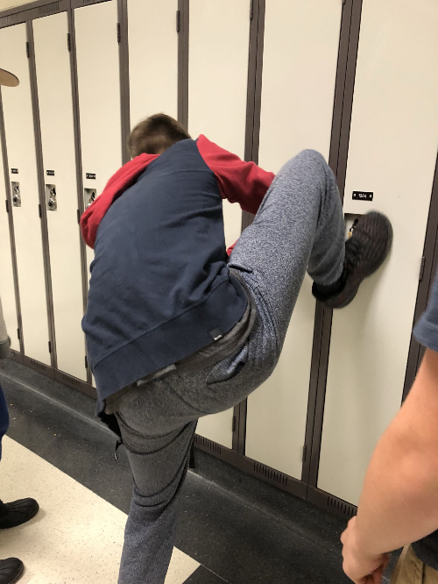
Lockers
1) Let’s think about lockers… what’s its purpose?
… to store things…
2) How do we identify lockers from one another?
Using their locker numbers…
3) How do you access a locker?
By knowing the locker number and combination….
For our purposes, let’s assume the lockers are combo-less
4) If I wanted to give someone else access to my locker, what would I do?
RIP IT OUT AND HAND IT TO THEM!
Hehe… ya just give them the locker number!

Slide 8
Locker Rooms
Just like a locker stores things
A variable stores things…
But a variable is a thing itself…
Each variable is just like a locker!
It has a number: its address
It stores something: its value
It belongs to someone: its owner
How would I give someone else access to my variable?
Give’m the locker number…
Which is… the memory address!
So what’s a variable?
It’s just a way to conveniently refer to their memory address!

Slide 9
Pointers!!!
A pointer is a variable which holds another variable’s memory address.
Once you have a pointer, you have access to two things:
The pointer itself
The variable it points to

Slide 10
Pointers

Slide 11
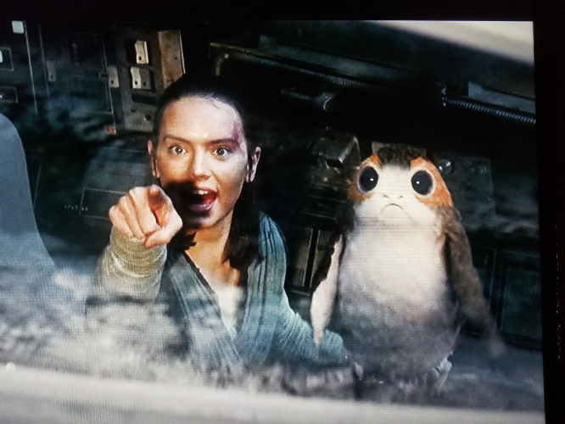
What is a Pointer?
A pointer is a variable that holds a memory address of another variable.
Essentially, anytime you would use an array in Java, you’d use a pointer in C.
You can access a value a pointer points to using the dereference operator (*).
C uses pointers because it’s easier to say, “that’s the place that has that data” rather than saying “This is the entire thing that which includes the data I’m interested in!”

Slide 12

Another thing… Arrays don’t Exist in C!
Wait… what???
You heard me… ARRAYS DON’T EXIST IN C
Basically, arrays are considered as local variables in C.
Meaning, we can’t return an array in C!
So, what do we do instead?
We return a pointer to the array instead!
BIG POINT: Arrays become pointers when passed into functions!

Slide 13
Address-OF (&) Operator
You can get the address of a variable via the address-of operator (&)
int x;
int* p = &x;

Slide 14

Pointers Example
int x = 10;
int y = 20;
int* p = &x;
We say “p points to x”
10
x
20
y
address of x
p

Slide 15



Pointers Example
p = &y;
int** pp = &p;
10
x
20
y
address of x
address of y
p
address of p
pp

Slide 16
Pointers and Arrays

Slide 17
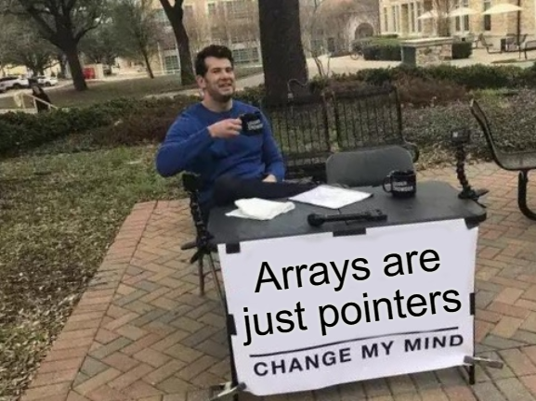
Pointers and Arrays
A pointer can point to one or more values.
A char* may point to a single char, or to an array of chars.

Slide 18


Arrays Example
char c = ‘x’;
char* s = &c;
s = “hi!”;
“Pointing to a single value” is the same as “pointing to an array of length 1”!
‘x’
c
address of c
address of
string literal
s
‘h’ | ‘i' | ‘!’ | ‘\0’

Slide 19
Accessing the Value at a pointer

Slide 20

The value-at (Dereference) operator
1) * is the value-at operator: it’s the inverse of &
Every time you use it, you remove a star.
2) It accesses the variable that a pointer points to
We say that it “dereferences” a pointer

Slide 21

Pointer Example
int x = 10;
int* p = &x;
*p = 15; //changes x!
Changing the value of a pointer (via dereference) will change the original value!
10
x
15
address of x
p

Slide 22
Array-Indexing operators

Slide 23
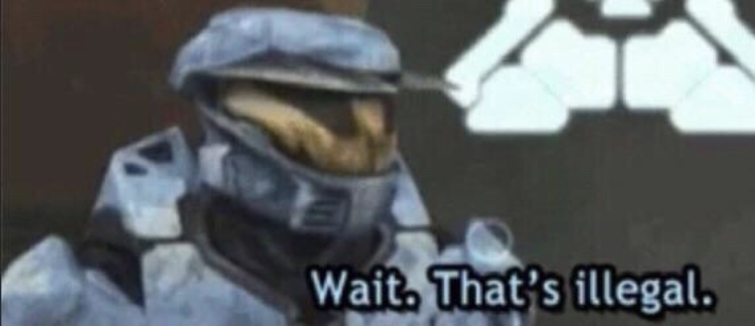
The array indexing operator
p[n] means “access the nth item pointed to by p.”
char* s = “hi!”;
char c = s[2];
char d = 2[s];
Now c and d are the same thing…
address of
string literal
s
‘h’ | ‘i' | ‘!’ | ‘\0’

Slide 24




What the Brackets Actually do
p[n] in C really means “dereference address p + n”
s[2]
= *(s+2)
= *(2+s)
= 2[s]
What about values bigger than a char?

Slide 25

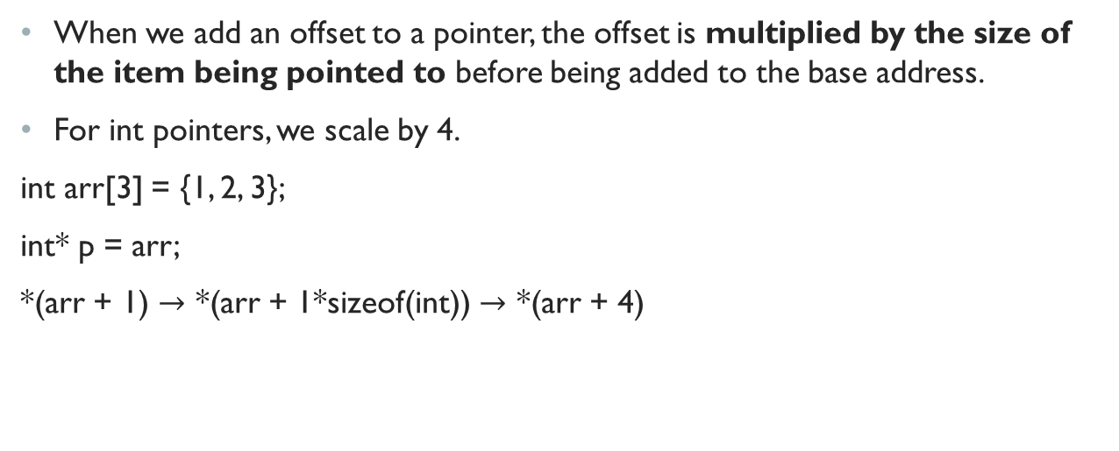
Scaling
When we add an offset to a pointer, the offset is multiplied by the size of the item being pointed to before being added to the base address.
For int pointers, we scale by 4.
int arr[3] = {1, 2, 3};
int* p = arr;
*(arr + 1) $→$ *(arr + 1*sizeof(int)) $→$ *(arr + 4)

Slide 26
Pointer Arithmetic & Void Pointers

Slide 27
Memory Addresses are just Numbers
1) Pointers hold memory addresses…
Memory addresses are just numbers.
2) It’s incredibly useful to do arithmetic on memory addresses
No dereferencing is involved in pointer arithmetic.
We are operating on the pointer itself!

Slide 28
Strings in C

Slide 29
Strings are just char arrays
Strings are just sequences of characters!
In C, we indicate the end of a String using a NULL TERMINATOR: ‘\0’
If we lose track of the NULL TERMINATOR, we’re pretty much screwed.

Slide 30
Strings in C
The end of a string is indicated by a NUL Terminator (‘\0’)
There are two ways to initialize strings in C, by a char array, or a char pointer
1) char mystr[100] = “hello”;
Allocates space for 100 characters, fills array with characters up to the length of the string, and fills the rest of the slots with ‘\0’!
2) char* mystr = “hello”;
Allocates the string in the static data segment
Allocates space for the pointer
Don’t do this if you want to do String Manipulation!

Slide 31
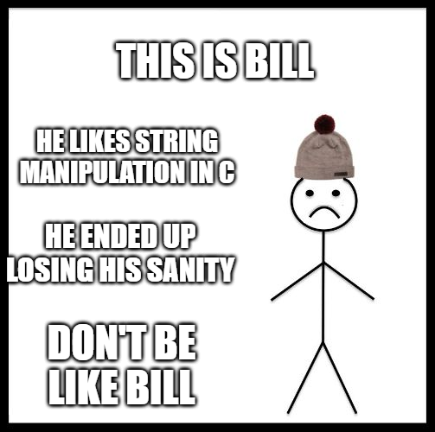
Basic String Functions
strlen(): Scans entire string for a ‘\0’ and return count of iterations to get there
strcmp(): compares two string and returns comparison value (compareTo in Java)
strcpy(a,b): copies string from b into memory at a
strcat(a,b): copies string from b into memory AFTER a.
Avoid string manipulation at ALL COSTS in C!!

Slide 32
String Manipulation Example
Suppose we start out with a char array mystr: char mystr[100];
mystr
If we strcpy the string, “this” into mystr:
mystr
If we strcat the string, “ is” into the modified mystr:
mystr
0 | 1 | 2 | 3 | 4 | 5 | 6 | 7 | 8 | 9
0 | 1 | 2 | 3 | 4 | 5 | 6 | 7 | 8 | 9
t | h | i | s | \0
0 | 1 | 2 | 3 | 4 | 5 | 6 | 7 | 8 | 9
t | h | i | s |  | i | s | \0

Slide 33
Lab 1 hints

Slide 34
Who likes bit manipulation?
Not me :I
Who wants to get some hints? ;)

Slide 35

Bitwise and
DeMorgan’s Law
$\sim \left(p∧q\right)=\sim p∨\sim q$
To get $p∧q$ back, just negate again!

Slide 36



Bit XOR
What’s the truth table for XOR again?
Yup!

Slide 37





Biconditional
What was the truth table for biconditional again?
Yup!

Slide 38
Notice anything?
Anybody notice anything strange about the truth tables for XOR and the Biconditional?
They’re logical inverses!
So, we can derive an expression for XOR!

Slide 39
Derivation of Boolean expression for XOR

Slide 40









Detecting signed Overflow in hardware (brief review)
Who here remembers adders?
I KNOW Logisim was yucky!!!

Slide 41

















Signed Overflow Detection
We can detect overflow by looking at the signs of the inputs!
If the signs are the same, there’s overflow if the output sign is different!
When input signs differ, we can’t have overflow!

Slide 42






































Why Sum-of-products & Karnaugh maps are awesome
The beauty of K-maps and SoPs is that given any truth table, it can make a Boolean expression!!!

Slide 43






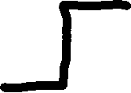




What would this look like as a circuit?

Slide 44
Add OK
Hm… now we have a way to check if there’s overflow in addition!
and… we have a nice Boolean expression too!
How would I get the signs?
Yup, just shift over by 31…
Logical negation might help…

Slide 45
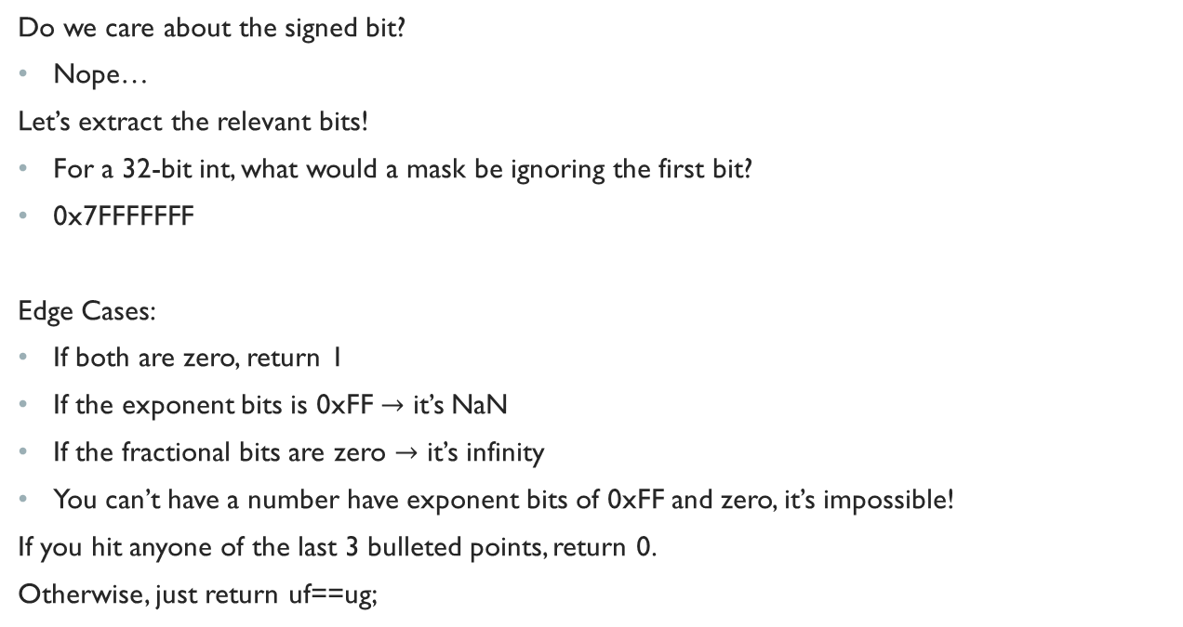
Float is Equal
Do we care about the signed bit?
Nope…
Let’s extract the relevant bits!
For a 32-bit int, what would a mask be ignoring the first bit?
0x7FFFFFFF
Edge Cases:
If both are zero, return 1
If the exponent bits is 0xFF $→$ it’s NaN
If the fractional bits are zero $→$ it’s infinity
You can’t have a number have exponent bits of 0xFF and zero, it’s impossible!
If you hit anyone of the last 3 bulleted points, return 0.
Otherwise, just return uf==ug;

Slide 46
I’ll leave the rest to you!
Should you have more questions, don’t hesitate to send me an email, schedule office hours, and I’d be happy to help you ☺

Slide 47
Structs & Lab 2 Hints Next Time!

