Slide 1
CS 449 Recitation 3
Gordon Lu

Slide 2
Logistics
We’re going to have a “quiz” today to test your knowledge of pointers and strings!!
Structs will be covered
Q&A on the Pointers Lab?

Slide 3
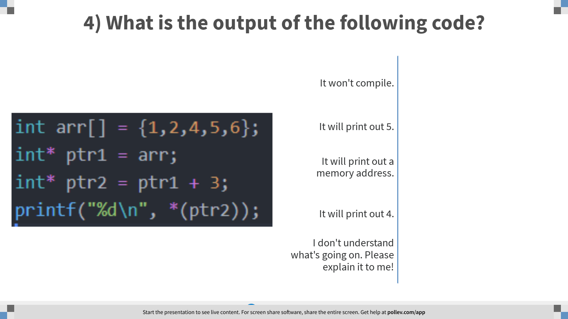
Notes:
Poll Title: 4) What is the output of the following code? https://www.polleverywhere.com/multiple_choice_polls/PvsLICwLTaEoaBELzD9QZ?flow=Default&onscreen=persist

Slide 4
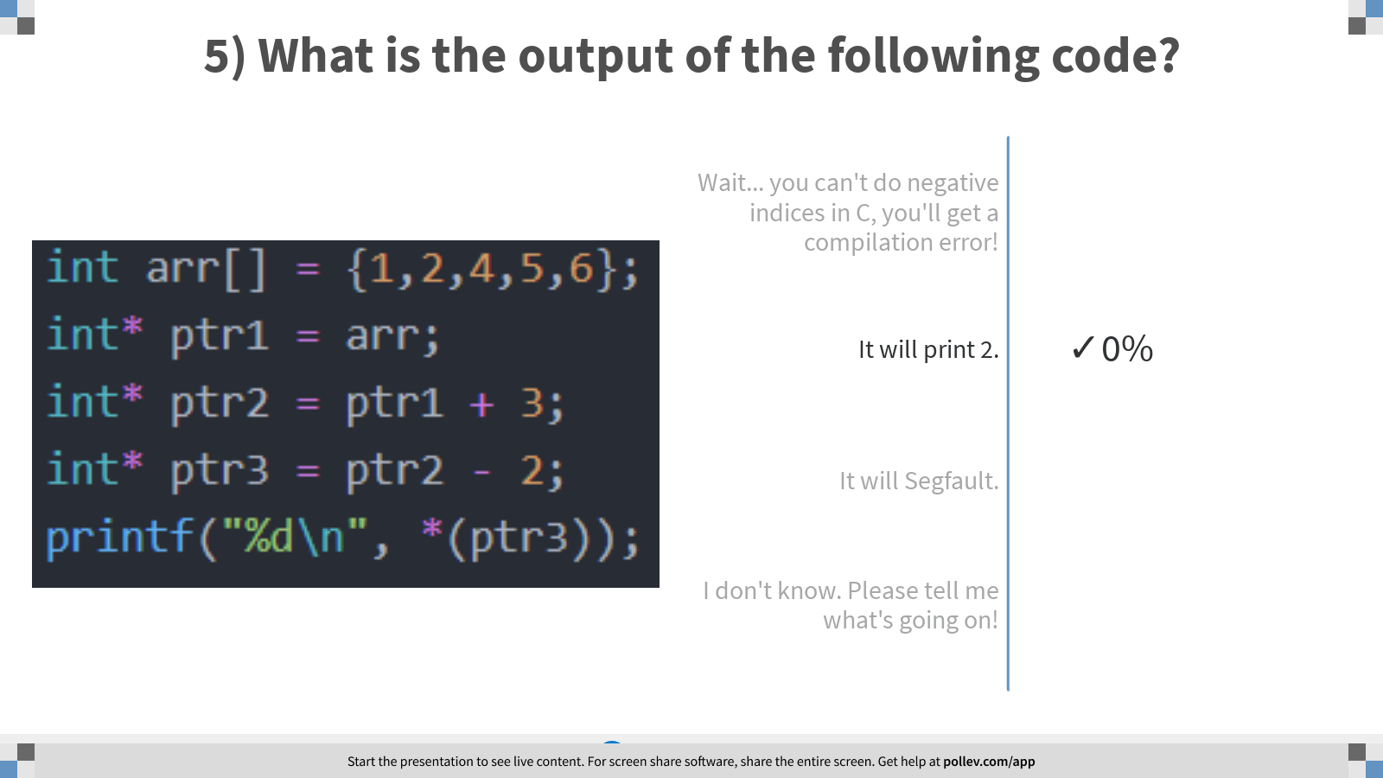
Notes:
Poll Title: 5) What is the output of the following code? https://www.polleverywhere.com/multiple_choice_polls/8yWtp60mGPiKQrL2MTkxs?flow=Default&onscreen=persist

Slide 5
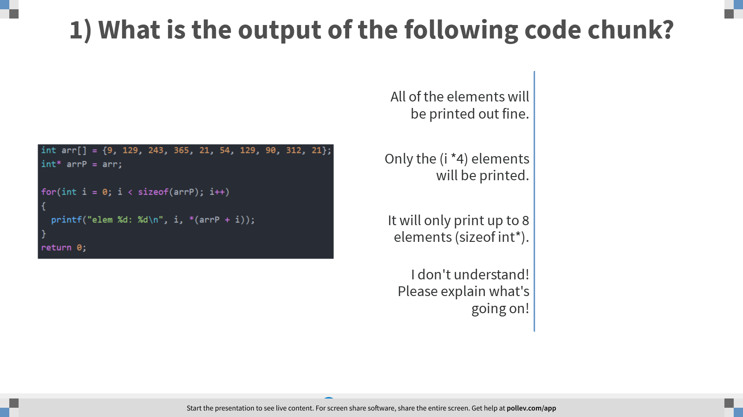
Notes:
Poll Title: 1) What is the output of the following code chunk? https://www.polleverywhere.com/multiple_choice_polls/82xl4mRuDdBrI5Kp8rE4n

Slide 6
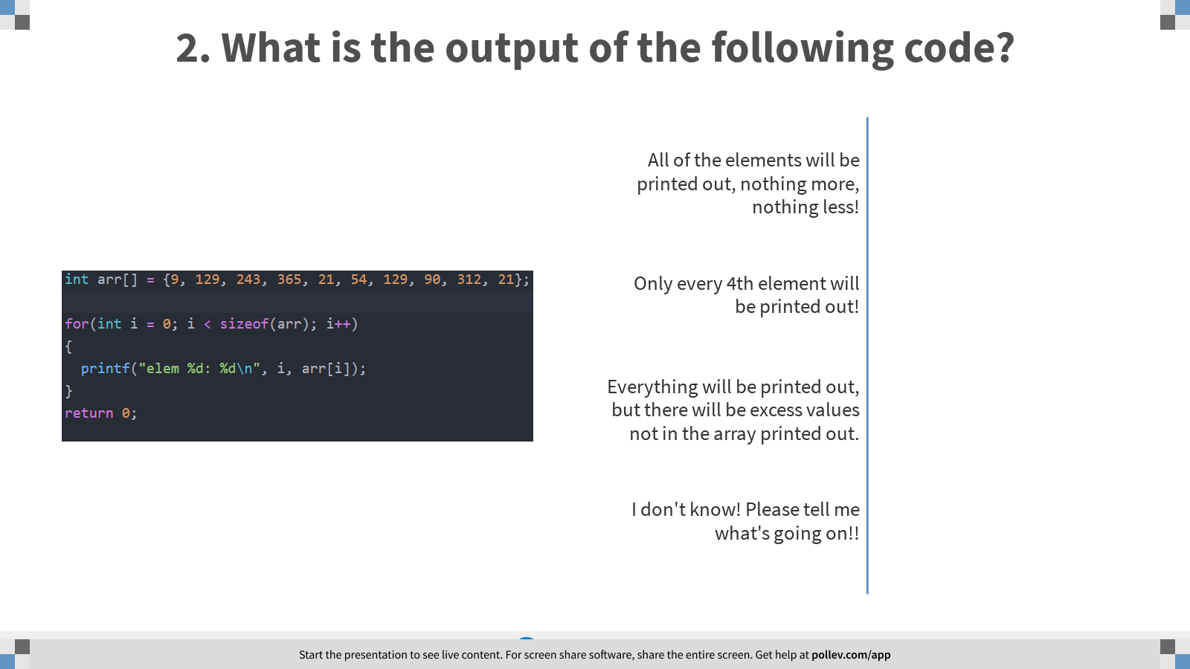
Notes:
Poll Title: 2. What is the output of the following code? https://www.polleverywhere.com/multiple_choice_polls/usEgWDUBW29QUMDCC9ZI6

Slide 7
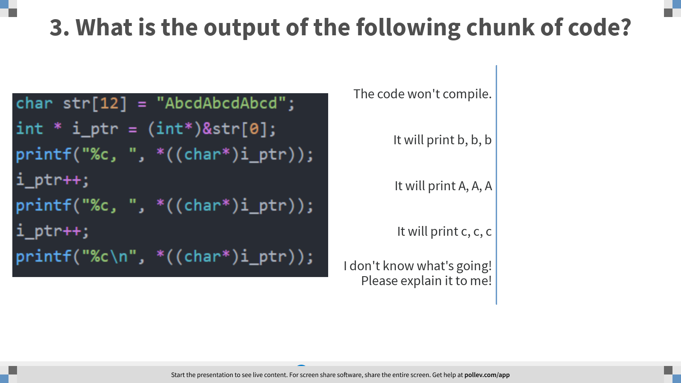
Notes:
Poll Title: 3. What is the output of the following chunk of code? https://www.polleverywhere.com/multiple_choice_polls/D23Lvf4bCCapBBWMGS4Oa

Slide 8
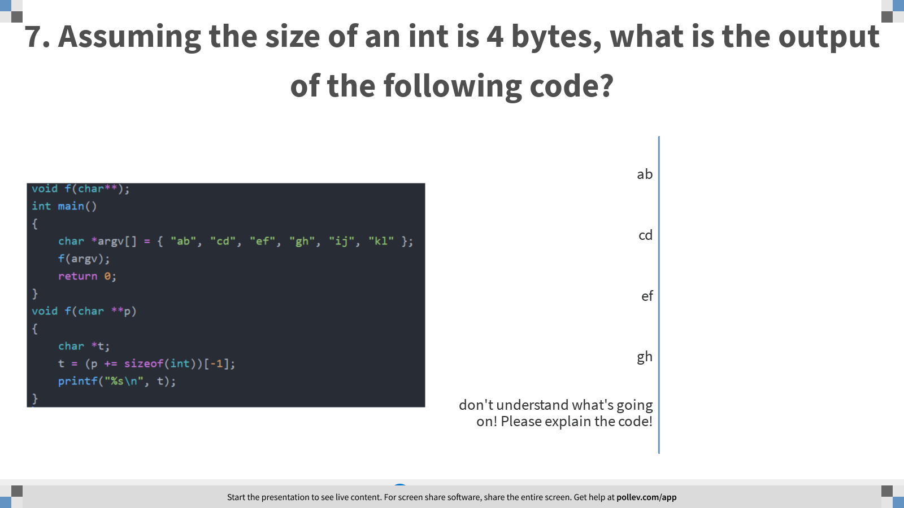
Notes:
Poll Title: 7. Assuming the size of an int is 4 bytes, what is the output of the following code? https://www.polleverywhere.com/multiple_choice_polls/zphA5hut0hBtn9RPy8uZV

Slide 9
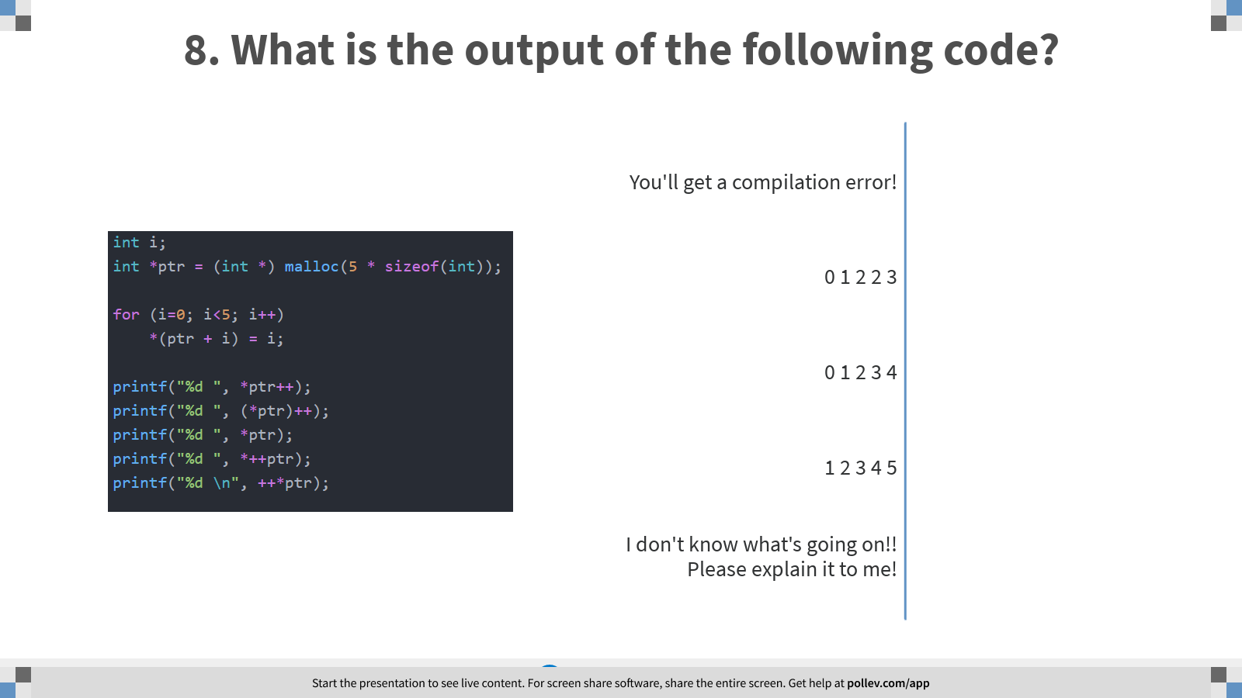
Notes:
Poll Title: 8. What is the output of the following code? https://www.polleverywhere.com/multiple_choice_polls/NrO03YpZ50umJ0LBjxQX0

Slide 10
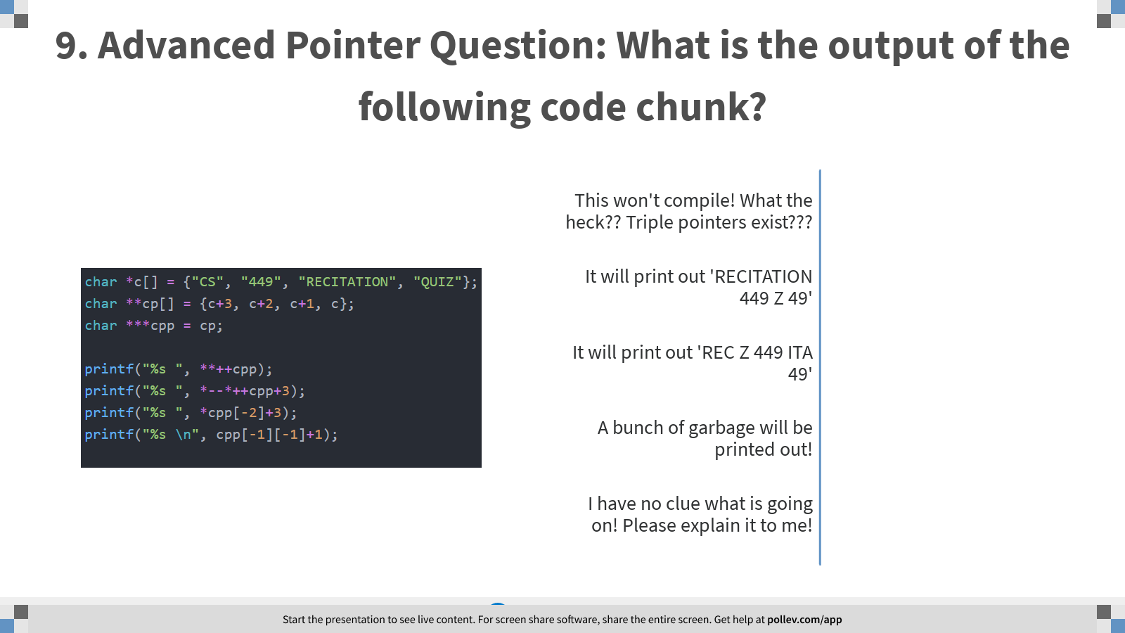
Notes:
Poll Title: 9. Advanced Pointer Question: What is the output of the following code chunk? https://www.polleverywhere.com/multiple_choice_polls/9HA4XPsbJRGlovamRpiIu

Slide 11
Now onto Structs!!

Slide 12
Struct: Classes’ Ancestors
Remember classes in Java??
Well, you can think of a struct like… a class
…without all of the fancy functions
... just the instance fields…
All you can do with a struct is store data!!

Slide 13
An Example Struct
Here’s an example of a Struct that represents a node:
struct Node{
struct Node* next;
int data;
};
Note the semicolon!!!
If you forget it, you’ll get a lot of errors!

Slide 14
Another Example
Here’s another example of a struct:
struct 449 {
char name[10];
double grade;
int num_labs_aced;
};
A struct created like this needs to be declared like so:
struct 449 student;

Slide 15
The Memory Representation of a Struct
All the struct fields are allocated inside the struct variable:
struct 449{
char name[10];
double grade;
int num_labs_aced;
};

Slide 16
Alignment and Padding
When you compile your program, it won’t be the size you expect… the C compiler will align the fields!
It will align the struct, so each field is a multiple of the maximum alignment of the largest data member.
For example, in your 449_student struct, our struct would be aligned to a multiple of its largest data member, which is a double, meaning a multiple of 8 bytes.

Slide 17
TypeDefs
typedef is a way of making a type alias
In other words, just a convenient way to refer to a type
The syntax of a typedef is a variable declaration…
but with typedef in front
Example: typedef int X; //X is another name for an int now
X x; //same as saying int x;

Slide 18
The better way to Declare Structs
Typically most C programmers will declare structs like so:
typedef struct 449{
char name[10];
double grade;
int num_labs_aced;
} 449;
This way, you can create a struct like so: 449 student;

Slide 19
Initializing Struct Fields
You can initialize structs pretty nicely, it kind of looks like the hard coded array initialization!
449 s1 = {“gordon”, 98.0, 100.0};
You can also make struct arrays!
449 students[ ] = {
{“gordon”, 100.0, 100.0},
{“wilkie”, 100.0, 100.0},
{“vinicius“, 100.0, 100.0},
};
You know what this means, right? You can make struct pointers too!!

Slide 20
Field Access (The . Operator)
It works just like in Java!
Regular structs require the . Operator:
students[0].grade = 10000.0;
Struct pointers require the -> Operator:
student_1 = &students[0];
student_1 -> grade = 10000.0;

Slide 21
Passing and Returning Structs
If you pass a struct to or return a struct from a function…the whole struct is copied!!
typedef struct bigStruct{
int arr[256];
} bigStruct;
void func(bigStruct big){ }
…
bigStruct big;
func(big); //This will copy 256 * 4 bits…

Slide 22
Passing by Reference
Rather than pass by value, structs are often passed as a pointer: “by reference”
void func(bigStruct* big){ }
…
bigStruct big;
func(&big);
This will copy the size of 1 pointer!!

Slide 23
Hints for the Lab

Slide 24
Determining whether two pointers are in the same block in memory
Consider the last 6 bits of a 32 bit number.
What is 2^6 in decimal?
64
Now, if we shift of the lower 6 bits of two pointers, and they are still the same, then this implies that the original addresses must have been 64 bytes of each other.

Slide 25
Determining whether a pointer points to an element in a given array
First, let’s extract the distance between the pointer and the array.
Let’s now consider this distance as the base address of our array.
Let’s extract the sign out of this distance
Now, let’s use this distance to extract the proposed last element’s size.
If the sign of the first element using this proposed distance and the last elements are different, they cannot possibly live in the array.

Slide 26
General Hints
Always return pointers. Never ever return arrays, they don’t exist in C!!!
Remember what dereferencing a pointer really means.
Or for that matter, what accessing an element at the ith position of an array means.
Remember how we know we’re at the end of a string.

Slide 27
What’s in store for next time
Basic memory allocation, allocation algorithms.
A brief introduction to x86 assembly (I’ll see what Petrucci has in mind)

Slide 28
Any Questions?

