Slide 1
CS 0449 Recitation 4
Gordon Lu

Slide 2
Logistics
C-Scope, Lifetime, and the Stack
The Heap & Memory Allocation
Hints for the Queue Lab
Q&A on the Queue Lab?

Slide 3
Scope, Lifetime, and Ownership

Slide 4

Scope
Scope is where a variable can be seen.
C has three basic levels of scope.
globals which can be seen by any function in any file
static globals which can be seen by any function in one file
locals which can be seen by one function

Slide 5
LIFETIME
Every variable takes up space in memory
That memory must be allocated: reserved for the variable
andddd when no longer needed, deallocated: released for other use
Lifetime is the time between allocation and deallocation
Global Variables last from program start to program exit
Local Variables only last as long as the enclosing function
IMPORTANT: Lifetime and Scope are NOT the same thing, although the lifetimes and scopes of locals and globals overlap.

Slide 6
Ownership
Ownership answers the question: Who is responsible for deallocating a piece of memory?
orrrr, how do we determine when it’s okay to deallocate memory?
C is dumb, and pretends the problem doesn’t exist ☹
Locals are owned by functions
Globals are owned by the program

Slide 7
The Stack

Slide 8
What’s the Stack?
1) It’s an area of memory provided to your program by the OS.
When your program starts, it’s already there
2) The stack holds information about function calls
3) It’s not a strict stack
You can read and write any part of it
…but it grows and shrinks like a stack
push and pop describe growth and shrinkage
4) Each program (thread) gets one stack
I mean.. cuz one function is running at a time!!

Slide 9
Activation Records
When a function is called, a bunch of data is pushed onto the stack.
This is the call’s activation record (stack frame)
It contains local variables (including arguments) and the return address

Slide 10
An example Activation Record
Stack
int main(){
int help_me, dude;
char buf[10];
return 0;
}
main‘s caller
return address
help_me
dude
buf[10]
main’s AR
garbage

Slide 11
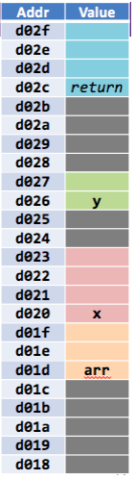
The low-level layout
Each variable (including array variables) gets enough bytes in the AR to hold its value.
Where the variable is located is up to… the COMPILER!!
int x;
char arr[3];
short y;

Slide 12
Call = Push, Return = pop
The stack grows when we call a function, and shrinks when it exits
int main(){ void fork(int* ptr){
int x; *ptr = knife();
fork(&x); }
return 0; int knife(){
} return 10;
}

Slide 13
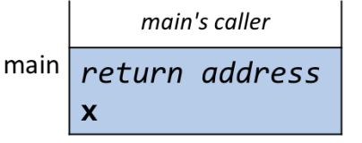
Example
The program’s AR in main without any other function calls is:

Slide 14
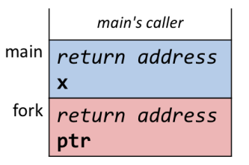
Example
After fork() is called, the AR becomes:

Slide 15
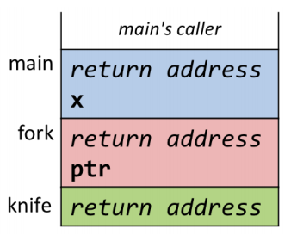
Example
After knife() is called within fork(), the AR becomes:

Slide 16
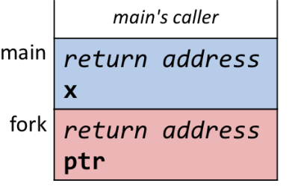
Example
After knife() is finished returning, the AR becomes:

Slide 17
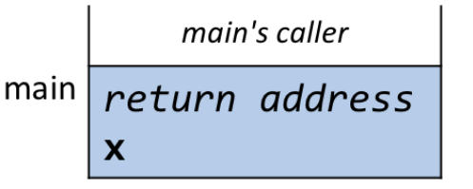
Example
After fork() is finished returning, the AR becomes:

Slide 18
Recursive Functions

Slide 19
Recursive Functions
Recursive functions work by using the call stack as an implicit stackdata structure.

Slide 20
Live Example
Given the recursive implementation of factorial:
int fact(int x){
if(x <= 2){ return x;
} else{
return x*fact(x-1);
}
}

Slide 21
More on Activation Records

Slide 22
They don’t really go away…
The stack is used constantly
So, it needs to be REALLY FAST
So, we implement it as a pointer
The stack pointer (sp)
Pushing the AR moves the sp down
Popping the AR moves the sp up

Slide 23
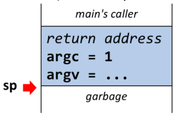
Example
Initially, the stack pointer is:

Slide 24
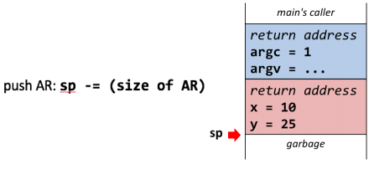
Example
After pushing onto the call stack, the stack pointer is:

Slide 25
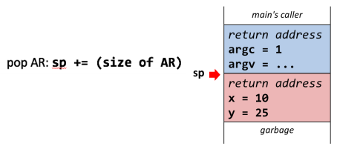
Example
After popping off the call stack, the stack pointer is:

Slide 26
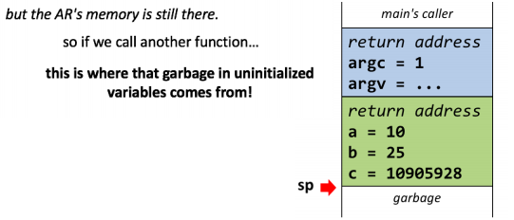
Example
The AR’s memory is still there, so calling another function is BAD
This is where the garbage in uninitialized variables comes from!

Slide 27
Memory Management

Slide 28
The Heap
The heap is a programmer-managed area of memory.
It has nothing to do with the heap data structure!
You can create and destroy pieces of memory on demand

Slide 29
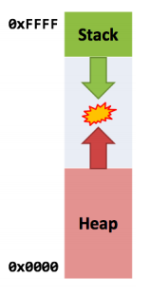
Memory Layout
The stack and heap both change size
The stack grows down (higher addresses to lower addresses)
The heap grows up (lower addresses to higher)
If they meet, your program is out of memory!
Having the stack and heap grow towards each other allows for maximum memory utilization, e.g. if you have a huge heap and small stack

Slide 30
The functions
1) The heap functions are in <stdlib.h>
2) To allocate memory, we invoke malloc:
int* arr = malloc(sizeof(int) * 20);
This allocates a 20-item int array on the heap
malloc takes the number of bytes to allocate and makes a block of bytes at least that big and returns a pointer to it.
3) When you’re done with that block of memory, you invoke free:
free(arr);

Slide 31
Allocating a Struct on the Heap
1) This is the closes to Java’s new as C gets: Food* f = malloc(sizeof(Food));
2) But just like anything on the stack…
Everything you malloc contains garbage.
3) To fix this, we invoke memset from <string.h>
memset(f, 0, sizeof(Food));
This says “fill the memory at f with 0s”
4) orrrr use calloc() instead of malloc()
Food* f = calloc(sizeof(Food), 1);
This says “allocate 1 * sizeof(Food) bytes and fill them with 0s”

Slide 32
Caveat I
If we do this: while(1)
malloc(101728);
2) Your program will run out of memory…
But you won’t get an error
This loop will run FOREVER
If you run out of memory, malloc returns NULL

Slide 33
Caveat II
int* arr = malloc(sizeof(int) * 20);
free(arr);
arr[0] = 1000; //OH NO
You don’t know what’ll happen.
Whenever you free heap memory, all pointers to it become invalid, and it’s your responsibility to never use them again.
So if multiple things point to this memory…
They’re allowed to point to it… but they better not access it
It’s like a bomb rigged to explode when you dereference it
Here’s another kind of invalid pointer: It used to point to some valid heap memory, but not anymore.

Slide 34
The Heap Commandments
When you malloc, check if it returns NULL
You must free everything you allocate
… and you must free it exactly once.
You must not access memory that has been freed.

Slide 35
Hints for the lab

Slide 36
General Advice for the Lab
Always, always, always be sure to draw pictures!!
Make sure you check if malloc fails.

Slide 37
Queue Reverse

Slide 38
Let’s Walk through an approach for insert head

Slide 39
What to expect for Next Time

Slide 40
Next Time
I plan on covering Memory Allocation in depth, meaning Bitmaps, Linked Allocations
I’ll also cover x86, and guides on using debugging in C
Also, don’t hesitate to send me an email if you ever find yourself confused!!

