Slide 1
CS 0449 Recitation 6
Gordon Lu

Slide 2
Logistics
You guys have a midterm coming up!!
The Compilation Toolchain
Dynamic Linking and Loading

Slide 3
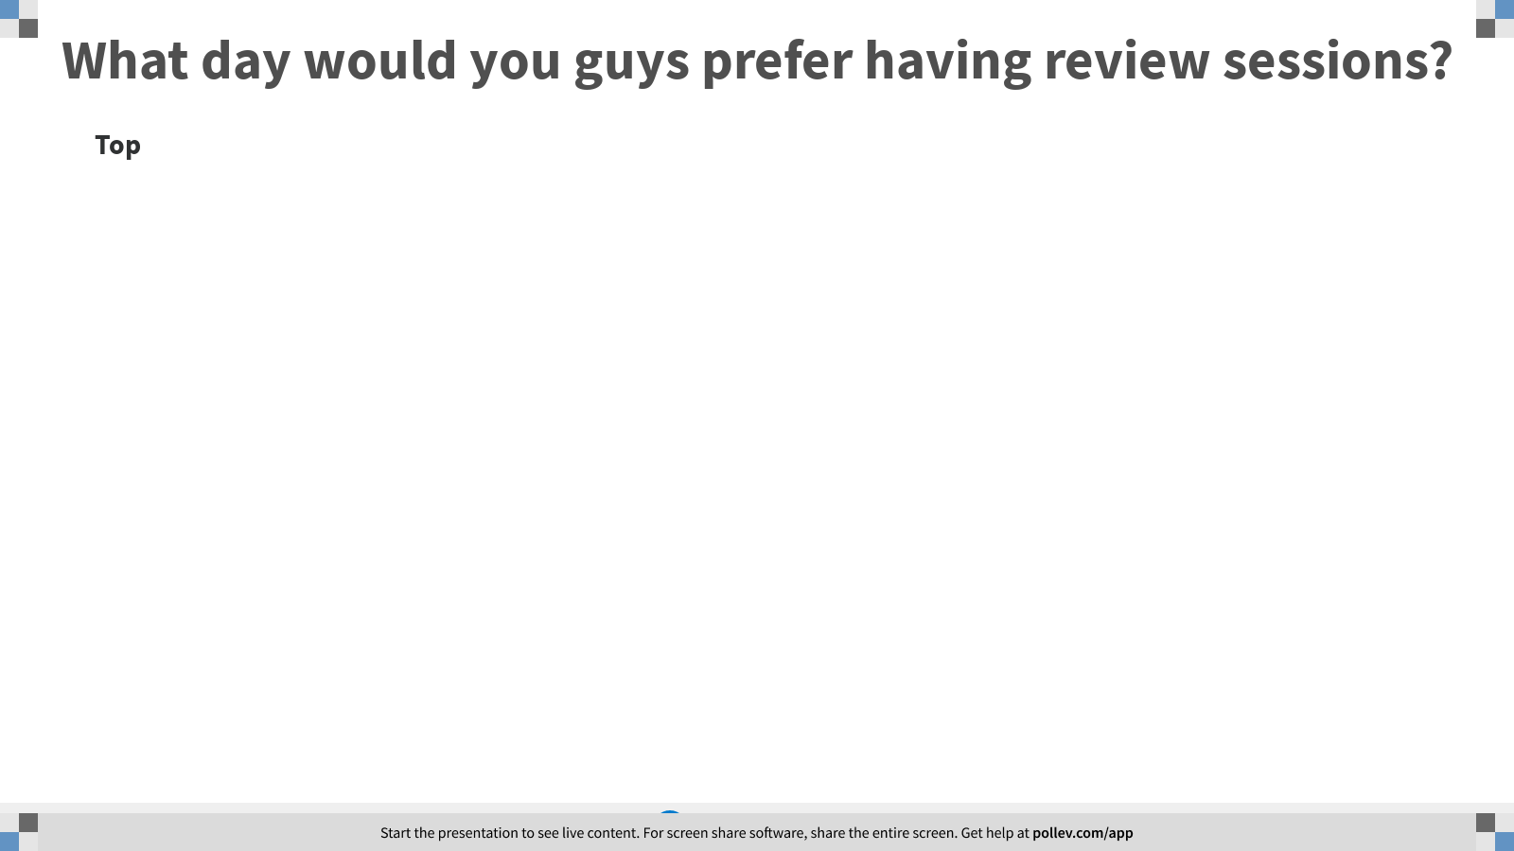
Notes:
Poll Title: What day would you guys prefer having review sessions? https://www.polleverywhere.com/discourses/C11bVouxVMC9ewjNmQq8h

Slide 4

Pre-Processing, Compilation, and Linking

Slide 5

The Compilation Toolchain
The Compilation Toolchain is the sequence of events that turn your programming language code to an executable file.
Loader
Process
Preprocessor
Compiler
Linker
file.c
Process lines
starting with #
Turns C Code
into Machine Code
Turns pieces of
programs into an
executable
Loads executable
into RAM and runs it

Slide 6
The PreProcessor

Slide 7
Header File (*.h)
You’ve seen these in almost every lab thus far… so what are they?
It’s like a public interface.
No actual code!!
A c file contains the implementation.
All the code!
Any structs, and such…

Slide 8
The #define Directive
Long story short, it’s wack.
It’s textual copy and paste
Here’s an example:
#define int float
#define true false
YUCK!

Slide 9
Include Guards
Sometimes, we might #include a header file multiple times by accident.
How do we handle this?
With include guards
They usually look something like this: #ifndef _FILE_H_
#define
//contents
#endif

Slide 10
Preprocessor Macros
We can actually use #define to make something like a function:
#define streq(a,b) (strcmp((a), (b)) == 0)
There are lots of parenthesis to maintain Operator Precedence!
But remember, it’s just textual replacement!!

Slide 11
The Compiler

Slide 12
all that really matters
If you’re interested in this stuff, take CS 1622, Dr.Petrucci teaches it!
Code.c
Compiler
Code.o
Turns C code into Machine code
Out pops an
object file, per source file

Slide 13
Object Files
For every C code file the compiler takes in, out pops an object file.
Regardless of how many headers it includes!

Slide 14
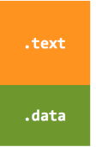
The Anatomy Of an Object File
An object file has several segments
1) The .text segment contains…
Machine code
2) The .data segment contains…
Global variables

Slide 15
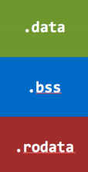
Kinds of Data
There are three kinds of data: 1) .data for globals
For example, int var = 10;
2) .bss is for globals initialized to zero
int buf[20];
There’s no need to store 0s
3) .rodata is for read-only data
“hello there”

Slide 16
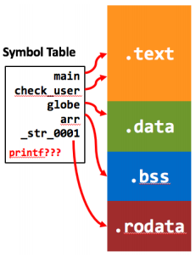
The Symbol Table
Not the 1501 Symbol Table…
Here, symbol means name
So, it’s a list of all things in the file
Their name
What they are
Which segment they’re in
Their address
other stuff
Also lists some things NOT in the file

Slide 17
The Linker

Slide 18
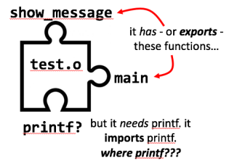
Puzzle Pieces
Object files are like an incomplete part of a whole…

Slide 19
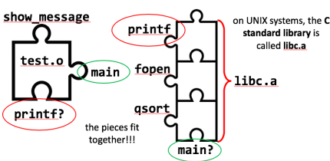
Linking
A library is just a collection of object files…

Slide 20
A complete Puzzle
The linker takes all these pieces and links them together
The result is… an executable!
The only real difference between an object file and an executable is “do it have everything it needs to be run?”

Slide 21
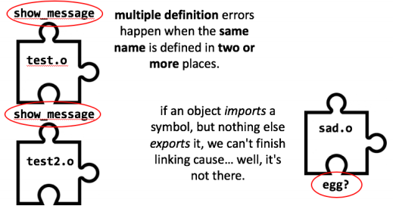
Linker Errors
When the linker is putting your puzzle together, things can go wrong.

Slide 22

Static
On functions, the static keyword is very similar to the private keyword in Java.
Static means don’t export this!!
Lowercase t means local symbol
It’s local to the file, no one else can see it!!

Slide 23
Extern
Leaving static off a function makes a bump
Extern on the other hand makes a hole
It has no effect on functions
The only time you would use extern is on global variables that are shared across files
GROSS

Slide 24
More on Linking
Linking is weirdly done by name
Source files in C don’t know anything about each other
So the job of the Linker is to match up names between files

Slide 25
The nm program
nm will allow you to see each file’s symbol table.
It will output many things.
First off, it will list the type of each symbol
T means a bump: an exported Text symbol
U means a hole: an Undefined symbol
It needs to be imported
D means a bump: an exported Data symbol
Lowercase t and d are local (static) symbols contained in the object file that are neither imported nor exported.
Yeah…. The linker is pretty dumb
It will try to mash EVERYTHING together

Slide 26
A Quick Detour: Function Pointers

Slide 27
Remember Pointers?
Well… you can have pointers to data anywhere in memory…
So, why not functions too?
A function pointer is… a pointer to a function…
In C, it looks scary…
int (*fp)(int); //uhhhhh
The above is actually a variable declaration.
It makes a variable fp that points to a function that takes an integer and returns and integer.
return
type
parameter
types

Slide 28
TypeDef is Amazing!!
What’s this??
float(**(*fp)(const char*))(float,float);
THIS IS A REAL TYPE
This is a pointer to a function which takes a const char*, and returns an array of function pointers, each of which takes two floats and returns a float.
typedef is really nice with function pointers!!
typedef float(*OPERATOR)(float, float);
typedef OPERATOR* (*OPERATOR_GETTER)(const char*);
OPERATOR_GETTER get_operators;

Slide 29
But why?
You can pass functions as arguments to other functions
This is a very powerful technique
You can parameterize actions like you can with values
Java actually implements function pointers indirectly by having you implement interfaces

Slide 30
Dynamic Linking

Slide 31

What if we left the holes in the executable
Like leaving a piece of the puzzle
This is called dynamic linking
Basically, we leave the last step of linking unfinished
When we run the program, then we find that last piece.

Slide 32
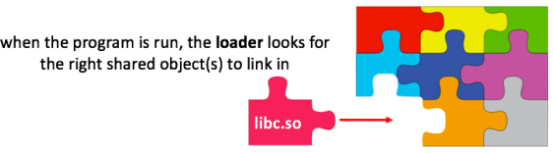
Dynamic Linking
Many programs need printf, why duplicate the effort?
Thus, we we put the C standard library (libc) into a special object file
A shared object (*.so) file
The loader is responsible for doing this final linking step

Slide 33

Static Linking
If we make the whole puzzle with no holes, this is static linking
But there are two major downsides:
You’ll have a bigger executable
It can embed bugs into your executables
libc ain’t perfect
If it has a serious bug, the only way to fix your program is…
Recompile and Redistribute
Statically linked executables can be loaded more quickly and have no dependencies, so they’re more self-contained and easier to distribute.

Slide 34
Pros and Cons
With dynamic linking…
1) We can just fix libc.so and now any program that sues it is automatically “fixed”
2) But…
Fixing bugs can break programs
Shared libraries can have multiple versions
If the shared library can’t be found, the program won’t run

Slide 35
A Quick Example
Suppose a program erroneously depends on a buggy library function
You fix that function in the shared library
And now the program crashes cause now that the function correctly returns NULL instead of an invalid-but-it-never-crashed pointer

Slide 36
Dynamic Loading

Slide 37
Time, time, Time
There are three times when we can put a library into an executable…
Link-Time (Static Linking)
Load-Time (Dynamic Linking)
Run-Time (Dynamic Loading)

Slide 38
Dynamically Loaded Libraries
A dynamically loaded library is just like a shared library…
But the application decides which shared object to load…
And when to load them!
While it’s running!!
This is often used to load optional functionality…
aka plugins

Slide 39
Asking the OS
To dynamically load a library, we have to ask the OS.
It will invoke the loader for us
Once it’s loaded, we can get function pointers to the functions inside.
What interface (or API) a plugin uses are defined either by the host program or by some standard.

Slide 40
What to expect for next time

Slide 41
So…What’s in store for next recitation
An Introduction to Processes
System Calls
The POSIX API

Slide 42
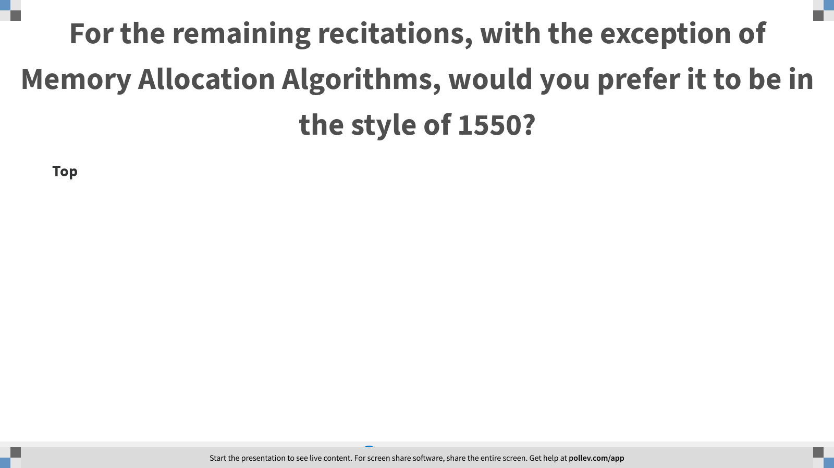
Notes:
Poll Title: For the remaining recitations, with the exception of Memory Allocation Algorithms, would you prefer it to be in the style of 1550? https://www.polleverywhere.com/discourses/oj8O7KGD2jtuMw6giyixJ

