Slide 1
CS 449 Recitation 6
Gordon Lu

Slide 2
General Announcement
I have created a discord server: https://discord.gg/tujnRJ8
This will serve as a space for those to communicate with each other about assignments, and for me to help with homework and other stuff.
Also, before you submit your homework, check it with me! I’ll check your work and tell you if you’ve got any mistakes!!

Slide 3
Answer the following survey
You are free to invite everyone from the 449 & 1501 classes for the review session I am planning.
I am willing to hold review sessions on multiple days!

Slide 4

Notes:
Poll Title: Review Session https://www.polleverywhere.com/surveys/QyIm1nyVebKUifD9cfclR

Slide 5
General Plan for Today
I really want to cover processes, and threads, but… to do so, it’s a good idea to understand executables… CS 1550 is a course based on the 2nd half of 449, so it’s critical that you understand processes, basic scheduling and synchronization primitives!
So, let’s go over multi-file compilation, and next week, I’ll do a crash course on x86, and linking, loading, and function pointers!

Slide 6
Multi-File Development

Slide 7
The Preprocessor
It’s just automated copy and paste!
Directives are the lines that start with #: like #include
These directive tell the preprocessor what to copy and paste!

Slide 8
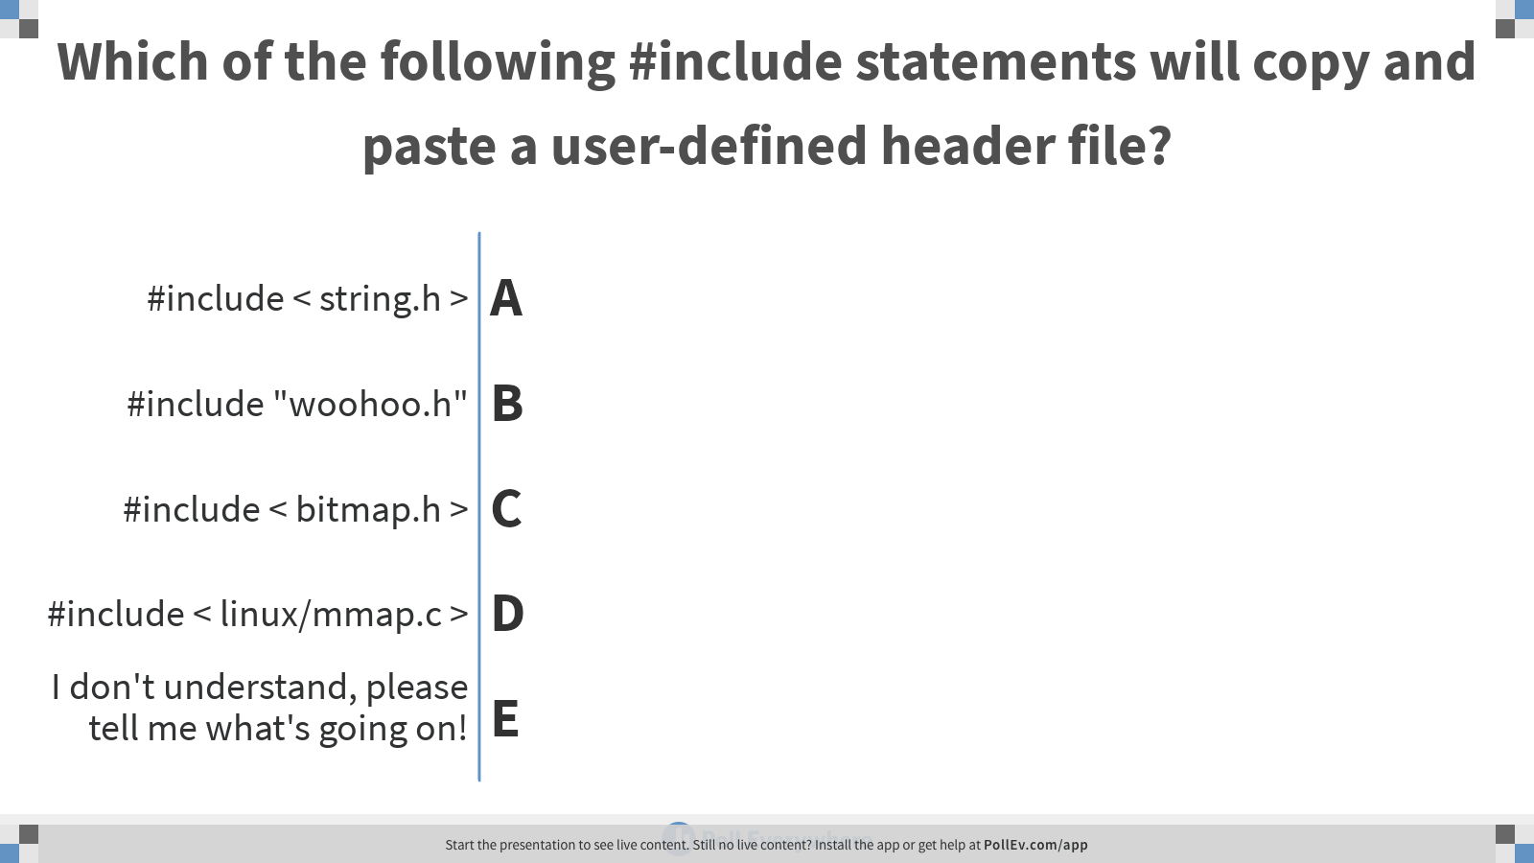
Notes:
Poll Title: Which of the following #include statements will copy and paste a user-defined header file? https://www.polleverywhere.com/multiple_choice_polls/mPjFTkw8cp991L6IE0epy

Slide 9
#include
#include copies the entire contents of the specified header file.
#include <filename.h>: Include a standard library header
#include "filename.h": Include some other header

Slide 10
Multi-file Compilation
Each C source file is compiled independently
- This is a translation unit: Each source file has one object file!
Multiple translation units then linked to make one program

Slide 11
Headers!!!
Each compilation unit usually has its own header file!
Think about this in terms of Java:
Header File is like the compilation unit’s public interface
The source code is like the compilation unit’s private implementation
Each source file includes its own header
But… it can include headers of other compilation units
Each source file can only see what other headers expose to it.

Slide 12
The General Form of a Header
If I want to write a header file named: cats.h
#ifndef _CATS_H_
#define _CATS_H_
//definition of structs, what you want to put in the header
#endif
This preprocessor stuff is called an include guard, and it avoids a redefinition error!

Slide 13
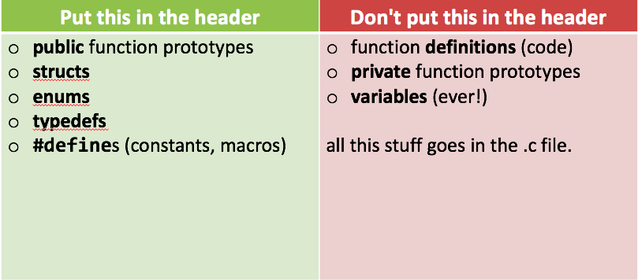
The Header File Manifesto
Anything you don’t want other files to see, you don’t put into the header.

Slide 14
Shell Scripts & Make Files

Slide 15
Shell Scripts
A shell script is a file containing list of shell commands
- It's a whole programming language!!
It's a text file ending in .sh and contains:
#! /bin/sh
…list of commands…
The first line is always required in a shell script: we’ve always got to include the SHE BANG (#!

Slide 16
A small shell script: compile.sh
The following shell script will compile a program:
#! /bin/sh
gcc -Wall –Werror –g --std=c99 -o prog_name file.c
The shell script will compile a file named file.c and generate an executable named prog_name

Slide 17
Running the Shell Script
To run the shell script, we have to convert it to an executable!
We can do so by changing the mode of the file: chmod +x compile.sh
Then, just run it like any other c program: ./compile.sh

Slide 18
A more flexible shell script
So, what if we just to enter command-line arguments or any generic c file?
Well, luckily, we can generalize this with $@.
So, if we want to compile any c file and create an executable called prog_name, we would do the following:
#! /bin/sh
gcc -Wall –Werror –g --std=c99 -o prog_name $@

Slide 19
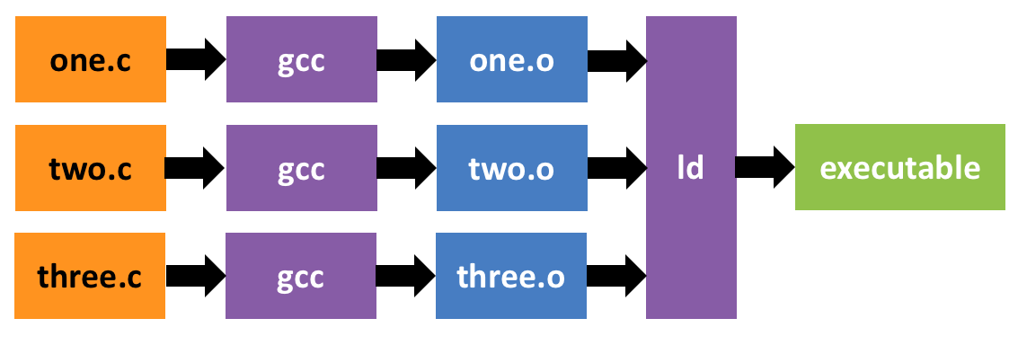
Dependencies
Build tools are based around the idea of dependencies:
Each arrow says: “The thing I’m looking at depends on what’s done before”
To successfully build the executable, we have to link each of the object files, successfully.

Slide 20
What’s make?
I’m sure you’ve all been curious about make each time you run test your program on thoth.
make is a programming language!
It’s a declarative language: you describe what, not how.
A makefile consists of several rules
Each rule contains a recipe, which are the commands that satisfy the rule

Slide 21
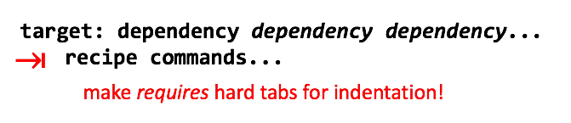
Dependencies and Targets
We indicate dependencies like so:
The target is the thing being built
The dependencies are what it needs to exist before rule is run
The commands are run to create target from dependencies
So… they’re just normal shell commands.

Slide 22

Generic Targets
We can make all .o files depend on .c files with:
%o %c
Then for the commands:
- $< -> dependencies
$@ -> target:
gcc –c: "produce an object file instead of an executable."

Slide 23
Any Questions?

