Slide 1
CS 0449 Recitation 5
Gordon Lu

Slide 2
Plans for Today
Calling Conventions
MIPS and x86 correspondences
Control Flow, Array-Indexing, etc.
Hints on the Traps for the Assembly Lab
Buffer Overflow to be reviewed next week
Questions on the Queue Lab

Slide 3
The Stack

Slide 4
What’s the Stack?
1) It’s an area of memory provided to your program by the OS.
When your program starts, it’s already there
2) The stack holds information about function calls
3) It’s not a strict stack
You can read and write any part of it
…but it grows and shrinks like a stack
push and pop describe growth and shrinkage
4) Each program (thread) gets one stack
I mean.. cuz one function is running at a time!!

Slide 5
Activation Records
When a function is called, a bunch of data is pushed onto the stack.
This is the call’s activation record (stack frame)
It contains local variables (including arguments) and the return address

Slide 6
An example Activation Record
Stack
int main(){
int help_me, dude;
char buf[10];
return 0;
}
main‘s caller
return address
help_me
dude
buf[10]
main’s AR
garbage

Slide 7
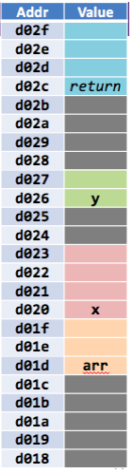
The low-level layout
Each variable (including array variables) gets enough bytes in the AR to hold its value.
Where the variable is located is up to… the COMPILER!!
int x;
char arr[3];
short y;

Slide 8
Call = Push, Return = pop
The stack grows when we call a function, and shrinks when it exits
int main(){ void fork(int* ptr){
int x; *ptr = knife();
fork(&x); }
return 0; int knife(){
} return 10;
}

Slide 9
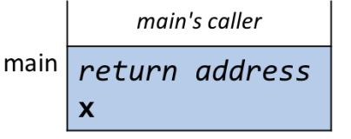
Example
The program’s AR in main without any other function calls is:

Slide 10
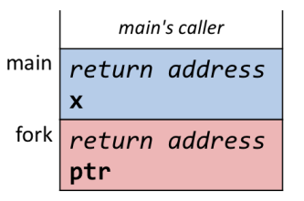
Example
After fork() is called, the AR becomes:

Slide 11
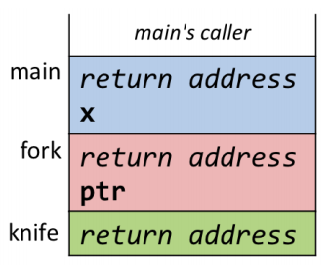
Example
After knife() is called within fork(), the AR becomes:

Slide 12
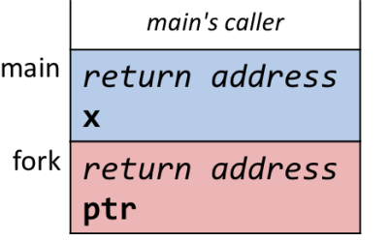
Example
After knife() is finished returning, the AR becomes:

Slide 13
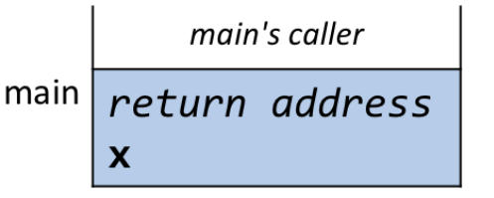
Example
After fork() is finished returning, the AR becomes:

Slide 14
Recursive Functions

Slide 15
Recursive Functions
Recursive functions work by using the call stack as an implicit stackdata structure.

Slide 16
Live Example
Given the recursive implementation of factorial:
int fact(int x){
if(x <= 2){ return x;
} else{
return x*fact(x-1);
}
}

Slide 17
More on Activation Records

Slide 18
They don’t really go away…
The stack is used constantly
So, it needs to be REALLY FAST
So, we implement it as a pointer
The stack pointer (sp)
Pushing the AR moves the sp down
Popping the AR moves the sp up

Slide 19
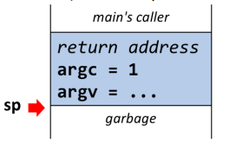
Example
Initially, the stack pointer is:

Slide 20
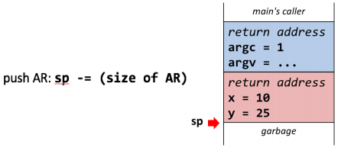
Example
After pushing onto the call stack, the stack pointer is:

Slide 21
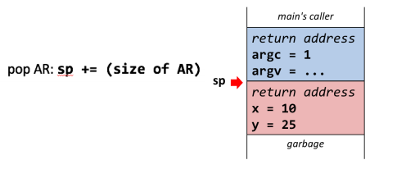
Example
After popping off the call stack, the stack pointer is:

Slide 22
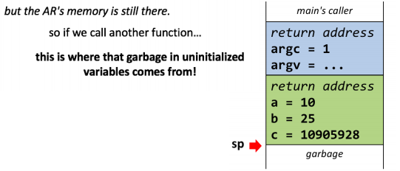
Example
The AR’s memory is still there, so calling another function is BAD
This is where the garbage in uninitialized variables comes from!

Slide 23

x86 Assembly

Slide 24
MIPS vs. x86
MIPS is a RISC ISA: Not many instruction, not human-oriented but easy to build!
x86 is a CISC ISA: Lots of instructions, human-oriented but tough to build!

Slide 25
IA-32 vs x86-64
IA-32 is the 32-bit version of x86.
Name | Meaning | Smaller Parts
%eax | Accumulator | %ax, Lower 16 bits of eax, %ah: Upper 8 bits of %ax %al: Lower 8 bits of %ax
%ebx | Base | %bx, Lower 16 bits of ebx, %bh: Upper 8 bits of %bx %bl: Lower 8 bits of %bx
%ecx | Counter | %cx, Lower 16 bits of ecx, %ch: Upper 8 bits of %cx %cl: Lower 8 bits of %cx
%edx | Data | %dx, Lower 16 bits of edx, %dh: Upper 8 bits of %dx %dl: Lower 8 bits of %dx
%esi | Source Index | %si
%edi | Destination Index | %di
%esp | Stack Pointer | %sp
%ebp | Base Pointer | %bp

Slide 26
x86 Registers
Name | IA-32 Equivalent
%rax | %eax
%rbx | %ebx
%rcx | %ecx
%rdx | %edx
%rsi | %esi
%rdi | %edi
$rsp | %esp
%rbp | %ebp
%r8 - %r15 | %r8d - %r15d

Slide 27
Basic Instruction Types
1) Transferring data between Memory and a Register: (R/I type formats)
Load data from memory into register: %reg = Mem[addr] (Analogous to lw $t0, arr)
Store register data into memory: Mem[addr] = %reg(Analogous to sw (arr), $t0)
2) Performing arithmetic operations on a register or memory (R/I type formats)
c = a + b, etc.
3) Control Flow: What instructions come next! (J type formats)
Unconditional jumps
Conditional branches

Slide 28
Basic Operand Types
Immediates: Constants
Indicated by $ in x86: $560
Register: 16 integer registers, 6 argument registers
%rsp is special: It’s the stack pointer!
Memory: Consecutive bytes of memory at a computed address!
- (%rax) -> Take data in %rax and get data at that address: *(rax + 0)

Slide 29
x86 Assembly: Instructions

Slide 30
Moving Data: The mov Instruction
General Form: mov(_) src, dest
(_): specializes expected size of operands!
Word means 16 bits = 2 bytes in x86 instructions (equivalent to half-word in MIPS)
Examples:
movb src, dest movl src, dest
- Move a single byte - Move 4 byte “long-word”
movw src, dest movq src, dest
- Move 2-byte word - Move 8 byte “quad-word”

Slide 31
Combinations of Operands with the mov Instruction
This is the opposite format of what MIPS does…
Source Operand | Destination Operand | Src, Dest | C Equivalent
Immediate | Register | movq $0x4, %rax | a = 0x4;
Immediate | Memory | movq $-147, (%rax) | *ptr = -147
Register | Register | movq %rax, %rdx | dest = source
Register | Memory | movq %rax, (%rdx) | *dest_ptr = source
Memory | Register | movq (%rax), %rdx | dest = *(ptr_src);
The src, dest syntax is known as AT&T syntax

Slide 32
Basic Memory Addressing Modes
Indirect: Mem[Reg[R]]
The Data in register R specifies the Memory Address!
Just like Pointer Dereferencing!!
Example: movq (%rcx), %rax
Displacement: Mem[Reg[R] + D]
Data in register R specifies the start of some memory region!
Displacement D specifies offset from that address!
Example: movq 8(%rbp), %rdx

Slide 33
Complete Memory Addressing Modes
General:
D(Rb, Ri, S): Mem[Reg[Rb]+ Reg[Ri]*S+D]
Rb: Base Register (any register)
Ri: Index Register (any register except %rsp)
S: Scaling Factor (1,2,4,8 (align to type you’re working with))
D: Displacement Value (aka the immediate)
Special Cases:
Form | Meaning | Special Case
D(Rb, Ri) | Mem[Reg[Rb] + Reg[Ri] + D] | (S = 1)
(Rb, Ri, S) | Mem[Reg[Rb] + Reg[Ri]*S] | (D = 0)
(Rb, Ri) | Mem[Reg[Rb] + Reg[Ri]] | (S = 1, D = 0)
(, Ri, S) | Mem[Reg[Ri] * S] | (Rb = 0, D = 0)

Slide 34
Examples
What is the C equivalent of the following:
-0x4(%rsp, %rbp, 8)
*(rsp + (rbp*8) -0x4)
(%rdx, %rbx)
*(rdx + rbx)
0x8(, %rax, 4)
*(rax*4 + 8)

Slide 35
More Address Computation
If not specified, the default values are: S = 1, D = 0, Reg[Rb] = 0, Reg[Ri] = 0
Assuming %rdx = 0xf000, %rcx = 0x0100:
Expression | Address Computation | Address
0x8(%rdx) | Reg[Rb] + D = 0xf000 + 0x8 | 0xf008
(%rdx, %rcx) | 0xf000 + 0x100 | 0xf100
(%rdx, %rcx, 4) | 0xf000 + 0x100*4 | 0xf400
0x80(,rdx,2) | 0xf000*2 + 0x80 | 0x1e080

Slide 36
Address Computation Instructions
leaq src, dest
Load Effective Address Quad-word
Set destination operand to address denoted by the expression (doesn’t go into memory, it just does math!!)
Uses:
Computing addressing without memory reference
Example: Translation of p = &x[i];
Computing arithmetic expressions of the form x + k * y
k = 1, 2, 4, or 8 (offset to get to next multiple of that data type in memory)

Slide 37
x86 Assembly: Conditionals

Slide 38
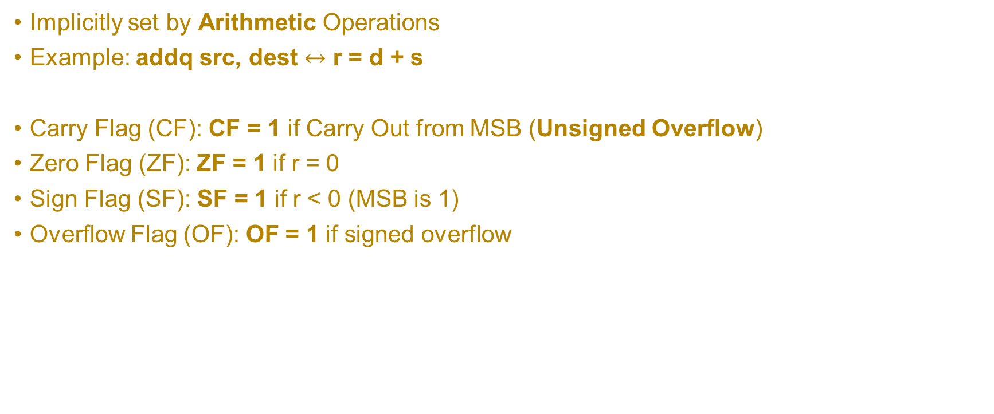
Condition Codes: Implicit
Implicitly set by Arithmetic Operations
Example: addq src, dest $↔$ r = d + s
Carry Flag (CF): CF = 1 if Carry Out from MSB (Unsigned Overflow)
Zero Flag (ZF): ZF = 1 if r = 0
Sign Flag (SF): SF = 1 if r < 0 (MSB is 1)
Overflow Flag (OF): OF = 1 if signed overflow

Slide 39
Condition Codes: Explicit - Compare
Explicitly set by the Compare instruction
cmpq src1, src2
cmpq a, b sets flags based on b – a but does not STORE the result anywhere!
Carry Flag (CF): CF = 1 if Carry Out from MSB (Unsigned Overflow)
Zero Flag (ZF): ZF = 1 if a == b
Sign Flag (SF): SF = 1 if (b – a) < 0 (MSB is 1)
Overflow Flag (OF): OF = 1 if signed overflow

Slide 40
Condition Codes: Explicit - Test
Explicitly set by the Test instruction
testq src2, src1
testq a, b sets flags based on a & b but does not STORE the result anywhere!
It’s useful to have one of the operands to be a mask!
Can’t have Carry Out or Overflow: CF = 0, OF = 0.
Zero Flag (ZF): ZF = 1 if a & b == 0
Sign Flag (SF): SF = 1 if a & b < 0 (signed)

Slide 41
x86 Assembly: Branching

Slide 42
Using Condition Codes: Jumping
j instructions
Jumps to a target address based on condition codes
Instruction | Meaning
jmp target | Unconditional jump
je target | Jump if equal (ZF == 1)
jne target | Jump if not equal (ZF == 0)
js target | Jump if negative (SF == 1)
jns target | Jump if not negative (SF == 0)
jg target | Jump if greater than (Signed)
jge target | Jump if greater than or equal (Signed)
jl target | Jump if less than (Signed)
jle target | Jump if less than or equal (Signed)
ja target | Jump if above (Unsigned “>”)
jb target | Jump if below (Unsigned “<“)

Slide 43
Using Condition Codes: Setting
set instructions
Sets lower order byte of dst to 0 or 1 based on condition codes (7 remaining bytes unchanged)
Instruction | Meaning
sete target | Set if equal (ZF == 1)
setne target | Set if not equal (ZF == 0)
sets target | Set if negative (SF == 1)
setns target | Set if not negative (SF == 0)
setg target | Set if greater than (Signed)
setge target | Set if greater than or equal (Signed)
setl target | Set if less than (Signed)
setle target | Set if less than or equal to (Signed)
seta target | Set if above (Unsigned “>”)
setb target | Set if below (Unsigned “<“)

Slide 44
movz_ and movs_ instructions
movz_ _ src, regDest: Move with zero extension
movs_ _ src, regDest: Move with sign extension
Copy from a smaller source to a larger destination
Source can be memory or register: Destination MUST be LARGER!!
Fill remaining bits of dest with zero (movz) or sign bit (movs)
movzSD / movsSD:
S: Size of Source (b = 1 byte or w = 2)
D: Size of Dest (w = 2 bytes, l = 4, q = 8)

Slide 45
Calling Conventions

Slide 46
Overview
Each function call will push an Activation Record onto the call stack
(This Activation Record will contain all the basic information about the function call (arguments, local variables, return address, other function calls, etc).
Returning will pop an Activation Record off the call stack.
Since the stack is utilized very often throughout a program’s duration, we use a stack pointer.
Push will move the sp down, Pop will move the sp up

Slide 47
General Idea
Every program is almost always going to have:
A program counter register (So we can keep track of where we are after a bunch of function calls and branches!)
A stack to keep track of information across multiple function calls
A stack pointer register to push and pop ARs off the call stack!
andddd other registers to store local data

Slide 48
General Function Calls
A function call consists of…
Putting arguments and return address in the right places!!
Jumping to the new function! (jal in MIPS)
Setting up the AR onto the stack (move the sp down)

Slide 49
General Function Returns
A function return consists of…
Putting the return value somewhere ($v0 in MIPS)
Cleaning up the AR off the stack (move up the sp)
Jumping back to the return address (jr ra in MIPS)

Slide 50
MIPS Calling Conventions

Slide 51
MIPS Calling Conventions
First, the first 4 arguments are put into the a0 – a3 registers.
Any arguments beyond the (a0 – a3) registers must be pushed onto the stack in reverse order
The stack grows down in memory, pushing arguments in reverse order guarantees that they’ll be in order in memory.
Then jal to jump to the new function and cache the return address in the ra register.

Slide 52
MIPS Calling Conventions
Function Prologue: Setting up resources before anything with the function is performed.
The ra is first pushed onto the stack, and any saved registers that the function needs are pushed onto the stack.
Function Epilogue: All the tidy work and cleaning up after the function has done its purpose.
Move the return value into the v0 register.
Pop previously pushed registers
Clean up the stack, then jump to the return address.
***This ensures that the stack is balanced!***

Slide 53
x86 Calling Conventions

Slide 54
Calling and Retuning in x86
It’s just call and ret
- call function_name pushes the return address then jumps to function_name
(its just jal function_name)
- ret pops the return address and jumps to it (its just jr ra)
- ret 24 pops the return address, adds 24 to the esp, then jumps to the return address

Slide 55
Calling and Retuning in c86
Calling a Function:
1) All arguments are pushed in reverse order:
Example:
sub esp, 12
mov [esp + 8], 3
mov [esp + 4], 2
mov [esp], 1
2) Call both jumps to the new function and pushes the return address!
Example: call func

Slide 56
Calling Conventions in x86
Function Prologue:
1) Make space for locals
func:
push rbp
mov rbp, rsp
sub rsp, 0x10 ←Make space for locals
2) Push any callee-saved registers into rbx, rdi, and rsi, but only if we need them!
Function Epilogue:
1) Place the return value into rax
2) Pop and jump to the return address
mov rax, [rbp-4]
mov rsp, rbp
pop rbp
ret

Slide 57
Prologue, Epilogue Shortcuts, and Base Pointer
Enter is the same as: push rbp
mov rbp, rsp
Leave is the same as: mov rsp, rbp
pop rbp
rsp is the stack pointer: it marks the bottom of the AR
rbp: is the base pointer: it marks the top of the AR
Every subsequent function call will make a link from the main AR to the next one… it’s a linked list of ARs, every time we pop off, we deallocate a node off our LL of ARs!

Slide 58
Where does the Return Value get stored?
eax is where the return value of a function will be stored in x86.
It’s the v0 of x86.
As for arguments, generally in: %rdi , %rsi , %rdx , %rcx , %r8 , and %r9
If we need more arguments, we would allocate them on the stack....
What about callee-saved registers, i.e., our s registers?
rbx, rsp, rbp, r12-r15

Slide 59
Hints for the Assembly Lab

Slide 60
We haven’t covered enough to go over the last two phases…
You will only be able to do the Traps for the Assembly Lab.
Let’s go over how to debug them…

Slide 61
Using GDB
You will run the executable (either trap1 or trap2) in GDB
disas <label_name> will dump out the contents of the function
set disassembly-flavor att will set the output of a disas to AT&T syntax
You can set a breakpoint, by the following: b <addr>
Then run up to the breakpoint by running the following: run
To inspect what is stored in a register do one of the following:
i r to inspect the value of all registers
x/s <addr> to inspect the value stored at a given address as a string
This entire lab is designed to test your abilities to debug!!
Enter the following outside of GDB, to get the raw contents of the file:
objdump -M intel -d <execname>
You can pipe this result to a file like: objdump -M intel -d <execname> > output.txt

Slide 62
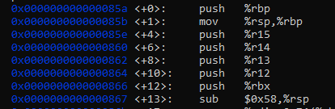
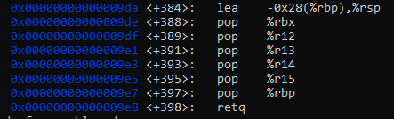
Identifying Parts of a Function
Consider the following x86:
……
We don’t want to get too focused in on the Prologue and Epilogue. We should look at what’s inside the prologue and epilogue, since they’re really there just to set up the Stack for what’s to come…
Function Prologue
Function Epilogue

Slide 63

Look for Control Flow and Function Calls
Consider the following x86:
Once we see that we’re making a comparison or some function call, we need to see what is being passed in, or what is being compared.
This will often lead us down the track of figuring out what the function is doing!!
Comparison
Function Call

Slide 64
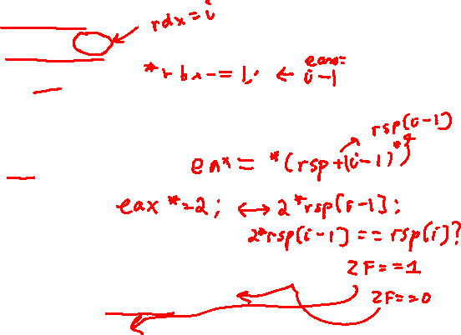
For Loops in x86
Java: x86:
for(int i = 1; i <= 5; i++){ mov $0x1,%ebx
if(2*arr[i-1] != arr[i]) movslq %ebx,%rdx
//kaboom!!! lea -0x1(%rbx),%eax
} cltq //sign-extend to 64-bits, optimization to account for signed OF
mov (%rsp,%rax,4),%eax
add %eax,%eax
cmp %eax,(%rsp,%rdx,4)
je 0x400e62 (where add $0x1, %ebx is)
callq 0x401218 <kaboom!!>
add $0x1,%ebx
cmp $0x5,%ebx

Slide 65
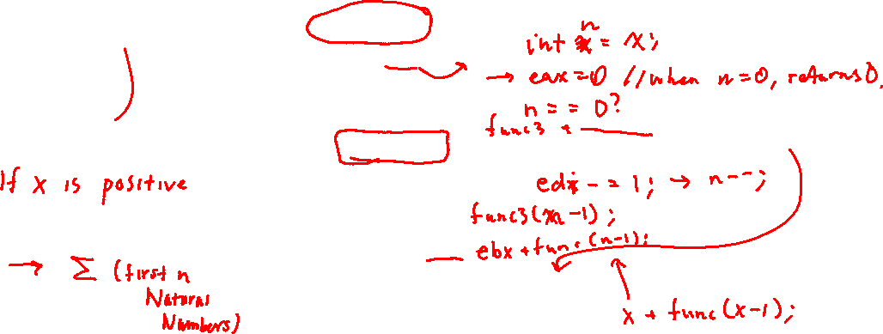
Recursion in x86
Java: x86:
int f(int x){ push %rbx
if(x == 0) mov %edi, %ebx return x; mov $0x0, %eax
return x+f(x-1); cmp $0x0, %edi
} jle 0x400e88 <exit> (0x400e88 is addr of exit)
lea -0x1(%rdi), %edi
callq func3
addq ebx, eax
pop %rbx (where exit is)
retq

Slide 66
Questions?

