Slide 1
CS 1501 Recitation 8
Gordon Lu

Slide 2
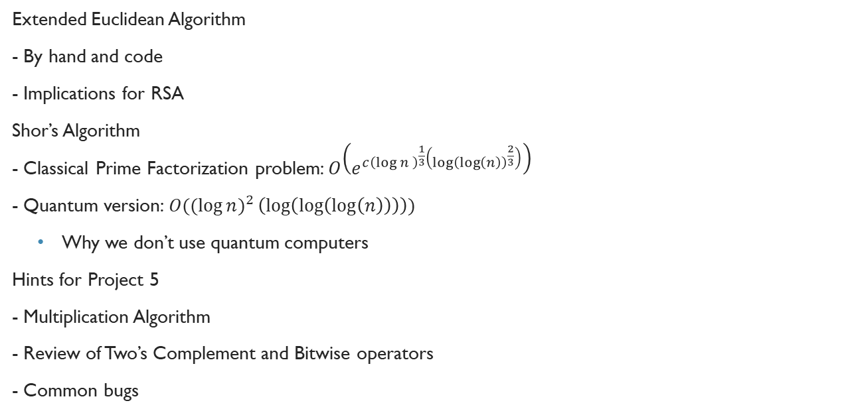
Agenda For Today
Extended Euclidean Algorithm
- By hand and code
- Implications for RSA
Shor’s Algorithm - Classical Prime Factorization problem: $O\left(e^{c{\left(\log{n }\right)}^{\frac{1}{3}}\left({\log\left(\log\left(n\right)\right)}^{\frac{2}{3}}\right)}\right)$
- Quantum version: $O(({\log{n)}}^{2}\left(\log\left(\log\left(\log\left(n\right)\right)\right)\right))$
Why we don’t use quantum computers
Hints for Project 5
- Multiplication Algorithm
- Review of Two’s Complement and Bitwise operators
- Common bugs

Slide 3
XGCD Algorithm
Gordon Lu

Slide 4
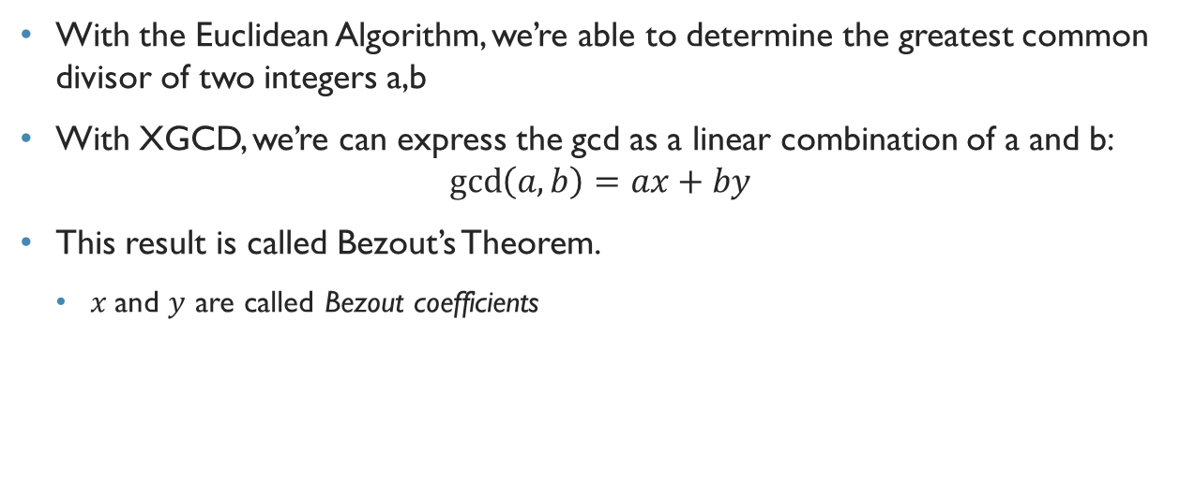
XGCD
With the Euclidean Algorithm, we’re able to determine the greatest common divisor of two integers a,b
With XGCD, we’re can express the gcd as a linear combination of a and b:
$$\gcd\left(a,b\right)=ax+by$$
This result is called Bezout’s Theorem.
$x$and $y$ are called Bezout coefficients

Slide 5
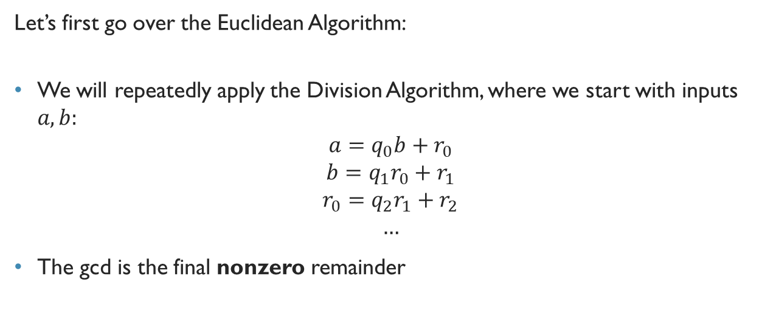
Euclidean Algorithm
Let’s first go over the Euclidean Algorithm:
We will repeatedly apply the Division Algorithm, where we start with inputs $a,b:$
$$a=q_{0}b+r_{0} \\ b=q_{1}r_{0}+r_{1} \\ r_{0}=q_{2}r_{1}+r_{2} \\ …$$
The gcd is the final nonzero remainder

Slide 6
But… Why does this Work?
Observe that the remainders decrease with each step, and can never be negative.
Therefore, one of the remainders will eventually be zero, at which point the algorithm stops.
The CS algorithm: def gcd(a,b): if b == 0: return a
return gcd(b, a%b)

Slide 7
GCD Example
gcd(10, 45)
gcd(1701, 3768)
gcd(24 ,60)

Slide 8
XGCD Example
xgcd(99, 78) =
3 = (99)(-11) + (78)(14)
xgcd(215, 109) =
1 = (215)(36) + (-71)(109)

Slide 9
Intuition for Recursive XGCD
So, we want to code up this process for finding the Bezout coefficients:
Observe that when we were trying to find these coefficients, we expressed each remainder as a LC of the other numbers on an iteration of GCD

Slide 10
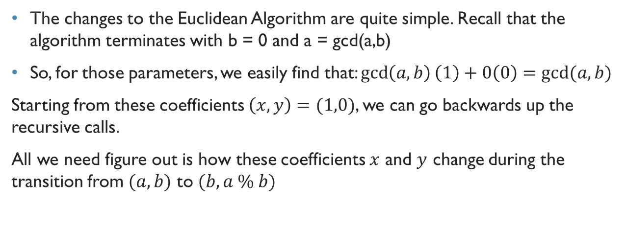
Deriving a Recursive Algorithm for XGCD
The changes to the Euclidean Algorithm are quite simple. Recall that the algorithm terminates with b = 0 and a = gcd(a,b)
So, for those parameters, we easily find that: $\gcd\left(a,b\right)\left(1\right)+0\left(0\right)=gcd⁡(a,b)$
Starting from these coefficients $\left(x,y\right)=(1,0)$, we can go backwards up the recursive calls.
All we need figure out is how these coefficients $x$ and $y$ change during the transition from $(a,b)$ to $(b, a \% b)$

Slide 11
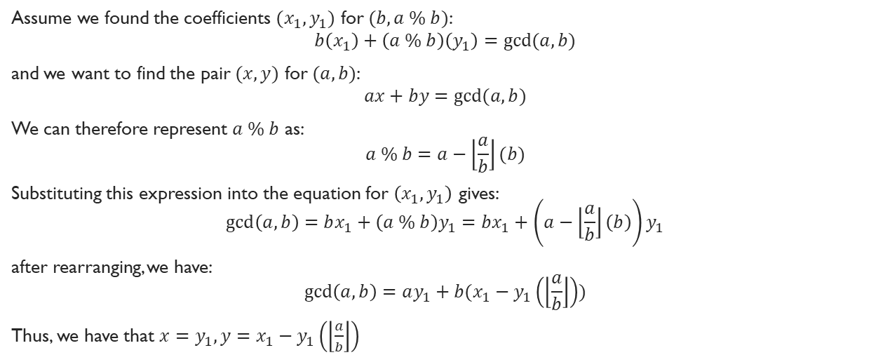
Deriving a Recursive Algorithm for XGCD
Assume we found the coefficients $(x_{1},y_{1})$ for $(b, a \% b)$:
$$b\left(x_{1}\right)+\left(a \% b\right)\left(y_{1}\right)=gcd⁡(a,b)$$
and we want to find the pair $(x,y)$ for $(a,b)$:
$$ax+by=gcd⁡(a,b)$$
We can therefore represent $a \% b$ as: $$a \% b=a−\left\lfloor \frac{a}{b}\right\rfloor (b)$$
Substituting this expression into the equation for $\left(x_{1},y_{1}\right)$ gives: $$\gcd\left(a,b\right)=bx_{1}+\left(a \% b\right)y_{1}=bx_{1}+\left(a−\left\lfloor \frac{a}{b}\right\rfloor \left(b\right)\right)y_{1}$$
after rearranging, we have: $$\gcd\left(a,b\right)=ay_{1}+b(x_{1}−y_{1}\left(\left\lfloor \frac{a}{b}\right\rfloor \right))$$
Thus, we have that $x=y_{1}, y=$ $x_{1}−y_{1}\left(\left\lfloor \frac{a}{b}\right\rfloor \right)$

Slide 12
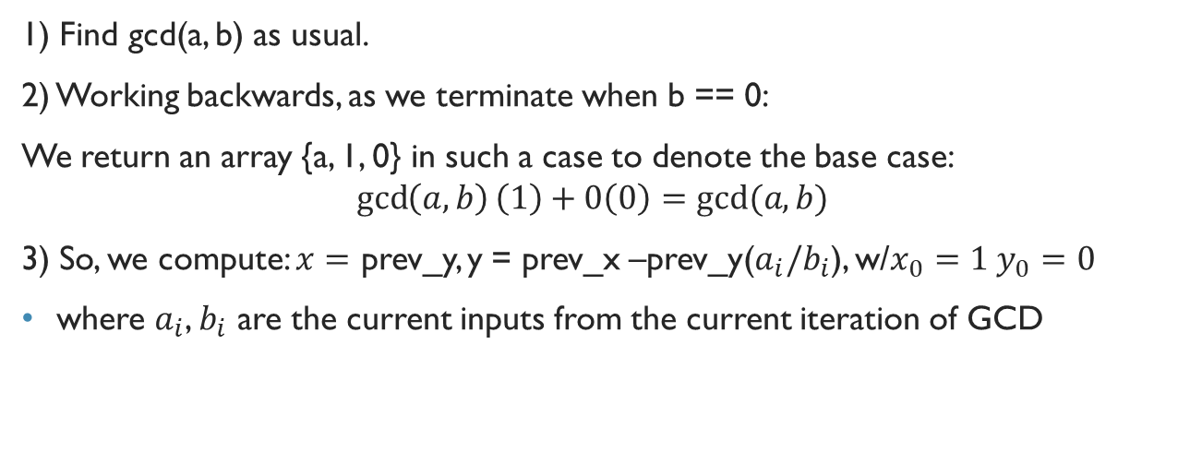
Summarizing Recursive XGCD
1) Find gcd(a, b) as usual.
2) Working backwards, as we terminate when b == 0:
We return an array {a, 1, 0} in such a case to denote the base case:
$$\gcd\left(a,b\right)\left(1\right)+0\left(0\right)=gcd⁡(a,b)$$
3) So, we compute: $x=$ prev_y, y = prev_x –prev_y($a_{i}/b_{i}$), w/$x_{0}=1 y_{0}=0$
where $a_{i}$, $b_{i}$ are the current inputs from the current iteration of GCD

Slide 13
An Implementation of Recursive XGCD
https://introcs.cs.princeton.edu/java/99crypto/ExtendedEuclid.java
You are welcome to use this for Project 5!

Slide 14
XGCD Example

Slide 15
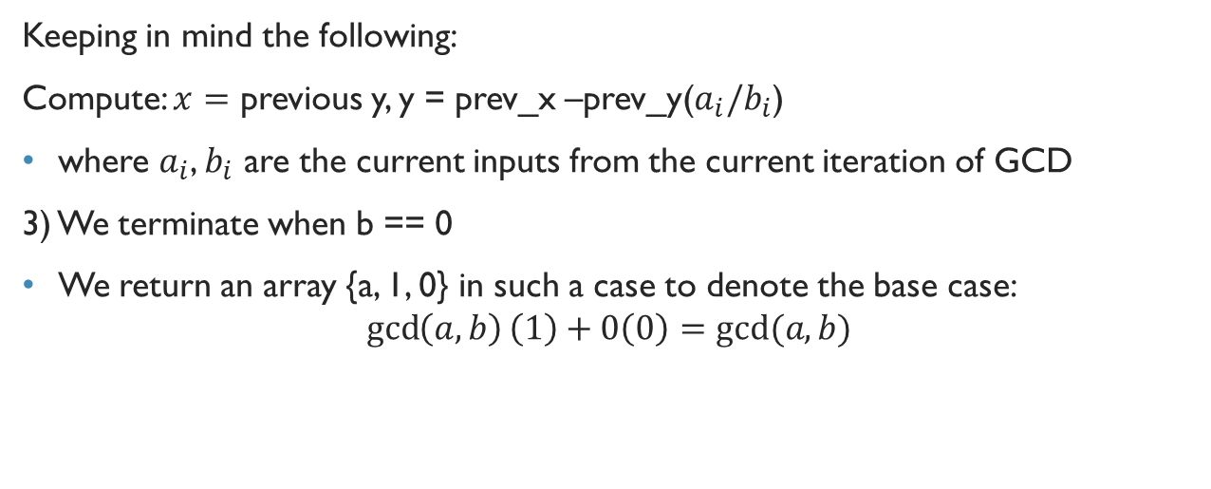
XGCD Example
Keeping in mind the following:
Compute: $x=$ previous y, y = prev_x –prev_y($a_{i}/b_{i}$)
where $a_{i}$, $b_{i}$ are the current inputs from the current iteration of GCD
3) We terminate when b == 0
We return an array {a, 1, 0} in such a case to denote the base case:
$$\gcd\left(a,b\right)\left(1\right)+0\left(0\right)=gcd⁡(a,b)$$

Slide 16
XGCD(99,78)
Row | a | b | a/b | a%b | gcd | x | y
1 | 99 | 78
2
3
4
5
6

Slide 17
XGCD(99,78)
Row | a | b | a/b | a%b | gcd | x | y
1 | 99 | 78 | 1 | 21
2
3
4
5
6

Slide 18
XGCD(99,78)
Row | a | b | a/b | a%b | gcd | x | y
1 | 99 | 78 | 1 | 21
2 | 78 | 21 | 3 | 15
3
4
5
6

Slide 19
XGCD(99,78)
Row | a | b | a/b | a%b | gcd | x | y
1 | 99 | 78 | 1 | 21
2 | 78 | 21 | 3 | 15
3 | 21 | 15 | 1 | 6
4
5
6

Slide 20
XGCD(99,78)
Row | a | b | a/b | a%b | gcd | x | y
1 | 99 | 78 | 1 | 21
2 | 78 | 21 | 3 | 15
3 | 21 | 15 | 1 | 6
4 | 15 | 6 | 2 | 3
5
6

Slide 21
XGCD(99,78)
Row | a | b | a/b | a%b | gcd | x | y
1 | 99 | 78 | 1 | 21
2 | 78 | 21 | 3 | 15
3 | 21 | 15 | 1 | 6
4 | 15 | 6 | 2 | 3
5 | 6 | 3 | 2 | 0
6

Slide 22
XGCD(99,78)
Row | a | b | a/b | a%b | gcd | x | y
1 | 99 | 78 | 1 | 21
2 | 78 | 21 | 3 | 15
3 | 21 | 15 | 1 | 6
4 | 15 | 6 | 2 | 3
5 | 6 | 3 | 2 | 0
6 | 3 | 0 | N/A | N/A

Slide 23
XGCD(99,78)
Row | a | b | a/b | a%b | gcd | x | y
1 | 99 | 78 | 1 | 21 | 3
2 | 78 | 21 | 3 | 15 | 3
3 | 21 | 15 | 1 | 6 | 3
4 | 15 | 6 | 2 | 3 | 3
5 | 6 | 3 | 2 | 0 | 3
6 | 3 | 0 | N/A | N/A | 3

Slide 24
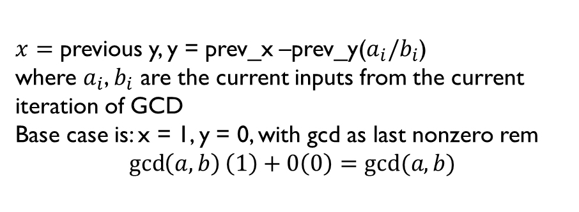
XGCD(99,78)
Row | a | b | a/b | a%b | gcd | x | y
1 | 99 | 78 | 1 | 21 | 3
2 | 78 | 21 | 3 | 15 | 3
3 | 21 | 15 | 1 | 6 | 3
4 | 15 | 6 | 2 | 3 | 3
5 | 6 | 3 | 2 | 0 | 3
6 | 3 | 0 | N/A | N/A | 3
$x=$ previous y, y = prev_x –prev_y($a_{i}/b_{i}$)
where $a_{i}$, $b_{i}$ are the current inputs from the current iteration of GCD
Base case is: x = 1, y = 0, with gcd as last nonzero rem
$$\gcd\left(a,b\right)\left(1\right)+0\left(0\right)=gcd⁡(a,b)$$

Slide 25
XGCD(99,78)
Row | a | b | a/b | a%b | gcd | x | y
1 | 99 | 78 | 1 | 21 | 3
2 | 78 | 21 | 3 | 15 | 3
3 | 21 | 15 | 1 | 6 | 3
4 | 15 | 6 | 2 | 3 | 3
5 | 6 | 3 | 2 | 0 | 3
6 | 3 | 0 | N/A | N/A | 3 | 1 | 0
$x=$ previous y, y = prev_x –prev_y($a_{i}/b_{i}$)
where $a_{i}$, $b_{i}$ are the current inputs from the current iteration of GCD
Base case is: x = 1, y = 0, with gcd as last nonzero rem
$$\gcd\left(a,b\right)\left(1\right)+0\left(0\right)=gcd⁡(a,b)$$

Slide 26

XGCD(99,78)
Row | a | b | a/b | a%b | gcd | x | y
1 | 99 | 78 | 1 | 21 | 3
2 | 78 | 21 | 3 | 15 | 3
3 | 21 | 15 | 1 | 6 | 3
4 | 15 | 6 | 2 | 3 | 3
5 | 6 | 3 | 2 | 0 | 3 | 0 | 1
6 | 3 | 0 | N/A | N/A | 3 | 1 | 0
y = prev_x – prev_y($a_{i}/b_{i}$)
= 1 – 0(2) = 1
$x=$ previous y, y = prev_x –prev_y($a_{i}/b_{i}$)
where $a_{i}$, $b_{i}$ are the current inputs from the current iteration of GCD
Base case is: x = 1, y = 0, with gcd as last nonzero rem
$$\gcd\left(a,b\right)\left(1\right)+0\left(0\right)=gcd⁡(a,b)$$

Slide 27

XGCD(99,78)
Row | a | b | a/b | a%b | gcd | x | y
1 | 99 | 78 | 1 | 21 | 3
2 | 78 | 21 | 3 | 15 | 3
3 | 21 | 15 | 1 | 6 | 3
4 | 15 | 6 | 2 | 3 | 3 | 1 | -2
5 | 6 | 3 | 2 | 0 | 3 | 0 | 1
6 | 3 | 0 | N/A | N/A | 3 | 1 | 0
y = prev_x – prev_y($a_{i}/b_{i}$)
= 0 – 1(2) = -2
$x=$ previous y, y = prev_x –prev_y($a_{i}/b_{i}$)
where $a_{i}$, $b_{i}$ are the current inputs from the current iteration of GCD
Base case is: x = 1, y = 0, with gcd as last nonzero rem
$$\gcd\left(a,b\right)\left(1\right)+0\left(0\right)=gcd⁡(a,b)$$

Slide 28

XGCD(99,78)
Row | a | b | a/b | a%b | gcd | x | y
1 | 99 | 78 | 1 | 21 | 3
2 | 78 | 21 | 3 | 15 | 3
3 | 21 | 15 | 1 | 6 | 3 | -2 | 3
4 | 15 | 6 | 2 | 3 | 3 | 1 | -2
5 | 6 | 3 | 2 | 0 | 3 | 0 | 1
6 | 3 | 0 | N/A | N/A | 3 | 1 | 0
y = prev_x – prev_y($a_{i}/b_{i}$)
= 1 – (-2)(1) = 3
$x=$ previous y, y = prev_x –prev_y($a_{i}/b_{i}$)
where $a_{i}$, $b_{i}$ are the current inputs from the current iteration of GCD
Base case is: x = 1, y = 0, with gcd as last nonzero rem
$$\gcd\left(a,b\right)\left(1\right)+0\left(0\right)=gcd⁡(a,b)$$

Slide 29

XGCD(99,78)
Row | a | b | a/b | a%b | gcd | x | y
1 | 99 | 78 | 1 | 21 | 3
2 | 78 | 21 | 3 | 15 | 3 | 3 | -11
3 | 21 | 15 | 1 | 6 | 3 | -2 | 3
4 | 15 | 6 | 2 | 3 | 3 | 1 | -2
5 | 6 | 3 | 2 | 0 | 3 | 0 | 1
6 | 3 | 0 | N/A | N/A | 3 | 1 | 0
y = prev_x – prev_y($a_{i}/b_{i}$)
= -2 – (3)(3) = -11
$x=$ previous y, y = prev_x –prev_y($a_{i}/b_{i}$)
where $a_{i}$, $b_{i}$ are the current inputs from the current iteration of GCD
Base case is: x = 1, y = 0, with gcd as last nonzero rem
$$\gcd\left(a,b\right)\left(1\right)+0\left(0\right)=gcd⁡(a,b)$$

Slide 30

XGCD(99,78)
Row | a | b | a/b | a%b | gcd | x | y
1 | 99 | 78 | 1 | 21 | 3 | -11 | 14
2 | 78 | 21 | 3 | 15 | 3 | 3 | -11
3 | 21 | 15 | 1 | 6 | 3 | -2 | 3
4 | 15 | 6 | 2 | 3 | 3 | 1 | -2
5 | 6 | 3 | 2 | 0 | 3 | 0 | 1
6 | 3 | 0 | N/A | N/A | 3 | 1 | 0
y = prev_x – prev_y($a_{i}/b_{i}$)
= 3 – (-11)(1) = 14
$x=$ previous y, y = prev_x –prev_y($a_{i}/b_{i}$)
where $a_{i}$, $b_{i}$ are the current inputs from the current iteration of GCD
Base case is: x = 1, y = 0, with gcd as last nonzero rem
$$\gcd\left(a,b\right)\left(1\right)+0\left(0\right)=gcd⁡(a,b)$$

Slide 31

Result of XGCD(99,78)
Therefore, we have $x=−11, y=14$:
$$\gcd\left(a,b\right)=3=(99)(-11) + (78)(14)$$

Slide 32
GCD and RSA

Slide 33
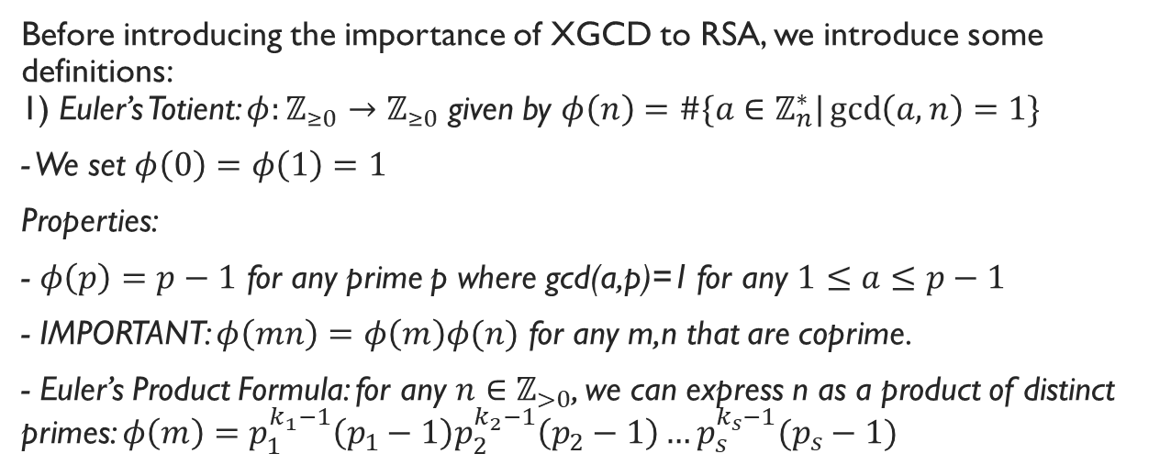
Definitions
Before introducing the importance of XGCD to RSA, we introduce some definitions: 1) Euler’s Totient: $φ:ℤ_{≥0}→ℤ_{≥0}$ given by $φ\left(n\right)=\#\{a∈ℤ_{n}^{∗}|\gcd\left(a,n\right)=1\}$
- We set $φ\left(0\right)=φ\left(1\right)=1$
Properties:
- $φ\left(p\right)=p−1$ for any prime p where gcd(a,p)=1 for any $1≤a≤p−1$
- IMPORTANT: $φ\left(mn\right)=φ\left(m\right)φ(n)$ for any m,n that are coprime.
- Euler’s Product Formula: for any $n∈ℤ_{>0}$, we can express n as a product of distinct primes: $φ\left(m\right)=p_{1}^{k_{1}−1}\left(p_{1}−1\right)p_{2}^{k_{2}−1}\left(p_{2}−1\right)…p_{s}^{k_{s}−1}(p_{s}−1)$

Slide 34
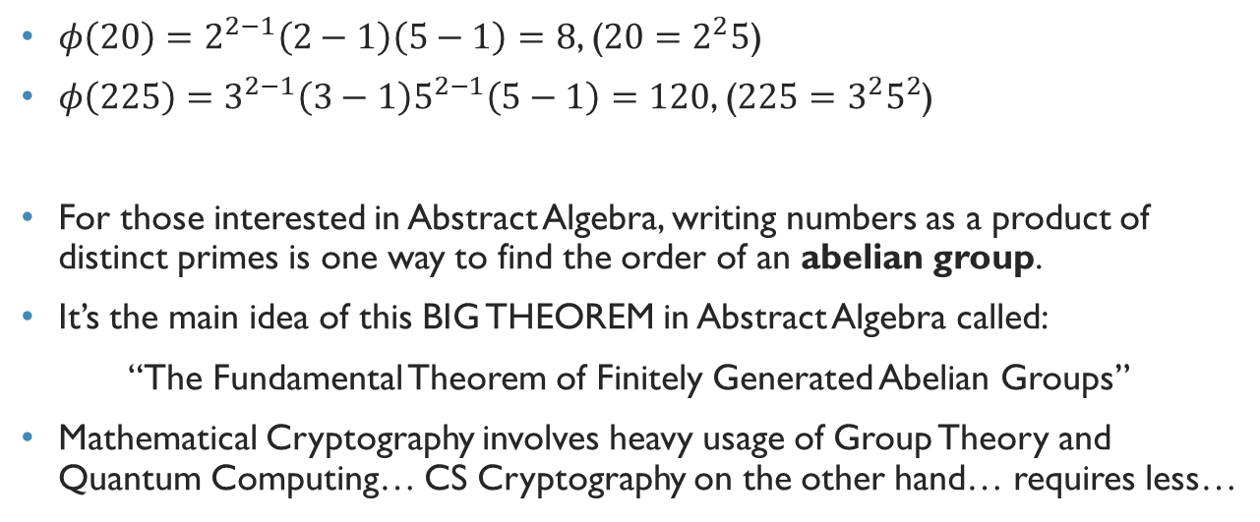
Euler’s Totient Example
$φ\left(20\right)=2^{2−1}\left(2−1\right)\left(5−1\right)=8$, ($20=2^{2}5$)
$φ\left(225\right)=3^{2−1}\left(3−1\right)5^{2−1}\left(5−1\right)=120$, ($225=3^{2}5^{2}$)
For those interested in Abstract Algebra, writing numbers as a product of distinct primes is one way to find the order of an abelian group.
It’s the main idea of this BIG THEOREM in Abstract Algebra called:
“The Fundamental Theorem of Finitely Generated Abelian Groups”
Mathematical Cryptography involves heavy usage of Group Theory and Quantum Computing… CS Cryptography on the other hand… requires less…

Slide 35
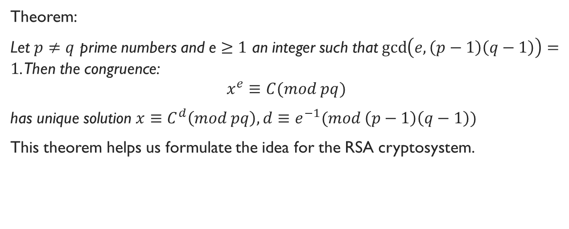
A Simple, but Powerful Theorem
Theorem:
Let $p≠q$ prime numbers and e $≥1$ an integer such that $\gcd\left(e, \left(p−1\right)\left(q−1\right)\right)=1$. Then the congruence:
$$x^{e}≡C(mod pq)$$
has unique solution $x≡C^{d}\left(mod pq\right), d≡e^{−1}(mod \left(p−1\right)\left(q−1\right))$
This theorem helps us formulate the idea for the RSA cryptosystem.

Slide 36
RSA
RSA is a cryptosystem that allows two entities to securely transmit data.
We will discuss how encryption and decryption work:

Slide 37
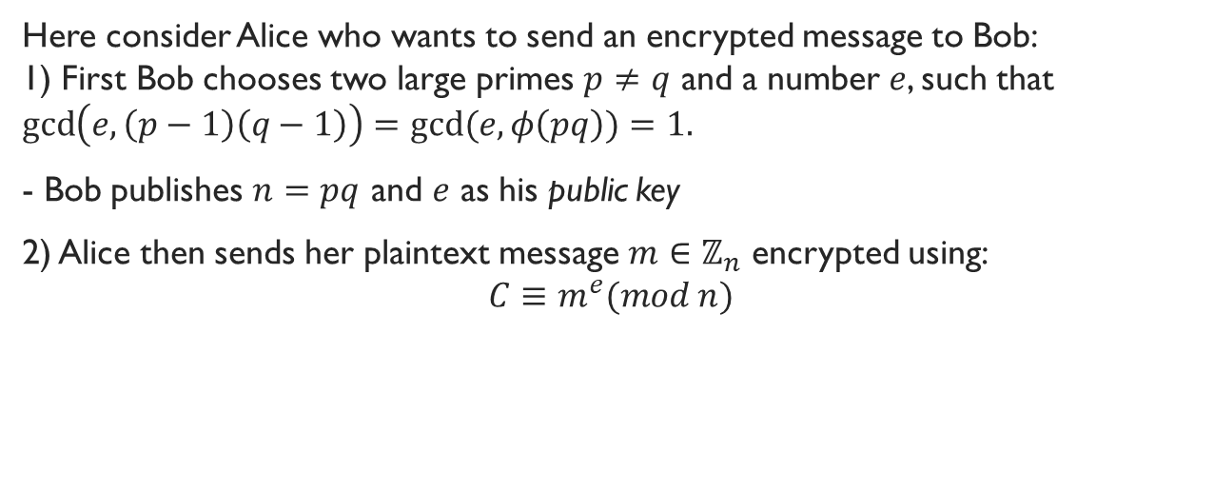
RSA Encryption
Here consider Alice who wants to send an encrypted message to Bob: 1) First Bob chooses two large primes $p≠q$ and a number $e$, such that $\gcd\left(e,\left(p−1\right)\left(q−1\right)\right)=gcd⁡(e, φ\left(pq\right))=1.$
- Bob publishes $n=pq$ and $e$ as his public key
2) Alice then sends her plaintext message $m∈ℤ_{n}$ encrypted using: $$C≡m^{e}(mod n)$$

Slide 38
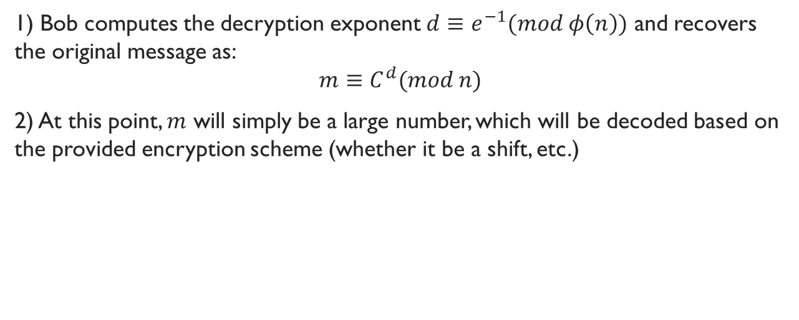
RSA Decryption
1) Bob computes the decryption exponent $d≡e^{−1}(mod φ\left(n\right))$ and recovers the original message as:
$$m≡C^{d}(mod n)$$
2) At this point, $m$ will simply be a large number, which will be decoded based on the provided encryption scheme (whether it be a shift, etc.)

Slide 39

But There’s a Concern…
We said: $d≡e^{−1}(mod \left(p−1\right)\left(q−1\right))$
This is equivalent to:
$$XGCD\left(e, φ\left(n\right)\right)$$
$$gcd⁡(e,φ\left(n\right)=e∗d−z∗φ\left(n\right)=1$$

Slide 40
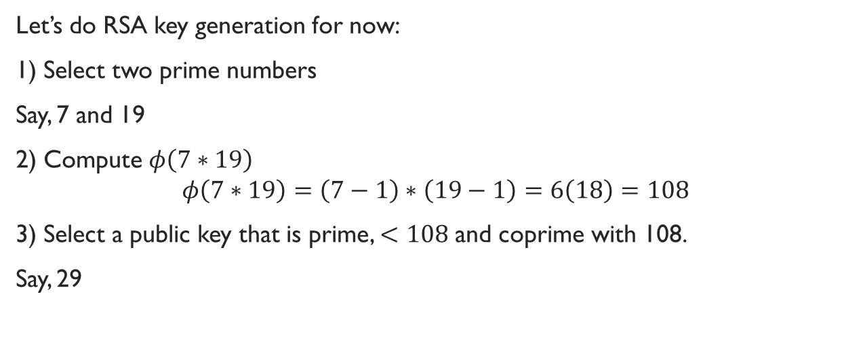
An Example of RSA Key Generation
Let’s do RSA key generation for now:
1) Select two prime numbers
Say, 7 and 19
2) Compute $φ\left(7∗19\right)$
$$φ\left(7∗19\right)=\left(7−1\right)∗\left(19−1\right)=6\left(18\right)=108$$
3) Select a public key that is prime, $<108$ and coprime with 108.
Say, 29

Slide 41

An Example of RSA Key Generation
4) Select a private key
Say, 41:
Then we verify $41∗29 \left(mod 108\right)=1$

Slide 42
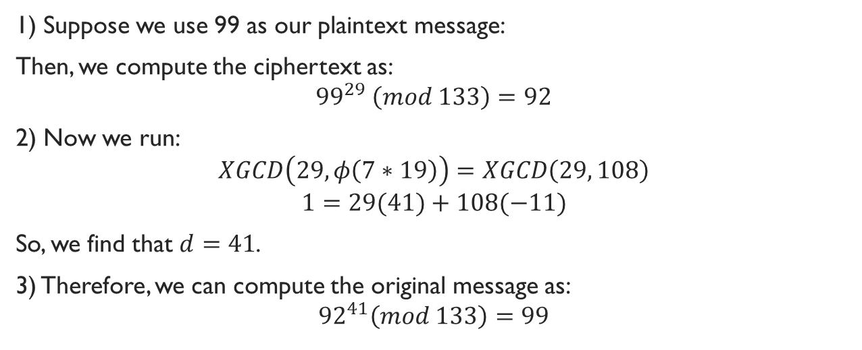
Example of RSA Encryption/Decryption
1) Suppose we use 99 as our plaintext message:
Then, we compute the ciphertext as:
$${99}^{29} \left(mod 133\right)=92$$
2) Now we run:
$$XGCD\left(29, φ\left(7∗19\right)\right)=XGCD\left(29, 108\right)$$
$$1=29(41)+108(−11)$$
So, we find that $d=41$.
3) Therefore, we can compute the original message as:
$${92}^{41}\left(mod 133\right)=99$$

Slide 43
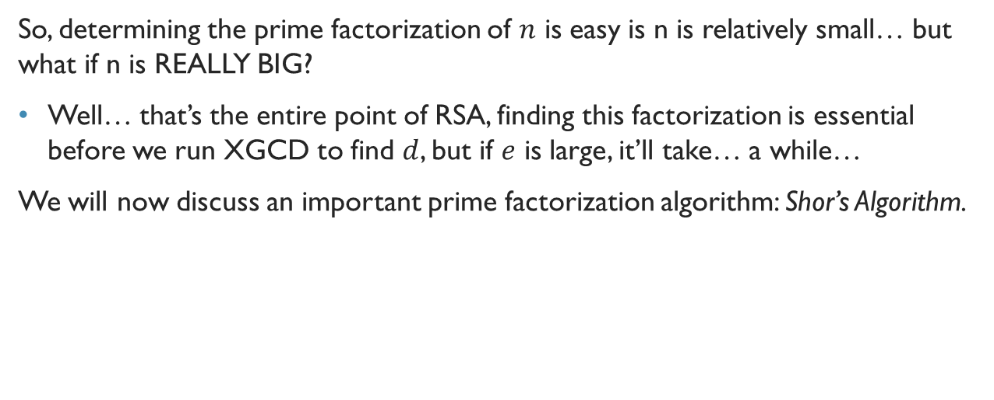
Caveats of RSA
So, determining the prime factorization of $n$ is easy is n is relatively small… but what if n is REALLY BIG?
Well… that’s the entire point of RSA, finding this factorization is essential before we run XGCD to find $d$, but if $e$ is large, it’ll take… a while…
We will now discuss an important prime factorization algorithm: Shor’s Algorithm.

Slide 44
Prime Factorization Algorithms

Slide 45

Classical Prime Factorization
A classical algorithm (using bits) using the best-known methods is:
$$O\left(e^{c{\left(\log{n }\right)}^{\frac{1}{3}}\left({\log\left(\log\left(n\right)\right)}^{\frac{2}{3}}\right)}\right)$$
Before we go over this classical algorithm, we must introduce the some definitions:

Slide 46
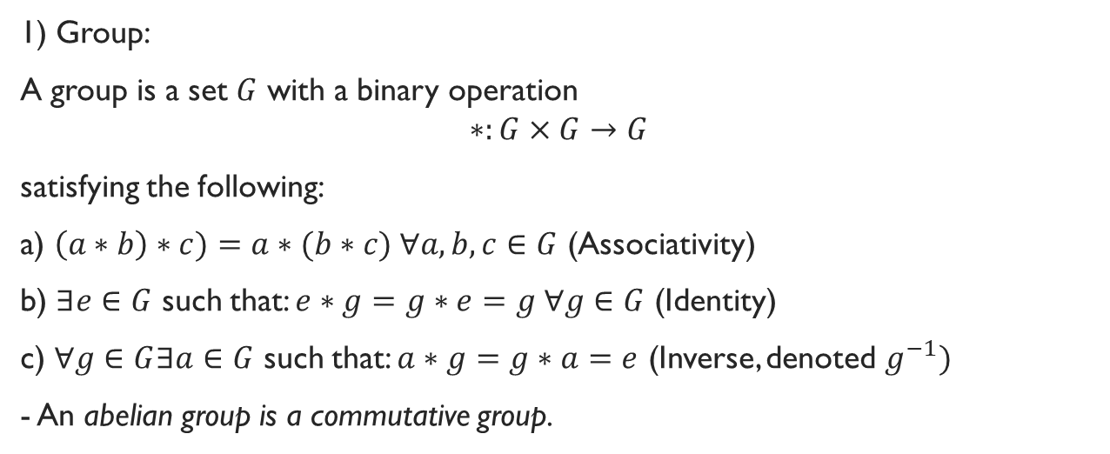
Groups and Cyclic Subgroups
1) Group:
A group is a set $G$ with a binary operation
$$∗:G×G→G$$
satisfying the following:
a) $\left(a∗b\right)∗c)=a∗(b∗c) ∀a,b,c∈G$ (Associativity)
b) $∃e∈G$ such that: $e∗g=g∗e=g ∀g∈G$ (Identity)
c) $∀g∈G∃a∈G$ such that: $a∗g=g∗a=e$ (Inverse, denoted $g^{−1})$
- An abelian group is a commutative group.

Slide 47
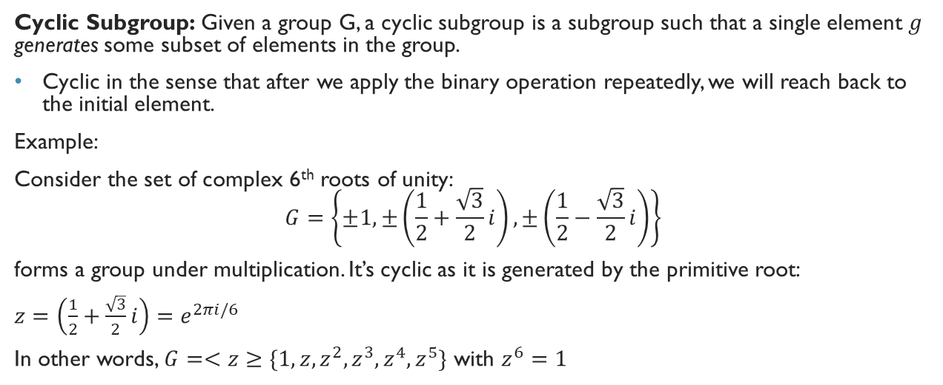
Cyclic Subgroups
Cyclic Subgroup: Given a group G, a cyclic subgroup is a subgroup such that a single element $g$ generates some subset of elements in the group.
Cyclic in the sense that after we apply the binary operation repeatedly, we will reach back to the initial element.
Example:
Consider the set of complex 6th roots of unity: $$G=\left\{±1, ±\left(\frac{1}{2}+\frac{\sqrt{3}}{2}i\right),±\left(\frac{1}{2}−\frac{\sqrt{3}}{2}i\right)\right\}$$
forms a group under multiplication. It’s cyclic as it is generated by the primitive root:
$z=$ $\left(\frac{1}{2}+\frac{\sqrt{3}}{2}i\right)=e^{2πi/6}$
In other words, $G=<z≥\{1,z,z^{2},z^{3},z^{4},z^{5}\}$ with $z^{6}=1$

Slide 48
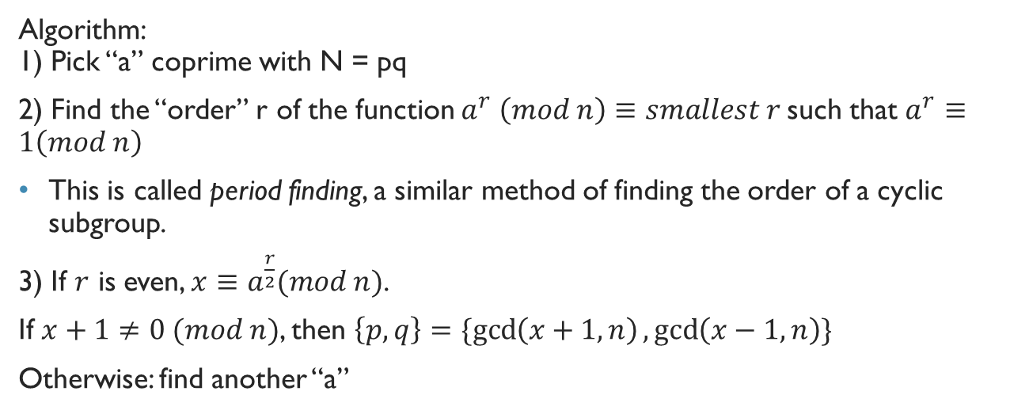
Classical Prime Factorization
Algorithm: 1) Pick “a” coprime with N = pq
2) Find the “order” r of the function $a^{r} \left(mod n\right)≡smallest r$such that $a^{r}≡1\left(mod n\right)$
This is called period finding, a similar method of finding the order of a cyclic subgroup.
3) If $r$ is even, $x≡a^{\frac{r}{2}}(mod n)$.
If $x+1≠0 (mod n)$, then $\left\{p,q\right\}=\{\gcd\left(x+1, n\right),\gcd\left(x−1, n\right)\}$
Otherwise: find another “a”

Slide 49
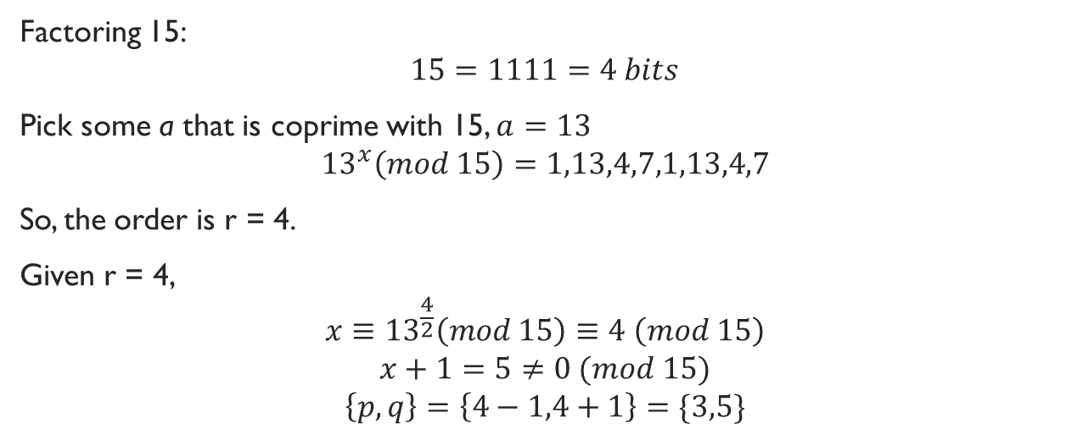
Prime Factorization Example
Factoring 15:
$$15=1111=4 bits$$
Pick some a that is coprime with 15, $a=13$
$${13}^{x}\left(mod 15\right)=1,13,4,7,1,13,4,7$$
So, the order is r = 4.
Given r = 4,
$$x≡{13}^{\frac{4}{2}}\left(mod 15\right)≡4 \left(mod 15\right)$$
$$x+1=5≠0 (mod 15)$$
$$\left\{p,q\right\}=\left\{4−1,4+1\right\}=\{3,5\}$$

Slide 50
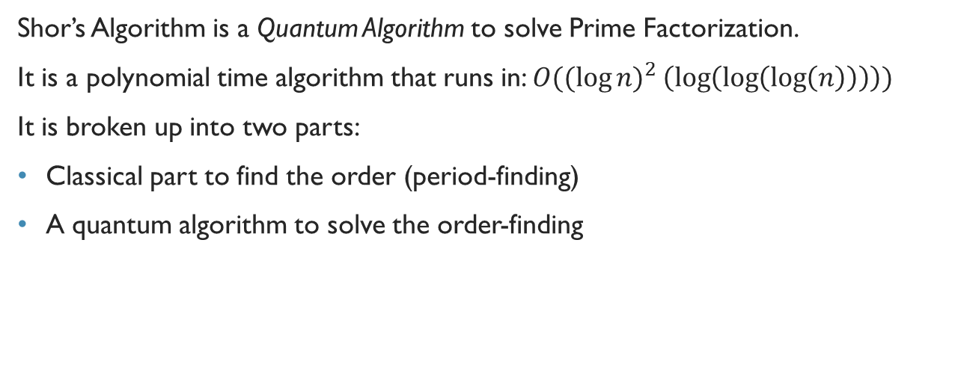
Shor’s Algorithm
Shor’s Algorithm is a Quantum Algorithm to solve Prime Factorization.
It is a polynomial time algorithm that runs in: $O(({\log{n)}}^{2}\left(\log\left(\log\left(\log\left(n\right)\right)\right)\right))$
It is broken up into two parts:
Classical part to find the order (period-finding)
A quantum algorithm to solve the order-finding

Slide 51
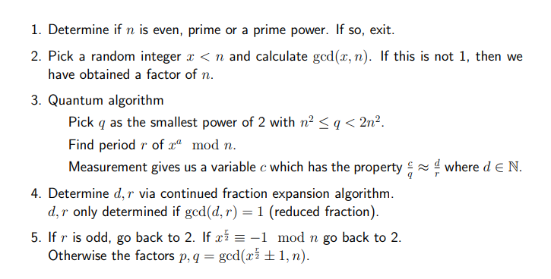
Sketch of Shor’s Algorithm
Quantum is dense… so I won’t bother you with the details, but you’ll need:
Quantum Fourier Transform
Hadamard Gates
Oracle

Slide 52
Why do we not use Shor’s Then??
Naturally, you should be wondering…
If Shor’s is so much faster than the classical algorithm, why do we not use Shor’s?
Shor’s Algorithm needs to be run on a Quantum Computer to work… but the best Quantum Computer can only compute up to 127 qubits…
Since our keys in RSA will be far larger than that, we can’t use Shor’s for now…
Until someone makes AN INSANE quantum computer, then… a lot of things will mess up….

Slide 53
Project 5

Slide 54
Project 5
Here, you are tasked with doing two functions:
multiply()
xgcd()
Seems easy right?
If you’ve learned anything about how Farnan runs a class… if there ain’t much, it’s definitely gonna be difficult….
In order to complete Project 5, you will need a solid understanding of how data is represented in a computer, so let’s get everyone on the same page:

Slide 55
A slight Detour: Review of Binary Representation

Slide 56
Review of Binary REpresentation
We represent information as bits and bytes:
A bit is simply a 0 or a 1.
We represent more information with sequences of bits
A common representation is called a byte, which is a sequence of 8 bits

Slide 57
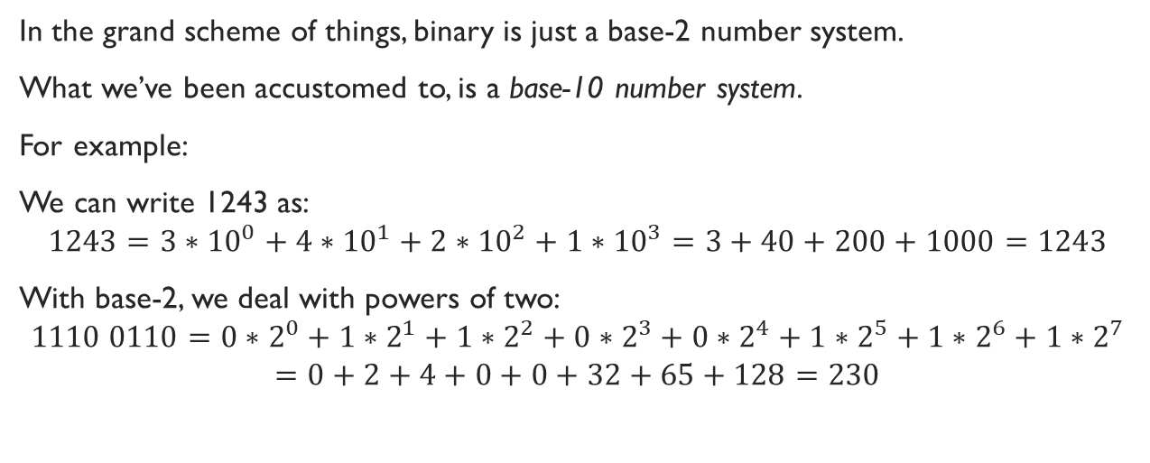
Base-2
In the grand scheme of things, binary is just a base-2 number system.
What we’ve been accustomed to, is a base-10 number system.
For example:
We can write 1243 as:
$$1243=3∗{10}^{0}+4∗{10}^{1}+2∗{10}^{2}+1∗{10}^{3}=3+40+200+1000=1243$$
With base-2, we deal with powers of two:
$$1110 0110=0∗2^{0}+1∗2^{1}+1∗2^{2}+0∗2^{3}+0∗2^{4}+1∗2^{5}+1∗2^{6}+1∗2^{7}=0+2+4+0+0+32+65+128=230$$

Slide 58
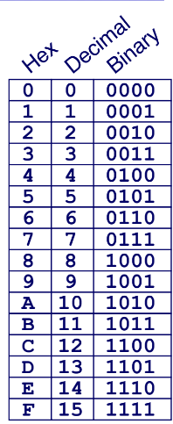
Bytes and Hex
Bytes are a sequence of 8 bits, so:
0000 0001 is a byte
Hexadecimal is a base-16 representation, that uses ‘0’ to ‘9’ and ‘A’ to ‘F’, so: 0xDA1D37B is a hexadecimal number
Notice how a single hex digit is 4 bits, so 2 hex digits is a byte.
Hexadecimal representations can help us type less but represent more!
1111 1111 = 0xFF for example!

Slide 59
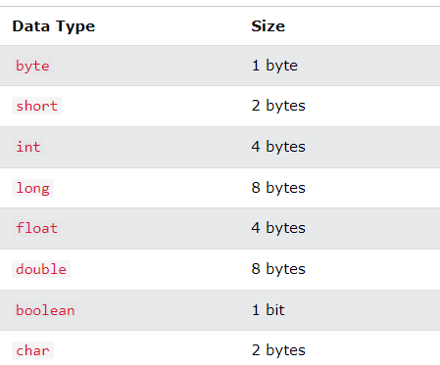
Primitive Data Type Sizes

Slide 60
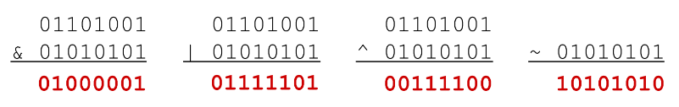
Bitwise Operations
Bitwise operations are VERY similar to the Boolean operations done in CS 441.
AND: A & B = 1 when A and B are both 1
OR: A | B = 1 when either A or B is 1
XOR: A ^ B = 1 when either A or B is 1, but not both
NOT: ~A = 1 when A is 0 and vice versa.

Slide 61
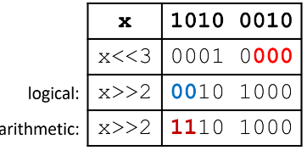
Shift Operations
We also have shift operations: 1) Left shift (x << n)
Fill with 0s on right
2) Right shift
Arithmetic shift (x >> n)
Signed values
Replicated most significant bit on left
Logical shift (x >>> n)
Unsigned values
Fill with 0s on left
IMPORTANT: If you shift by < 0 or >= number of bits in a number is a no-no.

Slide 62
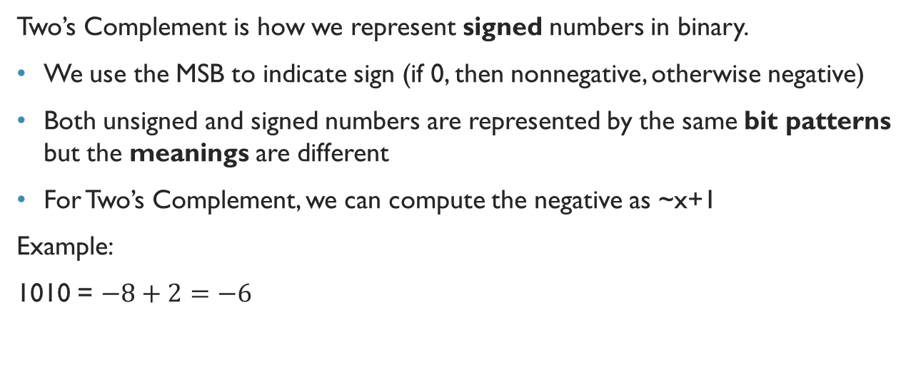
Signed and Unsigned Representation
Two’s Complement is how we represent signed numbers in binary.
We use the MSB to indicate sign (if 0, then nonnegative, otherwise negative)
Both unsigned and signed numbers are represented by the same bit patterns but the meanings are different
For Two’s Complement, we can compute the negative as ~x+1
Example:
1010 = $−8+2=−6$

Slide 63
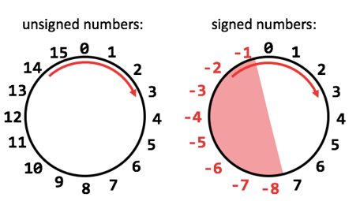
Hickory Dickory Dock, Think about Two’s Complement like a Clock
When we want to consider two’s complement inverses of each other, think of them as like opposite sides of a clock.

Slide 64
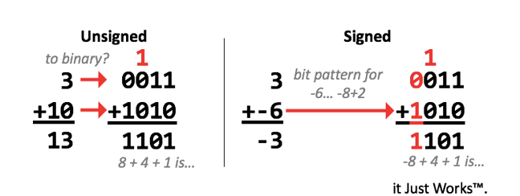
Binary Addition
Nothing really that new… just under a different number system!

Slide 65
Overflow
When we add two 32-bit numbers, we might get a 33-bit result… but how do we know?
Unsigned: if sum is smaller then either added, we got overflow
Signed: We add two numbers with the same sign, and we got a different sign

Slide 66
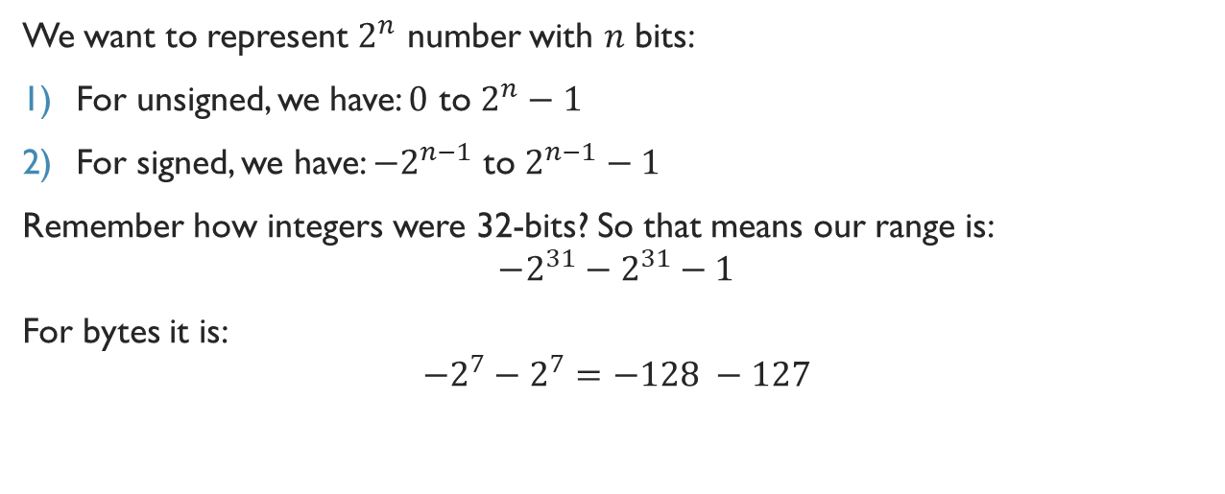
Range of Numbers
We want to represent $2^{n}$ number with $n$ bits:
For unsigned, we have: $0$ to $2^{n}−1$
For signed, we have: $−2^{n−1}$ to $2^{n−1}−1$
Remember how integers were 32-bits? So that means our range is:
$$−2^{31}−2^{31}−1$$
For bytes it is:
$$−2^{7}−2^{7}=−128 −127$$

Slide 67
Bit masking
Bit masking is incredibly useful especially when you want to look at a certain part of a number.
For example, if I want to determine if a number is odd:
I can simply do: (x&0x1) != 0x1
This will be incredibly useful for the project, as I can also use it toggle bits off and on.

Slide 68
Back to the Project

Slide 69
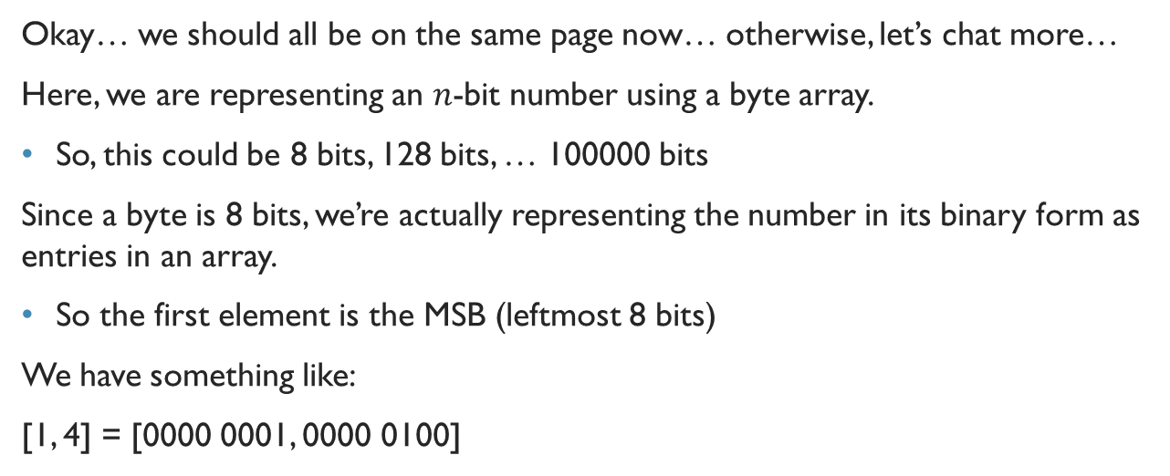
Hefty Integer Representation
Okay… we should all be on the same page now… otherwise, let’s chat more…
Here, we are representing an $n$-bit number using a byte array.
So, this could be 8 bits, 128 bits, … 100000 bits
Since a byte is 8 bits, we’re actually representing the number in its binary form as entries in an array.
So the first element is the MSB (leftmost 8 bits)
We have something like:
[1, 4] = [0000 0001, 0000 0100]

Slide 70
Hefty Integer
But what can you really do with that?
We can’t do operations bit-by-bit…
If we multiply, we can’t just add to a single byte… we gotta apply it to all of the entries in the byte array…
But there’s more…
In order to do an operation on a single bit of a byte… we gotta… use bitmasks or certain bitwise operations….

Slide 71
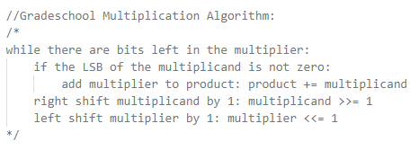
Gradeschool Multiplication Algorithm
multiply() is actually quite difficult:
Because… if you multiply two 32-bit numbers, you could get a 64-bit result…
Here is a 32-bit multiplication algorithm:
It is not easy to bring this to a general n-bit multiplication algorithm, but still doable:

Slide 72
XGCD
So, XGCD is also pretty difficult…
Remember that formula from before when we were talking about XGCD?
You need subtraction, division, mod and multiply…
So, if your multiply ain’t working you’re in big trouble…

Slide 73
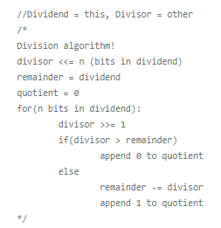
Gradeschool Division Algorithm
Here is a 32-bit division algorithm:
It is not easy to bring this to a general n-bit division algorithm, but still doable:

Slide 74
Common Errors and Advice
Remember that Java is pass-by-value NOT pass-by-reference…
Meaning that if you are careless with how you handle functions with an array, it could end up unnecessarily modifying the value of the array when you don’t want it to…
Do not trust Farnan’s tester…
If you choose to go with the gradeschool algorithms that I have provided, if implemented correctly, will work up to 32-bits…
BUT Farnan does not test numbers that require an extension to > 32 bits
ALSO, he does not test negative numbers with multiplication….

Slide 75
Common Errors and Advice
Remember the difference between >> and >>> .
Often times, doing an arithmetic right shift not only divides by 2 for each position shifted, but it also has another effect…
Slow runtime can often bring you down the rabbit hole of thinking that your code is incorrect, but how the number is represented in binary can actually slow down the runtime…
Most importantly… this project is not easy… it is not something you should get in one day. It is something you should think about for many days and be very cautious.
Be patient, and motivated. Always ask questions. Never be afraid to reach out if you are confused. This project is hard.

Slide 76
Thank you for being amazing ☺

Slide 77
It’s Our Last Recitation… ☹
Let me just preface this and say…
This is my last recitation ever as a UTA
I appreciate every single one of you for making my last semester as a student/TA an incredible experience.
I’ll be working at Capital One in the Fall, and applying to Graduate Schools in the Fall, so who knows, maybe you’ll see me again!
Otherwise, feel free to reach out to me on Discord or through LinkedIn:
LinkedIn: http://www.linkedin.com/in/glu99331/
Discord: twinkie#6908
Ratemyprofessor: https://www.ratemyprofessors.com/ShowRatings.jsp?tid=2588578

