Slide 1
CS 1501 Recitation 4
Gordon Lu

Slide 2
Agenda for Today
Priority Queues
Heapsort
What project 3 will look like
Questions for Project?

Slide 3
Office Hours for Break
I will be holding office hours over the break at the following times:
MWTuThFSaSu: 4-6PM (All over Zoom)
If you cannot make these times, feel free to send me a message, and we can meet at another time
I will be as available as possible over the break (Slack, Email, Discord)

Slide 4
Priority Queues

Slide 5
Motivation
There’s a common investment philosophy, “buy low, sell high”. Suppose I’m developing a stock portfolio algorithm to purchase a given stock based on its 7-day moving average. How would I want to choose a stock?
Well, I’d want to select the stock whose price is relatively low compared to its historic high
But I don’t want to go through the entire history to compare the current price to how it has performed in the past… that’ll take a while…

Slide 6
Enter Priority Queues
Essentially what I want is some data structure that can retrieve the minimum in O(1) time…
This is precisely what a PQ will do!!!
Before we introduce Priority Queues, we must first introduce the idea of a binary heap!

Slide 7
Binary Heaps
In a binary heap, the keys are stored in an array such that each key is guaranteed to be larger than (or equal to) the keys at two other specific positions.
All we require in a binary heap is that the parent is larger than its two children! [Heap Property]
Complete: the tree is completely filled except possibly the bottom level, which is filled from left to right
We also require that the root contains the highest priority item.
Note: Structurally like a BST but defined differently!

Slide 8
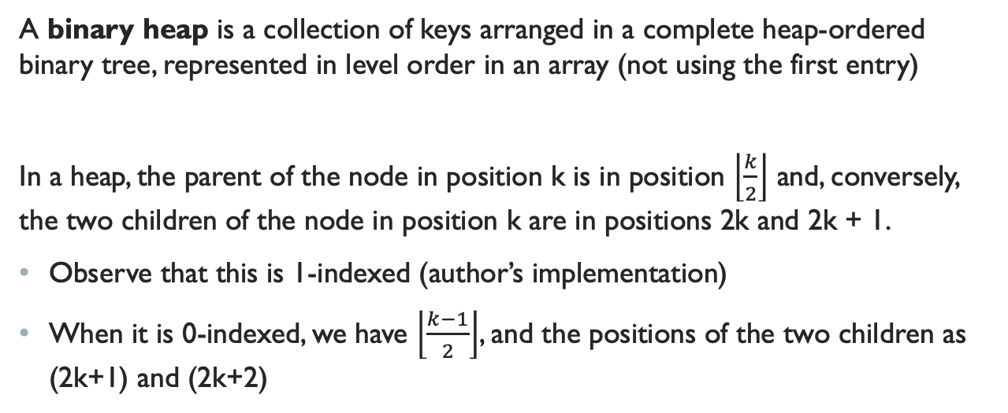
Binary Heap Representation
A binary heap is a collection of keys arranged in a complete heap-ordered binary tree, represented in level order in an array (not using the first entry)
In a heap, the parent of the node in position k is in position $\left\lfloor \frac{k}{2}\right\rfloor$ and, conversely, the two children of the node in position k are in positions 2k and 2k + 1.
Observe that this is 1-indexed (author’s implementation)
When it is 0-indexed, we have $\left\lfloor \frac{k−1}{2}\right\rfloor$, and the positions of the two children as (2k+1) and (2k+2)

Slide 9
Why Start at Index 1?
The authors represent complete binary trees sequentially within an array by putting the nodes in level order, with the root at position 1.
It’s for clarity so the heap can be visualized easier
You don’t really need to do it this way…

Slide 10
The Necessity for an Array-Based Representation
Instead of using explicit links (as in the binary tree structures), we can travel up and down by doing simple arithmetic on array indices:
To move up the tree from a[k] we set k to k/2;
To move down the tree, we set k to 2k or 2k+1.

Slide 11
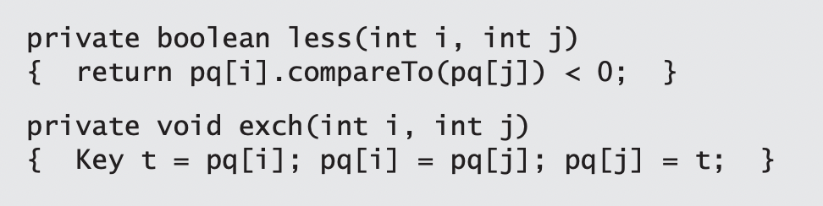
Heap Helper Methods
We represent a heap of size N in private array pq[] of length N + 1, with pq[0] unused and the heap in pq[1] through pq[N].

Slide 12
Heap Operations
Whenever we perform an operation on the Heap, we may violate the heap property, and may need to reheapify to restore it.
1) When the priority of some node is increased (or a new node is added at the bottom of a heap), we have to travel up the heap to restore the heap order. (Swim/Percolate Up)
2) When the priority of some node is decreased (for example, if we replace the node at the root with a new node that has a smaller key), we have to travel down the heap to restore the heap order. (Sink/Percolate Down)

Slide 13
Bottom-Up Reheapify
Swim:
If the heap order is violated because a node’s key becomes larger than that node’s parent’s key, then we can make progress toward fixing the violation by exchanging the node with its parent.
After the exchange, the node is larger than both its children (one is the old parent, and the other is smaller than the old parent because it was a child of that node) but the node may still be larger than its parent.
We can fix that violation in the same way, and so forth, moving up the heap until we reach a node with a larger key, or the root.

Slide 14
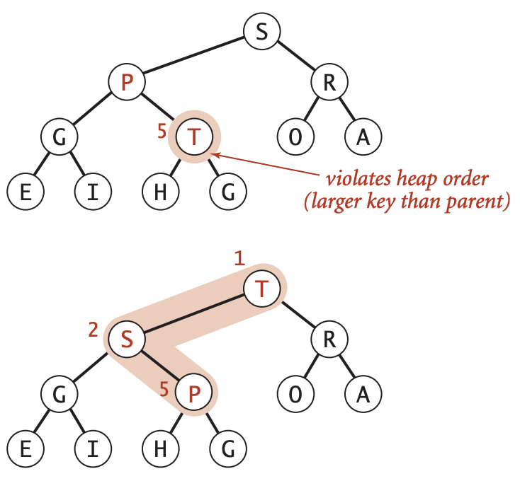
Swim Example

Slide 15
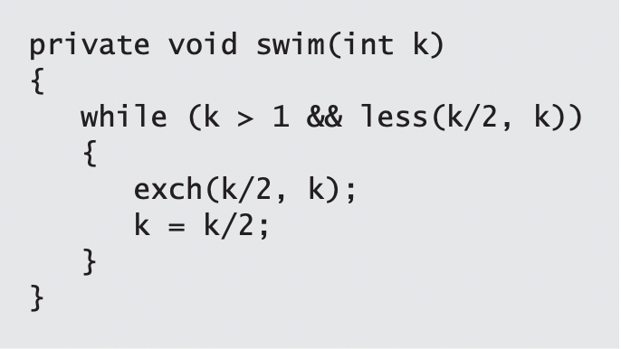
Swim Code
The parent of the node at position k in a heap is at position k/2
Therefore, when we get to a place where that node is not larger than its parent, we know that the heap order is satisfied throughout the heap.

Slide 16
Top-Down Reheapify
Sink:
If the heap order is violated because a node’s key becomes smaller than one or both of that node’s children’s keys, then we can make progress toward fixing the violation by exchanging the node with the larger of its two children.
This switch may cause a violation at the child!
We fix that violation in the same way, and so forth, moving down the heap until we reach a node with both children smaller (or equal), or the bottom.

Slide 17
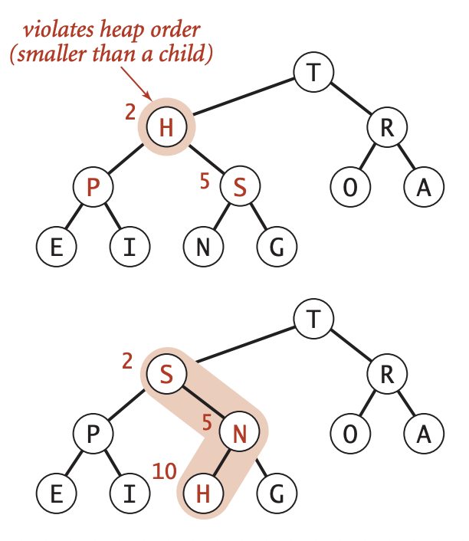
Sink Example

Slide 18
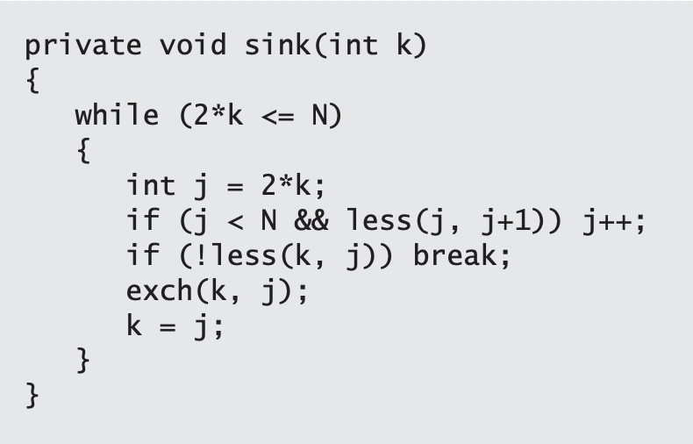
Sink Code
The children of the node at position k in a heap are at positions 2k and 2k+1.
Think about the node, having too small a key, as having to sink to a lower level in the heap

Slide 19
A real-Life Example of Sink/Swim
If we imagine the heap to represent a cutthroat corporate hierarchy, with each of the children of a node representing subordinates (and the parent representing the immediate superior), then these operations have amusing interpretations.
The swim() operation corresponds to a promising new manager arriving on the scene, being promoted up the chain of command (by exchanging jobs with any lower qualified boss) until the new person encounters a higher-qualified boss.
The sink() operation is analogous to the situation when the president of the company resigns and is replaced by someone from the outside.
If the president’s most powerful subordinate is stronger than the new person, they exchange jobs, and we move down the chain of command, demoting the new person and promoting others until the level of competence of the new person is reached, where there is no higher-qualified subordinate.

Slide 20
Priority Queue Operations
Sink and Swim provide the basis for two essential Priority Queue operations:
Insert:
We add the new key at the end of the array, increment the size of the heap, and then swim up through the heap with that key to restore the heap condition.
Remove the Maximum Priority Element:
We take the largest key off the top, put the item from the end of the heap at the top, decrement the size of the heap, and then sink down through the heap with that key to restore the heap condition.

Slide 21
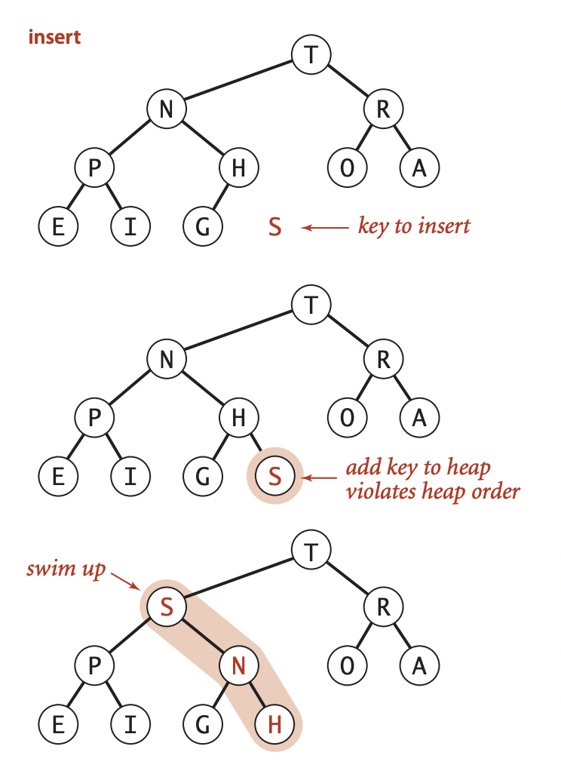
Insert Example

Slide 22
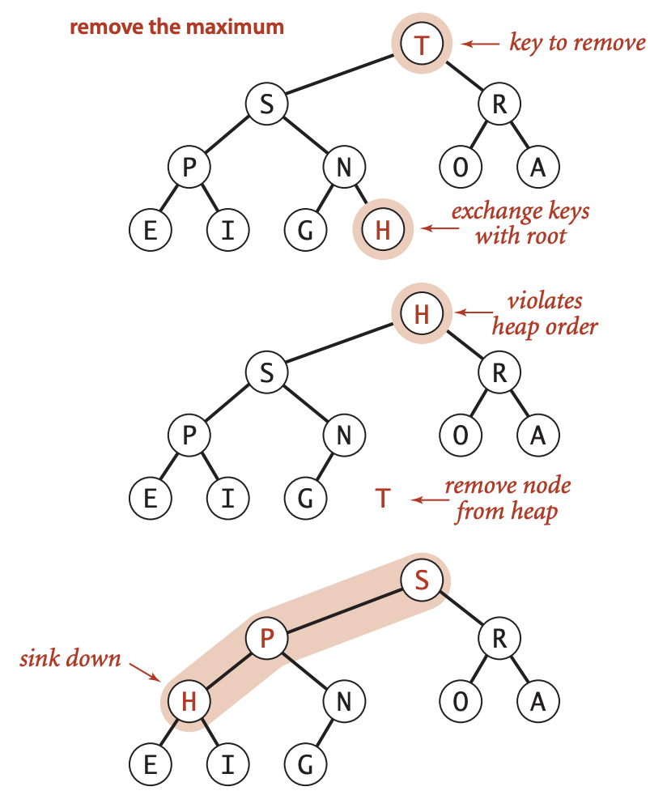
Remove Max Example

Slide 23
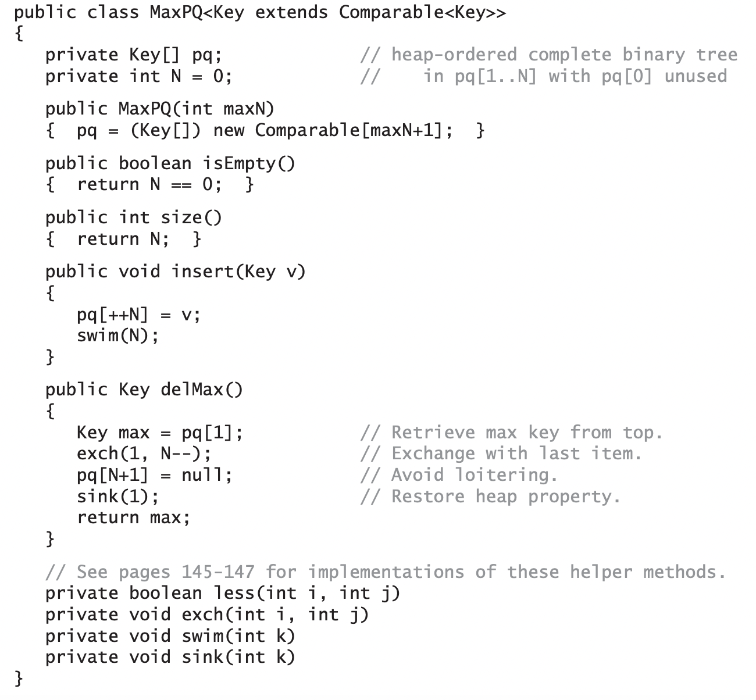
Max PQ Code
In insert, we increment N, add the new element at the end, then use swim() to restore the heap order
For delMax(), we take the value to be returned from pq[1], then move pq[N] to pq[1], decrement the size of the heap, and use sink() to restore the heap condition

Slide 24
Heap Sort

Slide 25
Heap Sort
Recall the discussion on sorting algorithms:
The best that a comparison-based sorting algorithm can do is O(n log n)
Heapsort is a comparison-based sorting algorithm that runs in O(n log n)
The idea: We insert all the items to be sorted into a minimum-oriented priority queue, then repeatedly use remove the minimum to remove them all in order.

Slide 26
HeapSort Phases
Heapsort breaks into two phases:
Heap Construction: Where we reorganize the original array into a heap,
Sortdown: Where we pull the items out of the heap in decreasing order to build the sorted result.

Slide 27
Heap Construction
We start by going from right to left, using sink() to make subheaps as we go.
Every position in the array is the root of a small subheap;
sink() works for such subheaps, as well.
If the two children of a node are heaps, then calling sink() on that node makes the subtree rooted at the parent a heap.

Slide 28
SortDown
Most of the work during heapsort is done during the second phase, where we remove the largest remaining item from the heap and put it into the array position vacated as the heap shrinks.
This process is a bit like selection sort (taking the items in decreasing order instead of in increasing order), but it uses many fewer compares because the heap provides a much more efficient way to find the largest item in the unsorted part of the array

Slide 29
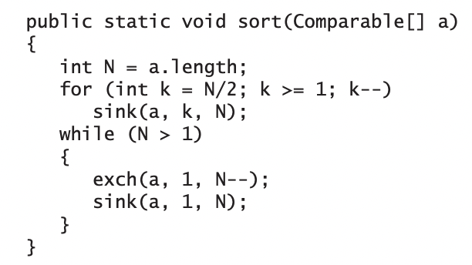
HeapSort Code
The for loop constructs the heap; then the while loop exchanges the largest element a[1] with a[N] and then repairs the heap, continuing until the heap is empty.

Slide 30
HeapSort Algorithm
1) First, construct the heap
Ideally the smallest priority element will end up at the beginning
So, for a Max Heap, this would end up with a sorted array in ASCENDING order, vice versa for a Min Heap
2) Sink a[1] to the bottom of the heap
3) Reheapify using a[1] … a[N] (ignore N+1)
4) Repeat using N = N-1

Slide 31
Indexable Priority Queues

Slide 32
Indexable Priority QUeues
We’re able to get the highest priority item in O(1), with a maximum of O(log n) for some other operations, but what if we wanted to retrieve any arbitrary element in O(1)?
IndexPQs!
A useful way of thinking of Indexable priority queues is as implementing an array, but with fast access to the smallest entry in the array.
Actually, it does even better—it gives fast access to the minimum entry in a specified subset of an array’s entries

Slide 33
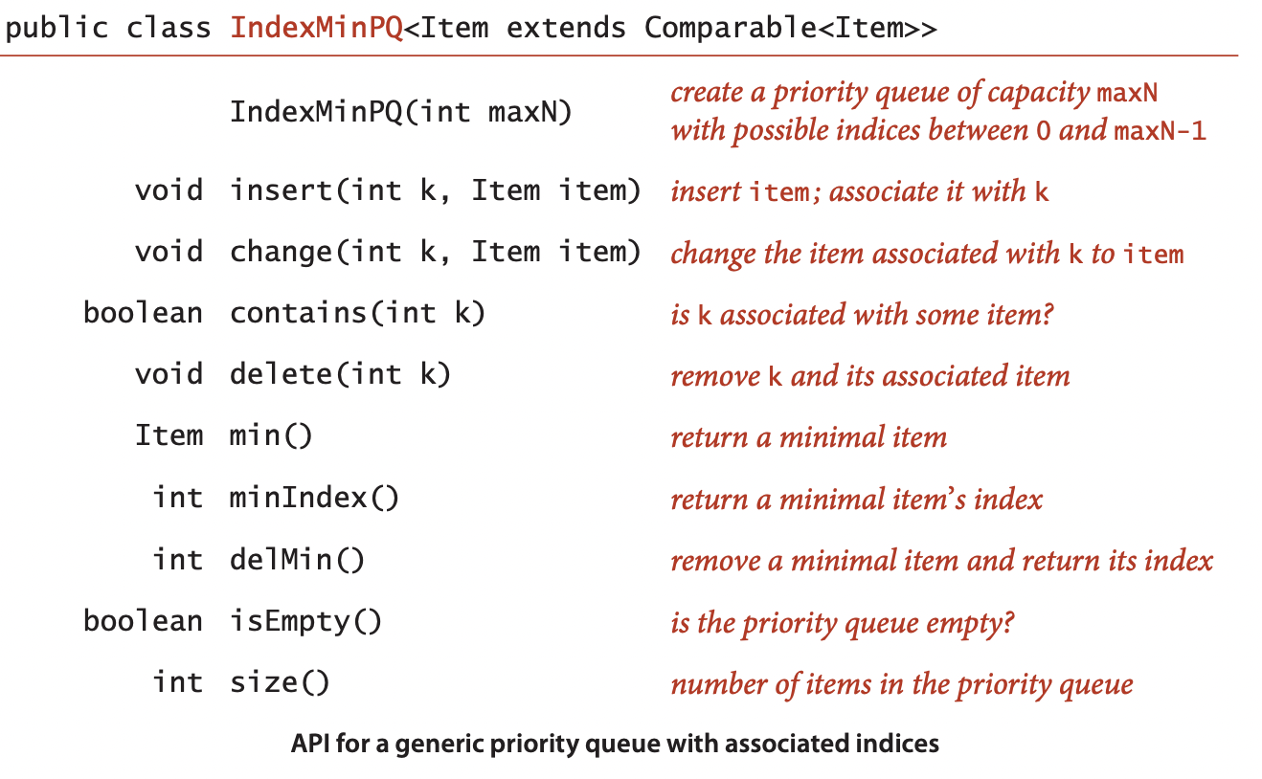
Index PQ API

Slide 34
Indexable PQs (Cont.)
You can think of an IndexMinPQ named pq as representing a subset of an array pq[0..N-1] of items.
Think of the call pq.insert(k, item) as adding k to the subset
Setting pq[k] = item and the call pq.change(k, item) as setting pq[k] = item
Both also maintain data structures needed to support the other operations, most importantly delMin() (remove and return the index of the minimum key) and change() (change the item associated with an index that is already in the data structure—just as in pq[i] = item)

Slide 35
Index PQs (Cont.)
Intuitively, when an item in the heap changes, we can restore the heap invariant with a sink operation (if the key increases) and a swim operation (if the key decreases).
To perform the operations, we use the index to find the item in the heap. The ability to locate an item in the heap also allows us to add the delete() operation to the API.

Slide 36
Author’s Implementation
The authors implement the Indexable Priority Queue using the following:
An array pq to represent the binary heap (the indices)
An array keys to hold the key values for each node in the heap
An array qp to give the index of position i in the pq [ ]
In other words: qp[pq[i]] = pq[qp[i]] = i

Slide 37
Let’s Take a Look at the Code
https://algs4.cs.princeton.edu/24pq/IndexMinPQ.java.html

Slide 38
What Project 3 will look Like (Discussion)

Slide 39
Advanced Priority Queues
Recall the discussion of indirection with priority queues.
You will be implementing an application that runs in no more than O(log n) for all operations.

Slide 40
One Variation of the Project
You will be writing a basic application to help a user select an apartment to rent.
You should write a PQ-based data structure that stores objects according to the relative priorities of two of their attributes, making it efficient to retrieve objects with the minimum or maximum value of either attribute (whether an attribute is a min attribute, such as price, or max attribute, such as size, is defined at initialization).
Your data structure should further be indexable to allow for efficient updates of entered items.
The user should then be able to efficiently retrieve the apartment with the highest square footage or lowest rent.
You should assume that the user is looking for apartments in multiple different cities.
Thus, the retrievals should be possible on the set of all entered apartments or on the set of all apartments from a specific city (e.g., "lowest rent in Pittsburgh", "most square footage in San Francisco").

Slide 41
Project Operations
Add an apartment
This will prompt the user for each of the above-listed attributes of an apartment to keep track of.
Update an apartment
This option will prompt the user for the street address, apartment number, and zip code of an apartment, and then ask the user if they would like to update the rent for the apartment.
Remove a specific apartment from consideration
This option will prompt the user for the street address, apartment number, and zip code of an apartment to remove from the data structure (e.g., if it is no longer to rent)
Note that this means you will need to support removal of apartments other than the minimum rent or maximum square footage

Slide 42
Project Operations (Cont.)
Retrieve the lowest rent apartment
Retrieve the highest square footage apartment
Retrieve the lowest rent apartment by city
This option will prompt the user to enter a city and then return the apartment with the lowest rent within that city.
Retrieve the highest square footage apartment by city
This option will prompt the user to enter a city and then return the biggest apartment within that city.

Slide 43
Project 2 Questions?

