Slide 1
CS 1501 Recitation 5
Gordon Lu

Slide 2
Agenda for Today
Review of Graphs
Some interesting Graph Theory results
Induced Subgraphs, Cut Vertices, Cut Sets
A cut vertex discovery algorithm (Mathematical way)
Tarjan’s Algorithm (The CS way)
Project 3 Hints
IndexMinPQ recap
Tracing through sample files

Slide 3
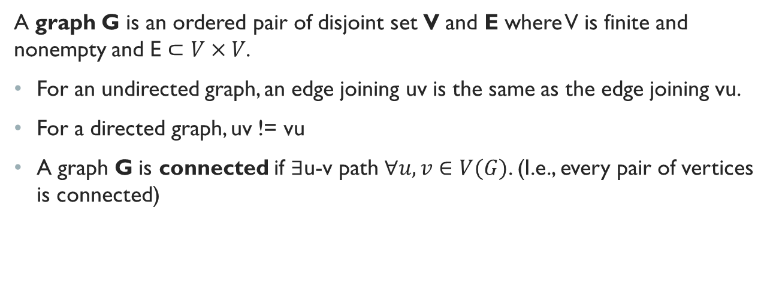
Recap of Graphs
A graph G is an ordered pair of disjoint set V and E where V is finite and nonempty and E $⊂V×V$.
For an undirected graph, an edge joining uv is the same as the edge joining vu.
For a directed graph, uv != vu
A graph G is connected if $∃$u-v path $∀u,v∈V(G)$. (I.e., every pair of vertices is connected)

Slide 4
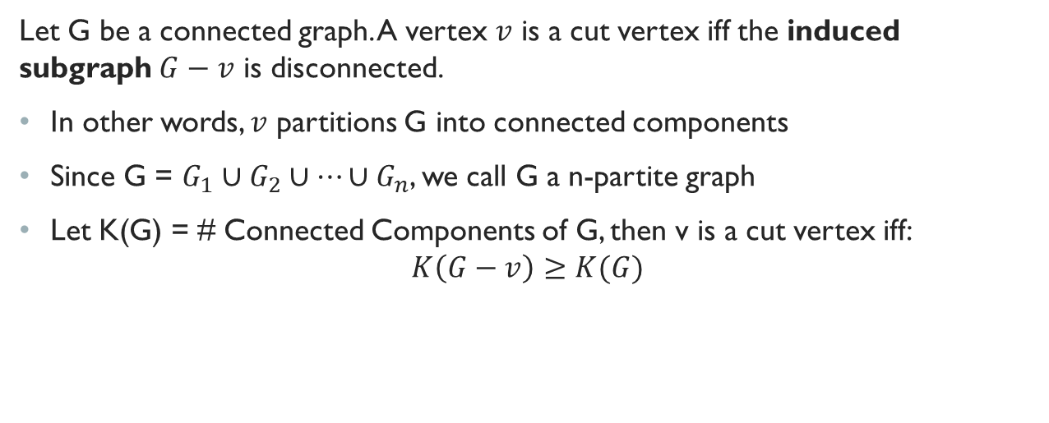
Cut Vertex
Let G be a connected graph. A vertex $v$ is a cut vertex iff the induced subgraph $G−v$ is disconnected.
In other words, $v$ partitions G into connected components
Since G = $G_{1}∪G_{2}∪…∪G_{n}$, we call G a n-partite graph
Let K(G) = # Connected Components of G, then v is a cut vertex iff: $K\left(G−v\right)≥K(G)$

Slide 5
Cut Sets
So… we know a cut vertex will make the induced subgraph G-v disconnected, but what if… we removed a set of vertices… this monstrosity is called a cut set.
You will need to do this for Project 4.

Slide 6
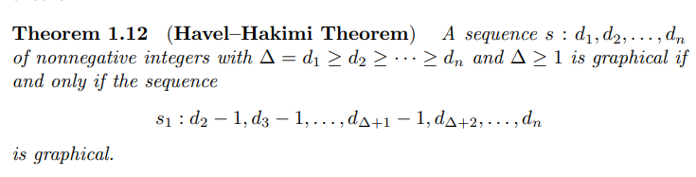
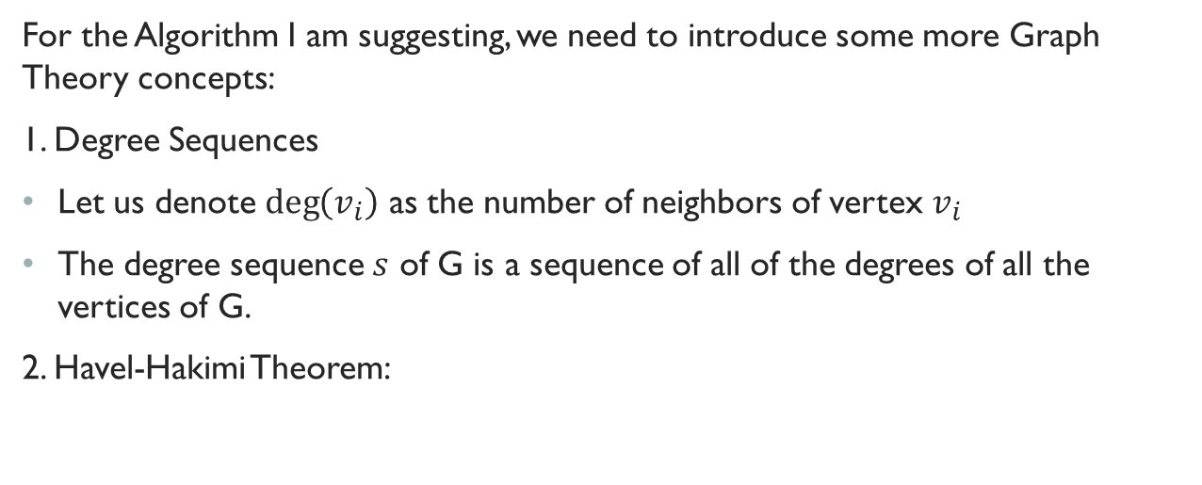
Gordon’s Cut Vertex Detection Algorithm
For the Algorithm I am suggesting, we need to introduce some more Graph Theory concepts:
1. Degree Sequences
Let us denote $\deg\left(v_{i}\right)$ as the number of neighbors of vertex $v_{i}$
The degree sequence $s$ of G is a sequence of all of the degrees of all the vertices of G.
2. Havel-Hakimi Theorem:

Slide 7
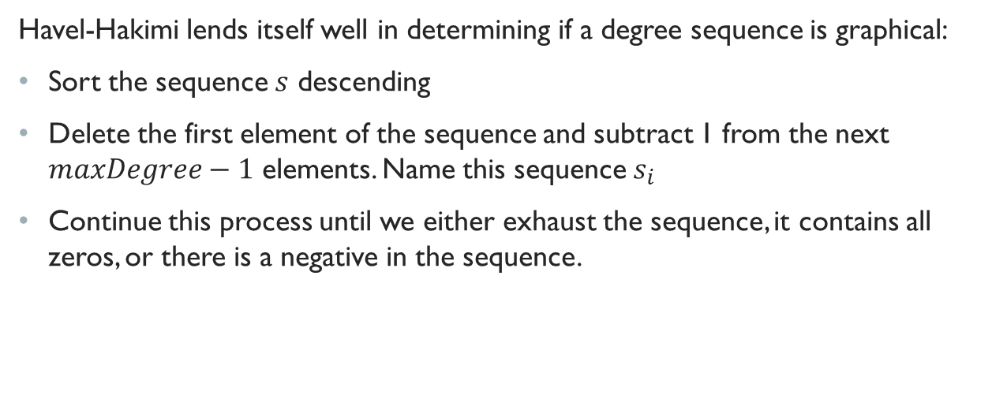
Gordon’s Cut Vertex Detection Algorithm (CONt.)
Havel-Hakimi lends itself well in determining if a degree sequence is graphical:
Sort the sequence $s$ descending
Delete the first element of the sequence and subtract 1 from the next $maxDegree−1$ elements. Name this sequence $s_{i}$
Continue this process until we either exhaust the sequence, it contains all zeros, or there is a negative in the sequence.

Slide 8
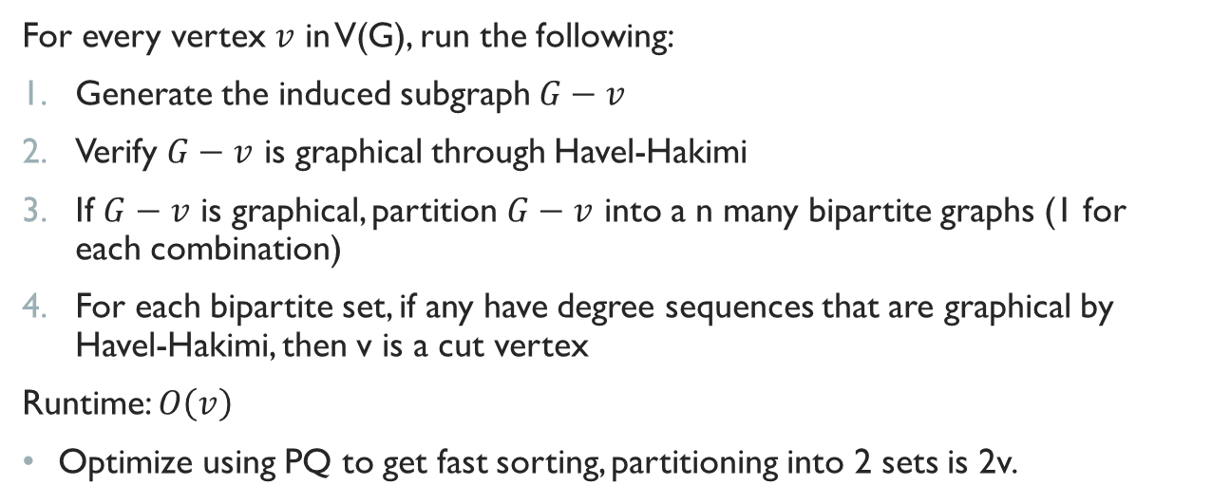
Gordon’s Algorithm
For every vertex $v$ in V(G), run the following:
Generate the induced subgraph $G−v$
Verify $G−v$ is graphical through Havel-Hakimi
If $G−v$ is graphical, partition $G−v$ into a n many bipartite graphs (1 for each combination)
For each bipartite set, if any have degree sequences that are graphical by Havel-Hakimi, then v is a cut vertex
Runtime: $O\left(v\right)$
Optimize using PQ to get fast sorting, partitioning into 2 sets is 2v.

Slide 9
Tarjan’s Algorithm
The idea is to use DFS.
In DFS tree, a vertex u is articulation point if one of the following two conditions is true.
u is root of DFS tree, and it has at least two children.
u is not root of DFS tree and it has a child v such that no vertex in subtree rooted with v has a back edge to one of the ancestors (in DFS tree) of u.

Slide 10
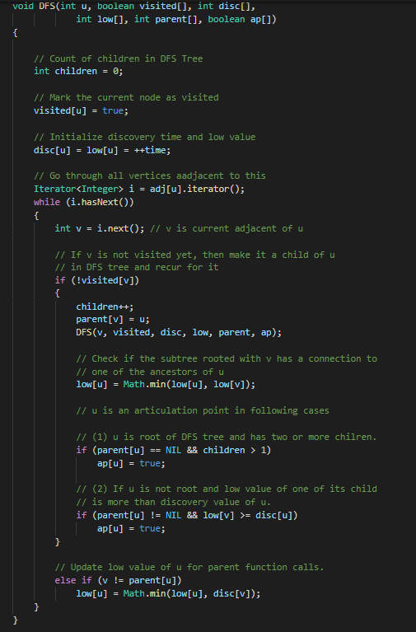
Let’s Take a Look at the Code
disc[ ] to store discovery time,
to determine best backedge for low[ ]

Slide 11
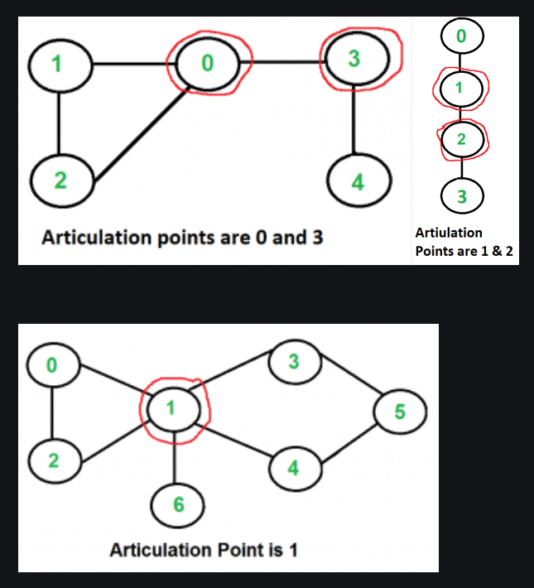
Examples

Slide 12
Indexable Priority Queues

Slide 13
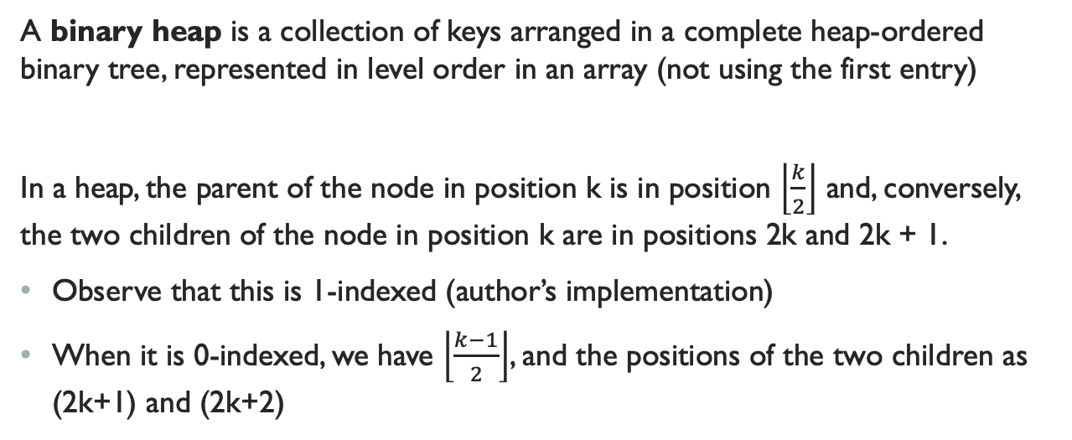
Binary Heap Representation
A binary heap is a collection of keys arranged in a complete heap-ordered binary tree, represented in level order in an array (not using the first entry)
In a heap, the parent of the node in position k is in position $\left\lfloor \frac{k}{2}\right\rfloor$ and, conversely, the two children of the node in position k are in positions 2k and 2k + 1.
Observe that this is 1-indexed (author’s implementation)
When it is 0-indexed, we have $\left\lfloor \frac{k−1}{2}\right\rfloor$, and the positions of the two children as (2k+1) and (2k+2)

Slide 14
Why Start at Index 1?
The authors represent complete binary trees sequentially within an array by putting the nodes in level order, with the root at position 1.
It’s for clarity so the heap can be visualized easier
You don’t really need to do it this way…

Slide 15
The Necessity for an Array-Based Representation
Instead of using explicit links (as in the binary tree structures), we can travel up and down by doing simple arithmetic on array indices:
To move up the tree from a[k] we set k to k/2;
To move down the tree, we set k to 2k or 2k+1.

Slide 16
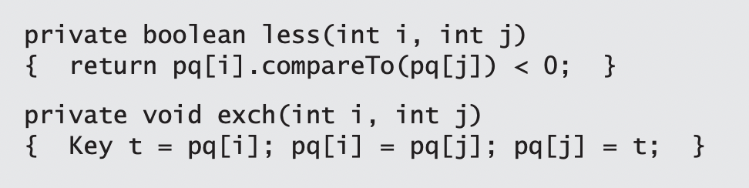
Heap Helper Methods
We represent a heap of size N in private array pq[] of length N + 1, with pq[0] unused and the heap in pq[1] through pq[N].

Slide 17
Heap Operations
Whenever we perform an operation on the Heap, we may violate the heap property, and may need to reheapify to restore it.
1) When the priority of some node is increased (or a new node is added at the bottom of a heap), we have to travel up the heap to restore the heap order. (Swim/Percolate Up)
2) When the priority of some node is decreased (for example, if we replace the node at the root with a new node that has a smaller key), we have to travel down the heap to restore the heap order. (Sink/Percolate Down)

Slide 18
Bottom-Up Reheapify
Swim:
If the heap order is violated because a node’s key becomes larger than that node’s parent’s key, then we can make progress toward fixing the violation by exchanging the node with its parent.
After the exchange, the node is larger than both its children (one is the old parent, and the other is smaller than the old parent because it was a child of that node) but the node may still be larger than its parent.
We can fix that violation in the same way, and so forth, moving up the heap until we reach a node with a larger key, or the root.

Slide 19
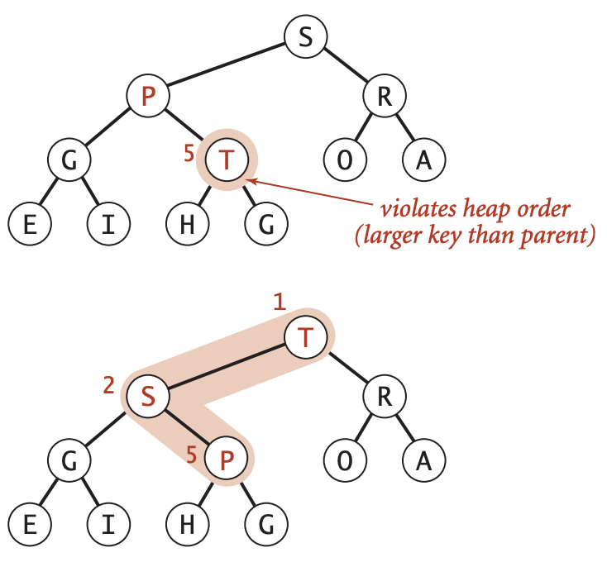
Swim Example

Slide 20
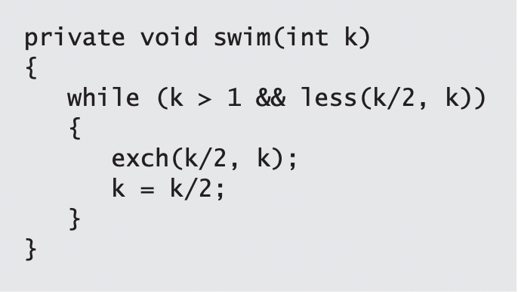
Swim Code
The parent of the node at position k in a heap is at position k/2
Therefore, when we get to a place where that node is not larger than its parent, we know that the heap order is satisfied throughout the heap.

Slide 21
Top-Down Reheapify
Sink:
If the heap order is violated because a node’s key becomes smaller than one or both of that node’s children’s keys, then we can make progress toward fixing the violation by exchanging the node with the larger of its two children.
This switch may cause a violation at the child!
We fix that violation in the same way, and so forth, moving down the heap until we reach a node with both children smaller (or equal), or the bottom.

Slide 22
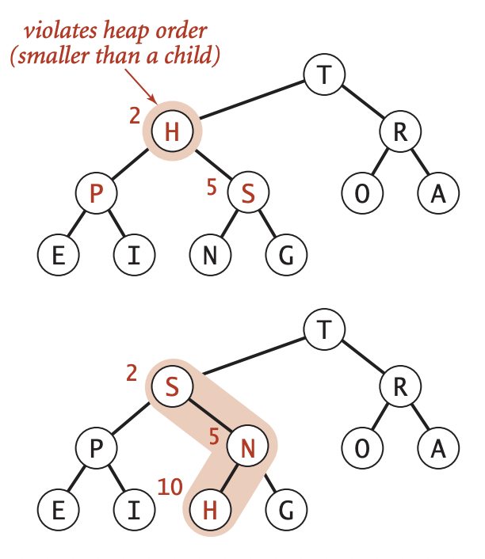
Sink Example

Slide 23
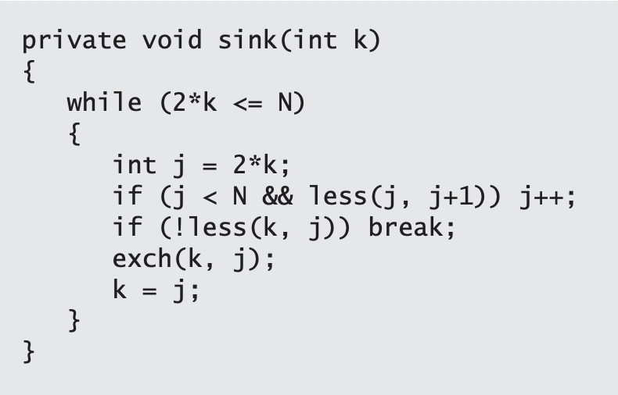
Sink Code
The children of the node at position k in a heap are at positions 2k and 2k+1.
Think about the node, having too small a key, as having to sink to a lower level in the heap

Slide 24
Indexable Priority QUeues
We’re able to get the highest priority item in O(1), with a maximum of O(log n) for some other operations, but what if we wanted to retrieve any arbitrary element in O(1)?
IndexPQs!
A useful way of thinking of Indexable priority queues is as implementing an array, but with fast access to the smallest entry in the array.
Actually, it does even better—it gives fast access to the minimum entry in a specified subset of an array’s entries

Slide 25
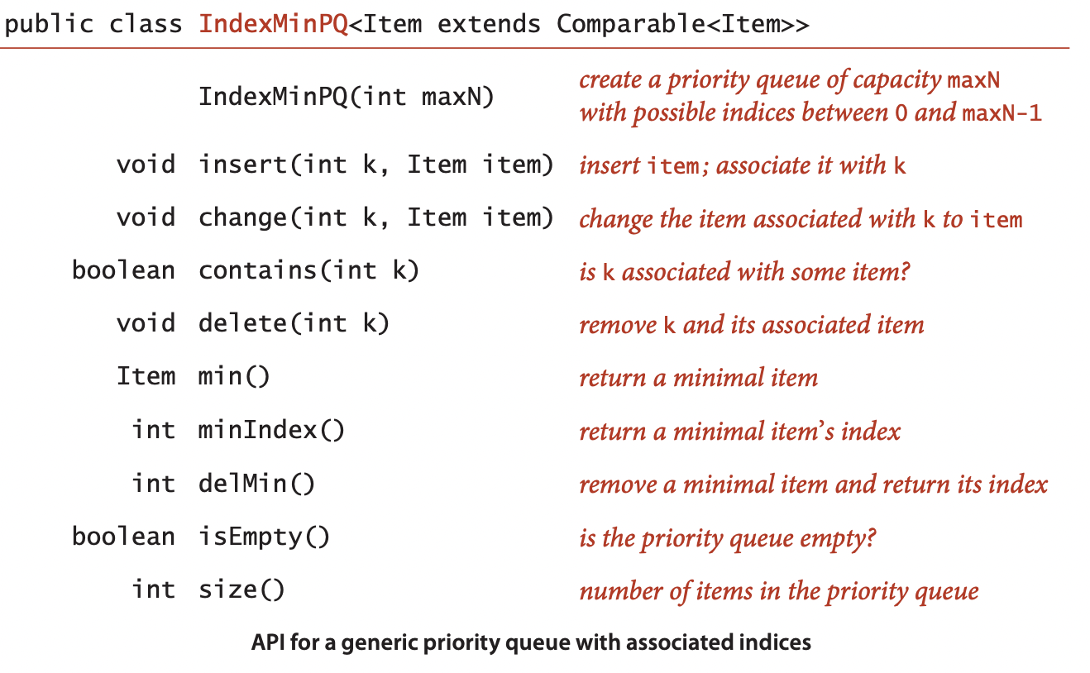
Index PQ API

Slide 26
Indexable PQs (Cont.)
You can think of an IndexMinPQ named pq as representing a subset of an array pq[0..N-1] of items.
Think of the call pq.insert(k, item) as adding k to the subset
Setting pq[k] = item and the call pq.change(k, item) as setting pq[k] = item
Both also maintain data structures needed to support the other operations, most importantly delMin() (remove and return the index of the minimum key) and change() (change the item associated with an index that is already in the data structure—just as in pq[i] = item)

Slide 27
Index PQs (Cont.)
Intuitively, when an item in the heap changes, we can restore the heap invariant with a sink operation (if the key increases) and a swim operation (if the key decreases).
To perform the operations, we use the index to find the item in the heap. The ability to locate an item in the heap also allows us to add the delete() operation to the API.

Slide 28
Author’s Implementation
The authors implement the Indexable Priority Queue using the following:
An array pq to represent the binary heap (the indices)
An array keys to hold the key values for each node in the heap
An array qp to give the index of position i in the pq [ ]
In other words: qp[pq[i]] = pq[qp[i]] = i

Slide 29
Let’s Take a Look at the Code
https://algs4.cs.princeton.edu/24pq/IndexMinPQ.java.html

Slide 30
Hints for the Project

Slide 31
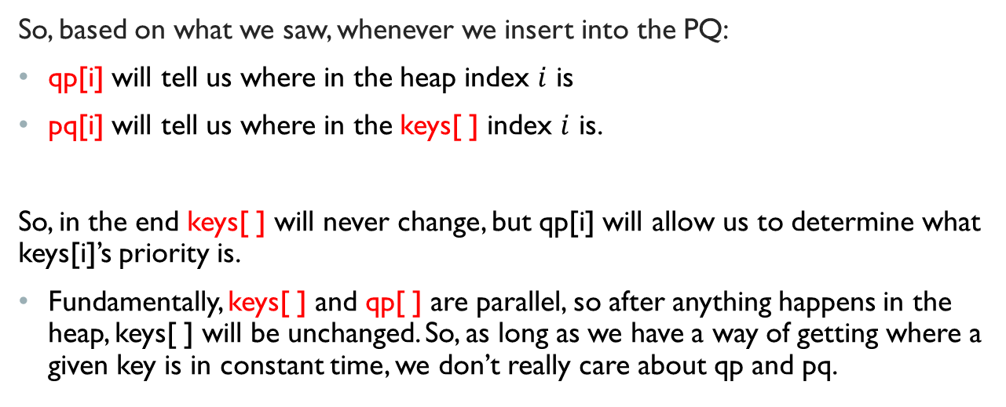
Explanation of The Arrays
So, based on what we saw, whenever we insert into the PQ:
qp[i] will tell us where in the heap index $i$ is
pq[i] will tell us where in the keys[ ] index $i$ is.
So, in the end keys[ ] will never change, but qp[i] will allow us to determine what keys[i]’s priority is.
Fundamentally, keys[ ] and qp[ ] are parallel, so after anything happens in the heap, keys[ ] will be unchanged. So, as long as we have a way of getting where a given key is in constant time, we don’t really care about qp and pq.

Slide 32
The Gist of things
In the project you want to track Cars by two attributes: price and mileage.
We want all operations to run in O(lg n) or less.

Slide 33
Methods to implement
add(Car c)
get(String vin)
updatePrice(String vin, int newPrice)
updateMileage(String vin, int newMileage)
updateColor(String vin, String newColor)
remove(String vin)
getPrice()
getPrice(String make, String model)
getMileage()
getMileage(String make, String model)

Slide 34
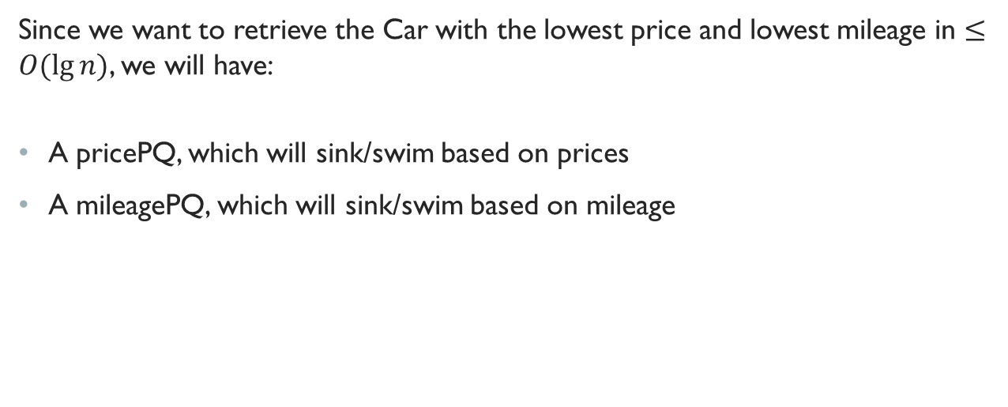
getPrice() and GetMileage()
Since we want to retrieve the Car with the lowest price and lowest mileage in $≤O(\lg{n)}$, we will have:
A pricePQ, which will sink/swim based on prices
A mileagePQ, which will sink/swim based on mileage

Slide 35
Get based on VIN
Since we want to retrieve any Car based on VIN, we cannot just iterate through keys[ ] in PQ, we have to use indirection to do this in constant time… but how?
Recall that in the end keys[ ] will never change, but qp[i] will allow us to determine what keys[i]’s priority is.
Fundamentally, keys[ ] and qp[ ] are parallel, so after anything happens in the heap, keys[ ] will be unchanged.
So, if we can map a given car’s VIN to where it is located in keys[ ] before we query, we can do it in constant time!

Slide 36
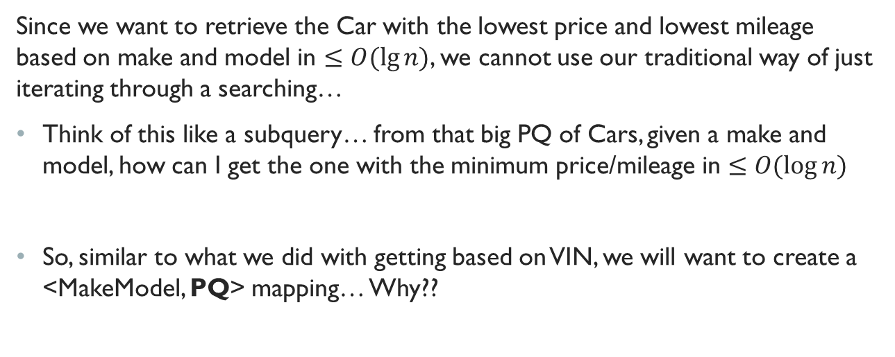
Get Min Based on Make and Model
Since we want to retrieve the Car with the lowest price and lowest mileage based on make and model in $≤O(\lg{n)}$, we cannot use our traditional way of just iterating through a searching…
Think of this like a subquery… from that big PQ of Cars, given a make and model, how can I get the one with the minimum price/mileage in $≤O(\log{n)}$
So, similar to what we did with getting based on VIN, we will want to create a <MakeModel, PQ> mapping… Why??

Slide 37

So… How does the PQ know which Attribute to compare?
It really doesn’t… remember, computers are stupid!
Greater is the MOST important function for this project… its how the heap will swap things around… if it’s not comparing the right thing… you’ll be in BIG TROUBLE!!!

Slide 38

A SideNote
Farnan’s tester sucks (this is not a diss on him)
It is FAR from adequate for extensive testing… in fact it doesn’t even TWO FUNCTIONS
You will need to add more extensive testing for this… not that hard to do… just draw out a heap and think about some edge cases!

