Slide 1
CS 1501 Recitation 7
Gordon Lu

Slide 2
Agenda for Today
Network Flow
Ford-Fulkerson
Edmond’s Karp heuristic
Hints for Project 4

Slide 3
Network Flow

Slide 4
Definitions
A flow network is an edge-weighted digraph with positive edge weights (referred to as capacities).
An st-flow network has two identified vertices, a source s and a sink t.
It is vacuously true that if there is no edge between two vertices, c(u,v) = 0.
Flow:
Total flow is the sum of the flows on its incoming edges (inflow) and the total flow on its outgoing edges (outflow), and the difference between the two as netflow

Slide 5
Defintions (Cont.)
An st-flow in an st-flow network is a set of nonnegative values associated with each edge, which are referred to as edge flows.
A flow is feasible if:
No edge’s flow > edge’s capacity ( f(u,w) <= c(u,w) for all u,w )
The local equilibrium condition is satisfied: Every vertex’s netflow is zero (except for s and t)

Slide 6
The problem at Hand
We want to solve the optimization problem:
Maximum st-flow: Given an st-flow network, find an st-flow such that no other flow from s to t has a larger value.

Slide 7
Ford-Fulkerson

Slide 8
Ford-Fulkerson
Ford-Fulkerson is an effective approach to solving max-flow problems.
It is a generic method for increasing flows incrementally along paths from source to sink.
A more descriptive term for this algorithm is the augmenting-path algorithm.

Slide 9
The Algorithm
We now introduce some more definitions:
Forward edges are simply edges along the path from source to sink
Backward edges are edges that go against the flow (source to sink)
Augmenting Path is a path p from s to t such that all edges in p have residual capacity (f(u,w) < c(u,w))
Ford-Fulkerson proceeds as follows:
Start with zero flow everywhere.
Increase flow along any augmenting path from source to sink (with no full forward edges or empty backward edges)
Continue until there are no such paths in the network.

Slide 10
Residual Network
The generic Ford-Fulkerson algorithm does not specify a particular method for finding an augmenting path.
Given a st-flow network and and an st-flow, the residual network for the flow has the same vertices as the original and one or two edges in the residual network for each edge in the original defined as follows:
For each edge e from v to w in the original, let f(v,w) be its flow and c(v,w) its capacity.
If f(v,w) > 0, include an edge w->v in the residual with capacity f(v,w)
If f(v,w) < c(v,w), include an edge v->w in the residual with capacity c(v,w)– f(v,w)

Slide 11
Residual Network
If an edge e from v to w is empty ( f(v,w) = 0), there is a single corresponding edge v->w with capacity c(v,w) in the residual.
If it is full ( f(v,w) = c(v,w) ), there is a single corresponding edge w->v with capacity f(v,w) in the residual.
If it is neither empty nor full, both v->w and w->v are in the residual with their respective capacities.

Slide 12
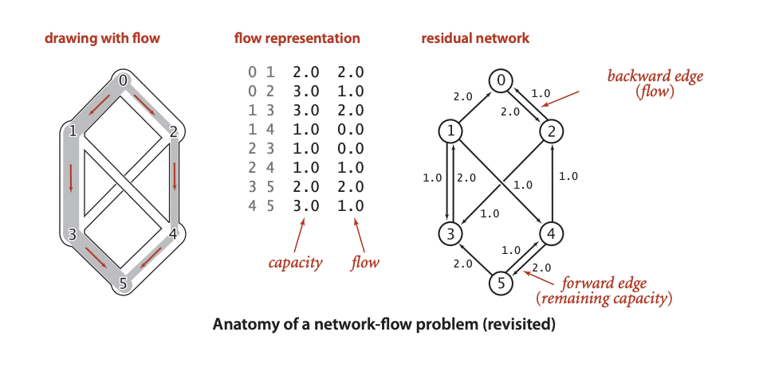
Residual Graph Example

Slide 13
Edmond’s Karp

Slide 14
Edmond’s Karp Heuristic
The simplest Ford-Fulkerson implementation is to use a shortest augmenting path.
AKA Edmond’s Karp.
Essentially, we search for an augmenting path amounts using BFS

Slide 15
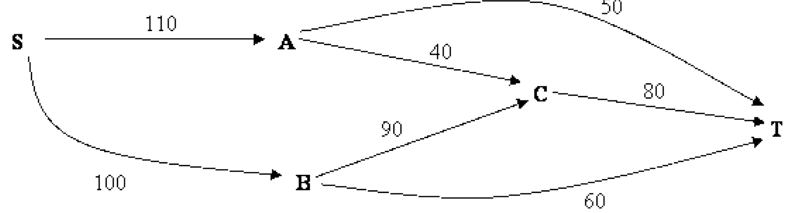
Edmond’s Karp in Action

Slide 16
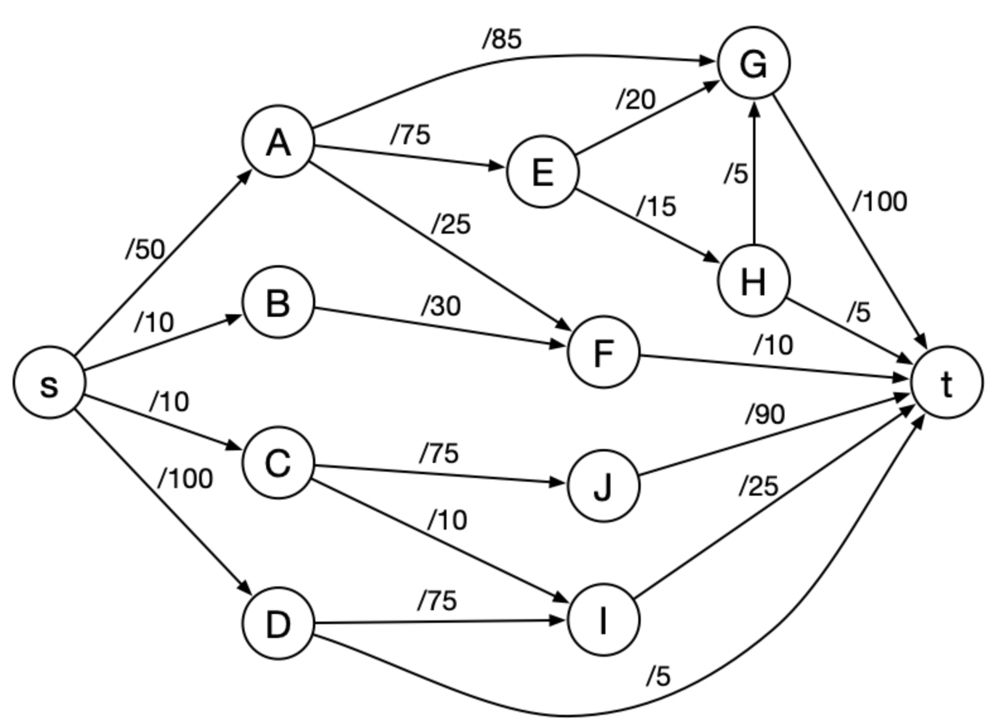
Another Example

Slide 17
St-cut
An st-cut on G is a set of edges in G that, if removed, will partition the vertices of G into two disjoint sets
One contains s
One contains t
For any st-flow, the flow across each st-cut is equal to the value of the flow.

Slide 18
MaxFlow MinCut Theorem
Let f be an st-flow, TFAE:
There exists an st-cut whose capacity equals the value of the flow f
f is a maxflow
There is no augmenting path w.r.t. f

Slide 19
Determining a Min-cut
First, run Ford Fulkerson to produce a residual graph with no further augmenting paths
The last attempt to find an augmenting path will visit every vertex reachable from s
Edges with only one endpoint in this set comprise a minimum st-cut

Slide 20
Project Hints

Slide 21
Methods to Implement
lowestLatencyPath(int u, int w);
bandwidthAlongPath(ArrayList<Integer>);
copperOnlyConnected();
connectedTwoVertFail();
lowestAvgLatST();

