Slide 1
CS 1501 Recitation 1
Gordon Lu

Slide 2
Introduction
Senior
My goal is to make sure you get the most out of this course. I hate to see someone struggle, so feel free to contact me if you ever feel stuck!
UTA for 1501 and 1656, but open to help with anything!

Slide 3
Logistics
I will be frequently posting slides on my website!
https://glu99331.github.io/
Office Hours:
Monday: 1-3PM
Friday: 4-6PM
You can schedule appointments with me here:
https://glu99331-office-hours.youcanbook.me/

Slide 4
Agenda
An overview of Git

Slide 5
An introduction to version control systems with Git

Slide 6
Version control systems
Version control systems record changes to a file or set of files over time so that you can recall specific versions later
Many systems have risen to popularity over the years
RCS
CVS
Subversion
We will focus on Git

Slide 7
Why use version control?
These systems help with:
Tracking changes
Short and long term undo
Backup and restore
Synchronization
Collaboration

Slide 8

Local version control systems
Notes:
log changes made to the file, any version can be restored at any time

Slide 9
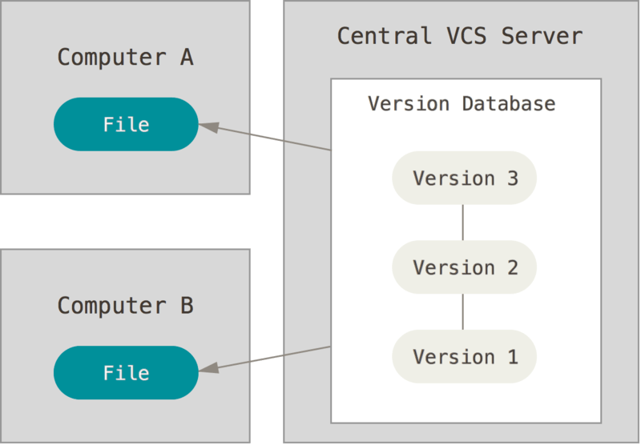
Centralized version control systems
Notes:
now added features to help with synchronization (computers A and B owned by the same user) and collaboration (computers A and B owned by different users)
also introduces problems: single point of failure, can't work offline

Slide 10
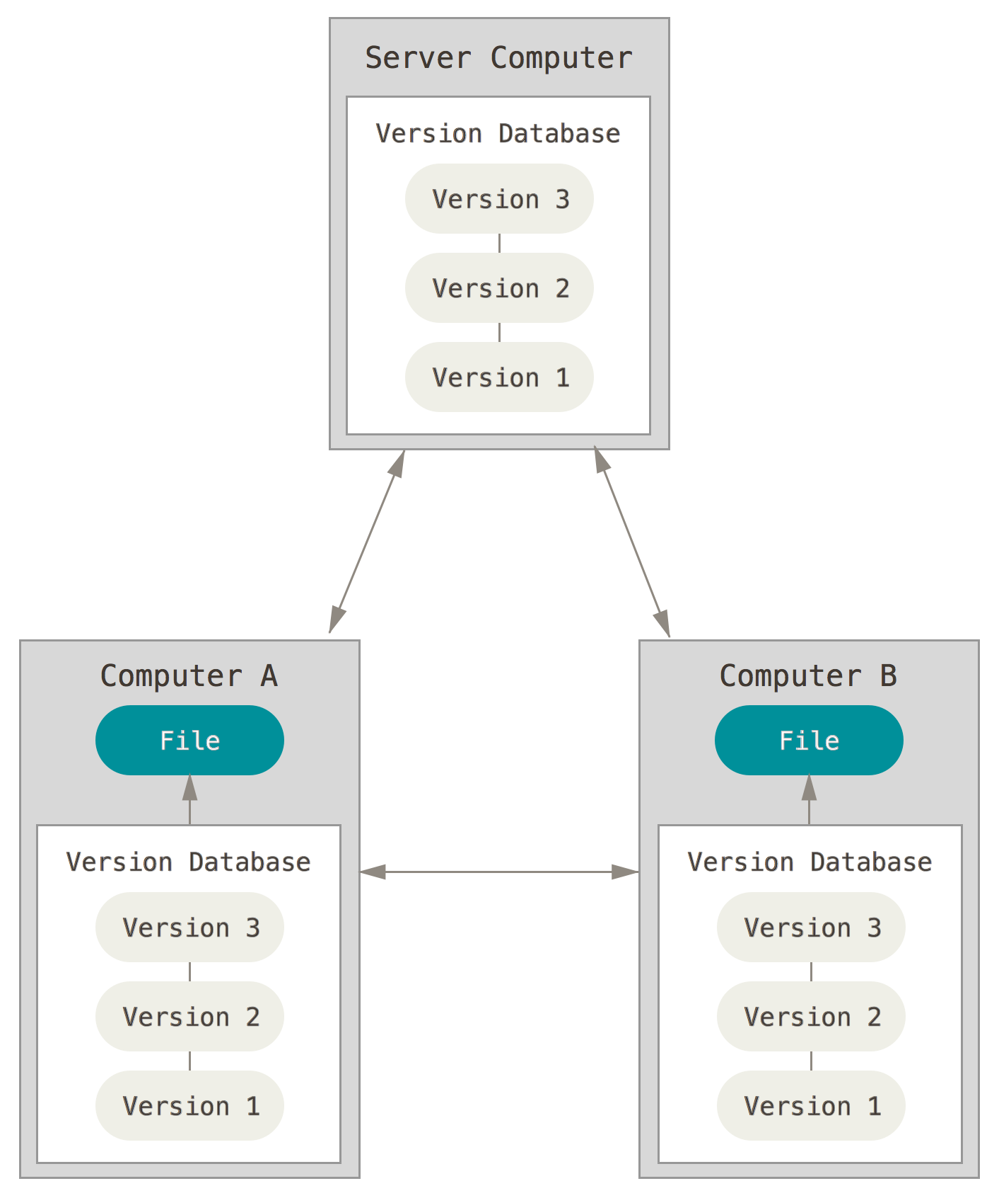
Distributed version control systems
Notes:
Copy of the version database in every working directory

Slide 11
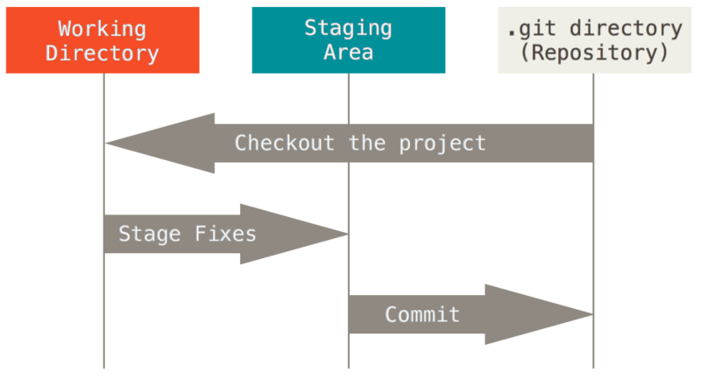
The basic Git workflow
Modify files in your working directory
Stage the files, adding snapshots to your staging area
Commit your changes to your local copy of the repository

Slide 12
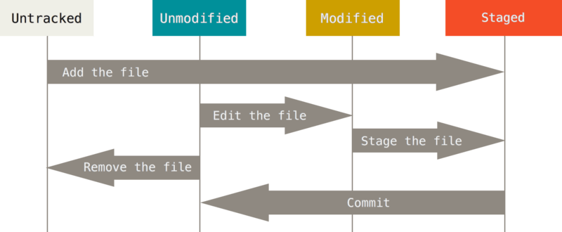
The lifecycle of a file in Git
Git does not necessary keep track of all files in your working directory

Slide 13
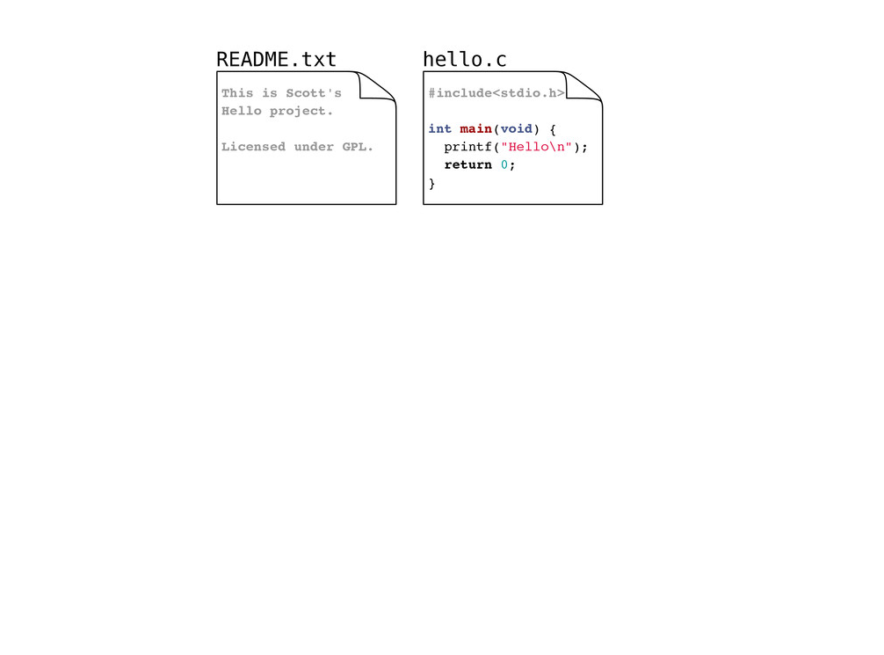
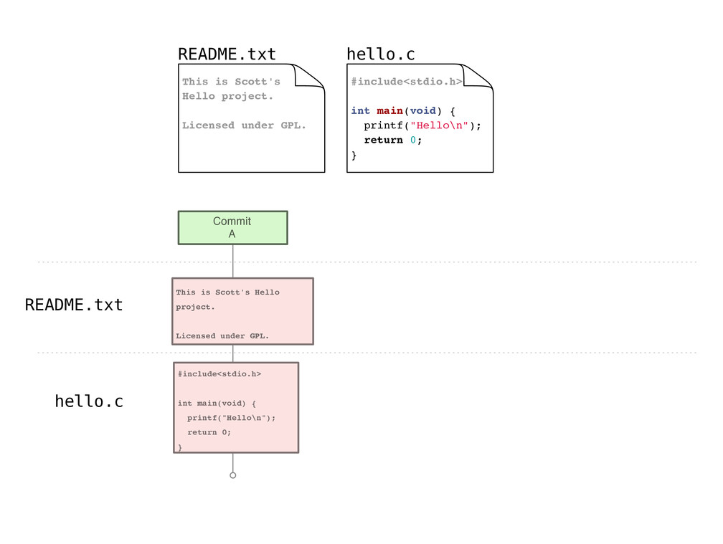
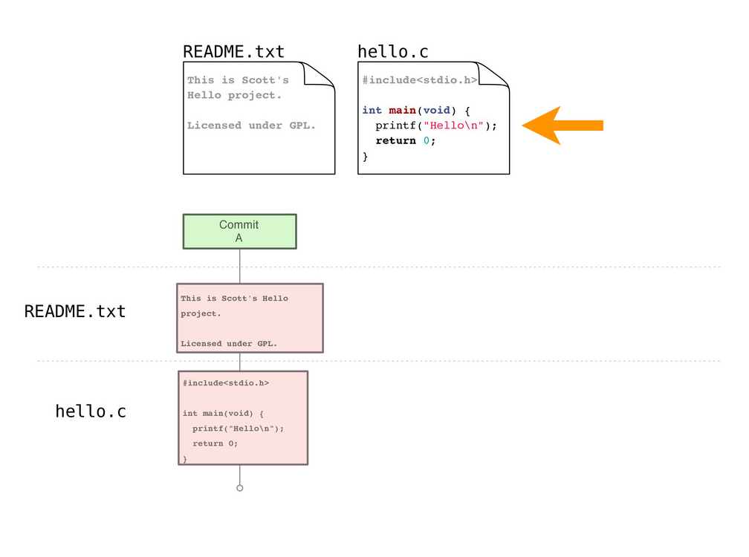

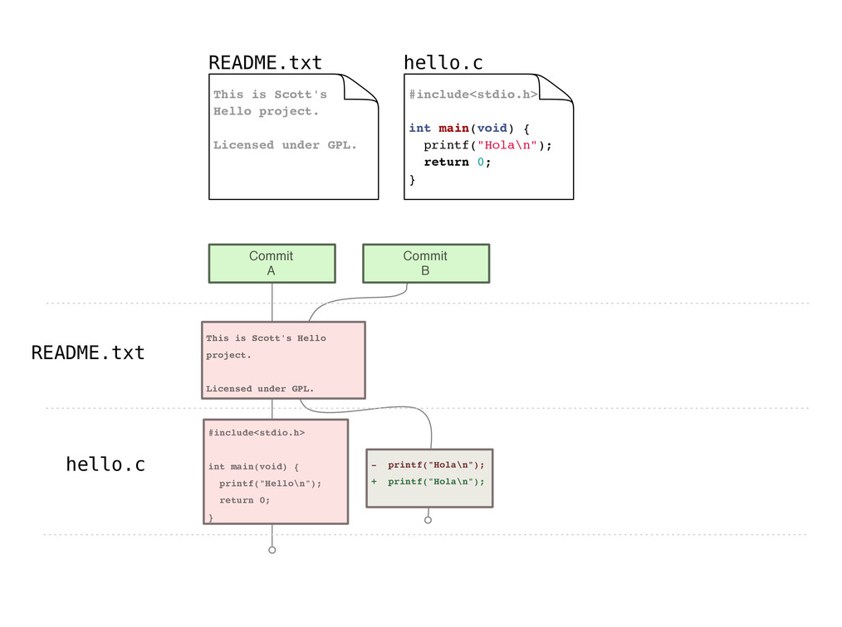
Example repository

Slide 14
Gitting started
Set your identity
$ git config --global user.name "John Doe"
$ git config --global user.email jdoe@example.com
Set other configuration options
$ git config --global color.ui true
Get help
$ git help verb
Notes:
Already installed on most Mac systems
Can install Git shell on Windows or use PowerShell Git application

Slide 15
Creating a new repository
$ git init
Creates a new (empty) repository in the current directory

Slide 16
Copying a repository
For this class, your instructor will create a repository for you, you will just need to copy it from GitHub to your computer using the following command:
$ git clone repository
Creates a copy of repository in the current directory

Slide 17
Staging files
As you work, you will create new files and modify existing files, when you are satisfied with your changes, you can stage them for commit with:
$ git add file_pattern
Notes:
Note this is not just for new files, but also for edited files

Slide 18
Committing changes
Commits create a new version in the repository
Include a commit message describing the new version
$ git commit -m msg
Notes:
Note that this is a local operation

Slide 19
Checking working directory status
$ git status
Reports:
Files in the working directory that are not tracked
File modifications not yet staged for commit
File additions and modifications staged for commit

Slide 20
Overviewing commit history
$ git log
Lists commits made to the current repository

Slide 21
Handy command - comparing versions
It may be handy to see exactly how files changed
$ git diff
Shows modifications not yet staged for commit
$ git diff commit_id
Show changes since the commit specified
$ git diff commit_id1 commit_id2
Show changes between two commits

Slide 22
Git Branching
Rather than having to modify and potentially mess up perfectly working code, we can create branches to work on a specific feature!
To create a branch from master, we can do the following:
$ git checkout –b [branch_name]
Then, we can proceed as normal and push, commit, and all changes will be push to the branch…
Once we are done with our changes, we can then merge:
$ git merge [branch_name]
To switch back, we can do the following:
$ git checkout master

Slide 23
Making Your Life Easier – Personal Access Tokens
When asked if you would like to authenticate to Git with your GitHub credentials, enter Y
You’ll begin to realize that every time you push code, you’ll be prompted to enter in your password…
Wouldn’t it be convenient to store your credentials somewhere??

Slide 24
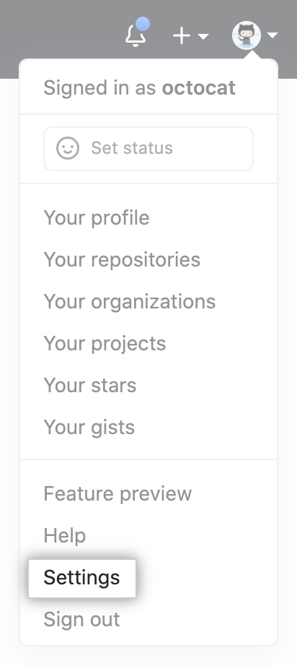
Generating a PAT
First, click on Settings on GitHub:
Then, go to Developer Settings → Personal access tokens
Click on Generate new token

Slide 25
Caching GitHub Credentials in Git
First, install GitHub CLI:
docs.github.com/en/github/getting-started-with-github/caching-your-github-credentials-in-git
Then, enter:
gh auth login
When prompted to select your preferred protocol, select HTTPS
When asked if you would like to authenticate to Git with your Github credentials, enter Y
Instead of entering in your password, use the generated PAT.

Slide 26
What we've covered here...
… presents only a brief overview of Git
Further topics:
branching
rebasing
tagging
…
Further resources:
https://git-scm.com/book/en/v2
http://gitref.org/
http://gitimmersion.com/

Slide 27
Git example (cloning and branching via GitHub)

