Slide 1
CS 0449 Recitation 9
Gordon Lu

Slide 2
Logistics
To be covered today:
Basic Memory Allocation
Hints on the Cache Lab

Slide 3
A Brief Introduction to Memory Allocation

Slide 4
The Heap is just a big chunk of data!

Slide 5

Every time we call malloc, we slice a chunk off of it!

Slide 6

Freeing memory leaves gaps!

Slide 7
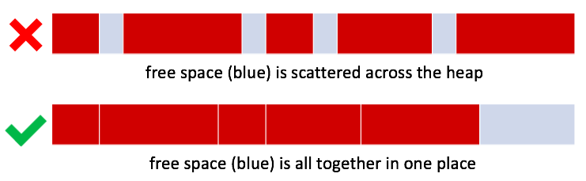
External Fragmentation
External Fragmentation is the result of having free memory split into lots of small fragments
- External because the free memory is outside the allocated blocks

Slide 8
Bit Maps!

Slide 9

Bit Maps
If we divided the heap into uniformly sized chunks:
What's a simple way to say which are used and which are free?
Use a boolean (true/false) per chunk!
We can use one bit for each, and pack all those bits into one int
11011100 01101111₂ = 0xDC6F
This is a bitmap
The bits are a map of the heap
Bitmaps are forced to use uniform size chunks.

Slide 10
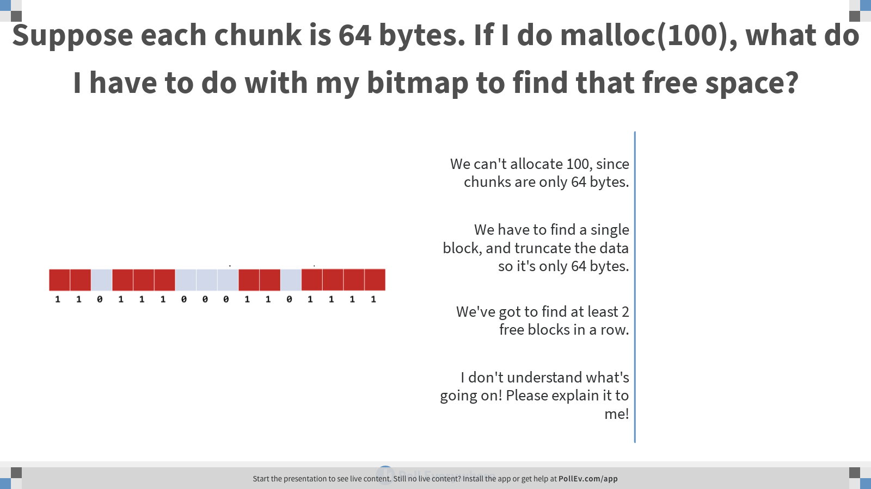
Notes:
Poll Title: Suppose each chunk is 64 bytes. If I do malloc(100), what do I have to do with my bitmap to find that free space? https://www.polleverywhere.com/multiple_choice_polls/kxrnOZ5W51SaJQxlXUlbn

Slide 11
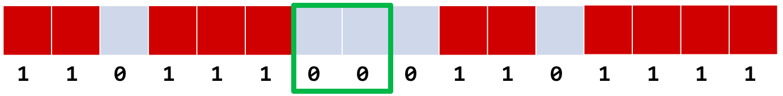
Allocation via Bit Maps
We've got to find at least 2 0s in a row

Slide 12
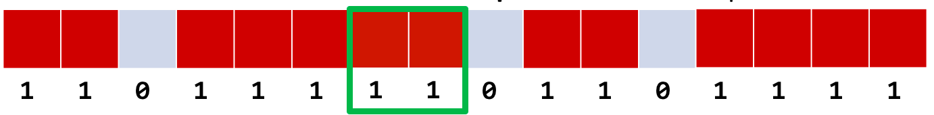
Allocation via Bit Maps
Then mark them as used! (Set the bits to 1)

Slide 13
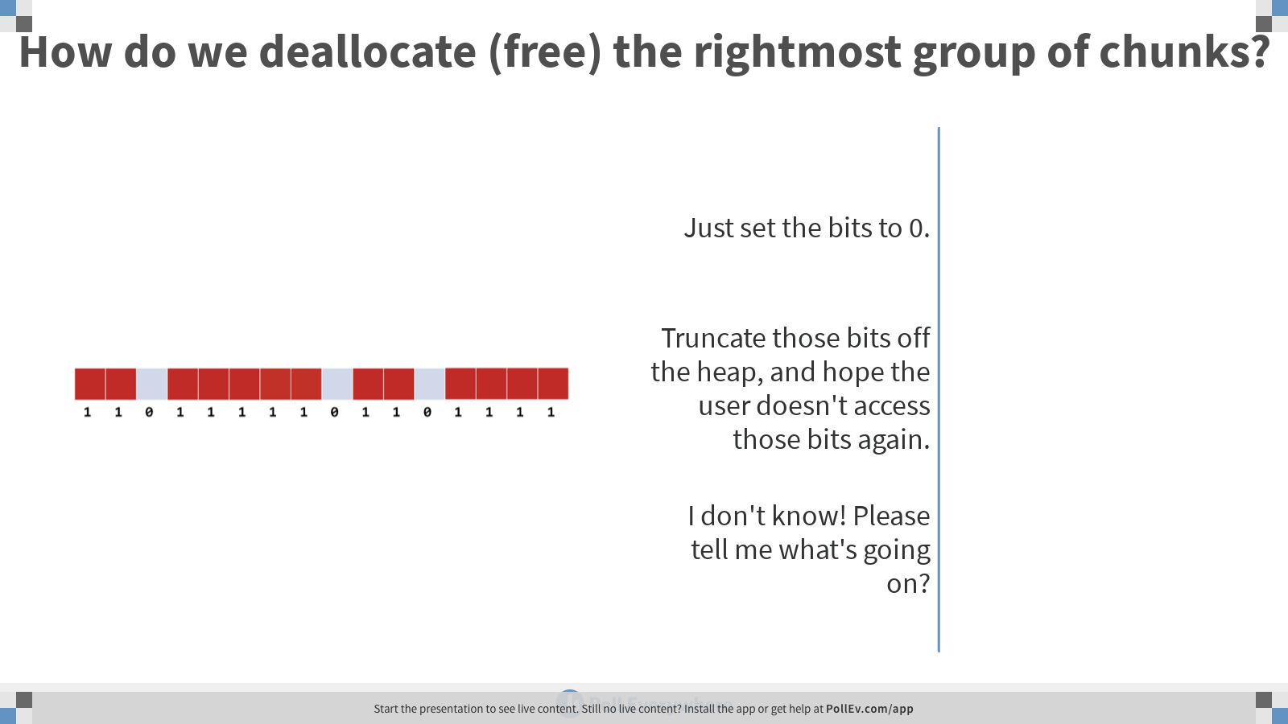
Notes:
Poll Title: How do we deallocate (free) the rightmost group of chunks? https://www.polleverywhere.com/multiple_choice_polls/S8uYsHHYbfEu4z9XAk3Ci

Slide 14
Deallocation via Bit Maps
So, what's the catch?
Since the bits are adjacent to one another, whenever you set some bits to 0, you "automatically" get bigger blocks of free memory

Slide 15
Entropy

Slide 16
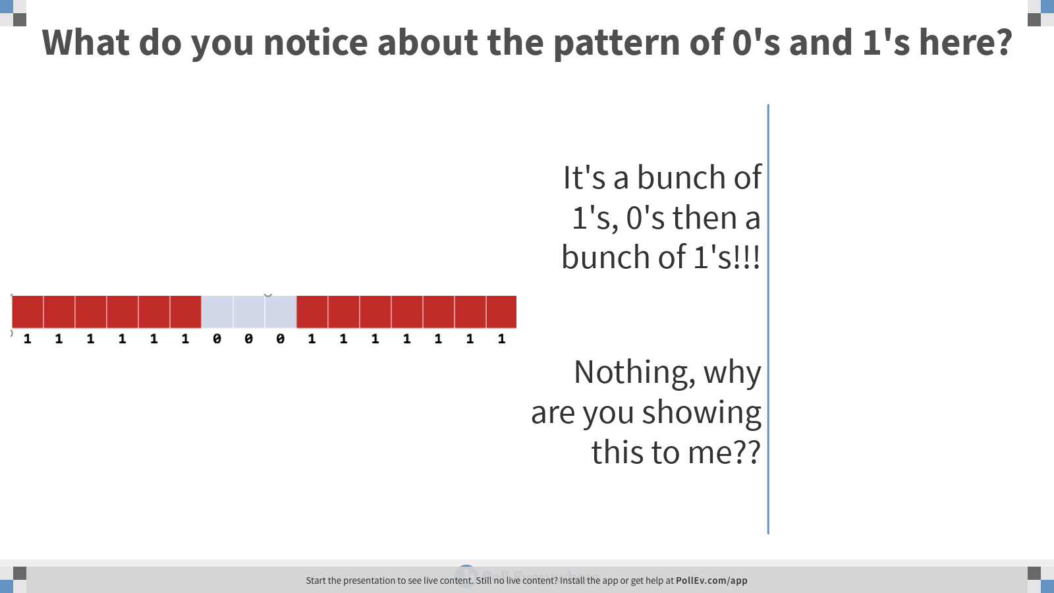
Notes:
Poll Title: What do you notice about the pattern of 0's and 1's here? https://www.polleverywhere.com/multiple_choice_polls/rQxp9KMGgsE7dNQJYxutr

Slide 17
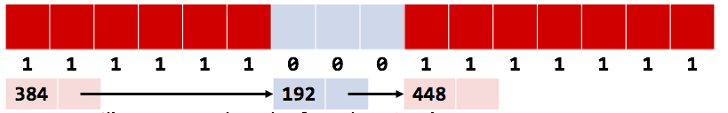
It seems silly to store a bunch of 1’s, 0’s then 1’s
What if we did this instead:
Record the exact sizes of each contiguous block
Then link em together… into a list

Slide 18

We can embed the list within the free and allocated blocks
Every block starts with a header that includes the size, pointer, and its status (used or not)
So, a 100B block will take up maybe 112B total:
12B for the header
100B for the space the user asked for
The allocator is the only one who sees these headers.

Slide 19
Allocation Algorithms

Slide 20

Tabula Rasa
When your program first starts up, the heap looks like this:

Slide 21
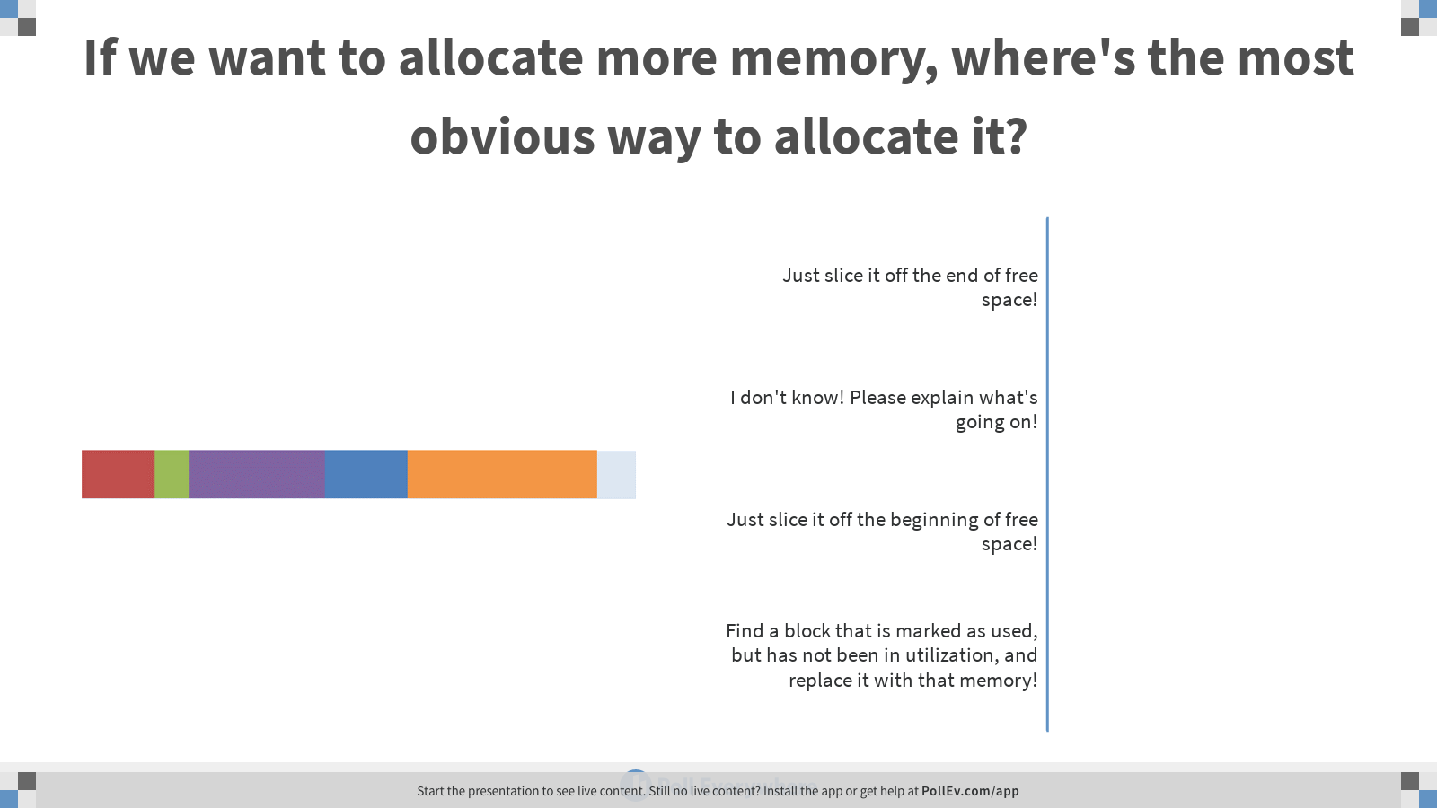
Notes:
Poll Title: If we want to allocate more memory, where's the most obvious way to allocate it? https://www.polleverywhere.com/multiple_choice_polls/WKjC36kmqZwwKTLlSOXQ3

Slide 22


Uh oh, something’s not right
In the middle of the program, the heap will look more like this:

Slide 23
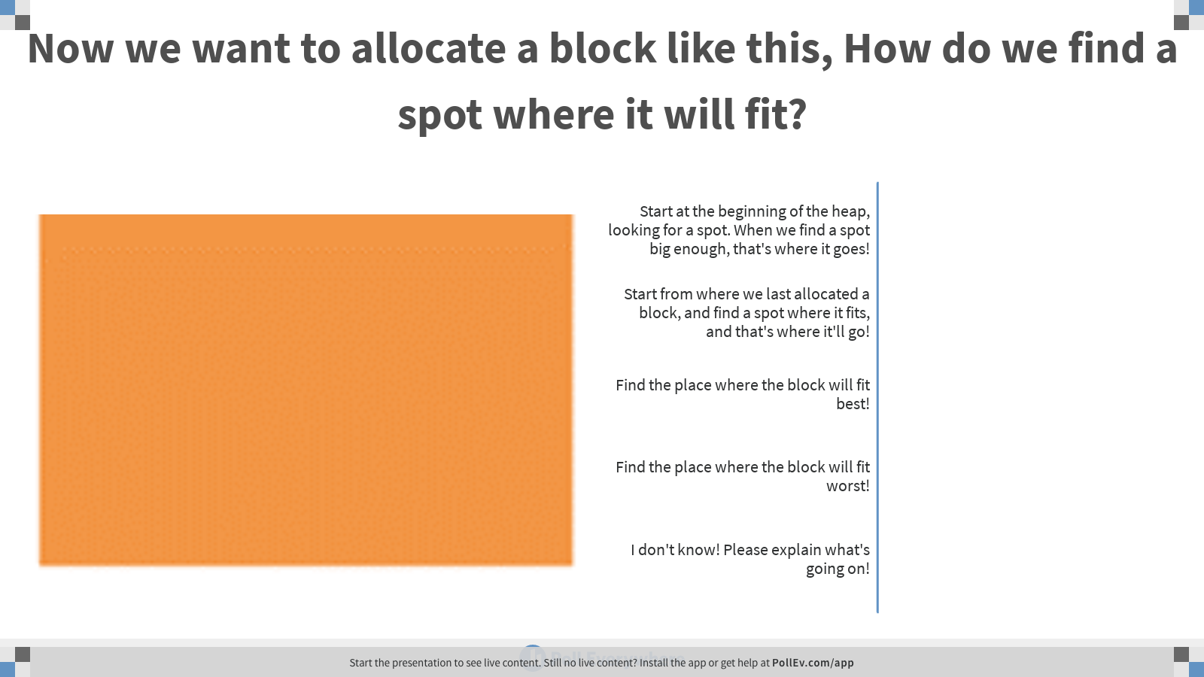
Notes:
Poll Title: Now we want to allocate a block like this, How do we find a spot where it will fit? https://www.polleverywhere.com/multiple_choice_polls/tHcJBcBPV6GFQK3g8QMHG

Slide 24
First Fit
We start at the beginning of the heap, looking for a spot
When we find a spot big enough, that's where it goes
This is called first-fit cause it puts it in the first spot it fits.
How long does it take to find that free block?
It's linear in the number of blocks

Slide 25
Downsides of First-Fit
With first-fit, the heap will often end up looking like this:
Everything's clustered around the beginning. This is good actually!
Cause it leaves us with a nice big empty space
But…
There are lots of holes
The holes will likely be small and therefore useless (wasted)
We waste a lot of time looking through those small holes before we get to that big empty space
Why start from the beginning every time?

Slide 26

Next Fit
What if we start looking from where we last allocated a block?
Next-Fit makes it faster to find a block, but spaces things out more:
Since it starts from the last allocation, it spreads things out and misses what might be good spaces earlier in the heap

Slide 27

A Square Peg in a Slightly Larger Square Hole:
Let's say our heap looks like this, and the orange block is the most-recently-allocated one:
Now we want to allocate this:

Slide 28
Where would First-Fit put this block?
Yep, at the first place it fits!

Slide 29
Where would Next-Fit put it?
Yep, the next place it fits starting from the orange block that was just allocated!!

Slide 30
But what place would make the most sense?
At wherever, the free space is closest to the right size!
This is best-fit.

Slide 31
But what if you wanted the worst possible case?
You’d put the chunk wherever it'll leave a bigger block of free space!
This is worst-fit.

Slide 32
The Best of Intentions

Slide 33
Neither of these schemes really makes things any better
Best-Fit will leave tons of tiny unusable holes
Worst-Fit will "clump" allocations better, but tends to leave several similarly-sized large holes that all gradually get smaller

Slide 34
But… there’s a corollary!
Worst of all, both algorithms force us to look at every free block in the heap on every allocation
Best-Fit can stop early by finding an exactly-sized hole for the desired block, but Worst-Fit HAS to look at all the free blocks.

Slide 35
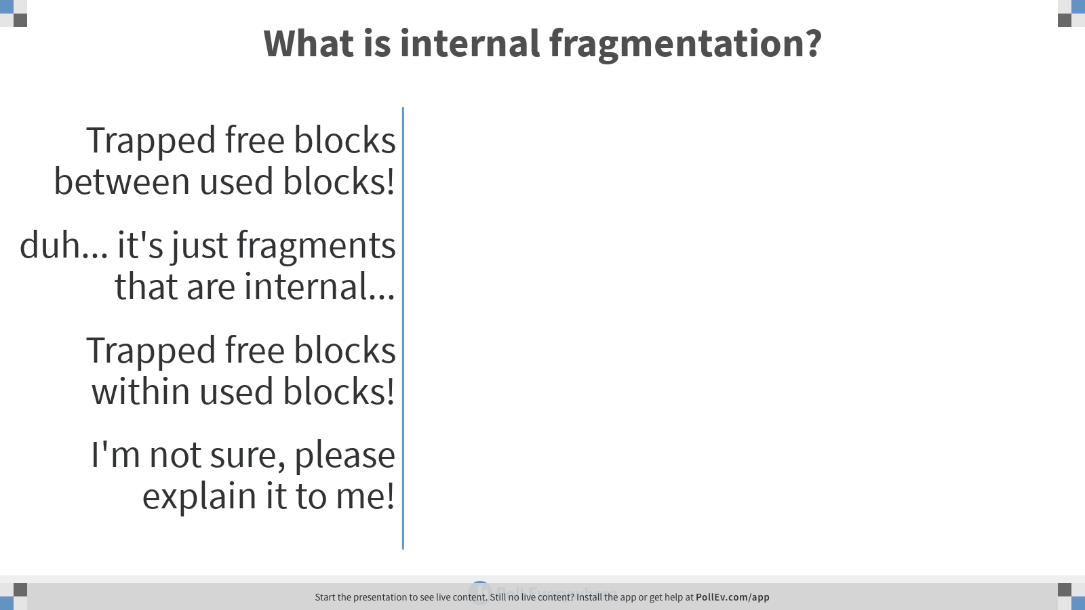
Notes:
Poll Title: What is internal fragmentation? https://www.polleverywhere.com/multiple_choice_polls/XduAG6BHEoOwX3jdBswNG

Slide 36
The correct answer is C!!

Slide 37
A brief reminder of internal fragmentation
Let’s say we called malloc(60), and we have the following heap:

Slide 38
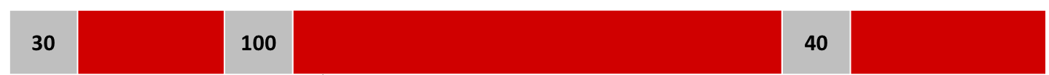
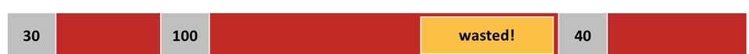
A brief reminder of internal fragmentation
Well, we could just allocate the 60, and mark the block as used:
But… we’ve left ourselves with 40 free blocks as used ☹
This is internal fragmentation!!

Slide 39
Splitting a Free Block

Slide 40
Efficient Memory Allocation
Rather than just carelessly allocate memory, we want to allocate exactly the amount of memory that the user requests!

Slide 41

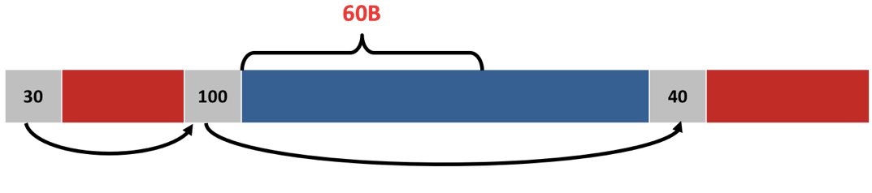
A General Split Block Algorithm
If we want to allocate 60 bytes:
Count 60B into the block and put a new header there:

Slide 42
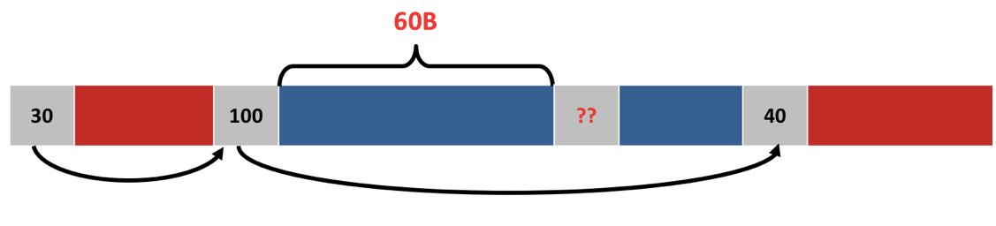
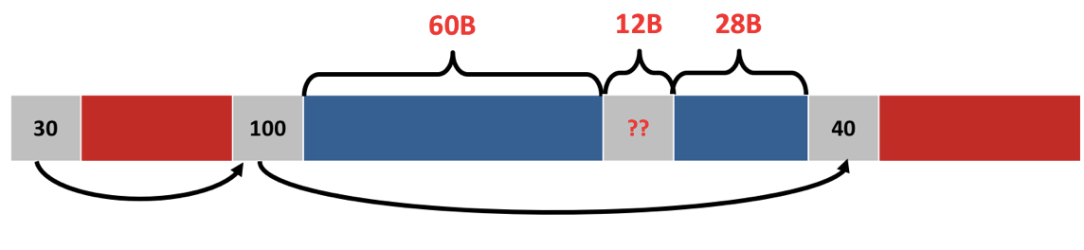
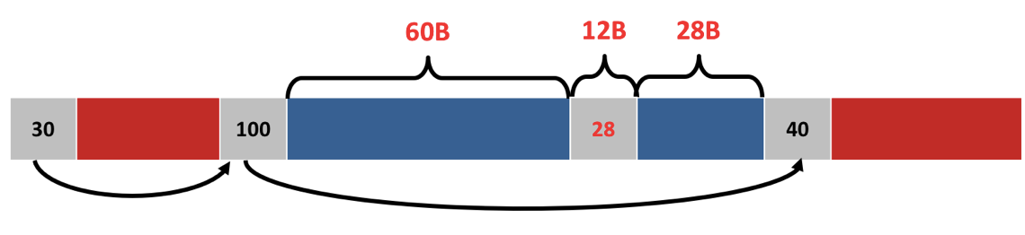
A General Split Block Algorithm (cont.)
2) Do 100-60-sizeof(header) to get the size of the new free block
Assume headers are 12 bytes

Slide 43
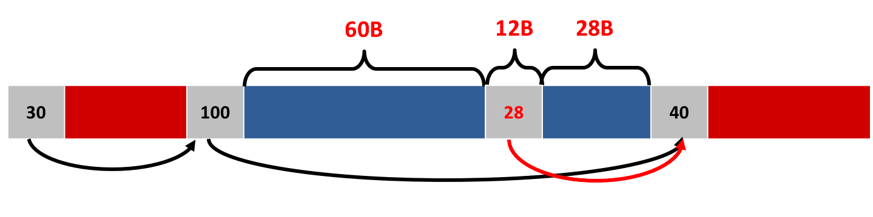
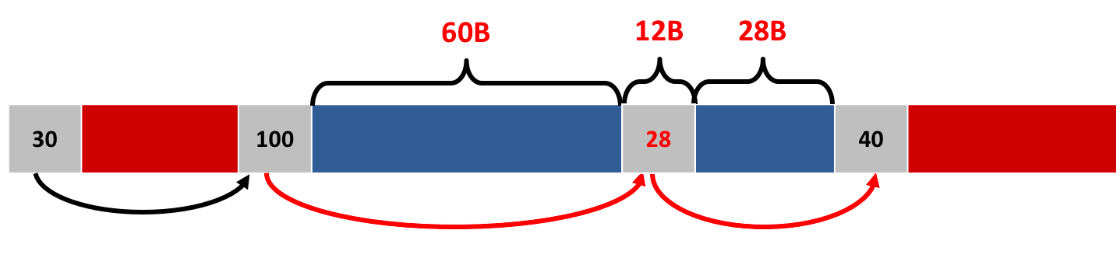
A General Split Block Algorithm (cont.)
3) Insert the new header into the linked list

Slide 44
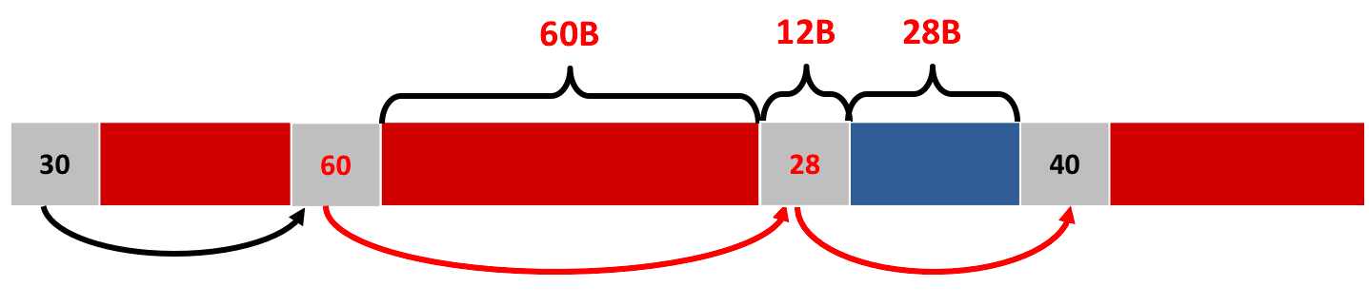
A General Split Block Algorithm (cont.)
Update the old header to the new size and mark it used

Slide 45
Heap Deallocation

Slide 46
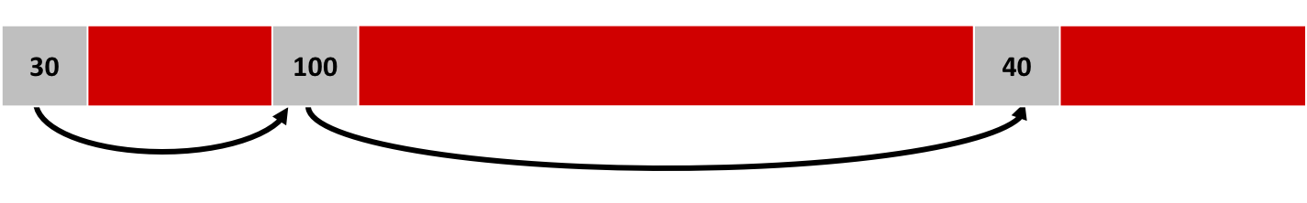
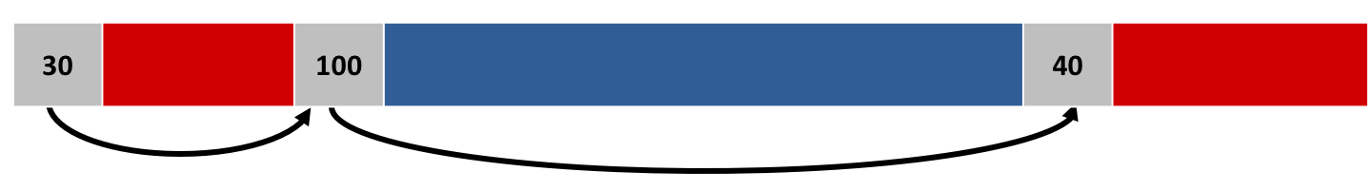
It’s actually a lot easier than malloc!
So, the user wants to free up 100B of memory:
So, just mark the block as free, and that’s it!!

Slide 47
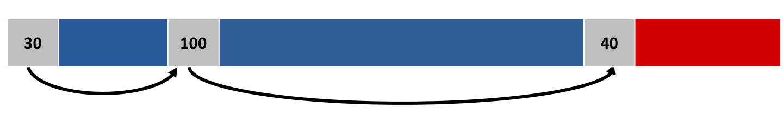
But… what if we have two adjacent free blocks?
Even if we have 120B of memory, we can’t allocate it!!

Slide 48
Coalescing
So, we coalesce the adjacent free blocks! (coalesce -> compact them blocks together!!)

Slide 49

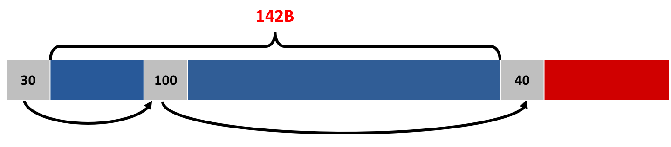
General Coalescing Algorithm
Given the current heap:
Sum the sizes of the two blocks + sizeof(header)

Slide 50
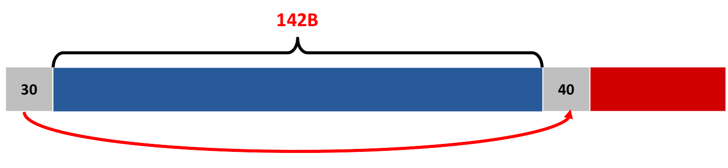
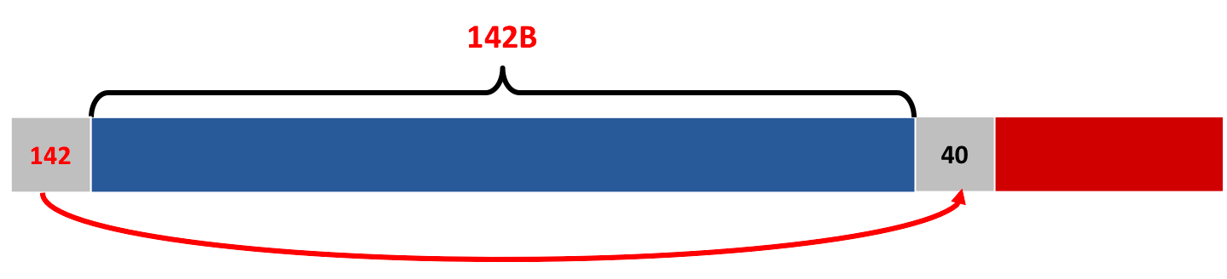
General Coalescing Algorithm (cont.)
2) Remove the middle header from the linked list.
3) Update the first header with the new size.

Slide 51
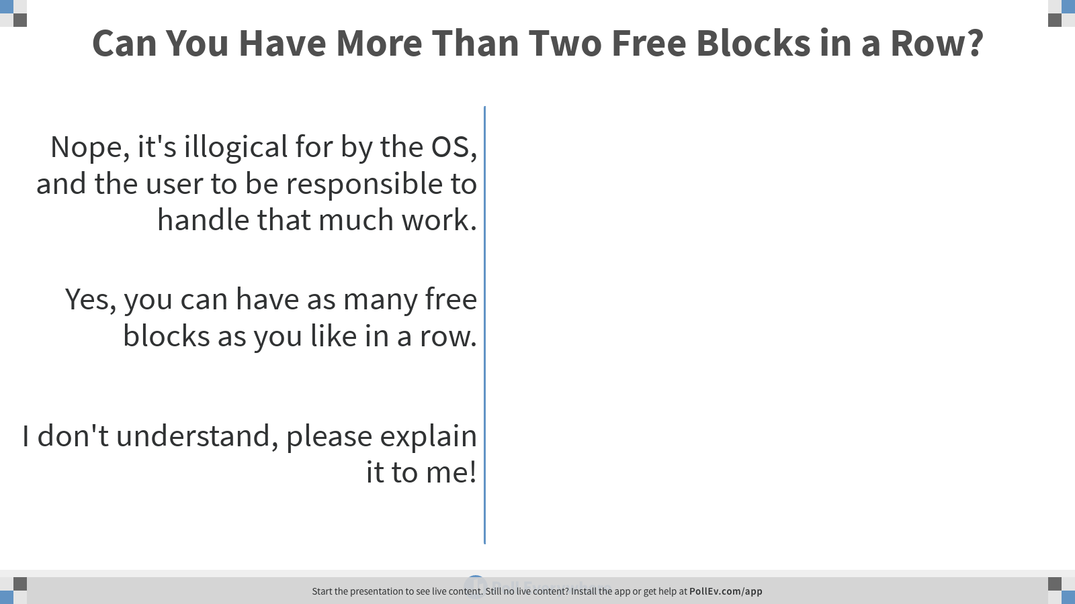
Notes:
Poll Title: Can You Have More Than Two Free Blocks in a Row? https://www.polleverywhere.com/multiple_choice_polls/85TOEckFMrn1Pstr7SD5o

Slide 52

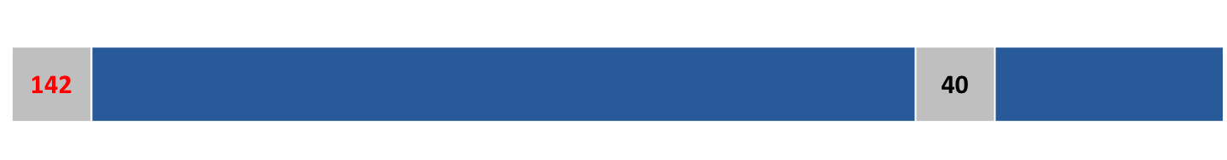
Can you have more than two free blocks in a row?
Yep, if you free a block between two free blocks!
Coalescing the first two free blocks yields:

Slide 53
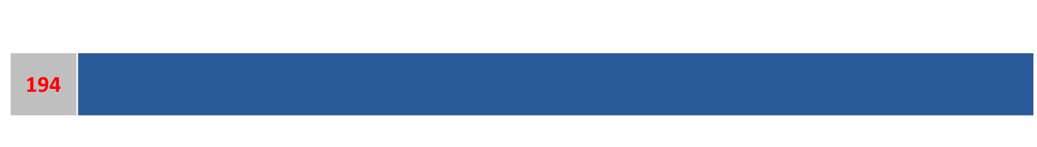
Can you have more than two free blocks in a row (cont.)?
2) Coalescing the new free block with the third free block yields:

Slide 54
Any Questions?

