Slide 1
CS 1501 Recitation 1
Gordon Lu

Slide 2
Introduction
Senior
My goal is to make sure you get the most out of this course. I hate to see someone struggle, so feel free to contact me if you ever feel stuck!
UTA for 1501

Slide 3
Logistics
I will be frequently posting slides on my website!
https://glu99331.github.io/
Office Hours:
MW: 2-4PM
Friday: 4-6PM
I am also a Peer Tutor, you can find the hours on my website!
I will be posting recitation videos in the following folder
https://pitt.hosted.panopto.com/Panopto/Pages/Sessions/List.aspx?folderID=df7af085-c8d1-421a-9d9a-ae18004df81f

Slide 4
Agenda
An overview of Git, Codespaces

Slide 5
An introduction to version control systems with Git

Slide 6
Version control systems
Version control systems record changes to a file or set of files over time so that you can recall specific versions later
Many systems have risen to popularity over the years
RCS
CVS
Subversion
We will focus on Git

Slide 7
Why use version control?
These systems help with:
Tracking changes
Short and long term undo
Backup and restore
Synchronization
Collaboration

Slide 8

Local version control systems
Notes:
log changes made to the file, any version can be restored at any time

Slide 9
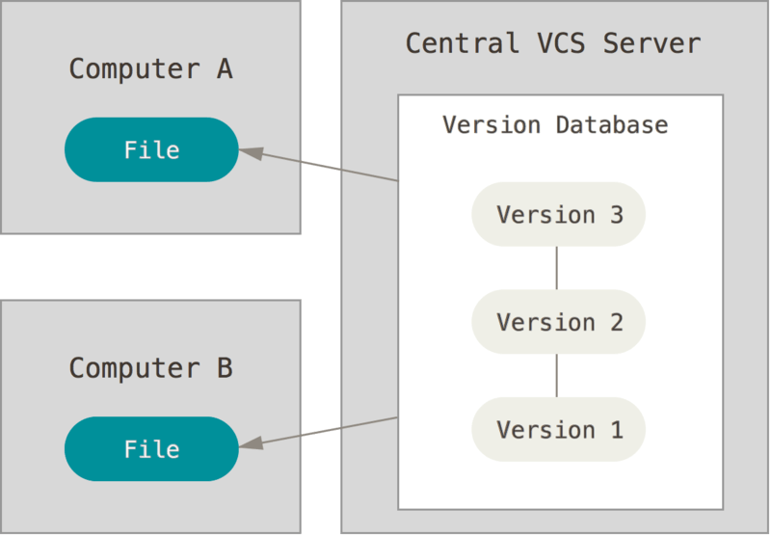
Centralized version control systems
Notes:
now added features to help with synchronization (computers A and B owned by the same user) and collaboration (computers A and B owned by different users)
also introduces problems: single point of failure, can't work offline

Slide 10
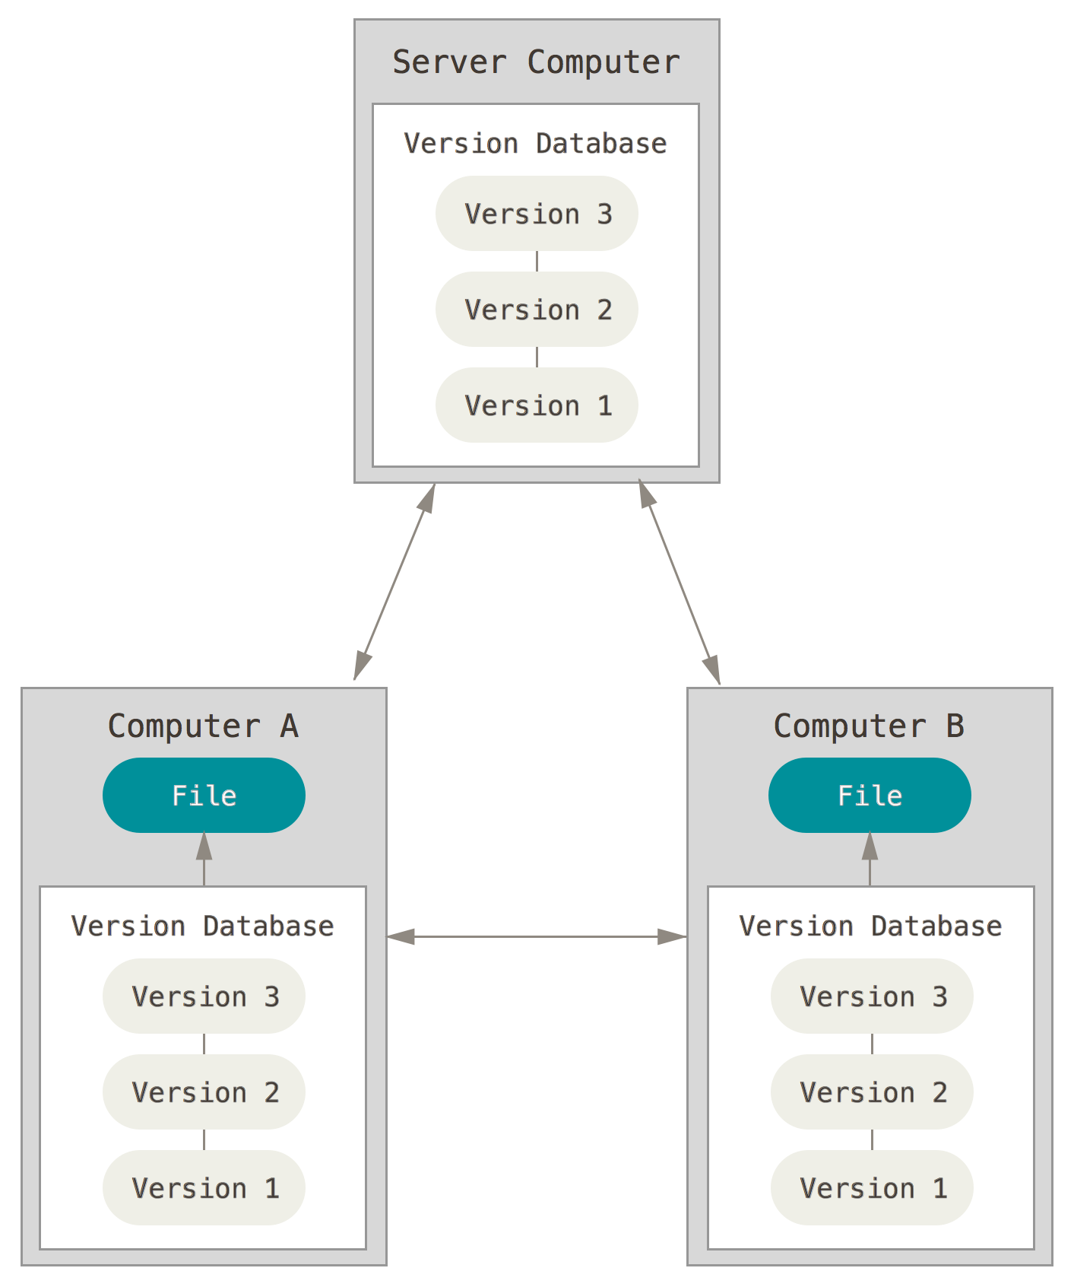
Distributed version control systems
Notes:
Copy of the version database in every working directory

Slide 11
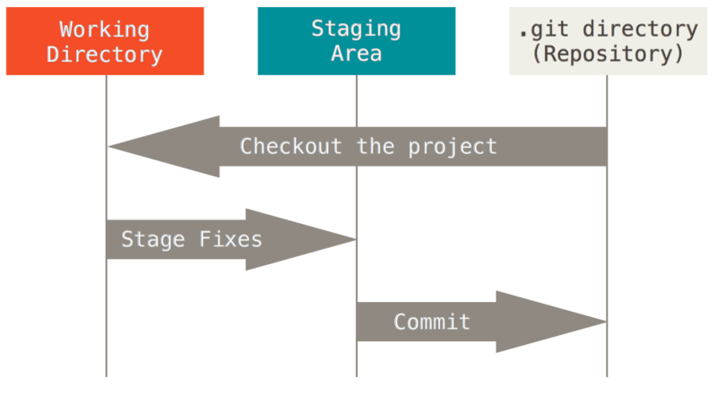
The basic Git workflow
Modify files in your working directory
Stage the files, adding snapshots to your staging area
Commit your changes to your local copy of the repository

Slide 12
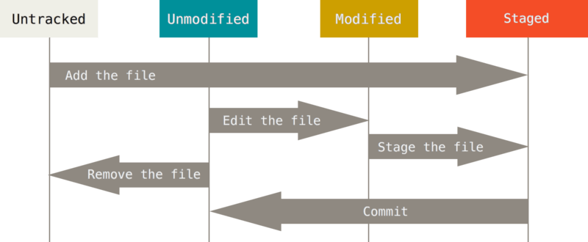
The lifecycle of a file in Git
Git does not necessary keep track of all files in your working directory

Slide 13
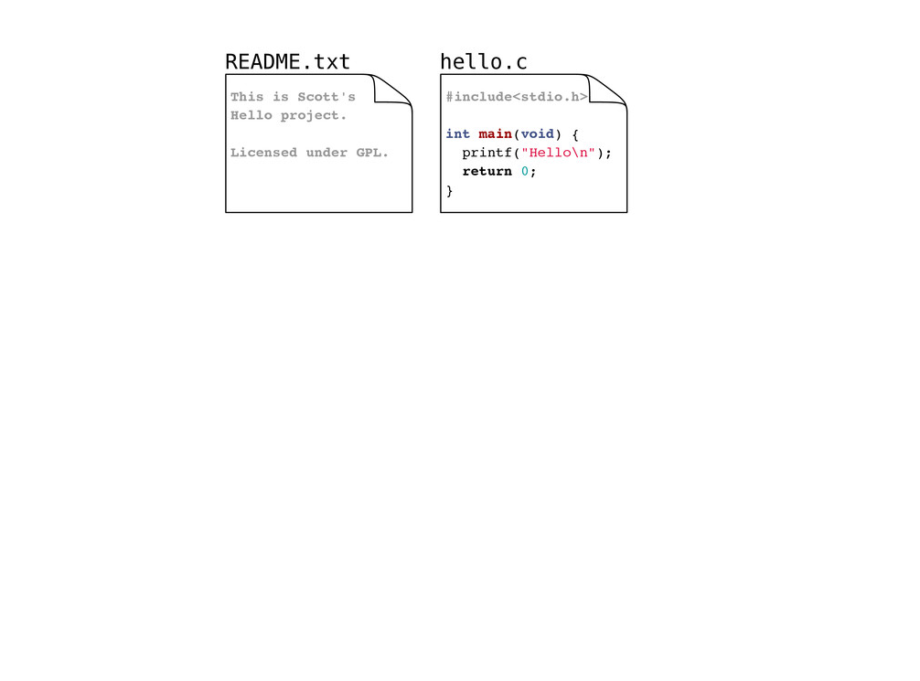
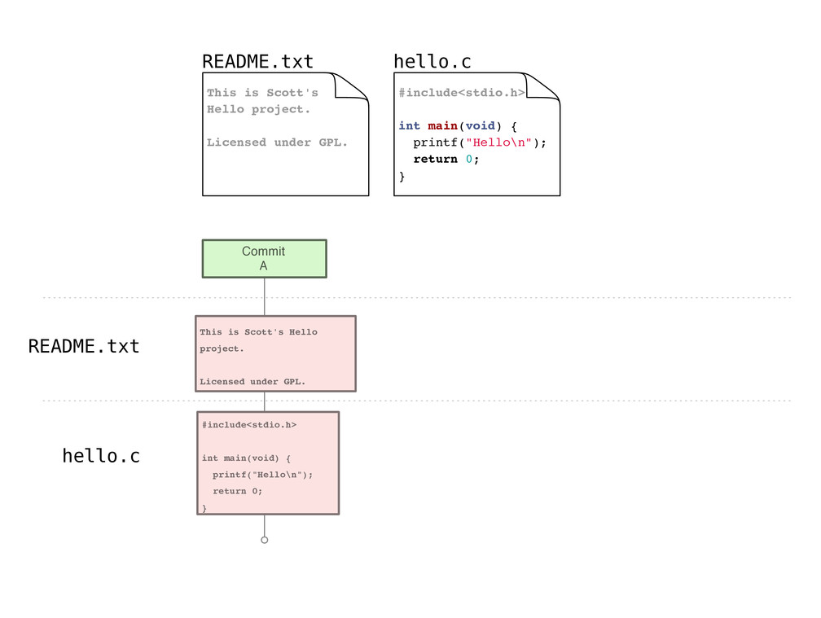
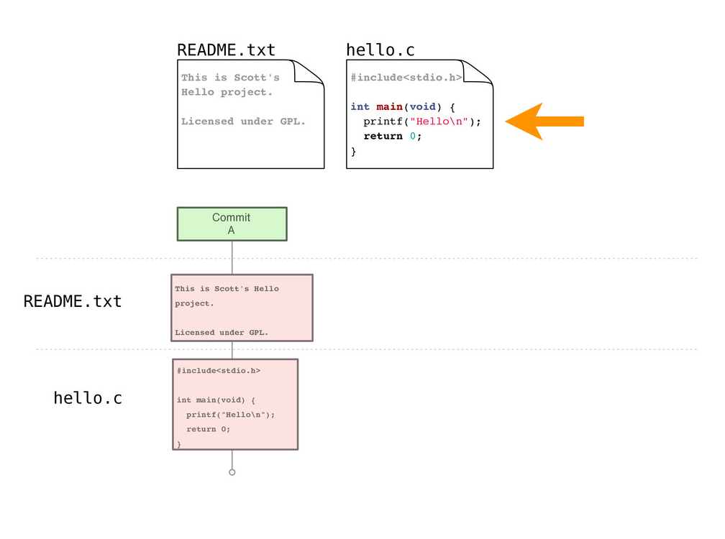

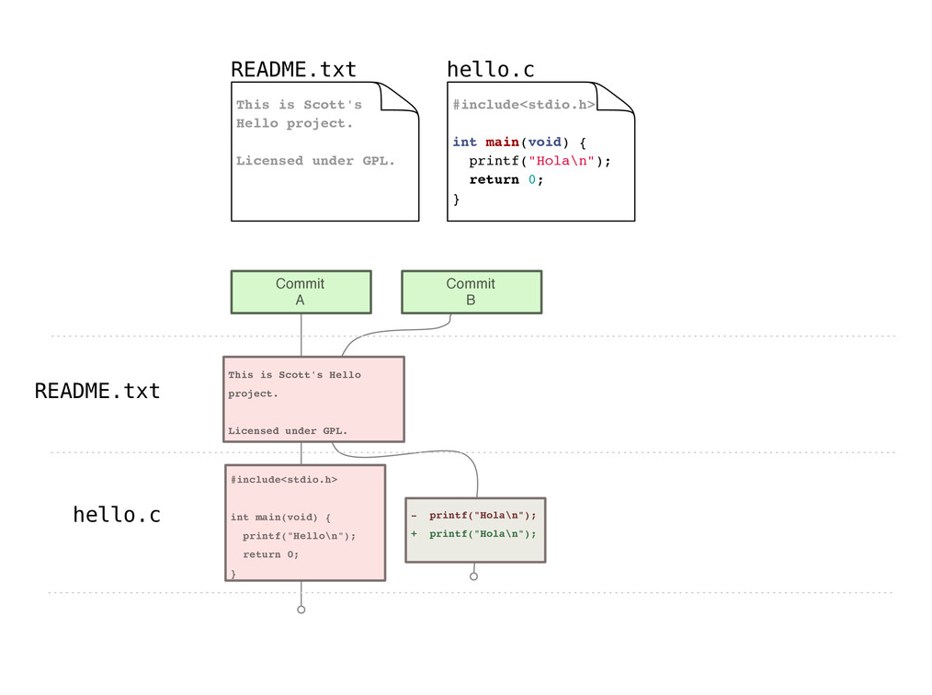
Example repository

Slide 14
Git-Specific Commands

Slide 15
Gitting started
Set your identity
$ git config --global user.name "John Doe"
$ git config --global user.email jdoe@example.com
Set other configuration options
$ git config --global color.ui true
Get help
$ git help verb
Notes:
Already installed on most Mac systems
Can install Git shell on Windows or use PowerShell Git application

Slide 16
Creating a new repository
$ git init
Creates a new (empty) repository in the current directory

Slide 17
Copying a repository
For this class, your instructor will create a repository for you, you will just need to copy it from GitHub to your computer using the following command:
$ git clone repository
Creates a copy of repository in the current directory

Slide 18
Staging files
As you work, you will create new files and modify existing files, when you are satisfied with your changes, you can stage them for commit with:
$ git add file_pattern
Notes:
Note this is not just for new files, but also for edited files

Slide 19
Committing changes
Commits create a new version in the repository
Include a commit message describing the new version
$ git commit -m msg
Notes:
Note that this is a local operation

Slide 20
Checking working directory status
$ git status
Reports:
Files in the working directory that are not tracked
File modifications not yet staged for commit
File additions and modifications staged for commit

Slide 21
Overviewing commit history
$ git log
Lists commits made to the current repository

Slide 22
Handy command - comparing versions
It may be handy to see exactly how files changed
$ git diff
Shows modifications not yet staged for commit
$ git diff commit_id
Show changes since the commit specified
$ git diff commit_id1 commit_id2
Show changes between two commits

Slide 23
Git Branching
Rather than having to modify and potentially mess up perfectly working code, we can create branches to work on a specific feature!
To create a branch from master, we can do the following:
$ git checkout –b [branch_name]
Then, we can proceed as normal and push, commit, and all changes will be push to the branch…
Once we are done with our changes, we can then merge:
$ git merge [branch_name]
To switch back, we can do the following:
$ git checkout master

Slide 24
Making Your Life Easier – Personal Access Tokens
You’ll begin to realize that every time you push code, you’ll be prompted to enter in your password…
Wouldn’t it be convenient to store your credentials somewhere??

Slide 25
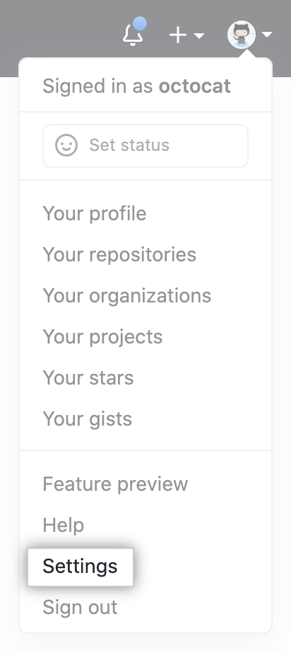
Generating a PAT
First, click on Settings on GitHub:
Then, go to Developer Settings → Personal access tokens
Click on Generate new token

Slide 26
Caching GitHub Credentials in Git
First, install GitHub CLI:
docs.github.com/en/github/getting-started-with-github/caching-your-github-credentials-in-git
Then, enter:
gh auth login
When prompted to select your preferred protocol, select HTTPS
When asked if you would like to authenticate to Git with your Github credentials, enter Y
Instead of entering in your password, use the generated PAT.

Slide 27
Git example (cloning and branching via GitHub)

Slide 28
Codespaces

Slide 29
What is GitHub Codespaces?
A service that provides developers with on-demand access to a secure development environment running a given codebase (Git repository) on a remote server.
TLDR; it allows us to edit the files in our Git repository without having to clone it…

Slide 30
What’s going on behind the scenes?
1. A shallow clone of the repository is created. (So, the repo is cloned with only the latest commits)
Done to speed up build time
2. A dedicated VM is allocated to your project on a remote server with all the necessary storage and computing resources.
3. A docker container running your project files is then created and run on the VM.
4. Then we’re all set to go! (Codespace setup and appropriate commands run based on con figuration and made available via browser)

Slide 31
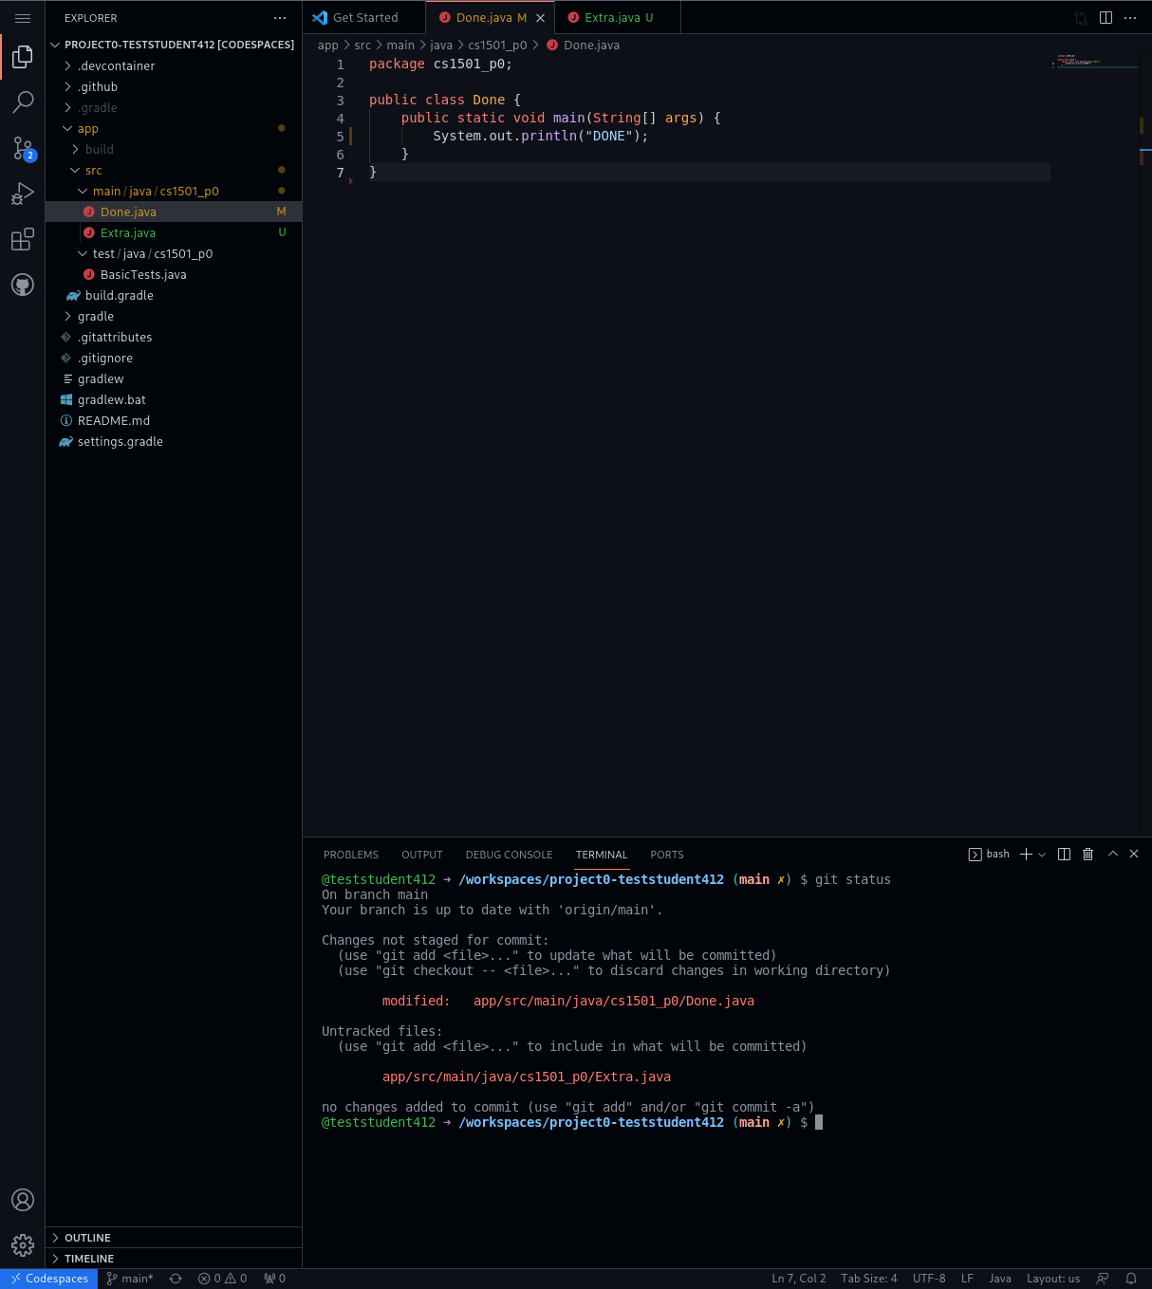
git in the Codespace

Slide 32
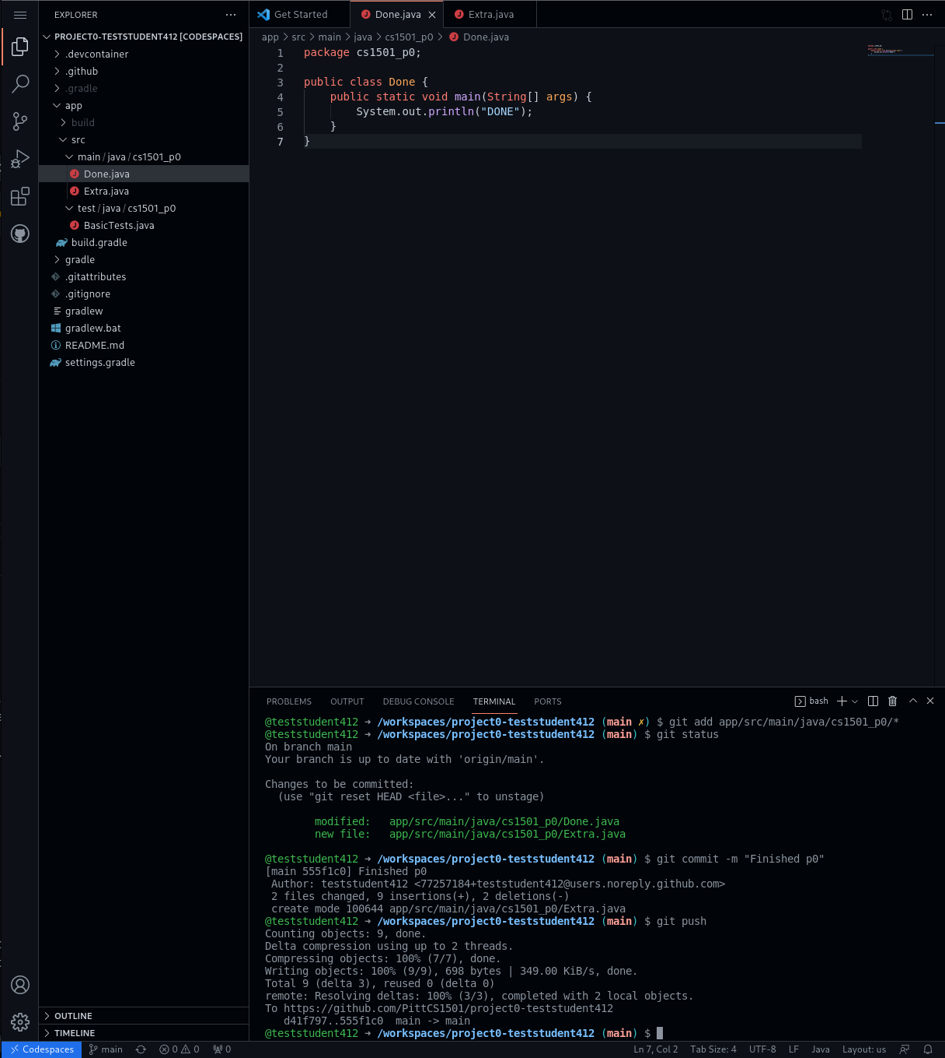
git in the Codespace
Notes:
Note the workflow to push back to GitHub!

Slide 33
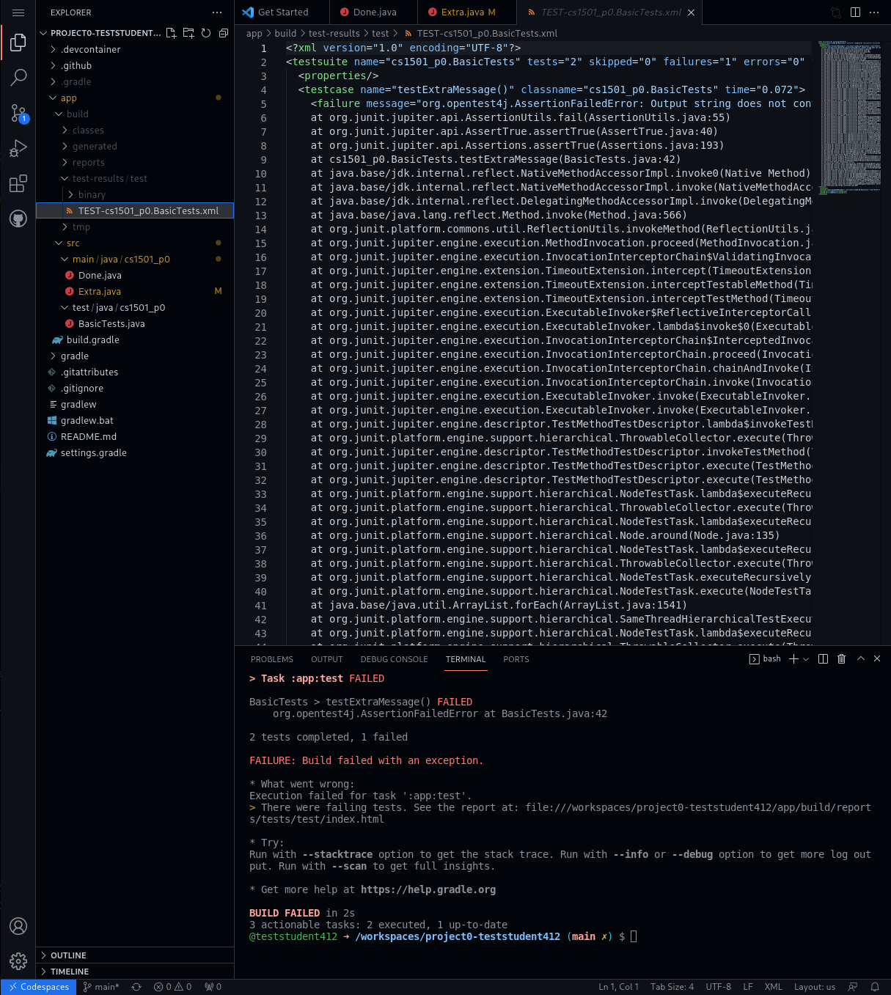
Viewing test errors
Notes:
Note path to find test output file
If this file doesn't exist, the code couldn't even compile, will only exists if tests failed at runtime

Slide 34
Project workflow
Go to repository on github.com
Open a new codespace
Edit files and test
git add all changes
git commit
git push
Go to GradeScope for final submission
Can submit on GradeScope multiple times
You don't need to wait until the project is done to commit and push. In fact, do this often!

Slide 35
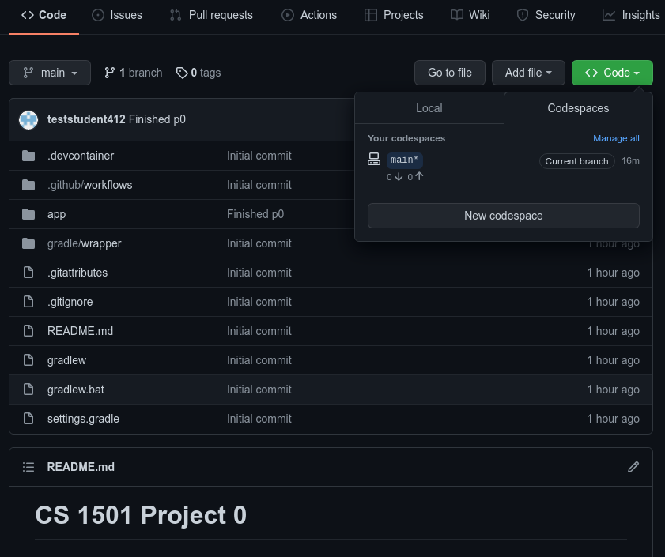
Coming back to a Codespace
Notes:
Just click on the codespace to reopen
Skips the 5min wait of building the image!

Slide 36
What we've covered here...
… presents only a brief overview of Git
Really the bare minimum needed for this class
Further topics:
branching
rebasing
tagging
…
Also covers only the bare minimum of Gradle
And doesn't really cover any JUnit!
Further resources:
https://git-scm.com/book/en/v2
https://gitimmersion.com/
https://docs.gradle.org/current/userguide/userguide.html
https://junit.org/junit5/docs/current/user-guide/

