Slide 1
CS 0449 RECITATION 6/7
Gordon Lu

Slide 2
Logistics
To be covered today:
Processes
System Calls
Memory Hierarchy
Caches
Next Time:
Virtual Memory
Page Replacement Algorithms
Paging & Page Tables
Memory Allocation Algorithms

Slide 3
Loading and Running an Executable

Slide 4
Remember our discussion from Last Recitation?
After the Loader, our program is now an executable.
But what is an Executable File?
It’s pretty much the same thing as an object file, but it has every thing it needs to be run:
Machine code ("text")
Data
Symbol table(s)
OS-specific info

Slide 5
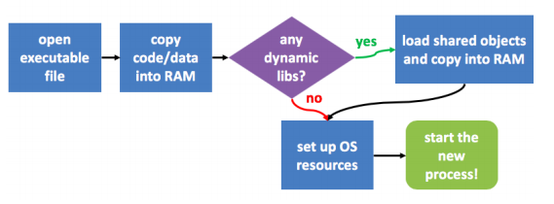
The Final Countdown
The loader is the last part of the OS, that loads the executable:

Slide 6
The Operating System

Slide 7
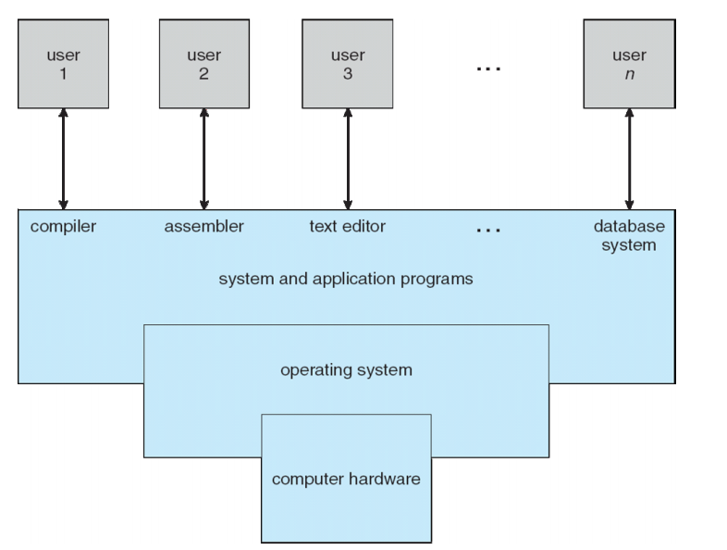
What is the Operating System?
On the previous slide, I mentioned the OS… but what exactly is it?
It is a program that acts as the mediator between the user of a computer and the computer hardware.

Slide 8
What Does an OS DO?
Resource Control
It’s the gatekeeper to all of the computer’s resources
Process Control
It ensures that all programs play nice
Hardware Abstraction
The OS LIES, it makes processes believe things that aren’t real

Slide 9
Processes

Slide 10

Processes
On the previous slide, I mentioned the processes… but what exactly are they?
A process is the in-memory representation of a program, all its data, and its resources
It is a program in execution
In order to accomplish its purpose, it needs resources.
CPU, memory, I/O, files
Initialization data
It is the responsibility of the OS to control access to these resources

Slide 11
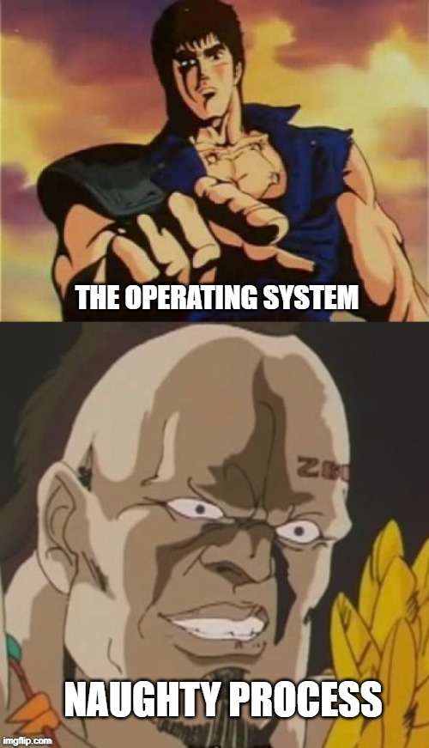
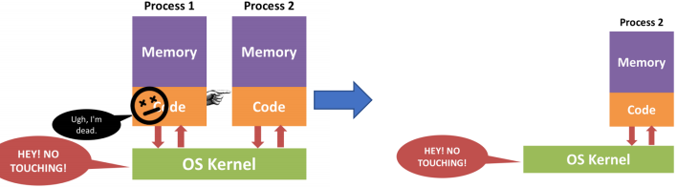
Processes that are on the naughty list
Remember, one of the responsibilities of the OS is it wants everyone to play nicely.
Think of the OS like Santa Claus here, if they try to access other process’ code/memory, they will be put on the naughty list
Being on the naughty list means the OS will kill the naughty process

Slide 12
The OS Kernel
On the previous slide, we see something called the OS Kernel… but what exactly is it?
The kernel is a special process
It is the program that makes the OS work
It makes every other process believe that they are the only program running on the entire computer (IT LIES)
It’s also allowed to do anything it wants
Meaning… a program gaining access to the kernel is REALLY BAD
Malware is basically a program that has taken control of the kernel

Slide 13
Address Spaces
Formally, address spaces are also referred to as memory partitions.
The OS allocates either fixed memory partitions and variable memory partitions for each process
In old CPU architectures, memory partitions were done through memory segmentation
This is where segfault comes from
They literally sliced up the memory and gave each process its own little cubby.
The kernel puts each process in its own address space

Slide 14
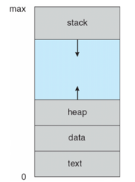
Putting it all Together
So a process is a program in execution, it contains: 1) Program code (text section)
2) Current activity (including PC), processor registers
3) Stack (temporaries, local variables)
4) Data (global variables)
5) Heap (dynamically allocated memory)

Slide 15
A process in-Memory
Each process has an address space.
When the process terminates, its memory is freed.

Slide 16
System Calls

Slide 17
A Barrier to Entry
Huh, that word… seems familiar
syscall in MIPS is short for system call
The OS Kernel can access any resource and control any other process
But… how do we prevent this power from falling into the wrong hands?

Slide 18
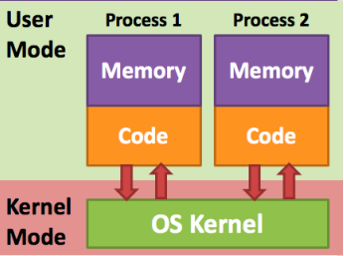
CPU Modes
The CPU can run in at least two modes: 1) User Mode for untrusted processes
This is very restrictive
Many instructions are illegal
Most memory is off-limits
Hardware can’t be accessed
2) Kernel Mode for running the kernel
How do we switch modes?

Slide 19
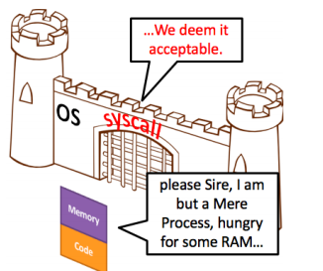
Enter System Calls
A system call is a special kind of function call that user-mode processes use to ask the OS to do something for them
If the OS is a castle wall..
Then syscalls are a gate
System calls are a CPU feature
Since it must switch modes

Slide 20
Syscall CPU Mechanisms
It’s similar to in MIPS how we put the syscall number in a certain register.
This will identify which operation the process wants to perform
Arguments get passed as usual
Then perform the syscall instruction

Slide 21
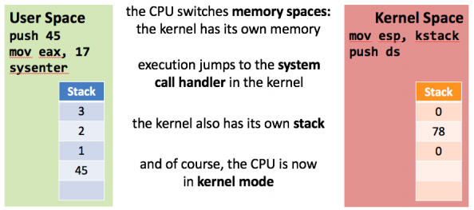
Opening the Portal
Switching modes causes a few things to happen:

Slide 22
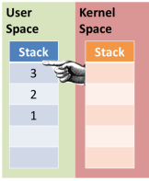
The Upside-Down
1) Kernel code is pretty similar to user code
There are some restrictions, like no libc
But you can do special things
Like accessing other processes’ memory spaces
2) This is how it sees the parameters to the system call – they’re on the user stack

Slide 23
Switching Tracks
1) When the kernel is done handling a syscall…
It could return to the user process
Or it could switch to another user process!
2) This is how one CPU can run many processes
3) At any given moment, it's only running one
But over time, they all get some attention
4) The OS is like a juggler

Slide 24
That’s It for Processes… For now…
In regard to processes, for the sake of time, let’s move onto Memory Hierarchy
I will try to go into depth with Threads, Process Creation, and Context Switches NEXT TIME

Slide 25
The Memory Hierarchy

Slide 26
In An Ideal World…
The ideal world has memory that is…
Copious in Supply
Very Fast
Non-volatile
But the reality is that we can only pick two of the following:
Copious Memory
Fast Memory
Affordable Memory
Goal: Get the real world as close as possible to the ideal world!

Slide 27
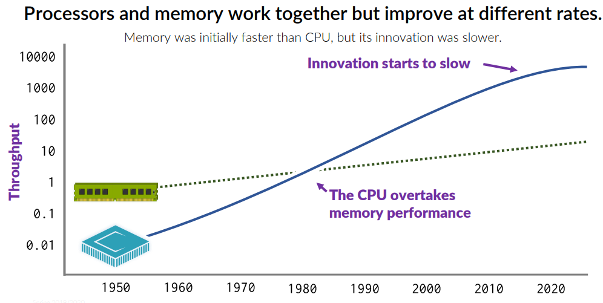
Moore’s Law

Slide 28
Memory Hierarchy
What is the Memory Hierarchy?
Memory is split into different levels dependent how much CPU power a process may require
The Memory Hierarchy:
Has different levels of memory
Some are fast, some are slow
Others are large and slow

Slide 29
Memory Hierarchy Levels
First, let’s introduce the idea of a Cache:
A cache is a small amount of fast, expensive memory
Within the Memory Hierarchy, we typically have the following levels:
L1 Cache: Typically on the CPU chip
Often referred to as the primary cache, it is the fastest memory int eh computer, and the closest to the processor
L2 & L3 Cache: Off-chip, typically made of SRAM (Static-Random Access Memory)
L2 caches typically holds data likely to be accessed by the CPU next, in modern CPUs, L2 caches are present on the CPU cores.
L3 caches are the larges cache memory unit and are also the slowest ones.

Slide 30
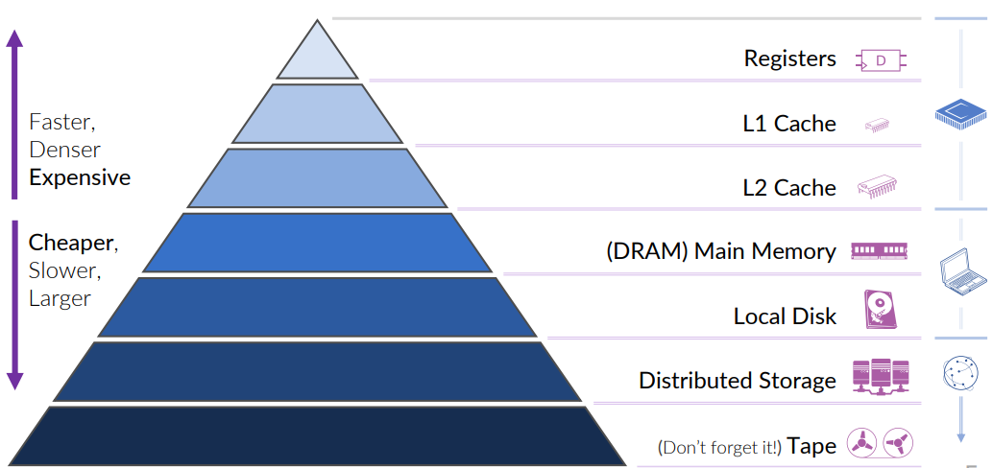
Memory Hierarchy Diagram

Slide 31
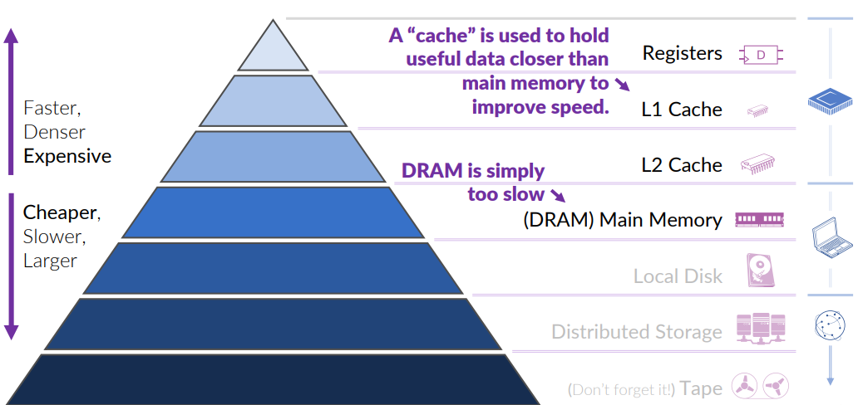
The Memory Hierarchy In terms of Speed

Slide 32
Memory Caching

Slide 33
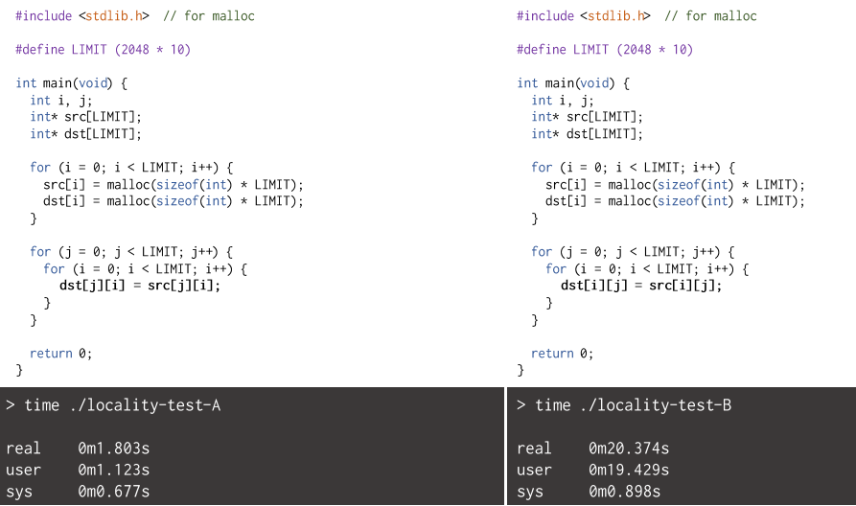
Experiment: Locality

Slide 34
Practical Performance
Caching is necessary for the utility of computers.
The CPU/Memory gap increases (The Memory Wall)
In order to actually use these fast CPUs, we need to improve the apparent speed of RAM.
Programs use memory a whole lot.
The bottleneck would grind performance to the point where CPUs cannot improve.

Slide 35

But… Data is Far Away!!
Let’s say you want to read a book.
You check it out of the library.
You have to go there.
Find the book.
Maybe take the bus back.
Wait in traffic.
Now it sits on your desk.
As long as it is near you, it’s easy to access the information.
Yet, if you need another book…
You would take the book ALL THE WAY back! (bare with me)

Slide 36

Caching: Keeping Things Close
Let’s say you want to read a book.
It’s not on your bookshelf.
So, still have to check it out of the library.
You gotta go there. Find the book. Etc.
Take the bus back.
Now it sits on your desk.
As long as it is near you, it is easy to access the information.
When we need another book… we put it aside.
Maybe a bookshelf.
The next time we need it, it will be nearby

Slide 37

The Metaphorical Cache
The bookshelf is a cache.
It holds information that you might want later.
It is [much] smaller than a library, but faster to retrieve things.
However, it is small. Placing a new book on the shelf may require taking an old book off.

Slide 38
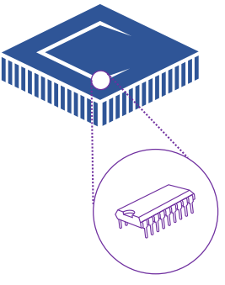
Memory Cache
RAM is the library. It is far away and getting stuff from there is slow.
To better handle the performance gap between the CPU and memory we add a smaller, fast memory near the CPU.
This is the CPU cache.

Slide 39
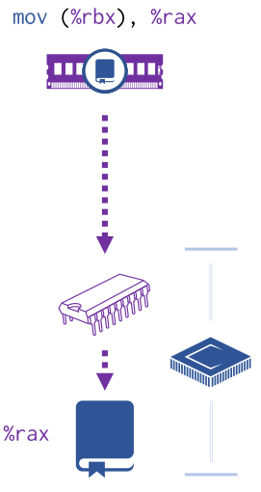
The Journey of Data
When data is requested, the goal is to read a word into a CPU register.
The CPU first contacts the cache and asks if it has a copy.
If it does… that is a cache hit, and, well, that was easy. Just copy that value into the register.
If it does not, this is a cache miss.
It will then contact the next component in the memory hierarchy. (RAM)
Ram copies the value to cache, and the cache copies the value to the register.

Slide 40
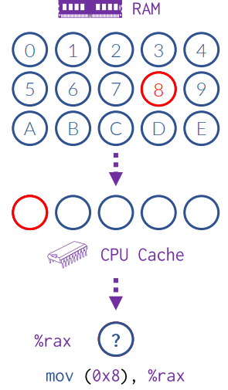
Missing the mark
When the CPU requests memory in an empty cache, the data obviously won’t be available locally.
This is a compulsory miss, a “miss” due to the first access of a block of data.
Also known as a “cold miss.”
These are, as they suggest, completely unavoidable.
They always incur the high penalty associated with a memory read.

Slide 41
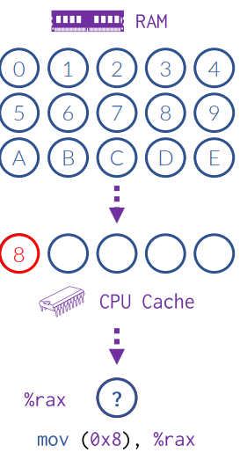
Hitting the Target
When the CPU requests memory that happens to already be in the cache, the data is read locally (quickly).
This is a cache hit.
Your best-case scenario.
These avoid having to communicate at all with memory.
No penalty taken for reading/writing to memory.
Very cheap in terms of time.

Slide 42
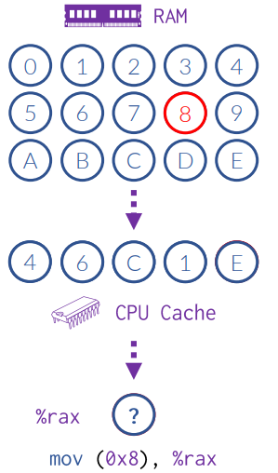
A Cache Half Full…
As the CPU requests memory, the cache will fill to satisfy each compulsory miss.
When it fills up completely, it will have no further room for the next miss.
On a miss, it requests the data from memory.
Yet, where does it go?? We must remove one.
This is a capacity miss. The memory requirements of the program are larger than the cache.

Slide 43
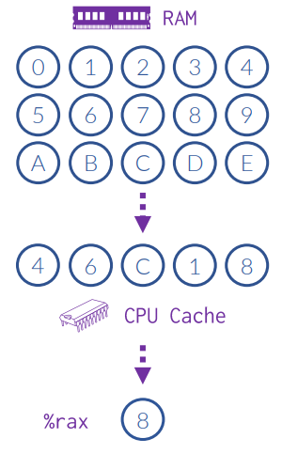
Locality…
It is difficult to know what block of data to omit from this cache on such a miss.
However we can exploit the common locality patterns of programs to improve our cache.
There is temporal locality: accessed data is likely to be used again in near future.
This is what caches generally capture.
However, spatial locality is also likely: data is often grouped together.
When we access a struct field, we will often access another which is nearby in memory.

Slide 44
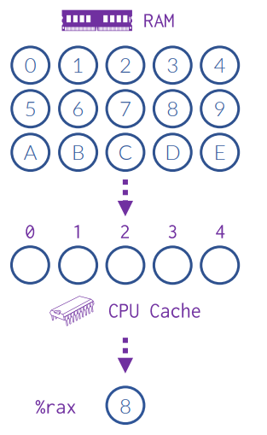
Exploring Space…
We would like to keep data that is adjacent in memory in the cache, together, at the same time.
To do this, we “hash” the address. This is used to determine the cache slot.
Just a fancy way to say: we divide the address by the cache size and use the remainder.
Every 0th block, 1st block, 2nd block, etc.
The 5th block (in this example) goes to the slot, the 6th goes to the slot, and so on.

Slide 45
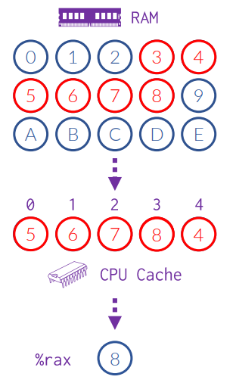
Direct and to the point…
Let’s read addresses 3, 4, 5, 6, and 7 (in that order) from memory.
Reading address 8 next incurs a capacity miss, but it evicts the address that is furthest away from the others.
This type of cache is good for programs that read through data sequentially.
That is because such programs will always remove the least recently used block on a miss, as shown here.
Because every address has a specific cache slot, this is called a direct-mapped cache.

Slide 46
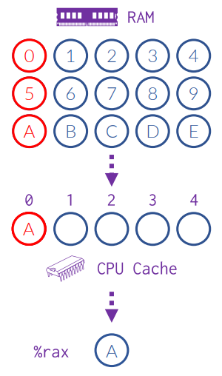
Missing your Connection…
Let’s consider an antagonist pattern.
What is the worst case for this cache?
If we read every 5th address in our memory in order, we would overwhelm our direct-mapped cache.
Let’s access 0, 5, A in that order.
Accessing address 0 is a compulsory miss.
Address 5, however, is a miss.
But our cache isn’t full!!
A miss that occurs even though your cache could fit the block is called a conflict miss.

Slide 47
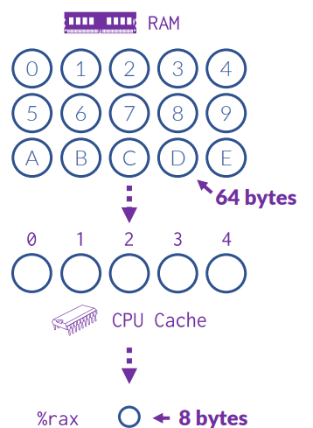
How big is that block?
Spatial locality is SO prevalent that it makes a whole lot of sense to pull more data than is requested.
If we request a word (8 bytes) from memory, and we have a cache miss, let’s pull 8 words at a time (64 bytes).
Therefore, the blocks visualized to the right can have a size, called the block size.
The bigger the block, the better spatial locality will become.
However, the more time it takes to copy from memory and the higher penalty if you throw it away on a miss!

Slide 48
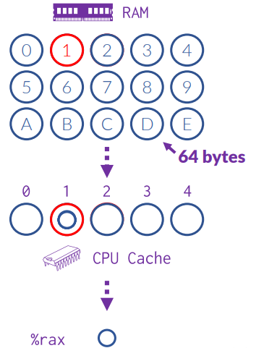
Block Size helps Locality…
When we request an address from our cache, we are requesting the block that contains that address.
Here, Block 0 contains byte addresses 0x00 through 0x39. Block 1 is 0x40 to 0x79, etc.
Let’s request 64-bit words in order starting at address 0x40 (Block 1)
There are 8 words in each cache block.
Therefore, we have only one compulsory miss.
And then we have 7 cache hits!!
If we request the ninth word, we will be at address 0x80 (and a compulsory miss.)

Slide 49
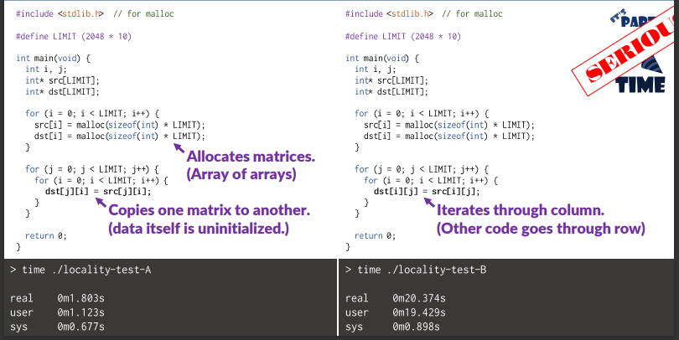
A tale of two C programs

Slide 50
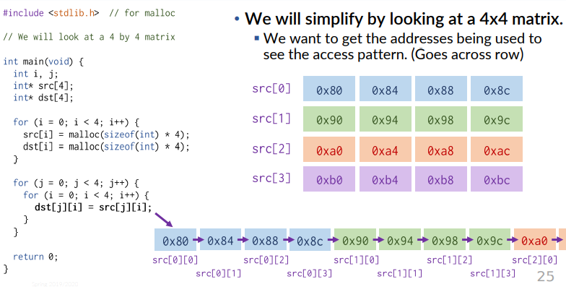
A deep Dive on the Left Program…

Slide 51
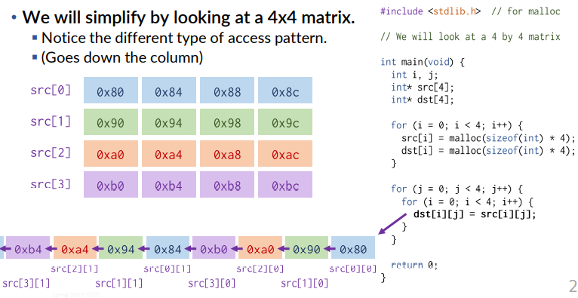
A deep Dive on the Right Program…

Slide 52
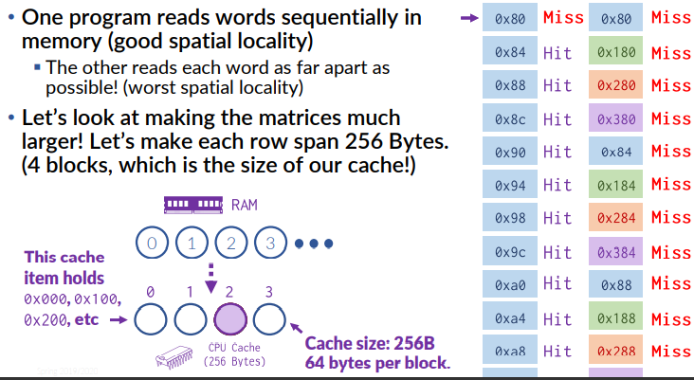
The Antagonist

Slide 53
Measuring Cache Performance
Recall that caches make computers practical.
Why? Well…
Our “slow” program effectively did not use the cache, and it was 10 times slower.
Simply: Caches offer much faster accesses than DRAM.
Perhaps 100s of times faster.
Consider the math:
miss rate (MR): Fraction of memory accesses not in cache.
hit rate (HR): Fraction of memory accesses found in cache. ( H𝑅 = 1 − 𝑀𝑅)
hit time (HT): Time it takes to read a block from cache to CPU. (Best case)
miss penalty (MP): Time it takes to read from main memory to cache.

Slide 54
A Closer Look
Recall that caches make computers practical.
Consider the math:
miss rate (MR): Fraction of memory accesses not in cache.
hit rate (HR): Fraction of memory accesses found in cache. ( H𝑅 = 1 − 𝑀𝑅)
hit time (HT): Time it takes to read a block from cache to CPU. (Best case)
miss penalty (MP): Time it takes to read from main memory to cache.
Average Memory Access Time (AMAT): The time it takes, on average, to perform a memory request, considering the cache performance.
𝐴𝑀𝐴𝑇 = 𝐻𝑇 + 𝑀𝑅 × 𝑀𝑃
Assuming a HT of 1 clock cycle and a MP of 100 clock cycles…
A HR of 97%: 𝐴𝑀𝐴𝑇 = 1 + 0.03 × 100 = 4 𝑐𝑦𝑐𝑙𝑒𝑠
A HR of 99%: 𝐴𝑀𝐴𝑇 = 1 + 0.01 × 100 = 2 𝑐𝑦𝑐𝑙𝑒𝑠
A hit-rate jump from just 97% to 99% doubles memory performance. Wow.

Slide 55
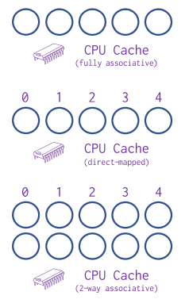
Cache Layout Summary
We have seen two types of cache layouts.
A freeform cache: blocks go wherever. ¯\_(ツ)_/¯
Also called a fully associative cache.
A direct-mapped cache: blocks go into slots.
They have their own trade-offs, and as usual…
We can have a hybrid approach!
Here, each cache slot has multiple bins.
You only need to evict when you fill up the bins. Best of both worlds!
Which do you evict? (Hmm… difficult choice.)

Slide 56
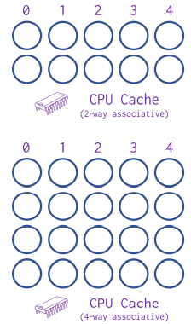
Associativity
With an associative cache, the address determines the slot.
Much like a direct-mapped cache.
However, the slot has a number of bins.
Any bin in the slot is viable for a block.
The number of bins is the number of “ways”
A direct-mapped cache is a 1-way cache.
When the cache determines if the block is in the cache already…
It determines the slot.
It scans every bin for a block tagged with that exact address.
Therefore, the cache performance degrades as you increase the number of ways.

Slide 57
Putting it all Together (Summary)
The notion of storing data is a complicated one.
Different technologies have different strengths (and costs)
Often trade-off between:
fast / small, expensive
slow / big, cheap
Hardware designs attempt to accommodate a variety of technologies.
Often using fast/small memories to act as a “cache” for slower ones.
Caches can be arranged in several ways:
Blocks go anywhere (fully-associative)
Blocks go in particular slots (direct-mapped / 1-way associative)
Hybrid: Blocks go to particular slots… but then can go in any bin in that slot.
Caches attempt to exploit temporal and spatial locality of programs.
And even a slight improvement to hit rate can dramatically improve overall performance of a program!

Slide 58
That’s all I have for now!

Slide 59
Geez… that took a while, so what’s next?
We’re going to cover Virtual Memory and Page Replacement Algorithm
(Possibly) Threads, Process Creation, Context Switches

