Slide 1
CS 0449 Recitation 8

Slide 2
Logistics
To be covered today:
Virtual Memory
Page Replacement Algorithms
Paging & Page Tables
Memory Allocation Algorithms
Live coding LRU eviction in Java

Slide 3
Memory Partitions

Slide 4
Remember from Last Time…
The ideal world has memory that is…
Copious in Supply
Very Fast
Non-volatile
But the reality is that we can only pick two of the following:
Copious Memory
Fast Memory
Affordable Memory
Goal: Get the real world as close as possible to the ideal world!

Slide 5
Fixed Partitions
Idea:
Divide memory into fixed spaces
Each process will be assigned a fixed space when it’s free
Mechanisms:
Separate input queues for each partition
Single input queue: has better ability to optimize CPU usage

Slide 6
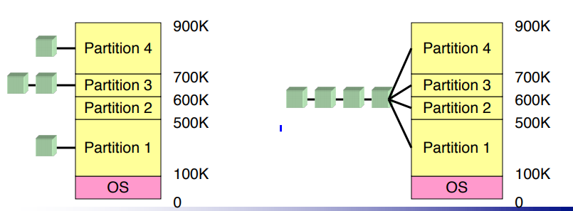
What’s the Difference Here?
On the right side, with individual input queues for each partition, we can easily determine with partition to put a process in. Downside is overhead.
On the left side, if we have a single input queue, we will use less memory, but it will take longer to identify which partition to assign a process to.

Slide 7
Memory Allocation

Slide 8
Base and Limit Registers
Special CPU registers: base & limit
Access to the registers limited to system mode
Registers contain:
Base: start of the process’s memory partition
Limit: length of the process’s memory partition
Address generation
Physical address: location in actual memory
Logical address: location from the process’s point of view
Physical address = base + logical address
Logical address larger than limit => error

Slide 9
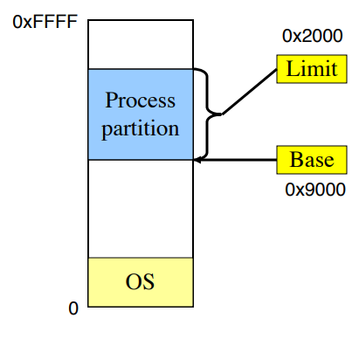
An Example
First, what does this diagram represent?
The processes that are allocated on the OS!
If we have a logical address of 0x1204, we can
Calculate the Physical Address like so:
Physical address = base + logical address
0x1204 + 0x9000 = 0xa204

Slide 10
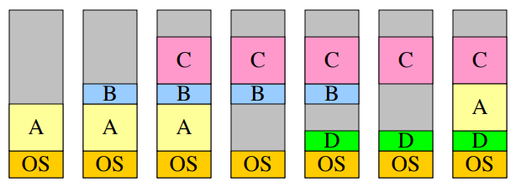
Swapping
Memory allocation changes as:
Processes come into memory
Processes leave memory

Slide 11
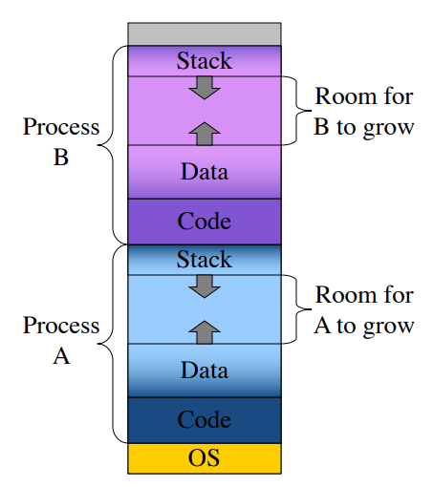
Swapping
We need to allow for programs to grow.
Allocate more memory for data
Meaning… a larger stack
This is handled by allocating more space than necessary at the start…
But this is inefficient: it will waste memory that’s not currently in use.

Slide 12
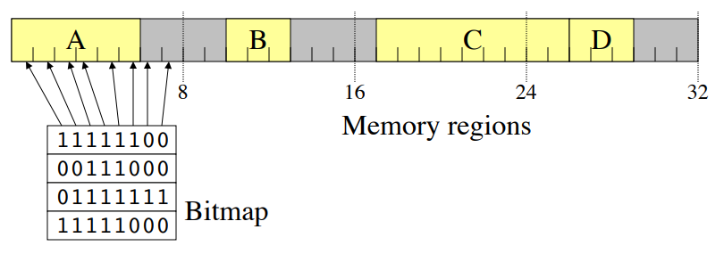
Tracking memory Usage: BitMaps
Keep track of free / allocated memory regions with a bitmap
One bit in map corresponds to a fixed-size region of memory
Bitmap is a constant size for a given amount of memory regardless of how much is allocated at a particular time
Chunk size determines efficiency
At 1 bit per 4KB chunk, we need just 256 bits (32 bytes) per MB of memory
For smaller chunks, we need more memory for the bitmap
Can be difficult to find large contiguous free areas in bitmap

Slide 13
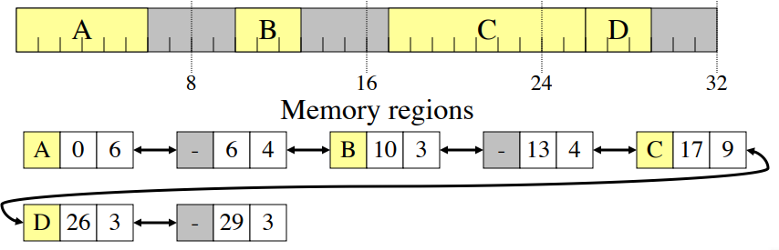
Tracking memory Usage: Linked Lists
Keep track of free / allocated memory regions with a linked list
Each entry in the list corresponds to a contiguous region of memory
Entry can indicate either allocated or free (and, optionally, owning process)
May have separate lists for free and allocated areas
Efficient if chunks are large
Fixed-size representation for each region
More regions => more space needed for free lists

Slide 14
Allocating Memory
Search through region list to find a large enough space
Suppose there are several choices: which one to use?
First fit: the first suitable hole on the list
Next fit: the first suitable after the previously allocated hole
Best fit: the smallest hole that is larger than the desired region (wastes least space?)
Worst fit: the largest available hole (leaves largest fragment)
Option: maintain separate queues for different-size holes

Slide 15
An Example

Slide 16
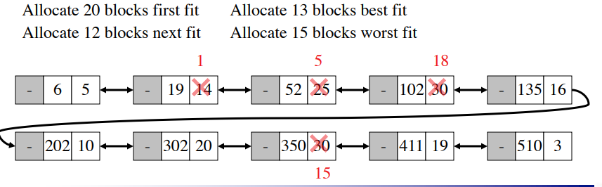
An Example

Slide 17
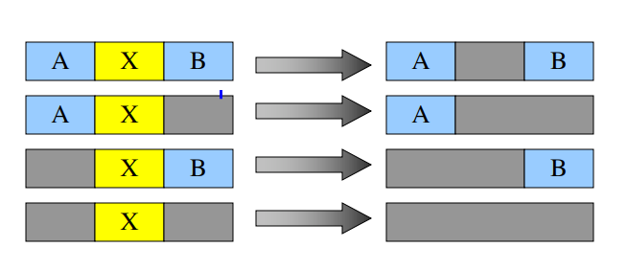
Freeing memory
Allocation structures must be updated when memory is freed
Easy with bitmaps: just set the appropriate bits in the bitmap
Linked lists: modify adjacent elements as needed
Merge adjacent free regions into a single region
May involve merging two regions with the just-freed area

Slide 18
Problems with Swapping
Process must fit into physical memory (impossible to run larger processes)
Memory becomes fragmented
External fragmentation: lots of small free areas
Compaction needed to reassemble larger free areas
Processes are either in memory or on disk: half and half doesn’t do any good

Slide 19
Virtual Memory

Slide 20
The motivation
Physical memory is a scarce resource!
Basic Idea: We want to allow the OS to hand out more memory than exists on the system!
Keep recently used stuff in Physical Memory
Move least recently used stuff to Disk
But… keep this information hidden from processes…
Processes will still see an address space from 0 – max address
The addresses each process accesses is not the real address sent to memory
Movement of information to and from disk is handled by the OS

Slide 21
Virtual and Physical Addresses
Programs use virtual addresses
Addresses local to the process
Hardware translates virtual addresses to physical addresses

Slide 22
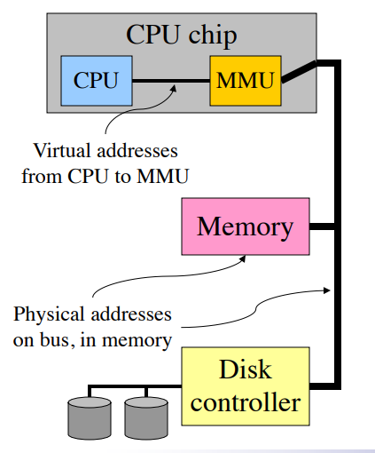
Enter the Memory Management Unit (MMU)
The translation from virtual address to physical address is done by the Memory Management Unit
It is typically on the same chip as the CPU
Only physical addresses leave the CPU/MMU schip
Physical memory is indexed by physical addresses

Slide 23
Paging and Page Tables

Slide 24
Paging and Page Tables
Virtual addresses are mapped to physical addresses
A unit of mapping is called a page (Typically 4KiB)
All addresses in the same virtual page are in the same physical page
A Page Table Entry (PTE) contains translation for a single page.
Page Table translates virtual page number to a physical page number
Not all virtual memory has a physical page
Not every physical page needs to be used

Slide 25
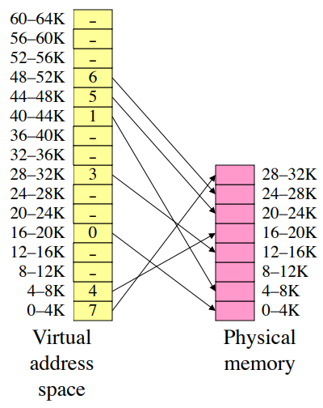
Example
Consider a 64KB virtual address space and a 32 KB physical memory:
Where would a Page whose lives at 17 KB in the virtual address space map to in Physical memory?
This looks like a prime candidate for a certain data structure… can anyone name it?

Slide 26
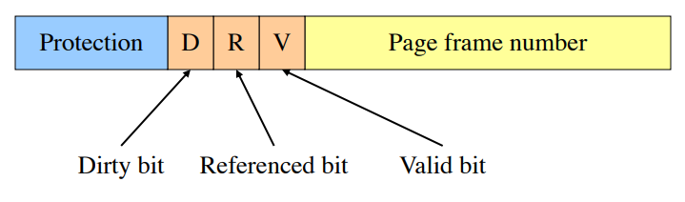
What’s in a Page Table Entry?
Each entry in the page table contains: 1) Valid bit: set if this logical page number has a corresponding physical frame in memory
If not valid, remainder of PTE is irrelevant
2) Page frame number: page in physical memory
3) Referenced bit: set if data on the page has been accessed
4) Dirty (modified) bit: set if data on the page has been modified
5) Protection information

Slide 27
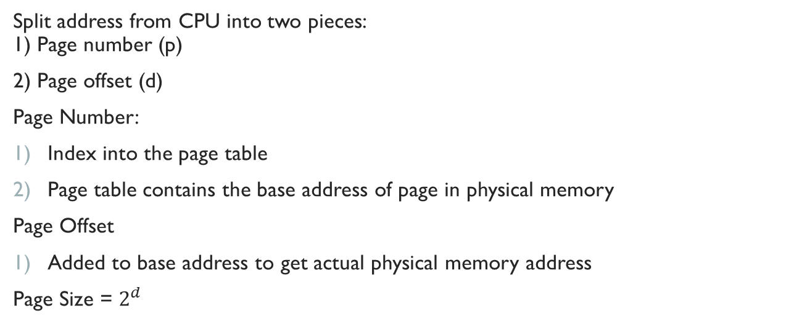
Mapping Logical to Physical Addresses
Split address from CPU into two pieces: 1) Page number (p)
2) Page offset (d)
Page Number:
Index into the page table
Page table contains the base address of page in physical memory
Page Offset
Added to base address to get actual physical memory address
Page Size = $2^{d}$

Slide 28


Example
4KB (4096 B) pages
32 bit logical addresses
$$2^{d}=4096$$
$$d=12 bits$$
$$32 −12=20 bits$$

Slide 29
Address Translation Architectures & Paging Structures

Slide 30
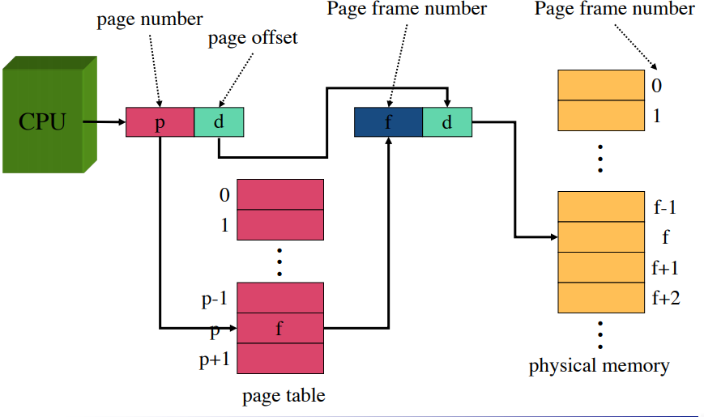
Address Translation Architecture

Slide 31
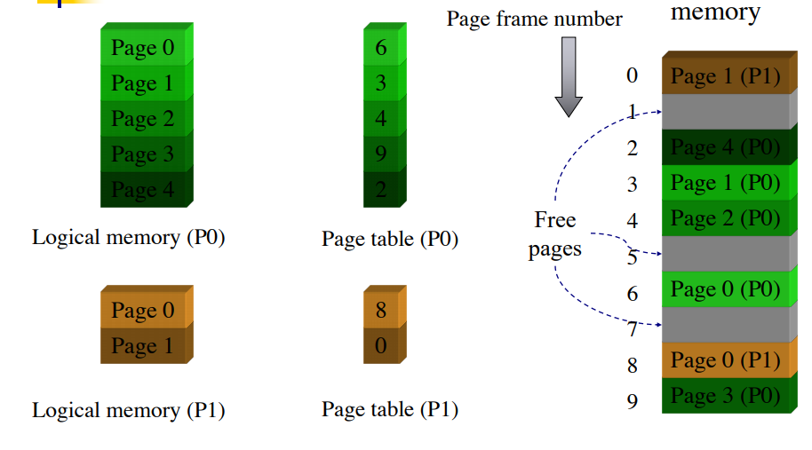
Memory and Paging Structures

Slide 32
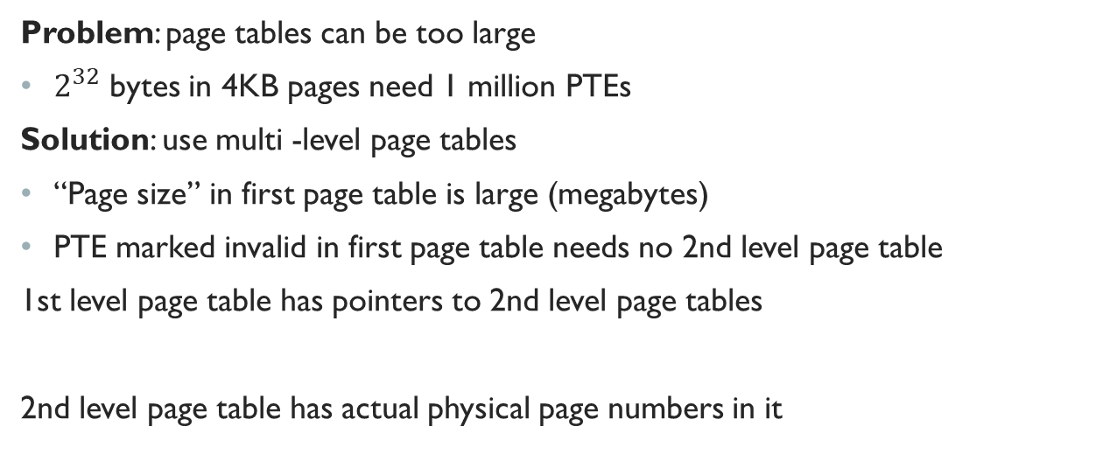
Two-Level Page Tables
Problem: page tables can be too large
$2^{32}$ bytes in 4KB pages need 1 million PTEs
Solution: use multi -level page tables
“Page size” in first page table is large (megabytes)
PTE marked invalid in first page table needs no 2nd level page table
1st level page table has pointers to 2nd level page tables
2nd level page table has actual physical page numbers in it

Slide 33
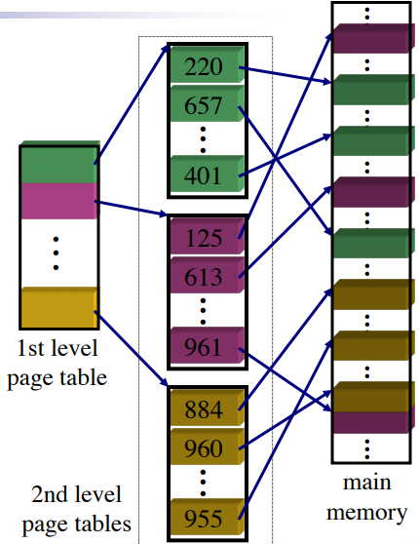
The Model

Slide 34
More on Two-Level Page Tables
1) Tradeoffs between 1st and 2nd level page table sizes
Total number of bits indexing 1st and 2nd level table is constant for a given page size and logical address length
Tradeoff between number of bits indexing 1st and number indexing 2nd level tables
More bits in 1st level: fine granularity at 2nd level
Fewer bits in 1st level: maybe less wasted space?
2) All addresses in table are physical addresses
3) Protection bits kept in 2nd level table

Slide 35
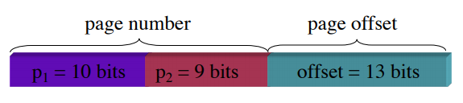
Two-Level Paging Example
System characteristics:
8 KB pages
32-bit logical address divided into:13 bit page offset, 19 bit page number
Page number divided into:
10 bit page number
9 bit page offset
Logical address looks like this:
p1 is an index into the 1st level page table
p2 is an index into the 2nd level page table pointed to by p1

Slide 36
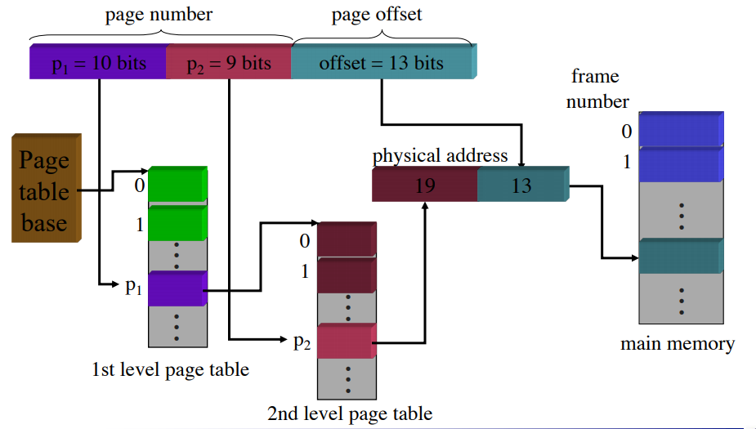
Two-Level Address Translation Example

Slide 37
Implementing Page Tables in Hardware
1) Page table resides in main (physical) memory
2) CPU uses special registers for paging
Page table base register (PTBR) points to the page table
Page table length register (PTLR) contains length of page table: restricts maximum legal logical address
3) Translating an address requires two memory accesses
First access reads page table entry (PTE)
Second access reads the data / instruction from memory
4) Reduce number of memory accesses
Can’t avoid second access (we need the value from memory)
Eliminate first access by keeping a hardware cache (called a translation lookaside buffer or TLB) of recently used page table entries

Slide 38
Translation Lookaside Buffer (TLB)

Slide 39
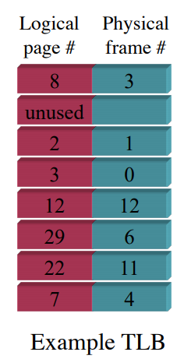
Enter TLB… (Sounds like DLB :P)
1) Search the TLB for the desired logical page number (Sounds cachey…)
Search entries in parallel
Use standard cache techniques
2) If desired logical page number is found, get frame number from TLB
3) If desired logical page number isn’t found
Get frame number from page table in memory
Replace an entry in the TLB with the logical & physical page numbers from this reference

Slide 40
Handling TLB Misses
1) If PTE isn’t found in TLB, OS needs to do the lookup in the page table
2) Lookup can be done in hardware or software
3) Hardware TLB replacement
CPU hardware does page table lookup
Can be faster than software
Less flexible than software, and more complex hardware
4) Software TLB replacement
OS gets TLB exception
Exception handler does page table lookup & places the result into the TLB
Program continues after return from exception
Larger TLB (lower miss rate) can make this feasible

Slide 41
Inverted Page Tables

Slide 42
Enter Inverted Page Tables
1) Reduce page table size further: keep one entry for each frame in memory
2) PTE contains:
Virtual address pointing to this frame
Information about the process that owns this page
3) Search page table by:
Hashing the virtual page number and process ID
Starting at the entry corresponding to the hash result
Search until either the entry is found or a limit is reached
4) Page frame number is index of PTE
5) Improve performance by using more advanced hashing algorithms

Slide 43
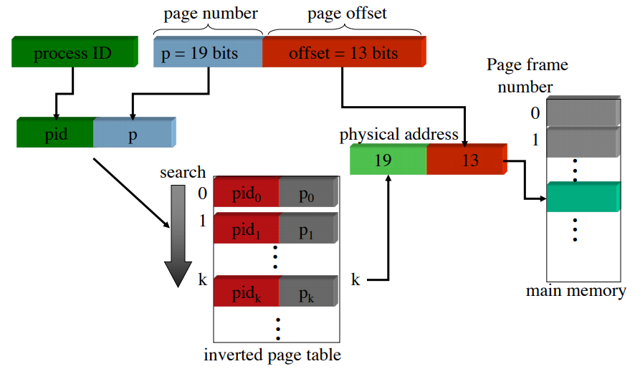
Inverted Page Table Architecture

Slide 44
Page Replacement Algorithms

Slide 45
Motivation for Page Replacement Algorithms
1) Page Fault forces a choice
What is a Page Fault? We don’t have room in our Page Table for another page!!
We don’t have room for a new page (steady state)
Which page must be removed to make room for an incoming page?
2) How is a page removed from physical memory?
If the page is unmodified, simply overwrite it: a copy already exists on disk
If the page has been modified, it must be written back to disk: prefer unmodified pages?
We had a certain field in our PTEs that reflected this, can anyone name it?
The Dirty Bit!
3) Better not choose an often used page
Will likely need to brough back in soon

Slide 46
Page Replacement Algorithms
We will go over the following:
Optimal Page Replacement Algorithm
Not-Recently-Used (NRU) Algorithm
First In First Out (FIFO) Algorithm
Second Chance Algorithm
Least Recently Used (LRU) Algorithm

Slide 47
Optimal Page Replacement
What’s the best we can possibly do?
Assume perfect knowledge of the future
Not realizable in practice (usually)
Useful for comparison: if another algorithm is within 5% of optimal, not much more can be done…
Algorithm: replace the page that will be used furthest in the future
Only works if we know the whole sequence!
Can be approximated by running the program twice
Once to generate the reference trace
Once (or more) to apply the optimal algorithm
Nice, but not achievable in real systems!

Slide 48
The Assumption
Since it is a 32-bit address space.
First 20 bits is used for the address
The rest is used for offset
Page Address Page Offset
l | 190a7c20
s | 3856bbe0
l | 190afc20
l | 15216f00
l | 190a7c20
l | 190a7c28
l | 190a7c28
l | 190aff38

Slide 49
Optimal Page Replacement Example
Let's suppose you have 12KB of physical memory
Page has 4KB
Assume OPT
l 190a7c20 s 3856bbe0 l 190afc20 l 15216f00
l 190a7c20 l 190a7c28 l 190a7c28 l 190aff38
0
1
2

Slide 50
Optimal Page Replacement Example
Let's suppose you have 12KB of physical memory
Page has 4KB Assume OPT
You already know memory access trace at the beginning
 | l | 190a7c20
 | s | 3856bbe0
 | l | 190afc20
 | l | 15216f00
 | l | 190a7c20
 | l | 190a7c28
 | l | 190a7c28
 | l | 190aff38
0
1
2

Slide 51
Optimal Page Replacement Example
Let's suppose you have 12KB of physical memory
Page has 4KB
Assume OPT
You already know memory access trace at the beginning
When evicting needed
Pagefault again
l 190a7c20 s 3856bbe0 l 190afc20 l 15216f00
l 190a7c20 l 190a7c28 l 190a7c28 l 190aff38
0 | 190a7
1 | 3856b
2 | 190af
We need to evict someone!!

Slide 52
Optimal Page Replacement Example
Let's suppose you have 12KB of physical memory
Page has 4KB
Assume OPT
You already know memory access trace at the beginning
When evicting needed
Pagefault again
We need to evict someone!!
l 190a7c20 s 3856bbe0 l 190afc20 l 15216f00
l 190a7c20 l 190a7c28 l 190a7c28 l 190aff38
0 | 190a7
1 | 3856b
2 | 190af

Slide 53
Optimal Page Replacement Example
Let's suppose you have 12KB of physical memory
Page has 4KB
Assume OPT
You already know memory access trace at the beginning
When evicting needed
Pagefault again
We need to evict someone!!
But page 190a7 will be used later!
l 190a7c20 s 3856bbe0 l 190afc20 l 15216f00
l 190a7c20 l 190a7c28 l 190a7c28 l 190aff38
0 | 190a7
1 | 3856b
2 | 190af

Slide 54
Optimal Page Replacement Example
Let's suppose you have 12KB of physical memory
Page has 4KB
Assume OPT
You already know memory access trace at the beginning
When evicting needed
Pagefault again
We need to evict someone!! But page 190a7 will be used later! | l s l l | 190a7c20 3856bbe0 190afc20 15216f00
Go next until find | l l | 190a7c20 190a7c28
one that is no | l | 190a7c28
longer needed in the future | l | 190aff38
0 | 190a7
1 | 3856b
2 | 190af

Slide 55
Optimal Page Replacement Example
Let's suppose you have 12KB of physical memory
Page has 4KB
Assume OPT
You already know memory access trace at the beginning
When evicting needed
Pagefault again
We need to evict someone!! But page 190a7 will be used later! | l s l l | 190a7c20 3856bbe0 190afc20 15216f00
Go next until find | l l | 190a7c20 190a7c28
one that is no | l | 190a7c28
longer needed in the future | l | 190aff38
0 | 190a7
1 | 190af
2

Slide 56
Optimal Page Replacement Example
Let's suppose you have 12KB of physical memory
Page has 4KB
Assume OPT
You already know memory access trace at the beginning
When evicting needed
Pagefault again
We need to evict someone!!
But page 190a7 will be used later!
l 190a7c20 s 3856bbe0 l 190afc20 l 15216f00
l 190a7c20 l 190a7c28 l 190a7c28 l 190aff38
0 | 190a7
1 | 190af
2 | 15216
Go next until find one that is no longer needed in the future

Slide 57
Optimal Page Replacement Example
Let's suppose you have 12KB of physical memory
Page has 4KB
Assume OPT
You already know memory access trace at the beginning
When evicting needed
Pagefault again
We need to evict someone!!
But page 190a7 will be used later!
l 190a7c20 s 3856bbe0 l 190afc20 l 15216f00
l 190a7c20 l 190a7c28 l 190a7c28 l 190aff38
0 | 190a7
1 | 3856b
2 | 15216
Go next until find one that is no longer needed in the future
What if there is a tie?
Multiple pages no longer needed in the future?

Slide 58
Optimal Page Replacement Example
Let's suppose you have 12KB of physical memory
Page has 4KB
Assume OPT
You already know memory access trace at the beginning
When evicting needed
Pagefault again
We need to evict someone!!
But page 190a7 will be used later!
l 190a7c20 s 3856bbe0 l 190afc20 l 15216f00
l 190a7c20 l 190a7c28 l 190a7c28 l 190aff38
0 | 190a7
1 | 3856b
2 | 15216
Go next until find one that is no longer needed in the future
What if there is a tie?
Multiple pages no longer needed in the future?
Use LRU among those tie pages

Slide 59
Not Recently Used (NRU) Algorithm
Each page has reference bit and dirty bit
Bits are set when page is referenced and/or modified
Pages are classified into four classes
0: not referenced, not dirty
1: not referenced, dirty
2: referenced, not dirty
3: referenced, dirty
Clear reference bit for all pages periodically
Can’t clear dirty bit: needed to indicate which pages need to be flushed to disk
Class 1 contains dirty pages where reference bit has been cleared
Algorithm: remove a page from the lowest non-empty class
Select a page at random from that class
Easy to understand and implement
Performance adequate (though not optimal)

Slide 60
First-In, First-Out (FIFO) Algorithm
Maintain a linked list of all pages
Maintain the order in which they entered memory
Page at front of list replaced
Advantage: (really) easy to implement
Disadvantage: page in memory the longest may be often used
This algorithm forces pages out regardless of usage
Usage may be helpful in determining which pages to keep

Slide 61
Second Chance Page Replacement Algorithm
Modify FIFO to avoid throwing out heavily used pages
If reference bit is 0, throw the page out
If reference bit is 1
Reset the reference bit to 0
Move page to the tail of the list
Continue search for a free page
Still easy to implement, and better than plain FIFO

Slide 62
Second Chance Algorithm Example
Let's suppose you have 12KB of physical memory
Page has 4KB Assume Second Chance Algorithm
 | l | 190a7c20
 | s l l l l l l | 3856bbe0 190a7c24 190afc20 15216f00 190a7c20 190a7c28 190a7c28
0
1
2

Slide 63
Second Chance Algorithm Example
Let's suppose you have 12KB of physical memory
Page has 4KB
Assume Second Chance Algorithm
Referenced bit (R bit): set to 1 If page accessed again after allocated in memory
l | 190a7c20
s | 3856bbe0
l | 190a7c24
l | 190afc20
l | 15216f00
l | 190a7c20
l | 190a7c28
l | 190a7c28
0
1
2
R bits

Slide 64
Second Chance Algorithm Example
Let's suppose you have 12KB of physical memory
Page has 4KB
Assume Second Chance Algorithm
Referenced bit (R bit)
l | 190a7c20
s | 3856bbe0
l | 190a7c24
l | 190afc20
l | 15216f00
l | 190a7c20
l | 190a7c28
l | 190a7c28
0
1
2
R bits

Slide 65
Second Chance Algorithm Example
Let's suppose you have 12KB of physical memory
Page has 4KB
Assume Second Chance Algorithm
Referenced bit (R bit)
Pagefault since it is not in the page table
l | 190a7c20
s | 3856bbe0
l | 190a7c24
l | 190afc20
l | 15216f00
l | 190a7c20
l | 190a7c28
l | 190a7c28
0
1
2
R bits

Slide 66
Second Chance Algorithm Example
Let's suppose you have 12KB of physical memory
Page has 4KB
Assume Second Chance Algorithm
Referenced bit (R bit)
Pagefault since it is not in the page table
l | 190a7c20
s | 3856bbe0
l | 190a7c24
l | 190afc20
l | 15216f00
l | 190a7c20
l | 190a7c28
l | 190a7c28
0 | 0 | 190a7
1
2
R bits

Slide 67
Second Chance Algorithm Example
Let's suppose you have 12KB of physical memory
Page has 4KB
Assume Second Chance Algorithm
Referenced bit (R bit)
l | 190a7c20
s | 3856bbe0
l | 190a7c24
l | 190afc20
l | 15216f00
l | 190a7c20
l | 190a7c28
l | 190a7c28
0 | 0 | 190a7
1
2
R bits

Slide 68
Second Chance Algorithm Example
Let's suppose you have 12KB of physical memory
Page has 4KB
Assume Second Chance Algorithm
Referenced bit (R bit)
Pagefault since it is not in the page table
l | 190a7c20
s | 3856bbe0
l | 190a7c24
l | 190afc20
l | 15216f00
l | 190a7c20
l | 190a7c28
l | 190a7c28
0 | 0 | 190a7
1
2
R bits

Slide 69
Second Chance Algorithm Example
Let's suppose you have 12KB of physical memory
Page has 4KB
Assume Second Chance Algorithm
Referenced bit (R bit)
Pagefault since it is not in the page table
l | 190a7c20
s | 3856bbe0
l | 190a7c24
l | 190afc20
l | 15216f00
l | 190a7c20
l | 190a7c28
l | 190a7c28
0 | 0 | 190a7
1 | 0 | 3856b
2
R bits

Slide 70
Second Chance Algorithm Example
Let's suppose you have 12KB of physical memory
Page has 4KB
Assume Second Chance Algorithm
Referenced bit (R bit)
l | 190a7c20
s | 3856bbe0
l | 190a7c24
l | 190afc20
l | 15216f00
l | 190a7c20
l | 190a7c28
l | 190a7c28
0 | 0 | 190a7
1 | 0 | 3856b
2
R bits

Slide 71
Second Chance Algorithm Example
Let's suppose you have 12KB of physical memory
Page has 4KB
Assume Second Chance Algorithm
Referenced bit (R bit)
Page 190a7
accessed again
l | 190a7c20
s | 3856bbe0
l | 190a7c24
l | 190afc20
l | 15216f00
l | 190a7c20
l | 190a7c28
l | 190a7c28
0 | 0 | 190a7
1 | 0 | 3856b
2
R bits

Slide 72
Second Chance Algorithm Example
Let's suppose you have 12KB of physical memory
Page has 4KB
Assume Second Chance Algorithm
Referenced bit (R bit)
No evicting needed
set R bit of 190a7 to 1
Page 190a7
accessed again
l | 190a7c20
s | 3856bbe0
l | 190a7c24
l | 190afc20
l | 15216f00
l | 190a7c20
l | 190a7c28
l | 190a7c28
0 | 1 | 190a7
1 | 0 | 3856b
2
R bits

Slide 73
Second Chance Algorithm Example
Let's suppose you have 12KB of physical memory
Page has 4KB
Assume Second Chance Algorithm
Referenced bit (R bit)
l | 190a7c20
s | 3856bbe0
l | 190a7c24
l | 190afc20
l | 15216f00
l | 190a7c20
l | 190a7c28
l | 190a7c28
0 | 1 | 190a7
1 | 0 | 3856b
2
R bits

Slide 74
Second Chance Algorithm Example
Let's suppose you have 12KB of physical memory
Page has 4KB
Assume Second Chance Algorithm
Referenced bit (R bit)
Pagefault since it is not in the page table
l | 190a7c20
s | 3856bbe0
l | 190a7c24
l | 190afc20
l | 15216f00
l | 190a7c20
l | 190a7c28
l | 190a7c28
0 | 1 | 190a7
1 | 0 | 3856b
2
R bits

Slide 75
Second Chance Algorithm Example
Let's suppose you have 12KB of physical memory
Page has 4KB
Assume Second Chance Algorithm
Referenced bit (R bit)
Pagefault since it is not in the page table
l | 190a7c20
s | 3856bbe0
l | 190a7c24
l | 190afc20
l | 15216f00
l | 190a7c20
l | 190a7c28
l | 190a7c28
0 | 1 | 190a7
1 | 0 | 3856b
2 | 0 | 190af
R bits

Slide 76
Second Chance Algorithm Example
Let's suppose you have 12KB of physical memory
Page has 4KB
Assume Second Chance Algorithm
Referenced bit (R bit)
l | 190a7c20
s | 3856bbe0
l | 190a7c24
l | 190afc20
l | 15216f00
l | 190a7c20
l | 190a7c28
l | 190a7c28
0 | 1 | 190a7
1 | 0 | 3856b
2 | 0 | 190af
R bits

Slide 77
Second Chance Algorithm Example
Let's suppose you have 12KB of physical memory
Page has 4KB
Assume Second Chance Algorithm
Referenced bit (R bit)
Pagefault again
l | 190a7c20
s | 3856bbe0
l | 190a7c24
l | 190afc20
l | 15216f00
l | 190a7c20
l | 190a7c28
l | 190a7c28
0 | 1 | 190a7
1 | 0 | 3856b
2 | 0 | 190af
R bits

Slide 78
Second Chance Algorithm Example
Let's suppose you have 12KB of physical memory
Page has 4KB
Assume Second Chance Algorithm
Referenced bit (R bit)
Pagefault again
We need to evict someone!!
l | 190a7c20
s | 3856bbe0
l | 190a7c24
l | 190afc20
l | 15216f00
l | 190a7c20
l | 190a7c28
l | 190a7c28
0 | 1 | 190a7
1 | 0 | 3856b
2 | 0 | 190af
R bits

Slide 79
Second Chance Algorithm Example
Let's suppose you have 12KB of physical memory
Page has 4KB
Assume Second Chance Algorithm
Referenced bit (R bit)
Pagefault again
We need to evict someone!!
l | 190a7c20
s | 3856bbe0
l | 190a7c24
l | 190afc20
l | 15216f00
l | 190a7c20
l | 190a7c28
l | 190a7c28
0 | 1 | 190a7
1 | 0 | 3856b
2 | 0 | 190af
R bits

Slide 80
Second Chance Algorithm Example
Let's suppose you have 12KB of physical memory
Page has 4KB
Assume Second Chance Algorithm
Referenced bit (R bit)
Pagefault again
We need to evict someone!!
l | 190a7c20
s | 3856bbe0
l | 190a7c24
l | 190afc20
l | 15216f00
l | 190a7c20
l | 190a7c28
l | 190a7c28
0 | 1 | 190a7
1 | 0 | 3856b
2 | 0 | 190af
R bits

Slide 81
Second Chance Algorithm Example
Let's suppose you have 12KB of physical memory
Page has 4KB
Assume Second Chance Algorithm
Referenced bit (R bit)
Pagefault again
We need to evict someone!!
Entry 0: R bit is 1
l | 190a7c20
s | 3856bbe0
l | 190a7c24
l | 190afc20
l | 15216f00
l | 190a7c20
l | 190a7c28
l | 190a7c28
0 | 1 | 190a7
1 | 0 | 3856b
2 | 0 | 190af
R bits

Slide 82
Second Chance Algorithm Example
Let's suppose you have 12KB of physical memory
Page has 4KB
Assume Second Chance Algorithm
Referenced bit (R bit)
Pagefault again
We need to evict someone!!
Entry 0: R bit is 1 Set it to 0 and go to next entry
l | 190a7c20
s | 3856bbe0
l | 190a7c24
l | 190afc20
l | 15216f00
l | 190a7c20
l | 190a7c28
l | 190a7c28
0 | 0 | 190a7
1 | 0 | 3856b
2 | 0 | 190af
R bits

Slide 83
Second Chance Algorithm Example
Let's suppose you have 12KB of physical memory
Page has 4KB
Assume Second Chance Algorithm
Referenced bit (R bit)
Pagefault again
We need to evict someone!!
Entry 1: R bit is 0
l | 190a7c20
s | 3856bbe0
l | 190a7c24
l | 190afc20
l | 15216f00
l | 190a7c20
l | 190a7c28
l | 190a7c28
0 | 0 | 190a7
1 | 0 | 3856b
2 | 0 | 190af
R bits

Slide 84
Second Chance Algorithm Example
Let's suppose you have 12KB of physical memory
Page has 4KB
Assume Second Chance Algorithm
Referenced bit (R bit)
Pagefault again
We need to evict someone!!
Entry 1: R bit is 0
Evict entry 1
l | 190a7c20
s | 3856bbe0
l | 190a7c24
l | 190afc20
l | 15216f00
l | 190a7c20
l | 190a7c28
l | 190a7c28
0 | 0 | 190a7
1 | 0 | 3856b
2 | 0 | 190af
R bits

Slide 85
Second Chance Algorithm Example
Let's suppose you have 12KB of physical memory
Page has 4KB
Assume Second Chance Algorithm
Referenced bit (R bit)
Pagefault again
We need to evict someone!!
Entry 1: R bit is 0
Evict entry 1
l | 190a7c20
s | 3856bbe0
l | 190a7c24
l | 190afc20
l | 15216f00
l | 190a7c20
l | 190a7c28
l | 190a7c28
0 | 0 | 190a7
1 | 0 | 190af
2 | 0
R bits

Slide 86
Second Chance Algorithm Example
Let's suppose you have 12KB of physical memory
Page has 4KB
Assume Second Chance Algorithm
Referenced bit (R bit)
Pagefault again
We need to evict someone!!
Entry 1: R bit is 0
Evict entry 1
l | 190a7c20
s | 3856bbe0
l | 190a7c24
l | 190afc20
l | 15216f00
l | 190a7c20
l | 190a7c28
l | 190a7c28
0 | 0 | 190a7
1 | 0 | 190af
2 | 0 | 15216
R bits

Slide 87
Second Chance Algorithm Example
Let's suppose you have 12KB of physical memory
Page has 4KB
Assume Second Chance Algorithm
Referenced bit (R bit)
Pagefault again
We need to evict someone!!
Entry 1: R bit is 0
Evict entry 1
l | 190a7c20
s | 3856bbe0
l | 190a7c24
l | 190afc20
l | 15216f00
l | 190a7c20
l | 190a7c28
l | 190a7c28
0 | 0 | 190a7
1 | 0 | 190af
2 | 0 | 15216
Similar as FIFO but pages accessed again will get another chance
R bits

Slide 88
Least Recently Used (LRU) Algorithm
Assume pages used recently will used again soon
Throw out page that has been unused for longest time
Must keep a linked list of pages
Most recently used at front, least at rear
Update this list every memory reference!
This can be somewhat slow: hardware has to update a linked list on every reference!
Alternatively, keep counter in each page table entry
Global counter increments with each CPU cycle
Copy global counter to PTE counter on a reference to the page
For replacement, evict page with lowest counter value

Slide 89
LRU Algorithm Example
Let's suppose you have 12KB of physical memory
Page has 4KB Assume Least Recently Used(LRU)
 | l | 190a7c20
 | s l l l l l l | 3856bbe0 190afc20 15216f00 190a7c20 190a7c28 190a7c28 190aff38
0
1
2

Slide 90
LRU Algorithm Example
Let's suppose you have 12KB of physical memory
Page has 4KB
Assume Least Recently Used(LRU)
Pagefault since it is not in the page table
l | 190a7c20
s | 3856bbe0
l | 190afc20
l | 15216f00
l | 190a7c20
l | 190a7c28
l | 190a7c28
l | 190aff38
0
1
2

Slide 91
LRU Algorithm Example
Let's suppose you have 12KB of physical memory
Page has 4KB
Assume Least Recently Used(LRU)
Pagefault since it is not in the page table
l | 190a7c20
s | 3856bbe0
l | 190afc20
l | 15216f00
l | 190a7c20
l | 190a7c28
l | 190a7c28
l | 190aff38
0 | 190a7
1
2

Slide 92
LRU Algorithm Example
Let's suppose you have 12KB of physical memory
Page has 4KB
Assume Least Recently Used(LRU)
l 190a7c20 s 3856bbe0 l 190afc20 l 15216f00
l 190a7c20 l 190a7c28 l 190a7c28 l 190aff38
0 | 190a7
1
2

Slide 93
LRU Algorithm Example
Let's suppose you have 12KB of physical memory
Page has 4KB
Assume Least Recently Used(LRU)
Pagefault since it is not in the page table
l | 190a7c20
s | 3856bbe0
l | 190afc20
l | 15216f00
l | 190a7c20
l | 190a7c28
l | 190a7c28
l | 190aff38
0 | 190a7
1
2

Slide 94
LRU Algorithm Example
Let's suppose you have 12KB of physical memory
Page has 4KB
Assume Least Recently Used(LRU)
Pagefault since it is not in the page table
l | 190a7c20
s | 3856bbe0
l | 190afc20
l | 15216f00
l | 190a7c20
l | 190a7c28
l | 190a7c28
l | 190aff38
0 | 190a7
1 | 3856b
2

Slide 95
LRU Algorithm Example
Let's suppose you have 12KB of physical memory
Page has 4KB Assume Least Recently Used(LRU)
 | l | 190a7c20
 | s l l l l l l | 3856bbe0 190afc20 15216f00 190a7c20 190a7c28 190a7c28 190aff38
0 | 190a7
1 | 3856b
2

Slide 96
LRU Algorithm Example
Let's suppose you have 12KB of physical memory
Page has 4KB
Assume Least Recently Used(LRU)
Pagefault since it is not in the page table
l | 190a7c20
s | 3856bbe0
l | 190afc20
l | 15216f00
l | 190a7c20
l | 190a7c28
l | 190a7c28
l | 190aff38
0 | 190a7
1 | 3856b
2 | 190af

Slide 97
LRU Algorithm Example
Let's suppose you have 12KB of physical memory
Page has 4KB Assume Least Recently Used(LRU)
 | l | 190a7c20
 | s l l l l l l | 3856bbe0 190afc20 15216f00 190a7c20 190a7c28 190a7c28 190aff38
0 | 190a7
1 | 3856b
2 | 190af

Slide 98
LRU Algorithm Example
Let's suppose you have 12KB of physical memory
Page has 4KB
Assume Least Recently Used(LRU)
Pagefault again
We need to evict someone!!
l 190a7c20 s 3856bbe0 l 190afc20 l 15216f00
l 190a7c20 l 190a7c28 l 190a7c28 l 190aff38
0 | 190a7
1 | 3856b
2 | 190af

Slide 99
LRU Algorithm Example
Let's suppose you have 12KB of physical memory
Page has 4KB
Assume Least Recently Used(LRU)
Pagefault again
We need to evict someone!!
l 190a7c20 s 3856bbe0 l 190afc20 l 15216f00
l 190a7c20 l 190a7c28 l 190a7c28 l 190aff38
0 | 190a7
1 | 3856b
2 | 190af

Slide 100
LRU Algorithm Example
Let's suppose you have 12KB of physical memory
Page has 4KB
Assume Least Recently Used(LRU)
Pagefault again
We need to evict someone!!
l 190a7c20 s 3856bbe0 l 190afc20 l 15216f00
l 190a7c20 l 190a7c28 l 190a7c28 l 190aff38
0 | 190a7
1 | 3856b
2 | 190af

Slide 101
LRU Algorithm Example
Let's suppose you have 12KB of physical memory
Page has 4KB
Assume Least Recently Used(LRU)
Pagefault again
We need to evict someone!!
l 190a7c20 s 3856bbe0 l 190afc20 l 15216f00
l 190a7c20 l 190a7c28 l 190a7c28 l 190aff38
0 | 3856b
1 | 190af
2

Slide 102
LRU Algorithm Example
Let's suppose you have 12KB of physical memory
Page has 4KB
Assume Least Recently Used(LRU)
Pagefault again
We need to evict someone!!
l 190a7c20 s 3856bbe0 l 190afc20 l 15216f00
l 190a7c20 l 190a7c28 l 190a7c28 l 190aff38
0 | 3856b
1 | 190af
2 | 15216

Slide 103
LRU Algorithm Example
Let's suppose you have 12KB of physical memory
Page has 4KB
l 190a7c20 s 3856bbe0 l 190afc20 l 15216f00
l 190a7c20 l 190a7c28 l 190a7c28 l 190aff38
0 | 3856b
1 | 190af
2 | 15216
Assume we skip to page 190af no page fault would occur since it is already in the page table

Slide 104
LRU Algorithm Example
Let's suppose you have 12KB of physical memory
Page has 4KB
l 190a7c20 s 3856bbe0 l 190afc20 l 15216f00
l 190a7c20 l 190a7c28 l 190a7c28 l 190aff38
0 | 3856b
1 | 190af
2 | 15216
However we need to change its
position since it was recently used

Slide 105
LRU Algorithm Example
Let's suppose you have 12KB of physical memory
Page has 4KB
l 190a7c20 s 3856bbe0 l 190afc20 l 15216f00
l 190a7c20 l 190a7c28 l 190a7c28 l 190aff38
0 | 3856b
1 | 15216
2 | 190af
However we need to change its
position since it was recently used

Slide 106
LRU Algorithm Example
Let's suppose you have 12KB of physical memory
Page has 4KB
Set dirty bit to true if a store
Set dirty bit to true for a store
l | 190a7c20
s | 3856bbe0
l | 190afc20
l | 15216f00
l | 190a7c20
l | 190a7c28
l | 190a7c28
l | 190aff38
0 | 3856b | 1
1 | 190af | 0
2 | 15216 | 0

Slide 107
LRU Algorithm Example
Let's suppose you have 12KB of physical memory
Page has 4KB
Set dirty bit to true if a store
Set dirty bit to true for a store
l 190a7c20
0 | 3856b | 1
1 | 190af | 0
2 | 15216 | 0
 | s | 3856bbe0
 | l | 190afc20
 | l | 15216f00
Dirty bit identifies a memory | l l | 190a7c20 190a7c28
address that will need to be | l | 190a7c28
“written to” since it was modified. | l | 190aff38

Slide 108
That’s it for now…

Slide 109
What to expect for next time…
I will be going over the draw back of the Page Replacement Algorithms we covered today…
I will be going over memory allocation algorithms…
anddd.... hints for the cache lab!!

Slide 110
Time for some live coding!

