Slide 1

RNS INSTITUTE OF TECHNOLOGY
BENGALURU - 98
DEPARTMENT OF INFORMATION SCIENCE & ENGINEERING
Presentation on Internship
Loan Prediction
NAME:- Akash Anand
USN: 1RN18IS010
New Age Solutions Technology
Internal Guide
Mrs. Hema N
Asst. Prof, Dept of ISE, RNSIT
External Guide
Mr. Aman Upadhya
Instructor, Nastech
Notes:
<number>

Slide 2
AGENDA
Abstract
Introduction
Literature Survey
Requirements
System Design
Detailed Design
Implementation
Testing
Conclusion and Future Enhancements
References
VIII Semester, Department of ISE, RNSIT
2021 - 2022
2

Slide 3
ABSTRACT
Loans are the core business of banks.
The main profit comes directly from the loan’s interest.
The two most pressing issues in the banking sector are:
1) How risky is the borrower?
2) Should we lend to the borrower given the risk?
Riskiness of borrower is proportional to Interest Rate.
ML is used to predict about whether to lend or not according to data.
VIII Semester, Department of ISE, RNSIT
2021 - 2022
3

Slide 4
INTRODUCTION
Banking sector previously used manual process to conclude decision about lending to a person.
It had inefficiency
It took lot of time
Using ML one could reduce time and increase efficiency .
I used different models to check efficiency
Model could be used to predict should a entity lend to that person according to given attribute about a person.
VIII Semester, Department of ISE, RNSIT
2021 - 2022
<number>

Slide 5
LITERATURE SURVEY
I surveyed 4 Papers :-
1. “Loan Prediction using Decision Tree and Random Forest “Author- Kshitiz Gautam, Arun Pratap Singh, Keshav Tyagi, Mr. Suresh Kumar Year-2020.
2. “Loan Prediction System Using Decision Tree and Random Forest Algorithms”Authors- Shubham Chaudhary, Vishal Baliyan, Yatharth Katheria
3. A. Goyal and R. Kaur, “Accuracy Prediction for Loan Risk Using Machine Learning Models”.
4. A. Goyal and R. Kaur, “A survey on Ensemble Model for Loan Prediction”, International Journal of Engineering Trends and Applications (IJETA), vol. 3(1), pp. 32-37, 2016.
I concluded that:-
Bank might take a lot of time doing classification manually.
Ensemble model use more than one model like Random Forest which works fine for these dataset.
Categorically classify for this type of data ,one can use Knn, Decision Tree and Random Forest.
These are very efficient and in fast in order classify one.
VIII Semester, Department of ISE, RNSIT
2021 - 2022
<number>

Slide 6
Requirements
Software Requirements
Hardware Requirements
Name of Components | Specification
OperatingSystem | Windows 10 , Ubuntu(20.0.8)
python | 3.6+
Browser | Chrome, IE
Integrated Development Environment | Jupytr notebooks
Name of Components | Specification
Processor | 10TH Gen CORE i3 Processor
RAM | 8GB
Hard Disk | GB
VIII Semester, Department of ISE, RNSIT
2021 - 2022
<number>

Slide 7
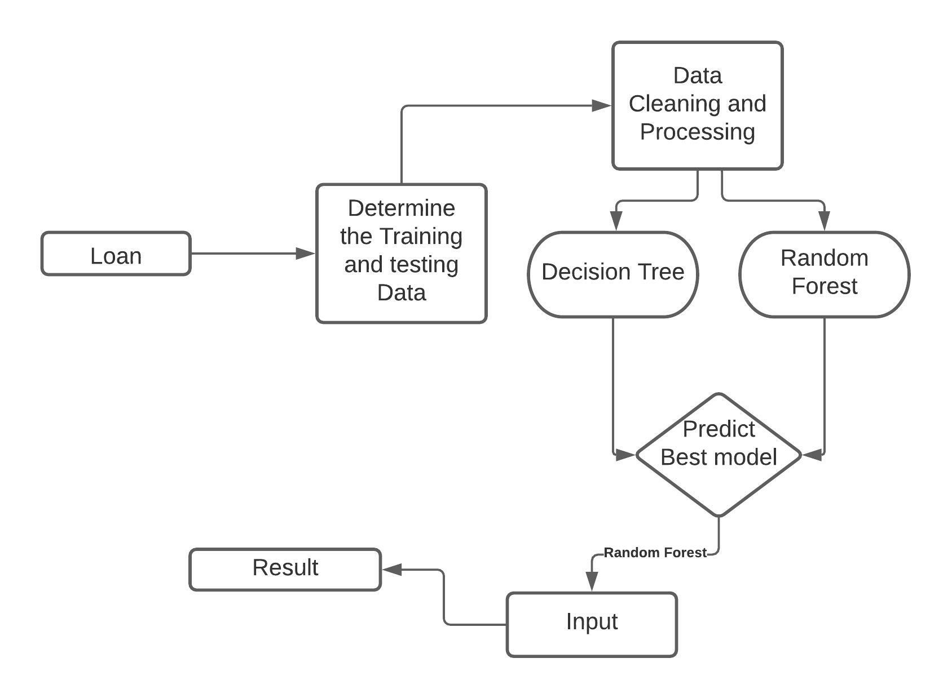
System Design
Phase 1 – Collection of data:
Through a Kaggle competition.
Phase 2 – Data preprocessing:
Here I have to perform various tasks to observe the patterns in images. discriminate some images which are not useful. Images with more number of detection, images with law brightness, images without bounding box.
Phase 3 – Comparing different models and training
Phase 4 – Result/Deploying the model
VIII Semester, Department of ISE, RNSIT
2021 - 2022
<number>
Notes:
<number>

Slide 8
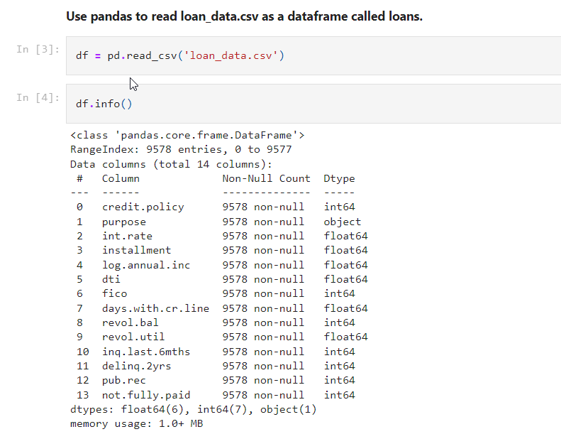
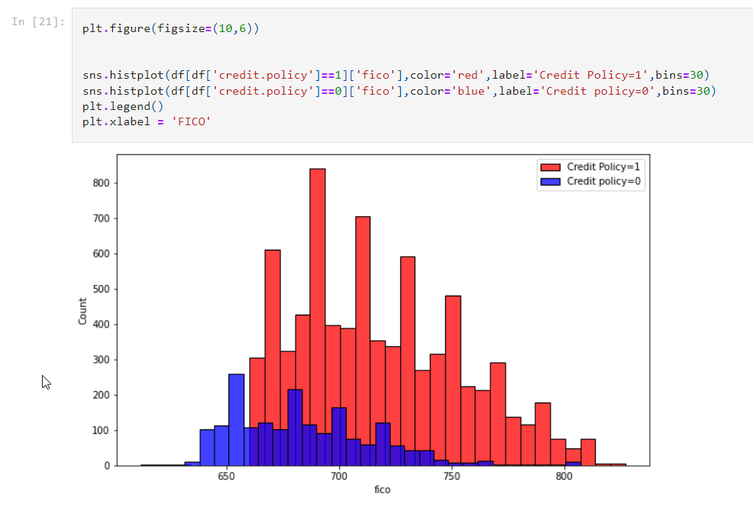
Implementation / Coding
Get the data
Exploratory data analysis.
plotting histogram for credit policy
VIII Semester, Department of ISE, RNSIT
2021 - 2022
<number>
Notes:
<number>

Slide 9
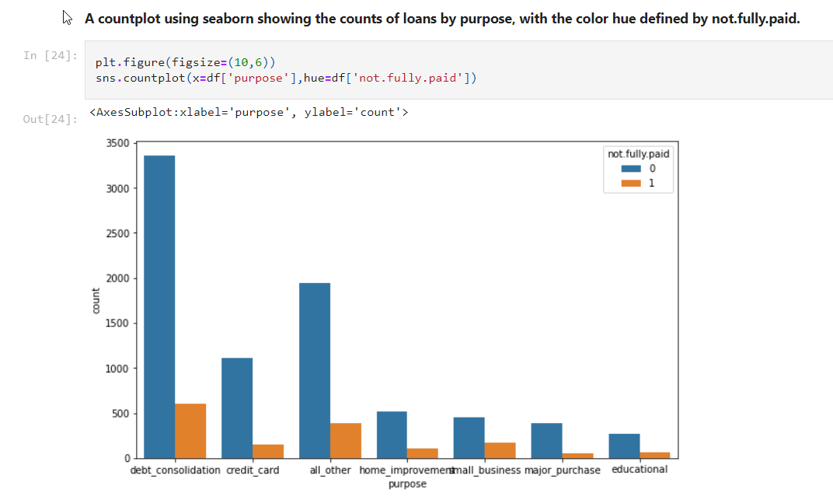
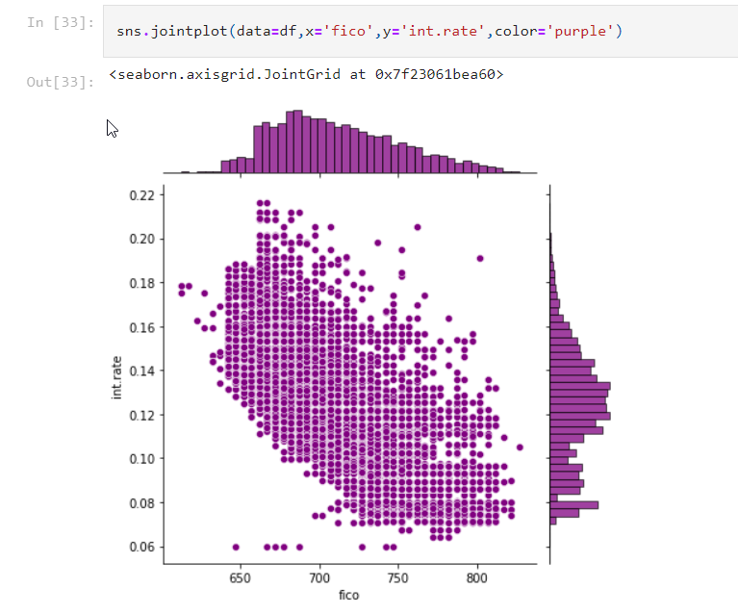
plotting histogram for purpose of loan
graph for fico Vs interest rate
VIII Semester, Department of ISE, RNSIT
2021 - 2022
<number>

Slide 10
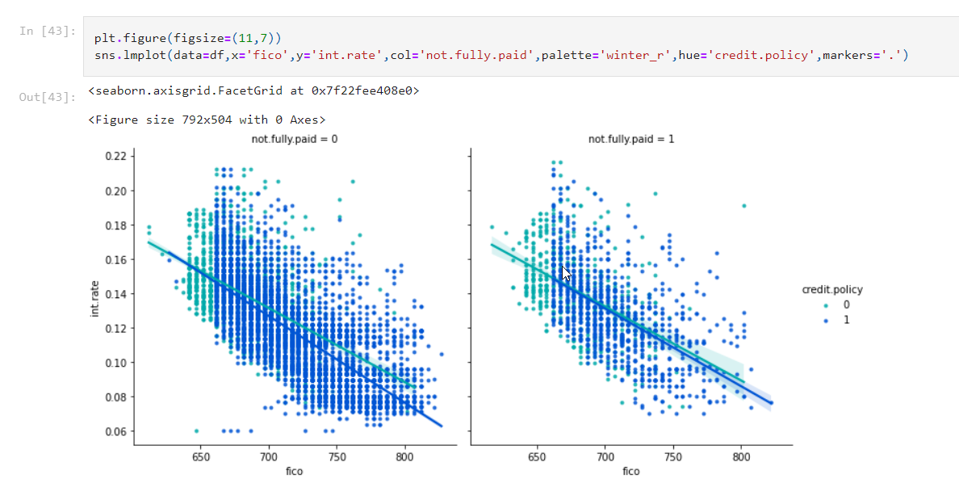
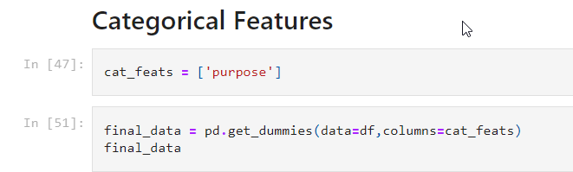
graph on fico Vs Int_rate w.r.t fully paid
VIII Semester, Department of ISE, RNSIT
2021 - 2022
<number>

Slide 11
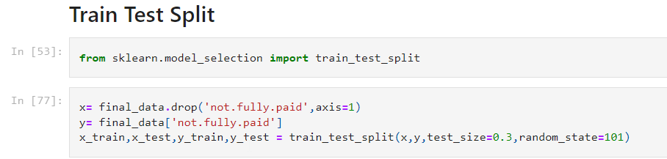
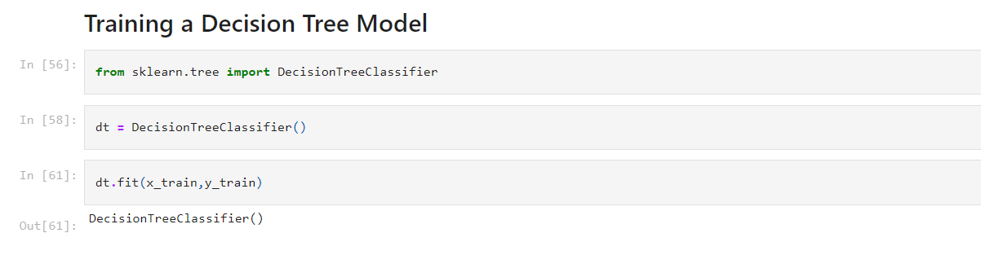
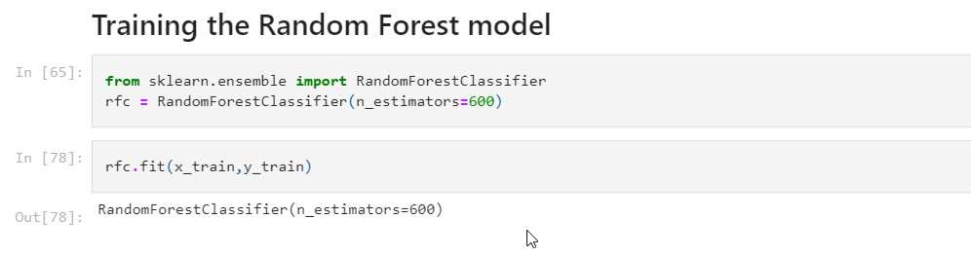
VIII Semester, Department of ISE, RNSIT
2021 - 2022
<number>

Slide 12
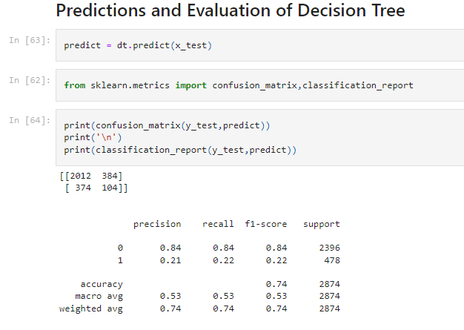
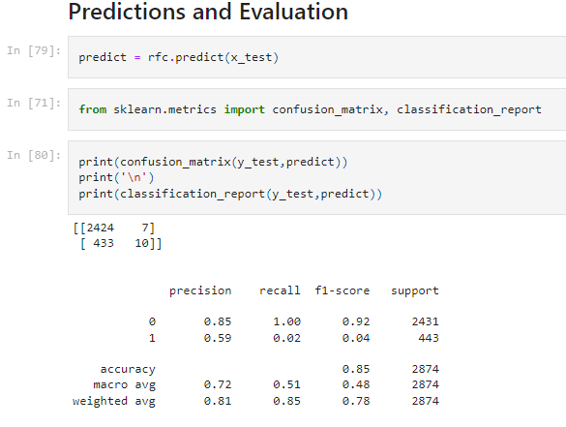
Results
VIII Semester, Department of ISE, RNSIT
2021 - 2022
<number>

Slide 13
CONCLUSIONS
The main purpose of this work is to classify and analyze the nature of the loan applicants. From a proper analysis of available data and constraints of the banking sector, it can be concluded that by keeping safety in mind that this modelling is much effective or highly efficient. This application is operating efficiently and fulfilling all the major requirements of Banker. Although the application is flexible with various systems and can be plugged effectively.
The module can be enhanced to cover below business scenarios
This paper work can be extended to higher level in future so the software could have some better changes to make it more reliable, secure, and accurate.
Thus, the system is trained with a present data sets which may be older in future so, it can also take part in new testing to be made such as to pass new test cases.
An website could be built and
VIII Semester, Department of ISE, RNSIT
2021 - 2022
<number>
Notes:
<number>

Slide 14
REFERENCES
Loan Prediction using Decision Tree and Random Forest Kshitiz Gautam, Arun Pratap Singh, Keshav Tyagi, Mr. Suresh Kumar, IRJET
Loan Prediction System Using Decision Tree and Random Forest Algorithms ,Shubham Chaudhary, Vishal Baliyan, Yatharth Katheria, IJETIE
A. Goyal and R. Kaur, “Accuracy Prediction for Loan Risk Using Machine Learning Models”.
A. Goyal and R. Kaur, “A survey on Ensemble Model for Loan Prediction”, International Journal of Engineering Trends and Applications (IJETA), vol. 3(1), pp. 32-37, 2016.
https://en.wikipedia.org/wiki/Exploratory_data_analysis
https://www.experian.com/blogs/ask-experian/credit-education/score- basics/what-is-a-good-credit-score/
VIII Semester, Department of ISE, RNSIT
2021 - 2022
<number>

Slide 15
THANK YOU
VIII Semester, Department of ISE, RNSIT
2021 - 2022
<number>

