Slide 1
A program for generating along-flowline profiles
George Lu
Glaciology Final Project
April 27th 2023
Notes:
Hi everyone, I’m George, and for my project I wanted to extend the practical that looked at interpolating gridded data. This was the practical where we had the velocity and thickness data sets and looked at selecting 2 points and seeing profiles along those points. I wanted to take this a step further and look at generating profiles along the flowlines of glaciers.

Slide 2
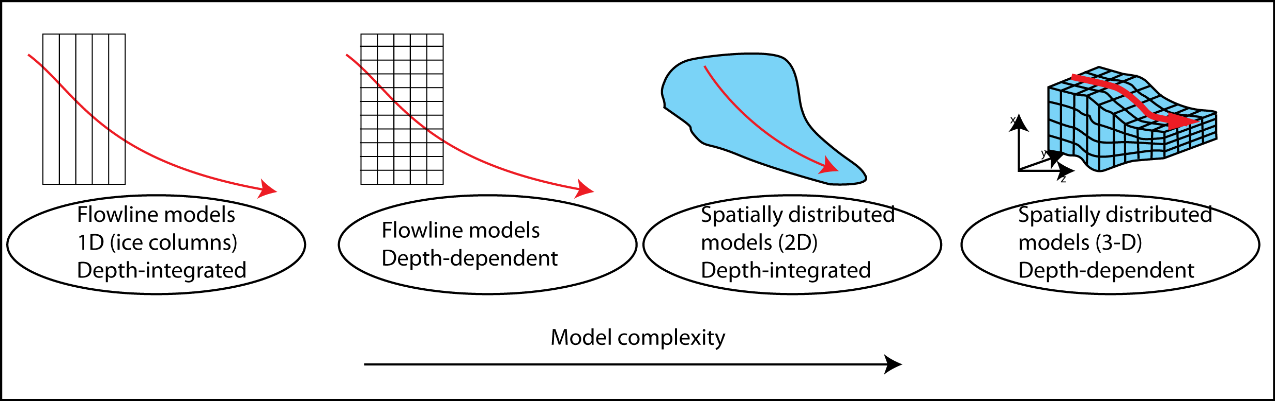
Motivation
From AntarcticGlaciers.org
Notes:
This is inspired by the general state of ice sheet modelling. As shown in this diagram, ice sheet models can have varying complexity, with the state of the art models being able to model ice in 3 dimensions. However, this level of complexity a) takes a lot of computational power, and b) sometimes makes assumptions that greatly simplify the physics. On the end of this spectrum are flowline models, which are one dimensional. In reducing the dimensionality of these models, we make a lot of large assumptions and simplifications, but doing so means that we can solve these models pretty much instantly. Additionally, we are able to include features that maybe be otherwise too difficult to directly include with these more complicated models.

Slide 3
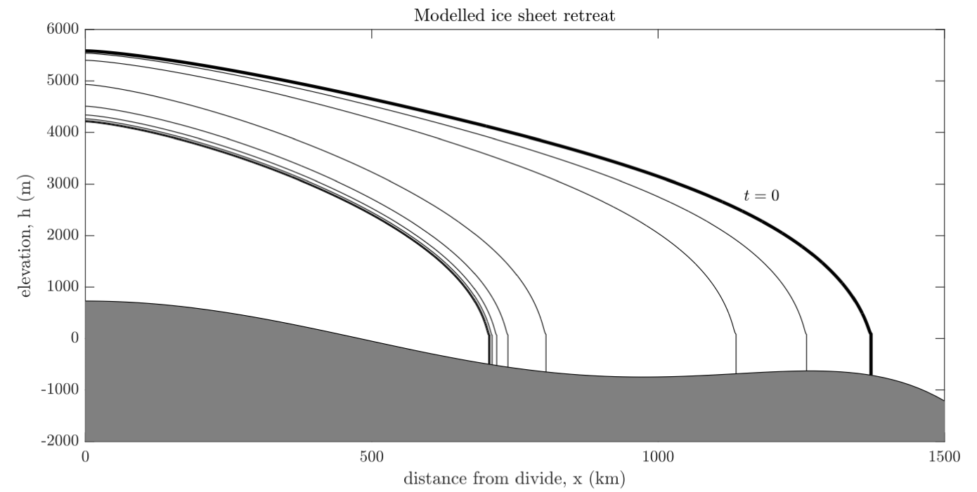
Motivation
Notes:
So for example, my current research uses a flowline model. And because of its simplicity, I am able to include explicit, physically realistic points of coupling with a subglacial channel system. (Eojin we should definitely chat about this because it’s relevant to your work which is great). And here is a plot of what this 1-D model outputs. Here I model the retreat of an ice sheet over a few thousand years. Obviously, given the ice sheet shape we see that this is very much a first-order type of investigation that looks at the broader physics, but isn’t directly translatable to real world observations.

Slide 4
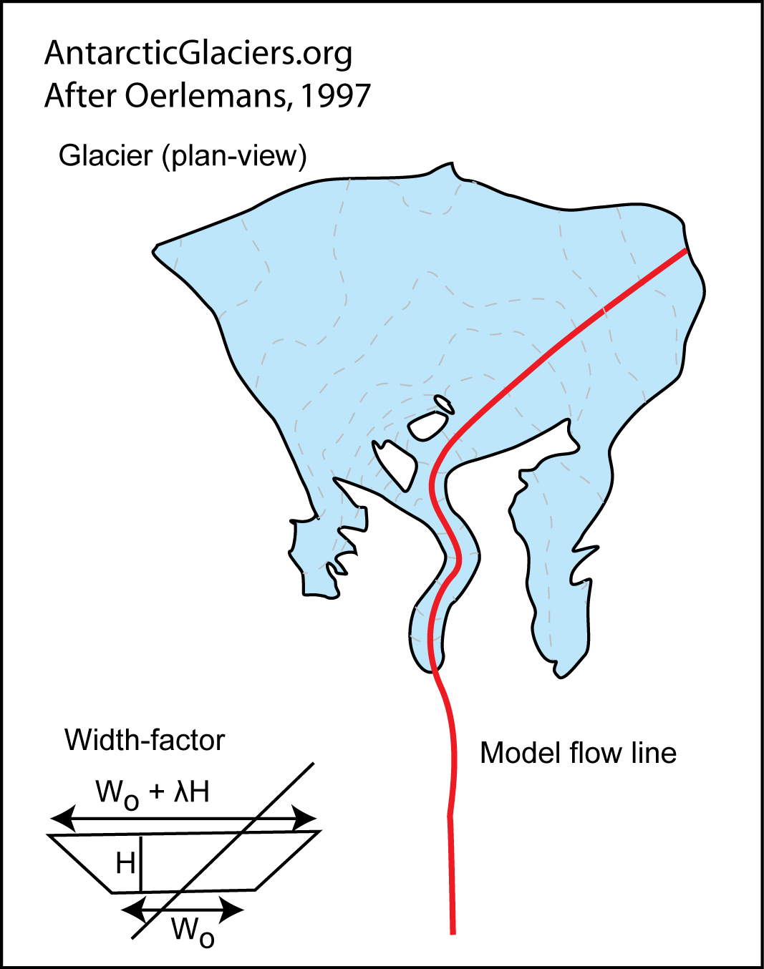
Motivation
How do we find this, but for any given point on a glacier?
How can we easily extract relevant data from this in an efficient manner?
Notes:
So that got me thinking, what happens when we do want to try and apply real world constraints to these simplified models? This is where flowlines come in. With valley glaciers this usually refers to this center line along the middle of the glacier where, a particle at the top of this glacier will follow this line to the terminus. And they use this profile as the 1D representation of the glacier. This means you could take values along this line, and perhaps use it in these simple 1-D models. First, I kind of wanted to see, without using more complicated algorithms and just my own intuition, if we can find lines like this for an ice sheet? And then, knowing these lines, we can easily use our interpolation skills from the practical to extract relevant data.

Slide 5
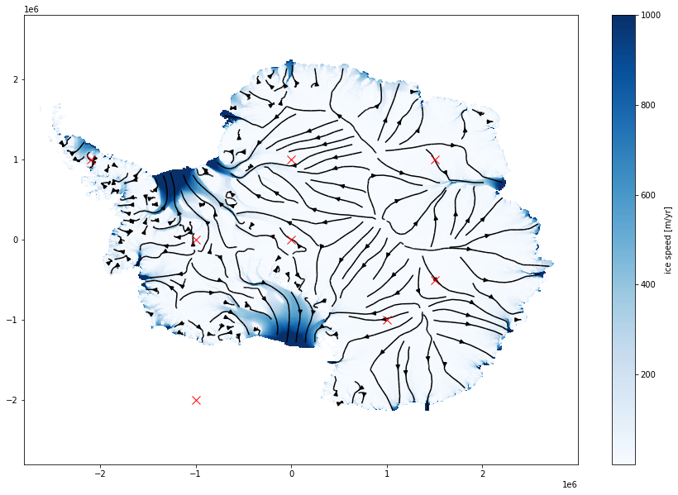
Notes:
And since ice sheets aren’t confined by valleys, this got me to thinking, why not introduce the capability to generate a flowline for any given point? So here is a plot I made using the velocity data that shows the speed of the ice sheet along with the streamlines, which is paths that are entirely tangential to the velocity field. In a steady state case where the velocities aren’t changing, this is also representative of the pathline. I’m assuming that maybe this can be a viable path that represents a section of the ice sheet. To generate this plot, I used a matplotlib function that calculates the streamlines for all the velocity data, but I’m not able to select a specific one. Consequently, I wanted to develop a program where I can click on a map, and it will spit out the relevant path that I can use to extract data with.

Slide 6
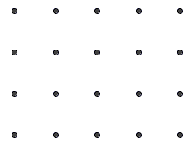
2 Separate Approaches
Following the directions of velocities
Notes:
So my first approach was to just follow my own rudimentary intuition and kind of brute force a stream line. The logic is as follows: given a starting point, I find the direction in which this velocity pointed. Then, using a defined search radius, I find the next point that this velocity is pointing at. This is then the next point along the flow line. I then rinse and repeat until I end up at the edge of the ice sheet. I think this method is pretty simple as it only requires some basic math with the velocity data, and isn’t complex at all.

Slide 7
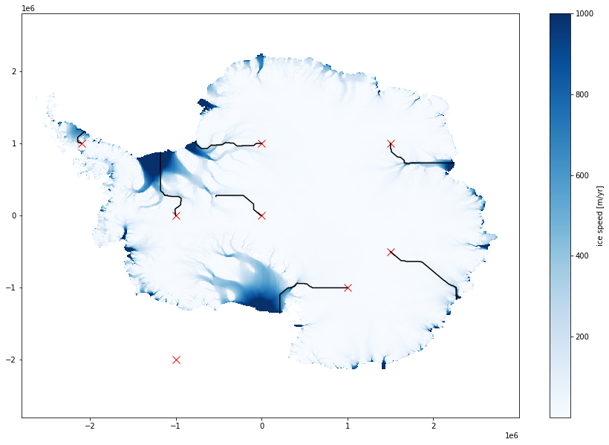
Notes:
So trying it out with 8 random seed points, these are the results. I picked these initial points for some variety. One is on the peninsula, others feed into wider ice shelves, others feed into narrower outlet glaciers, and one is just in the middle of the ocean to test if my solver will break if I picked it. Looking at these lines, they are a bit zig-zaggy, especially once they reach the shelf. I think this is because of my search radius, which might get messed up when there’s faster velocities. We also see one of the flowlines fail to reach the edge of the ice, which is strange.

Slide 8
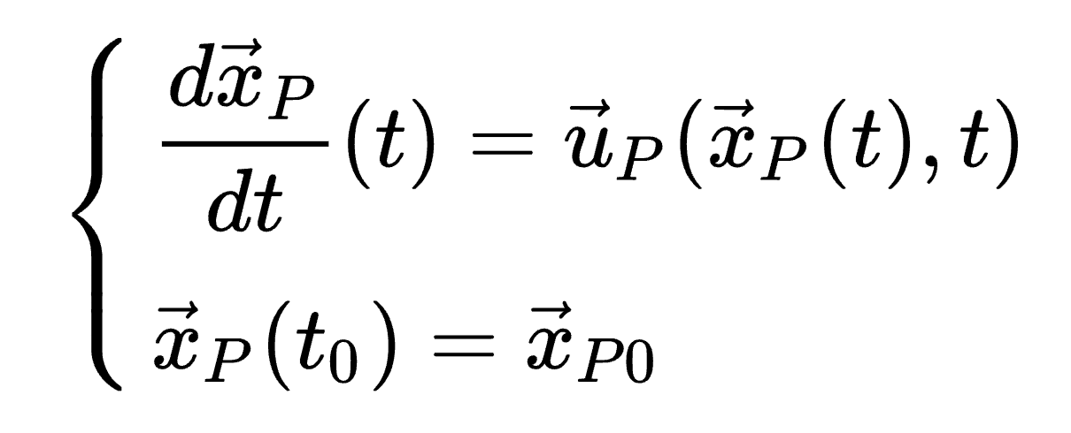
2 Separate Approaches
Calculating the pathline
Notes:
So then I wanted to also implement the correct approach, which I thought would be harder than it actually was. Basically here I take advantage of the fact that I am assuming these velocities are in a relatively steady state, so the streamlines from my earlier slide are equivalent to the pathlines which are defined here. The pathline is the path a particle would take given a starting point and a velocity field. Since we know the starting position, and we have a function for the evolution of the position, this is an initial value problem. And python has many solvers that are able to solve IVPs. So then, using scipys ivp solver, I can immediately extract a pathline for a given seed point in a really straightforward manner by just feeding them the velocity fields as the function to solve.

Slide 9

Notes:
And here are the results from that. We see that all our points now flow to the edge of the ice, and they seem generally smoother. It also takes around the same time as the solver I wrote earlier (just a tad slower), so it’s probably the better bet. An interesting test would be to see if the relationship in solution time between these two methods is linear based on amount of data or resolution.

Slide 10

Notes:
Here are the two paths compared. We see for some cases, my grid method isn’t bad, but theyre not quite the same. Another cool direction to go could be to identifying the specific reasons why my first method diverges from this solver’s solutions.

Slide 11
A rough Demonstration
Notes:
Anyways, comparing these two methods is kind of the part I of this project. Next, I wanted to apply it to the interactive picker that we had in class for defining transects to get data from. This was an easy adaptation of code from class, for at least this demo version which I’ll show.

Slide 12
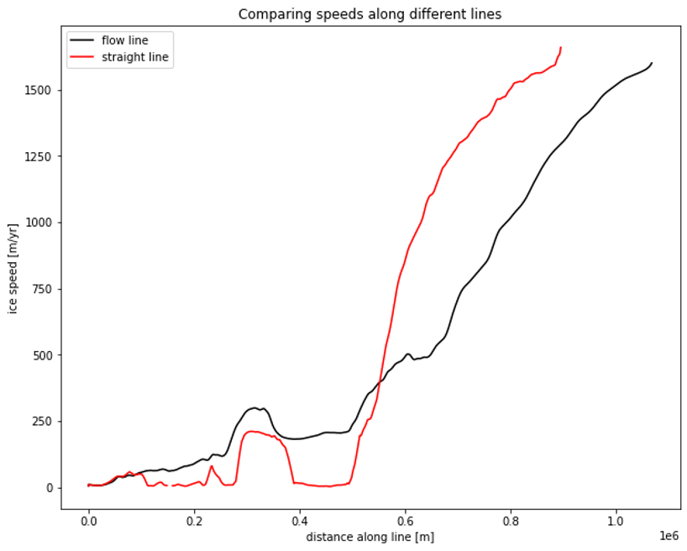
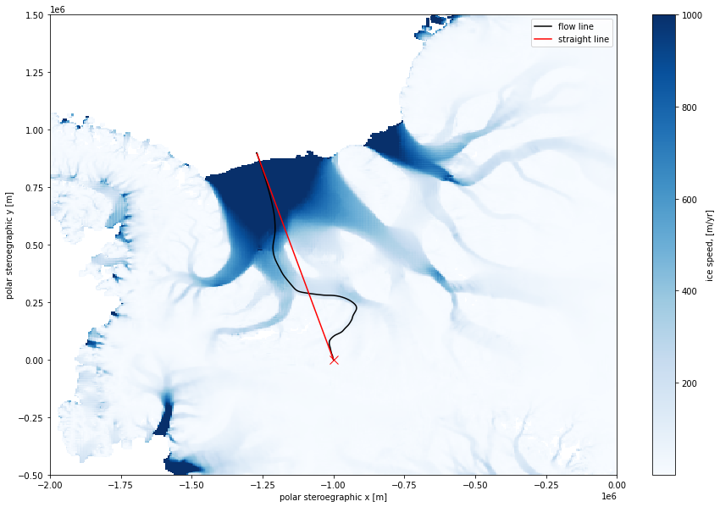
Example Usages of extracted flowline
Acquiring along-flowline measurements for various variables
Notes:
Ok so now that ive created this function, what can we do with this data? First I want to illustrate how being able to extract data along the flowline maybe quite useful compared to just taking a transect value. Here we looked at the speeds (from the same data set used to calculate the flowlines). From our intuition, we expect the speeds near the edge of the ice sheet to be faster than near the middle. With this straight line to the edge, we see it obviously isn’t the case, since we’re going in and out of regions of fast flow. However, when following along this determined flowline, we see that this relationship holds slightly more true.

Slide 13
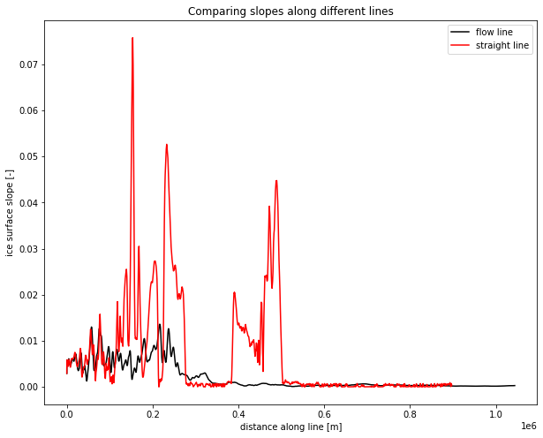
Example Usages of extracted flowline
Acquiring along-flowline measurements for various variables
Notes:
I also tried this out with the slope data and we see the same thing, we expect smaller slopes near the edge, and the flow line follows that much better than just taking a straight line. However, I found this slope data to be quite noisy, especially when interpolating it with coordinates determined by the velocity data. This is after some efforts at smoothing it.

Slide 14
Possible directions for future improvement
Use an adaptive grid search to adjust to velocity magnitudes in the first version of my code
Streamline the function to directly give you the variables requested along the flowline picked
Explore other methods of determining these lines without velocity data, which is trickier to come by
Notes:
And finally there’s a lot of additional stuff to look at. I think my search method isn’t entirely invalid, but could definitely be improved to match the IVP results. Finally, operating within the constraint of a jupyter notebook makes it a bit finicky selecting lines, but developing an actual program could be useful here if I’m looking to actually have it be a useful app or something. Finally, I think velocity data is great for generating these flowlines, but it requires more complicated data products – these velocity data sets either depends on models which makes many assumptions, or requires complicated feature tracking techniques. It would be nice to determine flowlines through just a single snapshot, so finding out a way to do that could be powerful. That’s everything I have thus far though, thanks for listening!

