Slide 1
Web Developer vs Web Designer
Vishnu bhagirathan

Slide 2
Agenda
What is Web Development?
01
Who is a Web Developer?
02
Who is a Web Designer?
03
Web Developer vs Web Designer: Key Roles
04
Salary Trends
05

Slide 3
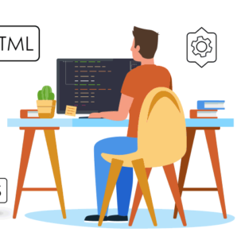
What is Web Development?
Web development is basically the tasks associated with developing websites for hosting via intranet or internet. The web development process involves web design, web content development, client-side/server-side scripting and network security configuration.

Slide 4

Who is a Web Developer?
A web developer is a programmer who specializes in the development of World Wide Web applications using a client-server model. They are also responsible for designing, coding and modifying websites, from layout to function and according to a client’s specifications.

Slide 5
Front-End Developer
Front-end development is known as client-side development. It mostly involves programming all the public-facing visuals and elements as part of a website’s design. Front-end developers often have to collaborate with web designers. They must have strong programming skills such as HTML, CSS, and JavaScript as they work with elements that are visible to the users.
HTML
CSS
JS
React
Angular
Bootstrap

Slide 6
Back-End Developer
Back-end refers to the hidden layer that the users can’t see when they visit a website. They must have strong programming skills. The back-end layer forms a dynamic connection between the front-end and the database. To get this layer working it’s important to have the knowledge of server-side frameworks such as NodeJS is mandatory.
PHP
NODE
JAVA
Ruby on rails
MySQL
Mango

Slide 7
Full-Stack Developer
A Full Stack Web Developer is someone who has a good understanding of how the web works at each and every level, including setting up and configuring Linux or Windows servers, coding server-side APIs, running the client-side of the application by using JavaScript, operating and querying databases and structuring and designing the web page with CSS, HTML and JavaScript.

Slide 8
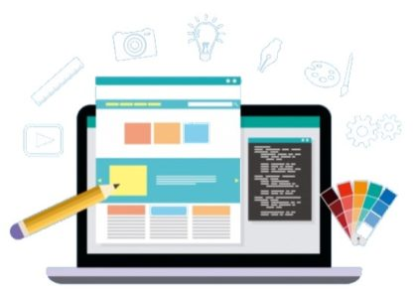
Who is a Web Designer?
Web designers create layouts that are visually pleasing for visitors. The work of a web designer is critical in making sure that visitors spend more time on a website. They analyze the latest trends in web design, respect design principles, and norms, follow what users expect when visiting a website, etc.

Slide 9
UI Designers
User Interface (UI) designers are the ones who deal with user interaction. They make sure that users are able to interact with the elements that are present on the website. The User Interface is everything that a visitor sees when they access a website, and it needs to be designed in a manner so that it fits the user’s expected workflow.

Slide 10
UX Designers
User Experience (UX) designers make sure that your website is able to keep the visitors engaged. They analyze data before finalizing any design on the website. Also, UX designers run complex tests and restructure the websites when needed to keep the user experience optimal.

Slide 11
Visual Designers
When we combine the duties of a UI and UX designer, it creates a separate profile called the visual designer. Visual designing refers to creating interfaces that are both visually pleasing and convenient to use. Also, they must respect the voice of a brand. Visual design skills involve both creativity and programming.

Slide 12
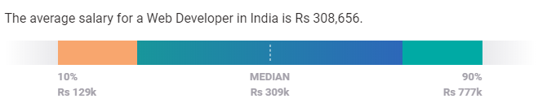
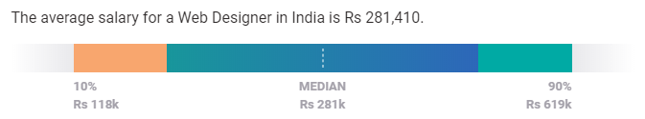
Salary Trends
Web Developer
Web Designer
*Source: Payscale.com

Slide 13
Web Dev vs Web Designer
Web Developer
Web Designer
Build the user interface using HTML, CSS, and JS languages.
Front-end developers can use styling preprocessors, JavaScript libraries, and frameworks to fasten development.
Front-end developers provide the markup design to back-end developers to implement a dynamic website.
Back-end developers create the backbone of the website using languages such as PHP and MySQL.
Web developers also use versioning tools to keep a history of the previous builds to quickly and effortlessly move back to a previous version.
Use software tools such as Adobe Photoshop, Framer, or Sketch to build the final layout design of the website
Good skills in graphic design and logo design
Have a good feel for user experience, to identify the simplest approach possible to attain the desired function.
Web designers MUST keep themselves up to date with the latest design trends.
They also need to keep in mind the branding of the website, color palettes to be used, and the typography and readability of the website.

Slide 14






Read suggestions

Slide 15
Thank you
For any queries or doubts you may contact me any time. Peace
Github: github.com/Viz38
Email: vishnub342@gmail.com
WhatsApp: 8848752606

