Slide 1
Quantum State Tomography
Aniket Sengupta, Luis Gonzalez Hofmann

Slide 2
Idealized Quantum State Tomography
Measure homodyne samples at given angles
From probability densities at different angles obtain quantum state
From samples reconstruct probability density
$${\left\{q_{i}^{\left(θ\right)}\right\}}_{i}$$
{q_i^((θ) ) }_i
Samples
$$p\left(θ\right)$$
𝑝(𝜃)
Probability Density
$$p\left(θ_{1}\right)$$
𝑝(𝜃_1 )
$$p\left(θ_{2}\right)$$
𝑝(𝜃_2 )
$$p\left(θ_{3}\right)$$
𝑝(𝜃_3 )
State $\hat{ρ}$
State 𝜌 ̂
Inverse Radon transform

Slide 3
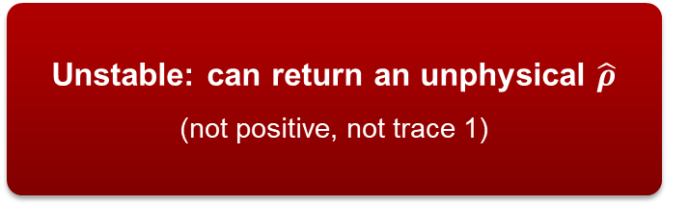
Quantum State Tomography in Practice
Finite samples
Estimate $p\left(θ\right)$ noisy histogram, not exact density
Estimate 𝑝(𝜃) noisy histogram, not exact density
Noise
Experimental imperfections corrupt measured distribution further
Direct inversion (inverse Radon transform)
Unstable: can return an unphysical $\hat{ρ}$
(not positive, not trace 1)
Need:
Robust to noise
Always returns a physical state
Maximum Likelihood Estimation (MLE)
Bayesian Mean Estimation (BME)

Slide 4
Maximum Likelihood Estimation (MLE)
How does MLE work in general
MLE for Quantum State Tomography
Implementation

Slide 5

Maximum Likelihood Estimation (MLE)
We have a model described by unknown parameter(s) $θ$
We observe data: X = {x₁, …, xₙ}
MLE asks: Which value of $θ$ makes the observed data most likely?
$θ^{\left(target\right)}= argmax P\left(X|θ\right)​ ≡argmax​ L\left(θ\right)$
Key idea: Choose the model parameters that make the data we actually observed as probable as possible.
Example: biased coin
Model: $P(H∣θ)=θ, P(T∣θ)=1−θ$
Model: P(H∣θ)=θ, P(T∣θ)=1−θ
After many tosses observe: $n_{H}$​ heads and $n_{T}$​ tails
After many tosses observe: n_H​ heads and n_T​ tails
The Likelihood is: $$L\left(θ\right)=θ^{n_{H}}{\left(1−θ\right)}^{n_{T}}​$$ If $n_{H}≠n_{T}$, the MLE algorithm will suggest that the coin is bias!
The Likelihood is: L(θ)=θ^(n_H ) (1−θ)^(n_T ) ​ If n_H≠n_T, the MLE algorithm will suggest that the coin is bias!

Slide 6
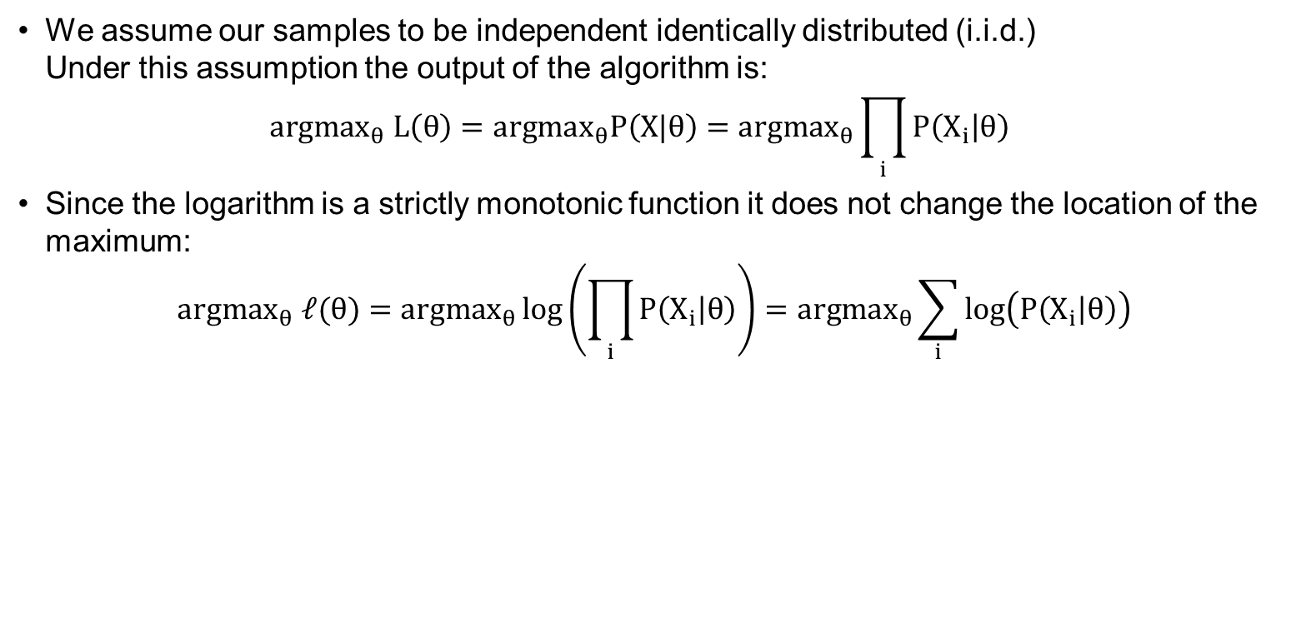
The Log-Likelihood
We assume our samples to be independent identically distributed (i.i.d.) Under this assumption the output of the algorithm is:
$${argmax}_{θ}​ L\left(θ\right)={argmax}_{θ}P\left(X|θ\right)={argmax}_{θ}\prod_{i}{P\left(X_{i} | θ\right)}$$
Since the logarithm is a strictly monotonic function it does not change the location of the maximum:
$${argmax}_{θ} ℓ(θ)={argmax}_{θ}\log\left(\prod_{i}{P\left(X_{i} | θ\right)}\right)={argmax}_{θ}\sum_{i}{\log\left(P\left(X_{i} | θ\right)\right)}$$
Easier to work with analytically
More numerically stable
Why do this?

Slide 7
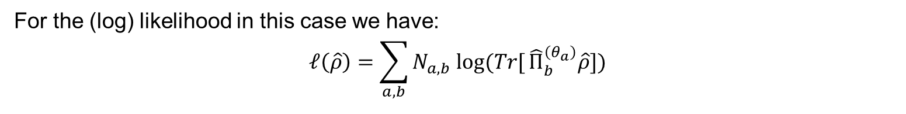
MLE for Quantum State tomography
Goal
Bin results
Reconstruct quantum state $\hat{ρ}$ from measured quadratures ${\left\{q{\left(θ_{a}\right)}_{j}\right\}}_{a,j}$
Reconstruct quantum state 𝜌 ̂ from measured quadratures {𝑞(𝜃_𝑎 )_𝑗 }_(𝑎,𝑗)
Quadratures are not a probability function but a probability density
Bin hits and projectors
Each $q{\left(θ_{a}\right)}_{j}$ falls into one bin.
Each 𝑞(𝜃_𝑎 )_𝑗 falls into one bin.
Bins characterized by projector ${\left\{{\hat{Π}}_{b}^{\left(θ_{a}\right)}\right\}}_{a,b}$ and number of hits $N_{a,b}$
Bins characterized by projector {Π ̂_𝑏^((𝜃_𝑎 ) ) }_(𝑎,𝑏) and number of hits 𝑁_(𝑎,𝑏)
For the (log) likelihood in this case we have:
$$ℓ\left(\hat{ρ}\right)=\sum_{a,b}{N_{a,b} log⁡(Tr[}{\hat{Π}}_{b}^{\left(θ_{a}\right)}\hat{ρ}])$$
Now how do we get the state maximizing the likelihood?

Slide 8

MLE for Quantum State tomography
Take initial guess state ${\hat{ρ}}^{(0)}$ and update the state (up to normalization) according to:
${\hat{ρ}}^{(n+1)}=\hat{R}\left({\hat{ρ}}^{\left(n\right)}\right){\hat{ρ}}^{\left(n\right)}\hat{R}\left({\hat{ρ}}^{\left(n\right)}\right)$
This operator is defined as:
$\hat{R}\left(\hat{ρ}\right)≡\frac{1}{n_{a}}\sum_{a=1}^{n_{a}}{\sum_{b}{N_{a,b}\frac{{\hat{Π}}_{b}^{\left(θ_{a}\right)}}{Tr[{\hat{Π}}_{b}^{\left(θ_{a}\right)}\hat{ρ}]}}}$
Why this works:
At the maximum of the Likelyhood: $$\hat{R}\left({\hat{ρ}}_{ML}\right) {\hat{ρ}}_{ML}={\hat{ρ}}_{ML}$$
At the maximum of the Likelyhood: 𝑅 ̂(𝜌 ̂_𝑀𝐿 ) 𝜌 ̂_𝑀𝐿=𝜌 ̂_𝑀𝐿
The algorithm searches for this fixed point. Convergence to the global maximum is not guaranteed.

Slide 9
Implementation
Input:
Range vector ${\left\{x\right\}}_{{x=x}_{min}}^{x_{max}}$
Range vector {𝑥}_(〖𝑥=𝑥〗_𝑚𝑖𝑛)^(𝑥_𝑚𝑎𝑥 )
Homodyne samples: select angles ${\left\{θ_{a}\right\}}_{a=1}^{n_{a}}$ and samples per angle $n_{θ}$
Homodyne samples: select angles {𝜃_𝑎 }_(𝑎=1)^(𝑛_𝑎 ) and samples per angle 𝑛_𝜃
Run sampling: choose target state, number of bins $n_{b}$ and get ${\left\{N_{a,b}\right\}}_{a,b}$
Run sampling: choose target state, number of bins 𝑛_𝑏 and get {𝑁_(𝑎,𝑏) }_(𝑎,𝑏)
Run Algorithm: Two stoping conditions
Run for a fixed number of iterations
Run until two subsecuent states are close to the same: ${fid}_{step}\left(n\right)= fid\left({\hat{ρ }}^{\left(n\right)},{\hat{ρ }}^{\left(n+1\right)}\right)≈ 1$
Run until two subsecuent states are close to the same: 〖𝑓𝑖𝑑〗_𝑠𝑡𝑒𝑝 (𝑛)= 𝑓𝑖𝑑((𝜌 ) ̂^((𝑛) ),(𝜌 ) ̂^((𝑛+1) ) )≈ 1
Returns:
Final state ${\hat{ρ}}_{out}$
Final state 𝜌 ̂_𝑜𝑢𝑡
List of all the ${\left\{{fid}_{step}\left(n\right)\right\}}_{n}$
List of all the {〖𝑓𝑖𝑑〗_𝑠𝑡𝑒𝑝 (𝑛)}_𝑛
Optionally all the intermediate states ${\left\{{\hat{ρ }}^{\left(n\right)}\right\}}_{n}$
Optionally all the intermediate states {(𝜌 ) ̂^((𝑛) ) }_𝑛

Slide 10
Our MLE Notebooks
Benchmarking simulation parameters (benchmark_nb.ipynb)
Test different parameters to see how the algorithm behaves:
Target states
Binning (play with n_b)
Samples (play with n_a and n_theta)
Interactive running of the algorithm (interactive.ipynb)
Select different target states and play with the sampling and algorithm parameters

Slide 11
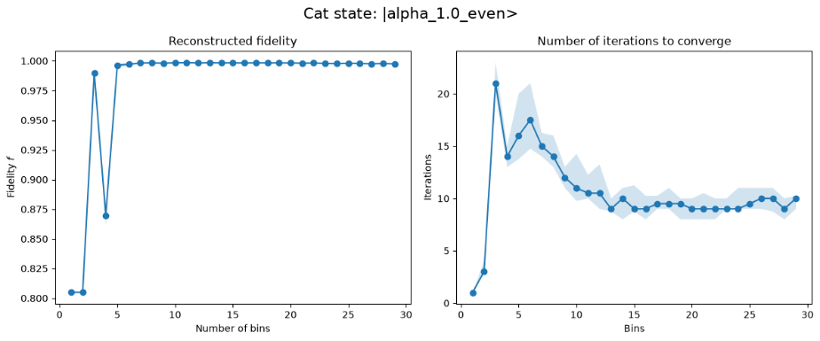
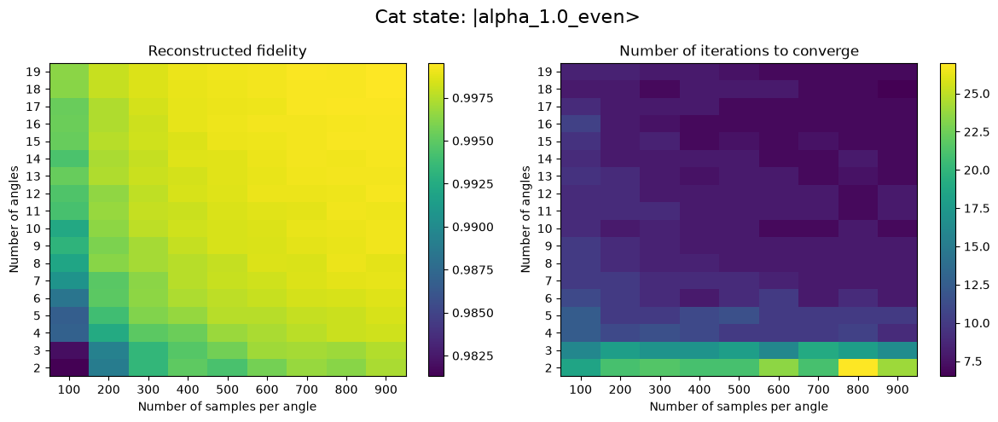
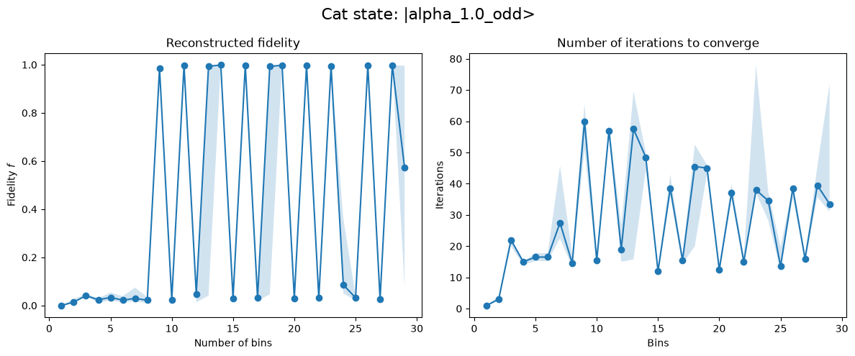
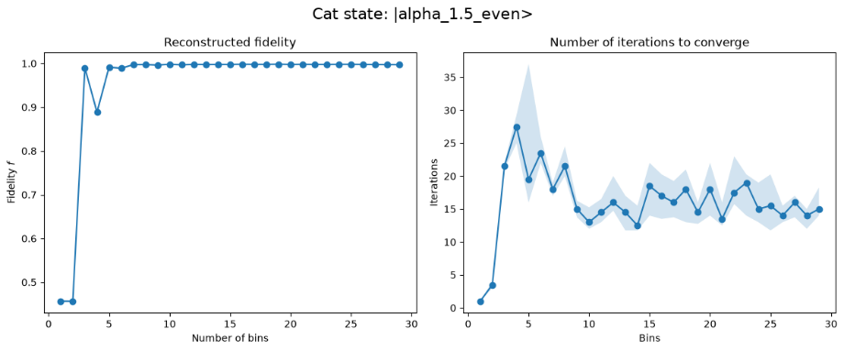
Benchmarking simulation parameters: Cat states

Slide 12
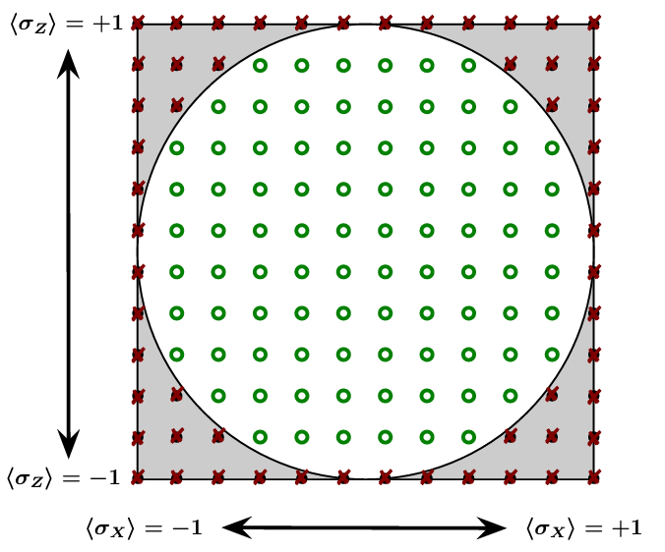
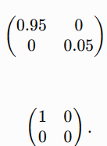
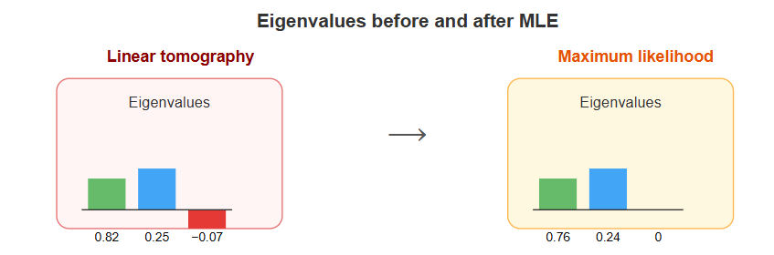
Why do we need other estimation techniques other than MLE
1. MLE maximizes the likelihood and can be rank deficient.
True eigenvalues of the density matrix:
MLE eigenvalues due to finite sampling
2. In MLE for special cases, convergence is not Guaranteed.
3. BME do come with error bars (uncertainty) of the estimate.

Slide 13




Bayesian Mean Estimation for Quantum State Tomography
1. Use the data to generate a likelihood function,
2. Choose a prior distribution over states. It represents the estimator’s ignorance, and should generally be chosen to be as ‘uniform’, or uninformative, as possible.
3. Multiply the prior by the likelihood and normalize to obtain a posterior distribution,
which represents the estimator’s knowledge. The proportionality constant is set by normalization.
4. Report the mean of this posterior,
This is the best concise description of the estimator’s knowledge.

Slide 14




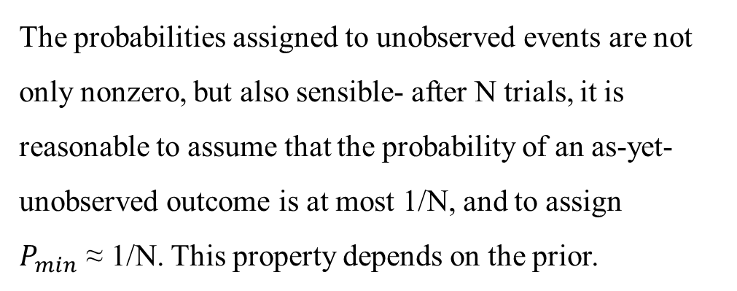
An Example of BME –
Coin flips (Bernoulli trials)
Heads: ‘b’
Tails: ‘(1-b)’
No. of Trials: ‘N’ with ‘n’ Heads
The probabilities assigned to unobserved events are not only nonzero, but also sensible- after N trials, it is reasonable to assume that the probability of an as-yet-unobserved outcome is at most 1/N, and to assign $P_{min}$ ≈ 1/N. This property depends on the prior.
Likelihood function
Initial estimator
Uniform Choice of Prior
Averaged over the Posterior

Slide 15
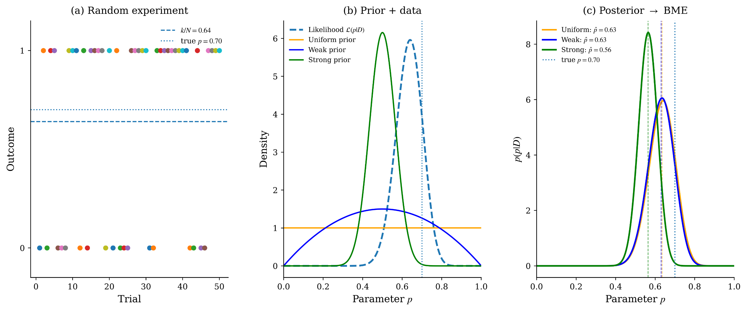
Estimating the Bernoulli parameter

Slide 16




The Metropolis-Hastings way of Integrating
It computes the average value of a distribution/function (in this case, $ρ$) over an integration measure.
It integrates by a simple jumping rule.
$ρ^{′}=J(ρ)$ where $J$ is the jump operator
Calculate this r-factor for consecutive $ρ^{′}s$
If r >1 (ρ′ is more likely than ρ), then we jump as before. If not, we jump to ρ′ with probability r, and stay at ρ (adding it, once again, to the running total) with probability 1−r.
This biasing ensures that the algorithm spends more time at more likely spots and tends to climb up into regions of high probability.
What is important is that J should generate the underlying measure dρ (uniform sampling in this case).

Slide 17
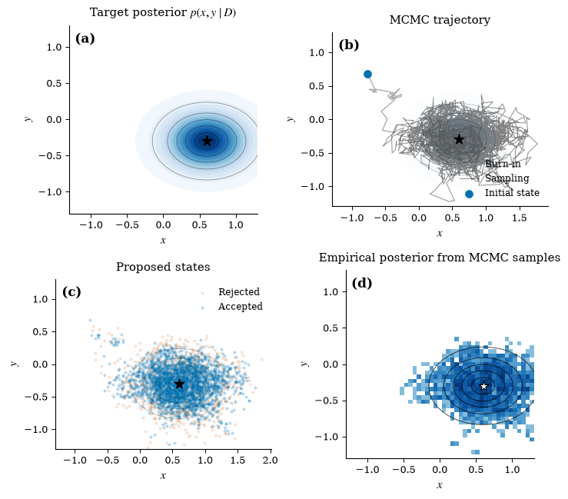
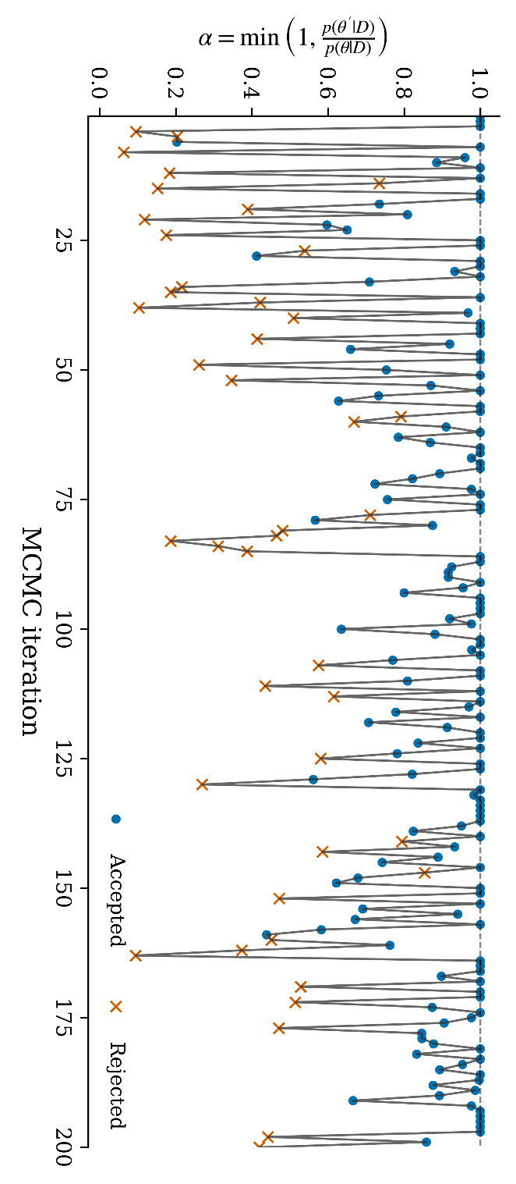

Slide 18
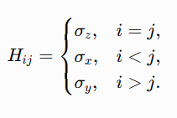



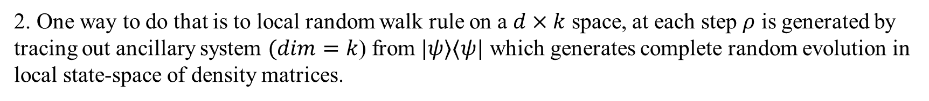
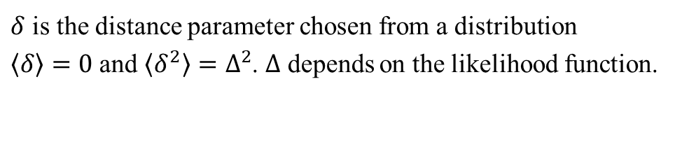
How do we Jump?
1 One way to do that is to generate random unitaries over Haar measure, generating random unitaries is computationally hard and it is only applicable for states with same purity. It doesn’t explore the full state-space.
2. One way to do that is to local random walk rule on a $d×k$ space, at each step $ρ$ is generated by tracing out ancillary system $(dim=k$) from $|ψ⟩⟨ψ|$ which generates complete random evolution in local state-space of density matrices.
$$(d×k)$$
$δ$ is the distance parameter chosen from a distribution
$⟨δ〉=0$ and $⟨δ^{2}〉=Δ^{2}$. $Δ$ depends on the likelihood function.
subspace
A good heuristic is $δ$should be chosen such that the acceptance ratio should be around 60%.

Slide 19
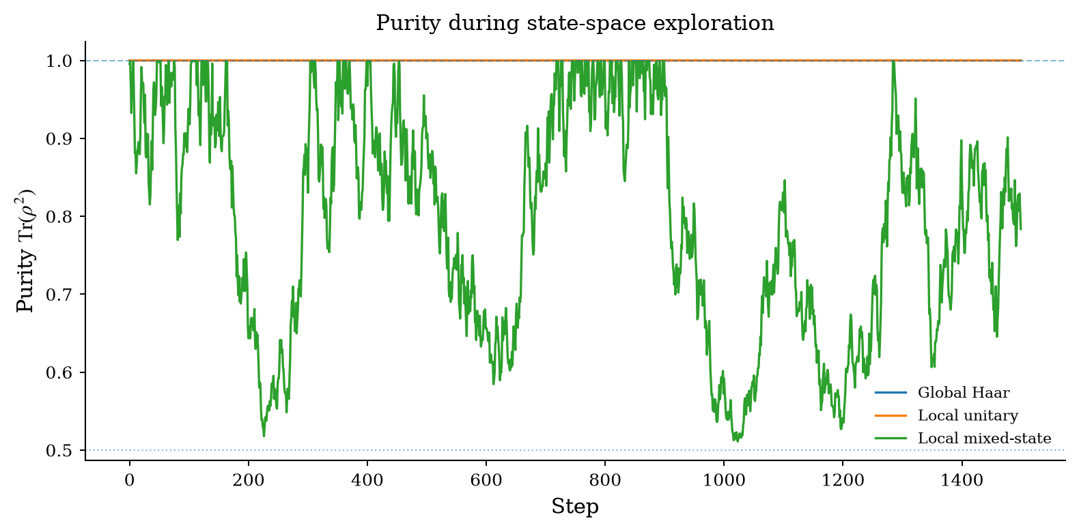
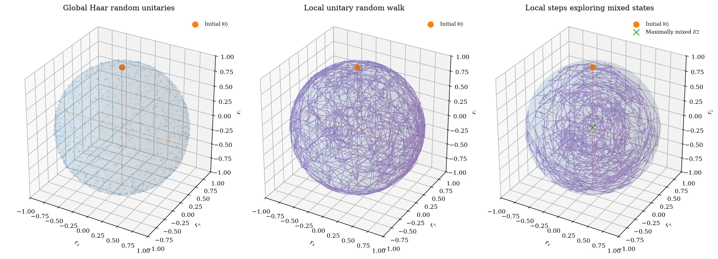
An Example for a single
qubit system

Slide 20
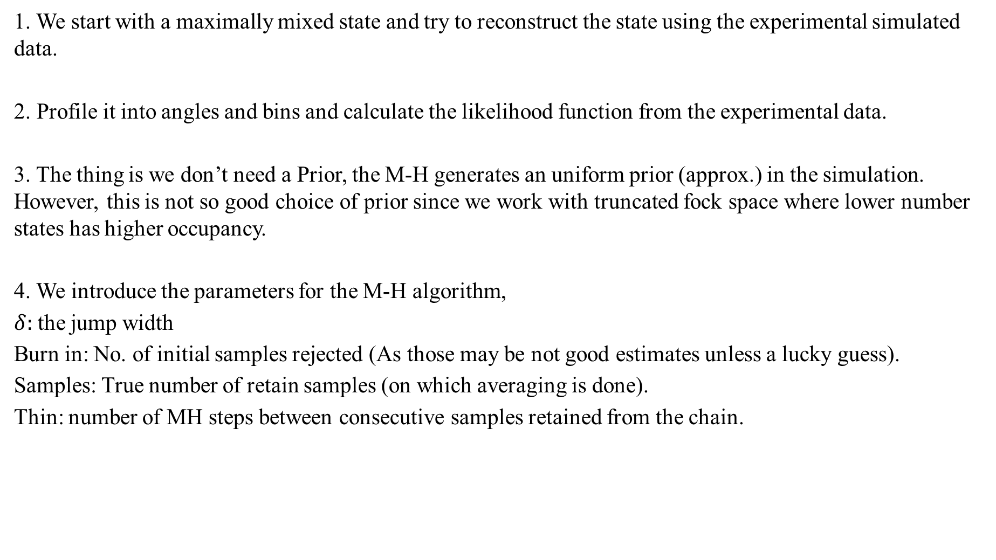
The Code is Messy-
1. We start with a maximally mixed state and try to reconstruct the state using the experimental simulated data.
2. Profile it into angles and bins and calculate the likelihood function from the experimental data.
3. The thing is we don’t need a Prior, the M-H generates an uniform prior (approx.) in the simulation. However, this is not so good choice of prior since we work with truncated fock space where lower number states has higher occupancy.
4. We introduce the parameters for the M-H algorithm,
$δ:$the jump width
Burn in: No. of initial samples rejected (As those may be not good estimates unless a lucky guess).
Samples: True number of retain samples (on which averaging is done).
Thin: number of MH steps between consecutive samples retained from the chain.

Slide 21
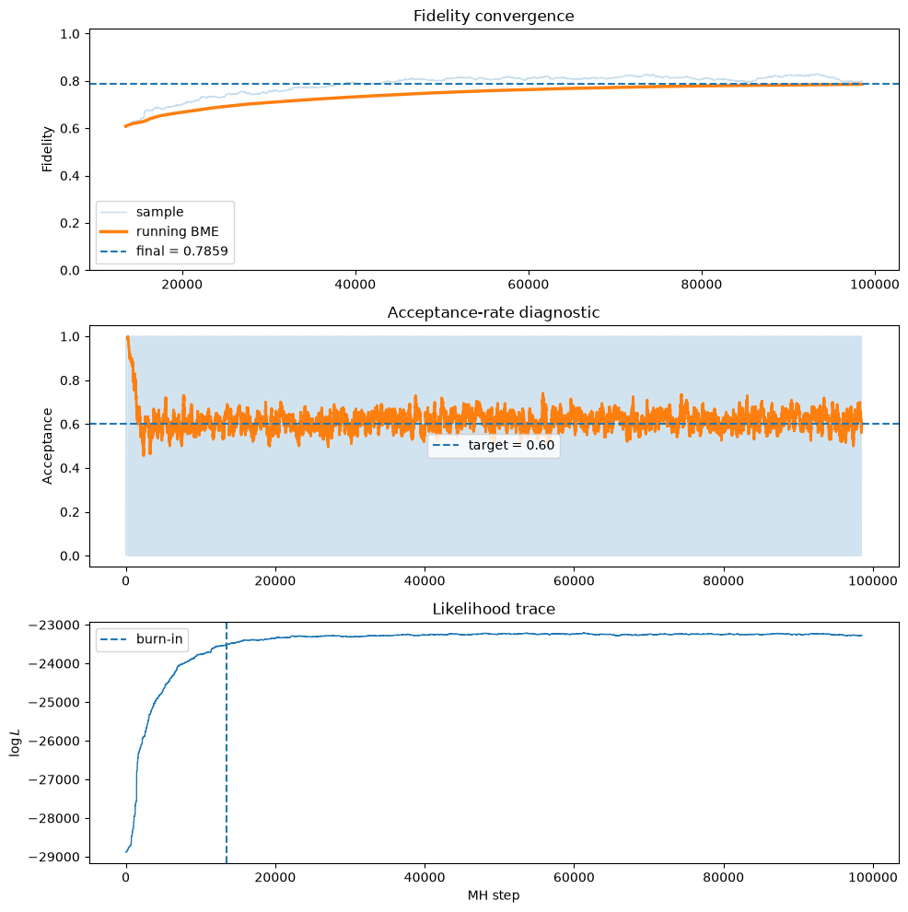
An Example of BME

Slide 22
Thank you!
Questions?

