Slide 1
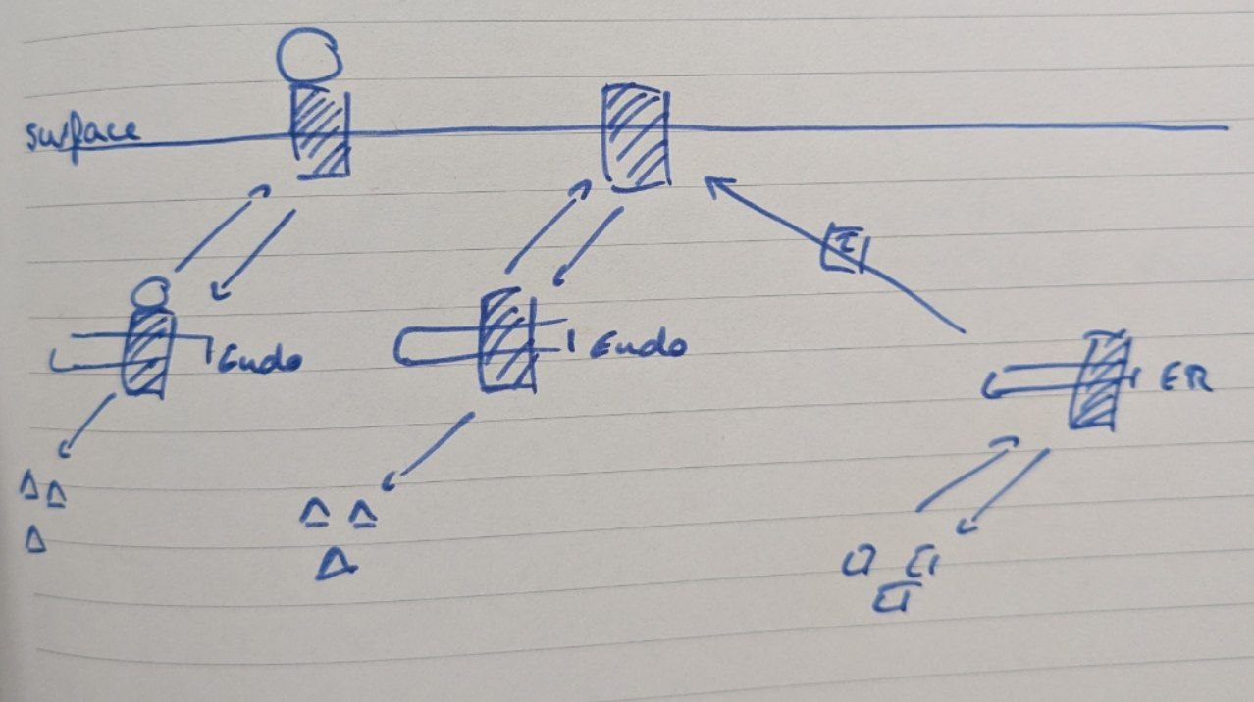
Results TCR-modeling

Slide 2
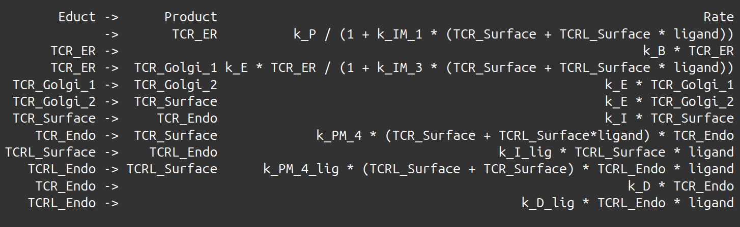
ODE-equations (reactions)

Slide 3
Observables (map model to data)
total_TCR = log2(TCR_ER + TCR_Endo + TCRL_Endo + TCR_Golgi_1 + TCR_Golgi_2 + TCR_Surface + TCRL_Surface + offset_Total) + scale_Total
surface_TCR_sek = log2(TCRL_Surface + offset_Surface_sec) + scale_Surface
surface_TCR_full = log2(TCRL_Surface + TCR_Surface + offset_Surface_full) + scale_Surface
Additionally: Add steady-state constraint for data without ligand, use that the derivative has to be 0

Slide 4
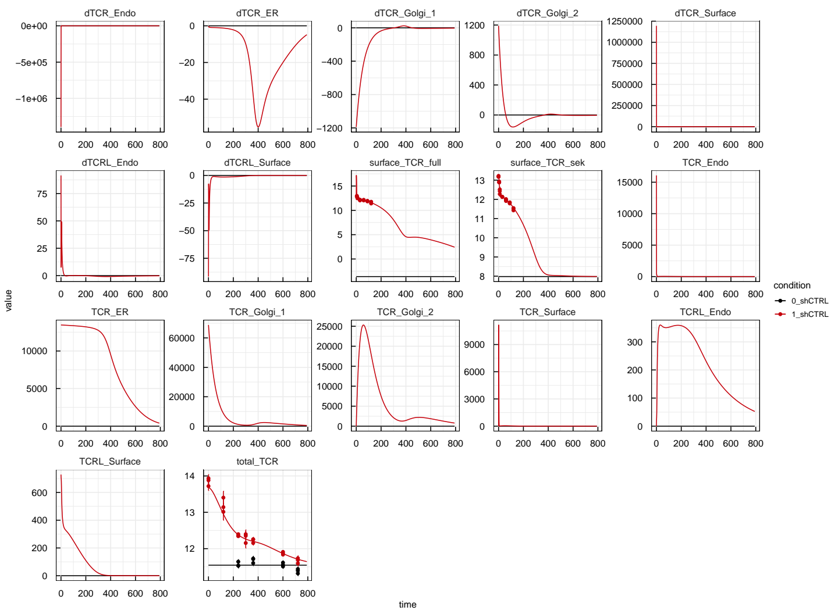
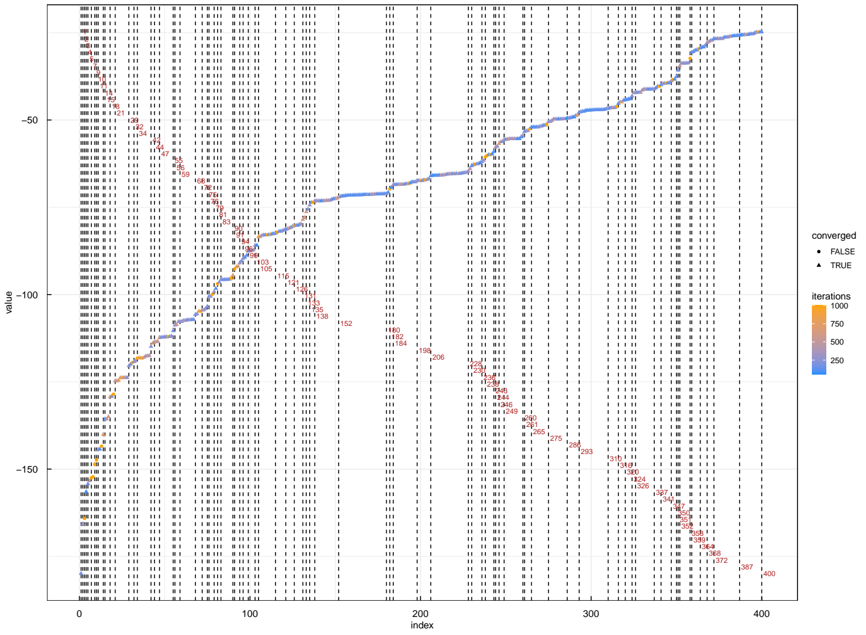
Results

Slide 5
What’s the problem?
Model too big for amount of data
Overlap in data rather small → oszillation possible
Too many feedbacks
No profile-based model reduction possible
No estimation of parameters possible

Slide 6
Trial and Error: Remove feedbacks
Set k_IM_3 to 0
Remove activation by TCR_Surface in
TCR_Endo → TCR_Surface reaction

Slide 7
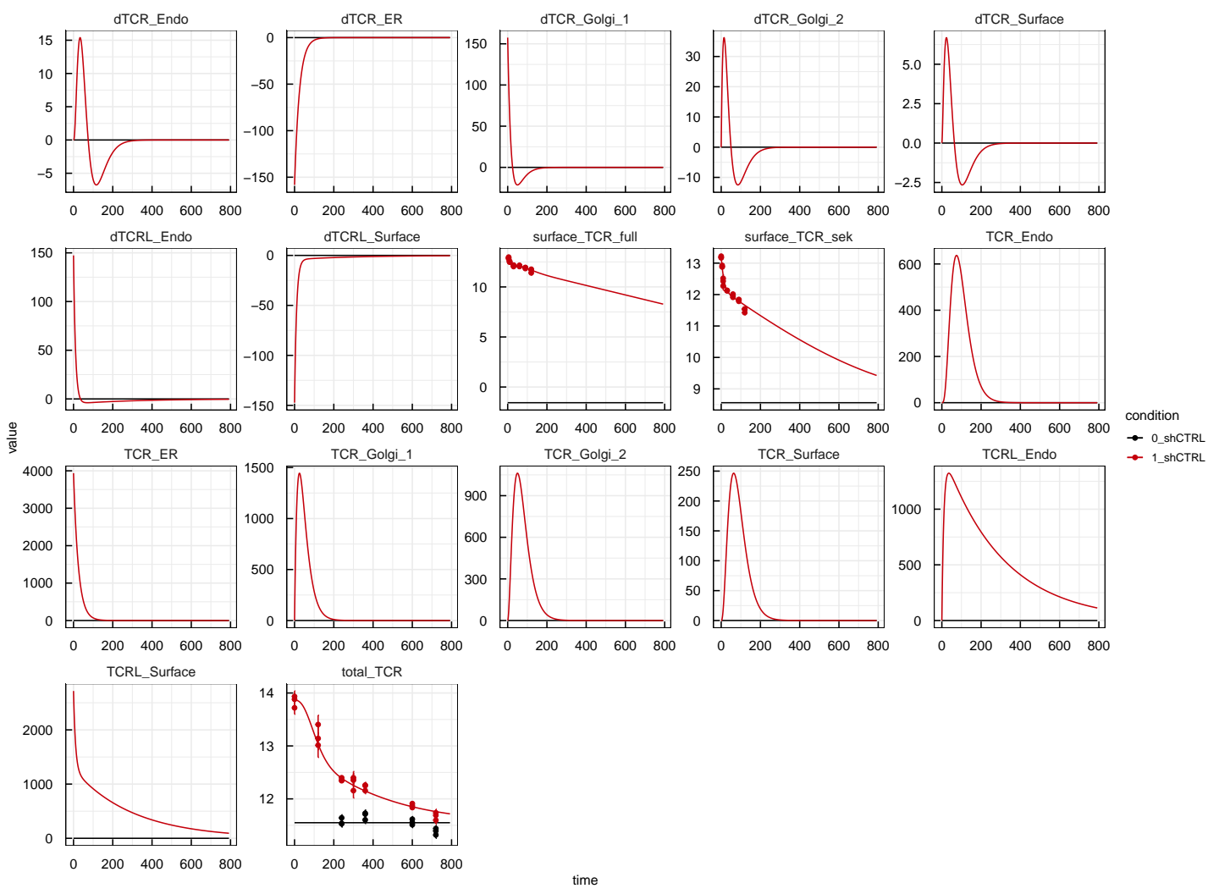
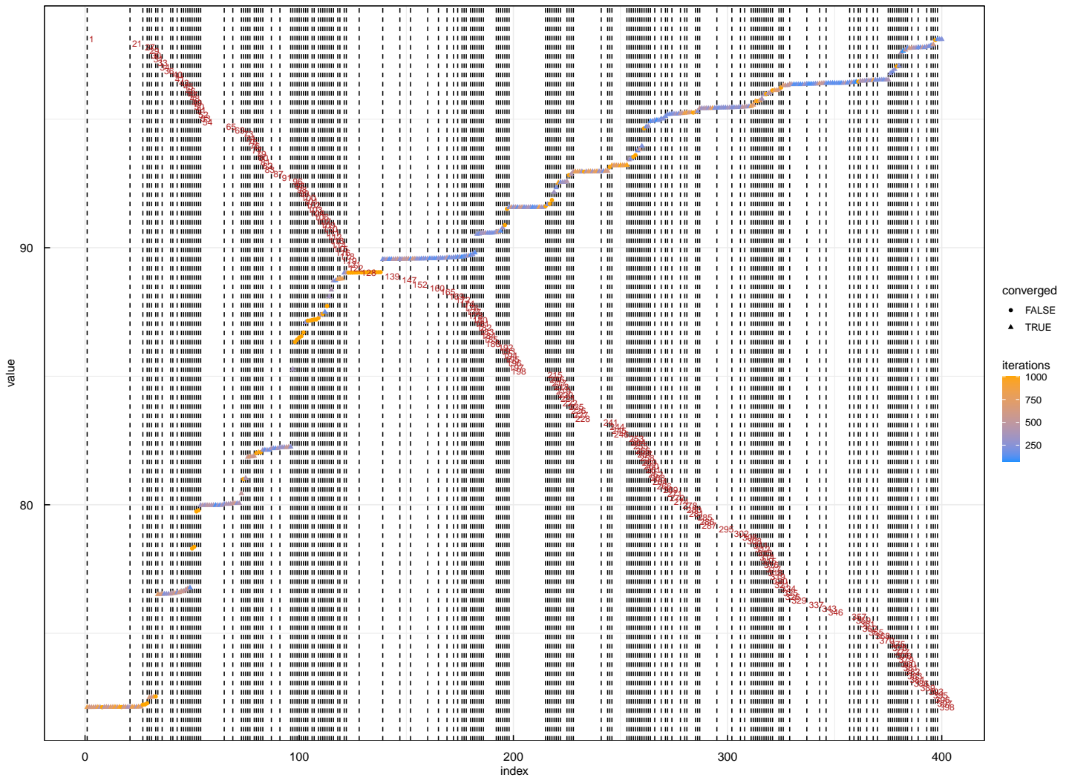
Results

Slide 8
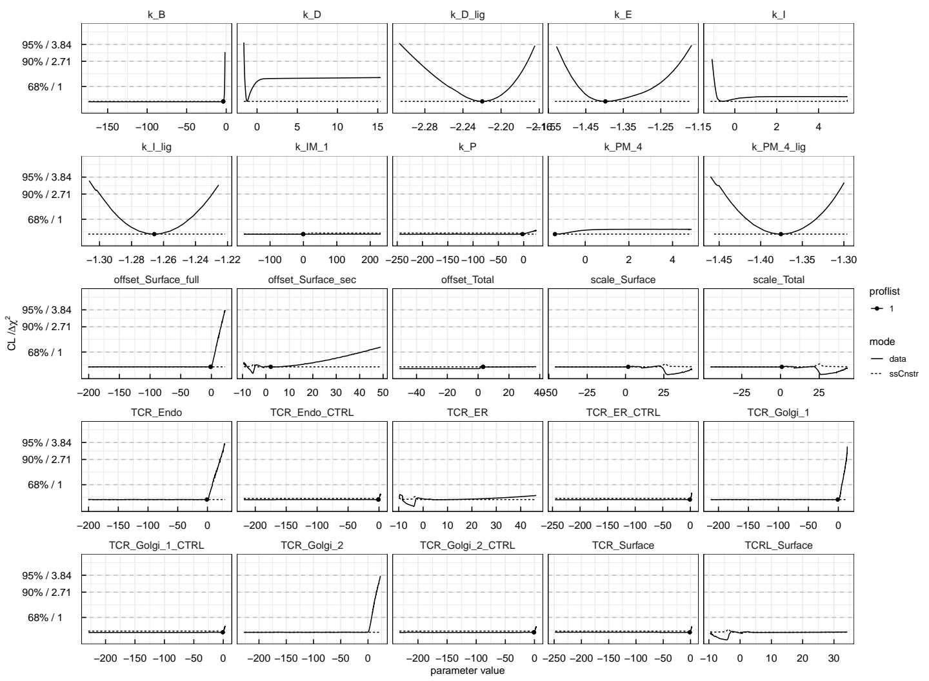
First
Profiles

Slide 9
Next steps, questions and ideas
Look at profiles paths and possible reduction
Can we measure the steady state fot the surface?
Maybe more overlap in time-points
Why is the ligand washed out?

