Slide 1
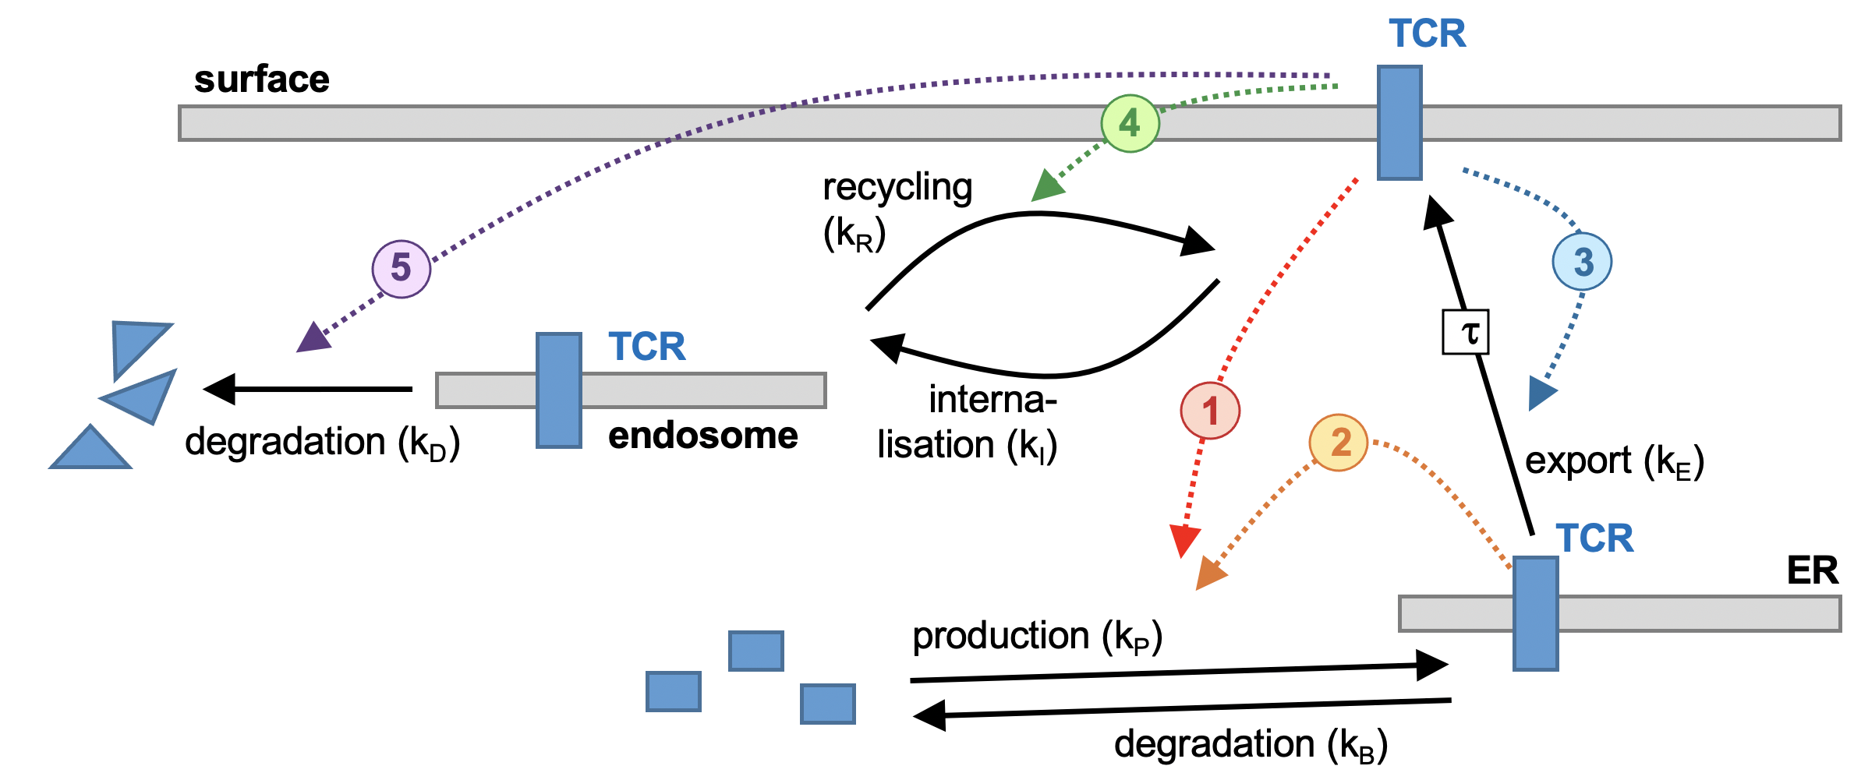
Model of TCR trafficking

Slide 2
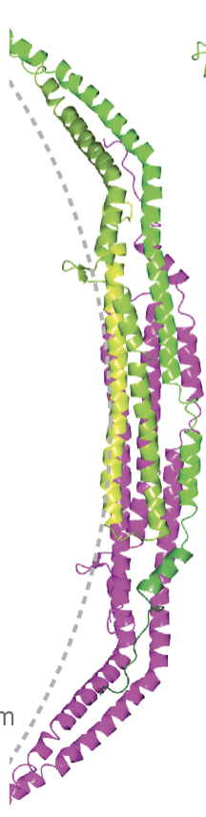
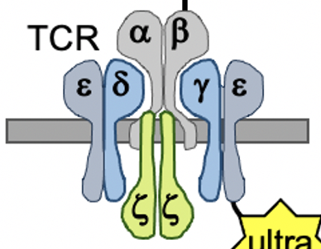
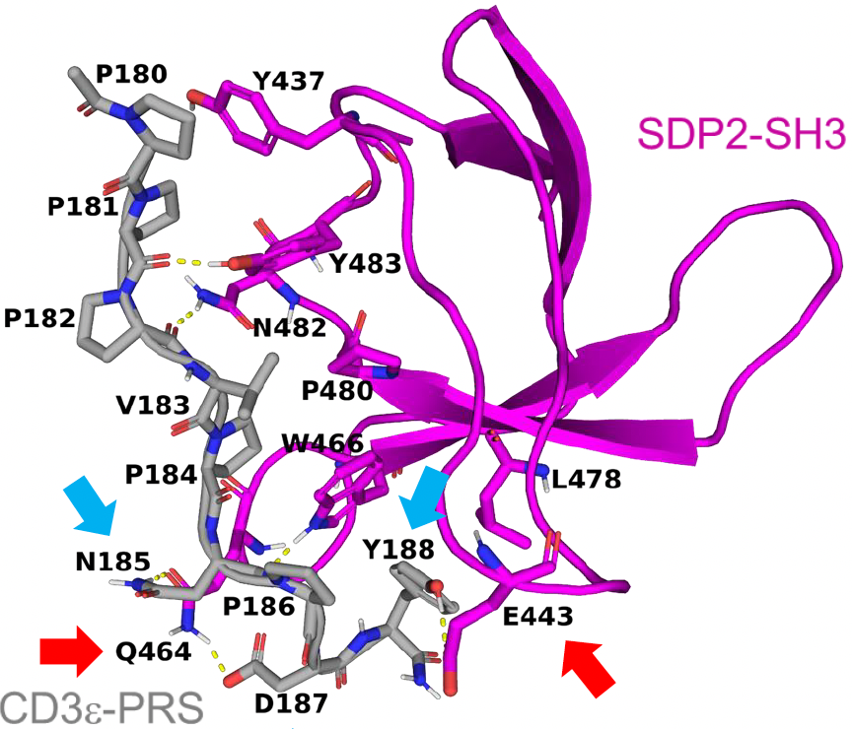
Syndapin 2 is a new member of the TCR signalosomes.
SH3 domain
F-Bar domains of syndapin dimer
CD3ε poly-proline region

Slide 3
Degradation of TCR in solution

Slide 4
Methods and materials
Jurkat-shCtrl and Jurkat-shSDP2
Stained on ice with OKT3 antibody (1 ug/mL)
Stimulated for 2, 4, 6, 10 and 12 hours at 37 degree incubator
200.000 cells/sample
End of stimulation = Transfer of samples to 96-well plate prepared with ice cold PBS.

Slide 5
Intracellular stain
Life-Death stain with efluor506 (1:1000)
Fixation of cells with bd fixation kit
Okt3 antibody stain (1:40)
mIgG antibody stain (1:500)
Washing steps were performed with FACS-Buffer (2% FCS, 98% PBS)
All centrifugation steps were performed at 400g for 4 min

Slide 6
**** | <0,0001
* | 0,0233
ns | 0,0543
* | 0,0275
ns | 0,9132
ns | 0,9960

Slide 7
ns | 0,1005
* | 0,0289
ns | 0,6255
ns | 0,5162
ns | 0,2716
ns | 0,6350

Slide 8
Internalization of TCR in solution

Slide 9
Methods and materials
Jurkat-shCtrl and Jurkat-shSDP2
Stained on ice with OKT3 antibody (1 ug/mL)
Stimulated for 5, 10, 30, 60, 90 and 120 minutes at 37 degree incubator
200.000 cells/sample
End of stimulation = Transfer of samples to 96-well plate prepared with ice cold PBS.

Slide 10
Extracellular stain (secondary antibody only)
Life-Death stain with efluor506 (1:1000)
mIgG-APC (1:500)
Washing steps were performed with FACS-Buffer
All centrifugation steps were performed at 300g for 4 min

Slide 11
**** | <0,0001
**** | <0,0001
**** | <0,0001
**** | <0,0001
**** | <0,0001
**** | <0,0001
**** | <0,0001

