Slide 1




KHARCH.AI
AI Expense Tracking System

Slide 2
OBJECTIVES
-
-
Automate expense tracking with AI
Provide smart financial insights
Enable voice input for easy logging
Improve budgeting and savings
Offer a seamless and user-friendly experience

Slide 3
INTRODUCTION
-
-
Kharch.ai is an AI-powered expense management system
It helps users track expenses, generate insights, and optimize spending.
Provides AI-driven suggestions for financial management.

Slide 4




TEAM
-
-
Shrey Sharma
2301650140088
Kushal Mishra
2301650140040
Riya Sharma
2301650140073
Vaibhav Mishra
2301650140103

Slide 5
Features
-
-
Voice-based expense input 🗣️
Automated expense categorization 📊
AI-powered insights & suggestions 🤖
Custom budgeting & alerts 💰
Detailed reports & analytics 📈

Slide 6
System Architecture
-
-
User Interface:
Flutter-based mobile app
Backend:
Flask with AI integration.
Database:
MySQL for secure data storage.
AI Module:
Pre-trained NLP model for categorization.

Slide 7
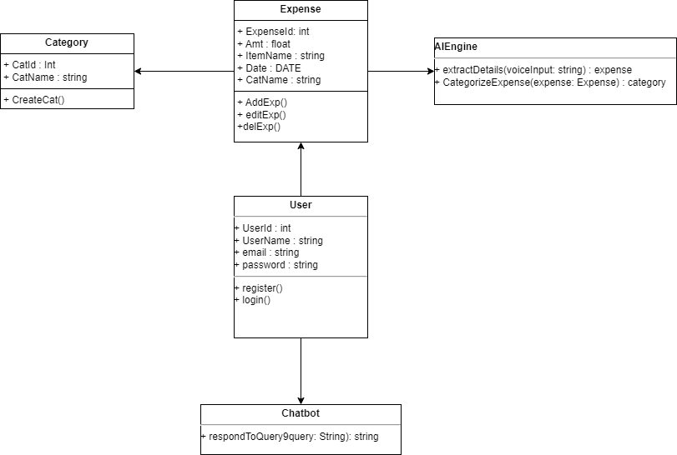
Architecture
-
-
Class Diagram

Slide 8
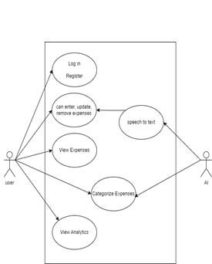
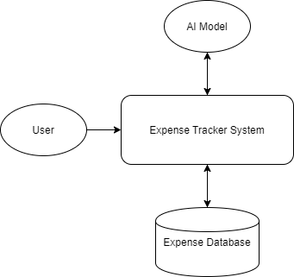
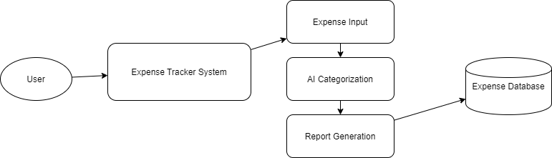
Architecture
Use Case Diagram
DataFlow 0 Diagram
-
-
DataFlow 1 Diagram

Slide 9
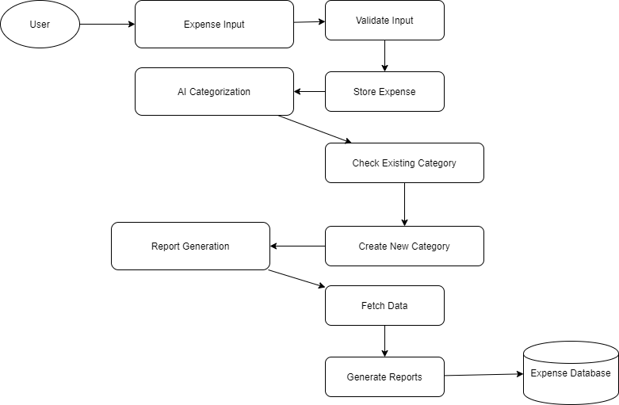
Architecture
-
-
DataFlow 2 Diagram

Slide 10
Future Scope
🚀 Advanced AI Predictions – Future expense forecasting
📱 Cross-Platform Support – Web & Mobile App
💳 Bank Integration – Auto-fetch transactions
🌍 Multi-Currency Support – Global accessibility

Slide 11
Thank You

