Slide 1

GlusterFS – Architecture & Roadmap
Vijay Bellur
GlusterFS co-maintainer
http://twitter.com/vbellur

Slide 2
Agenda
What is GlusterFS?
Architecture
Integration
Use Cases
Future Directions
Challenges
Q&A

Slide 3
What is GlusterFS?
A general purpose scale-out distributed file system.
Aggregates storage exports over network interconnect to provide a single unified namespace.
Filesystem is stackable and completely in userspace.
Layered on disk file systems that support extended attributes.

Slide 4
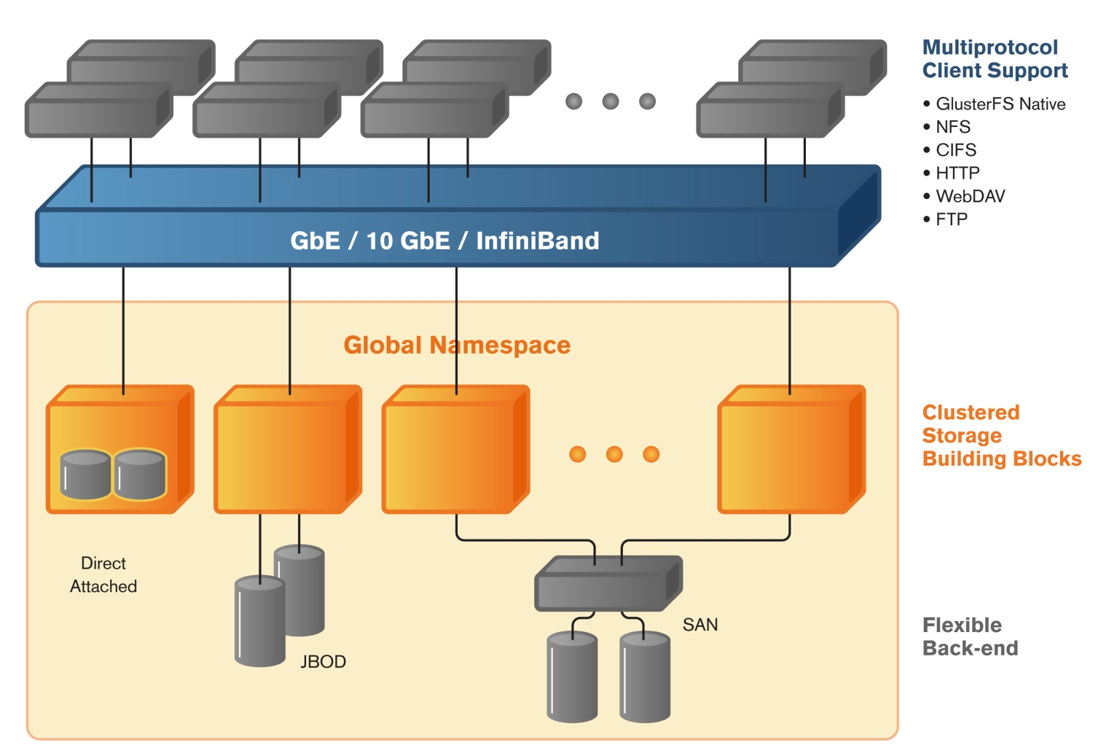

Typical GlusterFS Deployment
Global namespace
Scale-out storage building blocks
Supports thousands of clients
Access using GlusterFS native, NFS, SMB and HTTP protocols
Linear performance scaling

Slide 5
GlusterFS Architecture – Foundations
Software only, runs on commodity hardware
No external metadata servers
Scale-out with Elasticity
Extensible and modular
Deployment agnostic
Unified access
Largely POSIX compliant

Slide 6
Concepts & Algorithms

Slide 7
GlusterFS concepts – Trusted Storage Pool
Trusted Storage Pool (cluster) is a collection of storage servers.
Trusted Storage Pool is formed by invitation – “probe” a new member from the cluster and not vice versa.
Logical partition for all data and management operations.
Membership information used for determining quorum.
Members can be dynamically added and removed from the pool.

Slide 8
GlusterFS concepts – Trusted Storage Pool
Node1
Node2
Probe
Probe accepted
Node 1 and Node 2 are peers in a trusted storage pool
Node1
Node2

Slide 9
GlusterFS concepts – Trusted Storage Pool
Node1
Node2
Node1
Node2
Node3
Trusted Storage Pool
Node1
Node2
Node3
Detach

Slide 10
GlusterFS concepts - Bricks
A brick is the combination of a node and an export directory – for e.g. hostname:/dir
Each brick inherits limits of the underlying filesystem
No limit on the number bricks per node
Ideally, each brick in a cluster should be of the same size
Storage Node
Storage Node
Storage Node
/export1
/export1
/export1
/export2
/export2
/export2
/export3
/export3
/export3
/export4
/export5
3 bricks
5 bricks
3 bricks

Slide 11
GlusterFS concepts - Volumes
A volume is a logical collection of bricks.
Volume is identified by an administrator provided name.
Volume is a mountable entity and the volume name is provided at the time of mounting.
    mount -t glusterfs server1:/<volname> /my/mnt/point
Bricks from the same node can be part of different volumes

Slide 12
GlusterFS concepts - Volumes
Node2
Node3
Node1
/export/brick1
/export/brick1
/export/brick1
music
/export/brick2
/export/brick2
/export/brick2
Videos

Slide 13
Volume Types
Type of a volume is specified at the time of volume creation
Volume type determines how and where data is placed
Following volume types are supported in glusterfs:
  a) Distribute
  b) Stripe
  c) Replication
  d) Distributed Replicate
  e) Striped Replicate
  f) Distributed Striped Replicate

Slide 14
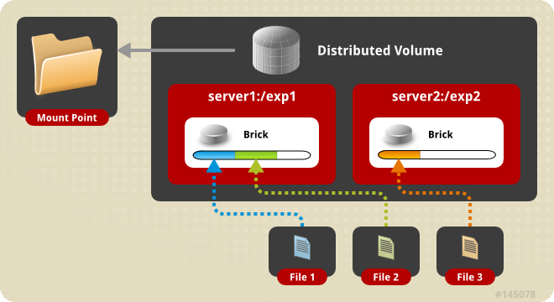
Distributed Volume
Distributes files across various bricks of the volume.
Directories are present on all bricks of the volume.
Single brick failure will result in loss of data availability.
Removes the need for an external meta data server.

Slide 15
How does a distributed volume work?
Uses Davies-Meyer hash algorithm.
A 32-bit hash space is divided into N ranges for N bricks
At the time of directory creation, a range is assigned to each directory.
During a file creation or retrieval, hash is computed on the file name. This hash value is used to locate or place the file.
Different directories in the same brick end up with different hash ranges.

Slide 16
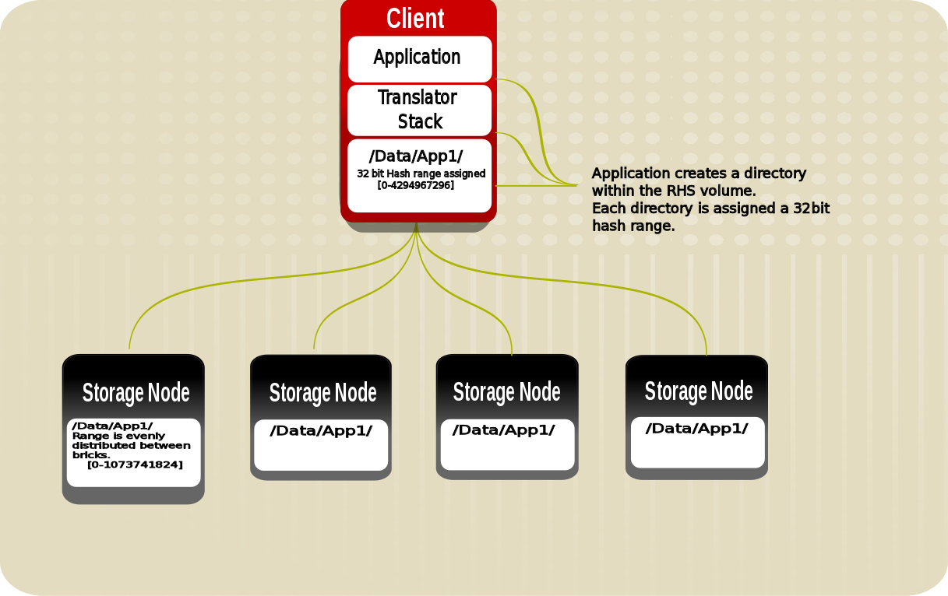
How does a distributed volume work?

Slide 17
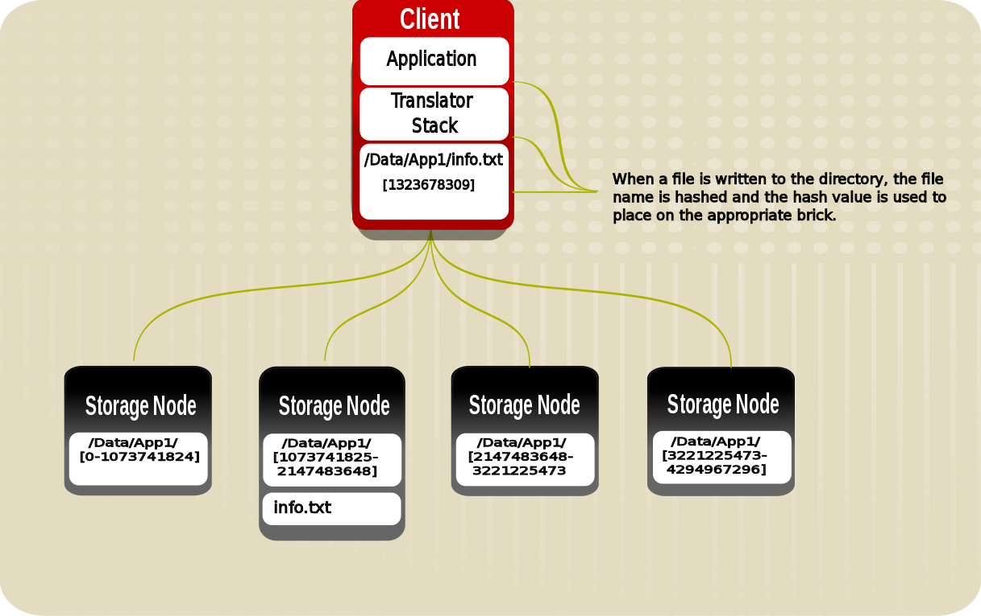
How does a distributed volume work?

Slide 18
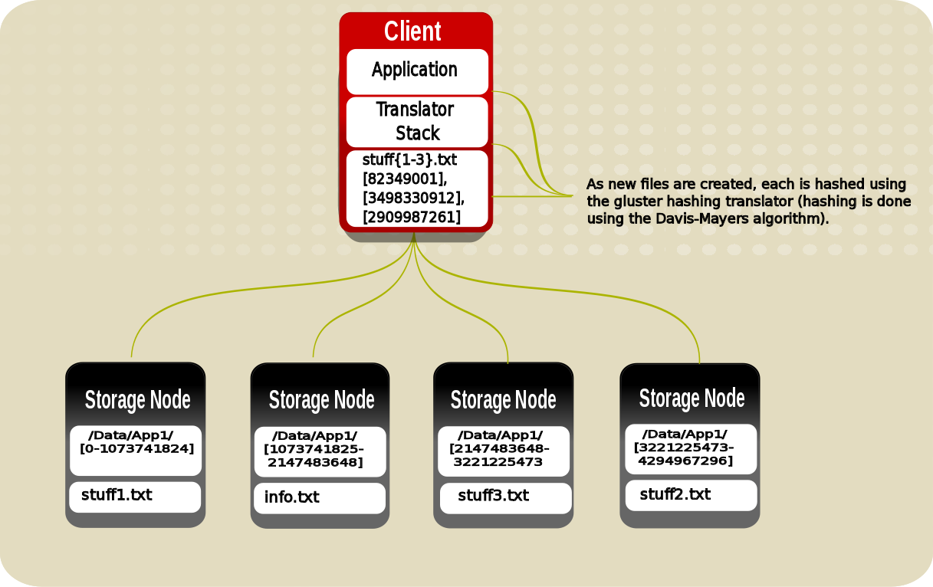
How does a distributed volume work?

Slide 19
Replicated Volume
Synchronous replication of all directory and file updates.
Provides high availability of data when node failures occur.
Transaction driven for ensuring consistency.
Changelogs maintained for re-conciliation.
Any number of replicas can be configured.

Slide 20
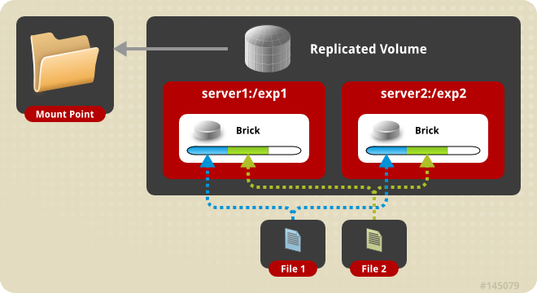
How does a replicated volume work?

Slide 21
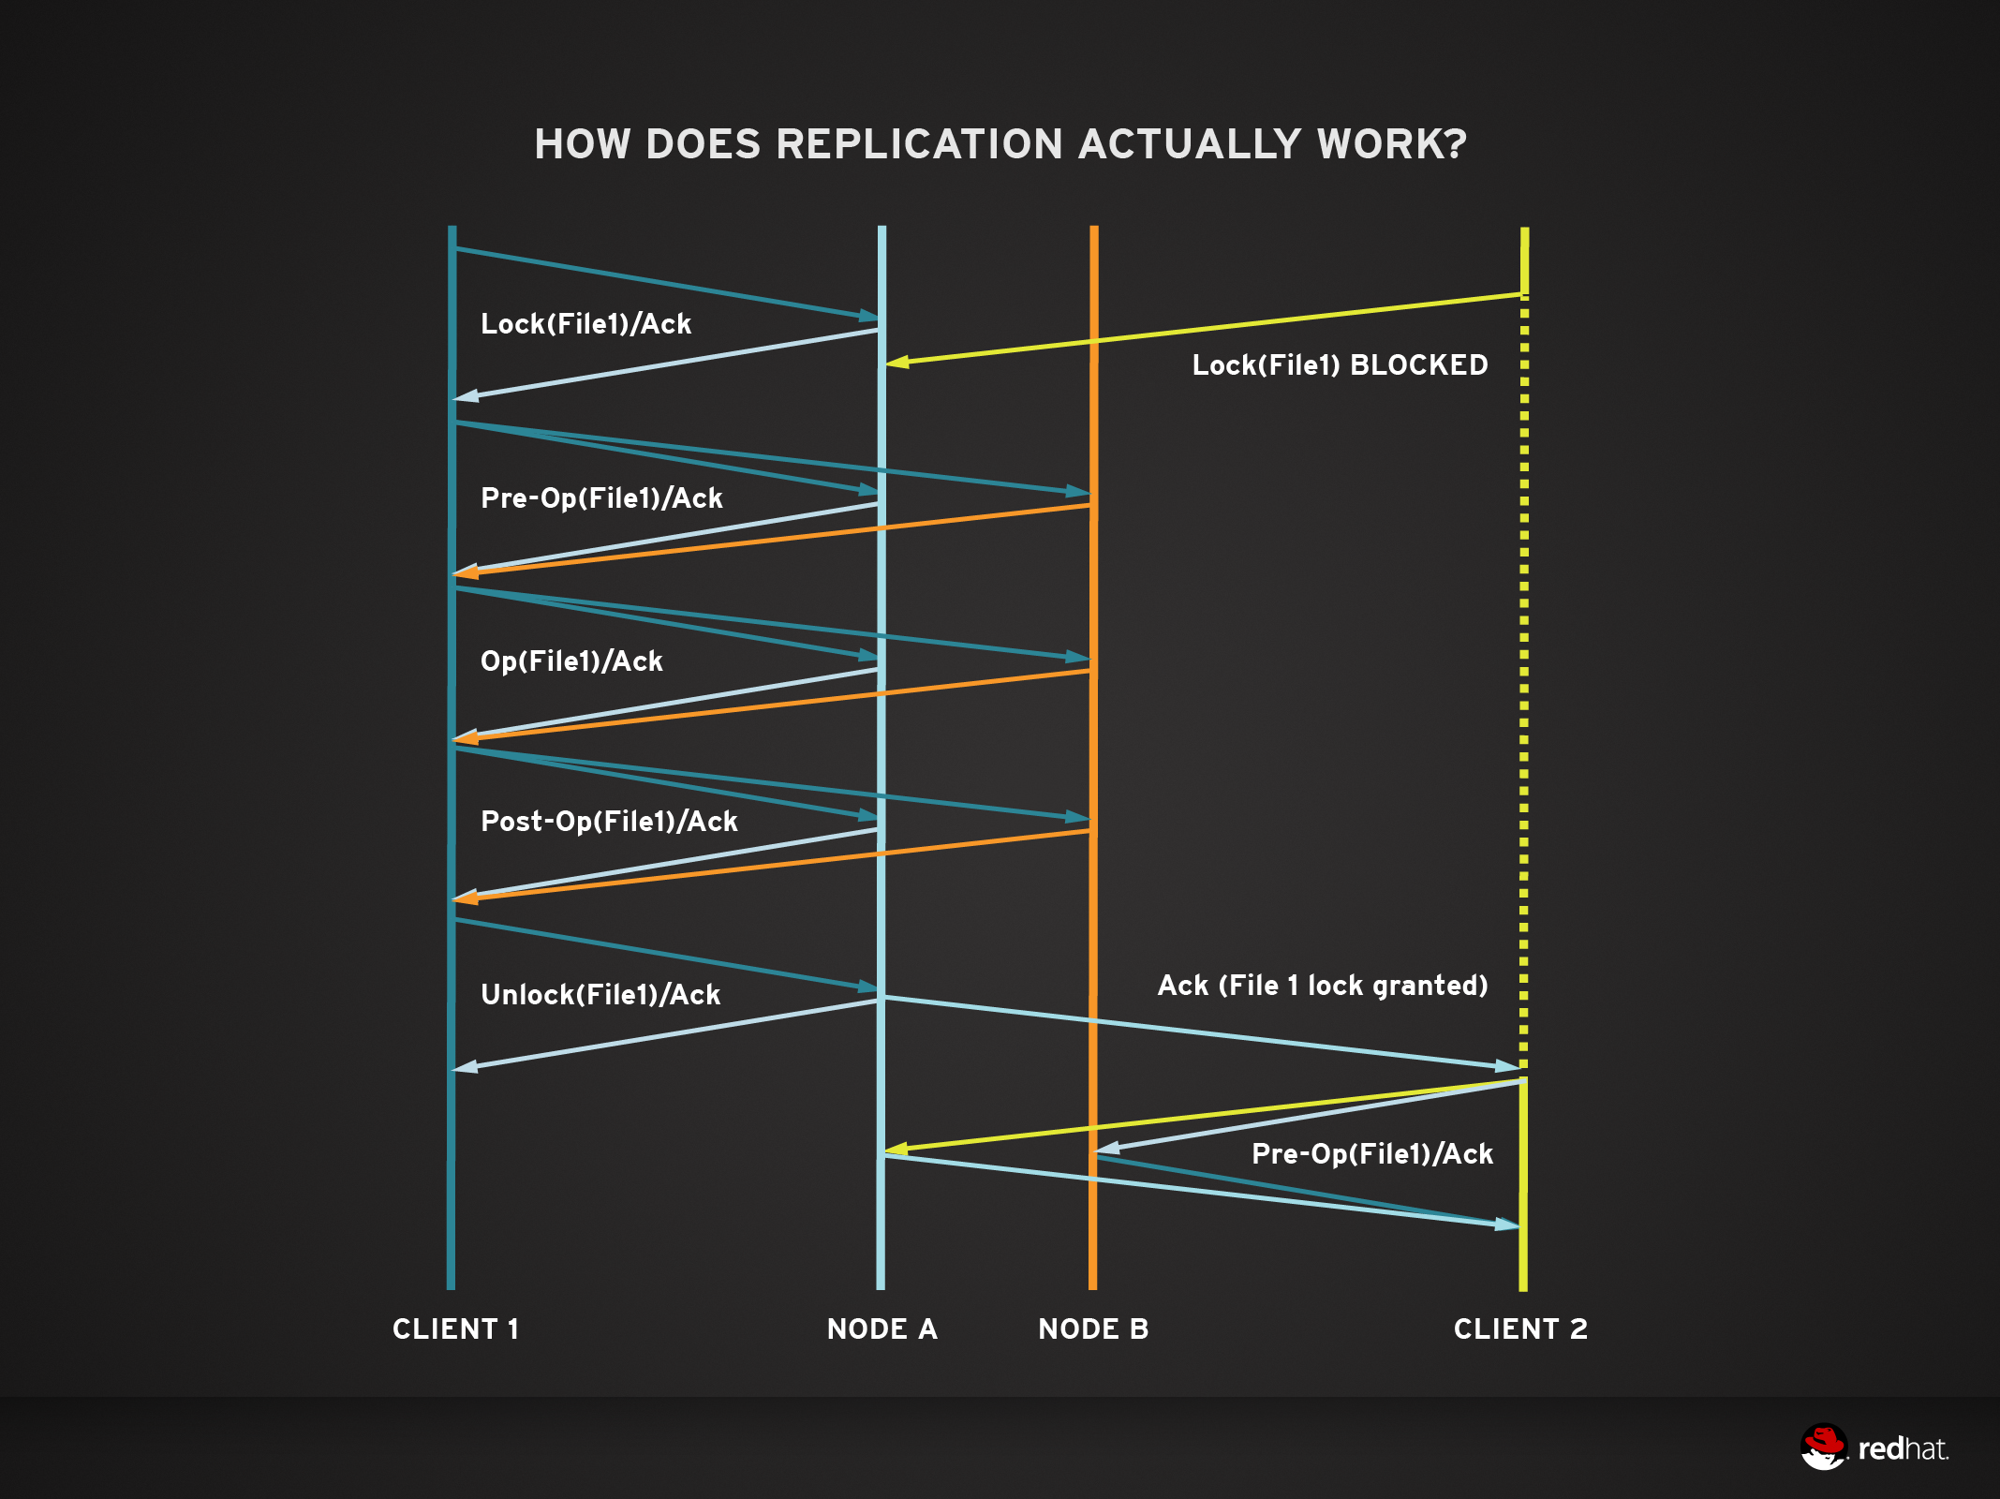
How does a replicated volume work?

Slide 22
Distributed Replicated Volume
Distribute files across replicated bricks
  Number of bricks must be a multiple of the replica count
  Ordering of bricks in volume definition matters
Scaling and high availability
Reads get load balanced.
Most preferred model of deployment currently.

Slide 23
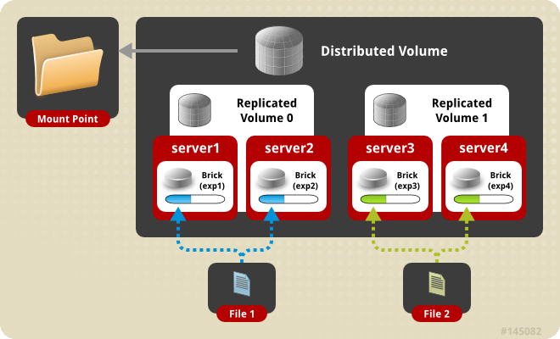
Distributed Replicated Volume

Slide 24
Striped Volume
Files are striped into chunks and placed in various bricks.
Recommended only when very large files greater than the size of the disks are present.
Chunks are files with holes – this helps in maintaining offset consistency.
A brick failure can result in data loss. Redundancy with replication is highly recommended (striped replicated volumes).

Slide 25
Elastic Volume Management
Application transparent operations that can be performed in the storage layer.
Addition of Bricks to a volume
Remove brick from a volume
Rebalance data spread within a volume
Replace a brick in a volume
Performance / Functionality tuning

Slide 26
Access Mechanisms

Slide 27
Access Mechanisms
Gluster volumes can be accessed via the following mechanisms:
    FUSE based Native protocol
    NFSv3
    SMB
    libgfapi
    ReST/HTTP
    HDFS

Slide 28
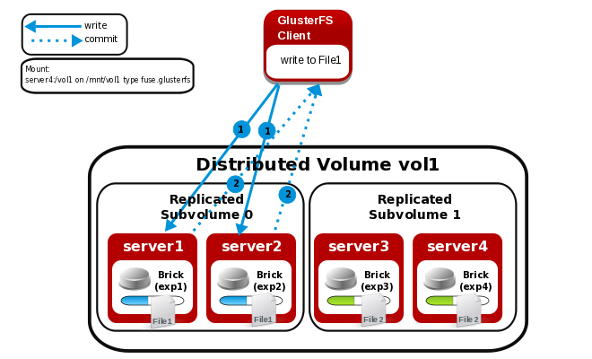
FUSE based native access

Slide 29
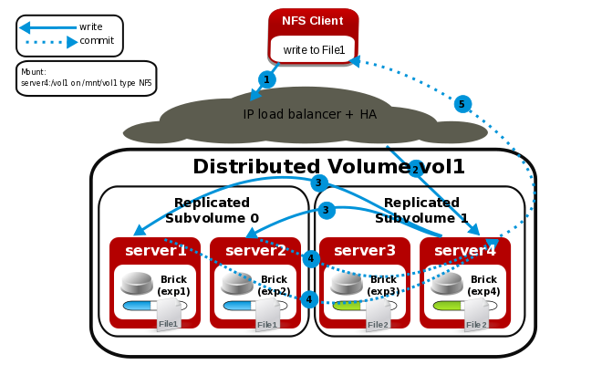
NFS access

Slide 30
libgfapi
Exposes APIs for accessing Gluster volumes.
Reduces context switches.
qemu, samba, NFS Ganesha integrated with libgfapi.
Both sync and async interfaces available.
Emerging bindings for various languages.

Slide 31
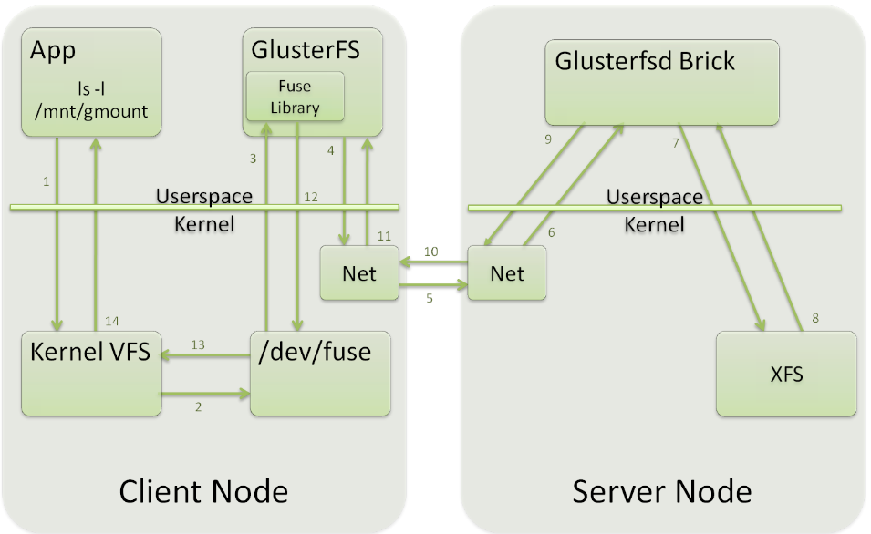
libgfapi v/s FUSE – FUSE access

Slide 32
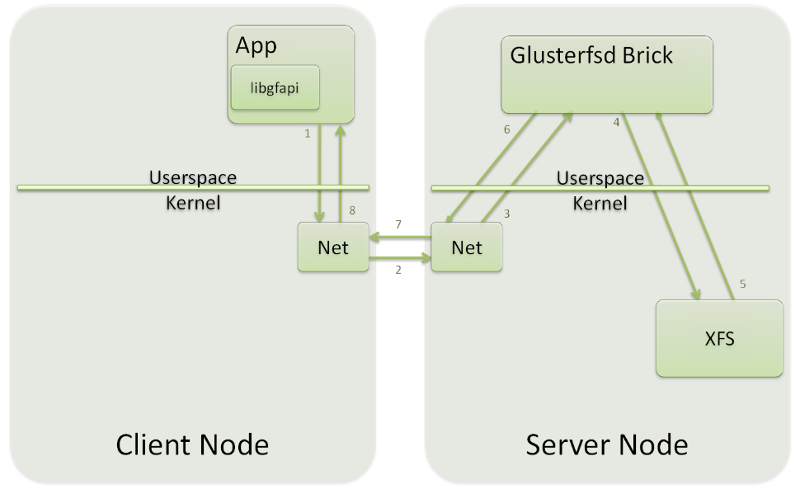
libgfapi v/s FUSE – libgfapi access

Slide 33
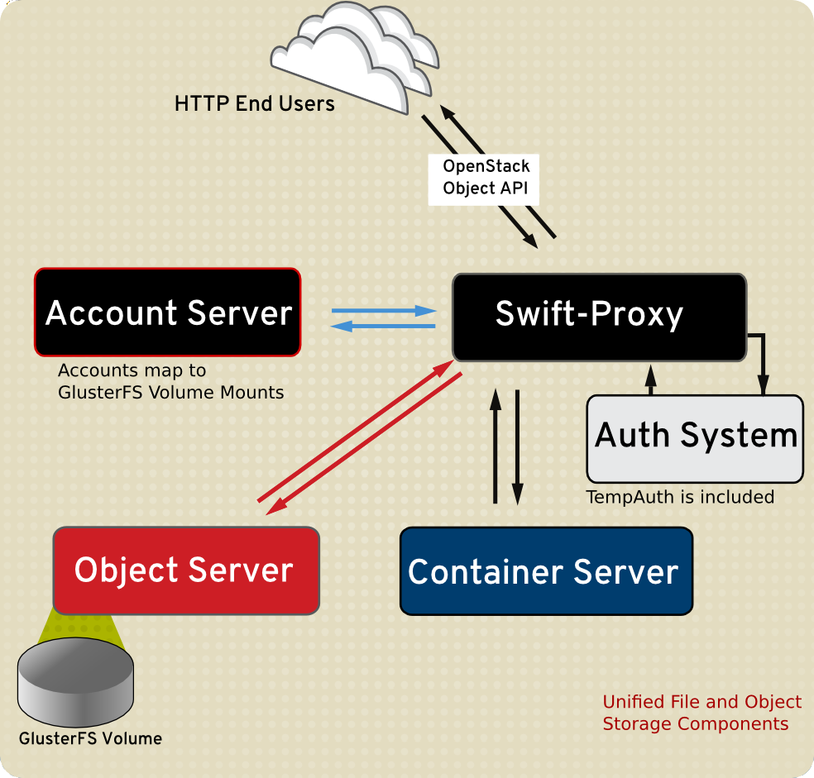
ReST based access

Slide 34
ReST - G4S
Unified File and object view.
Entity mapping between file and object building blocks
Client
HTTP Request (REST)
Proxy
Account
Volume
Container
Directory
Client
NFS or
Object
File
GlusterFS Mount

Slide 35
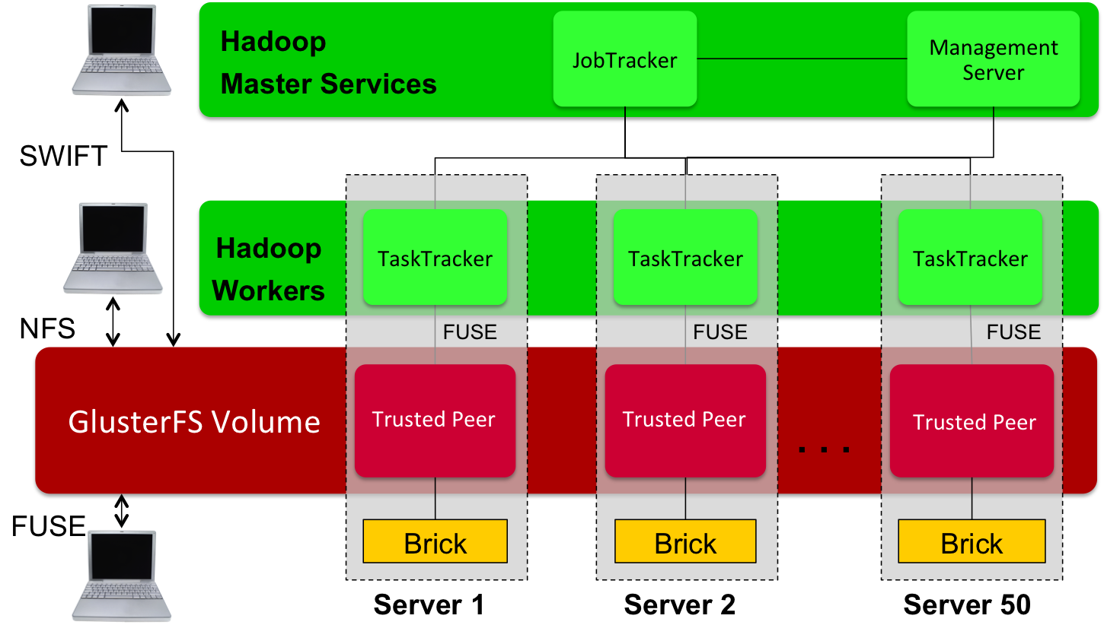
Hadoop access

Slide 36
Implementation

Slide 37
Translators in GlusterFS
Building blocks for a GlusterFS process.
Based on Translators in GNU HURD.
Each translator is a functional unit.
Translators can be stacked together for achieving desired functionality.
Translators are deployment agnostic – can be loaded in either the client or server stacks.

Slide 38
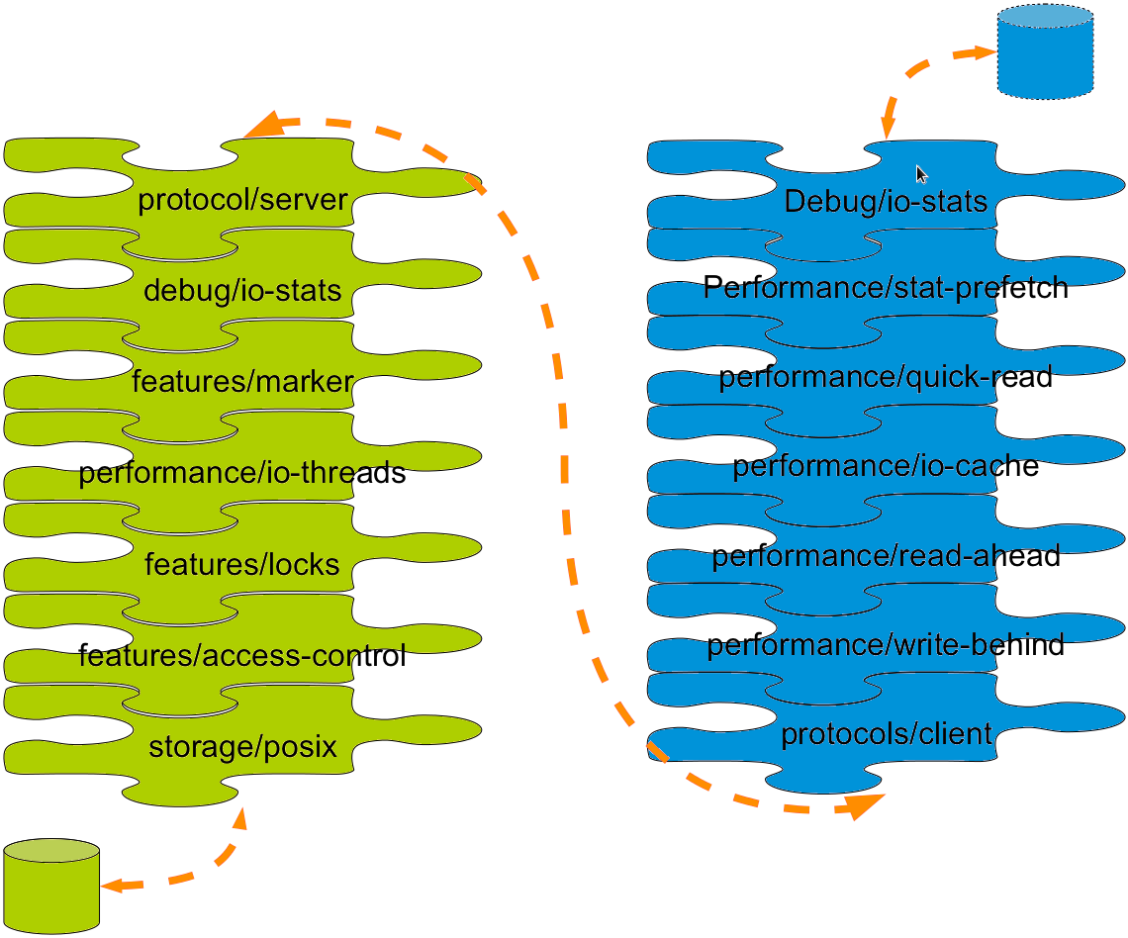
Customizable Translator Stack

Slide 39
Ecosystem Integration

Slide 40
Ecosystem Integration
Currently integrated with various ecosystems:
  OpenStack
  Samba
  Ganesha
  oVirt
  qemu
  Hadoop
  pcp
  Proxmox
  uWSGI

Slide 41

OpenStack Havana and GlusterFS – Current Integration
Nova
Nodes
Glance Images
Swift
Objects
Separate Compute and Storage Pools
GlusterFS directly provides Swift object service
  Integration with Keystone
  GeoReplication for multi-site support
Swift data also available via other protocols
Supports non-OpenStack use in addition to OpenStack use
KVM
KVM
libgfapi
…
KVM
Swift API
Cinder Data
Glance Data
Swift Data
Storage Server
Storage Server
Storage Server
…
Logical View
Physical View

Slide 42
OpenStack and GlusterFS – Future Integration
Nova
Glance Images
Swift
Objects
KVM
KVM
libgfapi
…
KVM
Block
File
Object
Swift API
Cinder Data
Glance Data
Glance Data
Swift Data
Manila Data
Savanna Data
Storage
Storage
Storage
…

Slide 43
GlusterFS & oVirt
Trusted Storage Pool and Gluster Volume management - oVirt 3.1
FUSE based posixFS support for VM image storage - oVirt 3.1
libgfapi based Gluster native storage domain - oVirt 3.3
Manage converged virtualization and storage clusters in oVirt
ReST APIs & SDK for GlusterFS management.

Slide 44
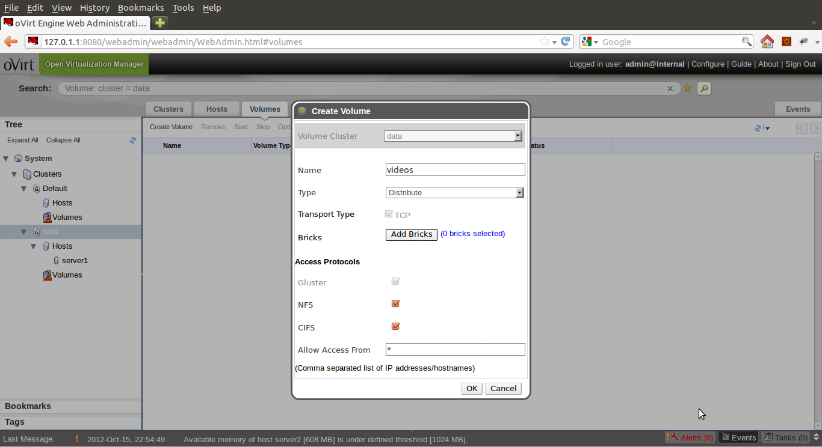
GlusterFS & oVirt

Slide 45
Use Cases - current
Unstructured data storage
Archival
Disaster Recovery
Virtual Machine Image Store
Cloud Storage for Service Providers
Content Cloud
Big Data
Semi-structured & Structured data

Slide 46
Future Directions

Slide 47
New Features in GlusterFS 3.5
Distributed geo-replication
File snapshots
Compression translator
Multi-brick Block Device volumes
Readdir ahead translator
Quota Scalability

Slide 48
Beta Features in GlusterFS 3.5
Disperse translator for Erasure Coding
Encryption at rest
Support for bricks on Btrfs
libgfapi support for NFS Ganesha (NFS v4)

Slide 49
Geo-replication in 3.5
Before 3.5
  Merkle tree based optimal volume crawling
  Single driver on the master
  SPOF
In 3.5
  Based on changelog
  One driver per replica set on the master
  No SPOF

Slide 50
Quota in 3.5
  Before 3.5
    Client side enforcement
    Configuration in volume files would block scalability
    GFID accesses could cause incorrect accounting
    Only hard quota supported
  In 3.5
    Server side enforcement
    Better configuration management for scalability.
    GFID to path conversion enables correct accounting.
    Both hard and soft quotas supported

Slide 51
Prominent Features beyond GlusterFS 3.5
Volume snapshots
New Style Replication
pNFS access with NFS Ganesha
Data tiering / HSM
Multi master geo-replication
Support Btrfs features
Caching improvements
libgfchangelog
and more...

Slide 52
Challenges
Scalability – 1024 nodes, 72 brontobytes?
Hard links
Rename
Monolithic tools
Monitoring
Reduce Capex and Opex

Slide 53
Resources
Mailing lists:
gluster-users@gluster.org
gluster-devel@nongnu.org
IRC:
#gluster and #gluster-dev on freenode
Links:
http://www.gluster.org
http://hekafs.org
http://forge.gluster.org
http://www.gluster.org/community/documentation/index.php/Arch

Slide 54
Thank you!
Vijay Bellur
vbellur at redhat dot com

