Slide 1

GlusterFS For Hadoop– Overview
Vijay Bellur
GlusterFS co-maintainer
Lalatendu Mohanty
GlusterFS Community

Slide 2
Agenda
What is GlusterFS?
Overview
Use Cases
Hadoop on GlusterFS
Q&A

Slide 3
What is GlusterFS?
A general purpose scale-out distributed file system.
Aggregates storage exports over network interconnect to provide a single unified namespace.
Filesystem is stackable and completely in userspace.
Layered on disk file systems that support extended attributes.

Slide 4
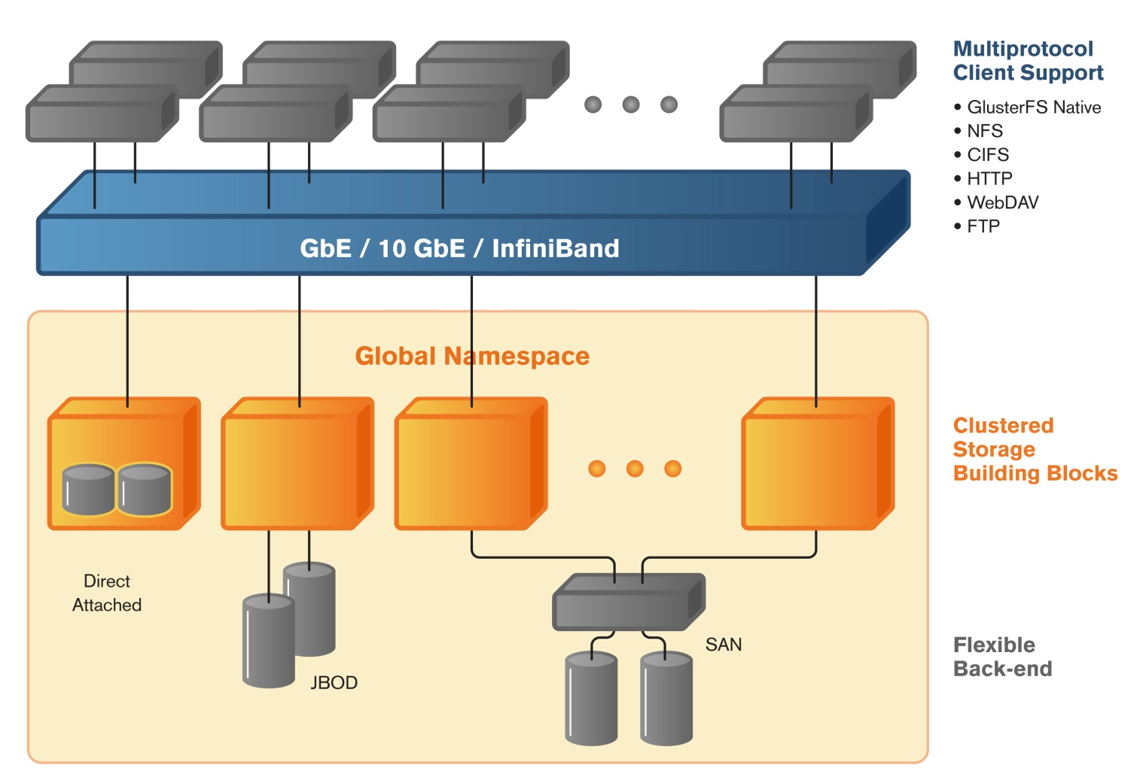

Typical GlusterFS Deployment
Global namespace
Scale-out storage building blocks
Supports thousands of clients
Access using GlusterFS native, NFS, SMB and HTTP protocols
Linear performance scaling

Slide 5
GlusterFS Architecture – Foundations
Software only, runs on commodity hardware
No external metadata servers
Scale-out with Elasticity
Extensible and modular
Deployment agnostic
Unified access
Largely POSIX compliant

Slide 6
Concepts & Algorithms

Slide 7
GlusterFS concepts – Trusted Storage Pool
Trusted Storage Pool (cluster) is a collection of storage servers.
Trusted Storage Pool is formed by invitation – “probe” a new member from the cluster and not vice versa.
Membership information used for determining quorum.
Members can be dynamically added and removed from the pool.

Slide 8
GlusterFS concepts - Bricks
A brick is the combination of a node and an export directory – for e.g. hostname:/dir
Each brick inherits limits of the underlying filesystem
No limit on the number bricks per node
Ideally, each brick in a cluster should be of the same size
Storage Node
Storage Node
Storage Node
/export1
/export1
/export1
/export2
/export2
/export2
/export3
/export3
/export3
/export4
/export5
3 bricks
5 bricks
3 bricks

Slide 9
GlusterFS concepts - Volumes
A volume is a logical collection of bricks.
Volume is identified by an administrator provided name.
Volume is a mountable entity and the volume name is provided at the time of mounting.
    mount -t glusterfs server1:/<volname> /my/mnt/point
Bricks from the same node can be part of different volumes

Slide 10
GlusterFS concepts - Volumes
Node2
Node3
Node1
/export/brick1
/export/brick1
/export/brick1
music
/export/brick2
/export/brick2
/export/brick2
Videos

Slide 11
Volume Types
Type of a volume is specified at the time of volume creation
Volume type determines how and where data is placed
Following volume types are supported in glusterfs:
  a) Distribute
  b) Stripe
  c) Replication
  d) Distributed Replicate
  e) Striped Replicate
  f) Distributed Striped Replicate

Slide 12
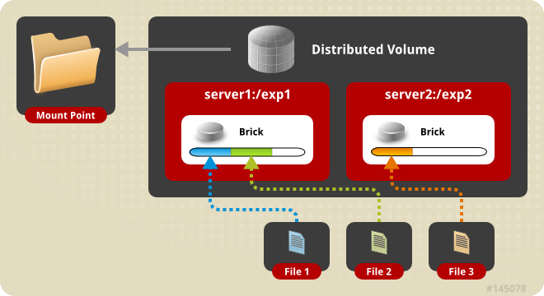
Distributed Volume
Distributes files across various bricks of the volume.
Directories are present on all bricks of the volume.
Single brick failure will result in loss of data availability.
Removes the need for an external meta data server.

Slide 13
How does a distributed volume work?
Uses Davies-Meyer hash algorithm.
A 32-bit hash space is divided into N ranges for N bricks
At the time of directory creation, a range is assigned to each directory.
During a file creation or retrieval, hash is computed on the file name. This hash value is used to locate or place the file.
Different directories in the same brick end up with different hash ranges.

Slide 14
Replicated Volume
Synchronous replication of all directory and file updates.
Provides high availability of data when node failures occur.
Transaction driven for ensuring consistency.
Changelogs maintained for re-conciliation.
Any number of replicas can be configured.

Slide 15
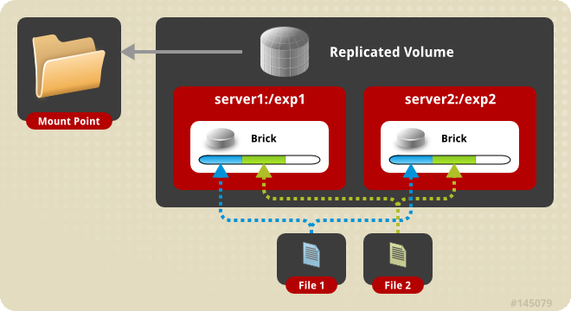
How does a replicated volume work?

Slide 16
Distributed Replicated Volume
Distribute files across replicated bricks
  Number of bricks must be a multiple of the replica count
  Ordering of bricks in volume definition matters
Scaling and high availability
Reads get load balanced.
Most preferred model of deployment currently.

Slide 17
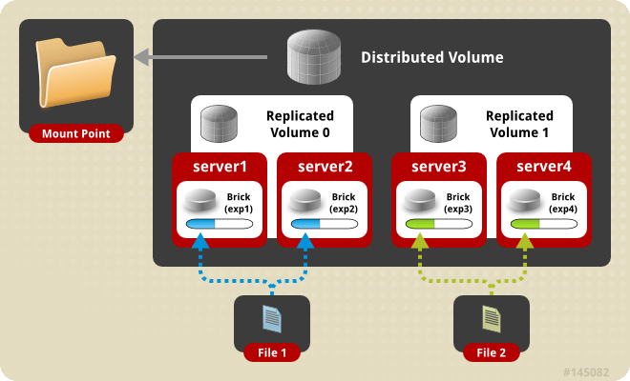
Distributed Replicated Volume

Slide 18
Striped Volume
Files are striped into chunks and placed in various bricks.
Recommended only when very large files greater than the size of the disks are present.
A brick failure can result in data loss. Redundancy with replication is highly recommended (striped replicated volumes).

Slide 19
Elastic Volume Management
Application transparent operations that can be performed in the storage layer.
Addition of Bricks to a volume
Remove brick from a volume
Rebalance data spread within a volume
Replace a brick in a volume
Performance / Functionality tuning

Slide 20
Access Mechanisms
Gluster volumes can be accessed via the following mechanisms:
    FUSE based Native protocol
    NFSv3 and v4
    SMB
    libgfapi
    ReST/HTTP
    HDFS

Slide 21
Implementation

Slide 22
Translators in GlusterFS
Building blocks for a GlusterFS process.
Based on Translators in GNU HURD.
Each translator is a functional unit.
Translators can be stacked together for achieving desired functionality.
Translators are deployment agnostic – can be loaded in either the client or server stacks.

Slide 23
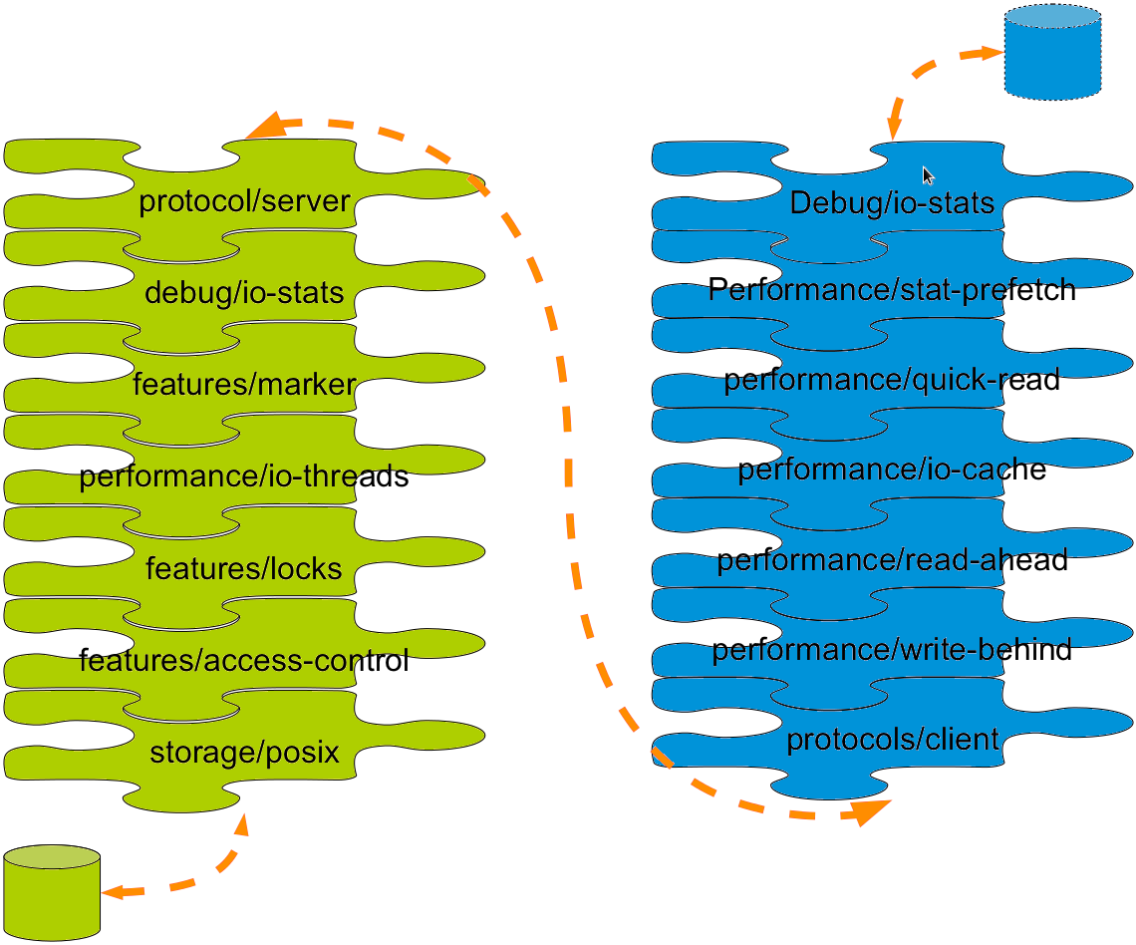
Customizable Translator Stack

Slide 24
Ecosystem Integration
Currently integrated with various ecosystems:
  OpenStack
  Samba
  Ganesha
  oVirt
  qemu
  Hadoop
  pcp
  Proxmox
  uWSGI

Slide 25
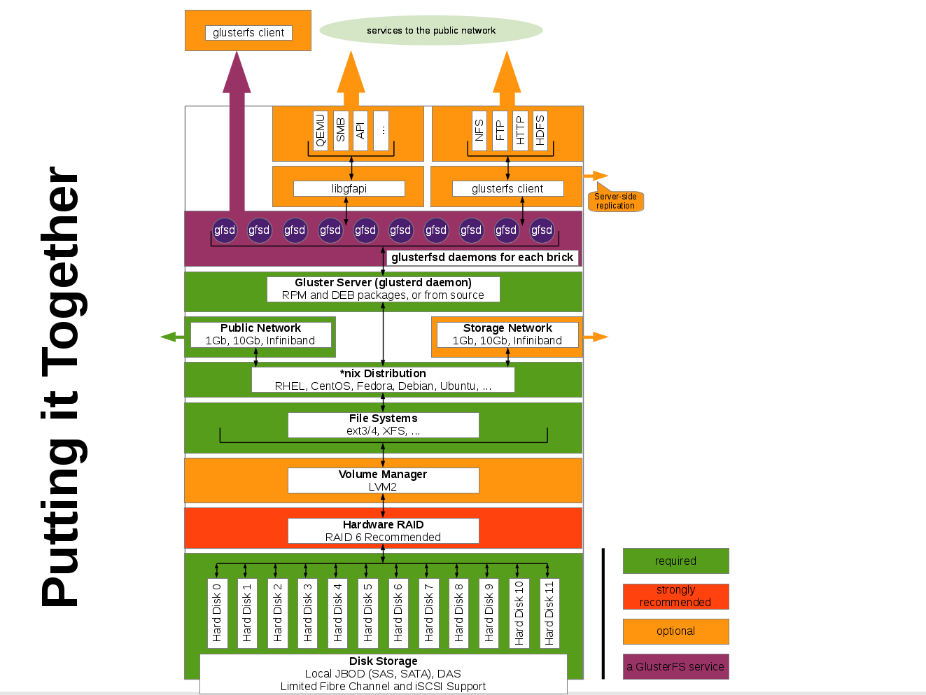

Slide 26
Use Cases - current
Unstructured data storage
Archival
Disaster Recovery
Virtual Machine Image Store
Cloud Storage for Service Providers
Content Cloud
Big Data
Semi-structured & Structured data

Slide 27
Hadoop And GlusterFS
GlusterFS can be used for Hadoop
GlusterFS Hadoop plugin replaces HDFS with GlusterFS
MapReduce jobs can be run on GlusterFS volumes.
https://github.com/gluster/glusterfs-hadoop

Slide 28
Advantage Of Using GlusterFS
Advantage of a POSIX compliant filesystem.
Same volume/storage can be used for MapReduce and storing application data.
  E.g. : log files, unstructured data.
No need to copy data from storage to HDFS for running MapReduce.
No need for “NameNode” i.e. metadata server.
Advantage of GlusterFS features (e.g. Geo-replication, Erasure Coding)
  Geo-replication is a distributed, continuous, asynchronous, and incremental replication service for disastrous recovery
  It can replicate data from one site to another over Local Area Networks (LANs), Wide Area Networks (WANs), and the
  Internet.

Slide 29
Advantage Of Using GlusterFS
Erasure Coding provides the fundamental technology for storage systems to add redundancy and tolerate failures.
On GlusterFS, MapReduce jobs use “data locality optimization”.
  That means Hadoop tries its best to run map tasks on nodes where the data is present locally to optimize on the network and inter-node communication latency.
GlusterFS works with Apache Spark Project and The Apache Ambari project.

Slide 30
Apache Spark Project
Apache Spark is an open-source data analytics cluster computing framework
Spark fits into the Hadoop open-source community, building on top of the Hadoop Distributed File System (HDFS)
Spark is not tied to the two-stage MapReduce paradigm and promises performance up to 100 times faster than Hadoop MapReduce, for certain applications.
Spark provides primitives for in-memory cluster computing.
https://spark.apache.org/docs/0.8.1/cluster-overview.html

Slide 31
Apache Ambari Project
The Apache Ambari project is for provisioning, managing, and monitoring Apache Hadoop clusters.
It provides an intuitive, easy-to-use Hadoop management web UI backed by its RESTful APIs.
Apache Ambari project supports the automated deployment and configuration of Hadoop on top of GlusterFS.
  http://www.gluster.org/2013/10/automated-hadoop-deployment-on-glusterfs-with-apache-ambari/
  http://ambari.apache.org/

Slide 32
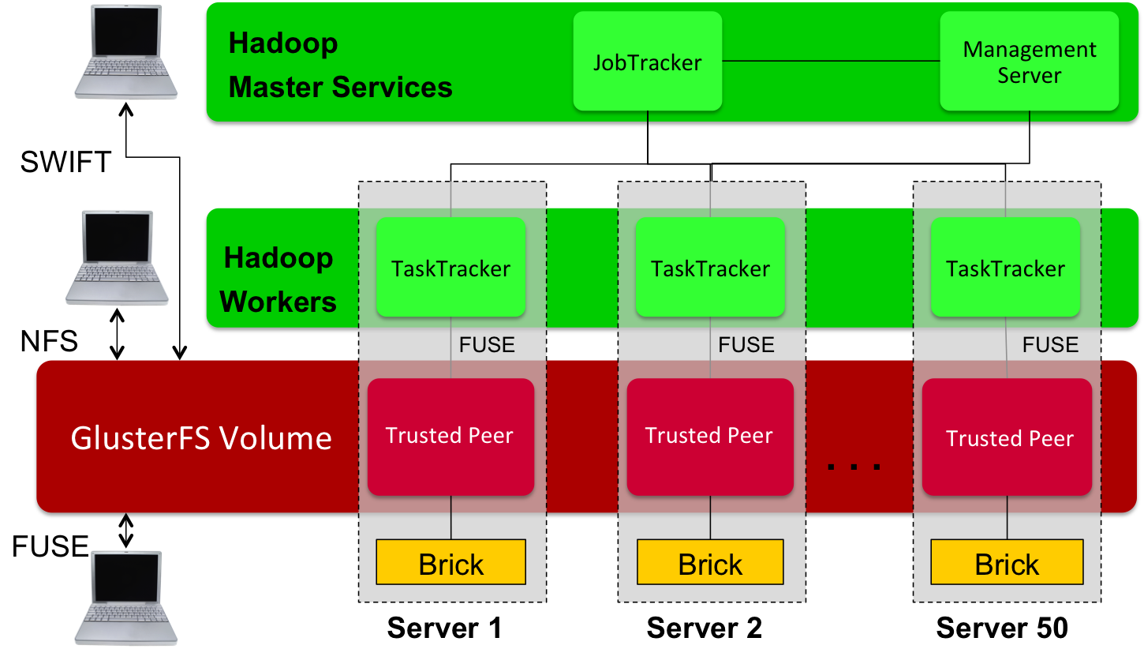
Hadoop access

Slide 33
Resources
Mailing lists:
gluster-users@gluster.org
gluster-devel@nongnu.org
IRC:
#gluster and #gluster-dev on freenode
Links:
http://www.gluster.org
http://hekafs.org
http://forge.gluster.org
http://www.gluster.org/community/documentation/index.php/Arch
http://hadoopecosystemtable.github.io/

Slide 34
Thank you!
Lalatendu Mohanty
lmohanty@redhat.com
Twitter: @lalatenduM

