Slide 1
GlusterFS for SysAdmins
Justin Clift, GlusterFS Integration
Open Source and Standards team @ Red Hat
2013-04

Slide 2

#whoami
Experienced SysAdmin (Solaris and Linux) for many, many years
Mostly worked on Mission Critical systems in corporate/enterprise environments (eg. Telco, banking, Insurance)
Has been helping build Open Source Communities after hours for many years (PostgreSQL, OpenOffice)
Dislikes networks being a bottleneck
(likes Infiniband. A lot :>)
Joined Red Hat mid 2010
jclift@redhat.com
Notes:
-Dustin Black
-Red Hat Certified Architect
-Senior Technical Account Manager with Red Hat Global Support Services
-More than 10 years of systems and infrastructure experience, with focus on Linux, UNIX, and networking
-I am not a coder. I'll hack a script together, or read code from others reasonably well, but I would never presume to be a developer.
-I believe strongly in the power of openness in most all aspects of life and business. Openness only improves the interests we all share.

Slide 3
Agenda
Technology Overview
Scaling Up and Out
A Peek at GlusterFS Logic
Redundancy and Fault Tolerance
Data Access
General Administration
Use Cases
Common Pitfalls
Notes:
I hope to make the GlusterFS concepts more tangible. I want you to walk away with the confidence to start working with GlusterFS today.

Slide 4
Technology
Overview
GlusterFS for SysAdmins

Slide 5
What is GlusterFS?
POSIX-Like Distributed File System
No Metadata Server
Network Attached Storage (NAS)
Heterogeneous Commodity Hardware
Aggregated Storage and Memory
Standards-Based – Clients, Applications, Networks
Flexible and Agile Scaling
  Capacity – Petabytes and beyond
  Performance – Thousands of Clients
Single Global Namespace
Notes:
-Commodity hardware: aggregated as building blocks for a clustered storage resource.
-Standards-based: No need to re-architect systems or applications, and no long-term lock-in to proprietary systems or protocols.
-Simple and inexpensive scalability.
-Scaling is non-interruptive to client access.
-Aggregated resources into unified storage volume abstracted from the hardware.

Slide 6
GlusterFS vs. Traditional Solutions
A basic NAS has limited scalability and redundancy
Other distributed filesystems limited by metadata
SAN is costly & complicated but high performance & scalable
GlusterFS
  Linear Scaling
  Minimal Overhead
  High Redundancy
  Simple and Inexpensive Deployment

Slide 7
Technology
Stack
GlusterFS for SysAdmins

Slide 8
Terminology
Brick
  A filesystem mountpoint
  A unit of storage used as a GlusterFS building block
Translator
  Logic between the bits and the Global Namespace
  Layered to provide GlusterFS functionality
Volume
  Bricks combined and passed through translators
Node / Peer
  Server running the gluster daemon and sharing volumes
Notes:
-Bricks are “stacked” to increase capacity
-Translators are “stacked” to increase functionality

Slide 9
Foundation Components
Private Cloud (Datacenter)
  Common Commodity x86_64 Servers
Public Cloud
  Amazon Web Services (AWS)
  EC2 + EBS
Notes:
-So if you're going to deploy GlusterFS, where do you start?
-Remember, for a datacenter deployment, we're talking about commodity server hardware as the foundation.
-In the public cloud space, your option right now is Amazon Web Services, with EC2 and EBS.
-RHS is the only supported high-availability option for EBS.

Slide 10
Disk, LVM, and Filesystems
Direct-Attached Storage (DAS)
-or-
Just a Bunch Of Disks (JBOD)
Hardware RAID
Logical Volume Management (LVM)
XFS, EXT3/4, BTRFS
  Extended attributes (xattr's) support required
XFS is strongly recommended for GlusterFS
Notes:
-XFS is the only filesystem supported with RHS.
-Extended attribute support is necessary because the file hash is stored there

Slide 11
Gluster Components
glusterd
  Elastic volume management daemon
  Runs on all export servers
  Interfaced through gluster CLI
glusterfsd
  GlusterFS brick daemon
  One process for each brick
  Managed by glusterd

Slide 12
Gluster Components
glusterfs
  NFS server daemon
  FUSE client daemon
mount.glusterfs
  FUSE native mount tool
gluster
  Gluster Console Manager (CLI)
Notes:
-gluster console commands can be run directly, or in interactive mode. Similar to virsh, ntpq

Slide 13
Data Access Overview
GlusterFS Native Client
  Filesystem in Userspace (FUSE)
NFS
  Built-in Service
SMB/CIFS
  Samba server required
Unified File and Object (UFO)
  Simultaneous object-based access
Notes:
-The native client uses fuse to build complete filesystem functionality without gluster itself having to operate in kernel space. This offers benefits in system stability and time-to-end-user for code updates.

Slide 14
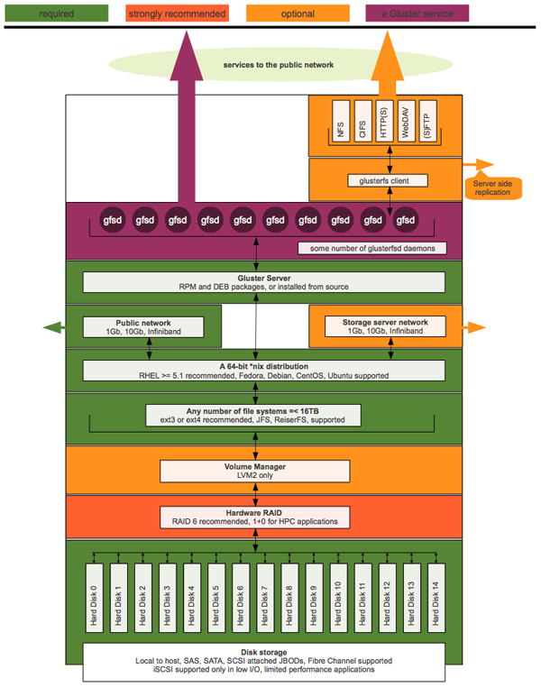
Putting it All Together

Slide 15
Scaling
GlusterFS for SysAdmins

Slide 16



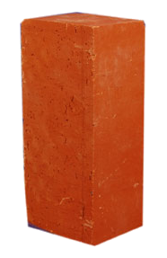

Scaling Up
Add disks and filesystems to a node
Expand a GlusterFS volume by adding bricks
XFS

Slide 17
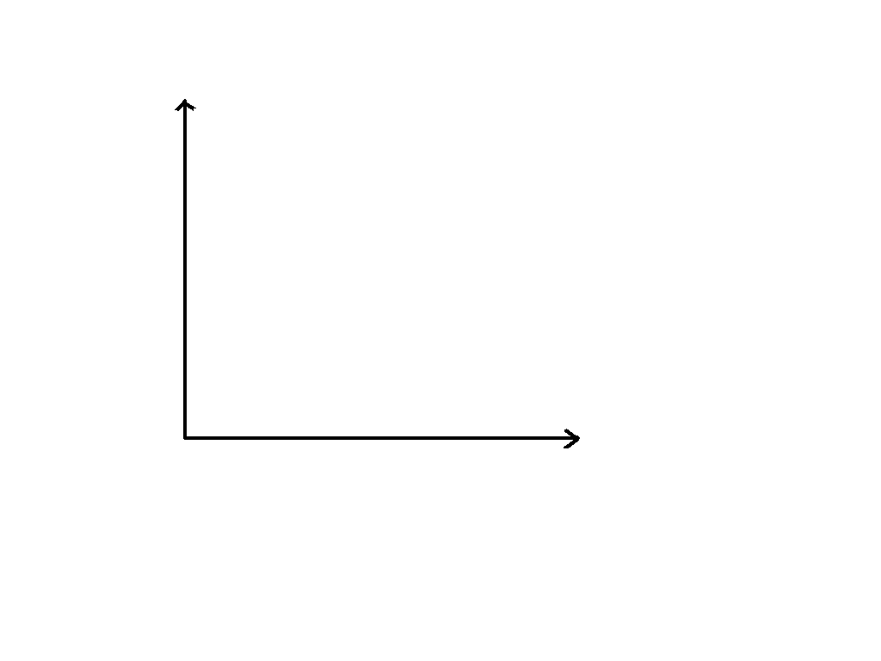

Scaling Out
Add GlusterFS nodes to trusted pool
Add filesystems as new bricks

Slide 18
Under the Hood
GlusterFS for SysAdmins

Slide 19
Elastic Hash Algorithm
No central metadata
  No Performance Bottleneck
  Eliminates risk scenarios
Location hashed intelligently on path and filename
  Unique identifiers, similar to md5sum
The “Elastic” Part
  Files assigned to virtual volumes
  Virtual volumes assigned to multiple bricks
  Volumes easily reassigned on the fly
Notes:
No metadata == No Performance Bottleneck or single point of failure (compared to single metadata node) or corruption issues (compared to distributed metadata).
Hash calculation is faster than metadata retrieval
Elastic hash is the core of how gluster scales linerally

Slide 20
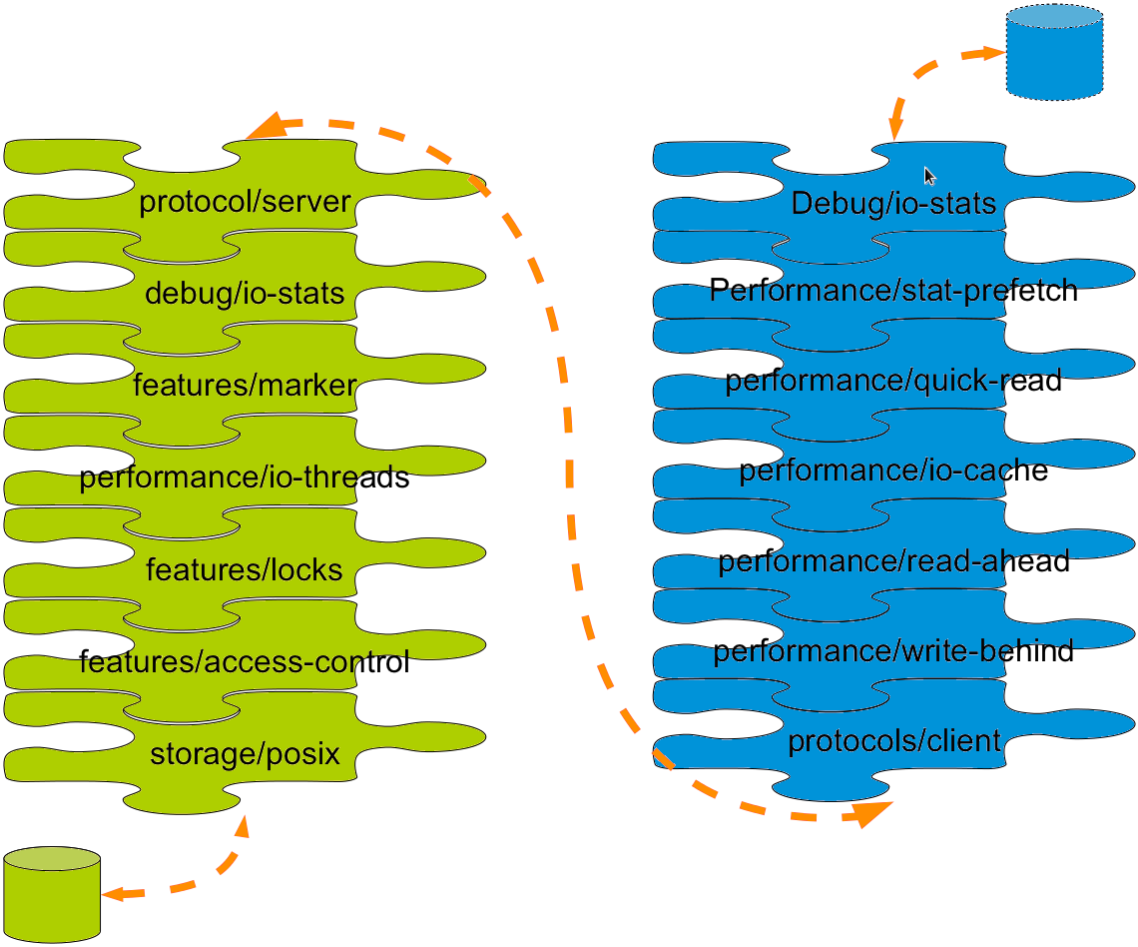
Translators
Notes:
Modular building blocks for functionality, like bricks are for storage

Slide 21
Distribution and Replication
GlusterFS for SysAdmins

Slide 22
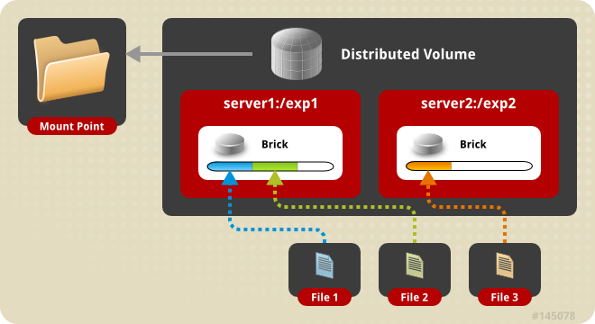
Distributed Volume
Files “evenly” spread across bricks
File-level RAID 0
Server/Disk failure could be catastrophic

Slide 23
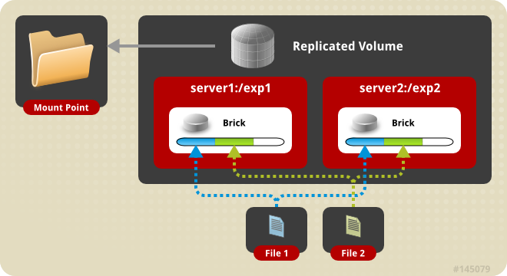
Replicated Volume
Copies files to multiple bricks
File-level RAID 1

Slide 24
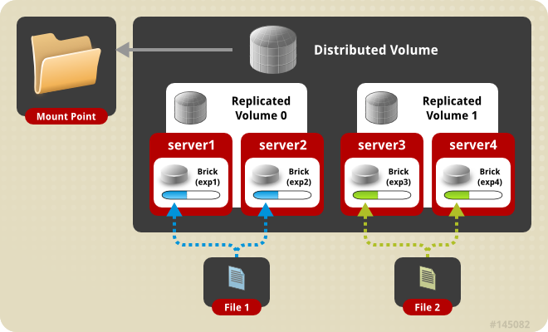
Distributed Replicated Volume
Distributes files across replicated bricks
RAID 1 plus improved read performance

Slide 25
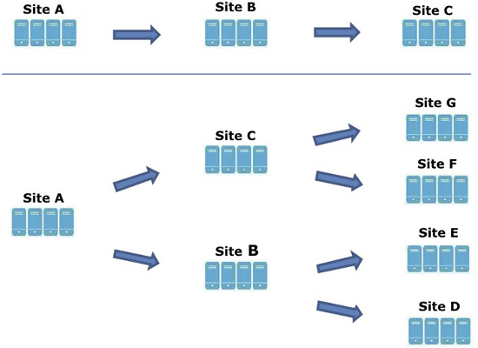
Geo Replication
Asynchronous across LAN, WAN, or Internet
Master-Slave model -- Cascading possible
Continuous and incremental
Data is passed between defined master and slave only
Notes:
When you configure geo-replication, you do so on a specific master (or source) host, replicating to a specific slave (or destination) host. Geo-replication does not scale linearly since all data is passed through the master and slave nodes specifically.
Because geo-replication is configured per-volume, you can gain scalability by choosing different master and slave geo-rep nodes for each volume.

Slide 26
Replicated Volumes vs Geo-replication
Replicated Volumes | Geo-replication
Mirrors data across clusters | Mirrors data across geographically distributed clusters
Provides high-availability | Ensures backing up of data for disaster recovery
Synchronous replication (each and every file operation is sent across all the bricks) | Asynchronous replication (checks for the changes in files periodically and syncs them on detecting differences)

Slide 27
Layered
Functionality
GlusterFS for SysAdmins

Slide 28
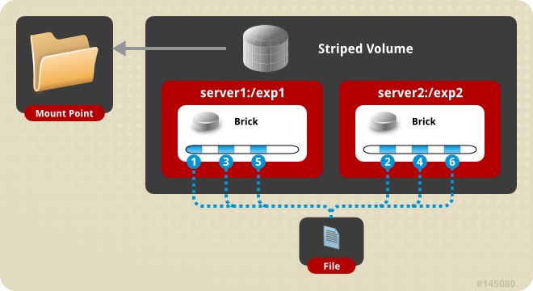
Striped Volumes
Individual files split among bricks
Similar to RAID 0
Limited Use Cases – HPC Pre/Post Processing
Notes:
Limited Read/Write performance increase, but in some cases the overhead can actually cause a performance degredation

Slide 29
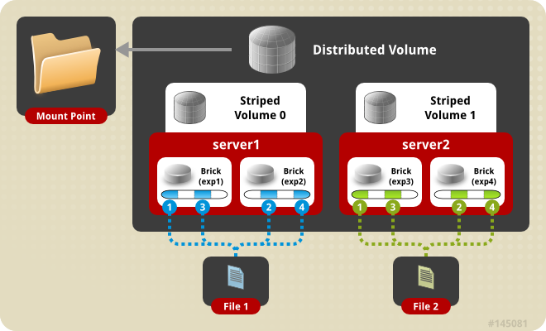
Distributed Striped Volume
Files striped across two or more nodes
Striping plus scalability

Slide 30
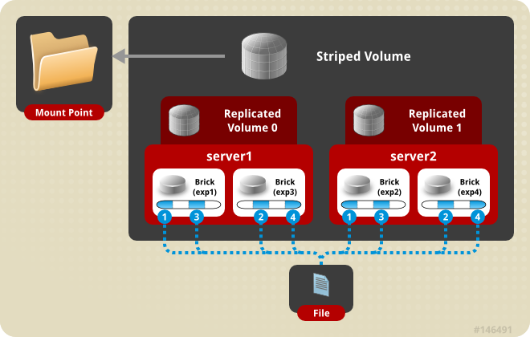
Striped Replicated Volume
GlusterFS 3.3+
Similar to RAID 10 (1+0)
Notes:
-Graphic is wrong --
-Replica 0 is exp1 and exp3
-Replica 1 is exp2 and exp4

Slide 31
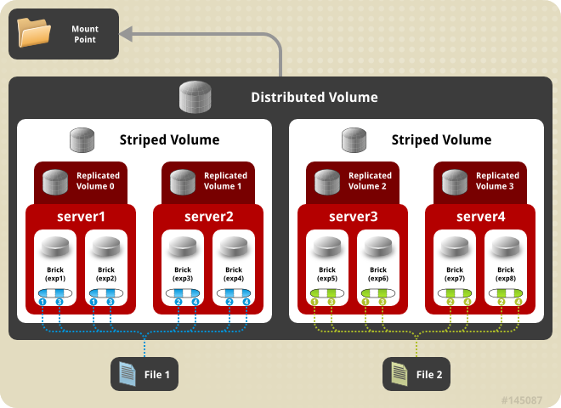
Distributed Striped Replicated Volume
GlusterFS 3.3+
Limited Use Cases – Map Reduce
Notes:
This graphic from the RHS 2.0 beta documentation actually represents a non-optimal configuration. We'll discuss this in more detail later.

Slide 32
Data Access
GlusterFS for SysAdmins

Slide 33
GlusterFS Native Client (FUSE)
FUSE kernel module allows the filesystem to be built and operated entirely in userspace
Specify mount to any GlusterFS node
Native Client fetches volfile from mount server, then communicates directly with all nodes to access data
Recommended for high concurrency and high write performance
Load is inherently balanced across distributed volumes
Notes:
-Native client will be the best choice when you have many nodes concurrently accessing the same data
-Client access to data is naturally load-balanced because the client is aware of the volume structure and the hash algorithm.

Slide 34
NFS
Standard NFS v3 clients
  Note: Mount with vers=3 option
Standard automounter is supported
Mount to any node, or use a load balancer
GlusterFS NFS server includes Network Lock Manager (NLM) to synchronize locks across clients
Better performance for reading many small files from a single client
Load balancing must be managed externally
Notes:
...mount with nfsvers=3 in modern distros that default to nfs 4
The need for this seems to be a bug, and I understand it is in the process of being fixed.
NFS will be the best choice when most of the data access by one client and for small files. This is mostly due to the benefits of native NFS caching.
Load balancing will need to be accomplished by external mechanisms

Slide 35
SMB/CIFS
GlusterFS volume is first mounted with the Native Client
  Redundantly on the GlusterFS peer
  -or-
  On an external server
Native mount point is then shared via Samba
Must be setup on each node you wish to connect to via CIFS
Load balancing must be managed externally
Notes:
-Use the GlusterFS native client first to mount the volume on the Samba server, and then share that mount point with Samba via normal methods.
-GlusterFS nodes can act as Samba servers (packages are included), or it can be an external service.
-Load balancing will need to be accomplished by external mechanisms

Slide 36
General
Administration
GlusterFS for SysAdmins

Slide 37
Preparing a Brick
# lvcreate -L 100G -n lv_brick1 vg_server1
# mkfs -t xfs -i size=512 /dev/vg_server1/lv_brick1
# mkdir /brick1
# mount /dev/vg_server1/lv_brick1 /brick1
# echo '/dev/vg_server1/lv_brick1 /brick1 xfs defaults 1 2' >> /etc/fstab
Notes:
An inode size smaller than 512 leaves no room for extended attributes (xattr). This means that every active inode will require a separate block for these. This has both a performance hit as well as a disk space usage penalty.

Slide 38
Adding Nodes (peers) and Volumes
Peer Probe
gluster> peer probe server3
gluster> peer status
Number of Peers: 2
Hostname: server2
Uuid: 5e987bda-16dd-43c2-835b-08b7d55e94e5
State: Peer in Cluster (Connected)
Hostname: server3
Uuid: 1e0ca3aa-9ef7-4f66-8f15-cbc348f29ff7
State: Peer in Cluster (Connected)
Distributed Volume
gluster> volume create my-dist-vol server2:/brick2 server3:/brick3
gluster> volume info my-dist-vol
Volume Name: my-dist-vol
Type: Distribute
Status: Created
Number of Bricks: 2
Transport-type: tcp
Bricks:
Brick1: server2:/brick2
Brick2: server3:/brick3
gluster> volume start my-dist-vol
Notes:
-peer status command shows all other peer nodes – excludes the local node
-I understand this to be a bug that's in the process of being fixed

Slide 39
Distributed Striped Replicated Volume
gluster> volume create test-volume replica 2 stripe 2 transport tcp \
server1:/exp1 server1:/exp2 server2:/exp3 server2:/exp4 \
server3:/exp5 server3:/exp6 server4:/exp7 server4:/exp8
Multiple bricks of a replicate volume are present on the same server. This setup is not optimal.
Do you still want to continue creating the volume? (y/n) y
Creation of volume test-volume has been successful. Please start the volume to access data.
<- test-volume
replica 2
stripe 2
<- distributed files ->
Notes:
-Support for striped replicated volumes is added in RHS 2.0
-I'm using this example because it's straight out of the documentation, but I want to point out that this is not an optimal configuration.
-With this configuration, the replication happens between bricks on the same node.
-We should alter the order of the bricks here so that the replication is between nodes.

Slide 40
Distributed Striped Replicated Volume
gluster> volume create test-volume stripe 2 replica 2 transport tcp \
server1:/exp1 server2:/exp3 server1:/exp2 server2:/exp4 \
server3:/exp5 server4:/exp7 server3:/exp6 server4:/exp8
Creation of volume test-volume has been successful. Please start the volume to access data.
gluster> volume info test-volume
Volume Name: test-volume
Type: Distributed-Striped-Replicate
Volume ID: 8f8b8b59-d1a1-42fe-ae05-abe2537d0e2d
Status: Created
Number of Bricks: 2 x 2 x 2 = 8
Transport-type: tcp
Bricks:
Brick1: server1:/exp1
Brick2: server2:/exp3
Brick3: server1:/exp2
Brick4: server2:/exp4
Brick5: server3:/exp5
Brick6: server4:/exp7
Brick7: server3:/exp6
Brick8: server4:/exp8
Notes:
-Brick order is corrected to ensure replication is between bricks on different nodes.
-Replica is always processed first in building the volume, regardless of whether it's before or after stripe on the command line.
-So, a 'replica 2' will create the replica between matching pairs of bricks in the order that the bricks are passed to the command. 'replica 3' will be matching trios of bricks, and so on.

Slide 41
Manipulating Bricks in a Volume
gluster> volume add-brick my-dist-vol server4:/brick4
gluster> volume rebalance my-dist-vol fix-layout start
gluster> volume rebalance my-dist-vol start
gluster> volume rebalance my-dist-vol status
Node Rebalanced-files size scanned failures status
--------- ----------- ----------- ----------- ----------- ------------
localhost 112 15674 170 0 completed
10.16.156.72 140 3423 321 2 completed
gluster> volume remove-brick my-dist-vol server2:/brick2 start
gluster> volume remove-brick my-dist-vol server2:/brick2 status
Node Rebalanced-files size scanned failures status
--------- ----------- ----------- ----------- ----------- ------------
localhost 16 16777216 52 0 in progress
192.168.1.1 13 16723211 47 0 in progress
gluster> volume remove-brick my-dist-vol server2:/brick2 commit
Notes:
Must add and remove in multiples of the replica and stripe counts

Slide 42
Migrating Data / Replacing Bricks
gluster> volume replace-brick my-dist-vol server3:/brick3 server5:/brick5 start
gluster> volume replace-brick my-dist-vol server3:/brick3 server5:/brick5 status
Current File = /usr/src/linux-headers-2.6.31-14/block/Makefile
Number of files migrated = 10567
Migration complete
gluster> volume replace-brick my-dist-vol server3:/brick3 server5:/brick5 commit

Slide 43
Volume Options
Auth
gluster> volume set my-dist-vol auth.allow 192.168.1.*
gluster> volume set my-dist-vol auth.reject 10.*
gluster> volume set my-dist-vol auth.allow 192.168.1.*
gluster> volume set my-dist-vol auth.reject 10.*
NFS
gluster> volume set my-dist-vol nfs.volume-access read-only
gluster> volume set my-dist-vol nfs.disable on
Other advanced options
gluster> volume set my-dist-vol features.read-only on
gluster> volume set my-dist-vol performance.cache-size 67108864

Slide 44
Volume Top Command
gluster> volume set my-dist-vol auth.allow 192.168.1.*
gluster> volume set my-dist-vol auth.reject 10.*
gluster> volume top my-dist-vol read brick server3:/brick3 list-cnt 3
Brick: server:/export/dir1
==========Read file stats========
read filename
call count
116 /clients/client0/~dmtmp/SEED/LARGE.FIL
64 /clients/client0/~dmtmp/SEED/MEDIUM.FIL
54 /clients/client2/~dmtmp/SEED/LARGE.FIL
Many top commands are available for analysis of files, directories, and bricks
Read and write performance test commands available
  Perform active dd tests and measure throughput

Slide 45
Volume Profiling
gluster> volume set my-dist-vol auth.allow 192.168.1.*
gluster> volume set my-dist-vol auth.reject 10.*
gluster> volume profile my-dist-vol start
gluster> volume profile my-dist-vol info
Brick: Test:/export/2
Cumulative Stats:
Block 1b+ 32b+ 64b+
Size:
Read: 0 0 0
Write: 908 28 8
...
%-latency Avg- Min- Max- calls Fop
latency Latency Latency
___________________________________________________________
4.82 1132.28 21.00 800970.00 4575 WRITE
5.70 156.47 9.00 665085.00 39163 READDIRP
11.35 315.02 9.00 1433947.00 38698 LOOKUP
11.88 1729.34 21.00 2569638.00 7382 FXATTROP
47.35 104235.02 2485.00 7789367.00 488 FSYNC
------------------
Duration : 335
BytesRead : 94505058
BytesWritten : 195571980
Notes:
??where is this stored, and how does it impact performance when on??

Slide 46
Geo-Replication
Setup SSH Keys
# ssh-keygen -f /var/lib/glusterd/geo-replication/secret.pem
# ssh-copy-id -i /var/lib/glusterd/geo-replication/secret.pem repluser@slavehost1
Replicate Via SSH to Remote GlusterFS Volume
gluster> volume geo-replication my-dist-vol repluser@slavehost1::my-dist-repl start
Starting geo-replication session between my-dist-vol & slavehost1:my-dist-repl has been successful
gluster> volume geo-replication my-dist-vol status
MASTER SLAVE STATUS
--------------------------------------------------------------------------------
my-dist-vol ssh://repluser@slavehost1::my-dist-repl OK
Output of volume info Now Reflects Replication
gluster> volume info my-dist-vol
...
Options Reconfigured:
geo-replication.indexing: on
Notes:
Specifying the double-colin between the remote host name and destination tells geo-replication that the destination is a glusterfs volume name. With a single colon, it will treat the destination as an absolute filesystem path.
Preceding the remote host with user@ causes geo-replication to interpret the communication protocol as ssh, which is generally preferred. If you use the simple remote syntax of:
hostname:volume
It will cause the local system to mount the remote volume locally with the native client, which will result in a necessary performance degradation because of the added fuse overhead. Over a WAN, this can be significant.

Slide 47
Use Cases
GlusterFS for SysAdmins

Slide 48
Common Solutions
Media / Content Distribution Network (CDN)
Backup / Archive / Disaster Recovery (DR)
Large Scale File Server
Home directories
High Performance Computing (HPC)
Infrastructure as a Service (IaaS) storage layer

Slide 49
Hadoop – Map Reduce
Access data within and outside of Hadoop
No HDFS name node single point of failure / bottleneck
Seamless replacement for HDFS
Scales with the massive growth of big data

Slide 50

CIC Electronic Signature Solutions
Hybrid Cloud: Electronic Signature Solutions
Challenge
  Must leverage economics of the cloud
  Storage performance in the cloud too slow
  Need to meet demanding client SLA’s
Solution
  Red Hat Storage Software Appliance
  Amazon EC2 and Elastic Block Storage (EBS)
Benefits
  Faster development and delivery of new products
  SLA’s met with headroom to spare
  Accelerated cloud migration
  Scale-out for rapid and simple expansion
  Data is highly available for 24/7 client access
Reduced time-to-market for new products
Meeting all client SLAs
Accelerating move to the cloud

Slide 51

Pandora Internet Radio
Private Cloud: Media Serving
Challenge
  Explosive user & title growth
  As many as 12 file formats for each song
  ‘Hot’ content and long tail
Solution
  Three data centers, each with a six-node GlusterFS cluster
  Replication for high availability
  250+ TB total capacity
Benefits
  Easily scale capacity
  Centralized management; one administrator to manage day-to-day operations
  No changes to application
  Higher reliability
1.2 PB of audio served per week
13 million files
Over 50 GB/sec peak traffic

Slide 52

Brightcove
Private Cloud: Media Serving
Challenge
  Explosive customer & title growth
  Massive video in multiple locations
  Costs rising, esp. with HD formats
Solution
  Complete scale-out based on commodity DAS/JBOD and GlusterFS
  Replication for high availability
  1PB total capacity
Benefits
  Easily scale capacity
  Centralized management; one administrator to manage day-to-day operations
  Higher reliability
  Path to multi-site
Over 1 PB currently in Gluster
Separate 4 PB project in the works
Notes:
Cloud-based online video platform

Slide 53

Pattern Energy
High Performance Computing for Weather Prediction
Challenge
  Need to deliver rapid advance weather predictions
  Identify wind and solar abundance in advance
  More effectively perform preventative maintenance and repair
Solution
  32 HP compute nodes
  Red Hat SSA for high throughput and availability
  20TB+ total capacity
Benefits
  Predicts solar and wind patterns 3 to 5 days in advance
  Maximize energy production and repair times
  Avoid costs of outsourcing weather predictions
  Solution has paid for itself many times over
Rapid and advance weather predictions
Maximizing energy assets
Cost savings and avoidance
Notes:
Cloud-based online video platform

Slide 54
Common
Pitfalls
GlusterFS for SysAdmins

Slide 55
Split-Brain Syndrome
Communication lost between replicated peers
Clients write separately to multiple copies of a file
No automatic fix
  May be subjective which copy is right – ALL may be!
  Admin determines the “bad” copy and removes it
  Self-heal will correct the volume
    Trigger a recursive stat to initiate
    Proactive self-healing in GlusterFS 3.3

Slide 56
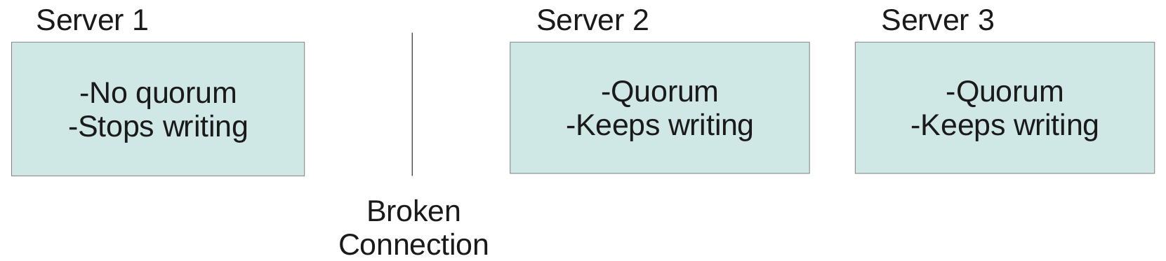
Quorum Enforcement
Disallows writes (EROFS) on non-quorum peers
Significantly reduces files affected by split-brain
Preferred when data integrity is the priority
Not preferred when application integrity is the priority
Notes:
Patch written by Jeff Darcy

Slide 57
Your Storage Servers are Sacred!
Don't touch the brick filesystems directly!
They're Linux servers, but treat them like appliances
  Separate security protocols
  Separate access standards
Don't let your Jr. Linux admins in!
  A well-meaning sysadmin can quickly break your system or destroy your data

Slide 58
Do it!
GlusterFS for SysAdmins

Slide 59
Do it!
Build a test environment in VMs in just minutes!
Get the bits:
  www.gluster.org has packages available for many Linux distributions (CentOS, Fedora, RHEL, Ubuntu)

Slide 60
Thank You!
GlusterFS:
www.gluster.org
Justin Clift - jclift@redhat.com
Slides Available at:
http://www.gluster.org/community/documentation/index.php/Presentations
GlusterFS for SysAdmins
Notes:
Question notes:
-Vs. CEPH
-CEPH is object-based at its core, with distributed filesystem as a layered function. GlusterFS is file-based at its core, with object methods (UFO) as a layered function.
-CEPH stores underlying data in files, but outside the CEPH constructs they are meaningless. Except for striping, GlusterFS files maintain complete integrity at the brick level.
-With CEPH, you define storage resources and data architecture (replication) separate, and CEPH actively and dynamically manages the mapping of the architecture to the storage. With GlusterFS, you manually manage both the storage resources and the data architecture.

