Slide 1
Integrating GlusterFS, qemu and oVirt
Vijay Bellur
Gluster Workshop – LinuxCon EU 2013

Slide 2
Agenda
Introduction
GlusterFS as VM Image Store
Integration with QEMU
Integration with oVirt
Q&A

Slide 3
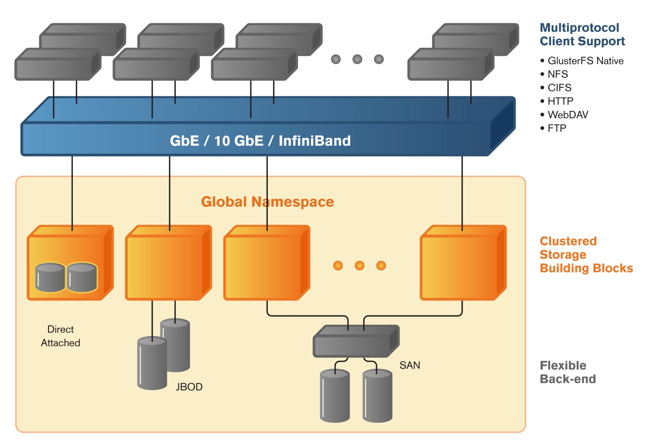

GlusterFS
Global namespace
Scale-out clustered storage building blocks
Support thousands of clients
Access using GlusterFS and NFS protocols
Linear performance scaling

Slide 4

KVM and Qemu
KVM is a full virtualization solution for Linux on x86 hardware containing virtualization extensions.
Qemu is the driver for KVM virtualization

Slide 5
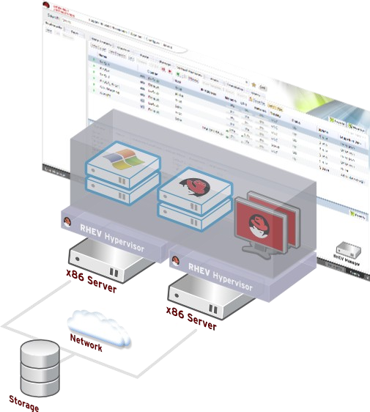
oVirt
Large scale, centralized management for server and desktop virtualization
Open source alternative to vCenter / vSphere
Focus on KVM

Slide 6
GlusterFS 3.3
Granular data self heal
Pro-active self healing
Online data migration with remove-brick
Support for O_DIRECT in FUSE

Slide 7
GlusterFS 3.4
Improved write-behind behavior
libgfapi with support for DVM
Block Device Translator
Support for volume/cluster management from oVirt
FUSE
      Scatter – Gather patchset
      gid caching
      Configurable fuse queue length
      aio support in posix translator

Slide 8
GlusterFS 3.5
fallocate() support
zerofill support in libgfapi
Improved block device translator
File snapshots

Slide 9
QEMU & GlusterFS Integration
Integration possible through:
GlusterFS native client - possible with qemu 1.2 and GlusterFS 3.3
GlusterFS NFS – possible with qemu 1.2 and GlusterFS 3.3
libgfapi – possible with qemu 1.3 and GlusterFS 3.4

Slide 10
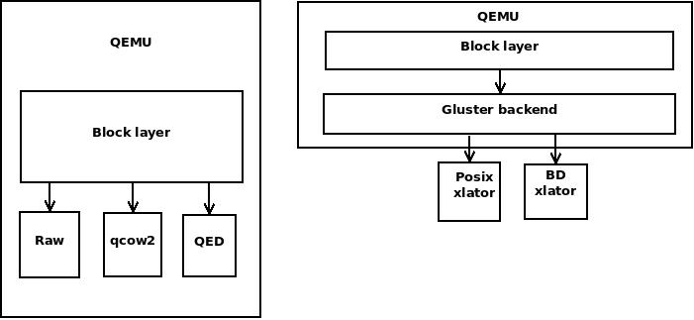
QEMU & GlusterFS Integration
        Source: LPC 2012

Slide 11
QEMU & GlusterFS Integration
FIO Numbers (Seq read, 4 files with direct io, qemu options: if=virtio, cache=none)
 | Aggregate BW(kB/s) | Min BW(kB/s) | Max BW(kB/s)
Base | 63076 | 15769 | 17488
FUSE mount | 29392 | 7348 | 9266
QEMU-GlusterFS native integration | 53609 | 13402 | 14909

Slide 12
oVirt & GlusterFS - Architecture
Architecture
Directory Services
CLI
Storage Server 1
VDSM
api
Engine
Storage Server 2
Python SDK
REST
over https
R
E
S
T
xmlrpc
VDSM
GWT Servlet
Storage Server n
Browser
gwtrpc
over https
VDSM

Slide 13
oVirt & GlusterFS
New feature in oVirt 3.1 http://wiki.ovirt.org/wiki/Features/Gluster_Support
Cluster Configuration Modes
  Virtualization only
  Gluster only
  Virtualization + Gluster (default)
New entities (Volumes, Bricks, Volume Options)
VDSM verbs for gluster management

Slide 14
oVirt & GlusterFS - Architecture
Architecture
Directory Services
CLI
Storage Server 1
VDSM
api
Engine
Storage Server 2
Python SDK
REST
over https
R
E
S
T
xmlrpc
VDSM
GWT Servlet
Storage Server n
Browser
gwtrpc
over https
VDSM

Slide 15
oVirt Gluster Management Features
Cluster Management
  Create Cluster
  Add / Remove Storage Servers
  Delete Cluster
Volume Management
  Create Volume
  Add / Remove bricks
  Start / Stop / Delete volume

Slide 16
oVirt Gluster Management Features
Advanced Search
Multi Level Administration & RBAC
Audit & Alerts
ReST API
Python SDK & CLI

Slide 17
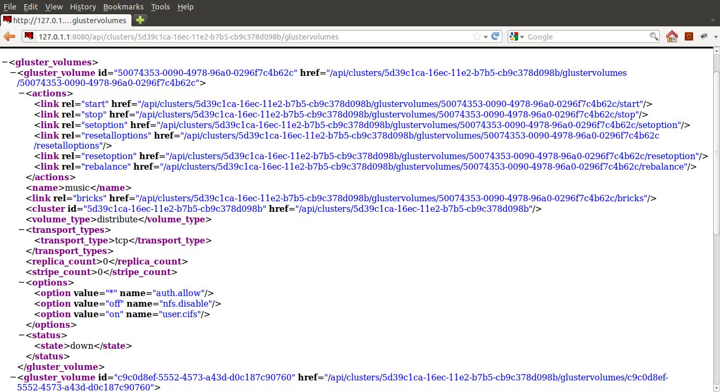
ReST API

Slide 18
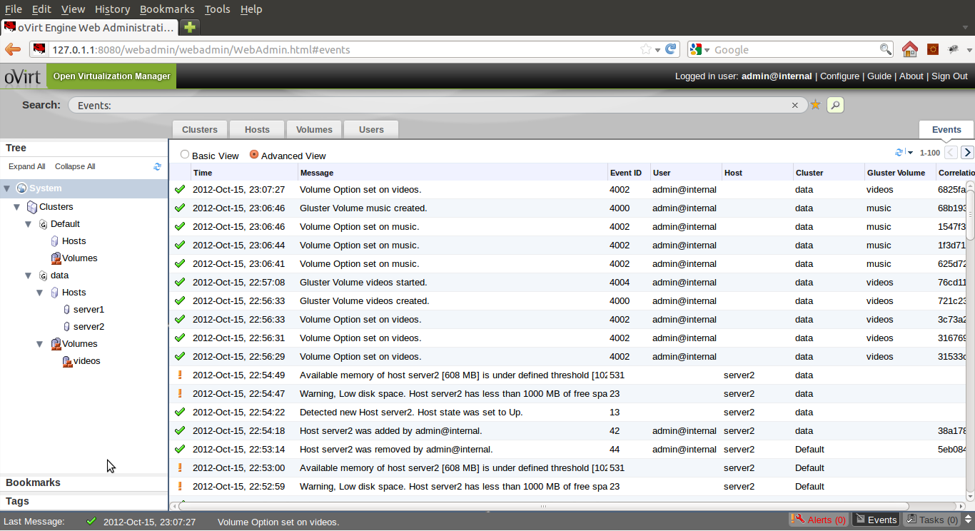
Events

Slide 19
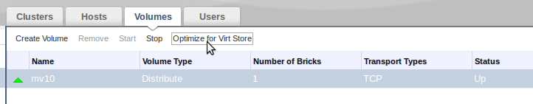
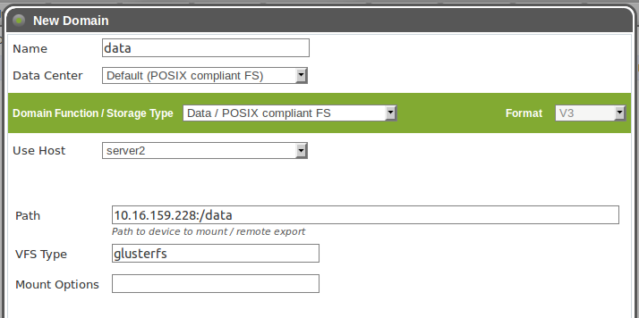
Gluster as Virt Store
Optimize volume for virt store (Sets optimization options on volume)
Create PosixFS storage domain (VFS type = glusterfs)

Slide 20
Upcoming features (oVirt 3.4 and beyond)
Upcoming features (3.2 and beyond)
Async Tasks
UFO configuration

Slide 21
Upcoming features (oVirt 3.2 and beyond)
Upcoming features (3.2 and beyond)
Storage Device management
Reports
Gluster native storage domain
Volume Quotas

Slide 22
Contribute
Git repository
  git://gerrit.ovirt.org/ovirt-engine
  git://gerrit.ovirt.org/vdsm
  git://git.gluster.com/glusterfs.git
IRC Channels
  #ovirt on oftc
  #gluster on freenode

Slide 23
Thank You!
Q & A

