Slide 1
GlusterFS Translators
Almost Live Tutorial
Jeff Darcy
August 28, 2012

Slide 2
Session Overview
Build a “negative lookup” caching translator
  add functionality
  hook things together
  build
  configure
  debug
Almost live - see each step as code is written, built, and run

Slide 3
The Problem
Dir A
Dir B
Dir C
Dir D
file 1
8
8
8
file 2
file 3
file 4
First process misses in A/B/C
Second process has no “memory” of misses, searches from the beginning again
Idea: cache the misses, return immediately

Slide 4
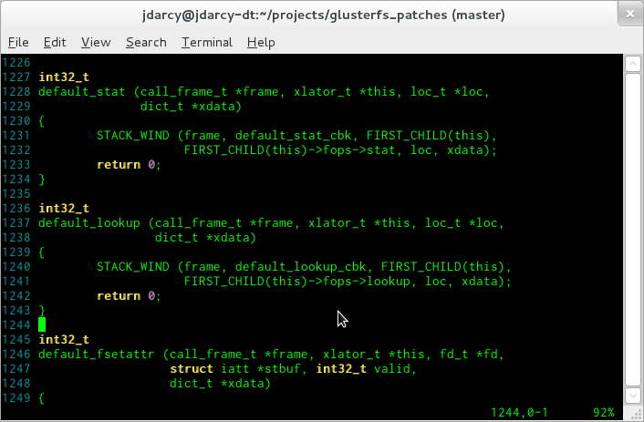
On the Shoulders of Giants
++++

Slide 5
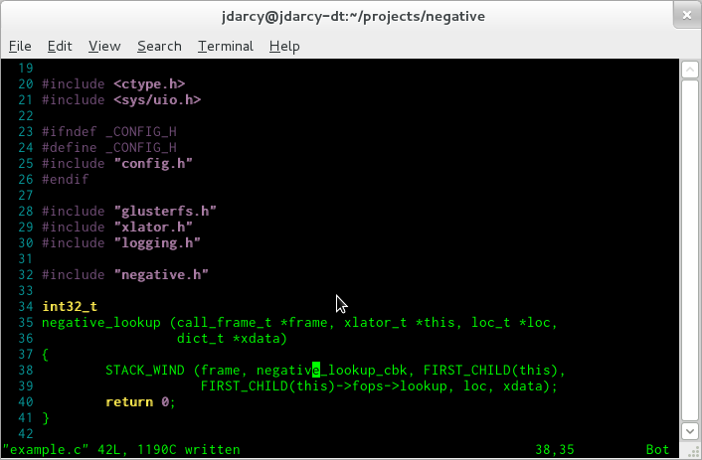
Minor Changes 1

Slide 6
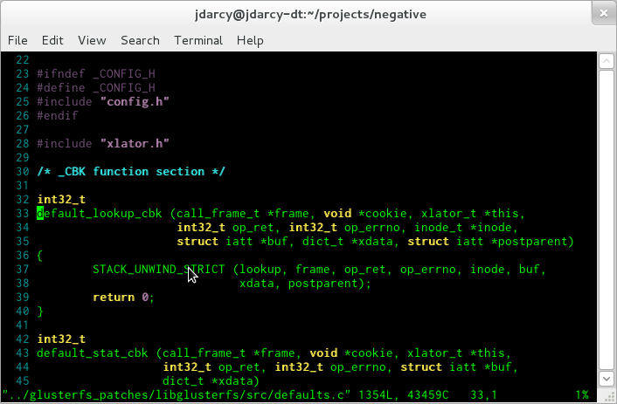
Back for Seconds

Slide 7
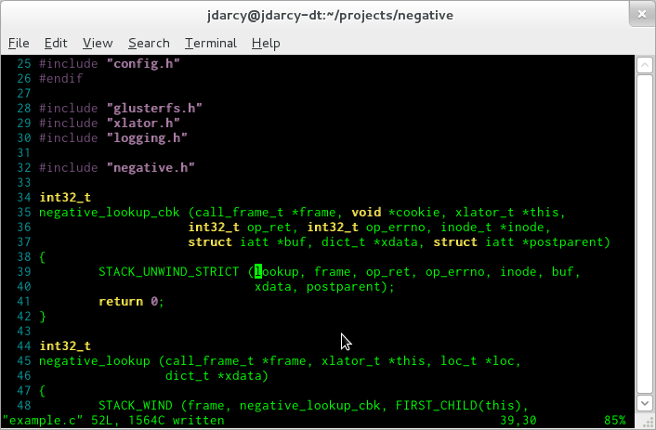
Minor Changes 2

Slide 8
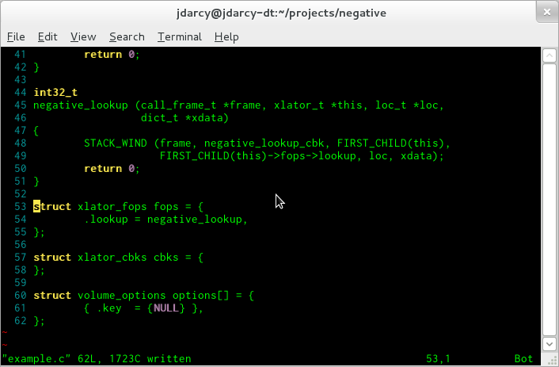
Boiler Plate

Slide 9
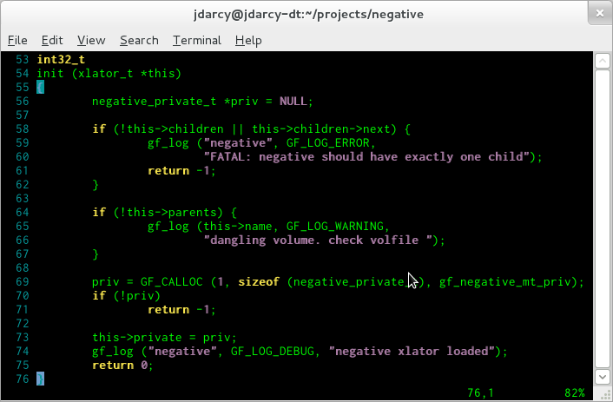
init

Slide 10
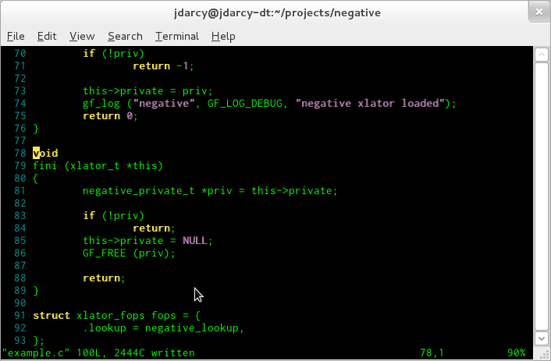
fini

Slide 11
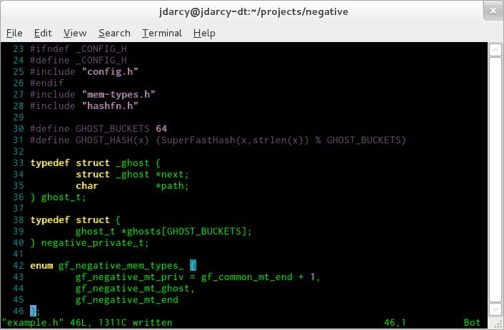
Header File

Slide 12
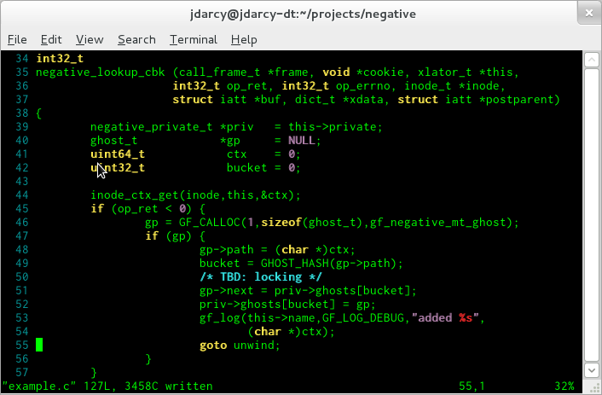
Updating the Cache (negatives)

Slide 13
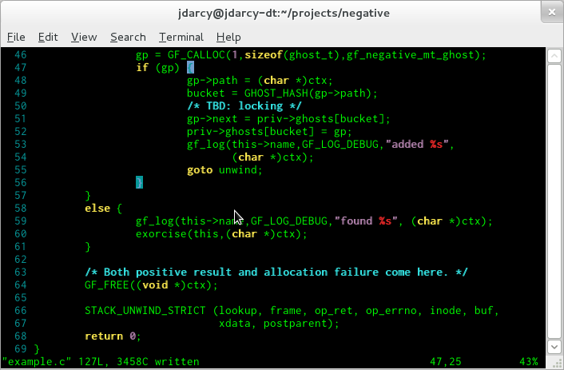
Updating the Cache (positives)

Slide 14
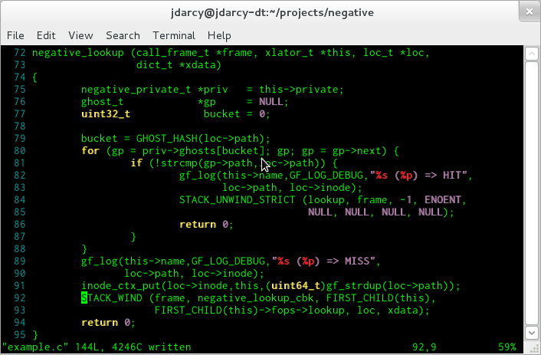
Checking the Cache

Slide 15
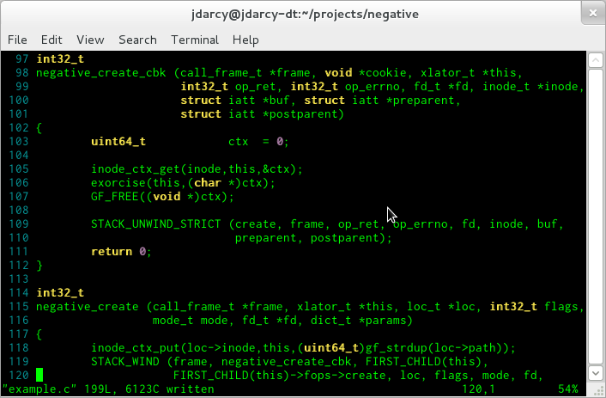
Final Pieces (create and mkdir)

Slide 16
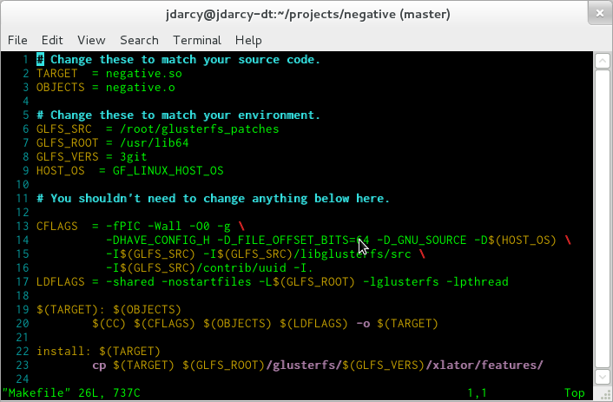
Time to Build

Slide 17
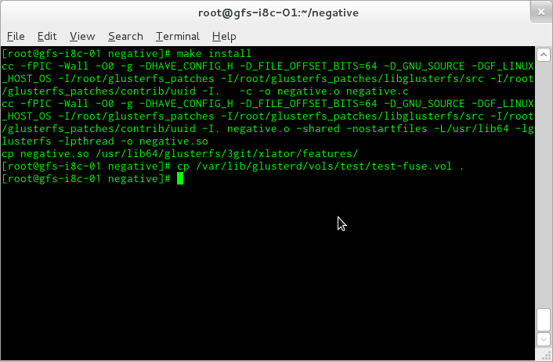
Almost There

Slide 18
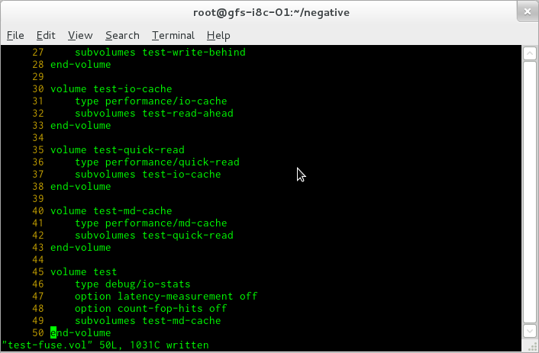
Original Volfile

Slide 19
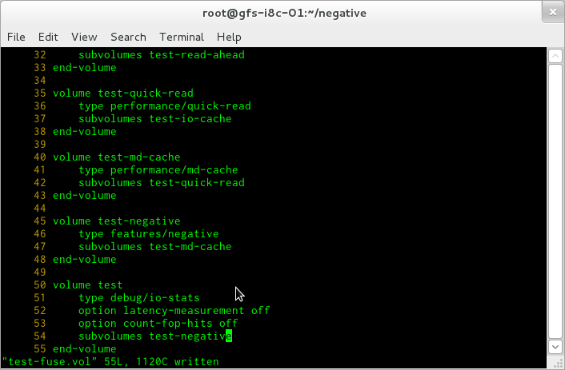
Modified Volfile

Slide 20
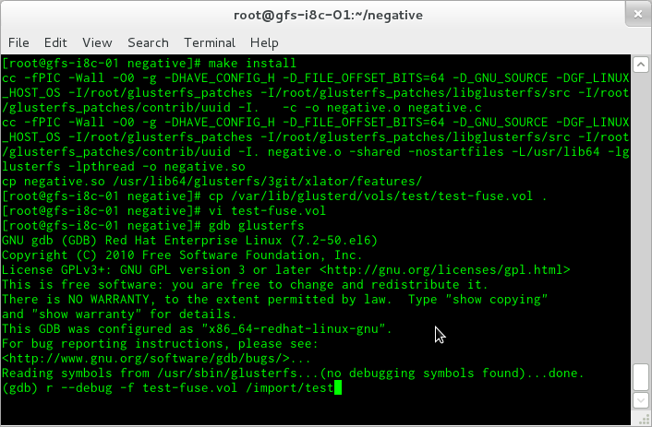
Running in a Debugger

Slide 21
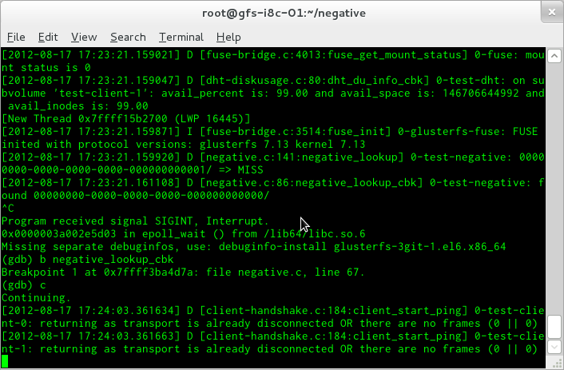
Setting First Breakpoint

Slide 22
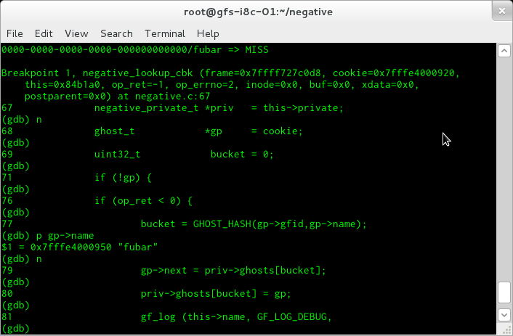
First Failed Lookup

Slide 23
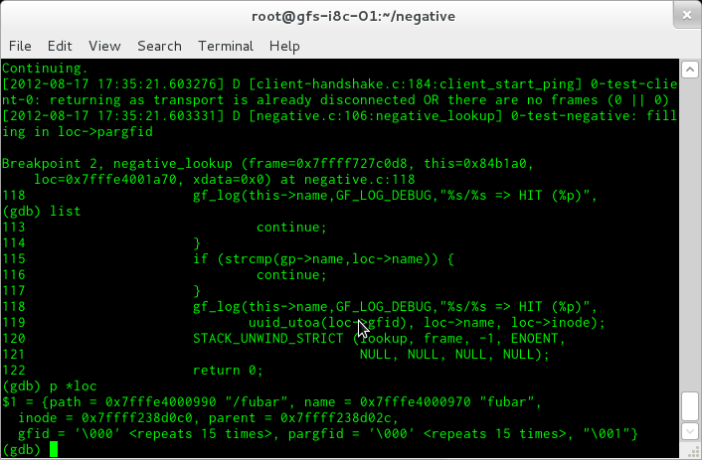
Cache Kicks In

Slide 24
How Well Does It Work?
Simulate PHP workload
  1000 files spread across 10 directories
  80% of requests to 10% of files
  test time for 10000 searches
Numbers for comparison only
  debug build
  wimpy test machines (GigE)

Slide 25
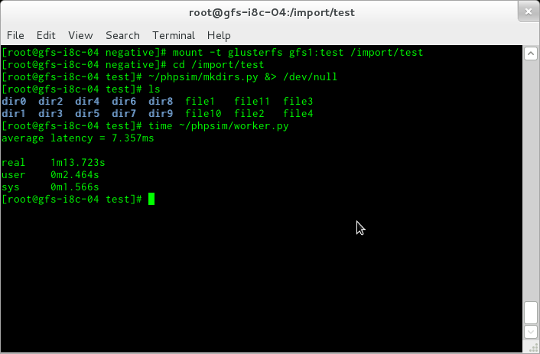
Getting a Baseline

Slide 26
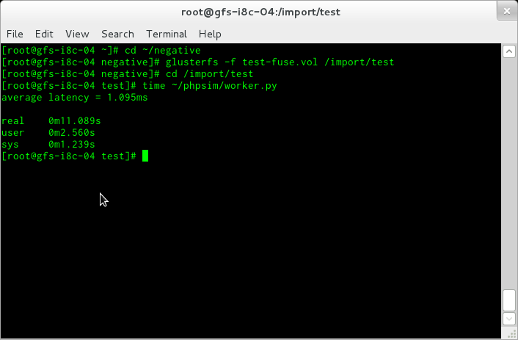
Are You Ready?

Slide 27
Interlude: glupy
Write translators in Python
Uses extending/embedding, ctypes module
Brand new project
  weekend hacking, mid-August 2012
  still implementing 70+ operation types
Article coming soon in $major_publication

Slide 28
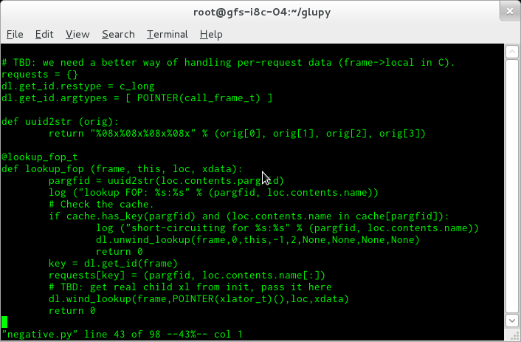
Python Lookup Function

Slide 29
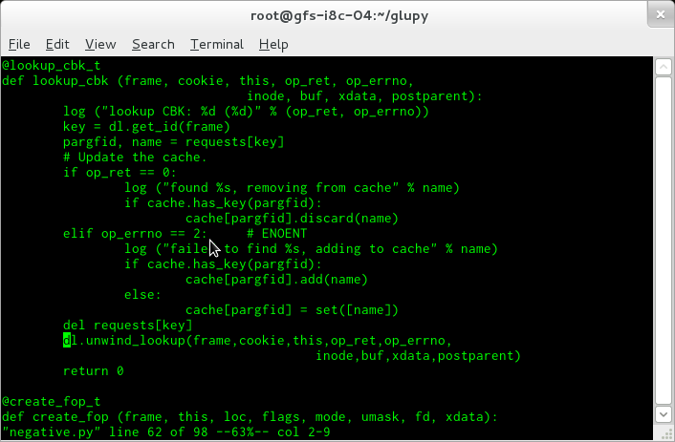
Python Callback Function

Slide 30
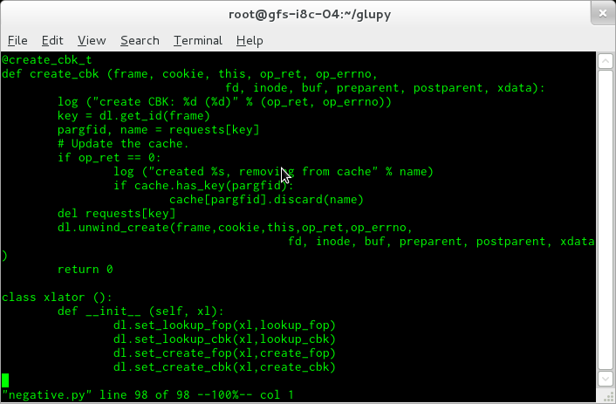
Python Setup

Slide 31
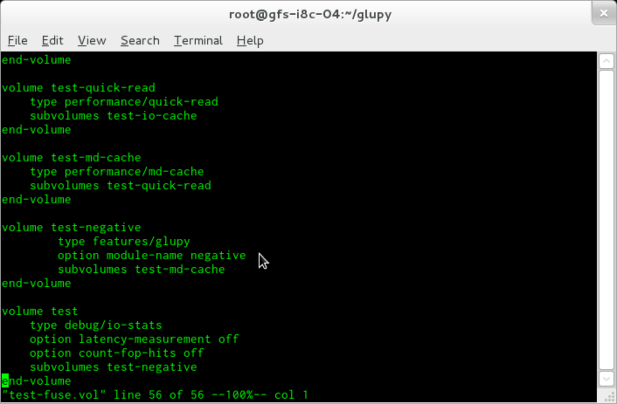
Yet Another Volfile

Slide 32
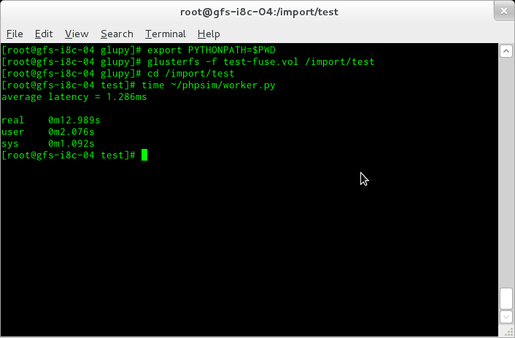
Scripting Languages Aren't So Slow

Slide 33
Conclusion
Even simple translators can produce big effects
Writing translators isn't that hard
Writing glupy translators will be even easier
What would you like GlusterFS to do today?

Slide 34
Resources
http://hekafs.org/index.php/2011/11/translator-101-class-1-setting-the-stage/
http://hekafs.org/index.php/2011/11/translator-101-lesson-2-init-fini-and-private-context/
http://hekafs.org/index.php/2011/11/translator-101-lesson-3-this-time-for-real/
http://hekafs.org/index.php/2011/11/translator-101-lesson-4-debugging-a-translator/
https://github.com/jdarcy/negative-lookup
https://github.com/jdarcy/glupy
http://www.gluster.org/

