Slide 1

YADL
“Yet another dedup library”
Ideators
Dan Lambright (Principal Software Engineer)
Luis Pabon (Principal Software Engineer)
Joseph Fernandes (Senior Software Engineer)
Red Hat

Slide 2
What is YADL ?
Software Defined Dedupe Solution
User-Land Library for Storage Systems
Stream based API's : inbound dedupe
Integrates with
  File (eg: GlusterFS)
  Block (eg: Ceph, pblcache)
  Object (eg: Ceph , Open Stack Swift )

Slide 3
What is YADL ?
Configurable
  Fixed Chunk
  Variable Chunk
Storage options
  On disk
  In memory

Slide 4
What is YADL ?
File
YADL API
YADL Library
Stream
Metadata
YADL Engine
Object
YADL Stores
Stream
.
.
.
.
Metadata
Block
Stream
Metadata
Notes:
Apply tools to new environments
My pov: systems software and educator

Slide 5
Future
Distributed Dedupe: YADL-Eco
  Optimal data distribution
  Network traffic sensitive
  SuperChunks : Aggregated Chunks
  Locality Sensitive Hashes
YADL Shells
  Direct Data Access (without api)
  File, Object, iscsi etc
  Wrappers over YADL
Notes:
Apply tools to new environments
My pov: systems software and educator

Slide 6
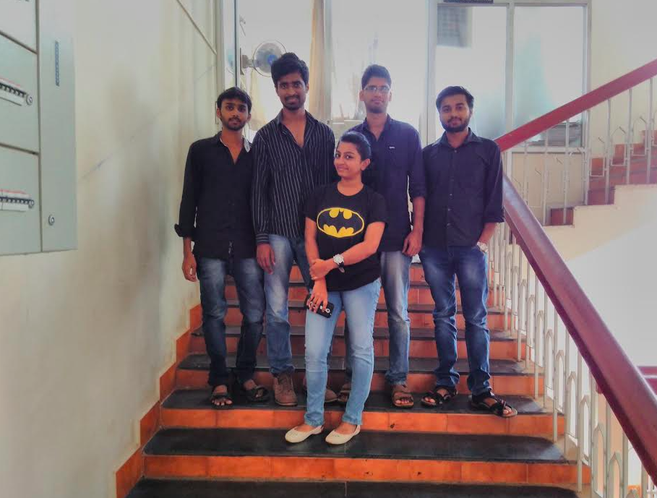
Developers
Karthik, Sukumar, Sonal, Srinivas & Ewen
Master of Computer Application,
NMAMIT,
Nitte – India
Dan Lambright
Principal Software Engineer
Red Hat
Joseph Elwin Fernandes
Senior Software Engineer
Red Hat
Luis Pabon
Principal Software Engineer
Red Hat

Slide 7

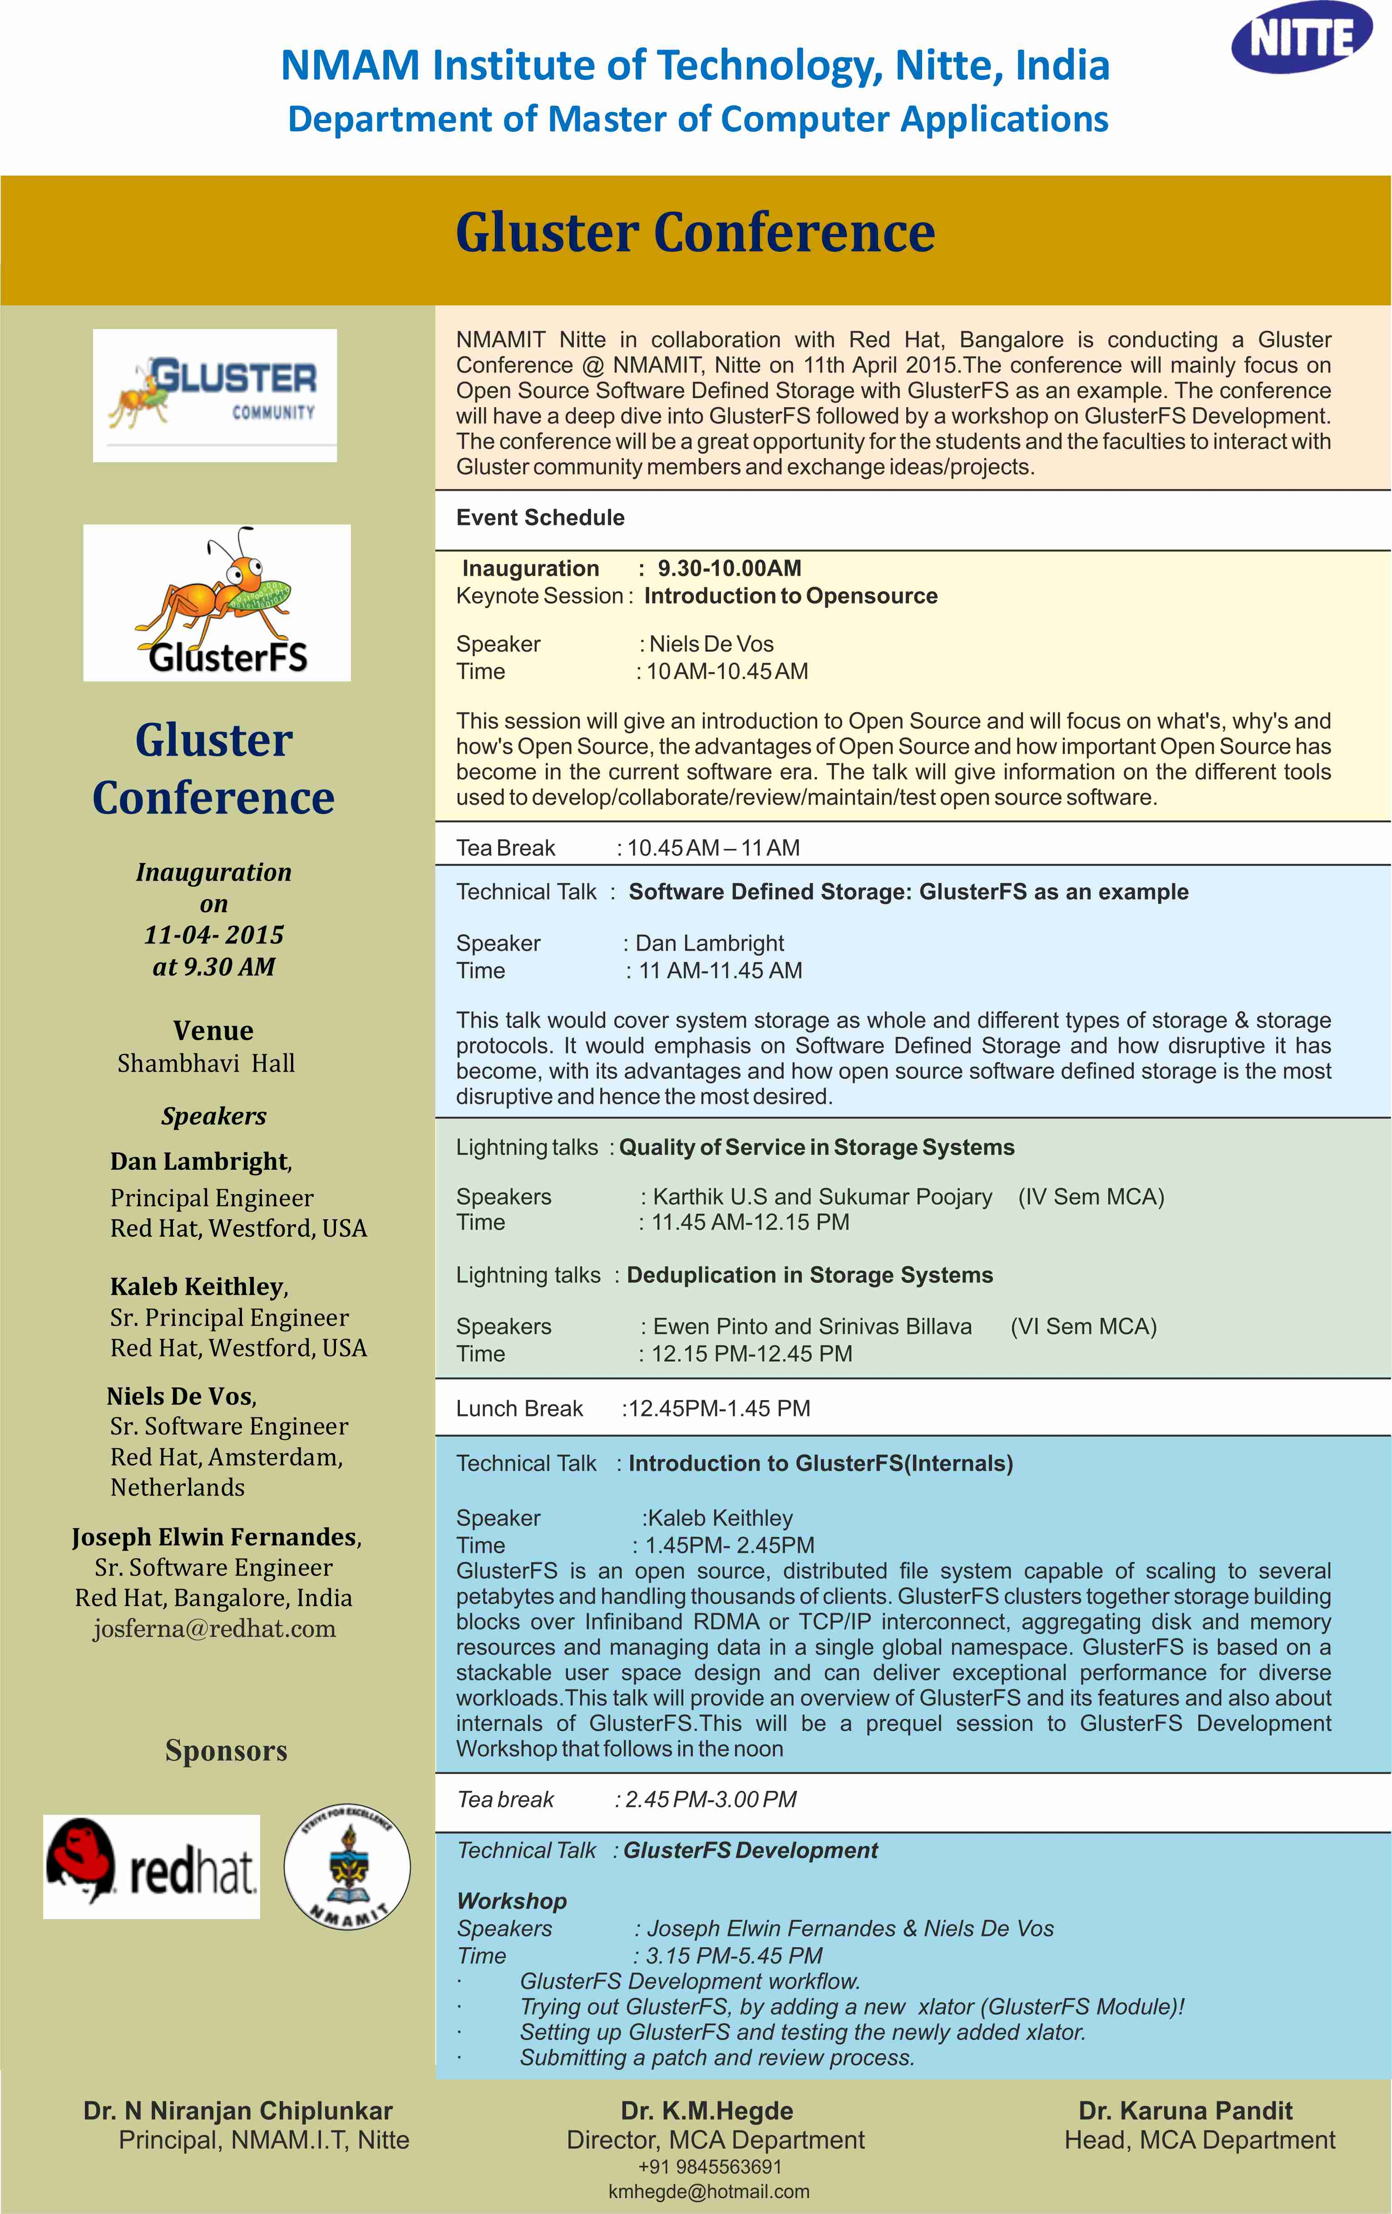
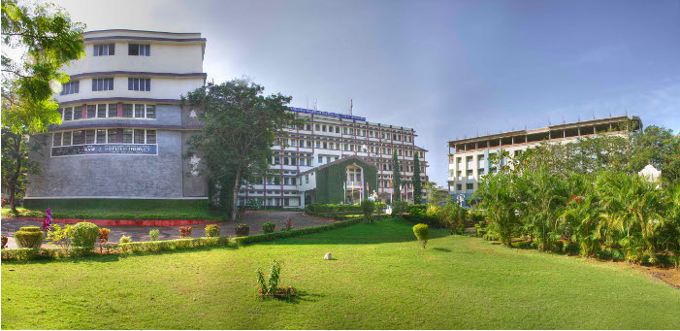
NMAMIT, Nitte ?
Gluster Conference 2015
… with connections to EMC and Intel..
and now Red Hat!
Notes:
Triplication is 200% overhead
Isillon
Raid5 – 1 failures
Raid6 - 2
Controller is local to server, need one for each

Slide 8
Put the thank you side here
Notes:
Triplication is 200% overhead
Isillon
Raid5 – 1 failures
Raid6 - 2
Controller is local to server, need one for each

