Slide 1
Quality Of Service
(QOS)
By:
Karthik U S Sukumar Poojari

Slide 2
Extracted from :
mClock: Handling Throughput Variability for
Hypervisor IO Scheduling
By Vmware
[https://labs.vmware.com/download/122/]

Slide 3
Quality Of Service
(QOS)
Outline:
Problem statement
Related works
mClock algorithm
Advantages and disadvantages
Conclusion

Slide 4
Problem Statement
Virtualized hosts run many virtual machines (VMs)
The hypervisor needs to provide each virtual machine with the illusion of owning dedicated physical resources: CPU, memory, network and storage IO.
Existing products such as VMware ESX server hypervisor provide guarantees for CPU and memory allocation using sophisticated controls such as reservations, limits and shares.
Storage IO resource allocation is much more rudimentary, limited to providing proportional shares to different VMs.

Slide 5
Problem Statement
Storage IO allocation is hard because of:
  The variable storage workload characteristics
  The available throughput changes with time
  Must adjust allocation dynamically

Slide 6
Problem Statement
Three controls:
  Reservation: minimum guarantee
  Limits: maximum allowed
  Shares: proportional allocation

Slide 7
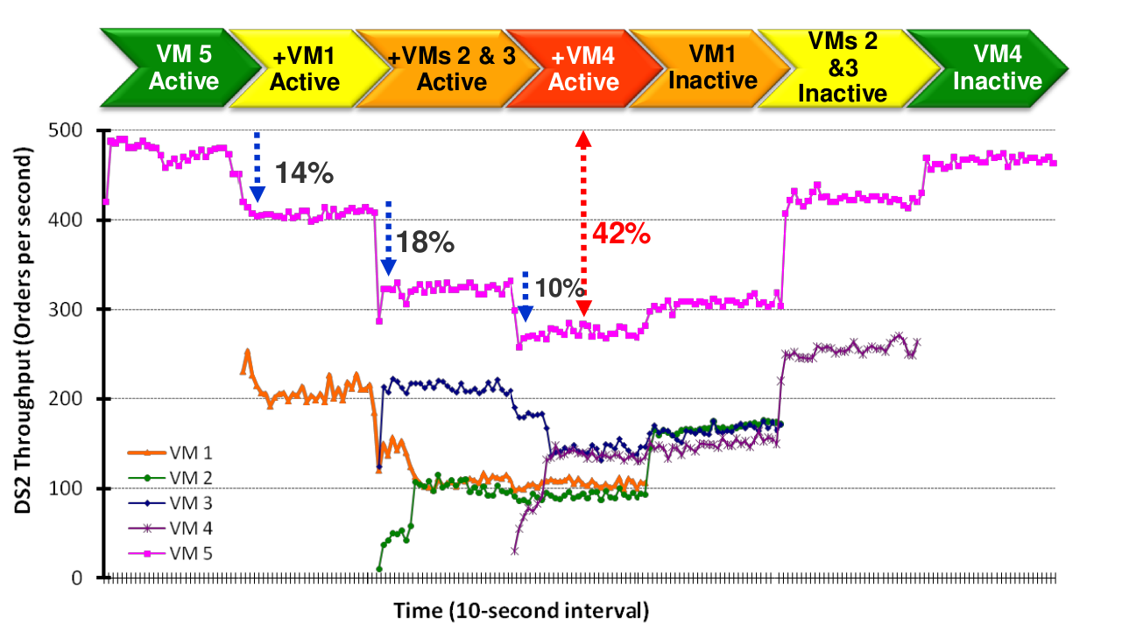
Problem Satement

Slide 8
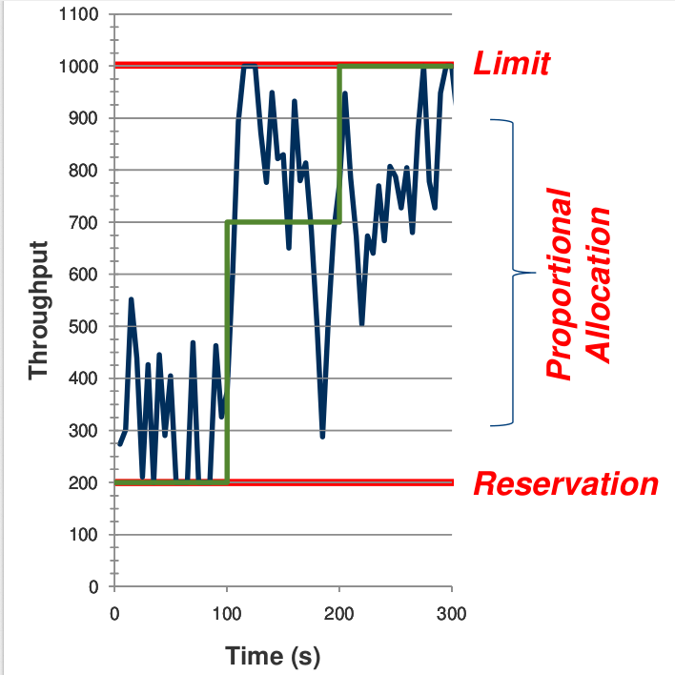
Goal

Slide 9
Related Works
Proportional Share Algorithms:
  WFQ, virtual-clock, SFQ, Self-clocked, WF²Q, SFQ(D)
  Does not support reservations, limits and latency control
Algorithms with support for latency
sensitive applications:
  BVT, SMART, Lottery scheduling
  Does not support reservations and limits
Reservation-based Algorithms:
  CPU & Memory management in ESX, Hierarchical CPU
  scheduling, Rialot
  Supports all the controls but does not handle varying service capacity

Slide 10
mClock Algorithm
It is a combination of Weight Based Scheduler and Constraint Based Scheduler
Each application has a weight wi
Each request is assigned a tag
Tags are spaced 1/wi apart i.e., Service allocation is proportional to wi
Global virtual time (gvt) gets updated on every request completion
Gvt is the minimum start tag in the system

Slide 11
mClock Algorithm: Symbols
Three real time tags:
Pi^{r} : Share based tag of request r and VM vi
Ri^{r} : Reservation tag of request r from VM vi
Li^{r} : Limit tag of request r from VM vi
wi : Weight of VM vi
ri : Reservation of VM vi
li : Maximum service allowance (Limit) for vi

Slide 12
mClock Algorithm
It has 3 main components:
  Tag Assignment
  Tag Adjustment
  Request Scheduling

Slide 13
Tag Assignment
/* Reservation tag */
R_{i}^{r} = max { R^{r−1} + 1/ri , t }
/* Limit tag */
L_{i}^{r} = max { L^{r−1} + 1/li , t }
/* Shares tag */
P_{i}^{r} = max { P^{r−1} + 1/wi , t }

Slide 14
Tag Assignment
VM v1 Request r Time t=10
r1 250 l1 1000 w1 1
Assume: R₁^{r-1} = 8 L₁^{r-1} = 8 P₁^{r-1} = 8
R₁^{r} = max { 8+1/250 , 10 }
L₁^{r} = max { 8+1/1000 , 10 }
P₁^{r} = max { 8+1/1 , 10 }

Slide 15
Tag Adjustment
Required whenever an idle VM becomes active
The initial P tag value of a freshly active VM is set to the current time
MinPtag = minimum of all P tags
For each active VM vj
P_{j}^{r} - = minPtag - t

Slide 16
Tag Adjustment
VM v2 Request r Time t=12
r2 100 l2 800 w2 2
MinPtag = 8
P₁^{r1} = 8
P₁^{r1} - = 8 – 12
P₁^{r1} = 8
P₁^{r2} = 10
P₁^{r2} - = 10 – 12
P₁^{r2} = 14

Slide 17
Request Scheduling
/* Constraint based */
if ( smallest reservation tag <= current time)
  Schedule request with smallest reservation tag
else
/* Weight based - reservations are met */
Schedule request with smallest shares tag
  Assuming request belong to VM vk
  Subtract 1/rk from reservation tags of VM vk
A VM is eligible if (limit tag <= current time)

Slide 18
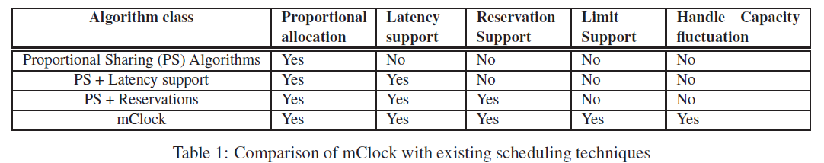
Advantages and Disadvantages
Supports all controls in a single algorithm
Handles variable & unknown capacity
Easy to implement
Supports all controls in a single algorithm
Handles variable & unknown capacity
Easy to implement
Not efficient with Distributed Architucture

Slide 19
Conclusion
Supports reservation, limit and shares in one place
Handles variable IO performance seen by
hypervisor
Can be used for other resources such as CPU,
memory & Network IO allocation as well

Slide 20
THANK YOU

