Slide 1

Tiering on Gluster
Dan Lambright
Red Hat

Slide 2
Tiering is...
  A logical volume composed of diverse storage units
    Fast / slow
    Secure / nonsecure
    Expired hold time / expired
    compressed / uncompressed,
    Cloud expensive elastic storage / cheap
    etc.
  A timely feature
    Storage customization tool / SDS
    New world of diverse storage (SSDs, HDD, etc)
    Recently added by Ceph, Isilon

Slide 3
Cache Tiering
  Fast storage as cache for slow storage
    Fa$t SSD, slow HDD
    Fast 2X replicated, slow erasure coded
    Attach / detach tiers dynamically
  What goes in the cache?
    Track usage patterns
    Migrate file between tiers per usage
  Difference from memory cache
    “slow moving”
    Large index

Slide 4
Optimizations
  Other implementations: Ceph, dm cache, btier
  Tiering options possible
    Bias migrating large files over small
    Sequential vs. random
    Access counters
    O_DIRECT for migration – no Linux cache pollution
    Migration frequency
    Break files into chunks – sharding
    Only migrate when SSD close to full
Notes:
Apply tools to new environments
My pov: systems software and educator

Slide 5
Implementation – metadata store
  API to datastore : libgfdb
    SQLite current back-end (used in Swift)
    Investigating others, e.g. levelDB
    Bloom filter or timing wheel/hash possible
  Optimizations being considered..
    Write back cache DB ops
    Sharding databases
    Schedule DB defrag (“vacuum”)
    Etc..
Notes:
Apply tools to new environments
My pov: systems software and educator

Slide 6
Implementation – metadata capture
  “changetimerecorder” translator
    Server side
    Captures external I/O times (per PID)
    Off by default (but in graph)
    Etc..
Notes:
Apply tools to new environments
My pov: systems software and educator

Slide 7
Integration - DHT
  Stacking changes
    readdir maintains state per graph rather than per DHT
    Hashed subvolume is fixed
    Sometimes unpopulated inodes ctx are ok
  Need to deal with …
    I/Os during migration (blocking lock + timeout ?)
    I/Os during graph switches
    Tier has different xattr namespace than DHT
      Don't clash (e.g. commit-hash)
    Migration vs. Rebalancing / global inode
    Leverage rebalance enhancements
Notes:
Apply tools to new environments
My pov: systems software and educator

Slide 8
Integration - glusterd
  Attach / detach tier dynamically
    Graph change
    Isomorphic to add/remove bricks
  Statistics
    Isomorphic to rebalance daemon
  Challenging to modify glusterd :)
Notes:
Apply tools to new environments
My pov: systems software and educator

Slide 9
Benchmarking
  Many benchmarks a poor fit for tiering
    Tiering needs stable workloads
      Data stays in hot tier for hours or longer
      e.g. a set of videos popular for several days
      e.g. hospital in-patient records
  New benchmarking tool
    FIO option for slow cache
    Can use with dm-cache, Ceph tiering, …
  DB results
    Scalability problems
Notes:
Apply tools to new environments
My pov: systems software and educator

Slide 10
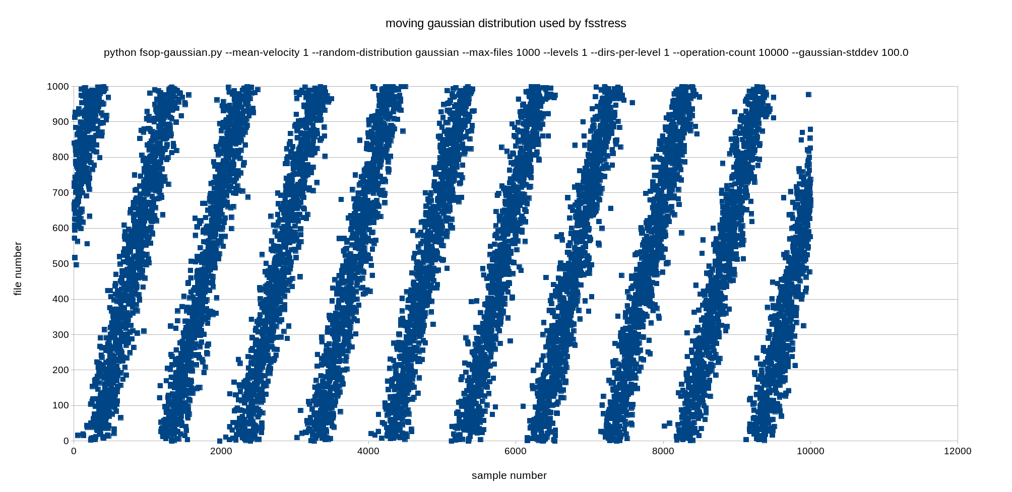
Divider Slide

Slide 11
Next steps
  Read-only caching
  Time-based migration
  Allow volume expansion (add/remove bricks)
  Scale meta-data tracking
Notes:
Apply tools to new environments
My pov: systems software and educator

Slide 12
Further out
  Volume based attach / detach
    Cli example
  Data classification
  Stacking > 2 DHT
$ gluster volume create slow-pool host1:/disk host2:/disk
$ gluster volume create tiered-vol host3:/ssd @slow-pool
Notes:
Apply tools to new environments
My pov: systems software and educator

