Slide 1
Red Hat Storage Server Administration Deep Dive
Dustin L. Black, RHCA
Sr. Technical Account Manager
Red Hat Global Support Services
** This session will include a live demo from 6-7pm **

Slide 2


Dustin L. Black, RHCA
Sr. Technical Account Manager
Red Hat, Inc.
dustin@redhat.com
@dustinlblack
Notes:
My name is Dustin Black. I'm a Red Hat Certified Architect, and a Senior Technical Account Manager with Red Hat. I specialize in Red Hat Storage and GlusterFS, and I've been working closely with our partner, Intuit, on a very interesting and exciting implementation of Red Hat Storage.

Slide 3
WTH is a TAM?
Premium named-resource support
Proactive and early access
Regular calls and on-site engagements
Customer advocate within Red Hat and upstream
Multi-vendor support coordinator
High-touch access to engineering
Influence for software enhancements
NOT Hands-on or consulting
Notes:
We provide semi-dedicated support to many of the world's largest enterprise Linux consumers.
This is not a hands-on role, but rather a collaborative support relationship with the customer.
Our goal is to provide a proactive and high-touch customer relationship with close ties to Red Hat Engineering.

Slide 4

Agenda
Technology Overview & Use Cases
Technology Stack
Under the Hood
Volumes and Layered Functionality
Asynchronous Replication
Data Access
SWAG Intermission
Demo Time!
Notes:
I hope to make the GlusterFS concepts more tangible. I want you to walk away with the confidence to start working with GlusterFS today.

Slide 5
Technology Overview

Slide 6
What is GlusterFS?
Clustered Scale-out General Purpose Storage Platform
  POSIX-y Distributed File System
  ...and so much more
Built on Commodity systems
  x86_64 Linux ++
  POSIX filesystems underneath (XFS, EXT4)
No Metadata Server
Standards-Based – Clients, Applications, Networks
Modular Architecture for Scale and Functionality
Notes:
-Commodity hardware: aggregated as building blocks for a clustered storage resource.
-Standards-based: No need to re-architect systems or applications, and no long-term lock-in to proprietary systems or protocols.
-Simple and inexpensive scalability.
-Scaling is non-interruptive to client access.
-Aggregated resources into unified storage volume abstracted from the hardware.

Slide 7






QEMU
Samba
app
Fuse Native
NFS
libgfapi
Network Interconnect

Slide 8

What is Red Hat Storage?
Enterprise Implementation of GlusterFS
Integrated Software Appliance
  RHEL + XFS + GlusterFS
Certified Hardware Compatibility
Subscription Model
24x7 Premium Support
Notes:
-Provided as an ISO for direct bare-metal installation.
-XFS filesystem is usually an add-on subscription for RHEL, but is included with Red Hat Storage
-XFS supports metadata journaling for quicker crash recovery and can be defragged and expanded online.
-RHS:GlusterFS::RHEL:Fedora
-GlusterFS and gluster.org are the upstream development and test bed for Red Hat Storage

Slide 9




release
feedback

Slide 10




upstream
iterate
release
enhance
debug
feedback
glusterfs-3.4
downstream

Slide 11
GlusterFS vs. Traditional Solutions
A basic NAS has limited scalability and redundancy
Other distributed filesystems are limited by metadata service
SAN is costly & complicated, but high performance & scalable
GlusterFS is...
  Linear Scaling
  Minimal Overhead
  High Redundancy
  Simple and Inexpensive Deployment

Slide 12
Use Cases

Slide 13

Common Solutions
Large Scale File Server
Media / Content Distribution Network (CDN)
Backup / Archive / Disaster Recovery (DR)
High Performance Computing (HPC)
Infrastructure as a Service (IaaS) storage layer
Database offload (blobs)
Unified Object Store + File Access

Slide 14

Hadoop – Map Reduce
Access data within and outside of Hadoop
No HDFS name node single point of failure / bottleneck
Seamless replacement for HDFS
Scales with the massive growth of big data

Slide 15

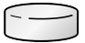



Swift
Cinder / Glance
Account
Container
Object
libgfapi-QEMU
Volume
Directory
Subdir/File

Slide 16
Technology Stack

Slide 17
Terminology
Brick
  Fundamentally, a filesystem mountpoint
  A unit of storage used as a capacity building block
Translator
  Logic between the file bits and the Global Namespace
  Layered to provide GlusterFS functionality
Everything is Modular
Notes:
-Bricks are “stacked” to increase capacity
-Translators are “stacked” to increase functionality

Slide 18
Terminology
Volume
  Bricks combined and passed through translators
  Ultimately, what's presented to the end user
Peer / Node
  Server hosting the brick filesystems
  Runs the gluster daemons and participates in volumes
Notes:
-Bricks are “stacked” to increase capacity
-Translators are “stacked” to increase functionality

Slide 19
Disk, LVM, and Filesystems
Direct-Attached Storage (DAS)
-or-
Just a Bunch Of Disks (JBOD)
Hardware RAID
  RHS: RAID 6 required
Logical Volume Management (LVM)
POSIX filesystem w/ Extended Attributes (EXT4, XFS, BTRFS, ...)
  RHS: XFS required
Notes:
-XFS is the only filesystem supported with RHS.
-Extended attribute support is necessary because the file hash is stored there

Slide 20

Data Access Overview
GlusterFS Native Client
  Filesystem in Userspace (FUSE)
NFS
  Built-in Service
SMB/CIFS
  Samba server required; NOW libgfapi-integrated!
Notes:
-The native client uses fuse to build complete filesystem functionality without gluster itself having to operate in kernel space. This offers benefits in system stability and time-to-end-user for code updates.

Slide 21
Data Access Overview
Gluster For OpenStack (G4O; aka UFO)
  Simultaneous object-based access via OpenStack Swift
NEW! libgfapi flexible abstracted storage
  Integrated with upstream Samba and Ganesha-NFS
Notes:
-The native client uses fuse to build complete filesystem functionality without gluster itself having to operate in kernel space. This offers benefits in system stability and time-to-end-user for code updates.

Slide 22

Gluster Components
glusterd
  Management daemon
  One instance on each GlusterFS server
  Interfaced through gluster CLI
glusterfsd
  GlusterFS brick daemon
  One process for each brick on each server
  Managed by glusterd

Slide 23
Gluster Components
glusterfs
  Volume service daemon
  One process for each volume service
    NFS server, FUSE client, Self-Heal, Quota, ...
mount.glusterfs
  FUSE native client mount extension
gluster
  Gluster Console Manager (CLI)
Notes:
-gluster console commands can be run directly, or in interactive mode. Similar to virsh, ntpq

Slide 24
glusterfs client*
services to the public network
libvirt*
SMB*
Swift*
HDFS*
FTP*
NFS-Gan.
Cinder
API
...
Translators
libgfapi
glusterfs
NFS*
glusterfs
client
Server-side
replication
gfsd
gfsd
gfsd
gfsd
gfsd
gfsd
gfsd
gfsd
gfsd
gfsd
glusterfsd brick daemons
GlusterFS Server (glusterd daemon)
RPM* and DEB packages, or from source
Public Network
1Gb, 10Gb, Infiniband
Storage Network
1Gb, 10Gb, Infiniband
Putting it Together
A 32- or 64-bit* Linux Distribution
RHEL*, CentOS, Fedora, Debian, Ubuntu, ...
Local File Systems
XFS*, ext3/4, BTRFS, ...
Volume Manager
LVM2*
required
Hardware RAID
RAID 6*, 1+0
strongly
recommended
optional
Hard Disk 0
Hard Disk 1
Hard Disk 2
Hard Disk 3
Hard Disk 4
Hard Disk 5
Hard Disk 6
Hard Disk 7
Hard Disk 8
Hard Disk 9
Hard Disk 10
Hard Disk 11
a GlusterFS
service
Disk Storage
Local JBOD* (SAS, SATA), DAS*
Limited Fibre Channel and iSCSI Support
*Red Hat Storage Supported

Slide 25
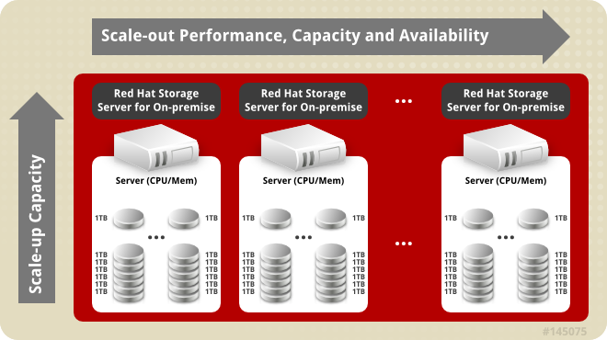
Up and Out!

Slide 26
Under the Hood

Slide 27

Elastic Hash Algorithm
No central metadata
  No Performance Bottleneck
  Eliminates risk scenarios
Location hashed intelligently on filename
  Unique identifiers, similar to md5sum
The “Elastic” Part
  Files assigned to virtual volumes
  Virtual volumes assigned to multiple bricks
  Volumes easily reassigned on the fly
Notes:
No metadata == No Performance Bottleneck or single point of failure (compared to single metadata node) or corruption issues (compared to distributed metadata).
Hash calculation is faster than metadata retrieval
Elastic hash is the core of how gluster scales linerally

Slide 28
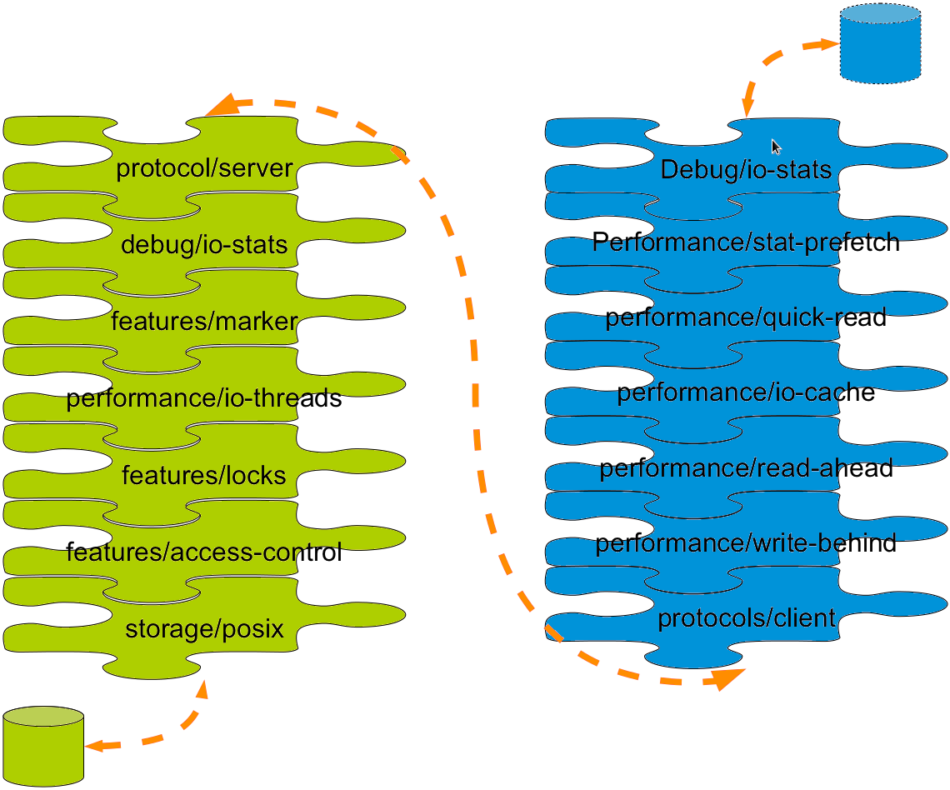
Translators
Notes:
Modular building blocks for functionality, like bricks are for storage

Slide 29
Your Storage Servers are Sacred!
Don't touch the brick filesystems directly!
They're Linux servers, but treat them like storage appliances
  Separate security protocols
  Separate access standards
Don't let your Jr. Linux admins in!
  A well-meaning sysadmin can quickly break your system or destroy your data

Slide 30
Basic Volumes

Slide 31
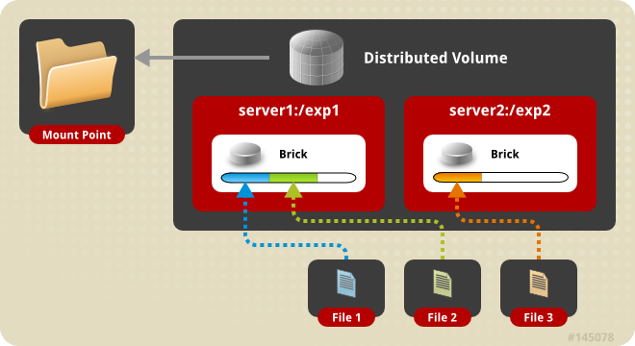
Distributed Volume
The default configuration
Files “evenly” spread across bricks
Similar to file-level RAID 0
Server/Disk failure could be catastrophic

Slide 32
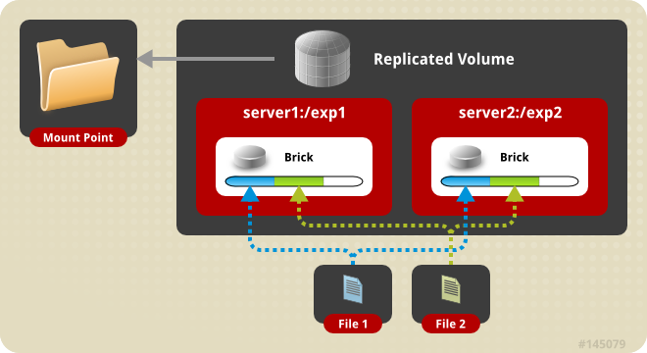
Replicated Volume
Files written synchronously to replica peers
Files read synchronously, but ultimately serviced by the first responder
Similar to file-level RAID 1

Slide 33
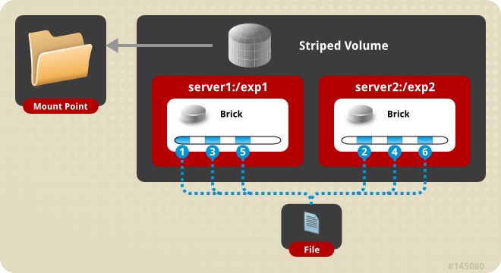
Striped Volumes
Individual files split among bricks (sparse files)
Similar to block-level RAID 0
Limited Use Cases
  HPC Pre/Post Processing
  File size exceeds brick size

Slide 34
Layered Functionality

Slide 35
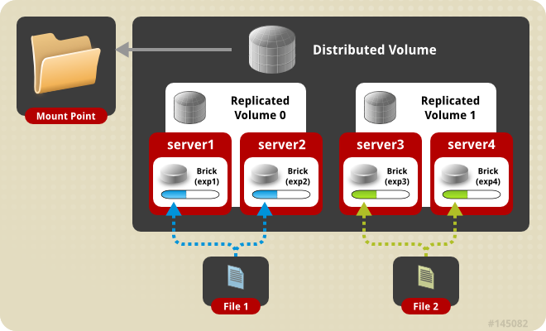
Distributed Replicated Volume
Distributes files across multiple replica sets

Slide 36
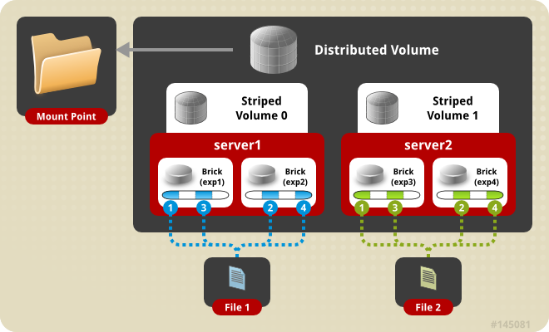
Distributed Striped Volume
Distributes files across multiple stripe sets
Striping plus scalability

Slide 37
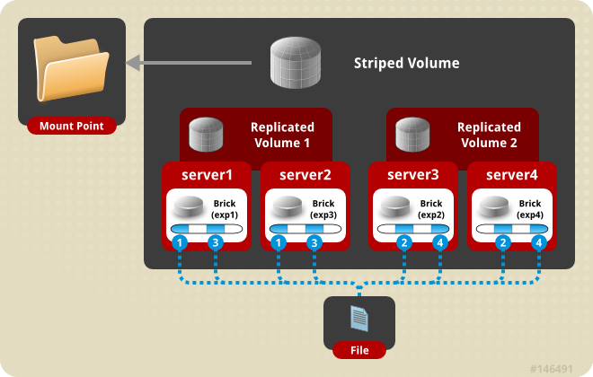
Striped Replicated Volume
Replicated sets of stripe sets
Similar to RAID 10 (1+0)

Slide 38
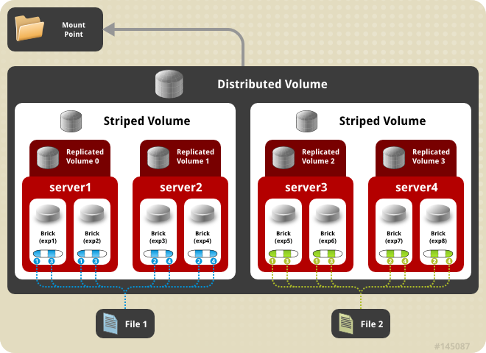
Distributed Striped Replicated Volume
Limited Use Cases – Map Reduce
Don't do it like this -->

Slide 39
Asynchronous Replication

Slide 40
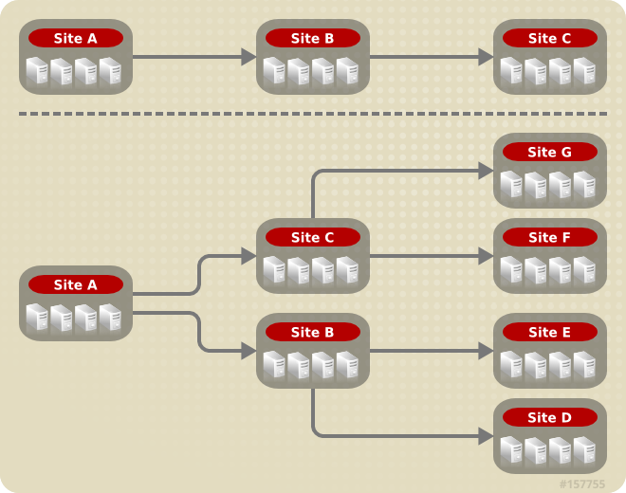
Geo Replication
Asynchronous across LAN, WAN, or Internet
Master-Slave model
  Cascading possible
Continuous and incremental
One Way

Slide 41
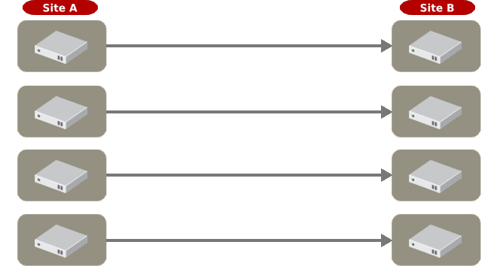
NEW! Distributed Geo-Replication
Drastic performance improvements
  Parallel transfers
  Efficient source scanning
  Pipelined and batched
  File type/layout agnostic
Available now in RHS 2.1
Planned for GlusterFS 3.5
Notes:
In a very short time, Red Hat engineers were able to characterize the limitations that Intuit was encountering, and propose new code to address them – a completely re-designed Geo-Replication stack.
Where the traditional GlusterFS Geo-Replication code relied on a serial stream between only two nodes, the new code employed an algorithm that would divide the replication workload between all members of the volumes on both the sending and receiving sides.
Additionally, the new code introduced an improved filesystem scanning mechanism that was significantly more efficient for Intuit's small-file use case.

Slide 42
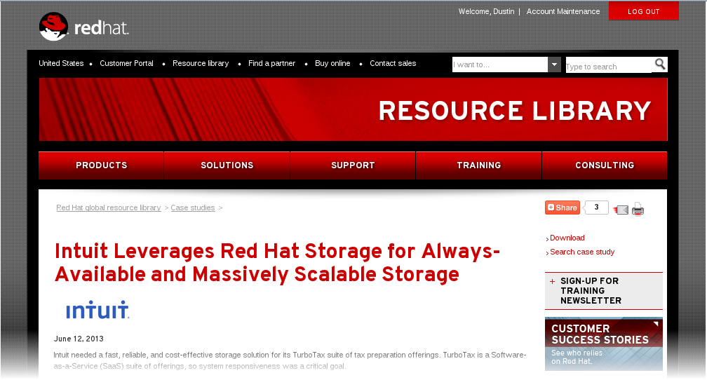
Distributed Geo-Replication
Drastic performance improvements
  Parallel transfers
  Efficient source scanning
  Pipelined and batched
  File type/layout agnostic
Perhaps it's not just for DR anymore...
http://www.redhat.com/resourcelibrary/case-studies/intuit-leverages-red-hat-storage-for-always-available-massively-scalable-storage
Notes:
In a very short time, Red Hat engineers were able to characterize the limitations that Intuit was encountering, and propose new code to address them – a completely re-designed Geo-Replication stack.
Where the traditional GlusterFS Geo-Replication code relied on a serial stream between only two nodes, the new code employed an algorithm that would divide the replication workload between all members of the volumes on both the sending and receiving sides.
Additionally, the new code introduced an improved filesystem scanning mechanism that was significantly more efficient for Intuit's small-file use case.

Slide 43
Data Access

Slide 44
GlusterFS Native Client (FUSE)
FUSE kernel module allows the filesystem to be built and operated entirely in userspace
Specify mount to any GlusterFS server
Native Client fetches volfile from mount server, then communicates directly with all nodes to access data
Recommended for high concurrency and high write performance
Load is inherently balanced across distributed volumes
Notes:
-Native client will be the best choice when you have many nodes concurrently accessing the same data
-Client access to data is naturally load-balanced because the client is aware of the volume structure and the hash algorithm.

Slide 45
NFS
Standard NFS v3 clients
Standard automounter is supported
Mount to any server, or use a load balancer
GlusterFS NFS server includes Network Lock Manager (NLM) to synchronize locks across clients
Better performance for reading many small files from a single client
Load balancing must be managed externally
Notes:
...mount with nfsvers=3 in modern distros that default to nfs 4
The need for this seems to be a bug, and I understand it is in the process of being fixed.
NFS will be the best choice when most of the data access by one client and for small files. This is mostly due to the benefits of native NFS caching.
Load balancing will need to be accomplished by external mechanisms

Slide 46
NEW! libgfapi
Introduced with GlusterFS 3.4
User-space library for accessing data in GlusterFS
Filesystem-like API
Runs in application process
no FUSE, no copies, no context switches
...but same volfiles, translators, etc.
Notes:
...mount with nfsvers=3 in modern distros that default to nfs 4
The need for this seems to be a bug, and I understand it is in the process of being fixed.
NFS will be the best choice when most of the data access by one client and for small files. This is mostly due to the benefits of native NFS caching.
Load balancing will need to be accomplished by external mechanisms

Slide 47
SMB/CIFS
NEW! In GlusterFS 3.4 – Samba + libgfapi
  No need for local native client mount & re-export
  Significant performance improvements with FUSE removed from the equation
Must be setup on each server you wish to connect to via CIFS
CTDB is required for Samba clustering
Notes:
-Use the GlusterFS native client first to mount the volume on the Samba server, and then share that mount point with Samba via normal methods.
-GlusterFS nodes can act as Samba servers (packages are included), or it can be an external service.
-Load balancing will need to be accomplished by external mechanisms

Slide 48
HDFS Compatibility

Slide 49

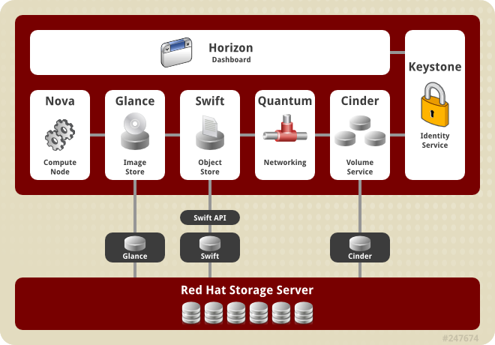
Gluster 4 OpenStack (G4O)
The feature formerly known as UFO

Slide 50

SWAG Intermission

Slide 51
Demo Time!

Slide 52
Do it!

Slide 53
Do it!
Build a test environment in VMs in just minutes!
Get the bits:
  Fedora 20 has GlusterFS packages natively: fedoraproject.org
  RHS 2.1 ISO available on the Red Hat Portal: access.redhat.com
  Go upstream: gluster.org
  Amazon Web Services (AWS)
    Amazon Linux AMI includes GlusterFS packages
    RHS AMI is available

Slide 54
Check Out Other Red Hat Storage Activities at The Summit
Enter the raffle to win tickets for a $500 gift card or trip to LegoLand!
  Entry cards available in all storage sessions - the more you attend, the more chances you have to win!
Talk to Storage Experts:
  Red Hat Booth (# 211)
      Infrastructure
      Infrastructure-as-a-Service
Storage Partner Solutions Booth (# 605)
Upstream Gluster projects
  Developer Lounge
Follow us on Twitter, Facebook: @RedHatStorage

Slide 55
Thank You!
** Please Leave Your Feedback in the Summit Mobile App Session Survey **
Contact
  dustin@redhat.com
  storage-sales@redhat.com
Resources
  www.gluster.org
  www.redhat.com/storage/
  access.redhat.com/support/offerings/tam/
Twitter
  @dustinlblack
  @gluster
  @RedHatStorage
Red Hat Storage Server Administration Deep Dive
Slides Available at: people.redhat.com/dblack
Notes:
Question notes:
-Vs. CEPH
-CEPH is object-based at its core, with distributed filesystem as a layered function. GlusterFS is file-based at its core, with object methods (UFO) as a layered function.
-CEPH stores underlying data in files, but outside the CEPH constructs they are meaningless. Except for striping, GlusterFS files maintain complete integrity at the brick level.
-With CEPH, you define storage resources and data architecture (replication) separate, and CEPH actively and dynamically manages the mapping of the architecture to the storage. With GlusterFS, you manually manage both the storage resources and the data architecture.

