Slide 2

GlusterD Thread Synchronization using user space RCU
Atin Mukherjee
SSE-Red Hat
Gluster Maintainer
IRC : atinm on freenode
Twitter: @mukherjee_atin
Mail: amukherj@redhat.com

Slide 3
Agenda
Introduction to Gluster & GlusterD
Big lock in thread synchronization in GlusterD
Issues with Big Lock approach
Different locking primitives
What is RCU
Advantage of RCU over read-write lock
RCU mechanisms – Insertion, Deletion, Reader
URCU flavors
URCU APIs
URCU use cases
Q&A

Slide 4
Gluster
Open-source general purpose scale-out distributed file system
Aggregates storage exports over network interconnect to provide a single unified namespace
Layered on disk file systems that support extended attributes

Slide 5
GlusterD
Manages the cluster configuration for Gluster
Responsible for
  Peer membership management
  Elastic volume management
  Configuration consistency
  Distributed command execution (orchestration)
  Service management (manages GlusterFS daemons)

Slide 6
Thread synchronization in GlusterD
GlusterD was initially designed as single threaded
Single threaded → Multi threaded to satisfy usecases like snapshot
Big lock
  A coarse grained lock
  Only one transaction can work inside big lock
  Protects all the shared data structures

Slide 7
Issues with Big Lock
Threads contend for even unrelated data
Can end up in a deadlock
  RPC request's callback also needs big lock
Shall we release big lock in between a transaction to get rid of above deadlock? Yes we do, but….
Here come's the problem - a small window of time when the shared data structures are prone to updates leading to inconsistencies

Slide 8
Different locking primitives
Fine grained locks
  Mutex
  Read-write lock
  Spin lock
  Seq lock
  Read-Copy-Update (RCU)

Slide 9
What is RCU
Synchronization mechanism
Not new, added to Linux Kernel in 2002
Allows reads to occur concurrently with update
Maintains multiple version of objects for read coherency
Almost zero over heads in read side critical section

Slide 10
Advantages of RCU over read-write lock
Concurrent readers & writers – writer writes, readers read
Wait free reads
  RCU readers have no wait overhead. They can never be blocked by writers
Existence guarantee
  RCU guarantees that RCU protected data in a readers critical section will remain in existence till the end of the critical section
Deadlock immunity
  RCU readers always run in a deterministic time as they never block. This means that they can never become a part of a deadlock.
No writer starvation
  As RCU readers don't block, writers can never starve.

Slide 11
RCU mechanism
RCU is made up of three fundamental mechanisms
  Publish-Subscribe Mechanism (for insertion)
  Wait For Pre-Existing RCU Readers to Complete (for deletion)
  Maintain Multiple Versions of Recently Updated Objects (for readers)

Slide 12
Publish-Subscribe model
rcu_assign_pointer () for publication
1 struct foo {
2 int a;
3 int b;
4 int c;
5 };
6 struct foo *gp = NULL;
7
8 /* . . . */
9
10 p = malloc (...);
11 p->a = 1;
12 p->b = 2;
13 p->c = 3;
14 gp = p;
1 struct foo {
2 int a;
3 int b;
4 int c;
5 };
6 struct foo *gp = NULL;
7
8 /* . . . */
9
10 p = malloc (...);
11 p->a = 1;
12 p->b = 2;
13 p->c = 3;
14 rcu_assign_pointer(gp, p);
rcu_dereference () for subscription
1 p = gp;
2 if (p != NULL) {
3 do_something_with(p->a, p->b, p->c);
4 }
1 rcu_read_lock();
2 p = rcu_dereference(gp);
3 if (p != NULL) {
4 do_something_with(p->a, p->b, p->c);
5 }
6 rcu_read_unlock();

Slide 13
Publish-Subscribe Model (ii)
rcu_assign_pointer () & rcu_dereference () embedded in special RCU variants of Linux's list-manipulation API
rcu_assign_pointer () → list_add_rcu ()
rcu_dereference () → list_for_each_entry_rcu ()

Slide 14
Wait For Pre-Existing RCU Readers to Complete
Approach used for deletion
Synchronous – synchronize_rcu ()
Asynchronous – call_rcu ()
q = malloc(...);
*q = *p;
q->b = 2;
q->c = 3;
list_replace_rcu(&p->list, &q->list);
synchronize_rcu();
free(p)
q = malloc(...);
*q = *p;
q->b = 2;
q->c = 3;
list_replace_rcu(&p->list, &q->list);
call_rcu (&p->list, cbk); /* cbk will free p */

Slide 15
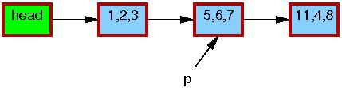
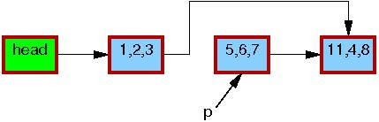

Maintain multiple version objects
Maintain multiple version objects
Used for existence gurantee
Used for existence gurantee
1. p = search(head, key);
2. list_del_rcu(&p->list);
3. synchronize_rcu();
4. free (p);
1. p = search(head, key);
2. list_del_rcu(&p->list);
3. synchronize_rcu();
4. free (p);
1. p = search(head, key);
2. list_del_rcu(&p->list);
3. synchronize_rcu();
4. free (p);
1. p = search(head, key);
2. list_del_rcu(&p->list);
3. synchronize_rcu();
4. free (p);
1. p = search(head, key);
2. list_del_rcu(&p->list);
3. synchronize_rcu();
4. free (p);
1. p = search(head, key);
2. list_del_rcu(&p->list);
3. synchronize_rcu();
4. free (p);

Slide 16
URCU flavors
QSBR (quiescent-state-based RCU)
  each thread must periodically invoke rcu_quiescent_state()
  Thread (un)registration required
Memory-barrier-based RCU
  Preemptible RCU implementation
  Introduces memory barrier in read critical secion, hence high read side overhead
“Bullet-proof” RCU (RCU-BP)
  Similar like memory barrier based RCU but thread (un)registration is taken care
  Primitive overheads but can be used by application without worrying about thread creation/destruction

Slide 17
URCU flavors (ii)
Signal-based RCU
  Removes memory barrier
  Can be used by library function
  requires that the user application give up a POSIX signal to be used by synchronize_rcu() in place of the read-side memory barriers.
  Requires explicit thread registration
Signal-based RCU using an out-of-tree sys_membarrier() system call
  sys_membarrier() system call instead of POSIX signal

Slide 18
URCU APIs
Atomic-operation and utility APIs
  caa_: Concurrent Architecture Abstraction.
  cmm_: Concurrent Memory Model.
  uatomic_: URCU Atomic Operation.
  https://lwn.net/Articles/573435/
The URCU APIs
  https://lwn.net/Articles/573439/
RCU-Protected Lists
  https://lwn.net/Articles/573441

Slide 19
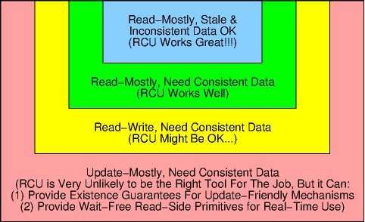
When is URCU useful

Slide 20
References
https://lwn.net/Articles/262464/
https://lwn.net/Articles/263130/
https://lwn.net/Articles/573424/
http://www.efficios.com/pub/lpc2011/Presentation-lpc2011-desnoyers-urcu.pdf
http://www.rdrop.com/~paulmck/RCU/RCU.IISc-Bangalore.2013.06.03a.pdf
http://urcu.so/

Slide 21
Q&A

