Slide 1
Introduction to Highly Available NFS Server on scale-out storage systems based on GlusterFS
Soumya Koduri
Red Hat
Meghana Madhusudhan
Red Hat

Slide 2
AGENDA
What is GlusterFS?
Integration with NFS-Ganesha
Clustered NFS
Step-by-step guide
Future Directions
Q&A

Slide 3
GlusterFS

Slide 4
GlusterFS
An open source, scale-out distributed file system
Software Only and operates in user-space
Aggregates Storage into a single unified namespace
No metadata server architecture
Provides a modular, stackable design
Runs on commodity hardware
Notes:
* aggregates various storage servers over Ethernet or Infiniband RDMA interconnect into one large parallel network file system
* uses any ondisk file system which supports extended attributes (eg: ext4, XFS, etc) to format to store data on disks

Slide 5
Architecture
Data is stored on disk using native formats (e.g. ext4, XFS)
Has client and server components
    Servers, known as storage bricks (glusterfsd daemon), export local filesystem as volume
    Clients (glusterfs process), creates composite virtual volumes from multiple remote servers using stackable translators
    Management service (glusterd daemon) manages volumes and cluster membership

Slide 6
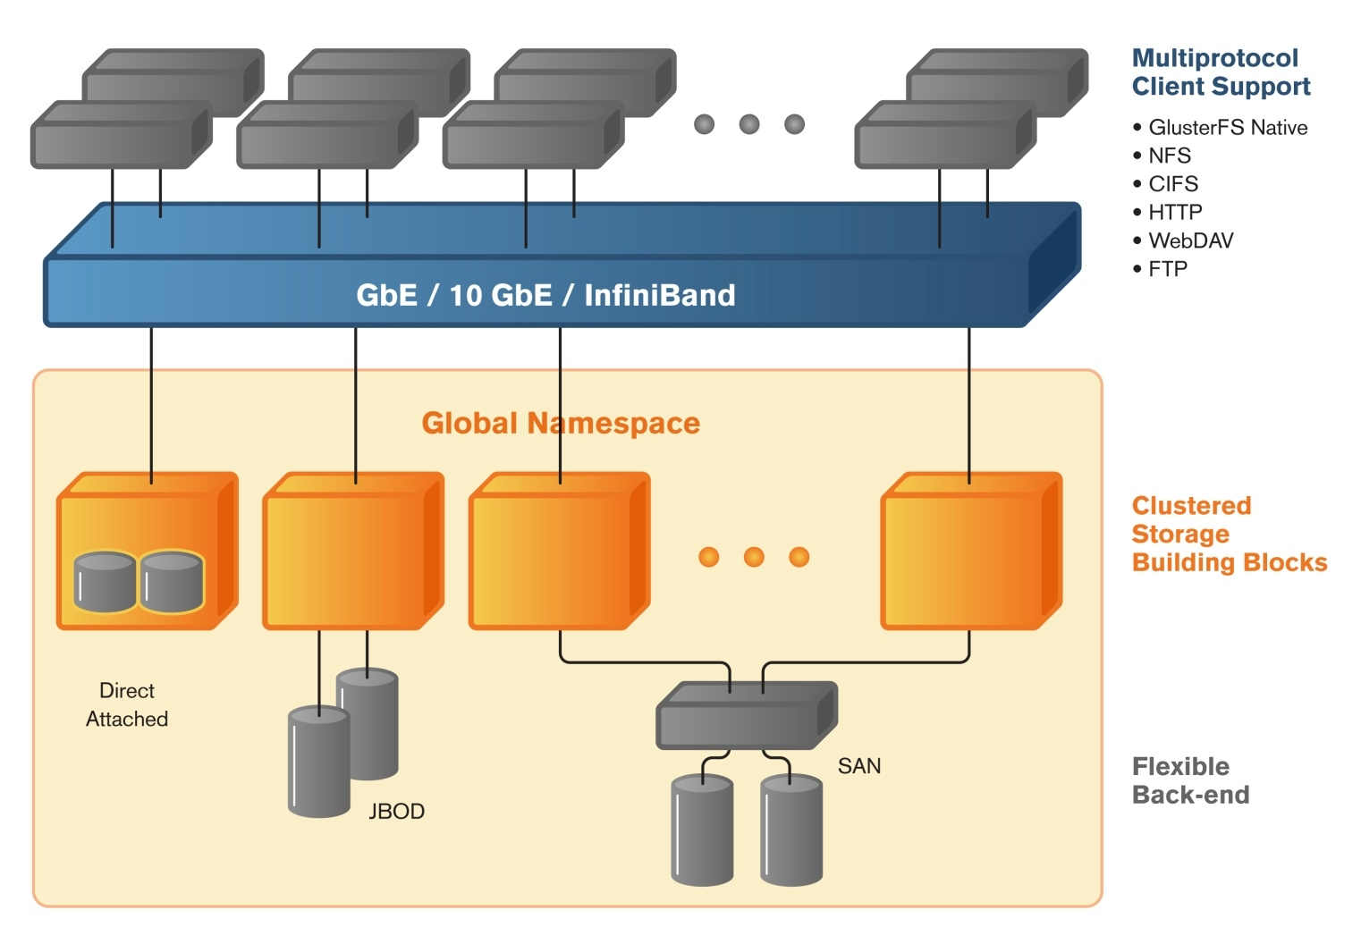
GlusterFS Deployment

Slide 7
Access Mechanisms
FUSE based Native protocol
NFSv3
libgfapi
ReST/HTTP
HDFS

Slide 8
libgfapi
A user-space library with APIs for accessing Gluster volumes.
Reduces context switches.
Many applications integrated with libgfapi (qemu, samba, NFS Ganesha).
Both sync and async interfaces available.
C and python bindings.
Available via 'glusterfs-api*' packages.

Slide 9
NFS-Ganesha

Slide 10
NFS access
Why NFS:
  Widely used network protocol
  Many enterprises still heavily depend on NFS to access their data from different operating systems and applications.
Native NFS (referred as Gluster-NFS):
  Acts as GlusterFS client residing on the same node as the GlusterFS server.
  Supports only NFSv3 protocol
  Not strictly protocol-complaint

Slide 11
NFS-Ganesha
A user-space, protocol-complaint NFS file server
Supports NFS v3, 4.0, 4.1, pNFS and 9P from the Plan9 operating system.
Provides a FUSE-compatible File System Abstraction Layer(FSAL) to plug in to any own storage mechanism
Can provide simultaneous access to multiple file systems.
Active participants:
CEA, Panasas, Red Hat, IBM, LinuxBox

Slide 12
Benefits of NFS-Ganesha
Dynamically export/unexport entries using D-Bus mechanism.
Can manage huge meta-data and data caches
Can act as proxy server for NFSv4
Provides better security and authentication mechanism for enterprise use
Portable to any Unix-like file-systems
Easy access to the services operating in the user-space (like Kerberos, NIS, LDAP)
Notes:
Running in User Space makes many things easier.
–
Security Managers (like Kerberos) reside in User
Space, they can be accessed directly via GSSAPI
(no need for “rpc_pipefs”)
–
ID mappers (NIS, LDAP) reside in User Space,
they can be accessed directly (the daemon is
linked with libnfsidmap)
–
Less constraints for memory allocation than in
kernel space, managing huge pieces of memory is
easy
–
When developing in User Space, you won't
(usually) crash the kernel

Slide 13
Modular Architecture
RPC Layer: implements ONC/RPCv2 and RPCSEC_GSS (based on libntirpc)
FSAL: File System Abstraction Layer, provides an API to generically address the exported namespace
Cache Inode: manages the metadata cache for FSAL. It is designed to scale to millions of entries
FSAL UP: provides the daemon with a way to be notified by the FSAL that changes have been made to the underlying FS outside Ganesha. These information is used to invalidate or update the Cache Inode.
Notes:
Memory allocation and management: NFS-Ganesha do not rely on malloc/free but allocates a big chunck of memory at startup and manages it on its own. This is done by using pre-allocated structures and blocks of memory managed as “Buddy Blocks”
Hash Table: provides a Red-Black Tree based hash table to provide associative addressing to internal structure. This layer is widely used to build various cache, including the metadata cache.
FSAL UP / Cache Inode UP: provides the daemon with a way to be notified by the FSAL that changes have been made to the underlying FS outside Ganesha. These information is used to invalidate or update the Cache Inode.
Each layer has a well defined API. It can be modified (e.g. to implement a different cache policy) without impacting the other modules

Slide 14
NFS-Ganesha Architecture
Admin
DBUS
Network Forechannel
Network
Backchannel
RPC Dispatcher
Dup Req
RPC Sec GSS
NFSv3, NFSv4.x/pNFS,
RQUOTA, 9P
Cache Inode
SAL
FSAL
FSAL_UP
Backend (POSIX, VFS, ZFS,
GLUSTER, GPFS, LUSTRE )

Slide 15

NFS-Ganesha + GlusterFS
NFS-Ganesha
Cache Inode
SAL
FSAL_GLUSTER
libgfapi
GlusterFS Volume
GlusterFS
Brick
GlusterFS
Brick

Slide 16
Integration with GlusterFS
Integrated with GlusterFS using 'libgfapi' library
That means,
  Additional protocol support w.r.t. NFSv4, pNFS
  Better security and authentication mechanisms for enterprise use.
  Performance improvement with additional caching

Slide 17
Clustered NFS

Slide 18
Clustered NFS
Stand-alone systems :
    are always bottleneck.
    cannot scale along with the back-end storage system.
    not suitable for mission-critical services
Clustering:
    High availability
    Load balancing
    Different configurations:
        Active-Active
        Active-Passive

Slide 19
Challenges Involved
  Cluster wide change notifications for cache invalidations
  Coordinate Grace period across nodes in the cluster
  Maintain and recover lock, share reservation and delegations state
  Provide “high availability” to stateful parts of NFS
    Share state across the cluster to allow failover
    IP Failover in case of node failure
    Lock recovery in case of node failure

Slide 20
Active-Active HA solution on GlusterFS
Primary Components
    Pacemaker
    Corosync
    PCS
    Resource agents
    HA setup scipt ('ganesha-ha.sh')
    Shared Storage Volume
    UPCALL infrastructure

Slide 21
Clustering Infrastructure
Using Open-source services
Pacemaker: Cluster resource manager that can start and stop resources
Corosync: Messaging component which is responsible for communication and membership among the machines
PCS: Cluster manager to easily manange the cluster settings on all nodes

Slide 22
Cluster Infrastructure
Resource-agents : Scripts that know how to control various services.
New resource-agent scripts added to
    ganesha_mon: Monitor NFS service on each node & failover the Virtual IP
    ganesha_grace: Puts entire cluster to Grace
If NFS service down on any of the nodes
    Entire cluster is put into grace via D-bus signal
    Virtual IP fails over to a different node (within the cluster).

Slide 23
HA setup script
Located at /usr/libexec/ganesha/ganesha-ha.sh.
Sets up, tears down and modifies the entire cluster.
Creates resource-agents required to monitor NFS service and IP failover.
Integrated with new Gluster CLI introduced to configure NFS-Ganesha.
Primary Input: ganesha-ha.conf file with the information about the servers to be added to the cluster along with Virtual IPs assigned, usually located at /etc/ganesha.

Slide 24
Upcall infrastructure
A generic and extensible framework.
    used to maintain states in the glusterfsd process for each of the files accessed
    sends notifications to the respective glusterfs clients in case of any change in that state.
Cache-Invalidation: Needed by NFS-Ganesha to serve as Multi-Head
  Config options:
    #gluster vol set <volname> features.cache-invalidation on/off
    #gluster vol set <volname> features.cache-invalidation-timeout <value>

Slide 25
Shared Storage Volume
Provides storage to share the cluster state across the NFS servers in the cluster
This state is used during failover for Lock recovery
Can be created and mounted on all the nodes using the following gluster CLI command -
  #gluster volume set all cluster.enable-shared-storage enable

Slide 26
Clustered NFS-Ganesha
Shared Storage Volume
Node A
Node B
Node C
Node D
Clustering Infrastructure
(Pacamaker/Corosync)
NFS-Ganesha service
Virtual IP
ganesha_mon
ganesha_grace

Slide 27
Clustered NFS-Ganesha
Shared Storage Volume
Node A
Node B
Node C
Node D
Clustering Infrastructure
(Pacamaker/Corosync)
NFS
Client
NFS-Ganesha service
Virtual IP
ganesha_mon
ganesha_grace

Slide 28
Clustered NFS-Ganesha
Shared Storage Volume
Node A
Node B
Node C
Node D
Clustering Infrastructure
(Pacamaker/Corosync)
NFS
Client
NFS-Ganesha service
Virtual IP
ganesha_mon
ganesha_grace

Slide 29
Clustered NFS-Ganesha
Shared Storage Volume
Node A
Node B
Node C
Node D
In Grace
Clustering Infrastructure
(Pacamaker/Corosync)
NFS
Client
NFS-Ganesha service
Virtual IP
ganesha_mon
ganesha_grace

Slide 30
Clustered NFS-Ganesha
Shared Storage Volume
Node A
Node B
Node C
Node D
In Grace
Clustering Infrastructure
(Pacamaker/Corosync)
NFS
Client
NFS-Ganesha service
Virtual IP
ganesha_mon
ganesha_grace

Slide 31
Step-by-step guide

Slide 32
Required Packages
Gluster RPMs (>= 3.7)
    glusterfs-server
    glusterfs-ganesha
Ganesha RPMs (>= 2.2)
    nfs-ganesha
    nfs-ganesha-gluster
Pacemaker & pcs RPMs

Slide 33
Pre-requisites
  Ensure all machines are DNS resolvable
  Disable and stop NetworkManager service, enable and start network service on all machines
  Enable IPv6 on all the cluster nodes.
  Install pacemaker pcs ccs resource-agents corosync
    #yum -y install pacemaker pcs ccs resource-agents corosync` on all machines
  Enable and start pcsd on all machines
    #chkconfig --add pcsd; chkconfig pcsd on; service pcsd start
  Populate /etc/ganesha/ganesha-ha.conf on all the nodes.

Slide 34
Pre-requisites
  Create and mount the Gluster shared volume on all the machines
  Set cluster auth password on all machines
    #echo redhat | passwd --stdin hacluster
    #pcs cluster auth on all the nodes
  Passwordless ssh needs to be enabled on all the HA nodes.
    On one (primary) node in the cluster, run:
      #ssh-keygen -f /var/lib/glusterd/nfs/secret.pem
    Deploy the pubkey ~root/.ssh/authorized keys on _all_ nodes, run:
      #ssh-copy-id -i /var/lib/glusterd/nfs/secret.pem.pub root@$node

Slide 35
Sample 'ganesha-ha.conf'
# Name of the HA cluster created. must be unique within the subnet
HA_NAME="ganesha-ha-360"
# The gluster server from which to mount the shared data volume.
HA_VOL_SERVER="server1"
# The subset of nodes of the Gluster Trusted Pool that form the ganesha HA cluster.
# Hostname is specified.
HA_CLUSTER_NODES="server1,server2,..."
#HA_CLUSTER_NODES="server1.lab.redhat.com,server2.lab.redhat.com,..."
# Virtual IPs for each of the nodes specified above.
VIP_server1="10.0.2.1"
VIP_server2="10.0.2.2"

Slide 36
Setting up the Cluster
New CLIs introduced to configure and manage NFS-Ganesha cluster & Exports
#gluster nfs-ganesha <enable/disable>
    Disable Gluster-NFS
    Start/stop NFS-Ganesha services on the cluster nodes.
    Setup/teardown the NFS-Ganesha cluster.
#gluster vol set <volname> ganesha.enable on/off
    Creates export config file with default parameters
    Dynamically export/unexport volumes.

Slide 37
Modifying the Cluster
Using HA script ganesha-ha.sh located at /usr/libexec/ganesha.
Execute the following commands on any of the nodes in the existing NFS-Ganesha cluster
To add a node to the cluster:
    #./ganesha-ha.sh --add <HA_CONF_DIR> <HOSTNAME> <NODE-VIP>
To delete a node from the cluster:
    #./ganesha-ha.sh --delete <HA_CONF_DIR> <HOSTNAME>
    Where, HA_CONF_DIR: The directory path containing the ganesha-ha.conf file.
      HOSTNAME: Hostname of the new node to be added
      NODE-VIP: Virtual IP of the new node to be added.

Slide 38
Modifying Export parameters
On any of the nodes in the existing ganesha cluster:
  Edit/add the required fields in the corresponding export file located at /etc/ganesha/exports.
  Execute the following command:
    #./ganesha-ha.sh --refresh-config <HA_CONFDIR> <Volname>
      Where,
      HA_CONFDIR: The directory path containing the ganesha-ha.conf file
      Volname: The name of the volume whose export configuration has to be changed.

Slide 39
Next

Slide 40
pNFS (Parallel Network File System)
Introduced as part of NFSv4.1 standard protocol
Needs a cluster consisting of M.D.S. (meta data server ) and D.S. (Data server)
Any filesystem can provide pNFS access via NFS-Ganesha by means of the FSAL easy plugin architecure
Support for pNFS protocol ops added to FSAL_GLUSTER (in NFS-Ganesha V2.2)
Currently supports only FILE LAYOUT

Slide 41
Future Directions
NFSv4 paves the way forward for interesting stuff
Adding NFSv4.x feature support for GlusterFS
    Directory Delegations
    Sessions
    Server-side copy
    Application I/O Advise (like posix_fadvise)
    Sparse file support/Space reservation
    ADB support
    Security labels
    Flex File Layouts in pNFS

Slide 42
Contact
Mailing lists:
    nfs-ganesha-devel@lists.sourceforge.net
    gluster-users@gluster.org
    gluster-devel@nongnu.org
IRC:
    #ganesha on freenode
    #gluster and #gluster-dev on freenode
    team: Apeksha, ansubram, jiffin, kkeithley, meghanam, ndevos, saurabh, skoduri

Slide 43
References & Links
Links (Home Page):
    https://github.com/nfs-ganesha/nfs-ganesha/wiki
    http://www.gluster.org
References:
    http://gluster.readthedocs.org
    http://blog.gluster.org/http://www.nfsv4bat.org/Documents/ConnectAThon/2012/NFS-GANESHA_cthon_2012.pdfhttp://events.linuxfoundation.org/sites/events/files/slides/Collab14_nfsGanesha.pdfhttp://www.snia.org/sites/default/files/Poornima_NFS_GaneshaForClusteredNAS.pdf
    http://clusterlabs.org/doc/

Slide 44
Q & A

Slide 45

Thank you!
Soumya Koduri
Meghana Madhusudhan

