Slide 1
Developing Apps and Integrating with GlusterFS
Justin Clift, GlusterFS Integration
Open Source and Standards team @ Red Hat
Gluster Community Day London 2013

Slide 2

#whoami
Previously an experienced SysAdmin (Solaris and Linux) for many, many years
Now works on GlusterFS integration
Mostly worked on Mission Critical systems in corporate/enterprise environments (eg. Telco, banking, Insurance)
Has been helping build Open Source Communities after hours for many years (PostgreSQL, OpenOffice back in the day)
Joined Red Hat mid 2010
jclift@redhat.com

Slide 3
Agenda
Options for Gluster Application development
What is Libgfapi?
Pros & Cons
Libgfapi example
Rapid Prototyping GlusterFS Translators
Translator example
Contact Me

Slide 4
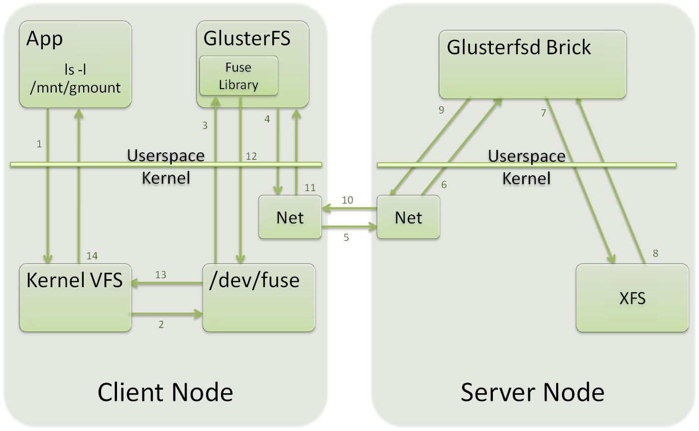
The old way: access through FUSE

Slide 5
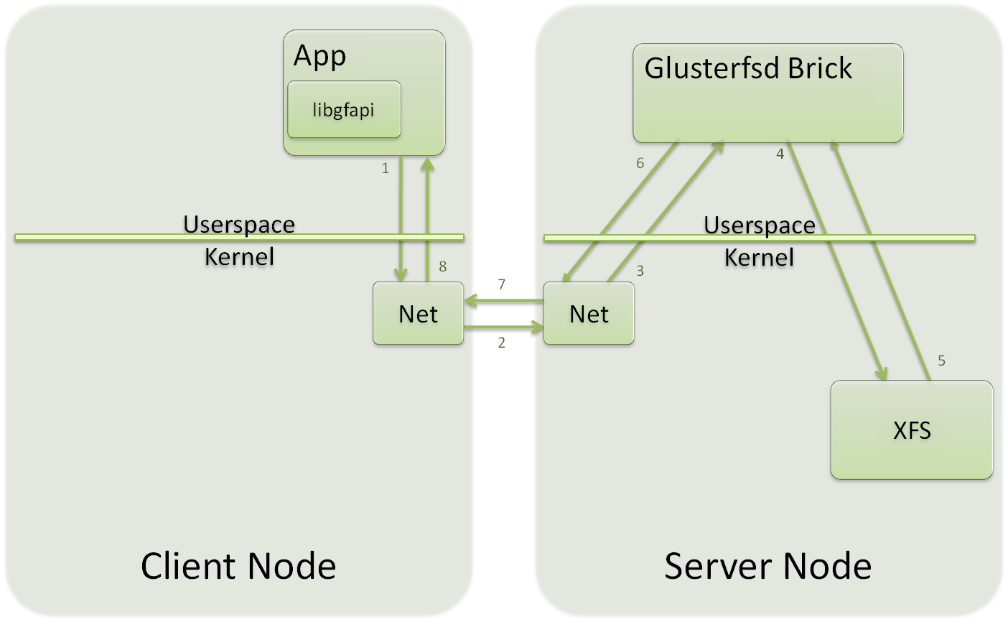
libgfapi: access through library

Slide 6
Pros: Why use Libgfapi?
Improved speed and latency
Eliminate the FUSE and kernel VFS layer from GlusterFS volume access
Examples:
  qemu storage layer
  Samba VFS plugin

Slide 7
Cons: Downsides
Existing applications need to be extended
  Not a drop in replacement for POSIX based filesystem access
Client side API only available for C and
Python so far

Slide 8
Python and C API
The C API is fairly comprehensive
  87 callable C functions. Eg:
    glfs_creat()
    glfs_open()
    glfs_close()
    glfs_seekdir()
    glfs_stat()
    glfs_chmod()
The Python API is only 19 functions so far
  Just the most used ones, more coming

Slide 9
Python API – Volume operations
set_logging(path, level)
mount()
creat(path, flags, mode)
getxattr(path, key, maxlen)
listxattr(path)
lstat(path)
mkdir(path)
open(path, flags)
opendir(path)
rename(old_path, new_path)
rmdir(path)
setxattr(path, key, value, vlen)
unlink(path)

Slide 10
Python API – File operations
fsync()
read(buflen, flags)
read_buffer(buf, flags)
write(data, flags)
fallocate(mode, offset, len)
discard(offset, len)

Slide 11
Libgfapi example
Example Python code:
# Import Python libgfapi library (required)
from gluster import gfapi
# Mount the volume
vol = gfapi.Volume('f19laptop', 'playground')
vol.mount()
# Create a file
import os
myfile = vol.creat('somefile.txt', os.O_RDWR, 0o640)

Slide 12
Libgfapi example (continued)
# Write to the file
bytes_written = myfile.write('This is some data')
print bytes_written
# Seek back to the start of the file
myfile.seek(0, os.SEEK_SET)
# Read from the file
file_data = myfile.read(5)
print file_data
# Rename the file
vol.rename('somefile.txt', 'someotherfile.txt')
# Delete the file
vol.unlink('someotherfile.txt')

Slide 13
Rapid Prototyping GlusterFS Translators
Uses the Python Gluster “Glupy” library
Easy to write translators, compared to C
Not as fast to execute as C based translators, but can still fire off over 1,000 times per second

Slide 14
Trivial “helloworld” example
import sys
from gluster_glupy import *
class xlator (Translator):
def __init__(self, c_this):
Translator.__init__(self, c_this)
def lookup_fop(self, frame, this, loc, xdata):
print "Python xlator: Hello!"
dl.wind_lookup(frame, POINTER(xlator_t)(), loc, xdata)
return 0
def lookup_cbk(self, frame, cookie, this, op_ret, op_errno, inode, buf, xdata, postparent):
print "Python xlator: Hello again!"
dl.unwind_lookup(frame, cookie, this, op_ret, op_errno, inode, buf, xdata, postparent)
return 0

Slide 15
Helloworld translator demo
[Run through the helloworld demo here]

Slide 16
Real world example
GlusterFlow translator:
https://forge.gluster.org/glusterflow/glusterflow/blobs/master/json/glusterflowclient.py
Fires off 1,600 times per second on my laptop in a F19 VM
Can be re-written in C if that's not fast enough

Slide 17
Questions?
User questions and experiences
  gluster-users@gluster.org
  #gluster on Freenode IRC
Developer questions and discussions
  gluster-devel@nongnu.org
  #gluster-dev on Freenode IRC
Announcements mailing list
  announce@gluster.org

Slide 18
Contact me
Happy for people to email me about any of this stuff:
Justin Clift
Work email: jclift@redhat.com
Personal email: justin@postgresql.org
Twitter: @realjustinclift

