Slide 1

Join the Supercolony:
Slaying Dragons at Gluster.org
John Mark Walker
Gluster Community Lead
March 7, 2013

Slide 2

Topics
Greatest Hits 2012
2013 Strategerie
“Expansion” is the word of the day

Slide 3
Open Source Dev
“Real” Open Source
  Enables more innovation on the fringes
  Engineering team from multiple sources
  Open source project is “upstream” from commercial product
  “Downstream” products are hardened, more secure and thoroughly tested
GlusterFS
Red Hat Storage + others

Slide 4
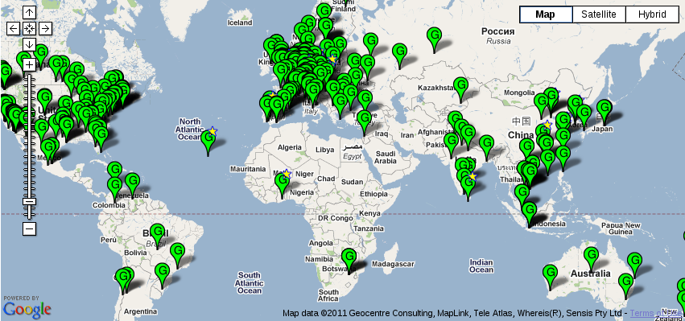
A Global Community

Slide 5
Gluster Universe: 2012
One project, one web site
Building momentum
Some strong links to other communities
Stronger integration
CloudStack
Xen
JBoss
OpenShift
Hadoop
GlusterFS
KVM
oVirt
OpenStack

Slide 6
GlusterFS Intersections
Some OpenStack integration
  Swift API layer for UFO
  Can provide storage services to OpenStack clients
Some Hadoop integration
  HDFS shim/plugin
QEMU, libvirt and block storage
Used by OpenShift

Slide 7
Time for some strategerie -
The Gluster Gameplan for 2013

Slide 8
Gluster Community Mission Statement
To grow the Gluster community into an open hybrid cloud and big data ecosystem of users, developers and partners, adding value to the community-at-large through contributions of new products, community evangelism and advocacy, feature development, documentation and quality control.

Slide 9
One web site, many projects -
Get ready for developer collaboration

Slide 10
More integrations -
More people devoted to integrating GlusterFS with leading open source tech

Slide 11
More releases -
More aggressive backporting of fixes to point releases

Slide 12
More documentation -
Community projects to lead docs development

Slide 13
I've been everywhere, man -
Workshops galore in Shanghai, Tokyo, Edinburgh, New Orleans, Bangalore, Silicon Valley, Seattle

Slide 14
Even more transparency -
Stay tuned

Slide 15
Thank you!
John Mark Walker
Gluster Community Guy
johnmark@redhat.com

Slide 16
http://gluster.org/presos.php
johnmark@redhat.com
Twitter & identi.ca
@johnmark

