Slide 1


Scale-Out backups with
Bareos and Gluster
Niels de Vos
Gluster co-maintainer
Red Hat Storage Developer
ndevos@redhat.com

Slide 2
Agenda
Gluster integration in Bareos
Introduction into GlusterFS
Quick Start
Example configuration and demo
Future plans

Slide 3
Gluster integration in Bareos
Store backup archives on Gluster Volumes
Gluster native backend for Storage Daemon
  Userspace only (libgfapi), no local mountpoints
Benefits from all Gluster capabilities:
  Scale-out and scale-up
  Multiple copies of data, local site and remote
Coming Soon: backup Gluster Volumes with Bareos

Slide 4
What is Gluster?
Scalable, general-purpose storage platform
  POSIX-y Distributed File System
  Object storage (swift)
  Distributed block storage (qemu)
  Flexible storage (libgfapi)
No Metadata Server
Heterogeneous Commodity Hardware
Flexible and Agile Scaling
  Capacity – Petabytes and beyond
  Performance – Thousands of Clients
Notes:
-Commodity hardware: aggregated as building blocks for a clustered storage resource.
-Standards-based: No need to re-architect systems or applications, and no long-term lock-in to proprietary systems or protocols.
-Simple and inexpensive scalability.
-Scaling is non-interruptive to client access.
-Aggregated resources into unified storage volume abstracted from the hardware.

Slide 5
Data Access Overview
GlusterFS Native Client
  Filesystem in Userspace (FUSE)
NFS
  Built-in Service, NFS-Ganesha with libgfapi
SMB/CIFS
  Samba server required (libgfapi based module)
Gluster For OpenStack (Swift-on-file)
libgfapi flexible abstracted storage
  Integrated with QEMU, Bareos and others
Notes:
-The native client uses fuse to build complete filesystem functionality without gluster itself having to operate in kernel space. This offers benefits in system stability and time-to-end-user for code updates.

Slide 6
Terminology
Brick
  Fundamentally, a filesystem mountpoint
  A unit of storage used as a capacity building block
Translator
  Logic between the file bits and the Global Namespace
  Layered to provide GlusterFS functionality
Notes:
-Bricks are “stacked” to increase capacity
-Translators are “stacked” to increase functionality

Slide 7
Terminology
Volume
  Bricks combined and passed through translators
  Ultimately, what's presented to the end user
Peer / Node
  Server hosting the brick filesystems
  Runs the Gluster daemons and participates in volumes
Trusted Storage Pool
  A group of peers, like a “Gluster cluster”
Notes:
-Bricks are “stacked” to increase capacity
-Translators are “stacked” to increase functionality

Slide 8
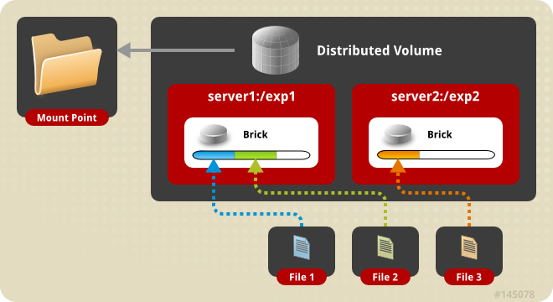
Distributed Volume
Files “evenly” spread across bricks
Similar to file-level RAID 0
Server/Disk failure could be catastrophic
Notes:
DEMO:
Add a peer
Add a brick to the volume
Rebalance the volume

Slide 9
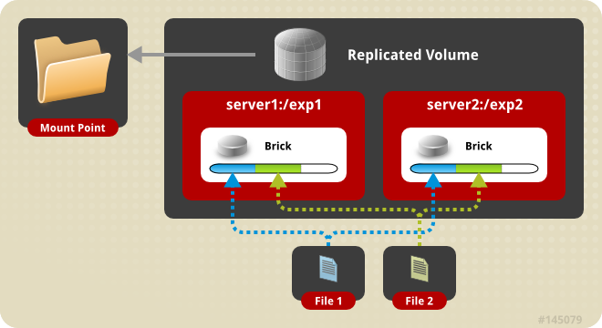
Replicated Volume
Copies files to multiple bricks
Similar to file-level RAID 1

Slide 10
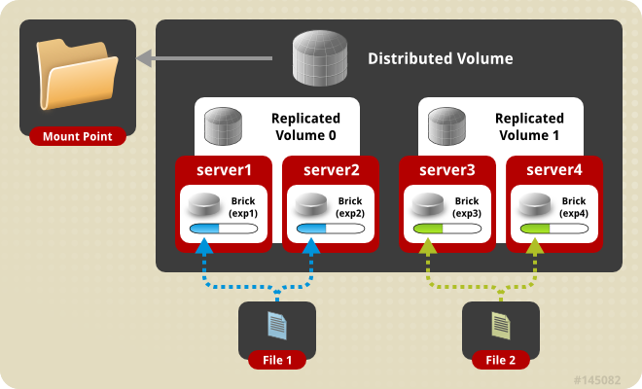
Distributes Replicated Volume
Distributes files across replicated bricks

Slide 11
Other Volume Types
Disperse
  Erasure coding, similar to RAID-6 over the network
  JBOD (no hardware RAID), cost effective
Sharding
  Splitting big files in pieces, distribute the pieces
Tiering
  Hot (fast) bricks and cold (slow) bricks
  Configurable rules to migrate contents between tiers

Slide 12
Geo-Replication
Continuous asynchronous replication for volumes
Incremental updates, changelog for modifications
Intelligent rsync over SSH
Site to site, over LAN, WAN and internet
Mixing of private and public clouds is possible
One master site, one or more slave sites

Slide 13
Quick Start
Available in Fedora, Debian, NetBSD and others
Community packages in multiple versions for different distributions on http://download.gluster.org/
CentOS Storage SIG packages and add-ons
Quick Start guides on http://gluster.org and CentOS wiki
Bareos packages from http://download.bareos.org

Slide 14
Quick Start – Gluster Setup
Install the packages (on all storage servers)
Start the GlusterD service (on all storage servers)
Peer probe other storage servers
Create and mount a filesystem to host a brick
Create a volume
Start the new volume
Mount the volume

Slide 15
Quick Start – Gluster Setup
On all storage servers:
# yum install glusterfs-server
# systemctl enable glusterd
# systemctl start glusterd
For all other storage servers:
# gluster peer probe $OTHER_HOSTNAME

Slide 16
Quick Start – Gluster Setup
For each brick:
# lvcreate -L 512G -n backups vg_bricks
# mkfs -t xfs /dev/vg_bricks/backups
# mkdir -p /bricks/backups
# mount /dev/vg_data/backups /brick/backups
# tail -n1 /proc/mounts >> /etc/fstab

Slide 17
Quick Start – Gluster Setup
For each volume:
# gluster volume create $VOLUME \
$HOSTNAME:/bricks/backups/data \
$OTHER_HOSTNAME:/bricks/backups/data \
…
# gluster volume start $VOLUME

Slide 18
Quick Start – Bareos Configuration
Install Bareos packages (inc. bareos-storage-glusterfs)
Enable access as non-root to Gluster
Create directory structure used by Bareos
Create a config for the Bareos Storage Daemon
Add the Storage to the Bareos Director configuration
Start the Bareos services

Slide 19
Quick Start – Bareos Configuration
On the Bareos Director (also runs Storage Daemon):
# yum install bareos-storage-glusterfs
# cd /etc/bareos
# vi bareos-sd.d/device-gluster.conf
(set correct Archive Device URL)
# vi bareos-sd.conf
(include the device-gluster.conf with @)
# vi bareos-dir.conf
(add Storage Daemon)

Slide 20
Quick Start – Bareos Configuration
On the storage servers:
# vi /etc/glusterfs/glusterd.vol
(add option rpc-auth-allow-insecure on)
# systemctl restart glusterd
On one storage server, per volume:
# gluster volume set $VOLUME \
server.server.allow-insecure on
# gluster volume stop $VOLUME
# gluster volume start $VOLUME

Slide 21
Quick Start – Bareos Configuration
On one storage server, per volume:
# mount -t glusterfs $SERVER:/$VOLUME /mnt
# mkdir /mnt/bareos
# chown bareos:bareos /mnt/bareos
# chmod ug=rwx /mnt/bareos
# umount /mnt

Slide 22
Quick Start – Bareos Job execution
On the Bareos Director:
# systemctl start bareos-sd
# systemctl start bareos-dir
On the Bareos Director:
# bconsole
* run job=BackupCatalog

Slide 23
Integration in other projects
oVirt for easier installation, management and monitoring
Nagios for improved monitoring and alerting
OpenStack Manila (filesystem as a service)
Hadoop plugin offers an alternative for HDFS
Bareos Gluster File Daemon plugin
… and many others

Slide 24
Resources
Mailing lists:
gluster-users@gluster.org
gluster-devel@gluster.org
IRC:
#gluster and #gluster-dev on Freenode
Links:
http://gluster.org/ & http://bareos.org/
http://gluster.readthedocs.org/
http://doc.bareos.org/

Slide 25

Thank you!
Niels de Vos
ndevos@redhat.com
ndevos on IRC

Slide 26
Software versions used for this demo
CentOS 7.1 with updates until 29 september 2015
glusterfs-3.7.4 from download.gluster.org
bareos-14.2.2 from download.bareos.org
Diagrams on the first slides come from the Administrators Guide for Red Hat Gluster Storage available through https://access.redhat.com/

