Slide 1

Software Defined Storage
NMAMIT, Nitte
Presented by the Gluster community
redhat storage
April 11, 2014

Slide 2
$ whoami
dlambrig@redhat.com
Formally of EMC, DELL

Slide 3
AGENDA
Storage Overview
  History
  Types
  Case study: EMC Symmetrix, DELL Equallogic
Software Defined Storage
  Definition
  Pros and Cons
  Case study: Gluster

Slide 4
STORAGE
Data is..
  Critical
  Ever growing
Storage persists data
  Reliable
  Fast
  Affordable

Slide 5
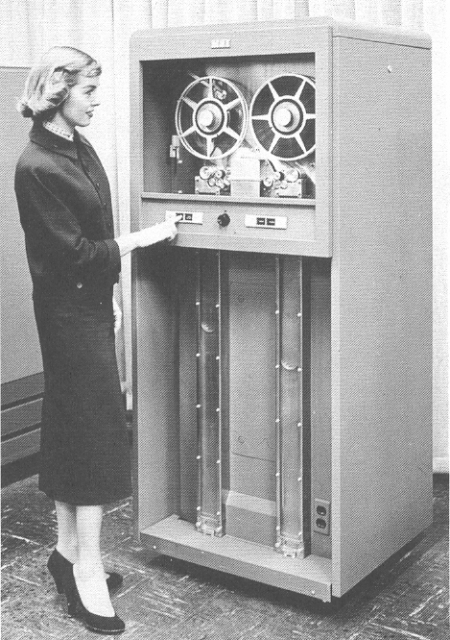
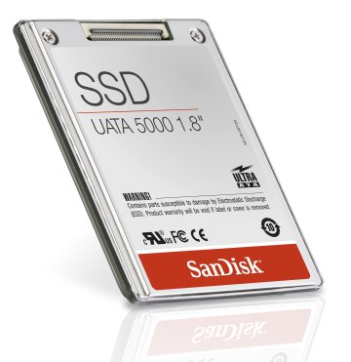
HISTORY
Tape
Hard disk drives
Solid-state disks
Persistent memory

Slide 6
STORAGE ATTRIBUTES

Slide 7
RELIABILITY
Failure vectors
  Hardware
  Software
  Interconnect
Strategies
  Backups
  Redundant hardware
  Replicate data
  RAID / erasure codes

Slide 8
PERFORMANCE
Caching
  On server
  On client
Parallelism

Slide 9
ACCESS
Architecture
  Direct attached storage (DASD)
  Storage area network (SAN)
  Network attached (NAS)
Protocol
  SCSI
  Fiber channel
  Ethernet

Slide 10
ENCAPSULATION / ORGANIZATION
Container
  Block
  File - hierarchical
  Object – two level
Locating data
  Flat index
  Filesystem
  Database

Slide 11
SCALE UP
Grow resources on machine
  Capacity
  Performance
  Feature set

Slide 12
SCALE OUT
Add resources by adding nodes
  CPU
  Redundancy
  Bandwidth
Inexpensive to grow

Slide 13
FEATURES
Backup
Archive
Disaster Recovery
SNAP
Compression
Deduplication

Slide 14
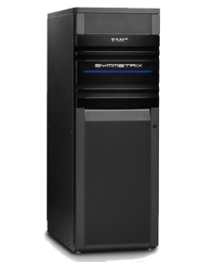
CASE STUDY: SYMMETRIX / VMAX (EMC)
Scale up block
Performance: big cache
Multiple redundancy
Custom built hardware and software
Legacy & modern access protocols
Expensive

Slide 15
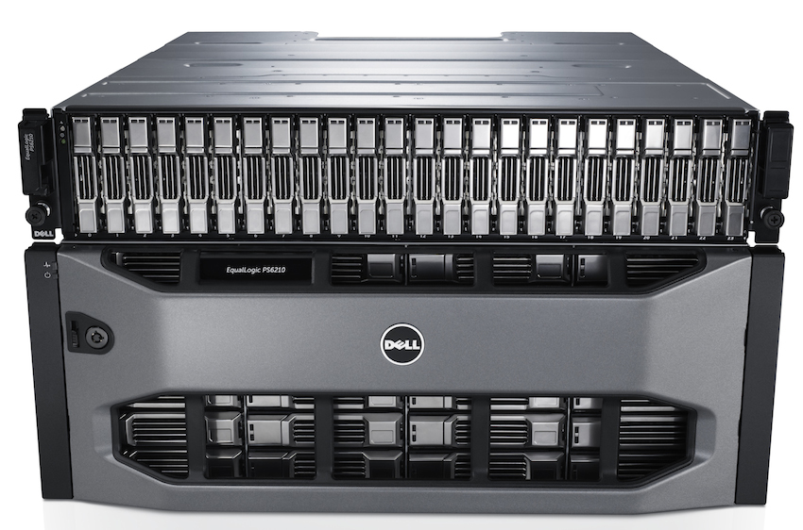
CASE STUDY: EQUALLOGIC (DELL)
ISCSI
“Low end” inexpensive, for SMB
RAID cache
Active/passive failover
Scale out block

Slide 16
SOFTWARE DEFINED STORAGE (SDS)

Slide 17
SOFTWARE STORAGE STACK
Typically..
  Runs on commodity hardware
  Modular design / components
  In user space
  Open source

Slide 18
USE CASE: CLOUD
Typically..
  Metered resources
  Virtual
  Self service
  Remotely accessible

Slide 19
SDS PROS
Easy to evolve
No vendor lock-in
Portable to different platforms

Slide 20
SDS CONS
Software slower than hardware
May be harder to manage
If open source, quality varies

Slide 21

CASE STUDY: GLUSTER
Open source
Scale-out
Multi-protocol access
Support from Red Hat available

Slide 22

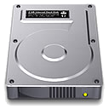

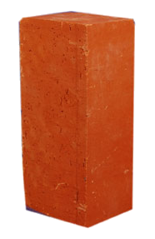
Scaling Up
Add disks and filesystems to a node
Expand a GlusterFS volume by adding bricks
XFS

Slide 23
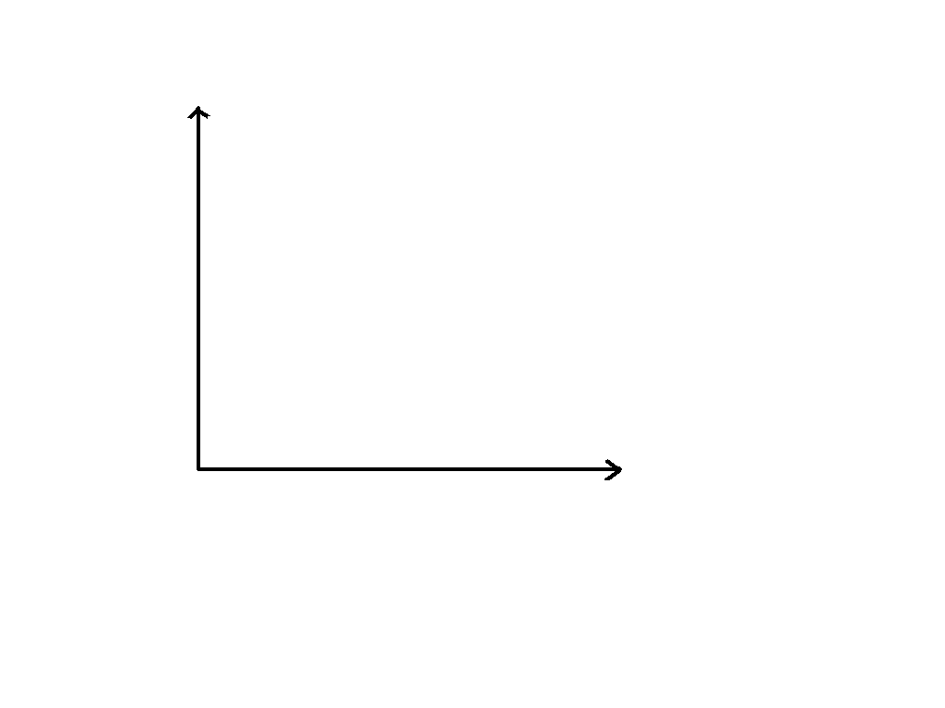

Scaling Out
Add GlusterFS nodes to trusted pool
Add filesystems as new bricks

Slide 24
DEMO: GLUSTER
Volume creation
Layered functionality translators
Linux application
  No special hardware
  Free (download)

Slide 25
Do it!
Build a test environment in VMs in just minutes!
Get the bits:
  Fedora has GlusterFS packages natively
  RHS ISO available on Red Hat Portal
  CentOS Storage SIG
  Go upstream: www.gluster.org

Slide 26




Thank You!
Slides Available at: http://www.redhat.com/people/dlambrig/talks
dlambright@redhat.com
RHS:
www.redhat.com/storage/
GlusterFS:
www.gluster.org
@Glusterorg
@RedHatStorage
Gluster
Red Hat Storage
Notes:
Question notes:
-Vs. CEPH
-CEPH is object-based at its core, with distributed filesystem as a layered function. GlusterFS is file-based at its core, with object methods (UFO) as a layered function.
-CEPH stores underlying data in files, but outside the CEPH constructs they are meaningless. Except for striping, GlusterFS files maintain complete integrity at the brick level.
-With CEPH, you define storage resources and data architecture (replication) separate, and CEPH actively and dynamically manages the mapping of the architecture to the storage. With GlusterFS, you manually manage both the storage resources and the data architecture.

Slide 27
Scaling Up
Add disks and filesystems to a node
Expand a GlusterFS volume by adding bricks
XFS

Slide 28
Scaling Out
Add GlusterFS nodes to trusted pool
Add filesystems as new bricks

Slide 29
TECHNOLOGY OVERVIEW

Slide 30
GLUSTERFS TERMS
Peer – trusted
Brick – physical storage
Volume – logical storage
  Distributed , replicated , striped
Translator
Userspace daemons:
  Glusterd - management
  Glusterfsd - datapath

Slide 31
ACCESS PROTOCOLS
Multi protocol access
  Posix (mount + FUSE)
  NFS
  SMB
  Object storage (swift)
  Distributed block storage (qemu)

Slide 32
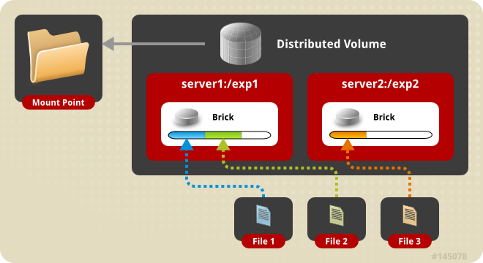
Distributed Volume
Files “evenly” spread across bricks
Similar to file-level RAID 0
Server/Disk failure could be catastrophic

Slide 33
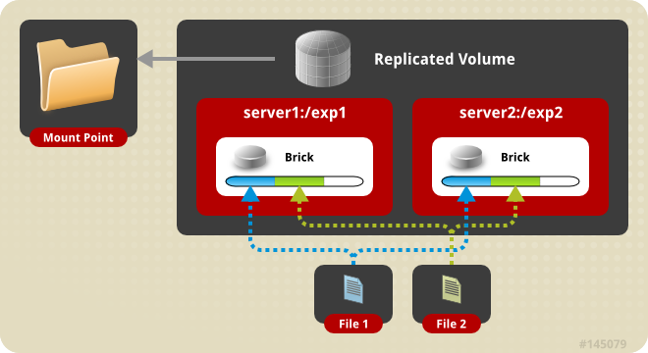
Replicated Volume
Copies files to multiple bricks
Similar to file-level RAID 1
Triplication (3 way replication) common

Slide 34
Preparing a Brick
# lvcreate -L 100G -n lv_brick1 vg_server1
# mkfs -t xfs -i size=512 /dev/vg_server1/lv_brick1
# mkdir /brick1
# mount /dev/vg_server1/lv_brick1 /brick1
# echo '/dev/vg_server1/lv_brick1 /brick1 xfs defaults 1 2' >> /etc/fstab
# service glusterd start
Notes:
An inode size smaller than 512 leaves no room for extended attributes (xattr). This means that every active inode will require a separate block for these. This has both a performance hit as well as a disk space usage penalty.

Slide 35
Adding Nodes (peers) and Volumes
Peer Probe
gluster> peer probe server3
gluster> peer status
Number of Peers: 2
Hostname: server2
Uuid: 5e987bda-16dd-43c2-835b-08b7d55e94e5
State: Peer in Cluster (Connected)
Hostname: server3
Uuid: 1e0ca3aa-9ef7-4f66-8f15-cbc348f29ff7
State: Peer in Cluster (Connected)
Distributed Volume
gluster> volume create my-dist-vol server2:/brick2 server3:/brick3
gluster> volume info my-dist-vol
Volume Name: my-dist-vol
Type: Distribute
Status: Created
Number of Bricks: 2
Transport-type: tcp
Bricks:
Brick1: server2:/brick2
Brick2: server3:/brick3
gluster> volume start my-dist-vol
# mount -t glusterfs server1:/brick1 /mnt
Notes:
-peer status command shows all other peer nodes – excludes the local node
-I understand this to be a bug that's in the process of being fixed

Slide 36
GLUSTERFS INTERNALS

Slide 37
INTERNALS
No metadata server
  No performance bottleneck or SPOF
  Location hashed on path and filename
  Hash calculation faster than meta-data retrieval
An aggregator of file systems
  XFS recommended
  Can use any FS that supports extended attributes
  No “internal format” of data, different access protocols could access the same data.

Slide 38
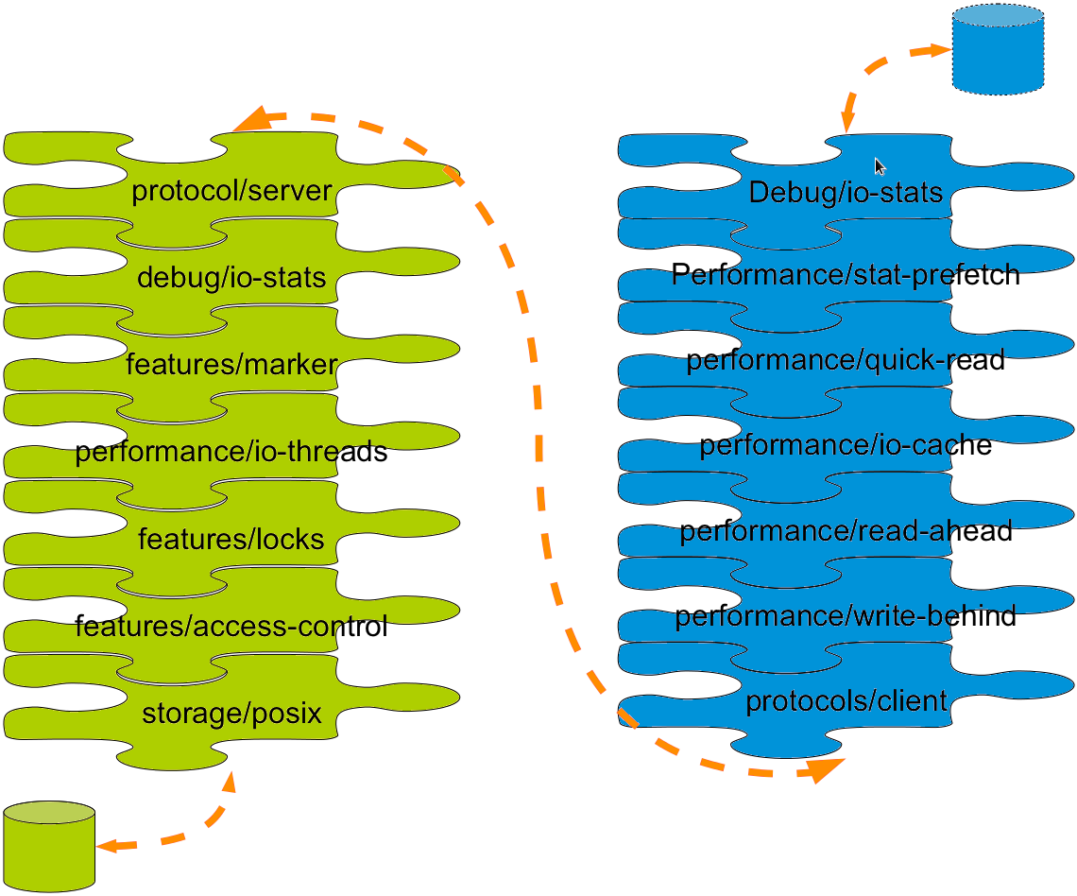
Translators
Notes:
Modular building blocks for functionality, like bricks are for storage

Slide 39
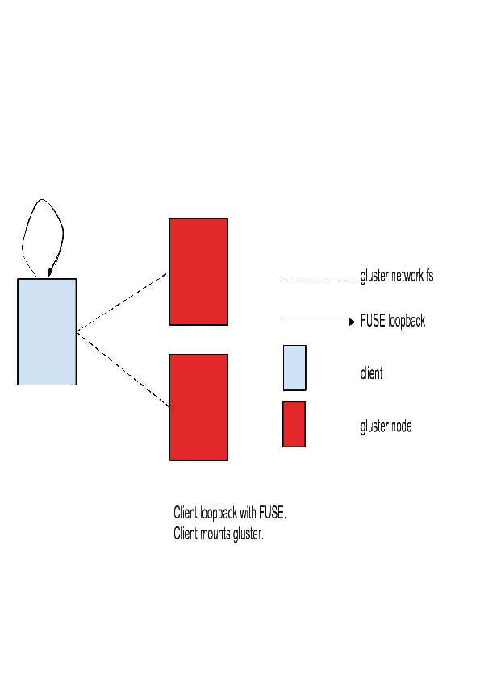
RUN ON CLIENT

Slide 40
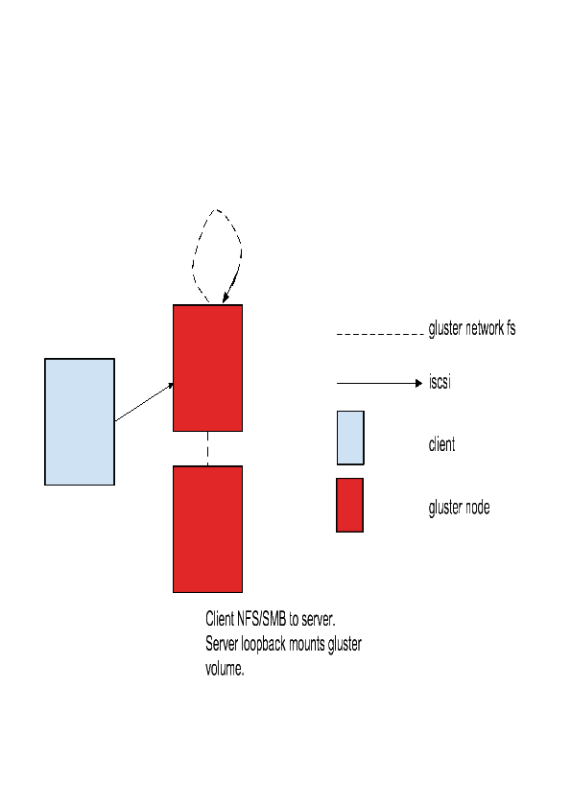
RUN ON SERVER
NFS

Slide 41
Do it!
Build a test environment in VMs in just minutes!
Get the bits:
  Fedora 19 has GlusterFS packages natively
  RHS 2.1 ISO available on Red Hat Portal
  Go upstream: www.gluster.org

Slide 42
Thank You!
Slides Available at: http://www.redhat.com/people/dlambrig/talks
(based on the slide deck from Niels de Vos)
dlambright@redhat.com
RHS:
www.redhat.com/storage/
GlusterFS:
www.gluster.org
@Glusterorg
@RedHatStorage
Gluster
Red Hat Storage
Notes:
Question notes:
-Vs. CEPH
-CEPH is object-based at its core, with distributed filesystem as a layered function. GlusterFS is file-based at its core, with object methods (UFO) as a layered function.
-CEPH stores underlying data in files, but outside the CEPH constructs they are meaningless. Except for striping, GlusterFS files maintain complete integrity at the brick level.
-With CEPH, you define storage resources and data architecture (replication) separate, and CEPH actively and dynamically manages the mapping of the architecture to the storage. With GlusterFS, you manually manage both the storage resources and the data architecture.

Slide 43
ISCSI IMPLICATIONS
Multipath
Raid
Scsi timeout
Change lun size
Run iSCSI target on client

