Slide 1
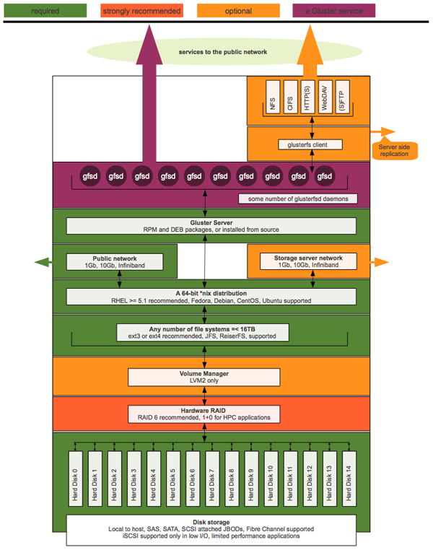
Original

Slide 2
glusterfs client
services to the public network
QEMU
SMB
API
...
NFS
FTP
HTTP
HDFS
libgfapi
glusterfs client
Server-side
replication
gfsd
gfsd
gfsd
gfsd
gfsd
gfsd
gfsd
gfsd
gfsd
gfsd
glusterfsd daemons for each brick
Gluster Server (glusterd daemon)
RPM and DEB packages, or from source
Public Network
1Gb, 10Gb, Infiniband
Storage Network
1Gb, 10Gb, Infiniband
A 64-bit *nix Distribution
RHEL, CentOS, Fedora, Debian, Ubuntu, ...
File Systems <= 16TB
ext3/4, XFS, ...
Revision 1
Volume Manager
LVM2
Hardware RAID
RAID 6 Recommended
required
strongly
recommended
Hard Disk 0
Hard Disk 1
Hard Disk 2
Hard Disk 3
Hard Disk 4
Hard Disk 5
Hard Disk 6
Hard Disk 7
Hard Disk 8
Hard Disk 9
Hard Disk 10
Hard Disk 11
optional
Disk Storage
Local JBOD (SAS, SATA), DAS
Limited Fibre Channel and iSCSI Support
a GlusterFS service

Slide 3
glusterfs client*
services to the public network
libvirt*
SMB*
Swift*
HDFS*
FTP*
NFS-Gan.
Cinder
API
...
Translators
libgfapi
glusterfs
NFS*
glusterfs
client
Server-side
replication
gfsd
gfsd
gfsd
gfsd
gfsd
gfsd
gfsd
gfsd
gfsd
gfsd
glusterfsd brick daemons
GlusterFS Server (glusterd daemon)
RPM* and DEB packages, or from source
Public Network
1Gb, 10Gb, Infiniband
Storage Network
1Gb, 10Gb, Infiniband
A 32- or 64-bit* Linux Distribution
RHEL*, CentOS, Fedora, Debian, Ubuntu, ...
File Systems <= 16TB
XFS*, ext3/4, BTRFS, ...
Revision 2
Volume Manager
LVM2*
required
Hardware RAID
RAID 6*, 1+0
strongly
recommended
optional
Hard Disk 0
Hard Disk 1
Hard Disk 2
Hard Disk 3
Hard Disk 4
Hard Disk 5
Hard Disk 6
Hard Disk 7
Hard Disk 8
Hard Disk 9
Hard Disk 10
Hard Disk 11
a GlusterFS
service
Disk Storage
Local JBOD* (SAS, SATA), DAS*
Limited Fibre Channel and iSCSI Support
*Red Hat Storage Supported

Slide 4
glusterfs client*
services to the public network
libvirt*
SMB*
Swift*
HDFS*
FTP*
NFS-Gan.
Cinder
API
...
Translators
libgfapi
glusterfs
NFS*
glusterfs
client
Server-side
replication
gfsd
gfsd
gfsd
gfsd
gfsd
gfsd
gfsd
gfsd
gfsd
gfsd
glusterfsd brick daemons
GlusterFS Server (glusterd daemon)
RPM* and DEB packages, or from source
Public Network
1Gb, 10Gb, Infiniband
Storage Network
1Gb, 10Gb, Infiniband
A 32- or 64-bit* Linux Distribution
RHEL*, CentOS, Fedora, Debian, Ubuntu, ...
Local File Systems
XFS*, ext3/4, BTRFS, ...
Revision 3
Volume Manager
LVM2*
required
Hardware RAID
RAID 6*, 1+0
strongly
recommended
optional
Hard Disk 0
Hard Disk 1
Hard Disk 2
Hard Disk 3
Hard Disk 4
Hard Disk 5
Hard Disk 6
Hard Disk 7
Hard Disk 8
Hard Disk 9
Hard Disk 10
Hard Disk 11
a GlusterFS
service
Disk Storage
Local JBOD* (SAS, SATA), DAS*
Limited Fibre Channel and iSCSI Support
*Red Hat Storage Supported

