Slide 1

Introduction into Scale-out Storage with Gluster
Niels de Vos
Red Hat Storage Engineer
GlusterFS co-maintainer
ndevos@redhat.com
November 28, 2015
Eindhoven

Slide 2
Agenda
What is Gluster?
Architecture
Quick start
How to get involved?

Slide 3
What is Gluster ?
Gluster is a distributed scale out filesystem that allows rapid provisioning of additional storage based on your storage consumption needs. It incorporates automatic failover as a primary feature. All of this is accomplished without a centralized metadata server.

Slide 4
Gluster in Keywords
Scalable, general-purpose storage platform
  POSIX-y Distributed File System
  Object storage (swift)
  Flexible storage (libgfapi)
No Metadata Server
Heterogeneous Commodity Hardware
Flexible and Agile Scaling
  Capacity – Petabytes and beyond
  Performance – Thousands of Clients
Notes:
-Commodity hardware: aggregated as building blocks for a clustered storage resource.
-Standards-based: No need to re-architect systems or applications, and no long-term lock-in to proprietary systems or protocols.
-Simple and inexpensive scalability.
-Scaling is non-interruptive to client access.
-Aggregated resources into unified storage volume abstracted from the hardware.

Slide 5
Gluster Use-Cases
Content Delivery Networks
  Media Streaming
  Download Servers
Archival
  Backup services
  Long term media archives
Virtual Machine images
High Performance / Distributed Computing
  Rendering Farms
  Big Data

Slide 6
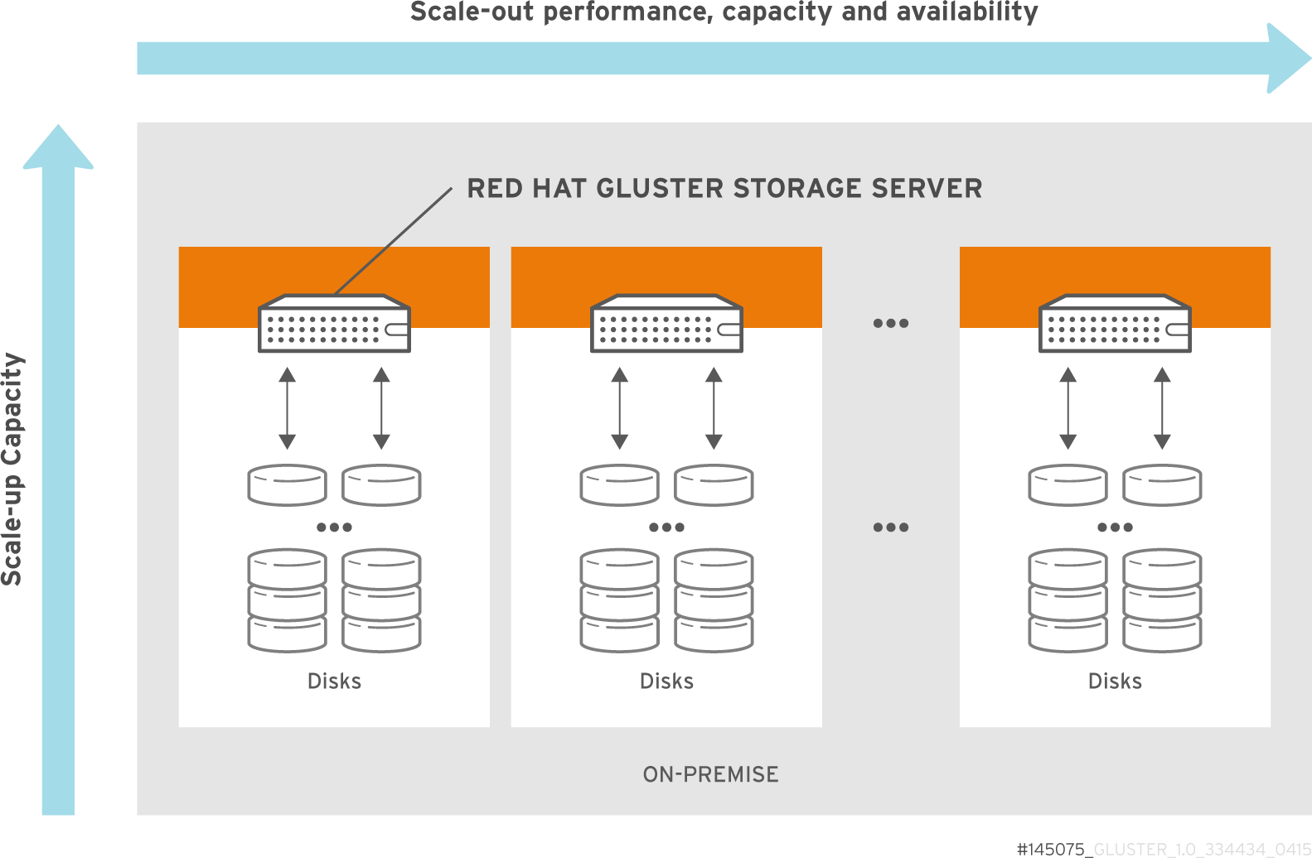
Scale-out and Scale-up

Slide 7
Data Access Overview
GlusterFS Native Client
  Filesystem in Userspace (FUSE)
NFS
  Built-in Service, NFS-Ganesha with libgfapi
SMB/CIFS
  Samba server required (libgfapi based module)
Gluster For OpenStack (Swift-on-file)
libgfapi flexible abstracted storage
  Integrated with QEMU, Bareos and others
Notes:
-The native client uses fuse to build complete filesystem functionality without gluster itself having to operate in kernel space. This offers benefits in system stability and time-to-end-user for code updates.

Slide 8
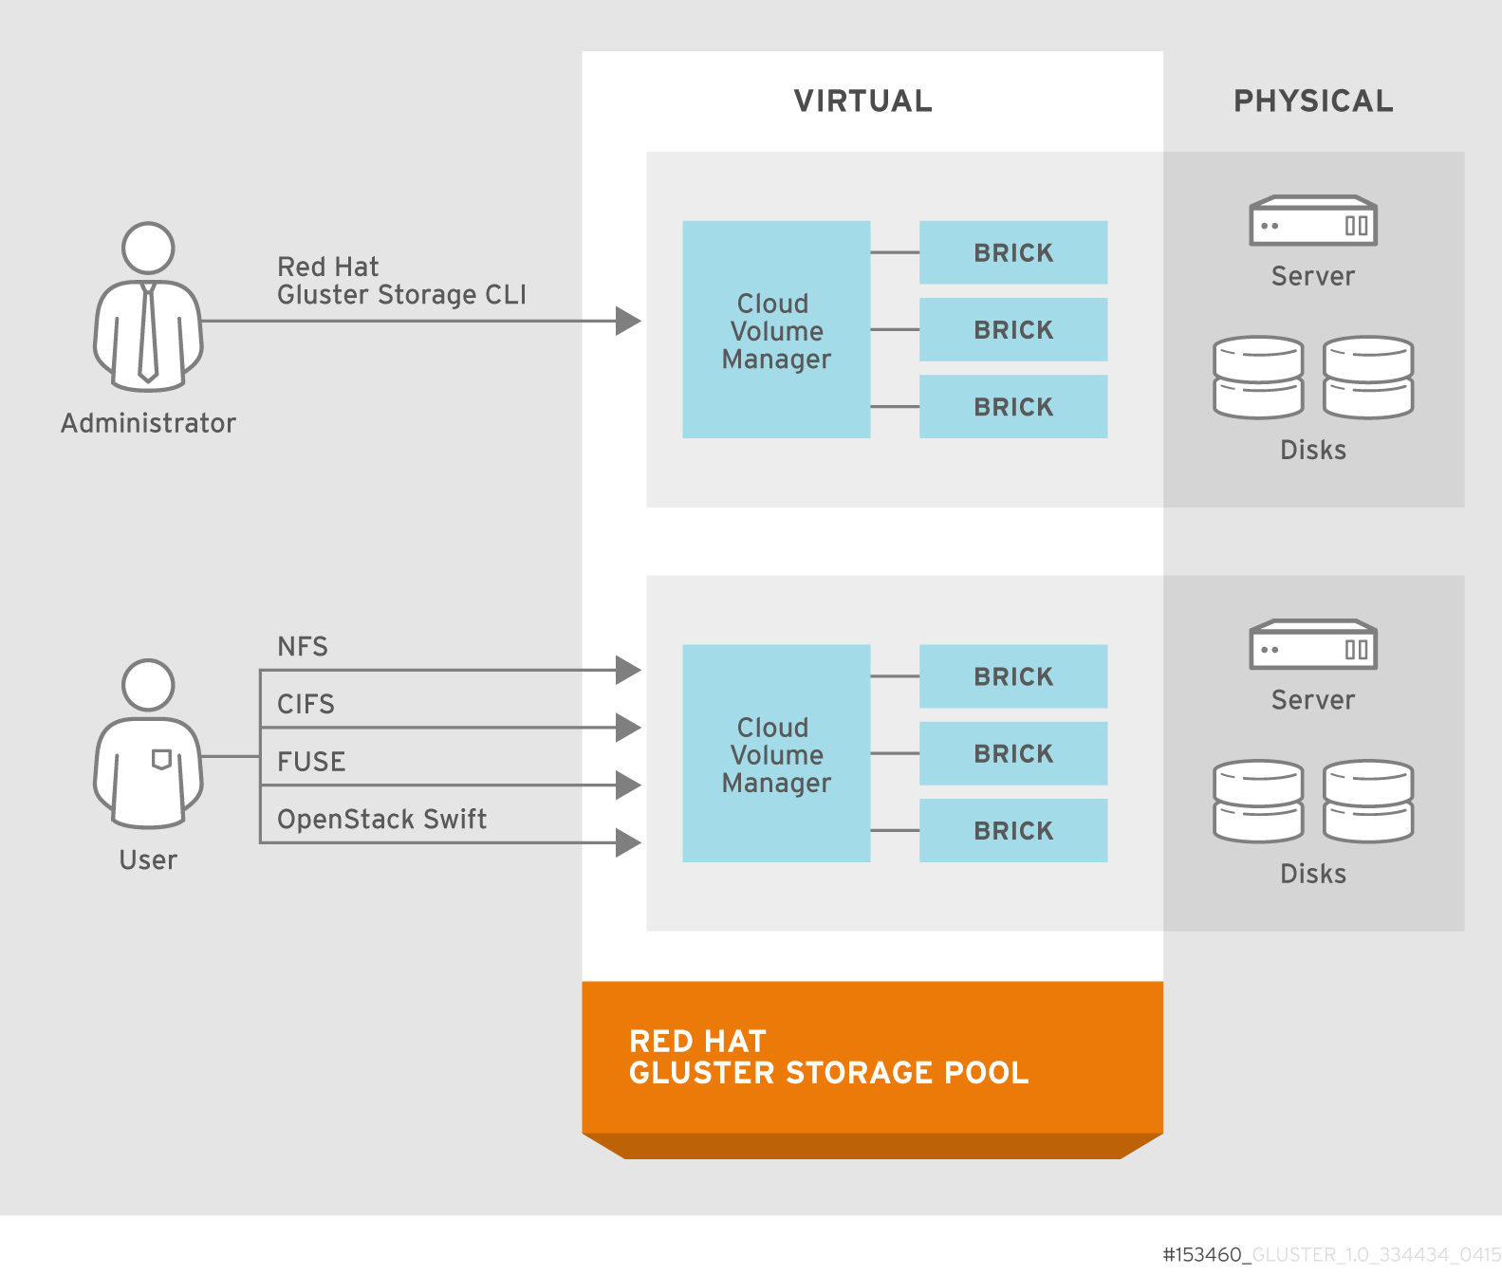
Architecture

Slide 9
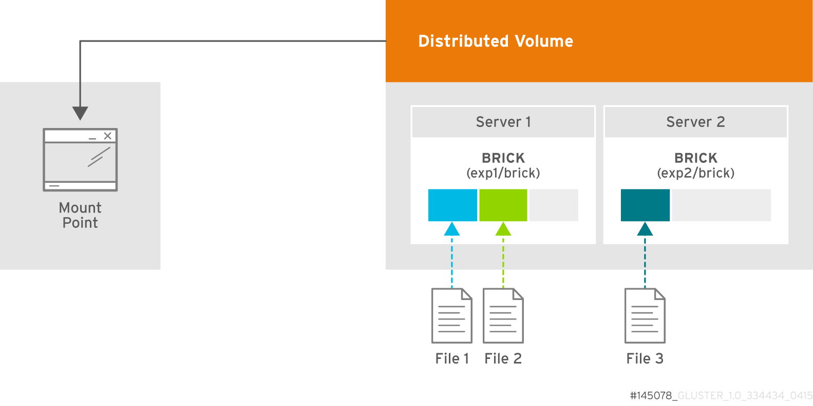
Distributed Volume
Files “evenly” spread across bricks
Similar to file-level RAID 0
Server/Disk failure could be catastrophic
Notes:
DEMO:
Add a peer
Add a brick to the volume
Rebalance the volume

Slide 10
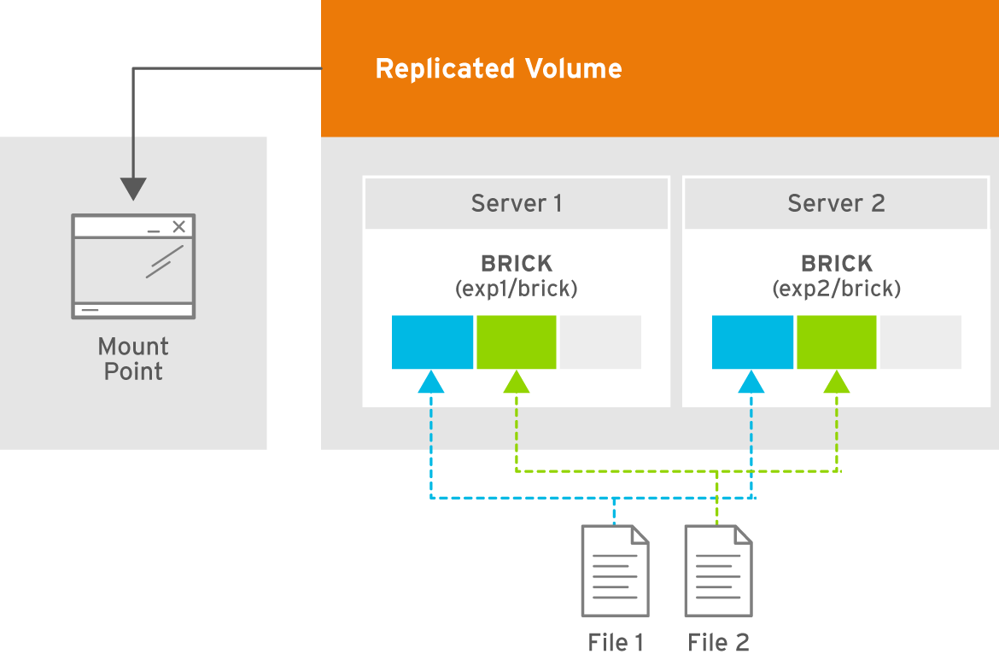
Replicated Volume
Copies files to multiple bricks
Similar to file-level RAID 1

Slide 11
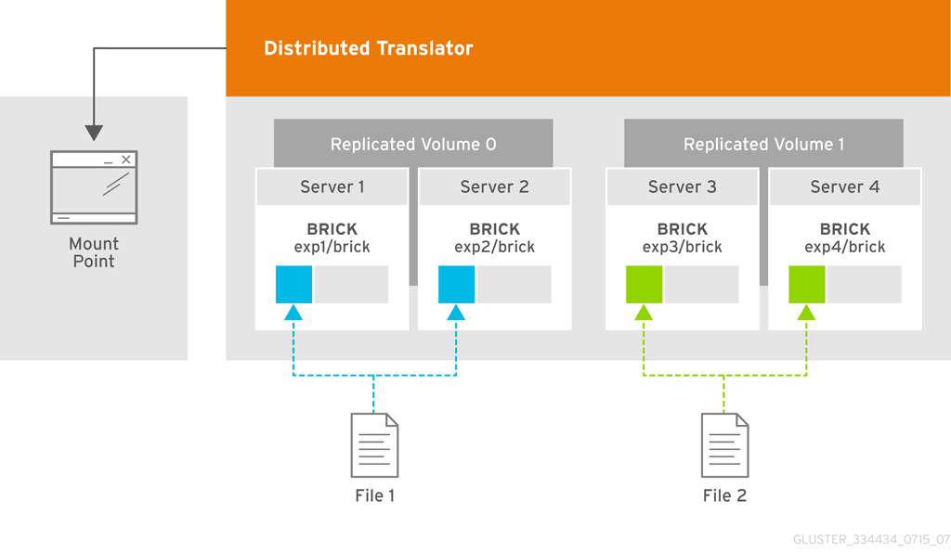
Distributed Replicated Volume
Distributes files across replicated bricks

Slide 12
Quick start
Assuming you have a disk at /dev/sdb:
# fdisk /dev/sdb
Format the partition:
# mkfs -t xfs /dev/sdb1
Mount the partition as a Gluster "brick":
# mkdir -p /bricks/testvol
# mount /dev/sdb1 /bricks/testvol

Slide 13
Quick start
Add an entry to /etc/fstab:
# tail -n1 /proc/mounts >> /etc/fstab
Install Gluster packages on both nodes:
# yum install -y centos-release-gluster
# yum install -y glusterfs-server

Slide 14
Quick start
Run the gluster peer probe command:
# gluster peer probe <ip or hostname of second host>
Configure your Gluster volume:
# gluster volume create testvol rep 2 \
node01:/bricks/testvol/data \
node02:/bricks/testvol/data
Test using the volume:
# mkdir /mnt/gluster
# mount -t glusterfs node01:/testvol
# cp -r /var/log /mnt/gluster

Slide 15
Recently added features
Arbiter Volumes
Policy based split-brain resolution
Bit-Rot detection
Sharding Volumes
Tiering
High-Availability for NFS-Ganesha with Pacemaker
Trashcan to recover deleted files
Glusterfind API
...
Notes:
-The native client uses fuse to build complete filesystem functionality without gluster itself having to operate in kernel space. This offers benefits in system stability and time-to-end-user for code updates.

Slide 16
Upcoming Features for next releases
New Style Replication
Kerberized Gluster network transport
SElinux contexts on Gluster mountpoints
Improved support for sparse files
Steps towards simultaneous Samba and NFSv4 access
  Common high availability configuration (Pacemaker)
  Leases/Delegations
  RichACL
...
Notes:
-The native client uses fuse to build complete filesystem functionality without gluster itself having to operate in kernel space. This offers benefits in system stability and time-to-end-user for code updates.

Slide 17
How to get involved ?
Homepage
http://gluster.org/
Community IRC Chat (on Freenode)
#gluster (for general topics)
#gluster-dev (for developers)
#gluster-meeting (meeting room)
Mailing Lists
http://www.gluster.org/mailman/listinfo/gluster-users
http://www.gluster.org/mailman/listinfo/gluster-devel
Documentation
http://gluster.readthedocs.org/
https://access.redhat.com/ - Red Hat Gluster Storage

Slide 18
Thanks!

