Slide 1

GlusterD 2.0

Slide 2

Atin Mukherjee
“An engineer by profession, a musician by passion”
Gluster Co Maintainer
Senior S/W Engineer @ Red Hat
Reach me @ IRC: atinm on #freenode, Twitter: @mukherjee_atin, mailto : amukherj@redhat.com, github: github.com/atinmu

Slide 3
Agenda
GlusterFS – a brief overview
GlusterFS concepts
Introduction to legacy GlusterD (GlusterD 1.0)
Why GlusterD 2.0
High level architecture
Components
Upgrades consideration
Q&A

Slide 4
GlusterFS
No meta-data server
Modular Architecture for Scale and Functionality
Heterogeneous commodity hardware
Scalable to petabytes & beyond
Open-source general purpose scale-out distributed file system
Aggregates storage exports over network interconnect to provide a single unified namespace
Layered on disk file systems that support extended attributes

Slide 5

GlusterFS Requirements
A node is server capable of hosting GlusterFS bricks
Server
    Intel/AMD x86 64-bit processor
    Disk: 8GB minimum using direct-attached-storage, RAID, Amazon EBS, and FC/Infiniband/iSCSI SAN disk backends using SATA/SAS/FC disks
    Memory: 1GB minimum
Networking
    10 Gigabit ethernet
    Infiniband (OFED 1.5.2 or later)
Logical Volume Manager
    LVM2 with thin provisioning
File System
    POSIX w/ Extended Attributes (EXT4, XFS, BTRFS, …)

Slide 6
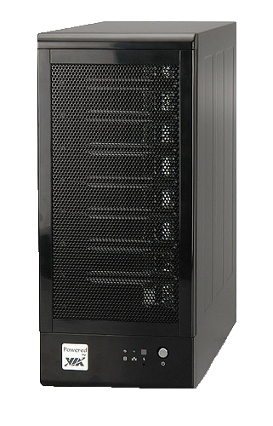
GlusterFS Concepts – Trusted Storage Pool
A collection of storage servers (nodes)
Also known as cluster
Trusted Storage Pool is formed by invitation – “probe”
Members can be dynamically added and removed from the pool
Only nodes in a Trusted Storage Pool can participate in volume creation
Node 1
Node 2
Node 3

Slide 7
GlusterFS Concepts – Bricks
A unit of storage used as a capacity building block
A brick is the directory on the local storage node
Layered on posix compliant file-system (e.g. XFS, ext4)
Each brick inherits limits of the underlying filesystem
It is recommended to use an independent thinly provisioned LVM as brick
  Thin provisioning is needed by Snapshot feature

Slide 8
GlusterFS Concepts – Volume
A volume is a logical collection of one or more bricks
Node hosting these bricks should be part of a single Trusted Storage Pool
One or more volumes can be hosted on the same node

Slide 9
What is GlusterD
Manages the cluster configuration for Gluster
  Peer membership management
  Elastic volume management
  Configuration consistency
  Distributed command execution (orchestration)
  Service management (manages Gluster daemons)

Slide 10
Issues with legacy GlusterD design
N * N exchange of Network messages for peer handshaking
Not scalable when N is probably in hundreds or thousands
Replicate configuration (management) data in all nodes
Initialization time can be very high
Can end up in a situation like “whom to believe, whom not to” - popularly known as split brain
Lack of transaction rollback mechanism

Slide 11
Why GlusterD 2.0
“Configure and deploy a 'thousand-node' Gluster cloud”

Slide 12
Why GlusterD 2.0 (ii)
More efficient/stable membership
  Especially at high scale
Stronger configuration consistency
Non trivial effort in adding management support for Gluster features (modularity & plugins)

Slide 13
Language choice
Legacy GlusterD is in C
“It wasn't enough just to add features into existing language because sometimes you can get more in the long run by taking things away...They wanted to start from scratch and rethink everything.” - Robert.C.Pike
GD2 is in Go and written from scratch!
  Suits best in writing a management plane of a file system (distributed)
  Garbage collection
  Standard libraries support
  One binary approach
  Built in rich features like go routines, channels for concurrency

Slide 14
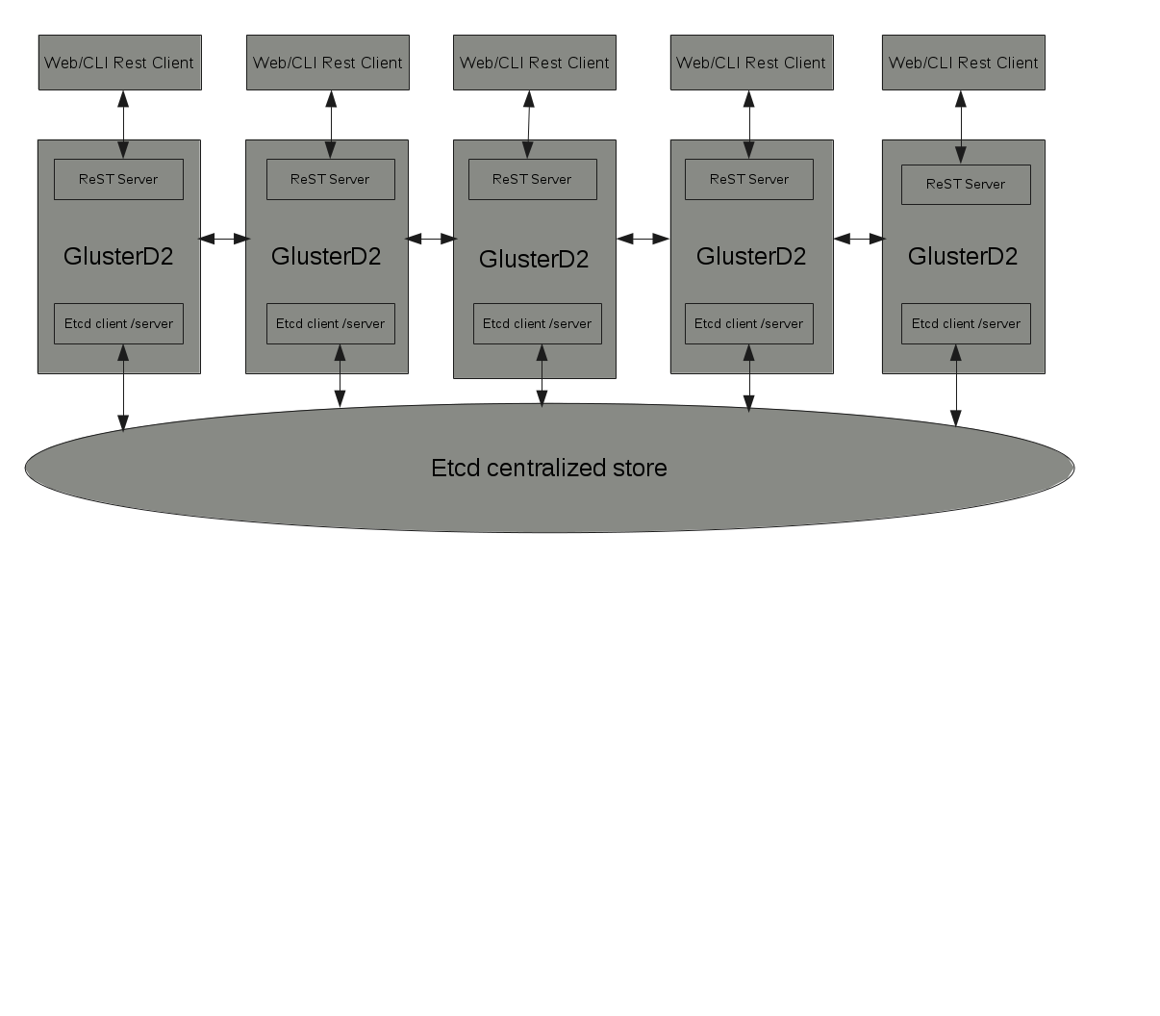
High Level Architecture

Slide 15
Component breakdown
ReST interfaces
Central store - etcd management & bootstrapping
RPC Mechanism
Transaction framework
Feature plug-in framework
Flexi volgen

Slide 16
ReST interface
HTTP ReST Interface
ReST API support
CLI to work as ReST Client

Slide 17
Central store - etcd
Configuration management (replication, consistency) handling by etcd
etcd bootstrapping
  etcd store initiatilization at GD2 boot up
  Modes – client(proxy)/server
  Interface to toggle between client to server and vice versa
External etcd integration too

Slide 18
RPC Framework
Brick to client (and vice versa) communication over existing sun rpc model
Protobuf RPC for GD2 to GD2 / daemons communication
Considerations
  Language support for both C & Go
  Auto code generation
  Support for SSL transports
  Non-blocking I/O support
  Programmer friendly implementation pattern (unlike thrift using Glib style)

Slide 19
Transaction framework
Drives the life cycle of a command including daemons
Executes actions in a given order
Modular - plan to make it consumable by other projects
To be built around central store
execution on required nodes only
Originator only commits into the central store

Slide 20
Feature plug-in framework
Ease of integration of Gluster features
Reduce burden on maintenance & ownership
Feature interface aims to provide
  insert xlators into a volume graph
  set options on xlators
  define and create custom volume graphs
  define and manage daemons
  create CLI commands
  hook into existing CLI commands
  query cluster and volume information
  associate information with objects (peers, volumes)

Slide 21
Flexi volgen
Volfile – source of information by which xlator stack is built up
Currently pretty much static in nature
Goal - make it easy for devs/users to add/remove xlators
SystemD-units style approach for the new volgen (Still under discussion)

Slide 22
Other improvements
Transaction based logging, probably centralized logging too!
Unit tests
Better op version management
Focus on improved documentation

Slide 23
Upgrades consideration
No rolling upgrade, service disruption is expected
Smooth upgrade from 3.x to 4.x (migration script)
Rollback - If upgrade fails, revert back to 3.x, old configuration data shouldn't be wiped off

Slide 24
References
Design documents - https://github.com/gluster/glusterfs-specs/tree/master/design/GlusterD2
Source code - https://github.com/gluster/glusterd2
Reach us @:
  gluster-devel@gluster.org, gluster-users@gluster.org
  #gluster-dev, #gluster on IRC

Slide 25
Q & A

Slide 26
THANK YOU

