Slide 1

Gluster roadmap:
Recent improvements and
upcoming features
Niels de Vos
GlusterFS co-maintainer
ndevos@redhat.com

Slide 2
Agenda
Introduction into Gluster
Quick Start
Current stable releases
History of feature additions
Plans for the upcoming 3.8 and 4.0 release
Detailed description of a few select features

Slide 3
What is GlusterFS?
Scalable, general-purpose storage platform
  POSIX-y Distributed File System
  Object storage (swift)
  Distributed block storage (qemu)
  Flexible storage (libgfapi)
No Metadata Server
Heterogeneous Commodity Hardware
Flexible and Agile Scaling
  Capacity – Petabytes and beyond
  Performance – Thousands of Clients
Notes:
-Commodity hardware: aggregated as building blocks for a clustered storage resource.
-Standards-based: No need to re-architect systems or applications, and no long-term lock-in to proprietary systems or protocols.
-Simple and inexpensive scalability.
-Scaling is non-interruptive to client access.
-Aggregated resources into unified storage volume abstracted from the hardware.

Slide 4
Terminology
Brick
  Fundamentally, a filesystem mountpoint
  A unit of storage used as a capacity building block
Translator
  Logic between the file bits and the Global Namespace
  Layered to provide GlusterFS functionality
Notes:
-Bricks are “stacked” to increase capacity
-Translators are “stacked” to increase functionality

Slide 5
Terminology
Volume
  Bricks combined and passed through translators
  Ultimately, what's presented to the end user
Peer / Node
  Server hosting the brick filesystems
  Runs the Gluster daemons and participates in volumes
Trusted Storage Pool
  A group of peers, like a “Gluster cluster”
Notes:
-Bricks are “stacked” to increase capacity
-Translators are “stacked” to increase functionality

Slide 6
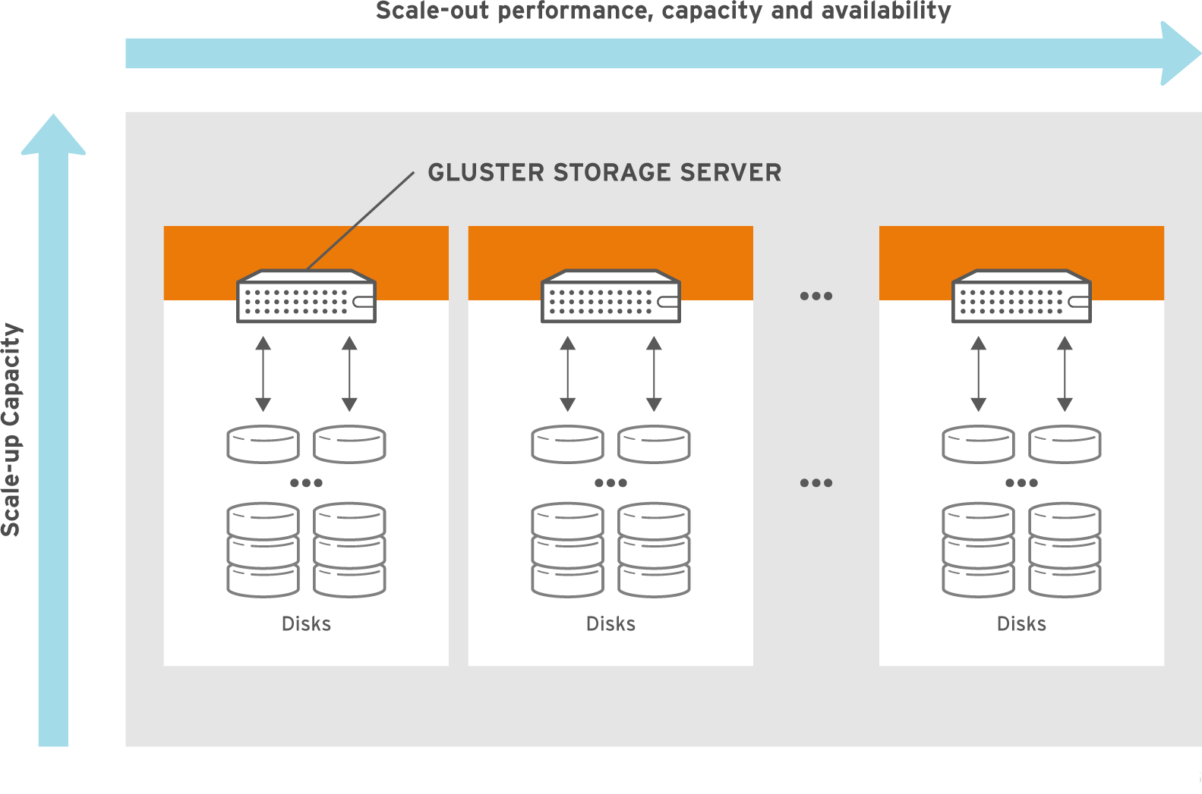
Scale-out and Scale-up

Slide 7
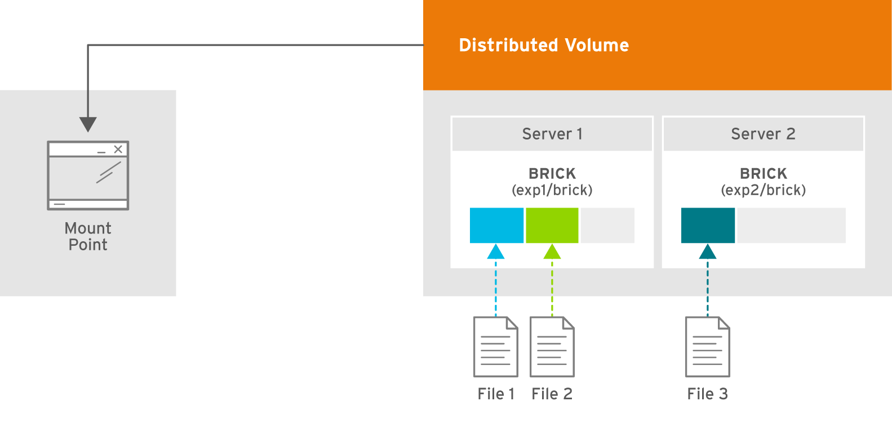
Distributed Volume
Files “evenly” spread across bricks
Similar to file-level RAID 0
Server/Disk failure could be catastrophic
Notes:
DEMO:
Add a peer
Add a brick to the volume
Rebalance the volume

Slide 8
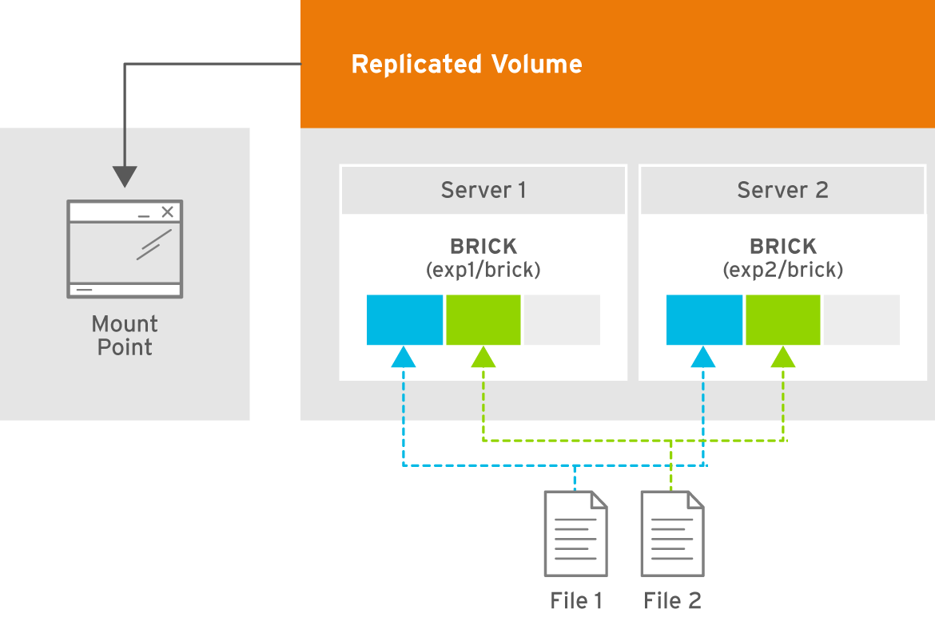
Replicated Volume
Copies files to multiple bricks
Similar to file-level RAID 1

Slide 9
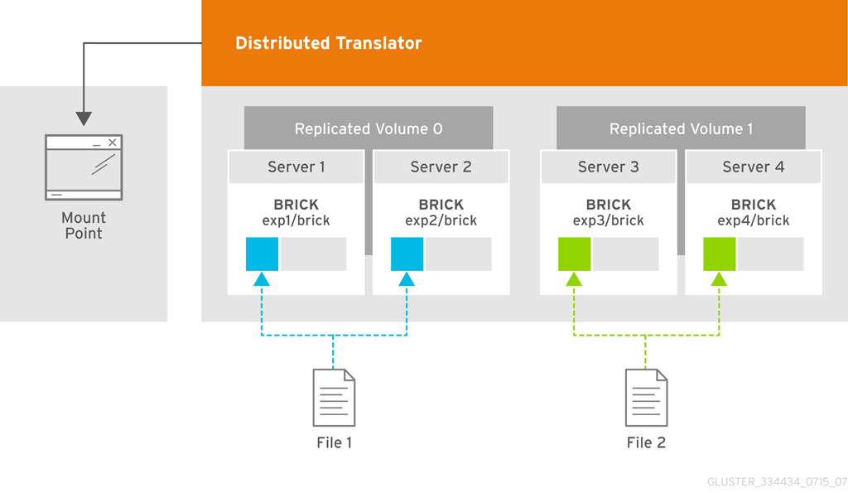
Distributed Replicated Volume
Distributes files across replicated bricks

Slide 10
Data Access Overview
GlusterFS Native Client
  Filesystem in Userspace (FUSE)
NFS
  Built-in Service, NFS-Ganesha with libgfapi
SMB/CIFS
  Samba server required (libgfapi based module)
Gluster For OpenStack (Swift-on-file)
  Object-based access via Swift
libgfapi flexible abstracted storage
  Integrated with QEMU, Bareos and others
Notes:
-The native client uses fuse to build complete filesystem functionality without gluster itself having to operate in kernel space. This offers benefits in system stability and time-to-end-user for code updates.

Slide 11
Quick Start
Available in Fedora, Debian, NetBSD and others
CentOS Storage SIG packages and add-ons
Community packages in multiple versions for different distributions on http://download.gluster.org/
Quick Start guides on http://gluster.org and CentOS wiki

Slide 12
Quick Start
Install the packages (on all storage servers)
Start the GlusterD service (on all storage servers)
Peer probe other storage servers
Create and mount a filesystem to host a brick
Create a volume
Start the new volume
Mount the volume

Slide 13
Current Stable Releases
Maintenance of three minor releases
  3.7, 3.6 and 3.5
Bugfixes only, non-intrusive features on high demand
Approximate release schedule:
  3.5 at the 10th of each month
  3.6 at the 20th of each month
  3.7 at the 30th of each month
Patches get backported to fix reported bugs

Slide 14
Features included in version 3.5
File Snapshot for qcow2 files
GFID access
On-Wire (de)compression
Quota Scalability
Readdir ahead
Zerofill
Brick Failure Detection
Parallel geo-replication

Slide 15
Features included in version 3.6
Improved SSL support
Heterogeneous bricks
Volume wide locks for GlusterD
Volume Snapshots
User Serviceable Snapshots
AFR refactor
RDMA improvements
Disperse translator for Erasure Coding

Slide 16
Features included in version 3.7
Small-file performance enhancements
Tiering for hot and cold contents
Trash translator making undelete of files possible
Netgroups and advanced exports configuration (NFS)
BitRot detection
Upcall infrastructure to notify client processes
Support for NFS Ganesha clusters
Arbiter volumes for 3-way replica, with only 2x the data
Sharding to improve performance for VM images

Slide 17
Tiering in version 3.7
Mapping file characteristics to subvolume characteristics
File characteristics:
  Size, age, access rate, type (filename extension)
Subvolume characteristics:
  Physical location, storage type, encoding method
User provided mapping via 'tags'
Implemented using 'DHT over DHT' pattern

Slide 18
Netgroups and Exports for NFS in 3.7
More advanced configuration for authentication based on /etc/exports like syntax
Support for netgroups
Patches written by Facebook developers
Forward ported from 3.4 to 3.7
Cleanups and posted for review

Slide 19
BitRot support in 3.7
Lazy checksum calculation after file close
BitD daemon utilizes the changelog API
Detection options for rotten data:
  Upon open() and read() (disabled by default)
  Periodic scan
Detection only, manual repair needed

Slide 20
Sharding in 3.7
Split files into shards that get distributed by DHT
Smaller shards help to
  decrease time when healing is needed
  make geo-replication faster
More even distribution over bricks improve
  utilization of space
  client distribution, and performance
Allows single files to be bigger than the bricks

Slide 21
NFS-Ganesha support in 3.7
Optionally replaces Gluster/NFS
Supports NFSv4 with Kerberos
Modifications to Gluster internals
  Upcall infrastructure
  Gluster CLI to manage NFS Genesha
  libgfapi improvements
High-Availability based on Pacemaker and Corosync

Slide 22
Plans for the next 3.8 release
Scale out/in support with Tiering
REST Management APIs for Gluster
Manageable by Heketi
  Easier integration in OpenStack, Kubernetes, …
Subdirectory mounting for the FUSE client
Converged High-Availability
  Pacemaker managed NFS-Ganesha and Samba
Quota for users/groups
SEEK_DATA/SEEK_HOLE for sparse files

Slide 23
… more plans for the next 3.8 release
Geo replication improvements
  Tiering aware
  Sharding support
Multi-threaded self heal
Throttling of clients doing excessive I/O
inotify like functionality
Kerberos for the Gluster protocols
... and much more

Slide 24
Preparations for multi-protocol support
Simultaneous access of files through SMB, NFS and FUSE protocols:
RichACL support
Coherent client-side caching
  Leases for SMB
  Delegations for NFSv4
  Layout recall for pNFS
Mandatory lock support
…

Slide 25
Plans for the next 4.0 release
Scalability and manageability improvements
  New Style Replication
  Improved Distributed Hashing Translator
  GlusterD 2.0 – aims to manage 1000 storage servers
Composite operations in the GlusterFS RPC protocol
Eventing framework for monitoring
... and much more

Slide 26
DHTv2 design
Improve scalability, reduce performance impact
  DHTv1 places all directories on all bricks
Separate data and metadata in their own subvolumes
Handle files and directories the same way
Different on-disk layout, upgrades not possible/planned

Slide 27
New Style Replication
Server-side replication
Full data journal, can be placed on SSD
More throughput for many workloads
More precise, faster repair and healing
Timebased journals provides the ability to implement snapshots of files
NSR would like a new name, suggestions welcome!

Slide 28
Resources
Mailing lists:
gluster-users@gluster.org
gluster-devel@gluster.org
IRC:
#gluster and #gluster-dev on Freenode
Links:
http://gluster.org/
http://gluster.readthedocs.org/
https://github.com/gluster/

Slide 29
Thank you!
Niels de Vos
ndevos@redhat.com
ndevos on IRC

