Slide 1
LabVIEW 8.5.1
A Brief Introduction To Labview
Presented by
The 2nd Law Enforcers, Team 178

Slide 2
Agenda
Introductions (15 Minutes)
  Introducing Your Presenters
  What is LabVIEW(8.5.1f5 with First 3.0a)
  Control Structures
  Variables
  Conditional Statements
  Inputs
  Outputs
  Wires
LabVIEW Program, Basic Concepts - Toggle Button (45 Minutes)
  Launching LabVIEW
    Project View
    Deployment Targets
    Virtual File Systems
  Creating a New VI
    Switching Between Views
    Adding Control Structures
      Types of Loops
      Types of Comparisons
      USING HELP
    Running the Program
    Probes and Highlighting Excecution
Notes:
Wes Stevens
Patt Cunningham
Adam Gresh
Brandon Bald
Steven McGinty
with thanks to...Mara, and all the others “alpha” testers.

Slide 3
Agenda (Continued)
Developing VIs
Receiving Input
Sending Output
Organizing Into Modules
Labview Program, Getting Input – Joystick Program (15 Minutes)
  Materials
    USB Joystick
  Initializing Resources
  Bundled Wires
  Enhancements to Toggle.vi, VI inputs and outputs.
  Some Cautions
    Static Widgets
    Reference Libraries
    Saved in Memory vs. Saved
Break (15 Minutes)
Labview Program, Sending Output – TBD (15 Minutes)
Labview Program, All Together Now (I/O) – (15 Minutes)
Introduction to the 2009 Robot Program (15 Minutes)
  Robot Main
    Begin (Initializing Things)
    TeleOp
    AutoIterative
    Disabled

Slide 4
Agenda (Continued)
Questions and Free Exploration

Slide 5
What is LabVIEW - Objectives
Understand how to check version and why it's important.
Be able to identify a front panel and a block diagram.
Know how to switch between front panel and block diagram.
Be able to identify a control structure.
Be able to identify a wire and understand data flow.
Be able to identify variables, constants and controls.
Understand how program execution flows in a simple diagram.
Be able to identify conditional statements and other types of operators.
Notes:
We want to establish a few basic ideas before we get into the details of how to write a program.
For the most part I just want you to get familiar with the way labview represents a program and get a look at some of the language features before we try to use them. This familiarity should make it easier to write your first program.

Slide 6
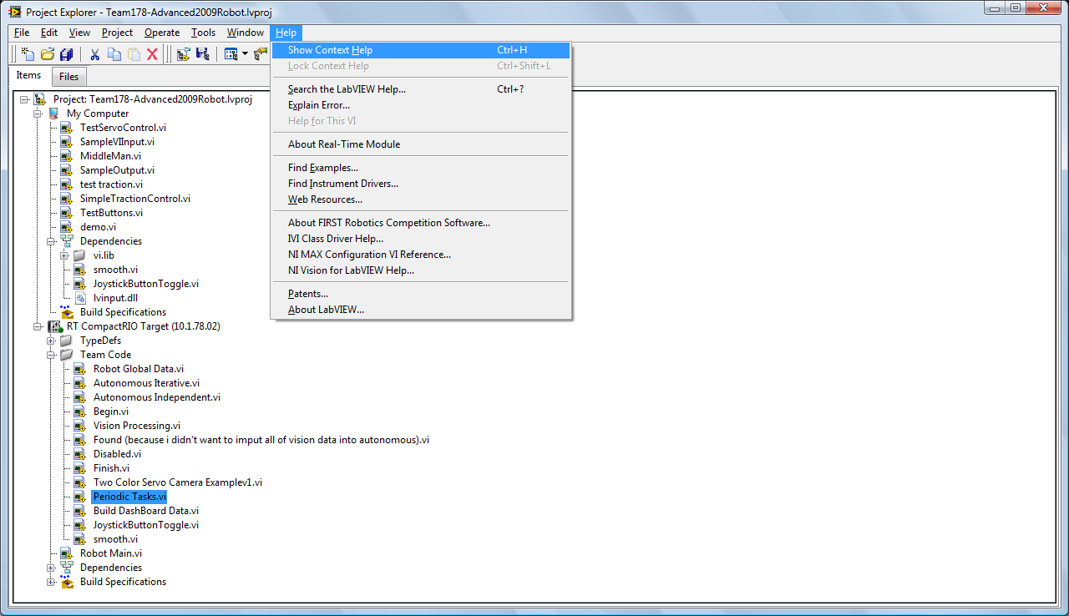
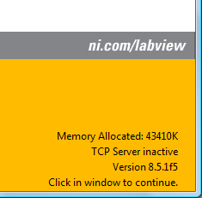
What is LabVIEW
Notes:
Why is version important? Vis generally only work in the version they were created in. If you create a vi in version 7 it is not likely to work in 8. It is even less likely to work in 6.
Dataflow language – waits for input to arrive before processing occurs. Be aware that there is parallel execution.
Iconic vs textual

Slide 7
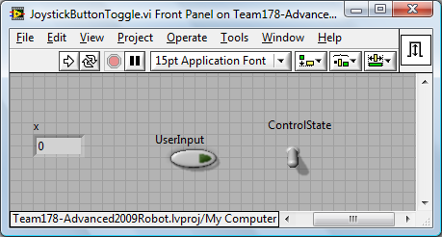
What is LabVIEW
The Front Panel
The front panel is a virtual representation of the inputs and outputs. Controls, constants and indicators will be visible on the front panel. The representation of an object does not control the behavior – a switch can be used as a way to display a value or to change a value. So can an LED.

Slide 8
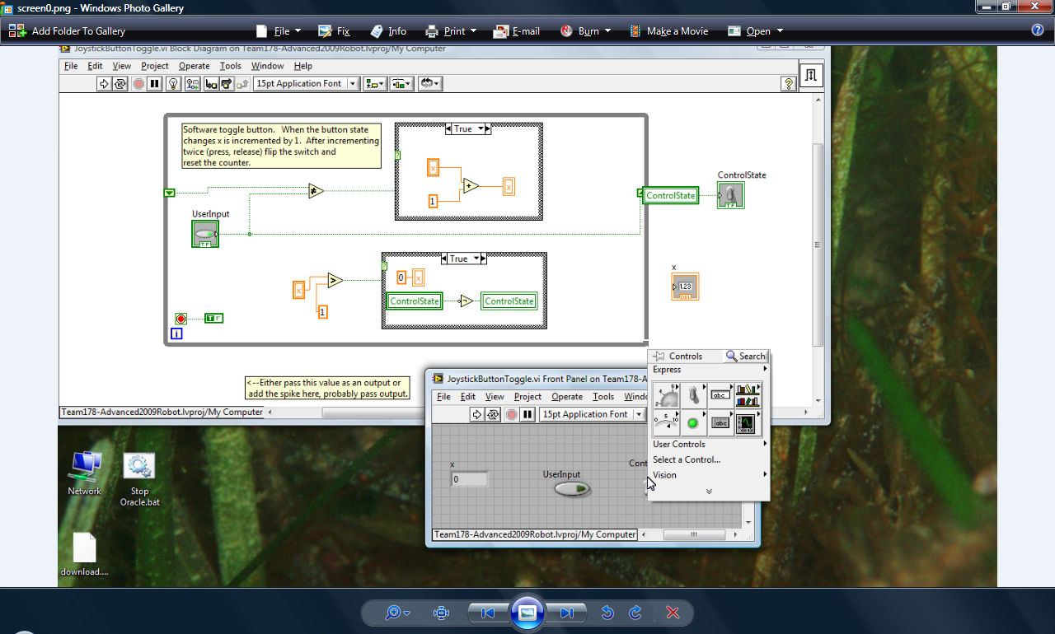
What is LabVIEW
The Front Panel
The front panel is a virtual representation of the inputs and outputs. Controls, constants and indicators will be visible on the front panel. The representation of an object does not control the behavior – a switch can be used as a way to display a value or to change a value. So can an LED.

Slide 9
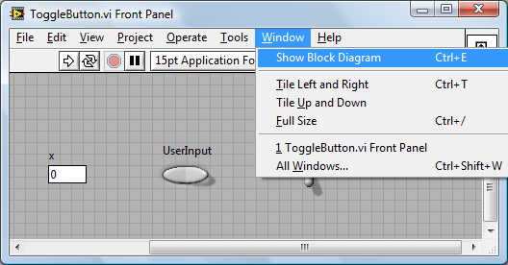
What is LabVIEW
Switching from Front Panel to Block Diagram
To switch from the front panel to the block diagram you can press control-e or select Window-Block Diagram from the main menu.

Slide 10
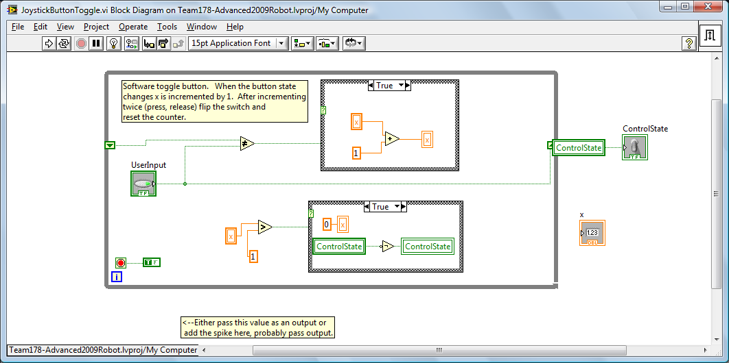
What is LabVIEW
The Block Diagram
The block diagram is where we write the program. Unlike text based languages the structure of the program is created using icons, lines and other visual representations.

Slide 11
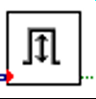
What is LabView
A VI is Made Up of A Front Panel and Block Diagram. Together the front panel and block diagram make up a VI.

Slide 12
What is LabView
A program or diagram is a collection of VIs organized inside control structures and connected by wires. LabVIEW also provides variables and constants.
Wire
Control Loop
Variable

Slide 13
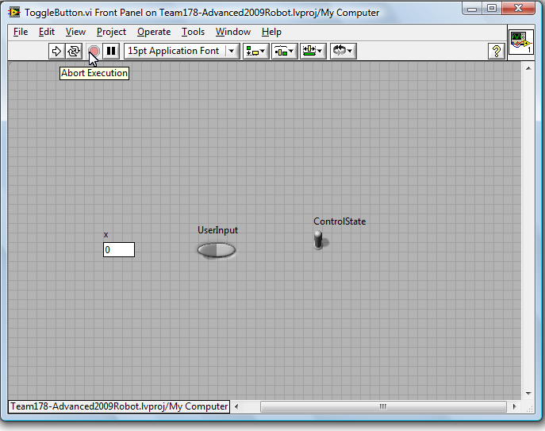
LabVIEW 'Language' Elements

Slide 14
LabVIEW 'Language' Elements
Front Panel

Slide 15
LabVIEW 'Language' Elements
Front Panel
Controls and Indicators appear on the front panel. As a programmer you choose whether each representation is a control or an indicator. As a user you won't know until you try to interact with it.

Slide 16
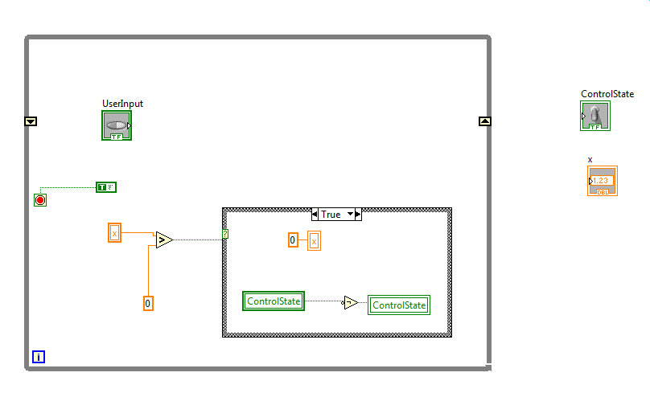
LabVIEW 'Language' Elements

Slide 17
LabVIEW 'Language' Elements
Block Diagram

Slide 18
LabVIEW 'Language' Elements
Block Diagram
Notice that controls also appear on the block diagram. Variables are created from the controls and indicators. If you remove a control or indicator that you have created variables from the variables are also removed.

Slide 19
LabVIEW 'Language' Elements
Block Diagram
Variables and constants. Notice that the variables and constants have the name of the contol or indicator that they were created from.

Slide 20
LabVIEW 'Language' Elements
Block Diagram
Operators can be created by right mouse clicking a blank spot on the block diagram and then selecting from the available palette menus.

Slide 21
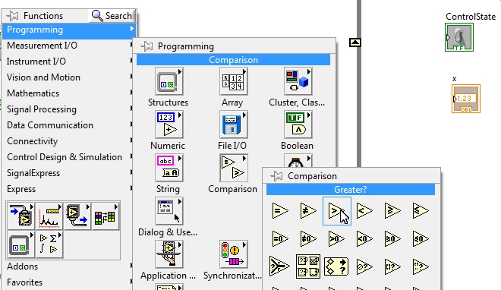
LabVIEW Language Elements
Block Diagram
Operators are VIs that can take input and send output. Many common operators are available on the programming palette, but you will find that operators are spread across a wide range of the other palettes as well.

Slide 22
LabVIEW 'Language' Elements
Block Diagram
Wires

Slide 23
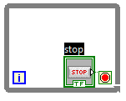
LabVIEW 'Language' Elements

Slide 24
LabVIEW 'Language' Elements
While Loop – a control structure

Slide 25

LabVIEW 'Language' Elements
While Loop – a control structure

Slide 26
LabVIEW 'Language' Elements
While Loop – a control structure
Wire – a control structure

Slide 27


LabVIEW 'Language' Elements
While Loop – a control structure
Wire – a control structure, controls data flow.

Slide 28
LabVIEW 'Language' Elements
While Loop – a control structure
Wire – a control structure
Wire – a control structure, controls data flow.
Control and Indicator – represent variables
Notes:
Find out if anyone knows when to use a control and when to use an indicator.

Slide 29



LabVIEW 'Language' Elements
While Loop – a control structure
Wire – a control structure
Wire – a control structure, controls data flow.
Control and Indicator – represent variables
Notes:
Find out if anyone knows when to use a control and when to use an indicator.

Slide 30
LabVIEW 'Language' Elements
While Loop – a control structure
Wire – a control structure
Wire – a control structure, controls data flow.
Control and Indicator – represent variables
Read and write variable values – program element
Notes:
Find out if anyone knows when to use a control and when to use an indicator.

Slide 31
LabVIEW 'Language' Elements
While Loop – a control structure
Wire – a control structure
Wire – a control structure, controls data flow.
Control and Indicator – represent variables
Read and write variable values – program element
Notes:
Find out if anyone knows when to use a control and when to use an indicator.

Slide 32
LabVIEW 'Language' Elements
While Loop – a control structure
Wire – a control structure
Wire – a control structure, controls data flow.
Control and Indicator – represent variables
Read and write variable values – program element
Constant – program element
Notes:
Find out if anyone knows when to use a control and when to use an indicator.

Slide 33

LabVIEW 'Language' Elements
While Loop – a control structure
Wire – a control structure
Wire – a control structure, controls data flow.
Control and Indicator – represent variables
Read and write variable values – program element
Constant – program element
Notes:
Find out if anyone knows when to use a control and when to use an indicator.

Slide 34
LabVIEW 'Language' Elements
While Loop – a control structure
Wire – a control structure
Wire – a control structure, controls data flow.
Control and Indicator – represent variables
Read and write variable values – program element
Constant – program element
Greater Than Operator – program element
Notes:
Find out if anyone knows when to use a control and when to use an indicator.

Slide 35
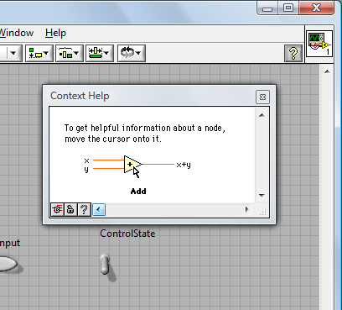
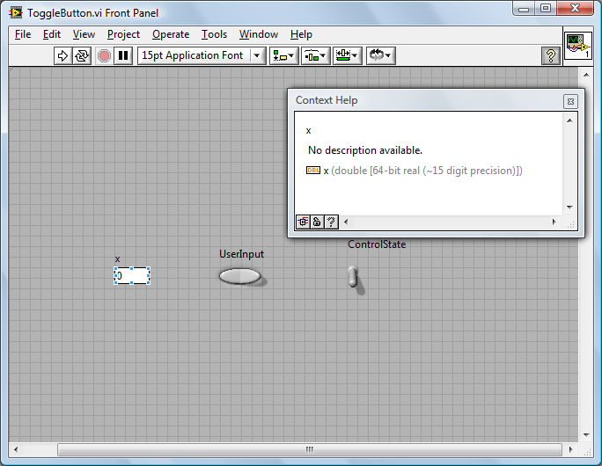
LabVIEW Help

Slide 36
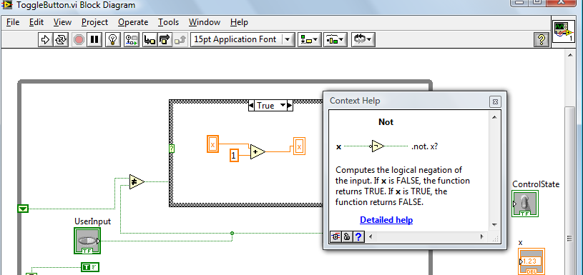
LabVIEW Help

Slide 37
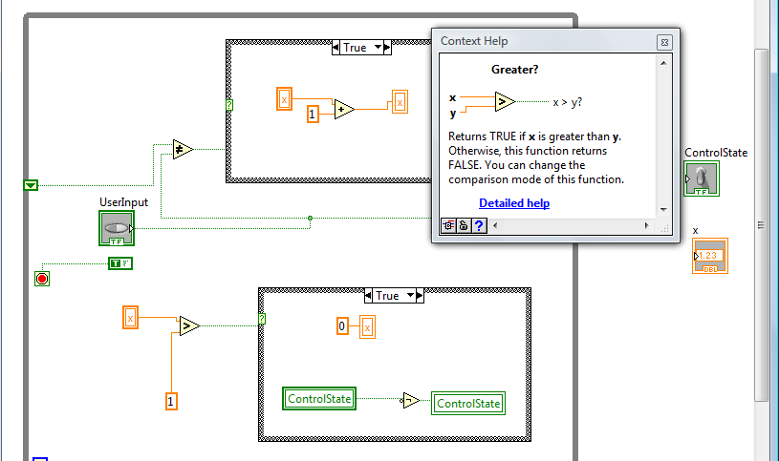
LabVIEW Help

Slide 38
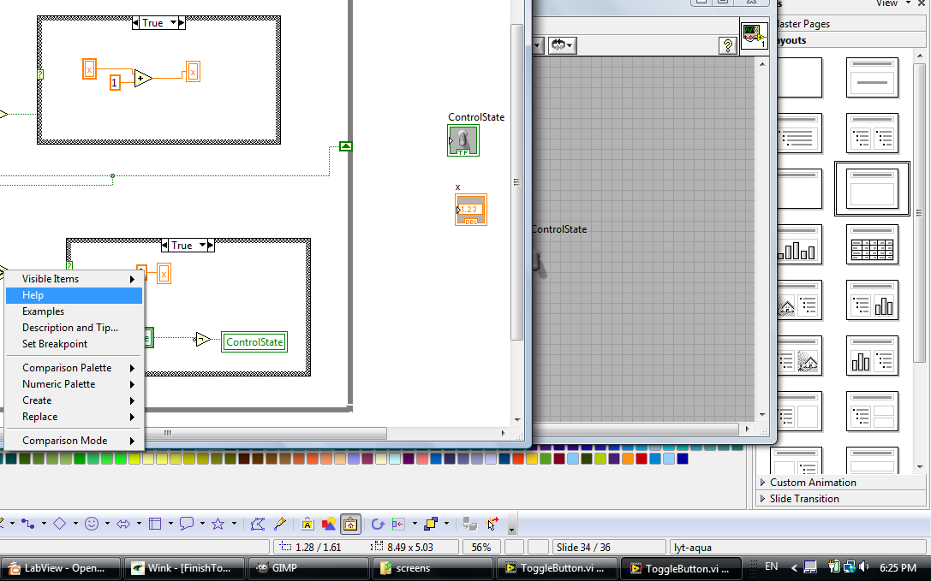
LabVIEW Help

Slide 39
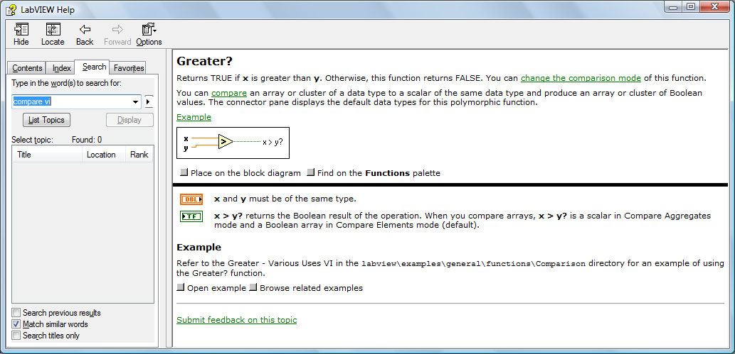
LabVIEW Help
Right mouse an object and click help to get more extensive help. This is the same screen opened by using the menu bar, but it opens to the selected object.

Slide 40
LabVIEW Program, Basic Concepts - Toggle Button
Objectives:
Understand how to start LabVIEW and create a new VI.
Learn to navigate between the block diagram and front panel.
Learn how to create controls and indicators from the front panel.
Learn how to create variables and control structures in the block diagram.
Learn how to use help.
Learn how to connect things with wires.
Learn how to execute a VI.
Learn how to debug a program.
Learn how to create a probe.

Slide 41
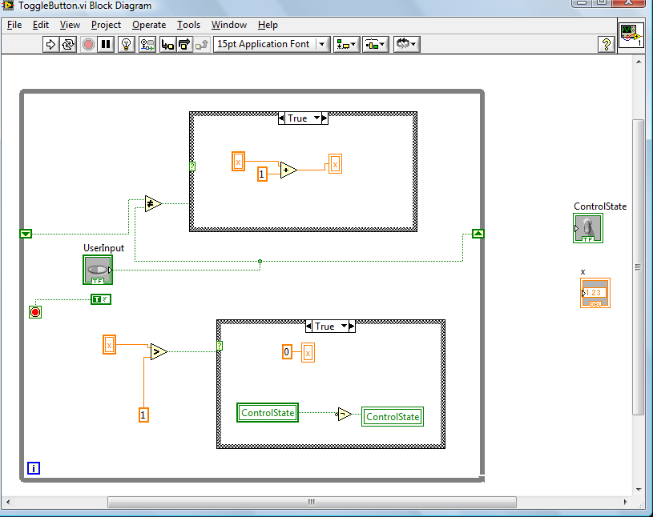
Lab I - 60 Minutes

Slide 42
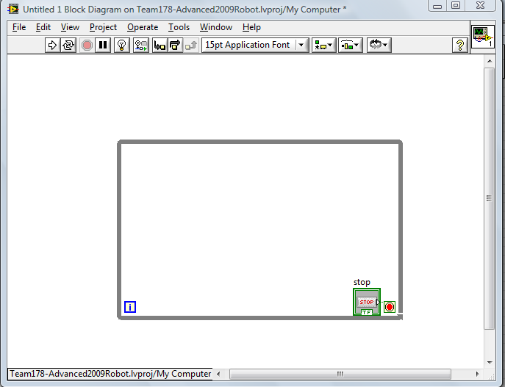
Lab I – While Loops
Notes:
Show the “Creating A While Loop With Shift Registers” demo.
Have the class follow along.

Slide 43
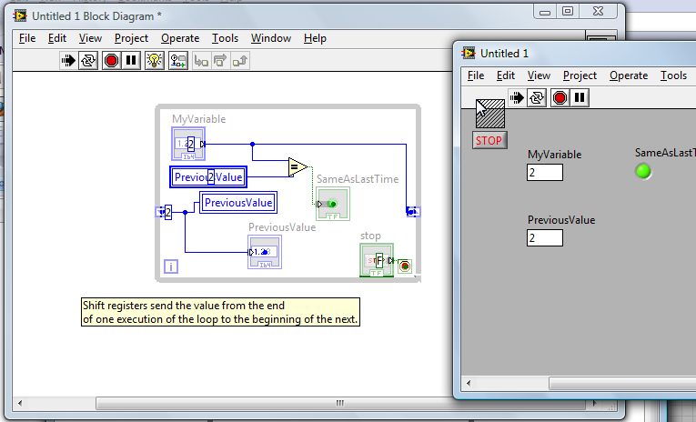
Lab I – Shift Registers
Notes:
Show the class the shift register demo.
Have the class create the shown shift register demo.

Slide 44
Developing VIs
Objectives:
Learn how to display the connector block.
Understand how to add inputs and outputs to the connector and what it means to be able to accept input and send output.
Learn how to add custom VIs to a diagram.
Learn to create an icon.
Understand how a VI fits into the greater picture.
Understand how to bundle and unbundle wires.

Slide 45
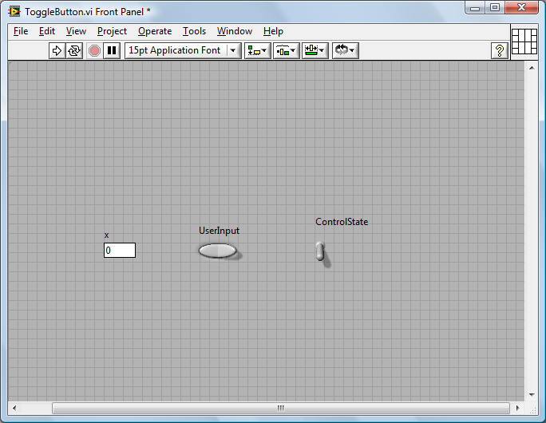
LabVIEW – Connector Block
Right mouse the icon on the front panel to reveal the connector block.

Slide 46

Connector Block
Left click a connector and then wire to a control to create an input or to an indicator to create an output. This is how you can receive parameters or return values.

Slide 47
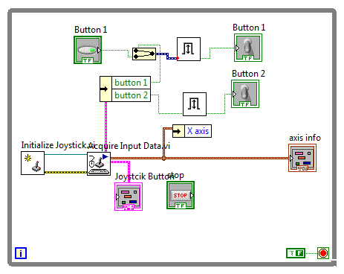
Why Connect?
Providing inputs and outputs allows our VI to interact with other Vis. If we have no connectors theres no way to interact with other widgets. Let's start looking at how to put the VI we created into the picture...
Notes:
This gets into the bigger picture. Vis need to connect in order to interact. You could have your entire program in one VI, but there would be no order or structure. A VI should represent an organizational unit. The unit should be some major concept, or an 'atomic' unit of work.

Slide 48
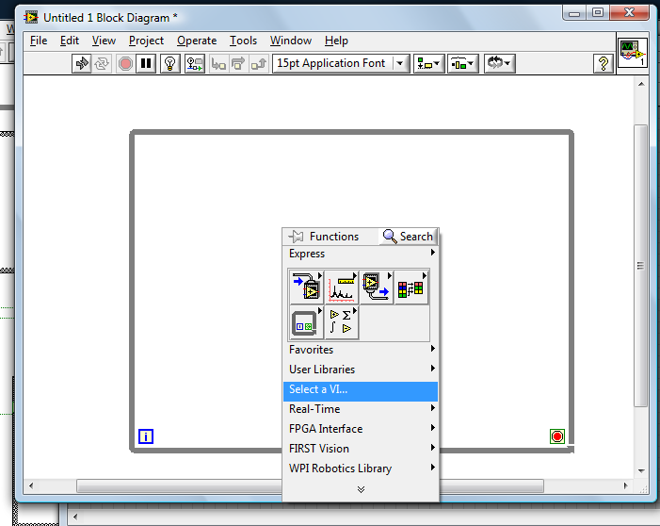
Adding a Custom VI
We have to locate our VI on disc in order to put it in a diagram.
Notes:
This gets into the bigger picture. Vis need to connect in order to interact. You could have your entire program in one VI, but there would be no order or structure. A VI should represent an organizational unit. The unit should be some major concept, or an 'atomic' unit of work.

Slide 49
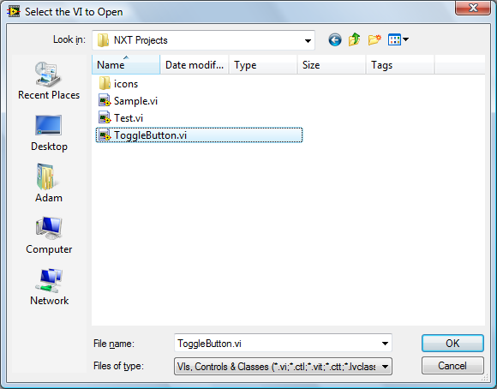
Adding a Custom VI
We have to locate our VI on disc in order to put it in a diagram.
Notes:
This gets into the bigger picture. Vis need to connect in order to interact. You could have your entire program in one VI, but there would be no order or structure. A VI should represent an organizational unit. The unit should be some major concept, or an 'atomic' unit of work.

Slide 50
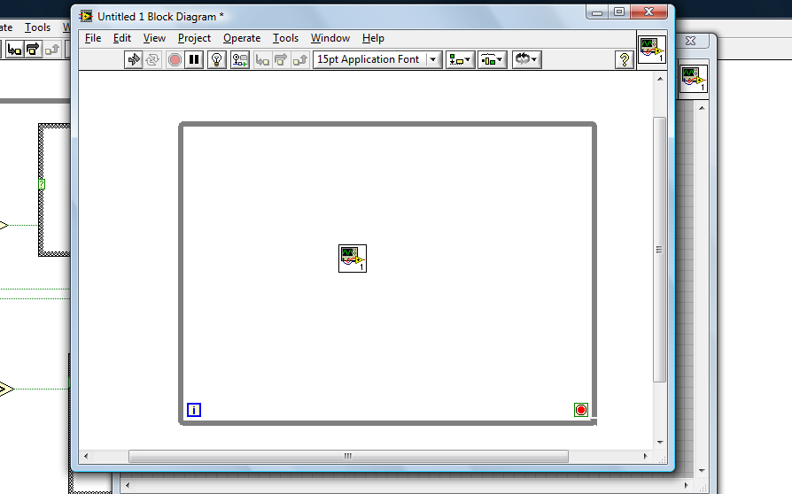
Eating Your Own Dog Food
This is what happens if we add our ToggleButton VI to a larger VI with no connectors.

Slide 51
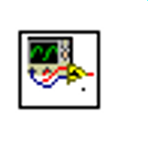
Eating Your Own Dog Food
This is what happens if we add our ToggleButton VI to a larger VI with no connectors. Notice that there is no way for our widget to interact. It's also kind of hard to tell our widget apart or get any idea what it does from the icon.

Slide 52
Eating Your Own Dog Food - Connector Block
Let's connect up the connector block and see how thing look then...

Slide 53
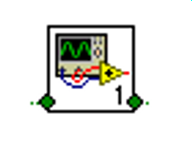
Eating Your Own Dog Food
Now we have some connectors, let's fix the icon...

Slide 54
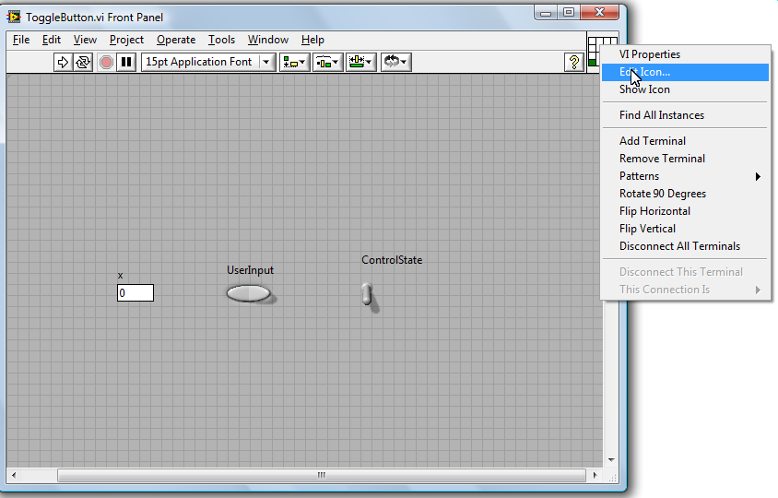
Icons
To open the editor right mouse on the icon/connector block and select edit icon...

Slide 55
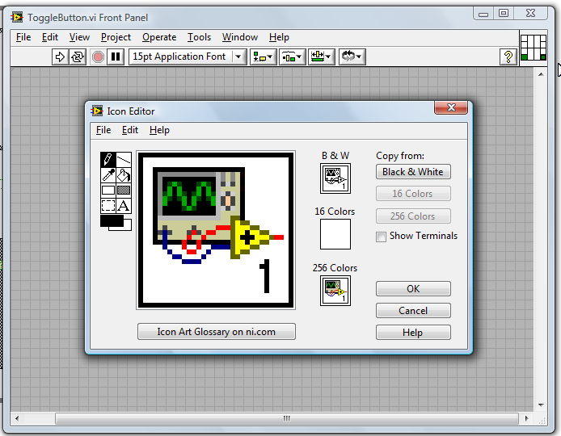
Icons
After right mousing on the icon/connector block and selecting edit icon we see the current icon.

Slide 56
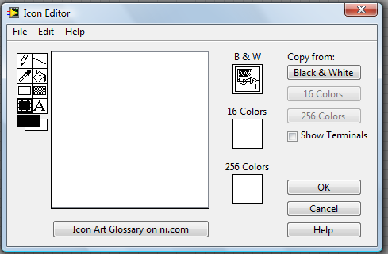
Icons
Clearing out the existing icon by highlighting and hitting delete.

Slide 57
Icons
We can download icons from NI or create our own files.

Slide 58
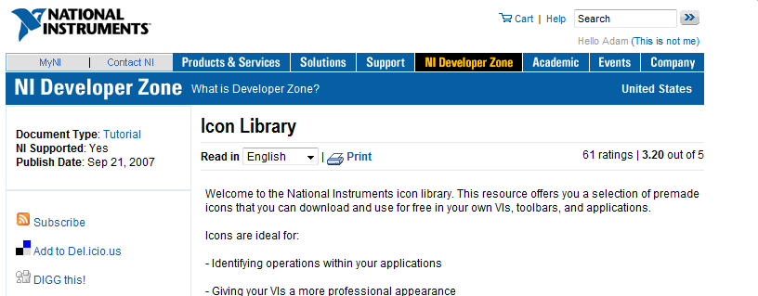
Icons
The button takes us to NI's website.

Slide 59
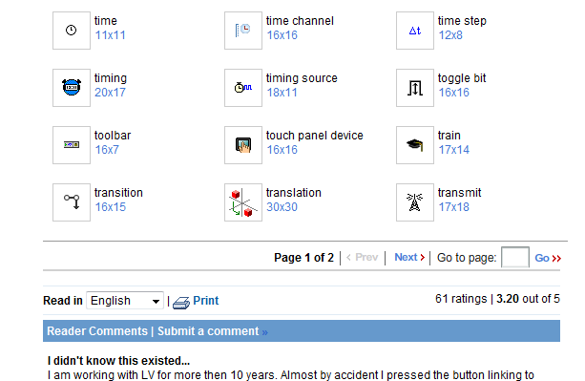
Icons
The icon for toggle bit conveys the meaning for our widget pretty well...

Slide 60
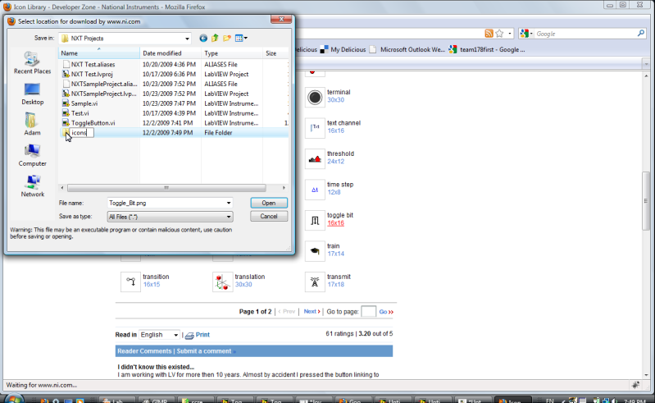
Icons
Our workspace is already getting cluttered. Lets create an area for icons.

Slide 61
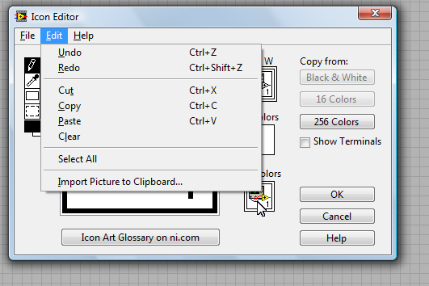
Icons
The icon is loaded from onto the clipboard from a file...

Slide 62
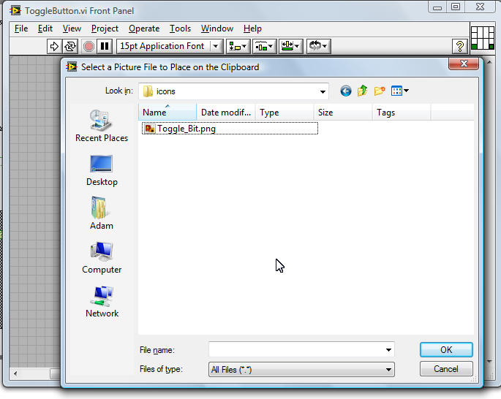
Icons – Importing from Files
The icon is loaded from onto the clipboard from a file...

Slide 63
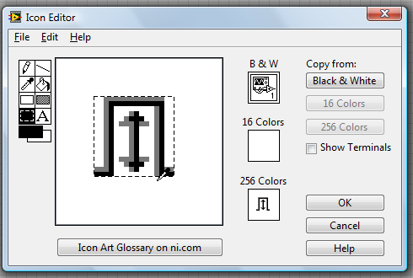
Icons
Here I've clicked on 256 colors and then pasted from the clipboard.

Slide 64
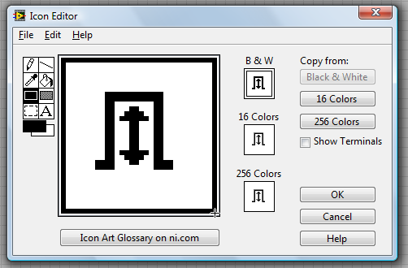
Icons
The border is just a box layered on top of the icon. It's drawn right in the icon editor.

Slide 65
Are Icons Important?
Fontwork

Slide 66
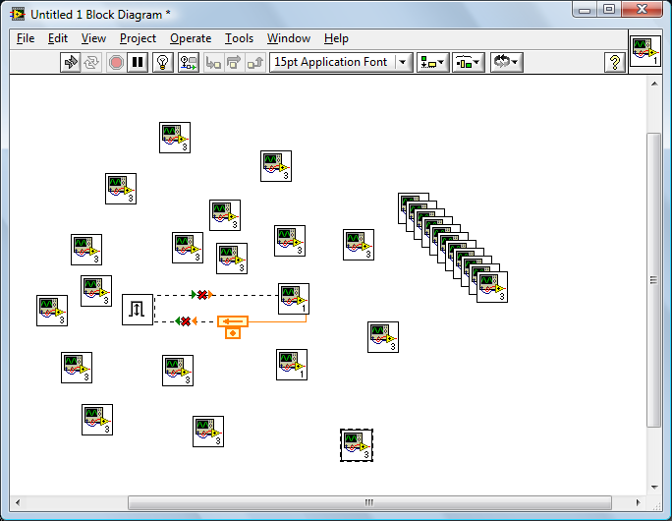
Are Icons Important?
YOU BET!
Fontwork
There are only 4 different widgets here, can you tell what any of them do? The more complicated the diagram the more important good icons are.

Slide 67
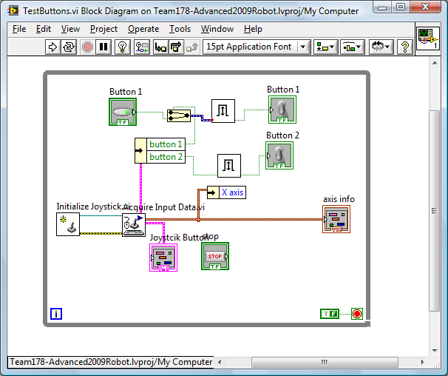
Unbundling
Fontwork
The thicker wires here are 'bundles'. The VIs the bundles come out of have many, many connections. If all the wires were shown the diagram would get difficult to read. Bundling is used as an organizational convenience.

Slide 68
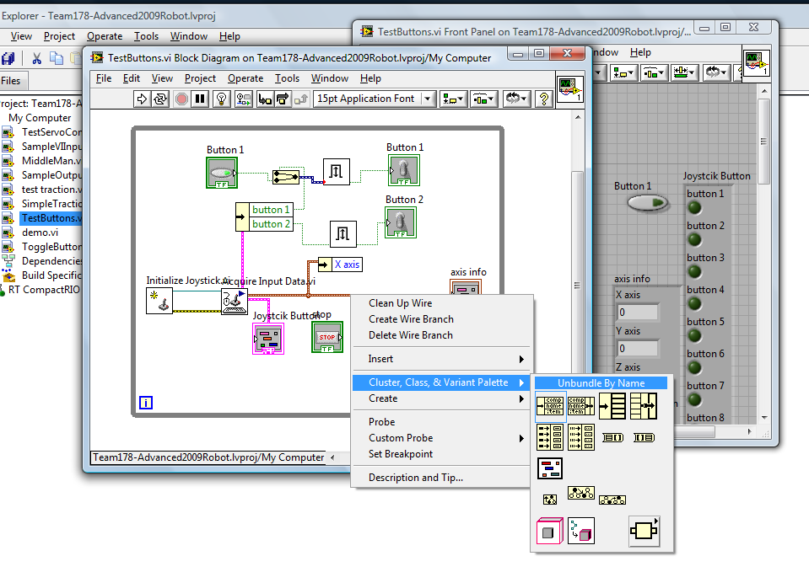
Unbundling

Slide 69
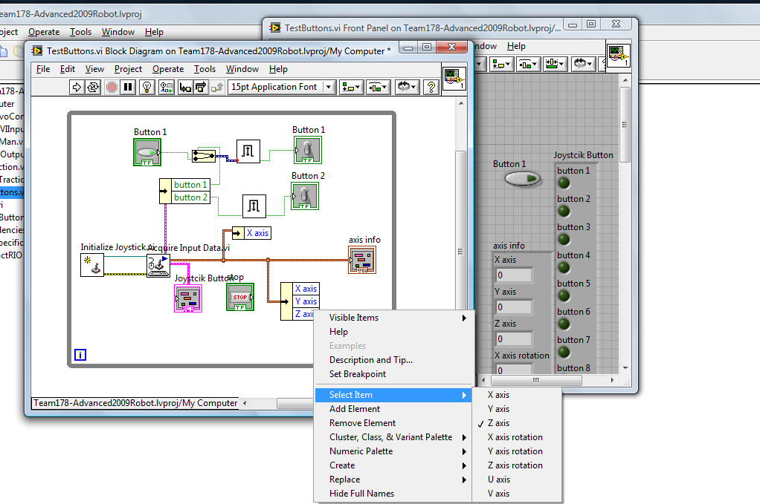
Unbundle by Name

Slide 70
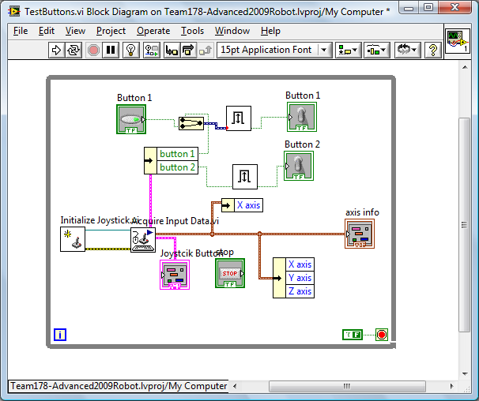
Lab – Input (15 Minutes)

Slide 71
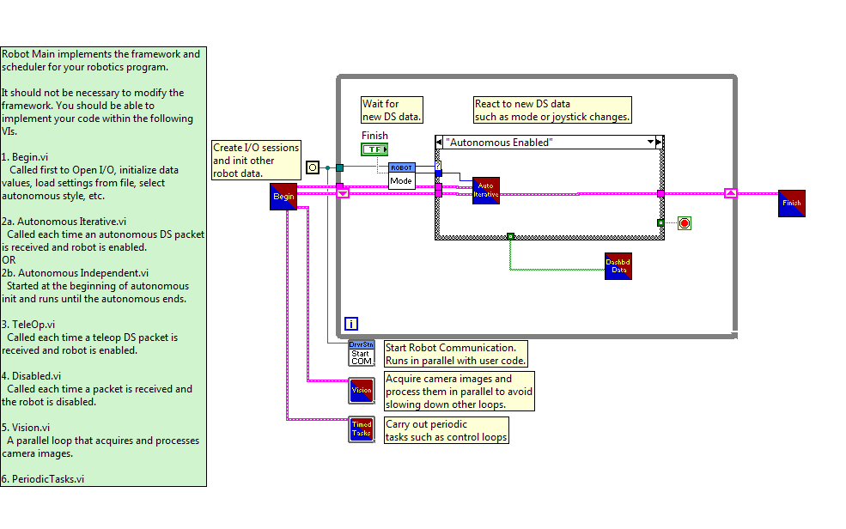
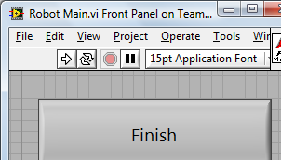
Introduction to the 2009 Robot Program (15 Minutes)

