Slide 1



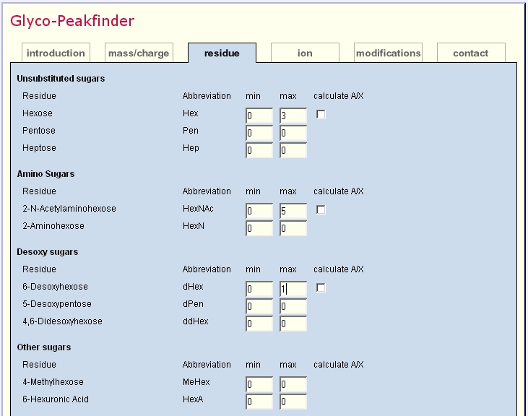
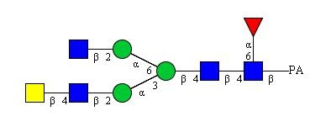
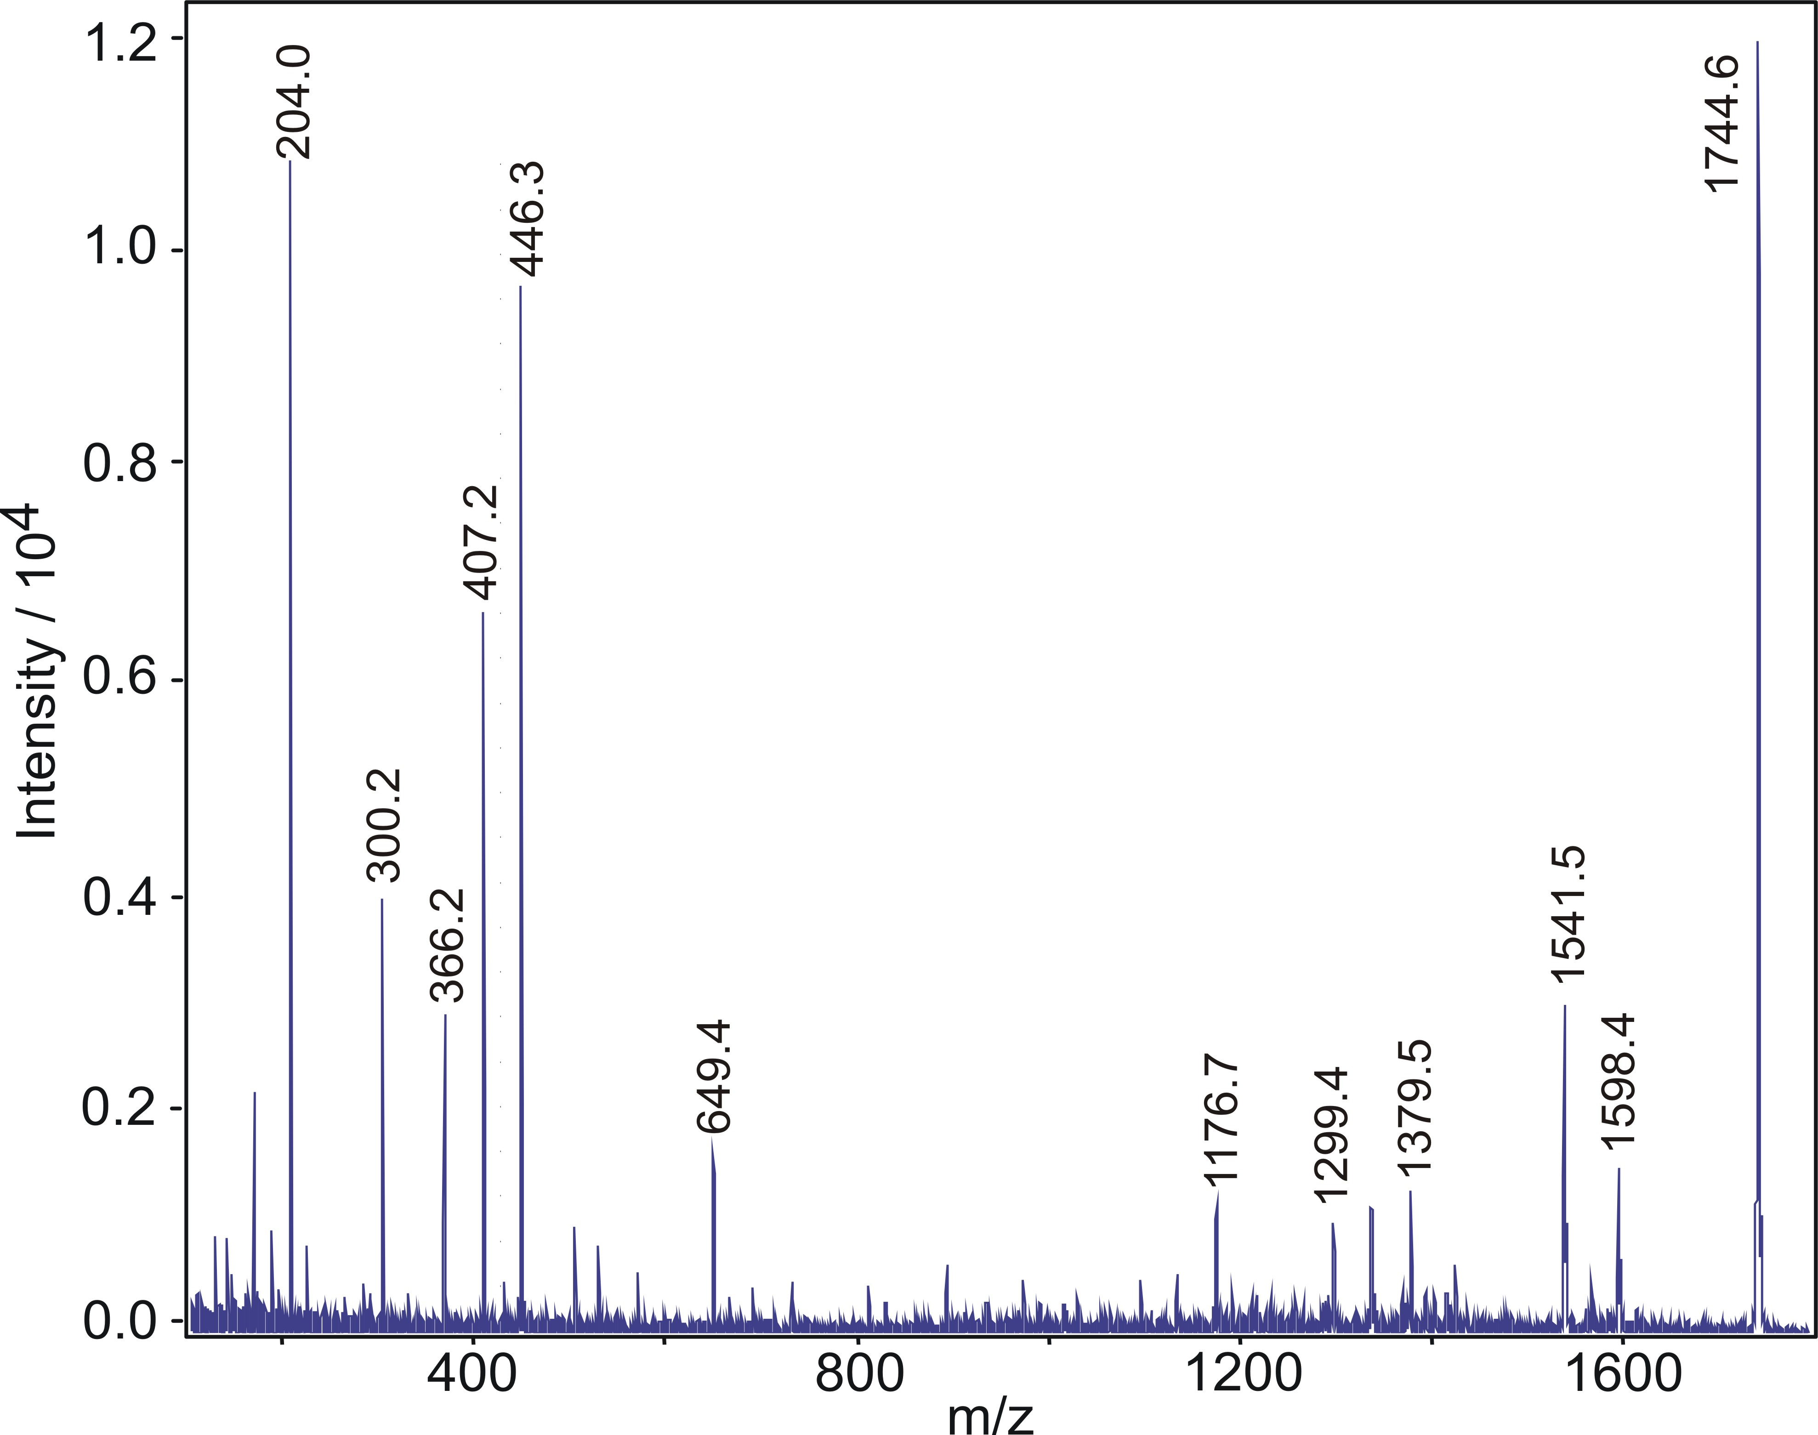
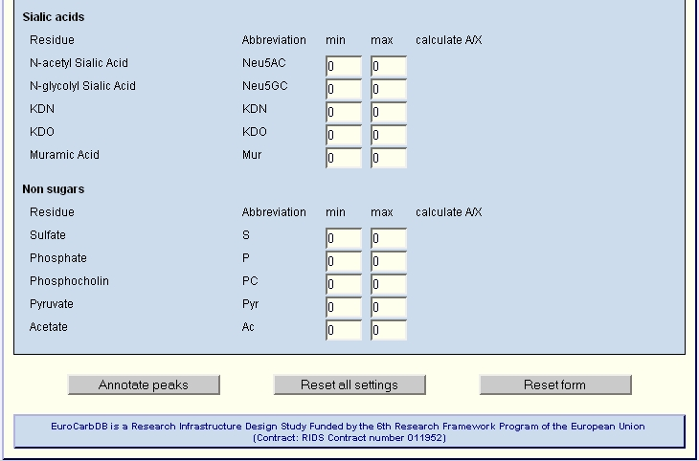
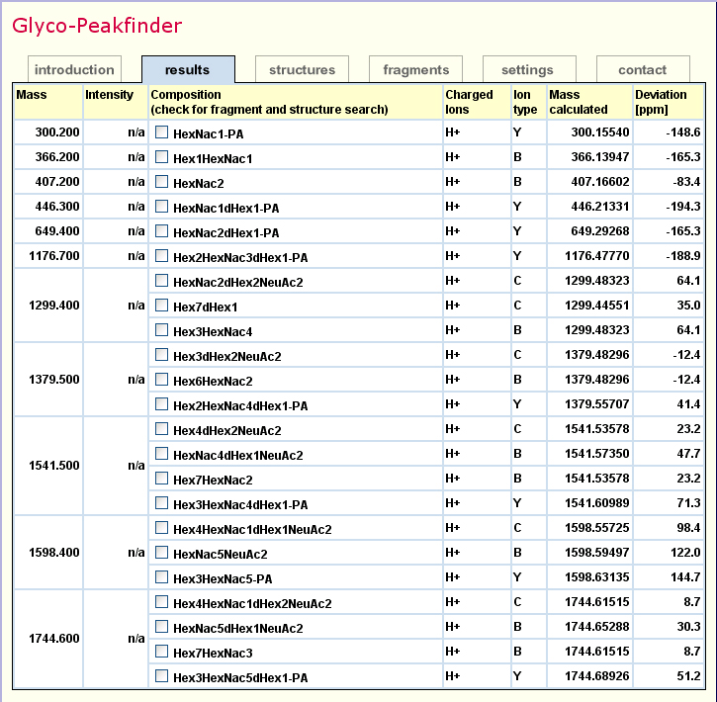
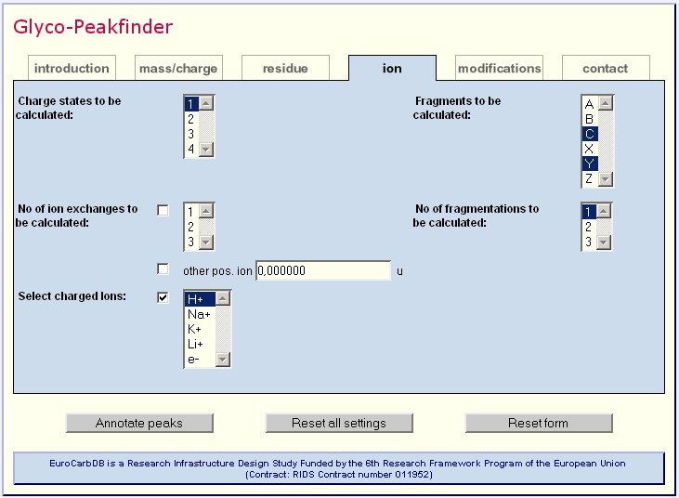
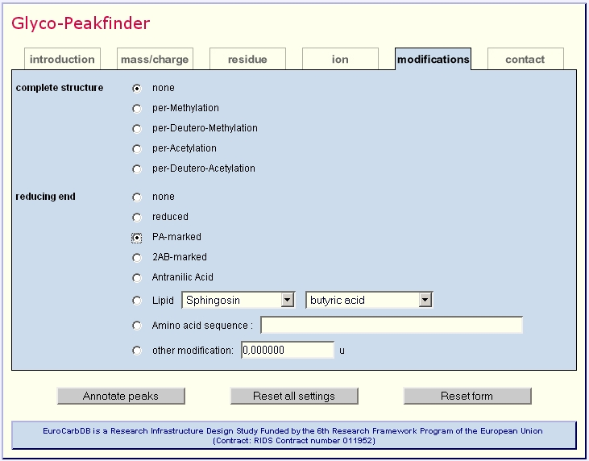
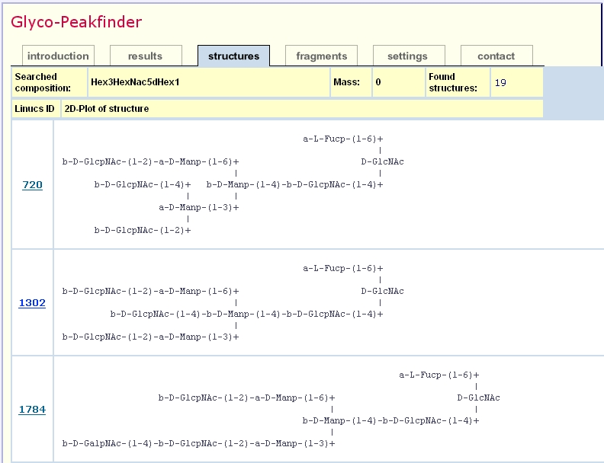

Webapplication "Glyco-Peakfinder"
Automated Annotation for MS Peaks of Glycoconjugates Combined with Database Searches
René Ranzinger¹, Kai Maaß², Hildegard Geyer², Rudolf Geyer², and Claus-Wilhelm von der Lieth¹
¹German Cancer Research Center, Central Spectroscopic Department - B090, Im Neuenheimer Feld 280, D-69120 Heidelberg, Germany
²Institute of Biochemistry, Faculty of Medicine, University of Giessen, Friedrichstrasse 24, D-35392 Giessen, Germany
Overview
Fast and automated interpretation of all classes of glycan MS-spectra
Parallel calculation of different ion series ( A,B,C,X,Y,Z )
Detection of multiply charged ions
Calculation of internal fragments
Calculation of modified structures ( e.g. permethylation )
Calculation of glycolipids and glycopeptides
Composition-based database search for structure identification
Directly accessible web-based application (http://www.eurocarbdb.org/applications/ms-tools)
Introduction
Mass spectrometry is one of the key technologies for the identification of glycan structures. While in proteomics the use of web-applications and databases for confirmation of determined structures and structure identification from MS spectra is part of daily work, in glycomics no such comprehensive databases or applications have been established so far. To fill this gap, “Glyco-Peakfinder” was developed. In contrast to other known tools, such as “GlycoMod” (5), which are basically focused on complete structures, MSn spectra with different types of ions (glycosidic cleavages and/or cross-ring cleavages) can be calculated in parallel. In addition, to assist in structure identification, the results from “Glyco-Peakfinder” can be used for a database composition search of reported oligosaccharides in GLYCOSCIENCES.de (2,3).
“Glyco-Peakfinder” was developed for the EUROCarbDB project (1), which is an initiative for the development of web-based carbohydrate databases aiming to combine experimental data from NMR, HPLC and MS, i.e. the key technologies for identification and analysis of carbohydrates.
Program Parameters
Peak lists can be loaded from different sources (different file formats are supported), the other parameters can be chosen from several forms:
Example for Structure Determination with “Glyco-Peakfinder”
Residues
The possible residues of the target structure can be selected with a minimum and maximum range. The default settings allows a rapid search for N-glycans.
Ions and charge states
The possible charge states and different charged ions can be chosen. For acidic residues, protons can be replaced by any of the selected charged ions.
All possible series (A, B, C, X, Y and Z) of ions can be derived within one calculation step. To avoid longer processing times the A and X fragment ions of each residue can be selected separately.
The program allows the simultaneous calculation of all selected items as well as multiple cleavages.
Modifications
Permethylated and peracetylated structures can be calculated with all fragmentation options.
Among native glycans, a modification at the reducing end can be chosen :
- different types of derivatisation
(e.g. 2 amino pyriden )
- glycopeptide
- glycolipid
Test structure
The example structure was found in a pyridylamino-oligosaccharide fraction obtained from batroxobin of Bothrops moojeni venom (4).
LIFT spectrum
The sample was spotted on a MALDI target, covered with ATT and analysed with an Ultraflex I (Bruker Daltonik, Bremen) in positive-ion LIFT mode.
Settings
The generated peaklist was loaded onto the Glyco-Peakfinder interface.
Further settings:
  Acc. of mass: 200 ppm
  Reducing end: PA
  Residues: Hex (0 - 8)
  HexNAc (0 - 8)
  dHex (0 - 2)
  Neu5Ac (0 - 2)
  singly charged ions and only singly cleavages allowed
Results
11 of 12 labeled peaks could be annotated. 5 have more than one possible annotation. A composition for the peak at 204.0 can be found with a deviation of 425 ppm.
Database search
The derived and selected compositions can be used for a glycan database search. While EUROCarbDB (1) remains a design study the structure determination uses the glycosciences.de database (2,3). Herein more than 10000 glycan structures can be found.
Outlook
Allow enzymatic digests for peptides
Request lipid and peptide masses from remote databases
Calculation of scores for different annotations of the same peak
Concomitant annotation of MS and MS^{n} data
Implementation of algorithms for an automated structure prediction
References: 1. for further information see: www.eurocarbdb.org, EUROCarbDB is a Research Infrastructure Design Study Funded by the 6th Research Framework Program of the European Union (Contract: RIDS contract number 011952)
2. see: www.glycosciences.de 3. T. Lütteke, A. Bohne-Lang, A. Loss, T. Goetz, M. Frank, C.W. von der Lieth, Glycobiology, 16, 2006, 71R-81R.
4. G. Lochnit, R. Geyer, Eur. J. Biochem. 228, 1995, 805-816. 5. C.A. Cooper, E. Gasteiger, N. Packer, Proteomics 1, 2001, 340-349.

