Slide 1



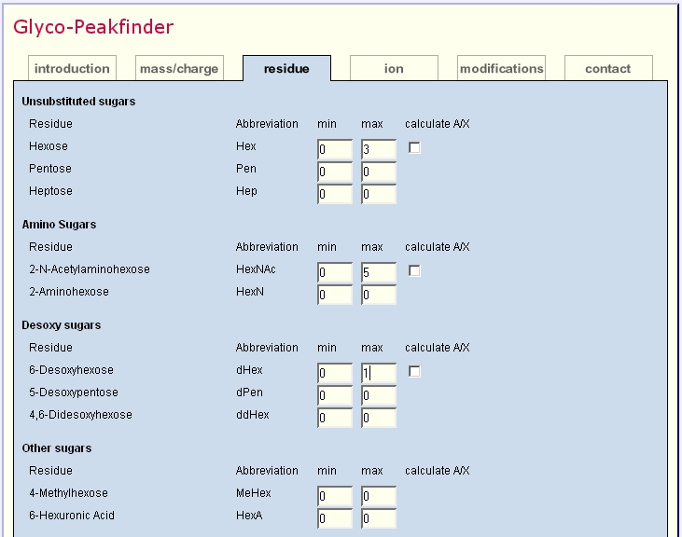
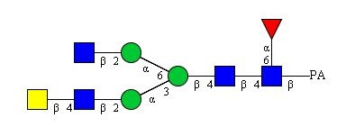
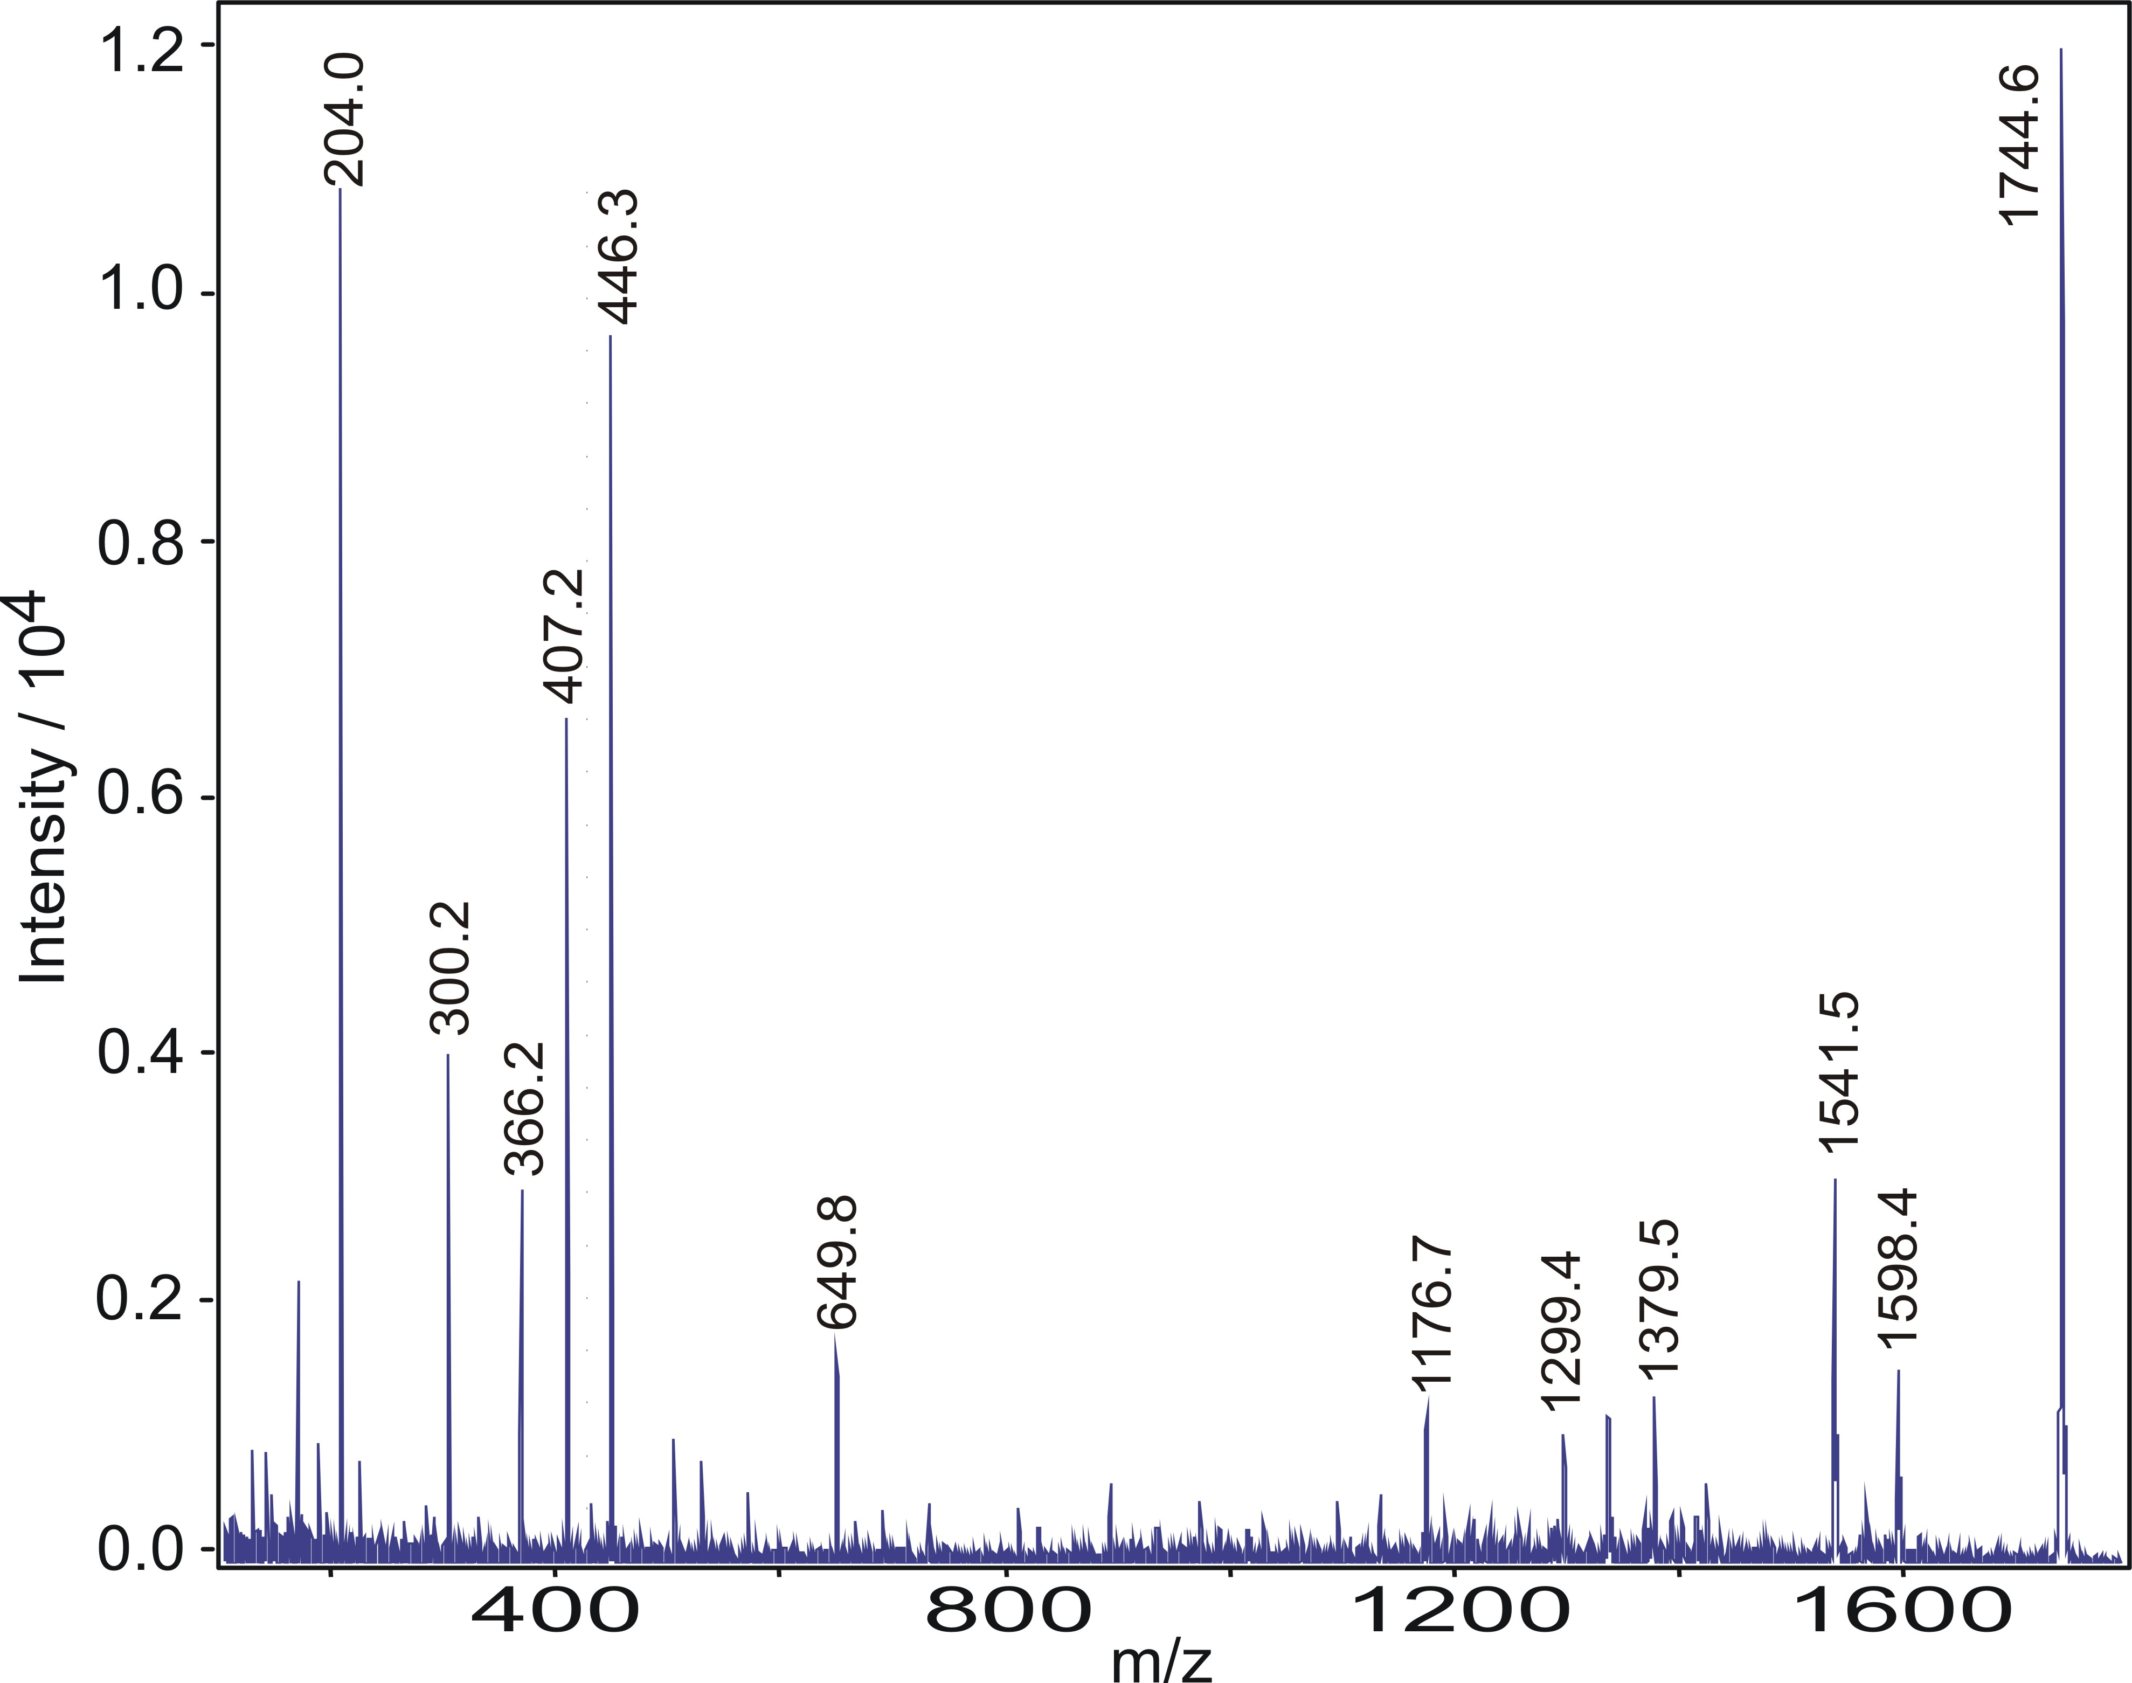
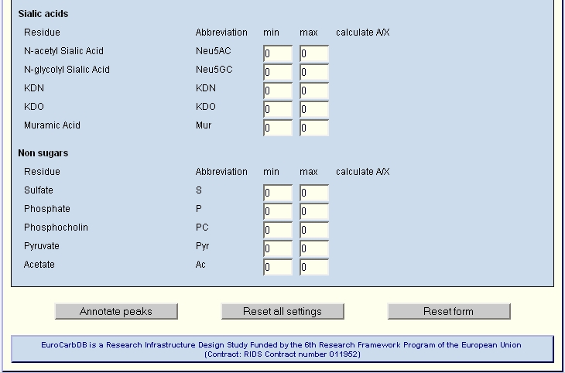
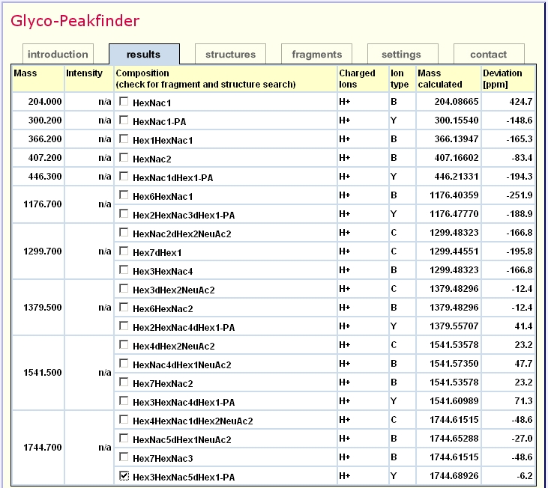
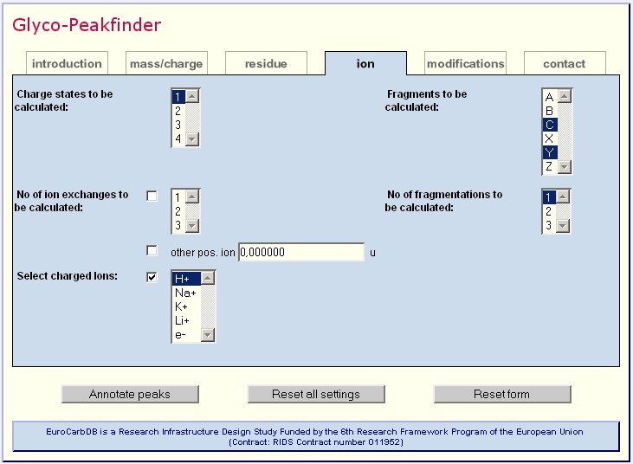
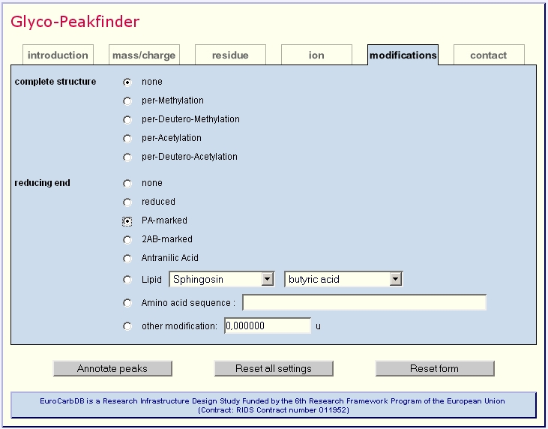
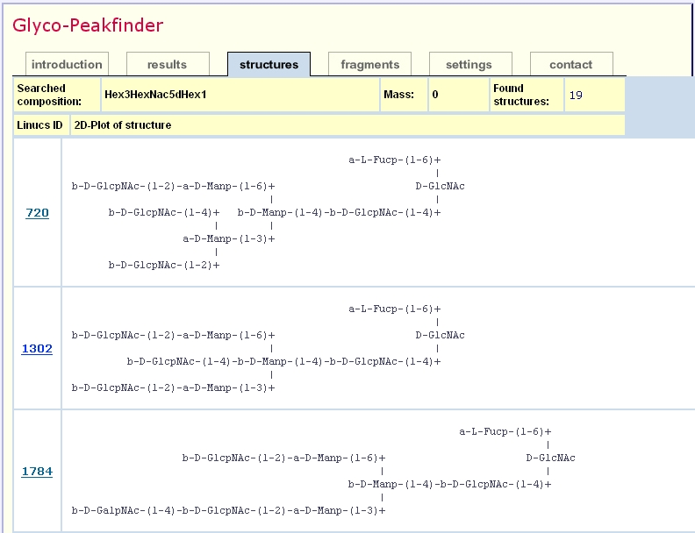
New strategies for
structure determination of glycans I: “GlycoPeakfinder”
Kai Maass¹, René Ranzinger², Hildegard Geyer¹, Claus-Wilhelm von der Lieth², and Rudolf Geyer¹
¹Institute of Biochemistry, Faculty of Medicine, University of Giessen, D-35392 Giessen, Germany;
²German Cancer Research Center, Central Spectroscopic Department - B090,
D-69120 Heidelberg, Germany
Overview
Fast and automated interpretation of all classes of glycan MS-spectra
Parallel calculation of different ion series (A, B, C, X, Y, Z)
Detection of multiply charged ions
Calculation of internal fragments
Calculation of modified structures (permethylation, peracetylation)
Composition-based database search for structure identification
Easy to use web-based application
Introduction
Automatic processing of mass spectrometric data in the field of glycomics is still an evolving field when compared to the field of proteomics. Up to now, neither large structural databases nor software tools are available which provide a complete workflow from experimental data to glycan structure determination.
The EUROCarbDB (1) is an initiative for the development of web-based European carbohydrate data bases aiming to combine analytical data from MS, NMR and HPLC, i.e., the key technologies for identification and analysis of carbohydrates. Apart from design studies for setup and use of new data bases, the EUROCarbDB project intends to provide software tools for easy interpretation of unknown spectra.
The “Glyco-Peakfinder” is a web-based software application for fast and automated annotation of peaks of all kinds of mass spectra of glycans. All possible compositions for a peak from a given mass list can be calculated using a strategy similar to composition-based sequencing of peptides (2).
Methods / Programme Parameters
Peak lists can be loaded from different sources (different file formats are supported), the other parameters can be chosen from several forms:
Example of workflow for structure determination with GlycoPeakfinder and GlycoWorkbench
Residues
The possibly involved residues can be selected with minimum and maximum range. The default settings allow a rapid search for N-glycans.
Ions and charge states
The possible charge states and all charged ions can be chosen.
For acidic residues, protons can be replaced by any of the selected charged ions.
All possible series (A, B, C, X, Y and Z) of ions can be derived within one calculation step. To avoid longer processing times all A and X fragment ions can be selected separately.
The programme allows the simultaneous calculation of all selected items as well as multiple cleavages.
Modifications
Permethylated and peracetylated structures can be calculated with all fragmentation options.
Among native glycans several types of modification at the reducing end can be chosen.
Algorithms for glycopeptides and glycolipids have already been intensively tested, but have not yet been implemented in the web-based version.
Test structure
The workflow was tested with a pyridylamino-oligosaccharide fraction obtained from batroxobin of Bothrops moojeni venom (5).
LIFT spectrum
The sample was spotted on a MALDI target, covered with ATT and analysed with an Ultraflex I (Bruker Daltonik, Bremen) in positive-ion LIFT mode.
Results
The generated peaklist was loaded onto the GlycoPeakfinder interface.
Further settings:
  Acc. of mass: 500 ppm
  Reducing end: PA
  Residues: Hex (0 - 8)
  HexNAc (0 - 8)
  dHex (0 - 2)
  Neu5Ac (0 - 2)
Database search
The derived and selected compositions can be used for a glycan database search. As long as EUROCarbDB is only a design study the structure determination uses the glycosciences.de database (3,4). Herein more than 13000 glycan structures can be found.
GlycoWorkbench
From the search result, three representative structures were selected and transferred to GlycoWorkbench (see Poster 22) for verification.
Conclusions
“Glyco-Peakfinder” allows annotation of sample profiles and
MS^{n} fragment spectra.
Comprehensive calculation of A-, B-, C-, X-, Y- and Z-ions is
achieved.
Simultaneous detection of multiply charged ions opens the
field of application to techniques other than MALDI.
Calculation of fragment-spectra for permethylated /
peracetylated structures and internal fragments
Calculation of any modification at the reducing end increases
the palette of analytes from native glycans to various
glycoconjugates.
Database search in glycosciences.de enables rapid structure
identification.
Datatransfer to GlycoWorkbench allows further investigations for
structure determination.
References and Acknowledgements
1. for further information see: www.eurocarbdb.org/applications/ms-tools,
EUROCarbDB is a Research Infrastructure Design Study Funded by the 6th Research Framework Program of the European Union (Contract: RIDS contract number 011952).
B. Spengler, J. Am. Soc. Mass Spectrom. 15, 2004, 703-714.
for further information see: www.glycosciences.de
T. Lütteke, A. Bohne-Lang, A. Loss, T. Goetz, M. Frank, C.W. von der Lieth, Glycobiology, 16, 2006, 71R-81R.
G. Lochnit, R. Geyer, Eur. J. Biochem. 228, 1995, 805-816.

