Slide 1


CRM Lead & Opportunity Conversion Analysis
Presented by: Glyny George

Slide 2
CRM Analytics
CRM Analytics is the process of collecting, analyzing, and interpreting customer and sales related data from a CRM system to improve decision-making, optimize sales processes, enhance customer relationships and increase revenue.
In short:
CRM Analytics = Turning customer and sales data into actionable insights to grow business.

Slide 3
Project Summary
Lead Funnel: 10K total leads, but only 10.33% convert →highlighting a need to improve nurturing and qualification.
Revenue Potential: Leads could generate $39.15M, while the opportunity pipeline shows a much larger $184.14M.
Opportunities:1.3K active out of 4.6K total with a42.77% win rate, showing strong sales performance but also a 41.56% loss rate.
Industry Insights: Safety & Security, Life Sciences, and Biopharma/Pharma dominate the pipeline and should be prioritized for growth.

Slide 4
KEY Lead KPIs
Total Lead
Expected Amount from Converted Leads
Conversion Rate-Conversion Rate (%)=(Leads Converted to Customers/Total Lead​)×100
Converted Accounts
Converted Opportunities
Lead By Source
Lead By industry
Lead by Stage

Slide 5
Key Insights from CRM lead Conversion Analysis
Overall Lead Funnel Performance
Total Leads:10,000
Expected Amount:$39.15M
Conversion Rate:10.33%
Only about 1 in 10 leads are converting → indicates a wide top funnel but low efficiency in lead nurturing.
Conversion Outcomes
Total converted Leads:1033
Converted Accounts:1016
Converted Opportunities:411
only ~40% of converted leads actually become opportunities.

Slide 6
Leads by Industry
Safety & Security:5357(dominant, ~53.6% of all leads)
Life Sciences:4120
Other industries are below 1% each, showing heavy dependency on just two sectors.
Risk: If these industries slow down, pipeline may shrink significantly.

Slide 7
Leads by Stage
Nurturing:5303(53% stuck here- potential bottleneck)
Prospect:2154
Converted:907
SQL:351
Very few reach Qualified (3) stage→ Slaes Qualification process seems weak.
Huge nurturing pool → indicates leads aren’t progressing effectively.

Slide 8
Lead by Source
Inside Sales: 2786 (top contributor)
Website:2195
Trade Show:1610
Webinar:1091
Digital Sources(Website + Webinar + Eblasts) together contribute nearly 35%, highlighting the importance of inbound marketing.

Slide 9
Key Takeaways from Lead
Low Conversion Rate: Only 10.33% conversion, showing inefficiency in moving leads through funnel.
Bottleneck in Nurturing Stage : Over 50% of leads stuck in nurturing – clear need for better engagement and qualification strategies.
Industry Dependence: Two industries (Safety & Security + life Sciences) = 95% of total leads, creating a risk of overreliance.
Strongest Sources : Inside sales and website drive the majority of leads; investing more here could yield higher ROI.
Opportunity Gap : Only 40% of converted leads become opportunities → need stronger qualifications and handoff to sales.

Slide 10
Key KPIs for Opportunity
Expected Amount
Active Opportunities-Total count of open opportunities.
Conversion Rate-Conversion Rate (%)=(Win Opportunities/Total Created Opportunities​)×100
Win Rate-Win Rate (%)=(Won Opportunities/(Win +Lost)Total Opportunities​)×100
Loss Rate-Loss Rate (%)=(Closed Lost Opportunities/Total Opportunities​)×100
Trend Analysis
Expected Vs Forecast: Running total comparison of expected revenue and forecast over time.
Active Vs Total Opportunities: Cumulative active vs. total opportunities trend.
Closed Won Vs Total Opportunities: Track closed-won deals against total opportunities.
Closed Won Vs Total Closed: Analyze closed-won deals compared to all closed deals.
Expected Amount by Opportunity Type
Opportunities by Industry

Slide 11
Key Insights of CRM Opportunity Analysis
Overall Performance
Total Opportunities: 4646
Expected Amount: $184.14M
Conversion Rate: 31.06%
This means nearly one-third of leads are successfully converting into opportunities.

Slide 12
Key Insights of CRM Opportunity
Conversion Analysis
Opportunity Status
Converted Opportunities:3374
Win Rate:42.77%
Loss Rate: 57.23%
Out of converted deals, wins are lower than losses , suggesting room for improving closure strategies.
Active opportunities:1272
Inactive opportunities: 3374
A large portion of opportunities have become inactive (72.6%), which may indicate delays in follow-up or lack of engagement.

Slide 13
Opportunities by Industry
Top industries by expected revenue:
Military:$47.05M(highest contributor,~25.5% of total)
Biopharma/Pharma:21.98M
Communications:$17.37M
Federal:$16.38M
The Military sector dominates expected revenue, so focusing on it could maximize ROI.

Slide 14
Expected Amount by Opportunity Type
Others:$179.39M(dominant category – but very broad, needs segmentation)
Safety & Security:$4.21M
New Business: $0.50M
Existing Business:$0.50M
The majority of pipeline is lumped into “Others”, which hides insights. Clear classification of opportunity types could help in better tracking.

Slide 15
Closed Won vs. Closed Lost
Closed Won Opportunities:1272(~27% of total)
Closed Lost Opportunities:1443(~31% of total)
More deals are being lost than won → signals a competitive or process challenge.

Slide 16
Key Takeways from Opportunity Analysis
Conversion Health : While the conversion rate is fair, the win rate is lower than loss rate. Improving closure strategies is essential.
Inactive Opportunities Issue : High inactive opportunities show a need for better follow-up, nurturing, or reactivation strategies.
Industry Focus: Military and Biopharma/Pharma industries are most lucrative. Efforts should be prioritized here.
Data Clarity: The “Others” category dominates opportunity type – refining this classification can help uncover trends and make decisions more actionable.
Revenue Growth Potential: By targeting active opportunities (1272) and re-engaging inactive ones, revenue could increase significantly.

Slide 17
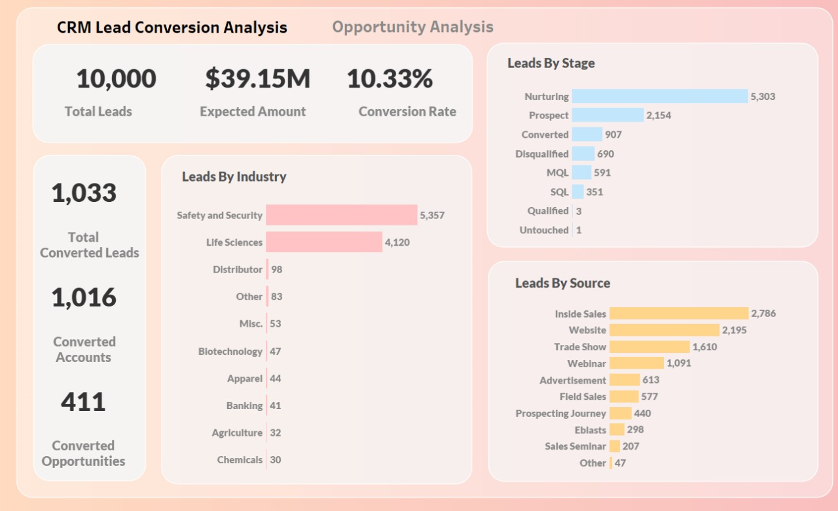
Lead Dashboard

Slide 18
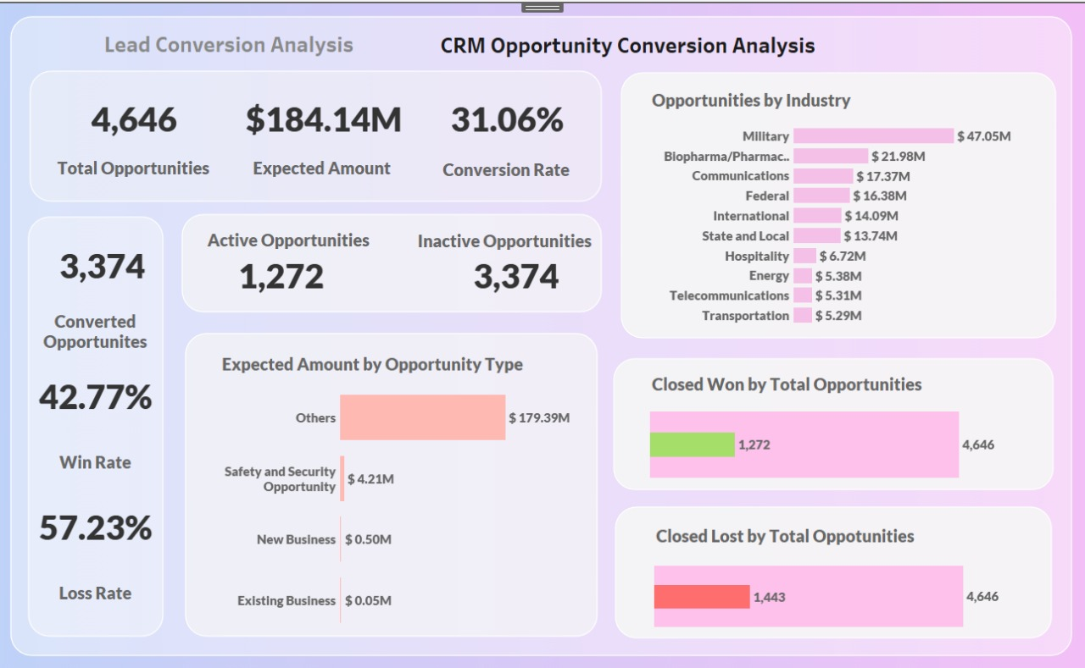
Opportunity Dashboard

Slide 19
Full Funnel View
Funnel Stage
Volume(Conversion%)
Leads Generated
Leads Converted
Converted to Opportunities
Total Opportunities
Opportunities Won
→10000(100%)
→1033(10.33%)
→411(3.9%)
→4646(46% of leads)
→1272(27% of opps – 12.7% of leads)
Insight:
Out of 10000 leads, only 1272 reach Closed Won
The biggest leakage is between Nurturing →Qualification at the lead stage, and Opportunity Lost at the deal stage

Slide 20
Strategic Recommendations
Improve Lead Qualification: Automate lead scoring (MQL→SQL) to reduce nurturing bottle neck.
Diversity Industry Focus: Too dependent on Safety & Security + Life Sciences at lead stage, and Military at opportunity stage. Expand into underperforming industries.
Win Rate Improvement: Analyze reasons for losses (pricing,competition,timing) and implement targeted win-back strategies.
Opportunity Classification: Refine “Others” category to better understand deal types and revenue streams.
Channel Optimization: Inside Sales and Websites are strong – invest more in digital funnels, but track ROI from trade shows and webinars too.

Slide 21
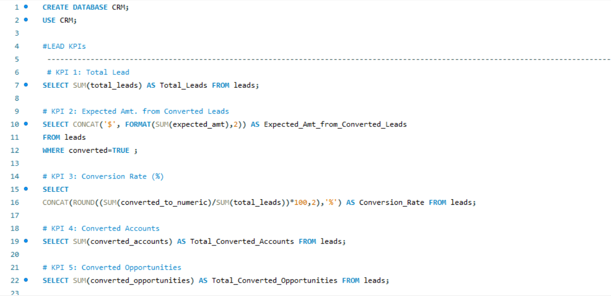
My SQL

Slide 22
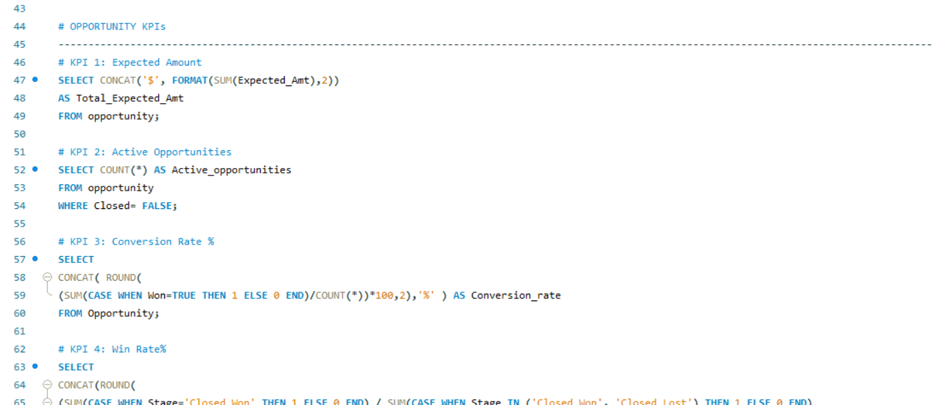
My SQL

Slide 23

Thank you

