Slide 1
HR Analysis A Project on Employee Retention
Project By:
Glyny George
Kusum Nayak
Mohit Palkar
Pushpa Poojeri
Shashanka T
Shubham Shinde

Slide 2
What is HR Domain?
Area of business focused on managing people within an organization
Covers everything from hiring to retirement
Human Resource(HR) Domain generally covers:
Recruitment & Hiring
Perfomance Management
Employee Records & Management
Payroll and Compensation
Training and Development
Employee Engagement and Satisfaction
Compliance and Policy
Notes:
1. Recruitment and Staffing
Posting job ads, sourcing candidates, conducting interviews
Hiring the right talent to fit company needs
2. Onboarding and Training
Helping new employees get settled and learn company processes
Offering skill development and career growth opportunities
3. Payroll and Compensation
Ensuring employees are paid accurately and on time
Handling bonuses, raises, and benefits
4. Performance Management
Monitoring and evaluating employee performance
Managing appraisals, promotions, and disciplinary actions
5. Employee Relations
Handling workplace conflicts or grievances
Promoting a positive work environment and company culture
6. Compliance and Legal
Making sure HR policies align with labor laws and regulations
Preventing legal issues related to employment
7. HR Technology & Analytics
Using HR software (like SAP, Workday, or Oracle) to manage data
Analyzing workforce trends to support strategic decisions

Slide 3
Role of Data Analyst in HR Domain
Data analysts help turn HR data into insights, making decisions more strategic and data-driven
Performance Management
Workforce Planning & Forecasting
Employee Engagement & Satisfaction
Diversity, Equity & Inclusion (DEI) Metrics
Here’s how HR teams use the capabilities of data analysts:
Recruitment Analytics
Employee Retention & Turnover
Learning & Development Effectiveness
Notes:
. Recruitment Analytics
What data analysts do: Analyze sourcing channels, time-to-hire, cost-per-hire, and candidate conversion rates.
Why it matters: Helps HR find which hiring platforms work best, reduce hiring costs, and speed up the process.
📊 2. Employee Retention & Turnover
What data analysts do: Track employee exit trends, predict turnover risk, and identify common reasons people leave.
Why it matters: Lets HR take proactive steps (like engagement programs or better benefits) to retain top talent.
🌱 3. Learning & Development Effectiveness
What data analysts do: Evaluate which training programs improve performance or skills.
Why it matters: Helps HR invest in the right learning paths and measure ROI on training.
🚀 4. Performance Management
What data analysts do: Analyze KPIs, feedback scores, and review patterns to spot top performers or performance gaps.
Why it matters: Supports fair appraisals, promotions, and targeted coaching.
🧠 5. Workforce Planning & Forecasting
What data analysts do: Use trends and predictive models to estimate future hiring needs, skill shortages, or workforce costs.
Why it matters: Enables HR to plan hiring and talent development in advance.
❤️ 6. Employee Engagement & Satisfaction
What data analysts do: Analyze survey results, pulse checks, and sentiment analysis (sometimes from open-ended feedback or even emails).
Why it matters: Helps HR understand morale and build a healthier work culture.
🧾 7. Diversity, Equity & Inclusion (DEI) Metrics
What data analysts do: Track representation, pay equity, promotion rates across different demographics.
Why it matters: Supports transparent and inclusive HR practices.

Slide 4
Contents
Project Objective
Tools and Methodology
Insights and Findings
Key KPI’s Measured
Dashboards and Visualization
SQL query images
Overall Takeaways
Recommendations

Slide 5
Project Objective
Analyze key performance indicators (KPIs) related to employee retention
Use data-driven insights to understand attrition trends
Leverage visualization tools for reporting and decision-making
Validate data by comparing database records with dashboards to ensure accuracy.

Slide 6
Tools and Methodology
Excel: Initial data cleaning and transformation
SQL: Data extraction from HR databases
Power BI & Tableau: Visualization and dashboarding
KPI Framework: Standardized retention metrics

Slide 7
Key KPI’s Measured
Average Attrition rate for all Departments
Average Hourly rate of Male Research Scientist
Attrition rate Vs Monthly income stats
Average working years for each Department
Job Role Vs Work life balance
Attrition rate Vs Year since last promotion relation

Slide 8
Insights and Findings
Overall Metrics:
Total Employees: 50000
Attrition Count: 25105
Overall Attrition Rate: 50.21%
Active Employees: 24895
Average Age: 39

Slide 9
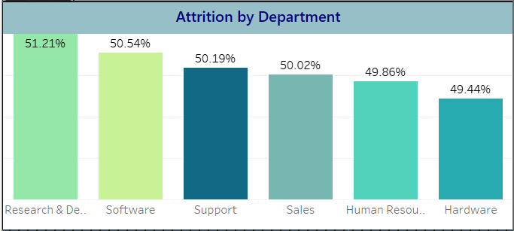
Attrition by Department
Highest Attrition in:
Research & Development (51.21%)
Software (50.54%)
Lowest attrition in:
Hardware (49.44%)
Insight: Although differences are marginal, R&D and software may require deeper investigation for potential burnout, project pressure, or skill mismatch.

Slide 10
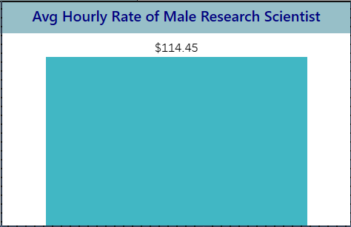
Average Hourly Rate of Male Research Scientist
$114.4/hour
Insight:
One of the highest-paying roles
may require review, if compensation is a motivator for retention or attrition.

Slide 11
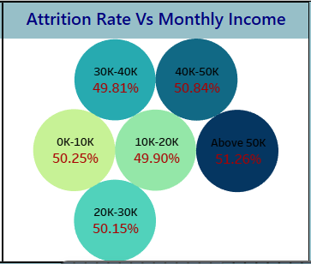
Attrition Rate vs Monthly Income
Lowest income group (0K-10K) has a 50.25% attrition rate
Highest income group (Above 50K) has 51.26%, the highest attrition rate
Insight:
Income doesn’t directly correlate with retention
possibly high expectations or poaching at higher income levels.
Notes:
Attrition rates hover around 50% for all income brackets.
The highest attrition rate is in the "Above 50K" category at 51.26%.
The lowest attrition rate is in the 30K–40K range at 49.81%.
Interestingly, there is no strong correlation between income and attrition; it appears relatively consistent across the board with very minor variation (less than 2%).
Interpretation:
Higher salaries do not necessarily guarantee lower attrition in this context.
Other factors beyond income—such as work environment, job satisfaction, career growth, and company culture—might play a more significant role in influencing attrition

Slide 12
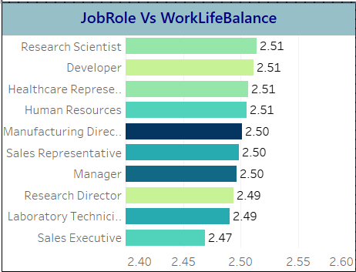
Job Role vs Work-Life Balance
Most roles have Work-Life Balance scores around 2.50–2.51
Lowest WLB:
Sales Executive (2.47)
Laboratory Technician (2.49)
Insight: Roles with lower WLB may experience hidden dissatisfaction contributing to attrition
Notes:
This bar chart shows the average Work-Life Balance scores for different job roles. Here's a quick summary of what it tells us:
Top Work-Life Balance Scores (2.51):
Research Scientist
Developer
Healthcare Representative
Human Resources
Lowest Work-Life Balance Score:
Sales Executive (2.47)
Others in the Middle:
Manufacturing Director, Sales Representative, and Manager all scored 2.50
Research Director and Laboratory Technician scored slightly lower at 2.49
The differences are relatively minor, but Sales Executives appear to have the least favorable work-life balance among the listed roles.
Would you like help interpreting what this might mean for employee satisfaction or how to improve work-life balance in specific roles?
4o
You said:
yes
ChatGPT said:
Great! Let's break this down a bit and talk about what these scores might imply and how they could guide improvement strategies.
🔍 Interpretation of the Data
The Work-Life Balance scores are pretty close together, ranging from 2.47 to 2.51, which suggests:
Most employees feel similarly about their work-life balance regardless of role.
However, even small differences can be meaningful when looked at across large teams or over time.
The lowest score is for Sales Executives (2.47), while Research Scientists, Developers, Healthcare Reps, and HR roles all top the chart at 2.51.
📉 What Might Be Affecting Sales Executives?
Sales roles often:
Involve irregular hours and frequent travel or client meetings.
Carry high-pressure targets or commission-based pay structures.
Require constant availability for clients, even outside normal hours.
These factors can easily erode work-life balance.
💡 Improvement Strategies by Role
Here are some targeted ideas based on role-specific needs:
🔹 Sales Executive
Implement clearer boundaries for after-hours communication.
Use tech to automate parts of the sales process (CRM systems, scheduling tools).
Rotate high-pressure accounts to avoid burnout.
🔹 Laboratory Technicians & Research Directors (2.49)
Encourage shift flexibility or job rotation to reduce monotony.
Provide wellness or mindfulness programs (these roles can be detail-intensive).
🔹 Manager Roles (2.50)
Offer delegation training and team management support.
Consider workload reviews to prevent over-responsibility creep.
🔹 All Roles
Promote use of PTO (Paid Time Off).
Normalize flexible scheduling or hybrid work if possible.
Collect regular feedback and adjust policies based on actual concerns.
📊 What You Could Do Next
Run a deeper survey: Ask qualitative questions to understand why certain roles feel worse off.
Compare with turnover or engagement data: Are roles with lower work-life balance scores also seeing higher attrition?
Set up a work-life initiative: Maybe pilot programs in roles with the lowest scores and track improvements.

Slide 13
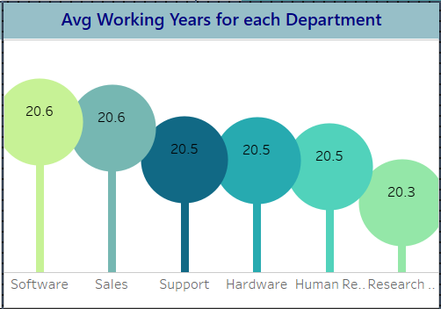
Average Working Years per Department
Range is tight: 20.0 – 20.6 years
Longest tenure:
Software & Sales (20.6 years)
Shortest:
Research & Development (20.0 years)
Insight: The slightly lower tenure in Research might indicate a younger team. career growth.
Notes:
Insight: Long-Term Loyalty Across Departments
This chart illustrates the average working years for employees across various departments. The data reveals a consistently high tenure, with all departments averaging around 20.5 years of service. Notably:
Software and Sales departments lead with the highest average at 20.6 years.
Support, Hardware, and HR closely follow at 20.5 years.
The Research department, though still high, shows a slightly lower average at 20.3 years.
📈 Narrative & Interpretation:
This suggests a strong organizational culture and employee retention across all units. The slightly lower tenure in Research might indicate:
A younger team,
Recent expansion,
Or higher turnover due to project-based work.
Meanwhile, the high averages in Software and Sales could reflect:
Established teams,
Greater opportunities for growth or stability,
Or effective leadership and job satisfaction in those areas.
🧠 Recommendation:
Conduct internal surveys or exit interviews to understand what keeps employees in certain departments longer.
Explore mentorship or knowledge transfer programs in departments with lower tenure to boost retention and continuity.

Slide 14
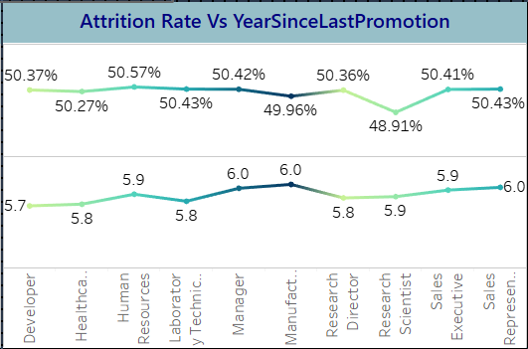
Attrition Rate vs Years Since Last Promotion
Top Line Graph (Attrition Rate):
The Lowest: Research Scientist(48.91%)
The Highest: Healthcare Representative(50.57%)
Bottom Line Graph (Years Since Last Promotion)
Shows the average number of years since the last promotion for each role.
Highest: Manager(6.0 years)
Insight: Even though some roles have a high average time since last promotion, their attrition rates vary.
Notes:
This chart visualizes Attrition Rate vs. Years Since Last Promotion across different job roles. Here’s a breakdown of the two line graphs:
Top Line Graph (Attrition Rate - %)
This shows the percentage of attrition for each job role.
The numbers above the line (ranging around ~50%) represent the attrition rate for each role.
For example:
Developer: ~50.37%
Research Scientist: ~48.91% (the lowest)
Healthcare Representative: ~50.57% (the highest)
Bottom Line Graph (Years Since Last Promotion)
This shows the average number of years since the last promotion for each role.
The numbers below the line (ranging from 5.7 to 6.0) indicate how long it has been, on average, since the last promotion.
For example:
Manager: 6.0 years (among the highest)
Healthcare Rep: 5.8 years
Sales Executive: 5.8 years
Insights:
Even though some roles have a high average time since last promotion, their attrition rates vary.
Research Scientist has the lowest attrition rate (48.91%), despite being around 5.8 years since their last promotion.
Roles like Sales Executive and Sales Representative have higher attrition rates despite shorter time since promotion (around 5.8–6.0 years), suggesting other factors besides promotion frequency affect attrition.

Slide 15
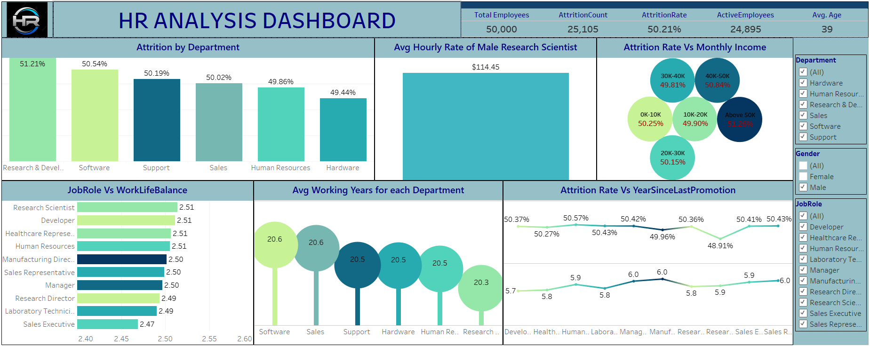
Tableau Dashboard

Slide 16
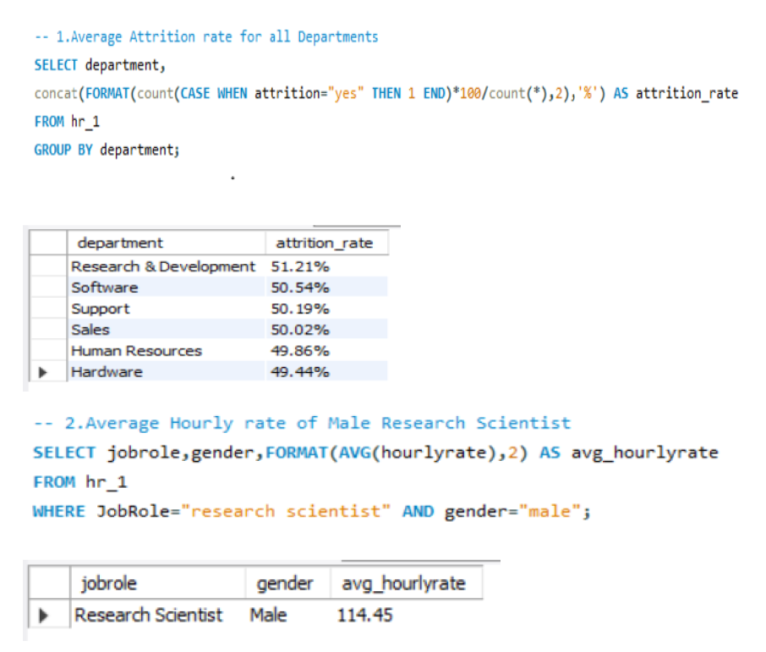
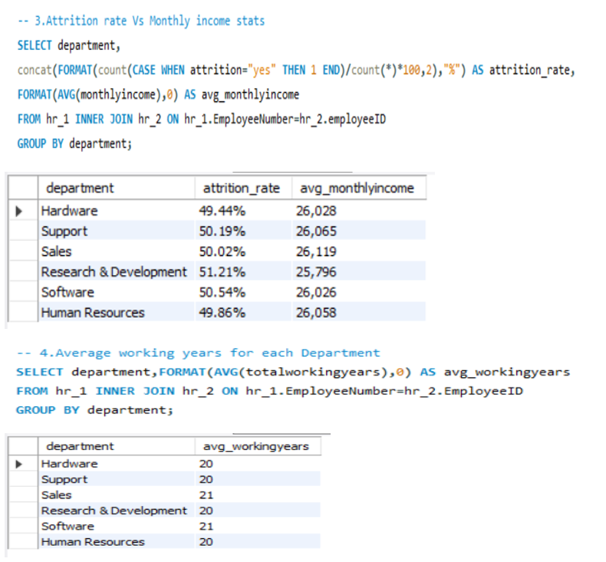
SQL QUERY IMAGEs
SQL Screenshot

Slide 17
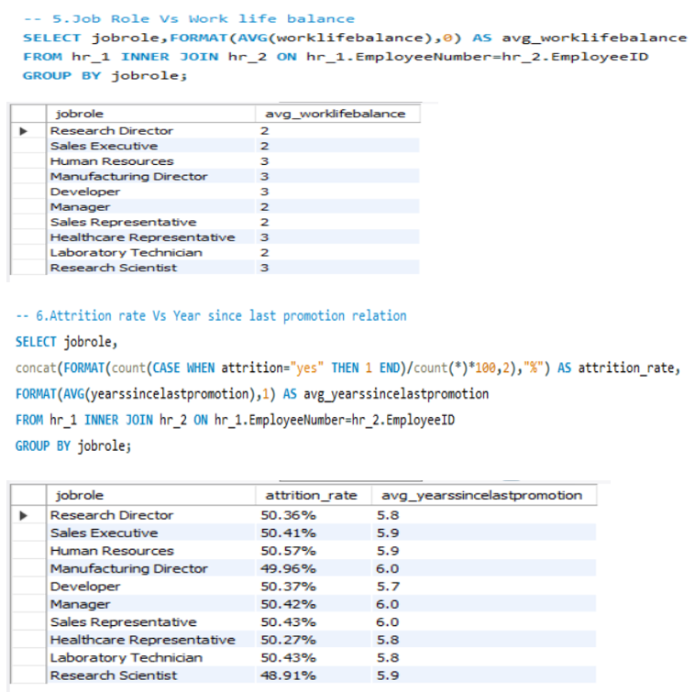
SSQL Screenshot Images

Slide 18
Overall Takeaways
The company has a very high attrition rate (~50%) – that’s 1 in 2 employees are leaving.
R&D and Software departments are top areas for attrition concerns.
Work-Life Balance and Income don’t show strong correlations with attrition directly.
Salary and promotions significantly influence attrition rates.

Slide 19
Recommendations
Introduce career development programs for long-tenured employees
Use internal transfers as a retention strategy
Increase salaries for employees at risk of leaving
Enhance work life balance policies (flexible hours, remote work, wellness programs)

Slide 20
Thank you

