Slide 1
SQL-ANALYTICS-II
SQL CTE (Common Table Expression)
SQL Temporary Tables
Assoc. Prof. Mahammad Sharifov

Slide 2
1. SQL CTE (Common Table Expression)
A Common Table Expression (CTE) is the result set of a query which exists temporarily and for use only within the context of a larger query. Much like a derived table, the result of a CTE is not stored and exists only for the duration of the query.
CTEs, like database views and derived tables, enable users to more easily write and maintain complex queries via increased readability and simplification. This reduction in complexity is achieved by deconstructing ordinarily complex queries into simple blocks to be used, and reused, if necessary, in rewriting the query.
Example use cases include:
Needing to reference a derived table multiple times in a single query
An alternative to creating a view in the database
Performing the same calculation multiple times over across multiple query components

Slide 3
1. SQL CTE (Common Table Expression)
The structure of a CTE includes the name, an optional column list, and a query that defines the CTE. After you define a CTE, you can use like a view in the SELECT, INSERT, UPDATE, DELETE, or CREATE VIEW statement.
The following illustrates the basic syntax of a CTE:
WITH cte_name (column_list) AS (
query
)
SELECT * FROM cte_name;

Slide 4
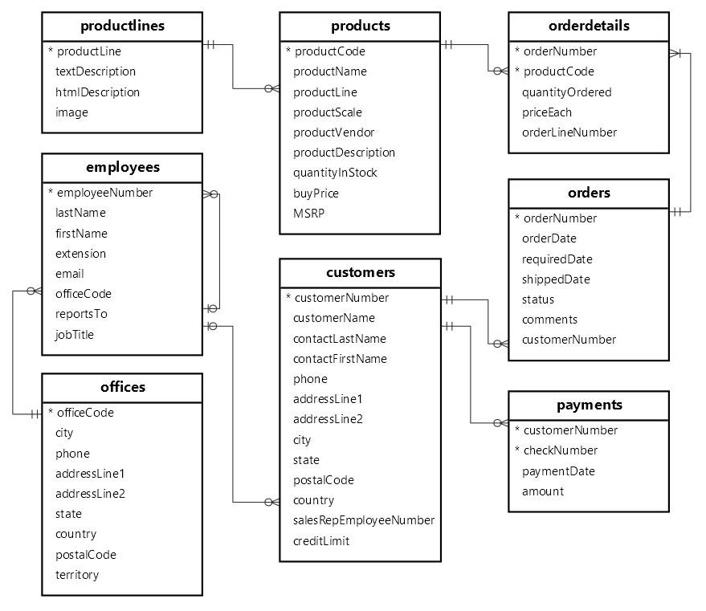
1. SQL CTE (Common Table Expression)
The structure of database:

Slide 5
1.1. SQL CTE / Example 1
Example-1 : Basic MySQL CTE example
We’ll use the customers table from the sample database for demonstration:
WITH customers_in_usa AS (
SELECT
customerName, state
FROM
customers
WHERE
country = 'USA'
) SELECT
customerName
FROM
customers_in_usa
WHERE
state = 'CA'
ORDER BY customerName;
How it works:
First, define a CTE with the name customers_in_usa that stores the customer name and state of customers in the USA. The defining query retrieves data from the customer's table.
Second, select the customers located in California from the CTE.

Slide 6
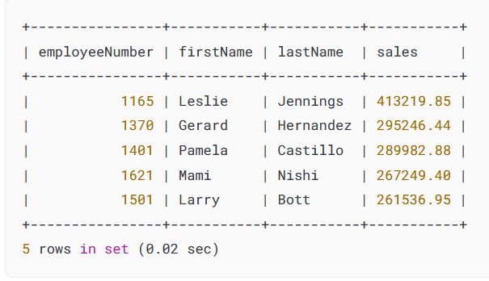
1.1. SQL CTE / Example 2
Example-2 : Getting top sales using a CTE
We’ll use the orders, orderdetails, employees table from the sample database for demonstration:
How it works:
The following example uses a CTE to retrieve the top 5 sales representatives based on their total sales in the
year 2003.
Second, join the CTE with the employees table to include the first and last names of the sales representatives.

Slide 7
1.1. SQL CTE / Example 2
Example-2 : Getting top sales using a CTE
WITH topsales2003 AS (
SELECT
salesRepEmployeeNumber employeeNumber,
SUM(quantityOrdered * priceEach) sales
FROM
orders
INNER JOIN
orderdetails USING (orderNumber)
INNER JOIN
customers USING (customerNumber)
WHERE
YEAR(shippedDate) = 2003
AND status = 'Shipped'
GROUP BY salesRepEmployeeNumber
ORDER BY sales DESC
LIMIT 5
)
SELECT
employeeNumber,
firstName,
lastName,
sales
FROM
employees
JOIN
topsales2003 USING (employeeNumber);

Slide 8
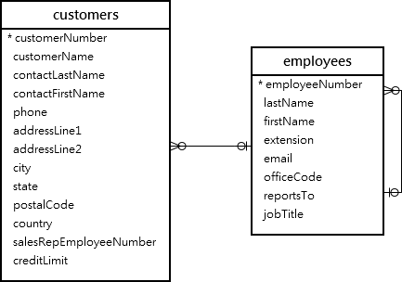
1.2. Multiple CTEs / Example 3
Example-3 : The following example uses multiple CTEs to map the customers with their respective sales representatives.
We’ll use the customers and employees from the sample database
How it works:
CTE salesrep: Select employeeNumber and concatenate the firstName and lastName columns to create a column named salesrepName, and include only employees with the job title 'Sales Rep’.
CTE customer_salesrep: selects customerName and salesrepName by joining the customers table with the salesrep CTE based on the common column employeeNumber.
Main query: Select all columns from the customer_salesrep CTE.

Slide 9
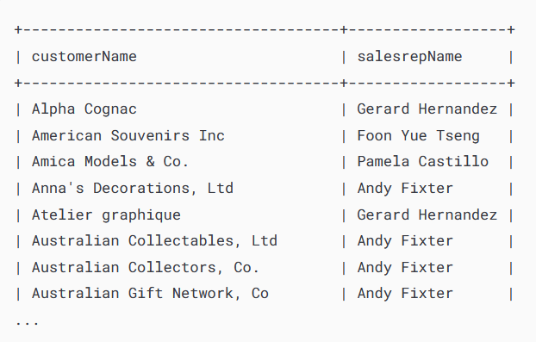
1.2. Multiple CTEs / Example 3
Example-3 : The following example uses multiple CTEs to map the customers with their respective sales representatives
WITH salesrep AS (
SELECT
employeeNumber,
CONCAT(firstName, ' ', lastName) AS salesrepName
FROM
employees
WHERE
jobTitle = 'Sales Rep’
) ,
customer_salesrep AS (
SELECT
customerName, salesrepName
FROM
customers
INNER JOIN
salesrep ON employeeNumber = salesrepEmployeeNumber
)
SELECT
*
FROM
customer_salesrep
ORDER BY customerName;

Slide 10
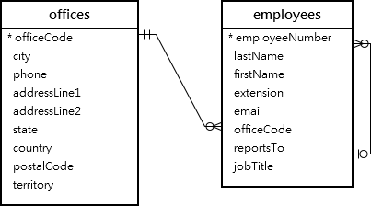
1.3. Multiple CTEs and JOIN / Example 4
Example-4 : The following example is creating two CTEs and joining them to get the Sales Representatives located in the USA, including their office information.
We’ll use the offices and employees from the sample database
How it works:
CTE e: Retrieve employees whose job title is Sales Rep.
CTE o: Retrieve offices located in the USA.
Main query: Joins the CTE e and o using the officeCode column.

Slide 11
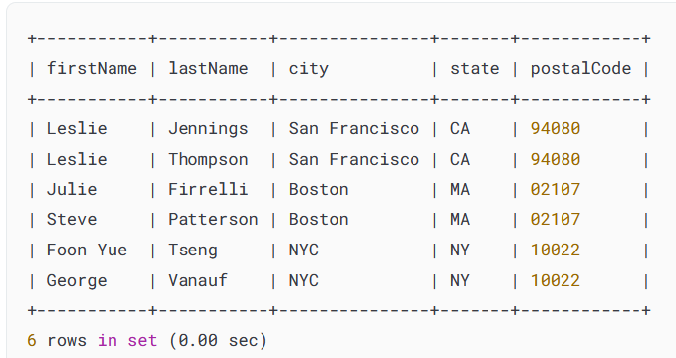
1.3. Multiple CTEs and JOIN / Example 4
Example-4 : The following example
WITH E AS (
SELECT
*
FROM
employees
WHERE
jobTitle = 'Sales Rep'
),
O AS (
SELECT
*
FROM
offices
WHERE
country = 'USA'
)
SELECT
firstName, lastName, city, state,
postalCode
FROM
E
INNER JOIN O USING (officeCode);

Slide 12
CTE Exercises / Exercise 1
Using CTE try to solve the following sub-tasks:
Get sum of orders by each customer
Get number of orders by each customer
List of all products with productName (inline, comma separated)
orderNumber | allProducts | sumOrders | countOrders
10100 | 1917 Grand Touring Sedan,1911 Ford Town Car,1932 Alfa …….. | 10223.83 | 4
10101 | 1932 Model A Ford J-Coupe,1928 Mercedes-Benz SSK,1939 Chevrolet Deluxe Coupe ……… | 10549.01 | 4
10102 | 1937 Lincoln Berline,1936 Mercedes-Benz 500K Special | 5494.78 | 2
10103 | 1952 Alpine Renault 1300, 1962 LanciaA Delta 16V, 1958 ……… | 50218.95 | 16
10104 | 1969 Corvair Monza,1957 Chevy Pickup,1998 Chrysler ……… | 40206.20 | 13
10105 | 1972 Alfa Romeo GTA,2001 Ferrari Enzo,1969 Ford Falcon ……… | 53959.21 | 15
10106 | 1980s Black Hawk Helicopter,P-51-D Mustang,1999 ……… | 52151.81 | 18

Slide 13
1. CTE / Exercises 1-5
By each productCode(name) to find SUM of orders
By each productLine to find COUNT of products
By each orderNumber to find MIN price of product, MAX price of product! (use window functions)
By each orederNumber to display RANK and DENSE_RANK (use window functions)
By each productLine to display RANK of buyPrice, MIN and MAX of buyPrices as well.

Slide 14
2. SQL Temporary Tables / Definition
In SQL, a temporary table is a special type of table that allows you to store a temporary result set, which you can reuse several times in a single session.
A MySQL temporary table has the following features:
A temporary table is created by using CREATE TEMPORARY TABLE statement.
MySQL removes the temporary table automatically when the session ends, or the connection is terminated. Also, you can use the DROP TABLE statement to remove a temporary table
A temporary table is only available and accessible to the client that creates it. Different clients can create temporary tables with the same name without causing errors because only the client that creates the temporary table can see it. However, in the same session, two temporary tables cannot share the same name.

Slide 15
2. SQL Temporary Tables / Definition
A temporary table can have the same name as a regular table in a database. For example, if you create a temporary table named employees in the sample database, the existing employees table becomes inaccessible. Every query you issue against the employees table is now referring to the temporary table employees.
Note : Even though a temporary table can have the same name as a regular table, it is not recommended. Because this may lead to confusion and potentially cause an unexpected data loss.
For example, if the connection to the database server is lost and you reconnect to the server automatically, you cannot differentiate between the temporary table and the regular one.
Then, you may issue a DROP TABLE statement to remove the permanent table instead of the temporary table, which is not expected.
To avoid this issue, you can use the DROP TEMPORARY TABLE

Slide 16
2. SQL Temporary Tables / Syntax
CASE 1 : The syntax of the CREATE TEMPORARY TABLE statement is like the syntax of the CREATE TABLE statement except for the TEMPORARY keyword:
CASE 2 : To create a temporary table whose structure is based on an existing table, we use the following syntax:
CREATE TEMPORARY TABLE table_name(
column1 datatype constraints,
column1 datatype constraints,
...,
table_constraints
) ;
CREATE TEMPORARY TABLE
temp_table_name
SELECT * FROM original_table
LIMIT 0 ;

Slide 17
2. SQL Temporary Tables / Example 1
STEP 1 : First, create a new temporary table called credits that stores customers’ credits:
STEP 2 : Then, insert rows from the customers table into the temporary table credits:
CREATE TEMPORARY TABLE credits(
customerNumber INT PRIMARY KEY,
creditLimit DEC(10, 2)
) ;
INSERT INTO credits(customerNumber,
creditLimit)
SELECT
customerNumber,
creditLimit
FROM
customers
WHERE
creditLimit > 0 ;

Slide 18
2. SQL Temporary Tables / Example 1
TESTING TEMPORARY TABLE : CREDITS
STEP 1 : First, write simple query with select statement to prove existence of temporary ‘credits’ table
STEP 2 : Second, switch to different database, then come back to current database (classicmodels) and again test existence of ‘credits’ table
STEP 3 : At the end, quit current session and reconnect to database again to test existence of ‘credits’ temporary table

Slide 19
2. SQL Temporary Tables / Example 2
CASE 2 : Creating a temporary table whose structure is based on a query example:
The following example creates a temporary table that stores the top 10 customers by revenue.
The structure of the temporary table is derived from a SELECT statement:
CREATE TEMPORARY TABLE top_customers
SELECT p.customerNumber,
c.customerName,
ROUND ( SUM(p.amount), 2) sales
FROM payments p
INNER JOIN customers c ON c.customerNumber = p.customerNumber
GROUP BY p.customerNumber
ORDER BY sales DESC
LIMIT 10 ;
SELECT
customerNumber,
customerName,
sales
FROM
top_customers
ORDER BY sales ;

Slide 20
2. SQL Temporary Tables / Dropping
DROPPING TEMPORARY TABLE : You can use the DROP TABLE statement to remove temporary tables however it is good practice to add the TEMPORARY keyword as follows:
DROP TEMPORARY TABLE table_name;

Slide 21
2. SQL Temporary Tables / Exercises
EXERCISE 1 :
Use the customers and employees from the sample database.
The following exercise should use multiple CTEs to map the customers with their respective sales representatives;
Create Temporary Table from combining 2 CTE’s by select statement
EXERCISE 2 :
Create Temporary Table by selecting (partition by) each orderNumber displaying with MIN price of order, MAX price of order;
Use select statement to display results by grouping orderNumber with MIN price of order and MAX price of orders;
Use select statement to select results from both Temporary Table and Permanent Table : oredrNumber, productName, MIN price and MAX price

