Slide 1

ARCHITECTURE OF WEB
& MOBILE APPLICATIONS

Slide 2
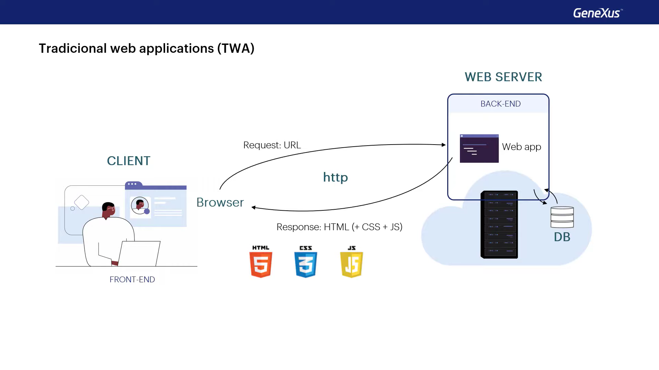

Slide 3
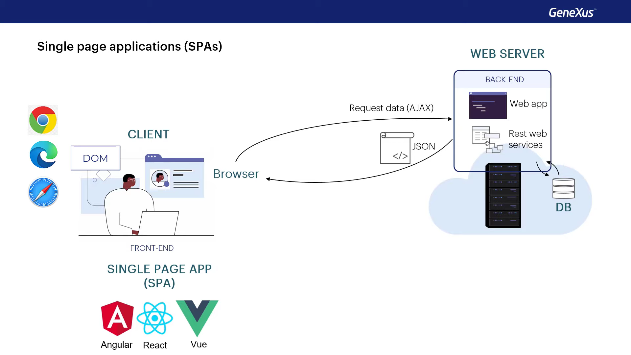

Slide 4
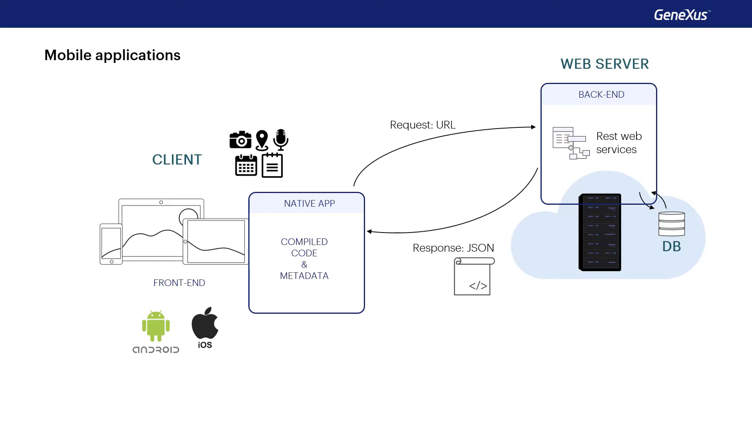

Slide 5
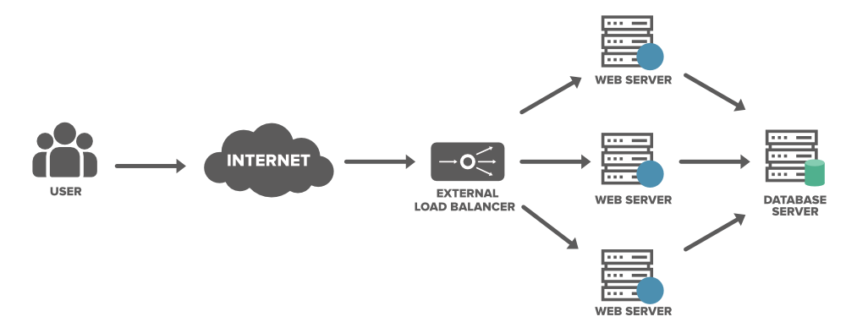

Slide 6
